Slide 1
Dipolar antennas
https://www.imec-int.com/en/integrated-photonics

Slide 2
Today
Last week:
  Ring resonators
Today:
  Recap ring resonators
  Dipolar antennas

Slide 3
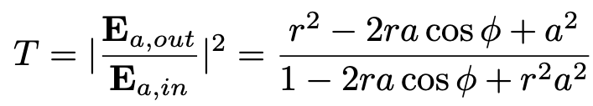
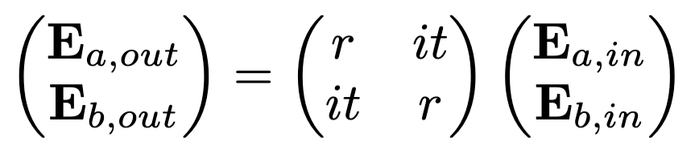
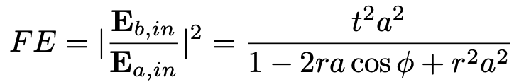

Recap ring resonators
Power transmission depends on $φ$ as follows
Power build-up depends on $φ$ as follows
On resonance: $φ=2πm$

Slide 4
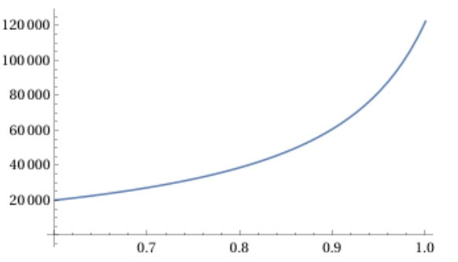
Ring resonators: coupling regimes
Q-factor
a = 0.9
r

Slide 5
Dos and don’ts
When do you want a long resonator, when a short one?
Do we ever want low reflection?
What happens in the presence of losses?
Myth or truth?
  If I make the ring smaller, I will have higher finesse.
  It’s always better to put the ring as far away as possible from the bus waveguide.
  The length of the coupling region does not matter, it can exceed 2L_{beat} as long as r and t are correct

Slide 6
Hertzian dipoles

Slide 7
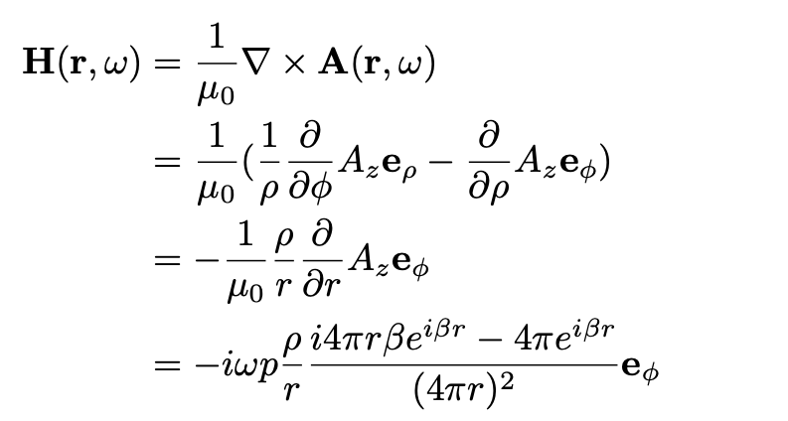
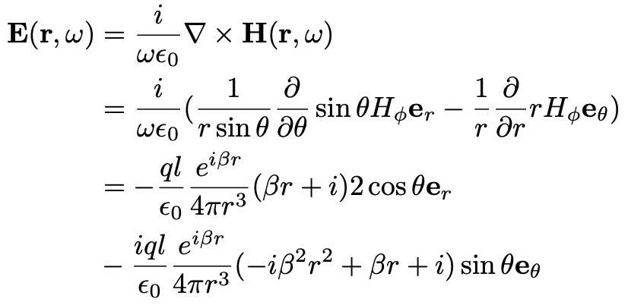
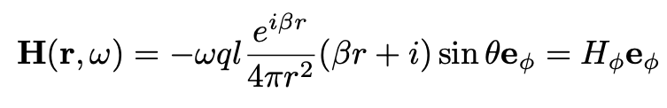
Hertzian dipoles
Magnetic field
Electric field

Slide 8
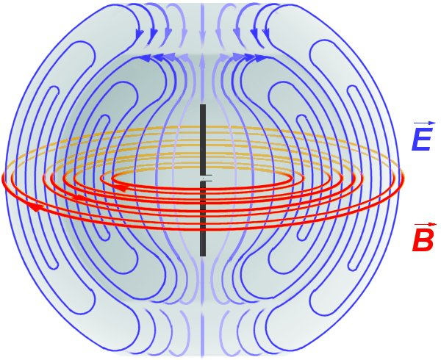
Field distribution of a Hertzian dipole
k

