Slide 1
On-chip resonators
https://www.imec-int.com/en/integrated-photonics

Slide 2
Today
Last week:
  Multi-mode interference devices
Today:
  On-chip resonators

Slide 3
Fundamentals of resonators
Made from two highly reflective mirrors

Slide 4
Fundamentals of resonators
Linewidth (full width at half maximum) – cavity lifetime
Free spectral range (FSR) – cavity roundtrip time
Finesse

Slide 5
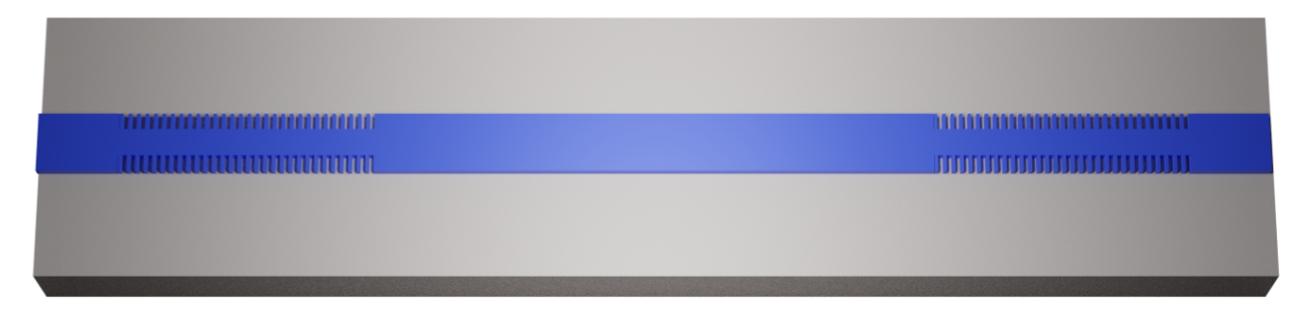
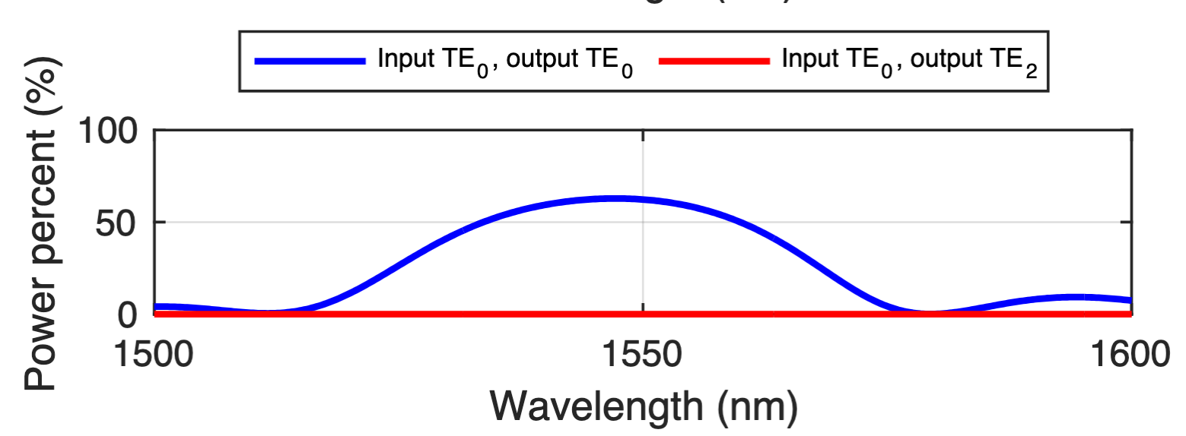
On-chip Fabry-Perot resonators in silicon
On-chip mirrors: Bragg mirrors, can be made very reflective through design

Slide 6
Do’s and don’ts
When do you want a long resonator, when a short one?
Do we ever want low reflection?
What happens in the presence of losses?

