Slide 1
On-chip resonators
https://www.imec-int.com/en/integrated-photonics

Slide 2
Today
Last week:
    Fabry-Perot resonators: linewidth, free-spectral range, finesse
Today:
  Recap Fabry-Perot resonators
  Ring resonators

Slide 3
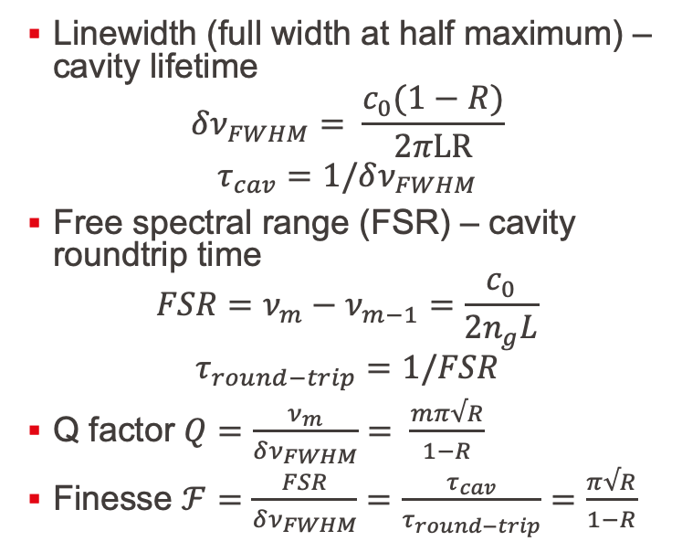
Fundamentals of resonators
Linewidth (full width at half maximum) – cavity lifetime
$$δν_{FWHM}= \frac{c_{0}(1−R)}{2πLR}$$
$$τ_{cav}=1/δν_{FWHM}$$
Free spectral range (FSR) – cavity roundtrip time
$$FSR=ν_{m}−ν_{m−1}=\frac{c_{0}}{2n_{g}L}$$
$$τ_{round−trip}=1/FSR$$
Q factor $Q=\frac{ν_{m}}{δν_{FWHM}}= \frac{mπ√R}{1−R}$
Finesse $ℱ=\frac{FSR}{δν_{FWHM}}=\frac{τ_{cav}}{τ_{round−trip}}=$ $\frac{π√R}{1−R}$

Slide 4
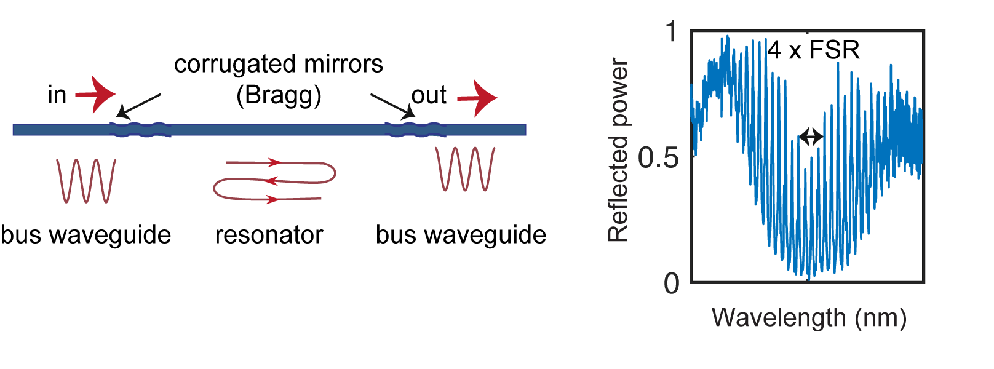
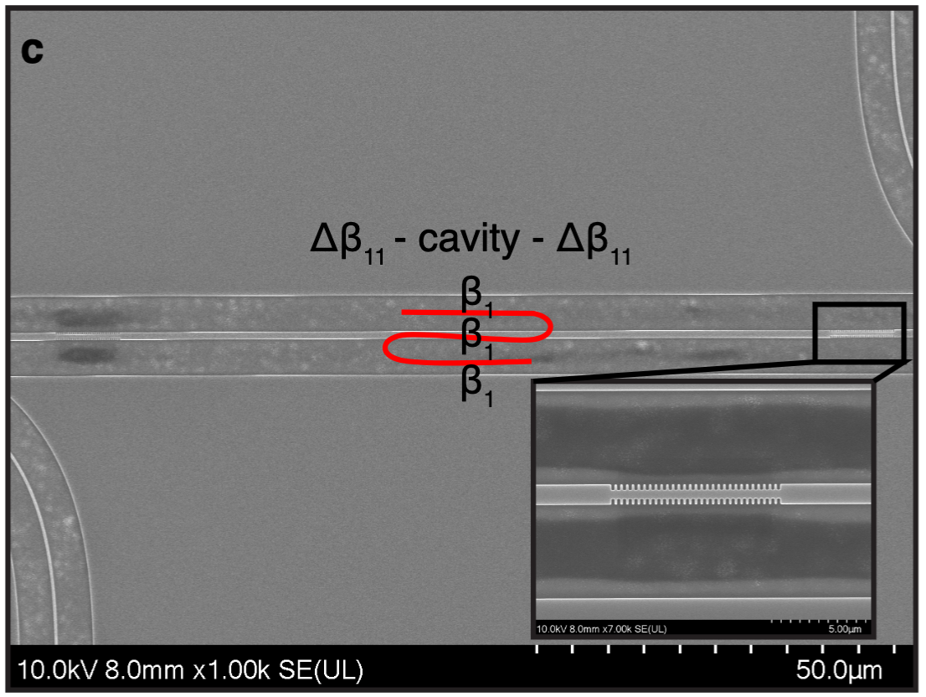
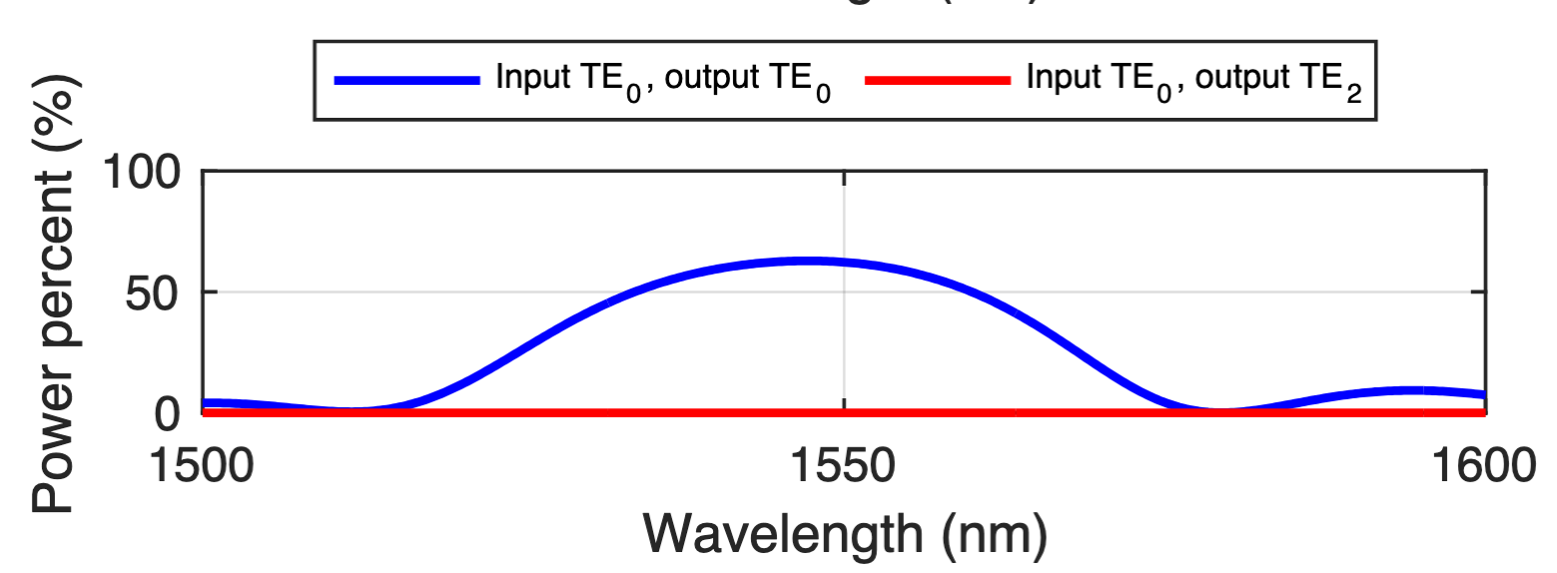
On-chip Fabry-Perot resonators in silicon
On-chip mirrors: Bragg mirrors, can be made very reflective through design

Slide 5
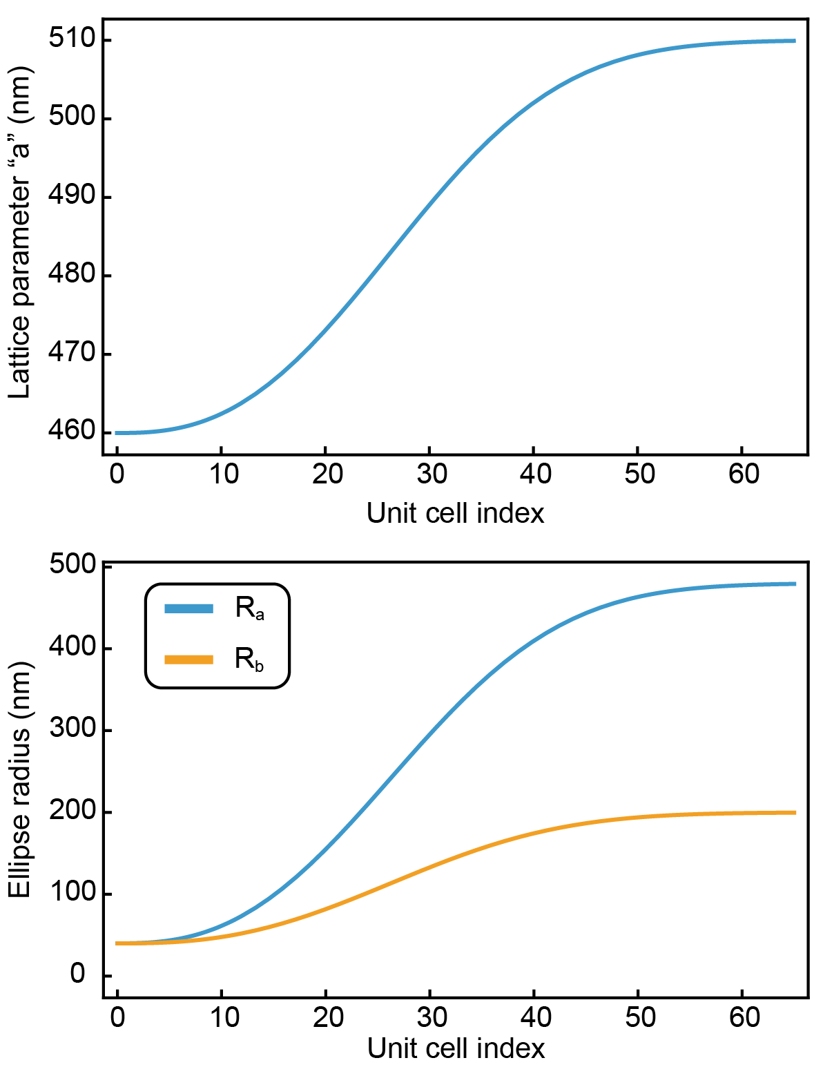
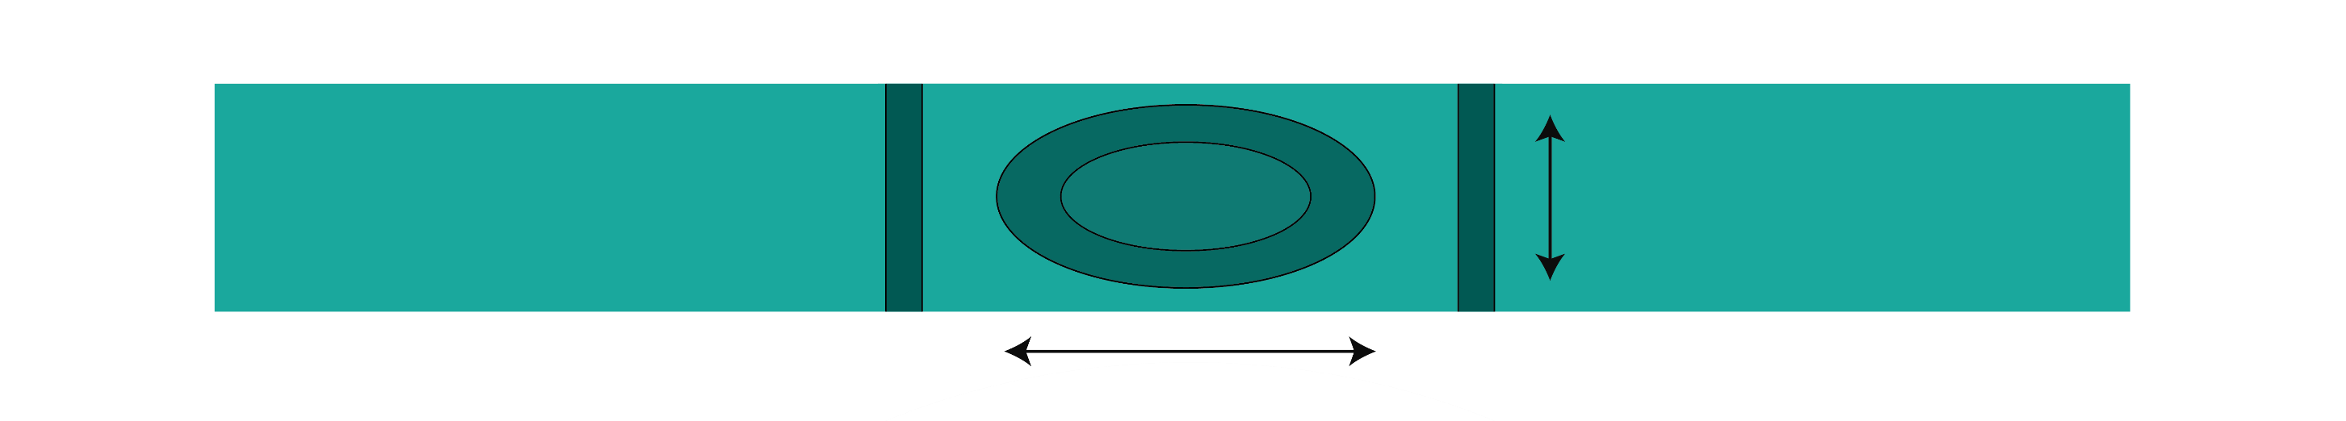
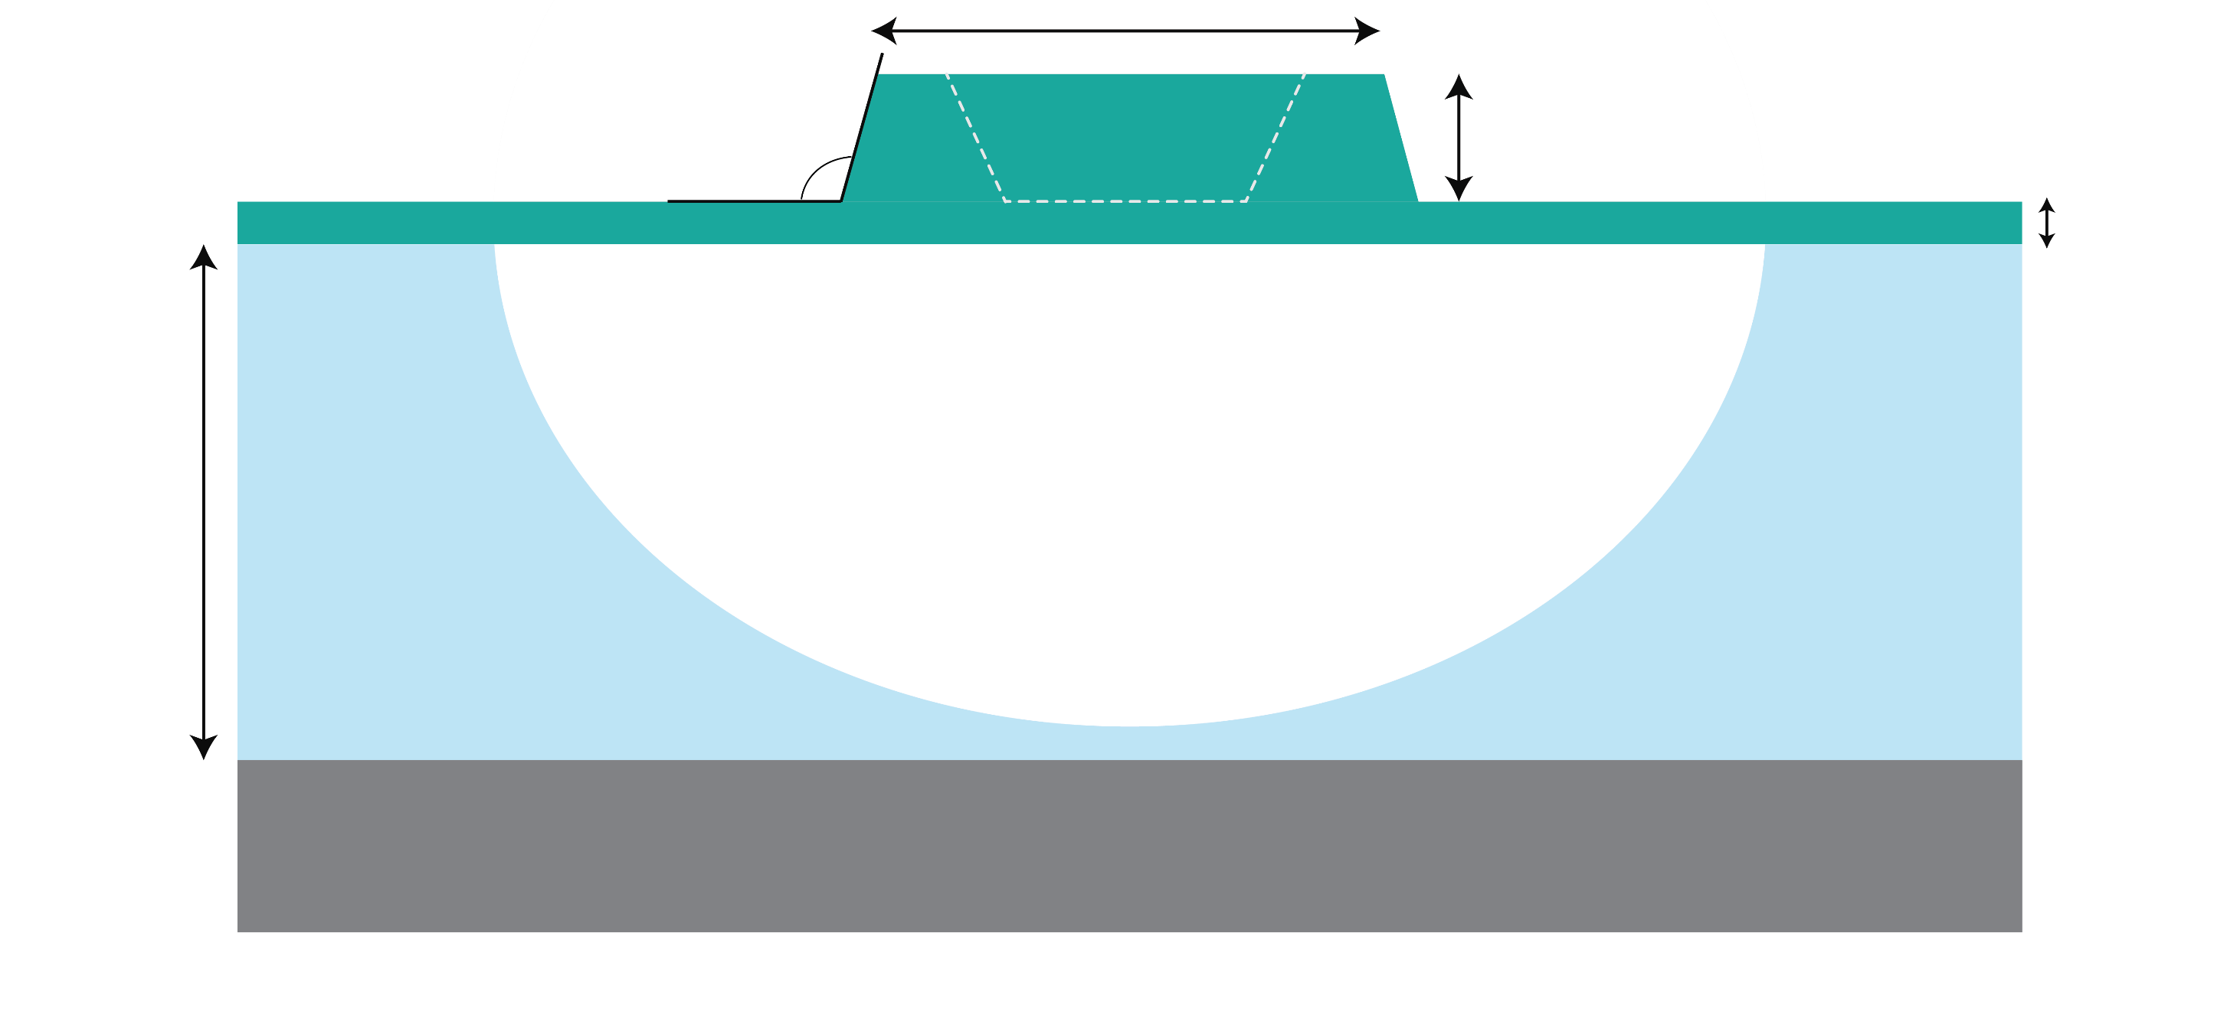
On-chip Fabry-Perot resonators in lithium niobate
a
2R_{b}
2R_{a}
1.2 μm
75 º
0.3 μm
0.1 μm
4.7 μm
LN
SiO₂
Si

Slide 6
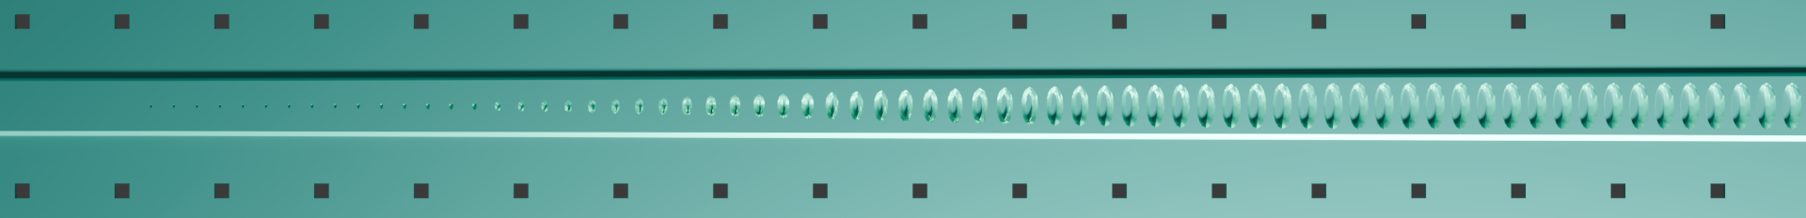
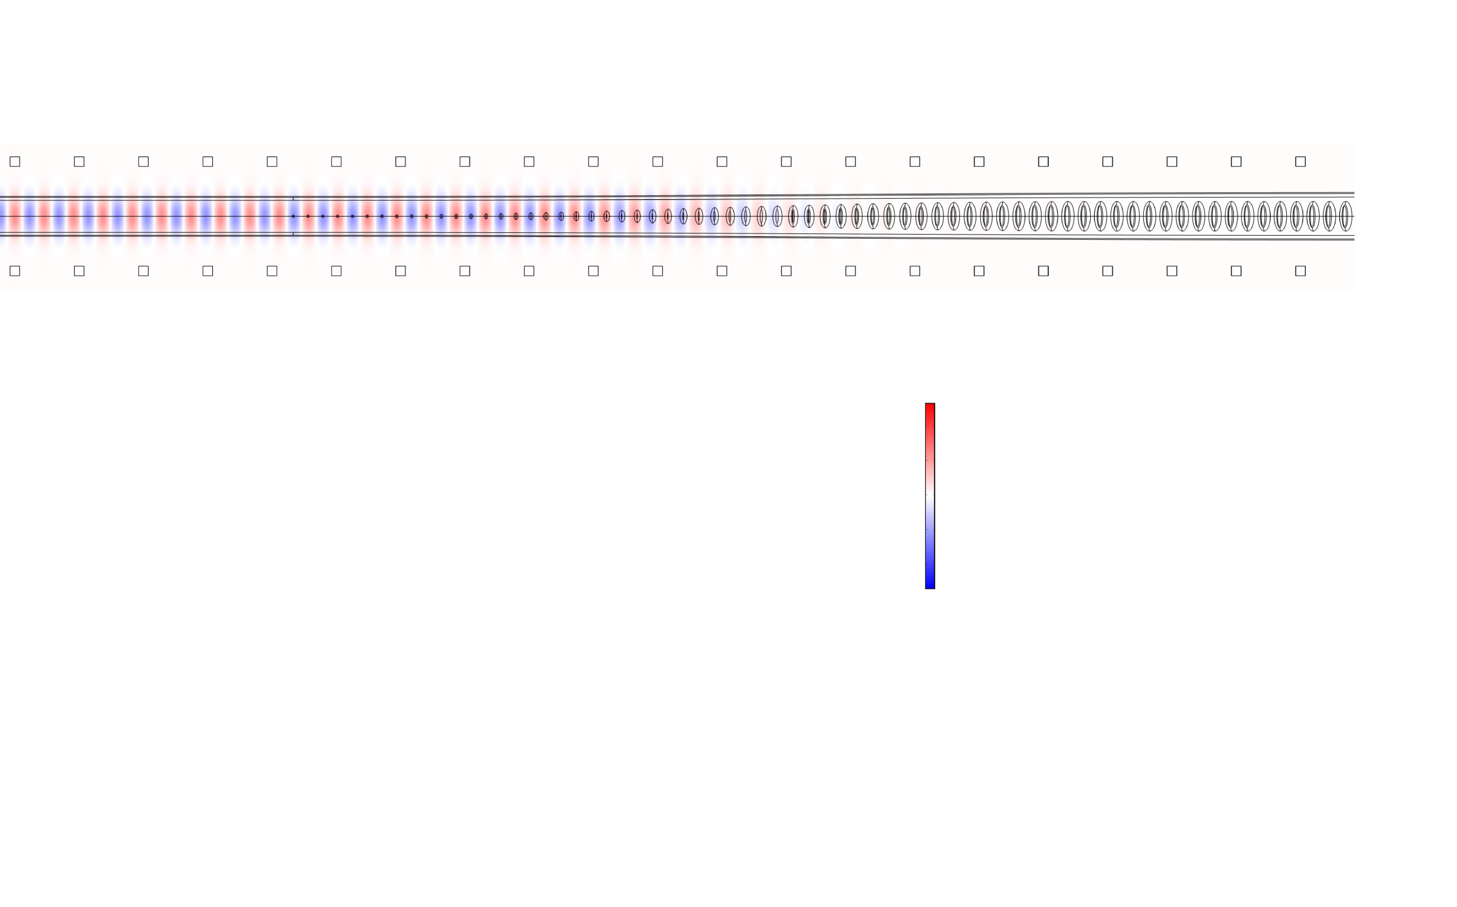
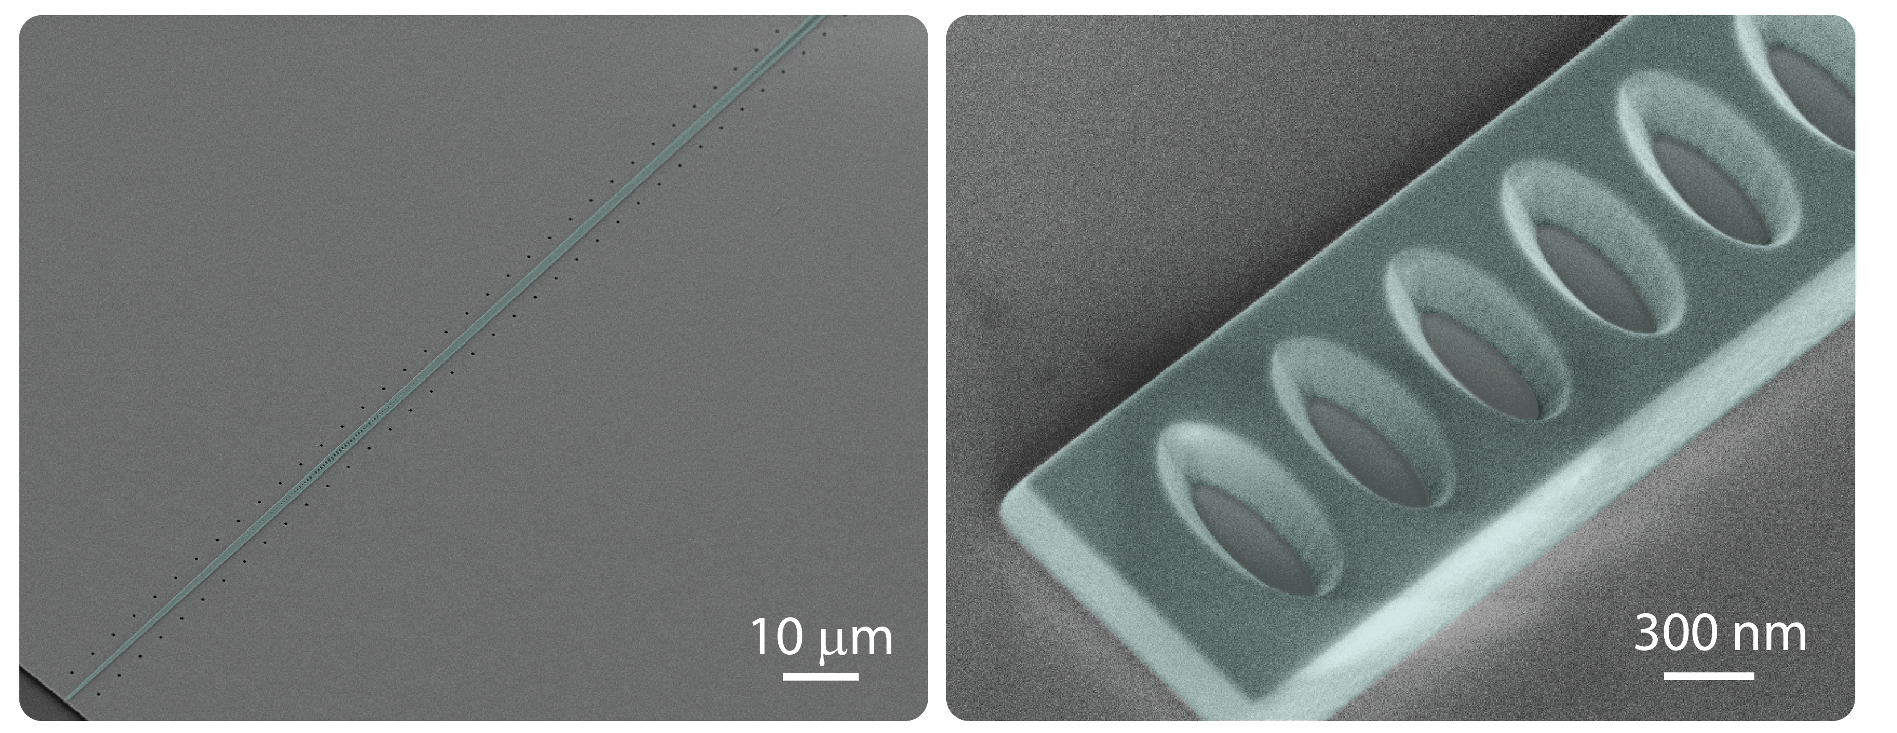
1
y
E_{y}
x
-1

Slide 7
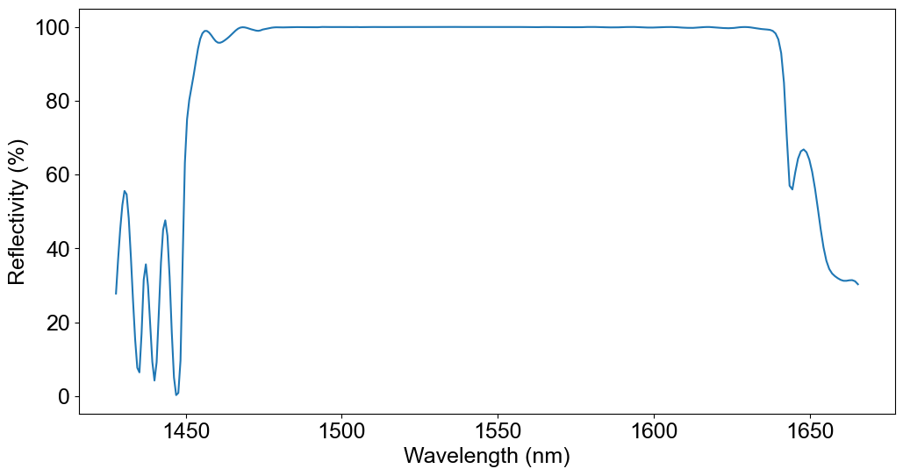
Reflection of double-chirped mirrors

Slide 8
Ring resonators

Slide 9
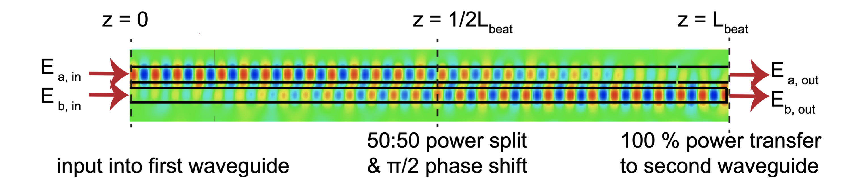
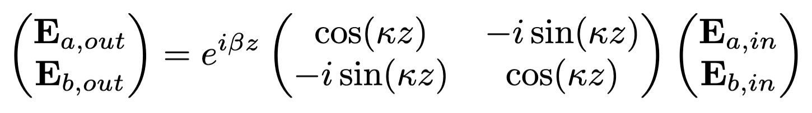
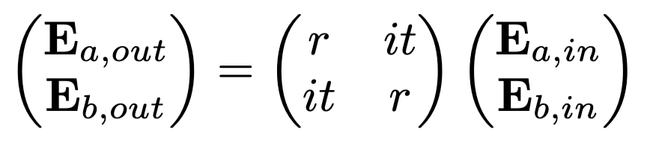
Basics of ring resonators
Coupling region:

Slide 10
Coupling regimes

Slide 11
Do’s and don’ts
When do you want a long resonator, when a short one?
Do we ever want low reflection?
What happens in the presence of losses?
Myth or truth?
  If I make the ring smaller, I will have higher finesse.
  It’s always better to put the ring as far away as possible from the bus waveguide.
  The length of the coupling region does not matter, it can exceed 2L_{beat} as long as r and t are correct

