Slide 1
Multimode interference devices
https://www.imec-int.com/en/integrated-photonics

Slide 2
Today
Last week:
  Start multi-mode interference devices
  Principle of self-imaging
Today:
  Continue multimode interference devices

Slide 3
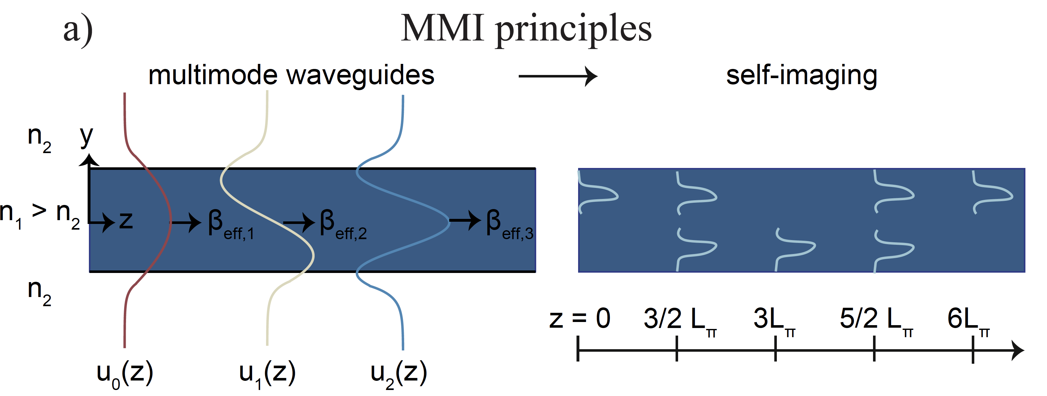
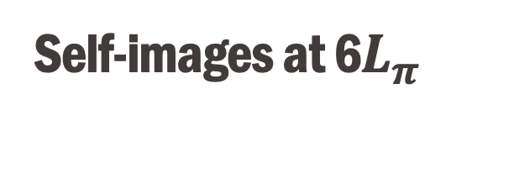
Self-images at 6$L_{π}$
Now we’re utilizing higher order modes to our own benefit
Self-imaging

Slide 4
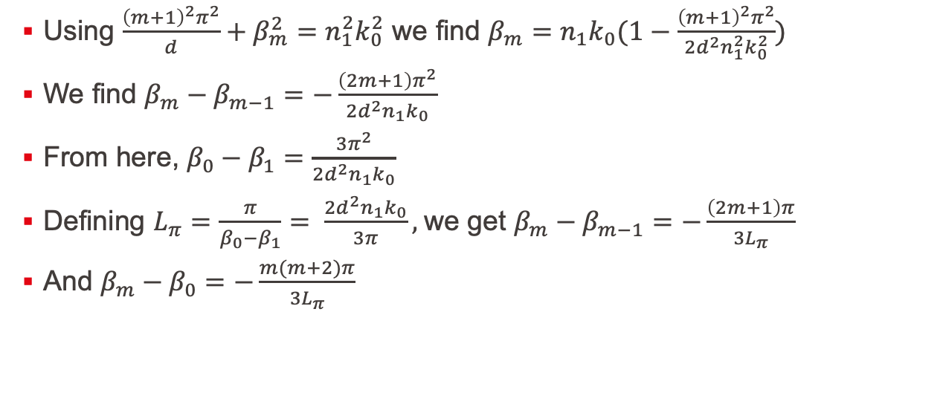
Last time
Using $\frac{{\left(m+1\right)}^{2}π^{2}}{d}+β_{m}^{2}=n_{1}^{2}k_{0}^{2}$ we find $β_{m}=n_{1}k_{0}(1−\frac{{\left(m+1\right)}^{2}π^{2}}{2d^{2}n_{1}^{2}k_{0}^{2}})$
We find $β_{m}−β_{m−1}=−\frac{\left(2m+1\right)π^{2}}{2d^{2}n_{1}k_{0}}$
From here, $β_{0}−β_{1}=\frac{3π^{2}}{2d^{2}n_{1}k_{0}}$
Defining $L_{π}=\frac{π}{β_{0}−β_{1}}= \frac{2d^{2}n_{1}k_{0}}{3π},$we get $β_{m}−β_{m−1}=−\frac{\left(2m+1\right)π}{{3L}_{π}}$
And $β_{m}−β_{0}=−\frac{m(m+2)π}{{3L}_{π}}$

Slide 5
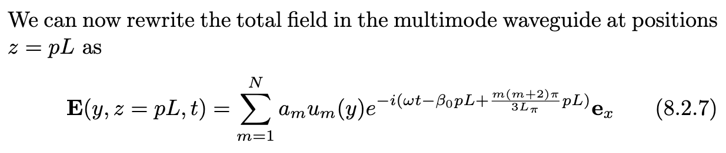
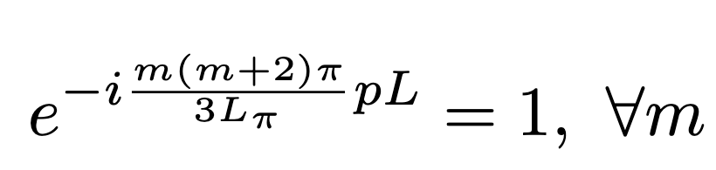

Self-imaging
Self-imaging:
Result: $L=6L_{π}$

Slide 6
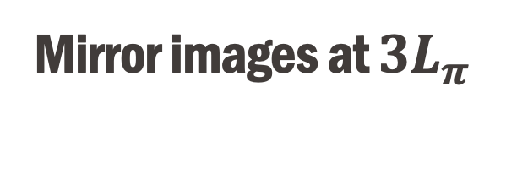
Mirror images at $3L_{π}$
Now we’re utilizing higher order modes to our own benefit
Self-imaging

Slide 7
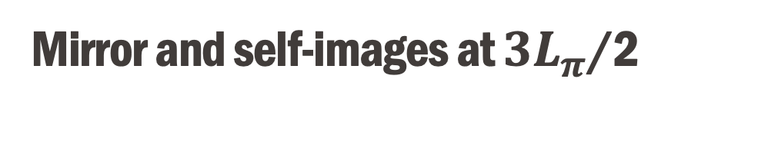
Mirror and self-images at $3L_{π}$/2
Now we’re utilizing higher order modes to our own benefit
Self-imaging

Slide 8
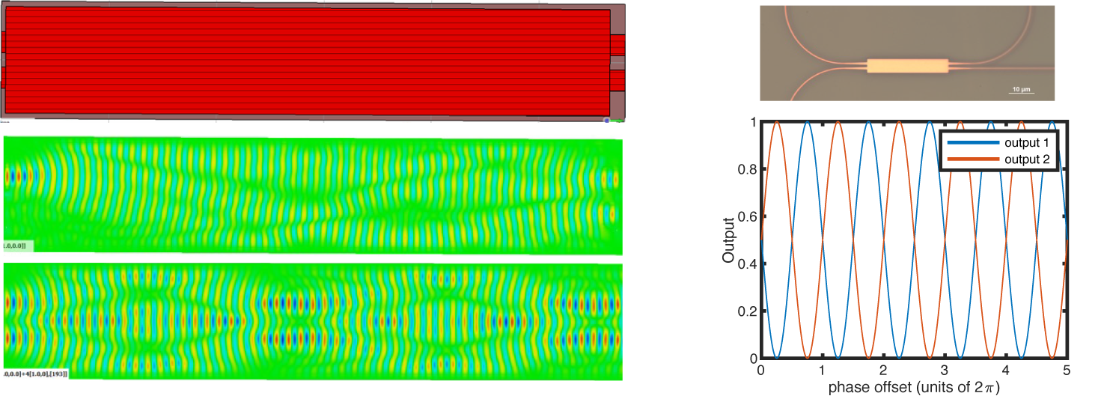
50:50 beam splitter using MMIs

Slide 9

Do’s and don’ts
Short or long $L_{π}?$
What are mirror images good for?
Robustness to fabrication imperfections?

