Slide 1
Dipolar antennas
https://www.imec-int.com/en/integrated-photonics

Slide 2
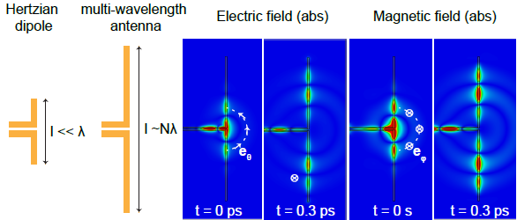
Today
Last week:
  Ring resonators
  Concepts of antennas
Today:
  Recap dipole (hertzian) antennas

Slide 3

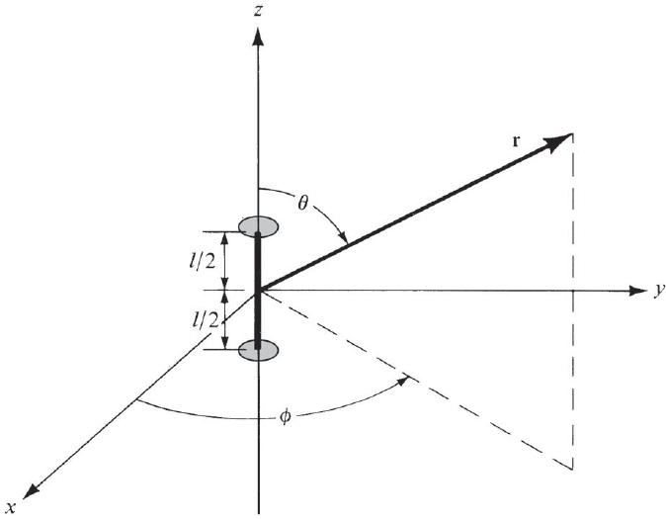


Hertzian dipoles
Current flow
Fourier Transform
I
$p=ql$ dipole momentum

Slide 4

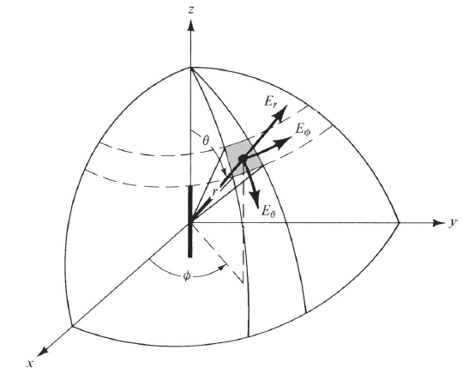
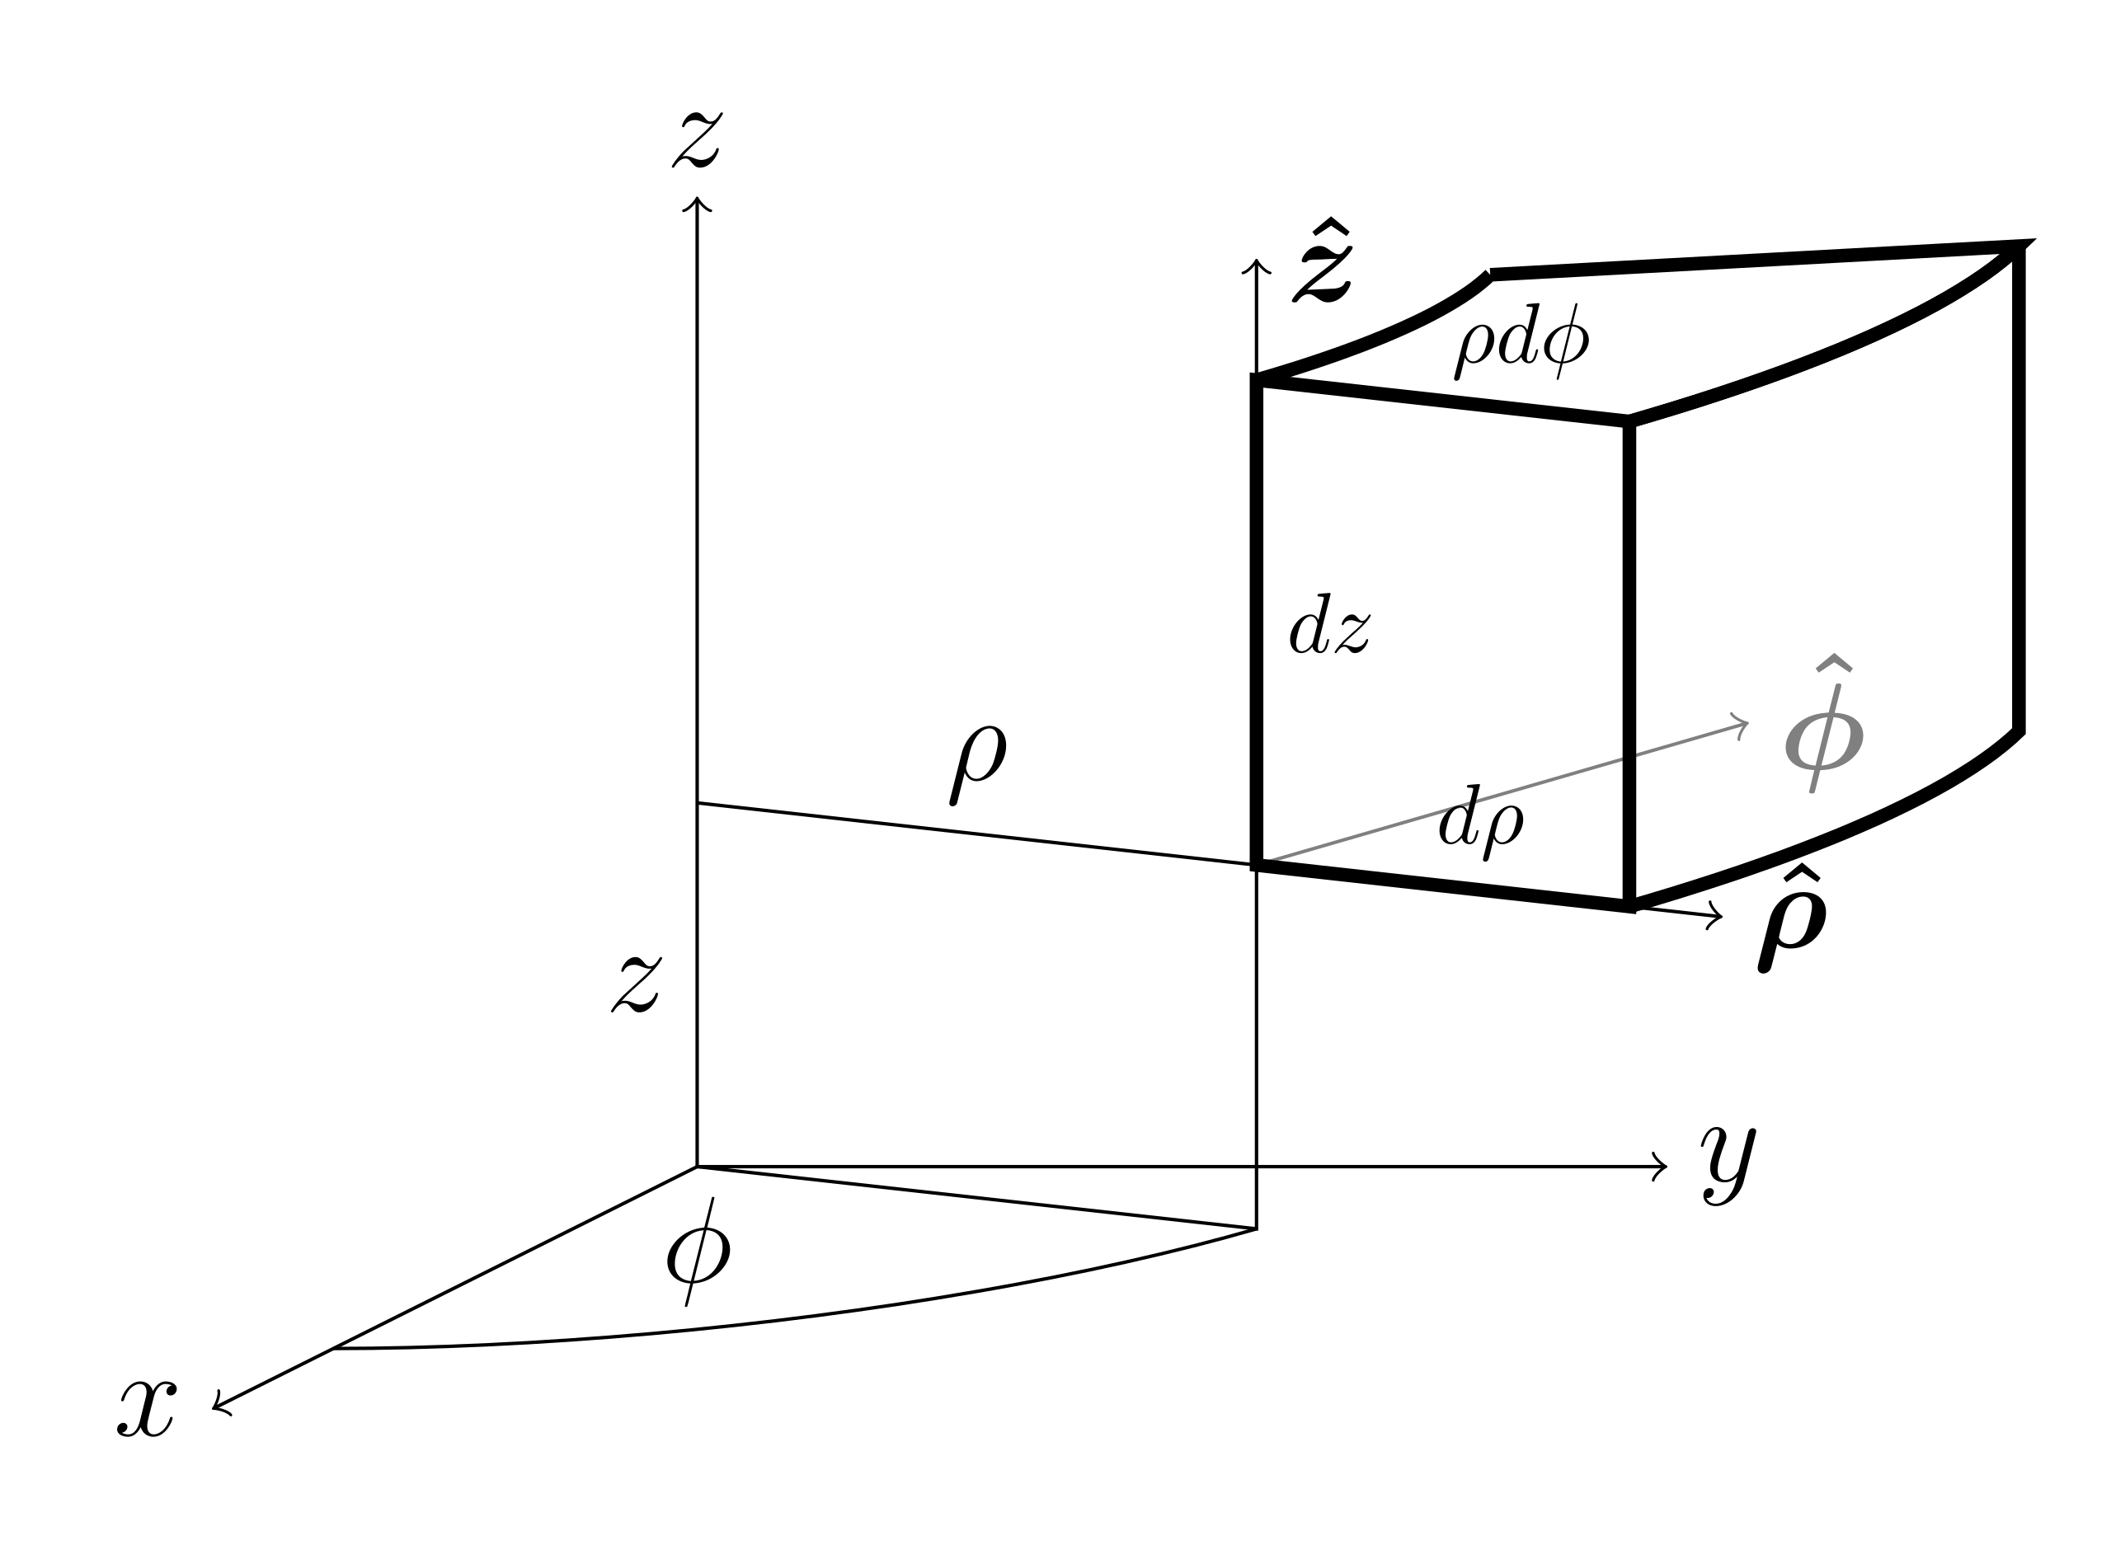
Hertzian dipoles
We want to calculate the resultant electric field emitted at the distance r from the source (which is placed at the origin of the system). To do so, we need:
Calculate the associated magnetic potential A(r,ω) and then differentiate to move to the electric field.
Pick the most convenient coordinate system to solve:.
Spherical coordinates
Cylindrical coordinates

Slide 5
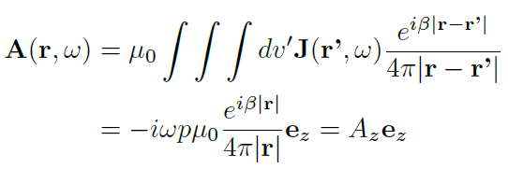

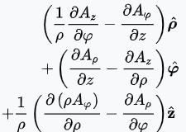
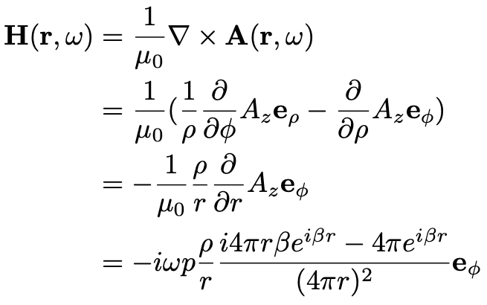




Hertzian dipoles
The potential has only component aligned as the z-axis (containing the dipole)!
This does not mean that the electromagnetic field has a single component as well!
$$A_{φ}\left(ρ,φ,z\right)=0$$
$$A_{θ}\left(ρ,φ,z\right)=0$$
The curl in cylindrical coordinate:
So the magnetic field is calculated as:
=
$$\frac{∂A_{z}}{∂ρ}=\frac{∂A_{z}}{∂r}\frac{∂r}{∂ρ}=\frac{ρ}{r}\frac{∂A_{z}}{∂r}$$

Slide 6
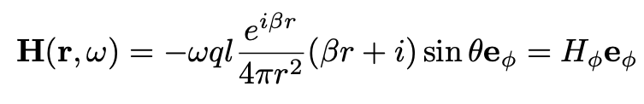

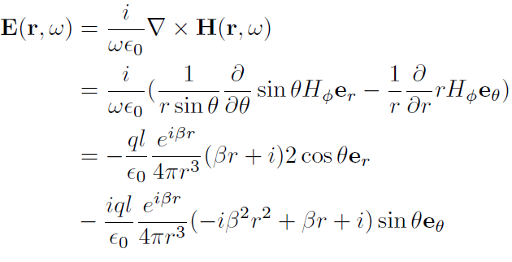
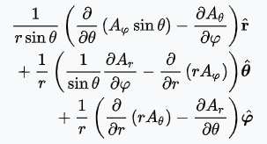

Hertzian dipoles
Now, it is convenient to move to the spherical coordinates by using:
$$ρ=r\sin{θ}$$
The magnetic field is only radial, along the rotation (azimuthal) angle φ.
What about the electric field? We can use the Maxwell’s equation, yet in the spherical system is a lot of fun….
=
The electric field exhibits two components:
directed along the polar angle θ
directed along the radial coordinate r
Therefore it is perpendicular to the magnetic field. Surprised?!

Slide 7
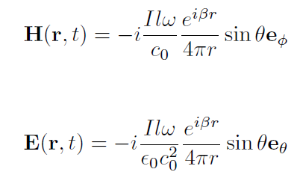
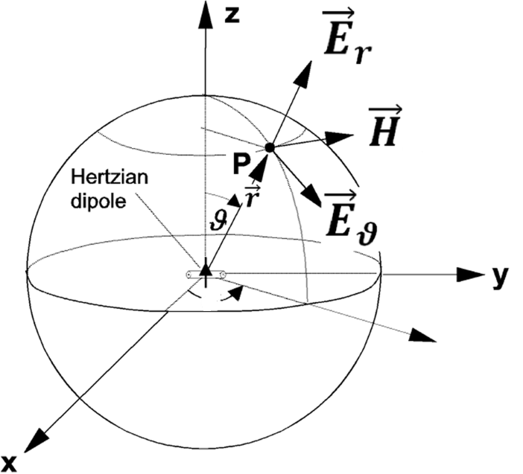
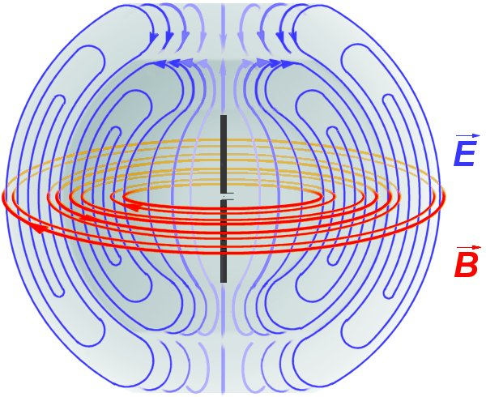
Hertzian dipoles
In the far-field regime ($βr≫1):$ (the field wave becomes transverse electromagnetic, TEM)
≈ 0
φ
k
φ

Slide 8

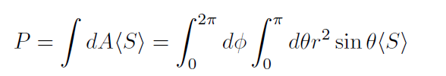
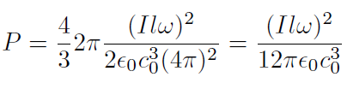
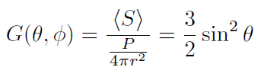
Hertzian dipoles: some important formulas
Poynting vector
Total power
Antenna gain
isotropic
antenna

