Slide 1
ML Exercise
Clustering

Slide 2
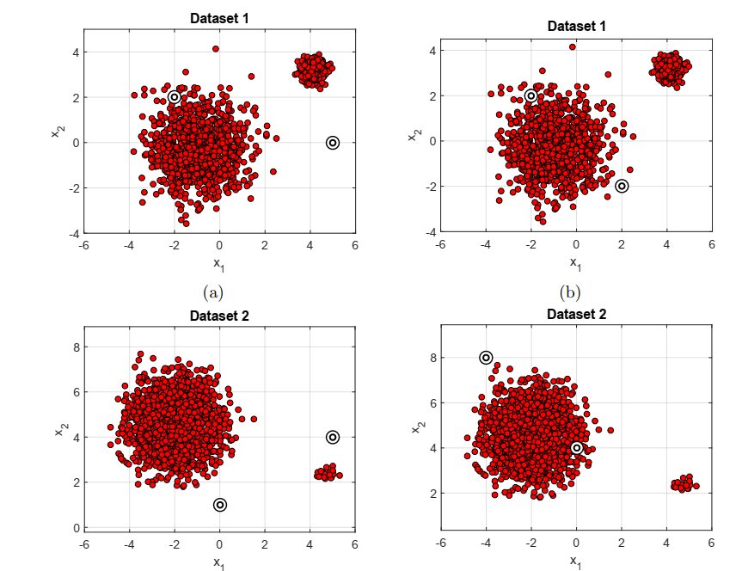
Clustering with K means
Understand the influence of initialization.
Be careful dataset 2 is imbalanced.

Slide 3
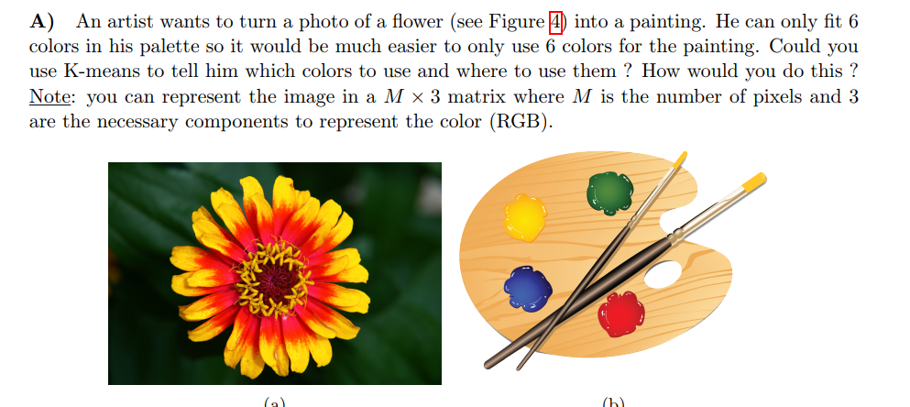
Clustering with K means

Slide 4
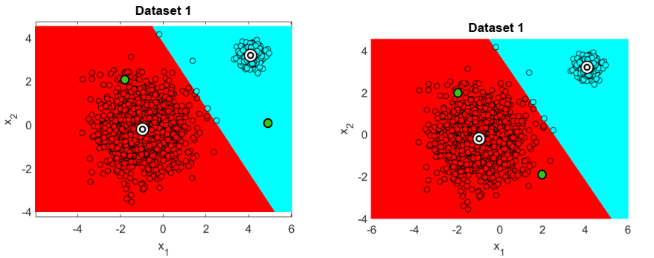
Clustering with K means
Despite the different initialization, the dataset is correctly clustered.

Slide 5
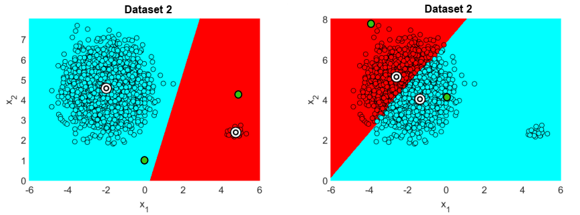
Clustering with K means
When the two clusters are imbalanced, the results are depended on the initialization.
This centroid is attracted by the bigger and data-dense cluster, but not by the data-sparse cluster

Slide 6
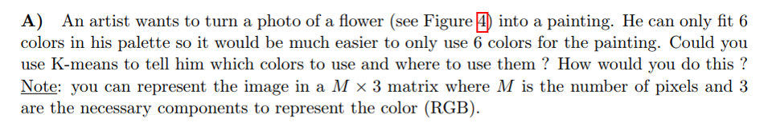


Clustering with K means
Represent each pixel as 3-d data. [R, G, B]
Six colors ---→ six clusters, each centroid is the selected color.
Before
After ; only 6 colors

Slide 7


Clustering with K means
Represent each pixel as 3-d data. [R, G, B]
The two raspberries are clustered into same cluster since they share same color.
How to make two raspberries more separatable?
  Add the position to the data dimension [x, y, R, G, B]
  Now the two raspberries are different and separatable.
Be careful ! The data scope of x, y and R, G, B might be very different
  Normalize all dimensions before K-means. + L2 norm
  Or, use a weighted norm, give higher weight to RBG ([0, 255])

Slide 8
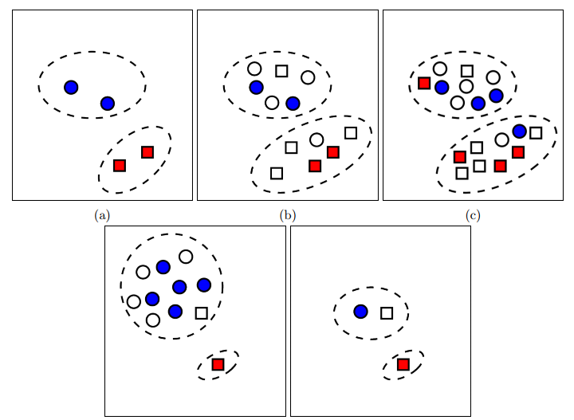
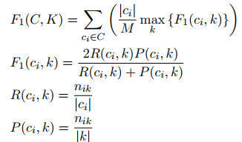
Semisupervised clustering F1-measure
Before you proceed, be sure you really understand all the formulas.

Slide 9
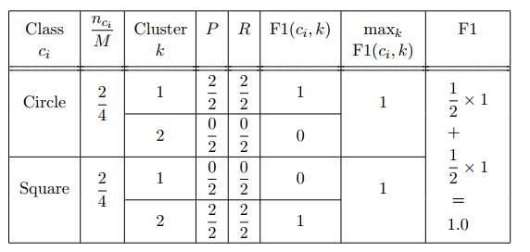
Semisupervised clustering F1-measure
(a)

Slide 10
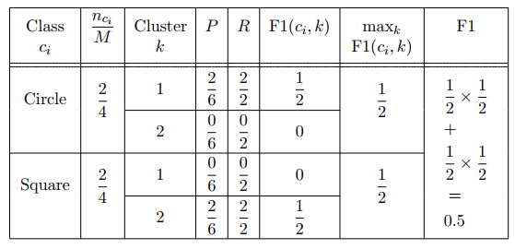
Semisupervised clustering F1-measure
(b)

Slide 11
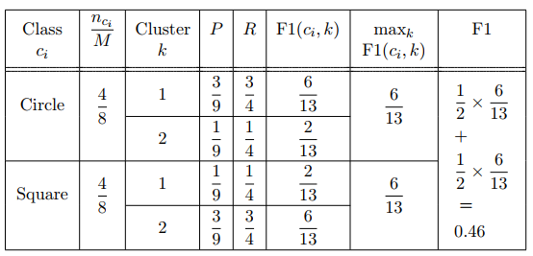
Semisupervised clustering F1-measure
(c)

Slide 12

Semisupervised clustering F1-measure
(d)

Slide 13
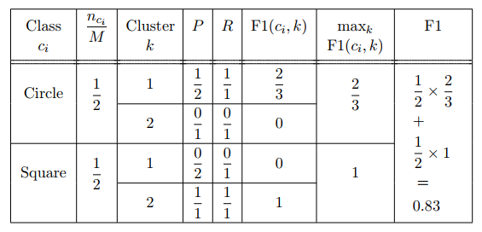
Semisupervised clustering F1-measure
(e)

Slide 14
Semisupervised clustering F1-measure
Compare a and b
  (a) 1 (b) 0.5
  More labeled data (and all correctly cluster),
  higher F1
Compare b and c
  B 0.5, c 0.46
  Since c has two misclustered data
Compare d and e
  D 0.72 e 0.83
  F1red=1; F1blue=2/3, (e) gives higher weight to F1red and thus has higher total F1
  Be careful about the data imbalance.

Slide 15
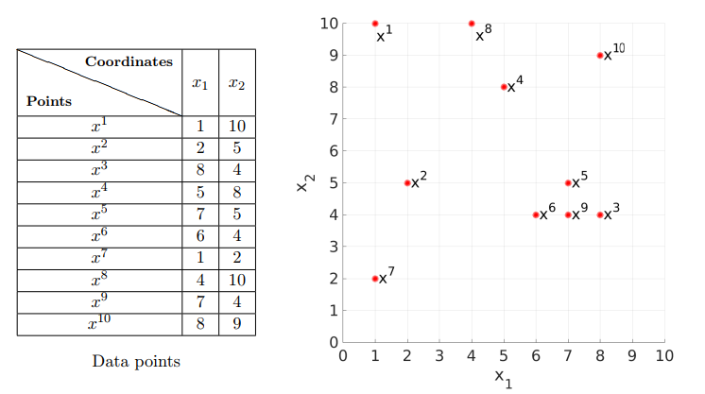
DBSCAN

Slide 16
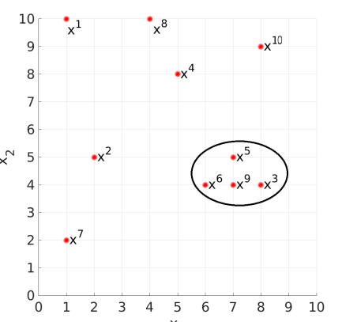
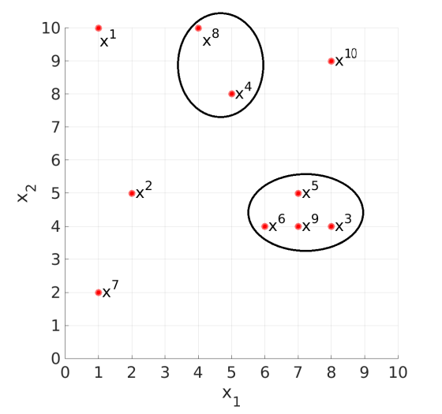
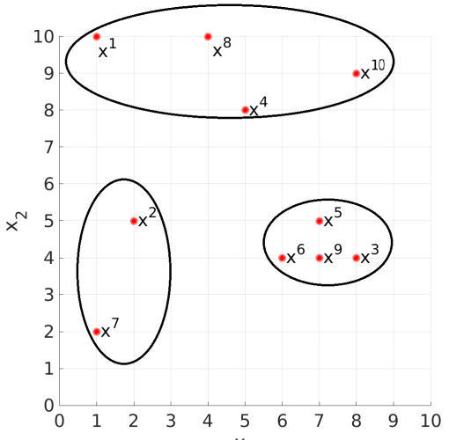
DBSCAN
Intuitively, one cluster must have at least MinPoints data, with intra-distance lower than $ε$

Slide 17
5 Computational Cost (To be done at home)
The solution is uploaded on Moodle

