Slide 1
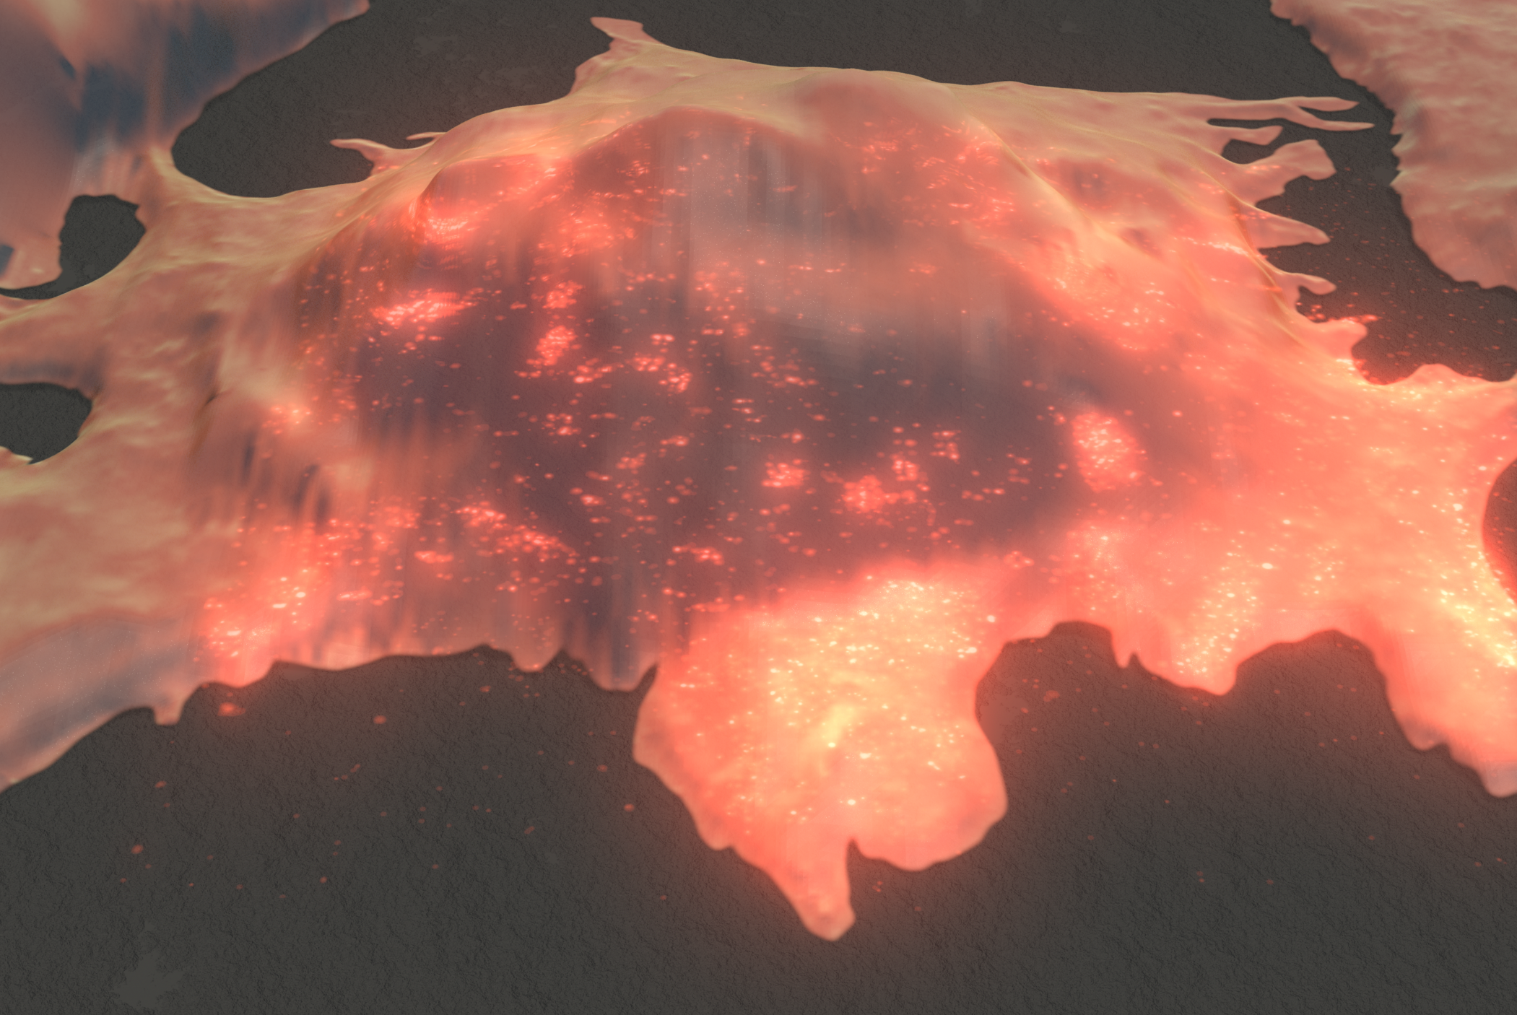
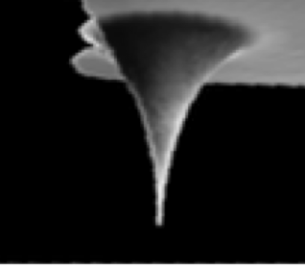
MICRO-428
Georg E. Fantner
Laboratory for Bio- and Nano- Instrumentation
MT - 428 / METROLOGY
Nanoscale metrology – Part 1: Atomic force microscopy

Slide 2
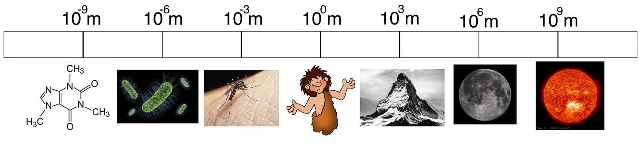
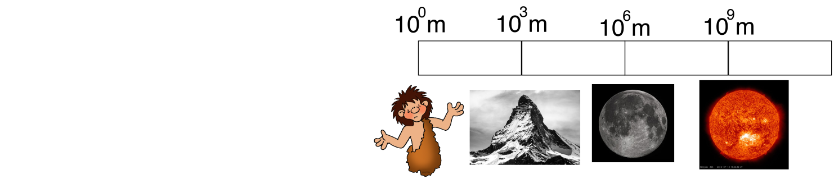
Why we need nanoscale microscopy

Slide 3

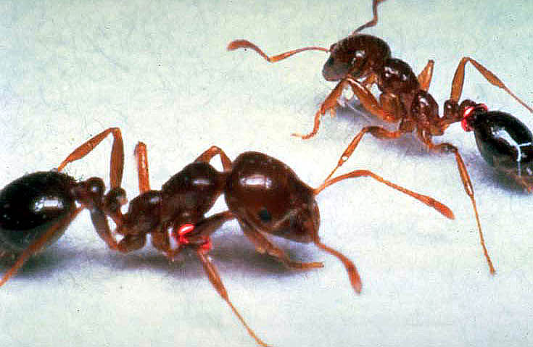
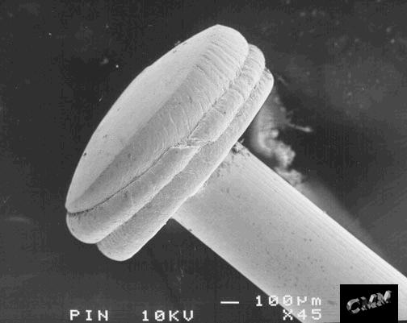
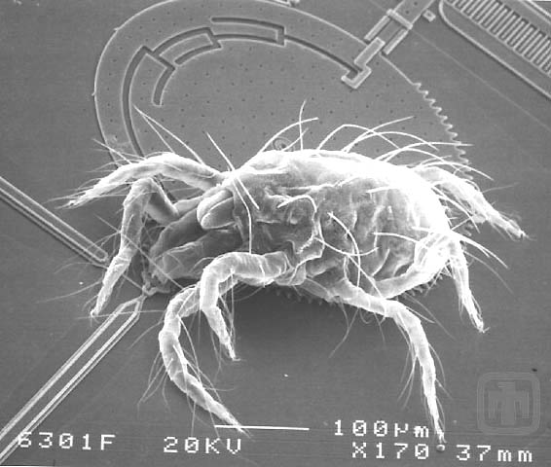
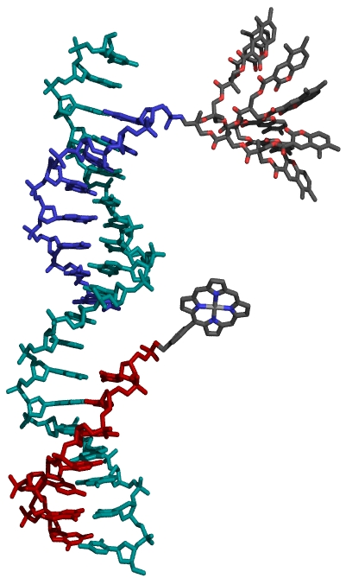
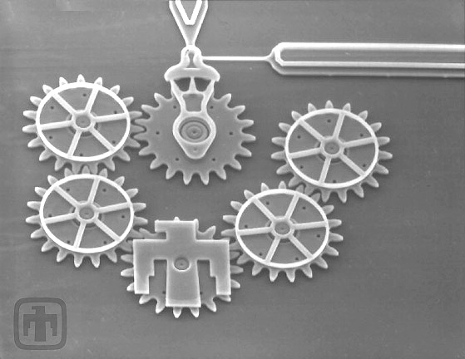
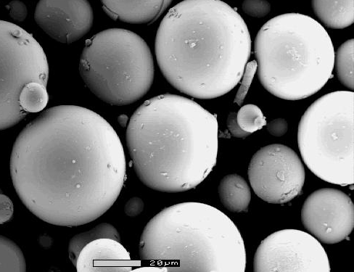
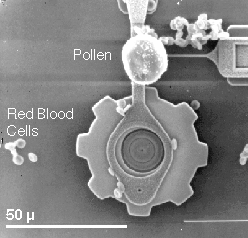
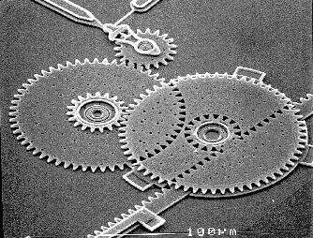
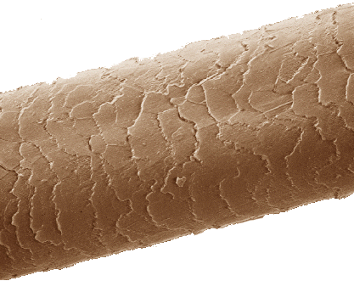
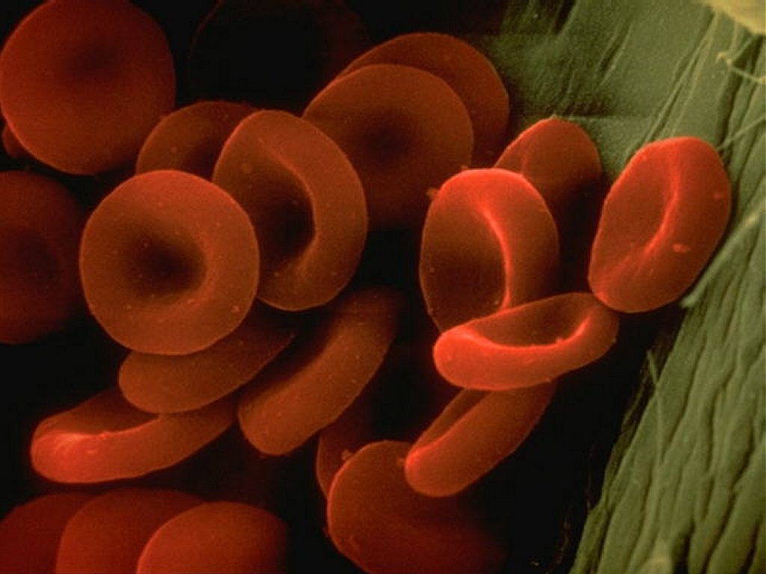
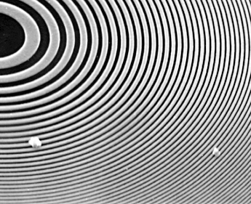
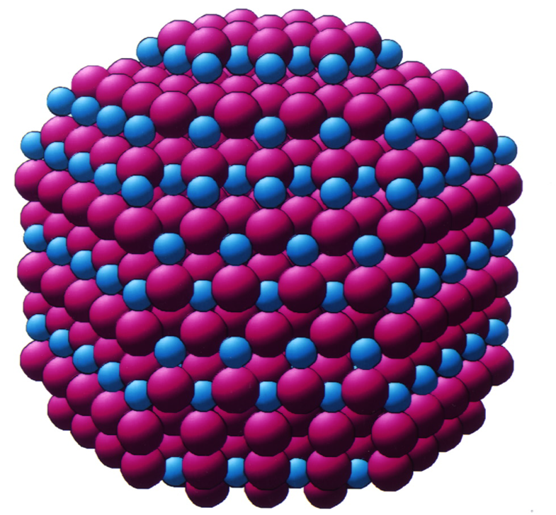
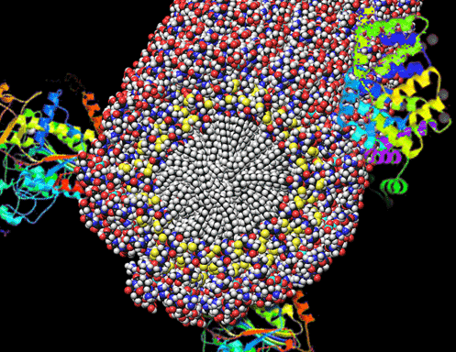
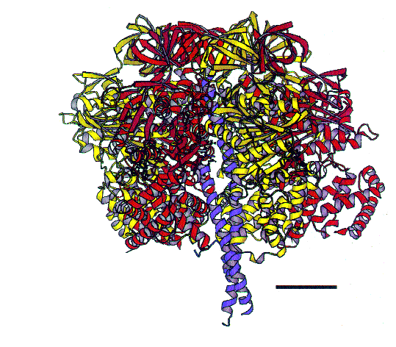
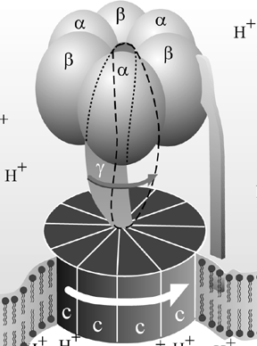
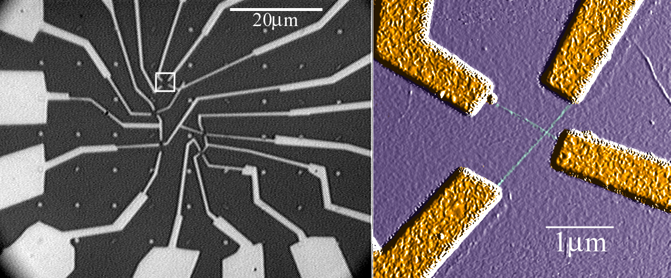
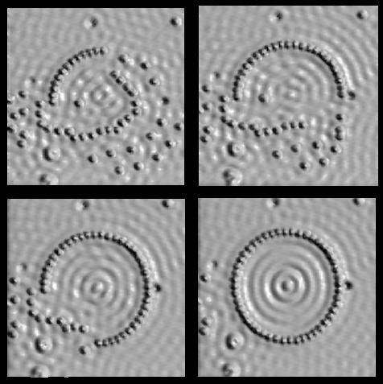
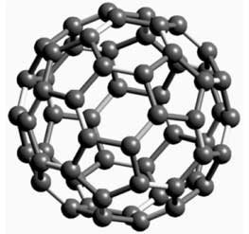
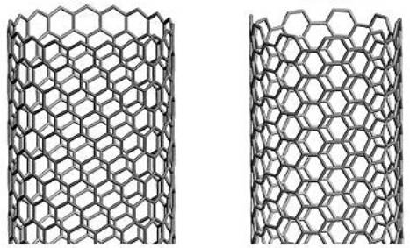
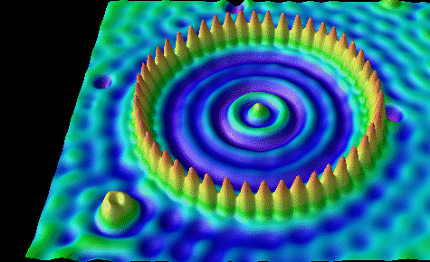
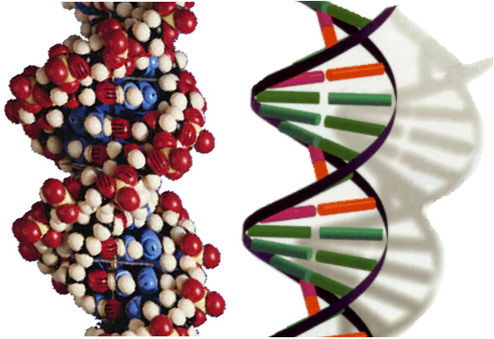
The Scale of Things – Nanometers and More
Things Natural
Things Manmade
10⁻² m
1 cm
10 mm
Head of a pin
1-2 mm
The Challenge
Ant
~ 5 mm
10⁻³ m
1,000,000 nanometers =
1 millimeter (mm)
Microwave
MicroElectroMechanical (MEMS) devices
10 -100 μm wide
Dust mite
200 μm
10⁻⁴ m
0.1 mm
100 μm
Human hair
~ 60-120 μm wide
Fly ash
~ 10-20 μm
Microworld
10⁻⁵ m
0.01 mm
10 μm
Pollen grain
Infrared
Red blood cells
Red blood cells
(~7-8 μm)
10⁻⁶ m
1,000 nanometers =
Zone plate x-ray “lens”
Outer ring spacing ~35 nm
1 micrometer (μm)
Visible
Fabricate and combine nanoscale building blocks to make useful devices, e.g., a photosynthetic reaction center with integral semiconductor storage.
10⁻⁷ m
0.1 μm
100 nm
Ultraviolet
Nanoworld
Self-assembled,
Nature-inspired structure
Many 10s of nm
10⁻⁸ m
0.01 μm
10 nm
~10 nm diameter
Nanotube electrode
ATP synthase
10⁻⁹ m
1 nanometer (nm)
Soft x-ray
Carbon buckyball
~1 nm diameter
Carbon nanotube
~1.3 nm diameter
DNA
~2-1/2 nm diameter
Atoms of silicon
spacing 0.078 nm
10⁻¹⁰ m
0.1 nm
Quantum corral of 48 iron atoms on copper surface
positioned one at a time with an STM tip
Corral diameter 14 nm
Office of Basic Energy Sciences
Office of Science, U.S. DOE
Version 05-26-06, pmd

Slide 4
Introduction to Optical Microscopy and imaging systems
Ray optics
Image construction
Diffraction
Microscope design (infinity microscopes)
Resolution, spatial frequencies
Imaging modes:
  Bright-field
  Dark field
  Phase contrast
  Differential interference contrast (DIC)
  Fluorescence
Super resolution optical microscopy
  Structured illumination microscopy
  Single molecule localization microscope (PALM/STORM)
  Stimmulated emmission depletion microscopy

Slide 5
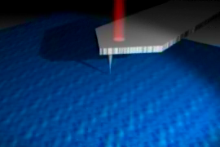
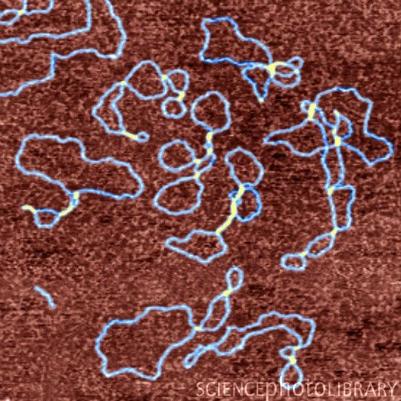
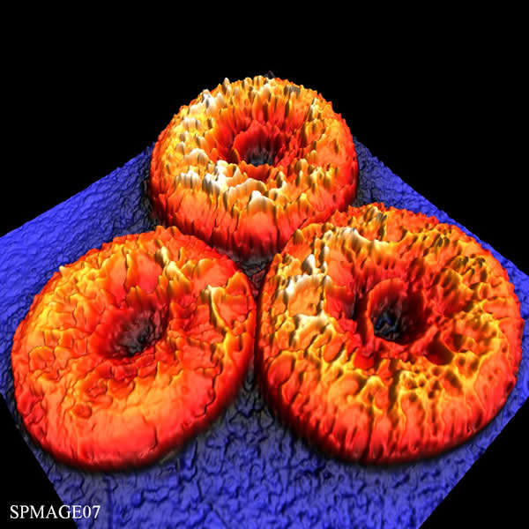
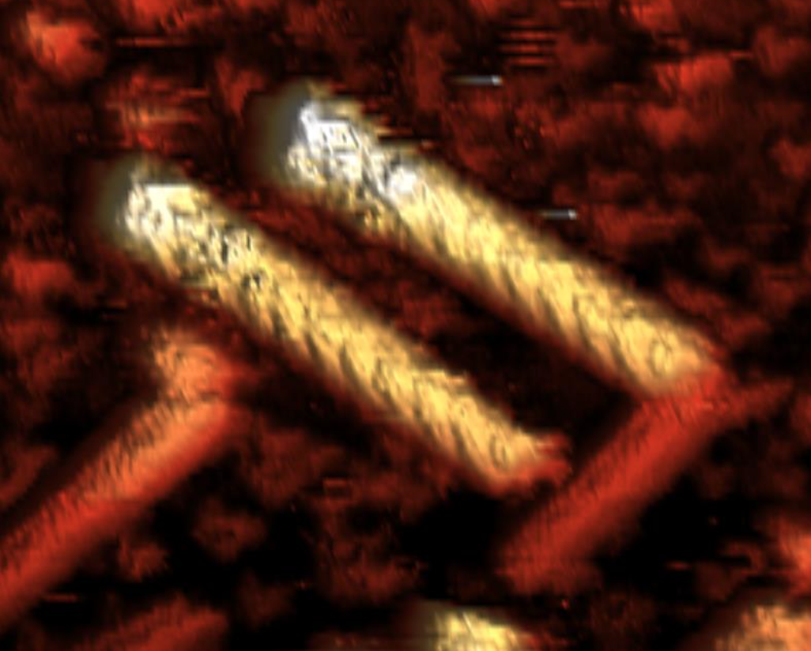
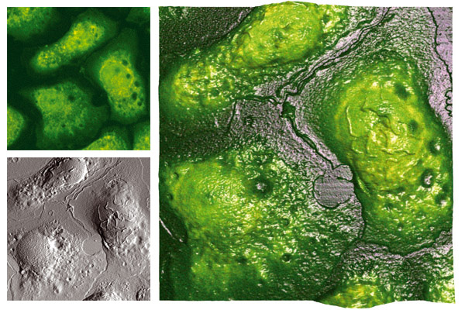
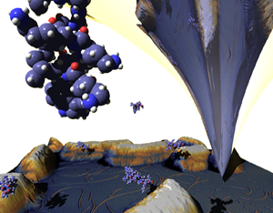
Atomic Force Microscopy
Scanning tunnelling microscopy (STM)
Components of an Atomic force microscopy
  Optical beam detection
  Piezos & hysteresis
  Feedback
AFM modes:
  Force spectroscopy
  Contact mode
  Tapping mode & phase imaging
  Non-contact mode
  Off-resonance mode
AFM cantilever
Image resolution and artefacts

Slide 6
Electron Microscopy
Components of electron microscopes:
  Electron sources
  Electrostatic lenses
  Electron detectors
Electron/matter interactions
Transmission electron microscopes
Scanning electron microscopes
Sample preparation for EM
EM resolution
X-ray analysis
EM artifacts
Focussed Ion Beam (FIB)
Correlated microscopy

