Slide 1
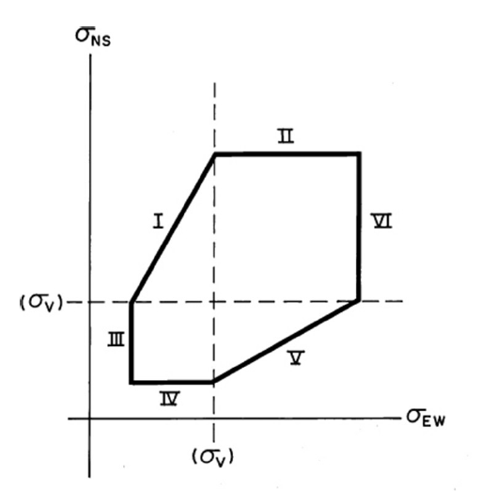
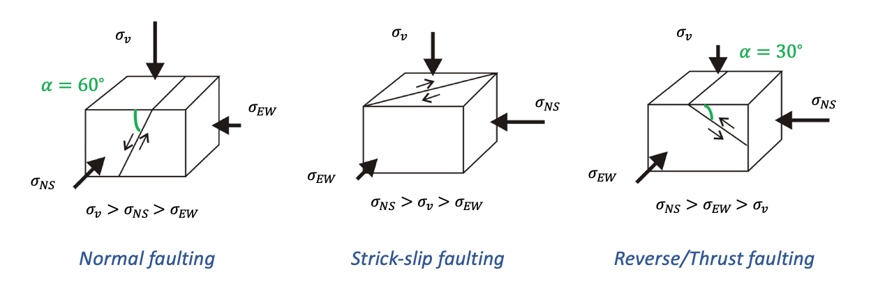



Anderson’s theory of faulting
High angles
Reference:
Investigation of geological fault reactivation and opening.
Pedro K. Nacht, Maria F. F. de Oliveira, Deane M. Roehl and Alvaro M. Costa
$Ι:$Strick-slip faulting
$ΙΙ:$Thrust faulting
$ΙΙΙ:$Strick-slip faulting

Slide 2
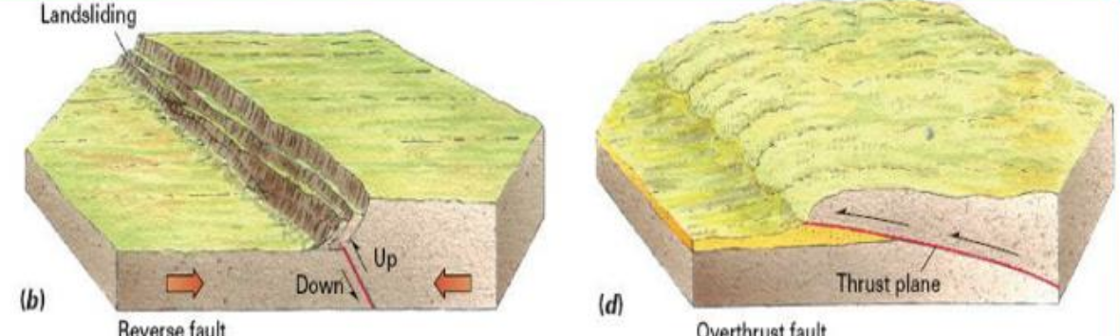
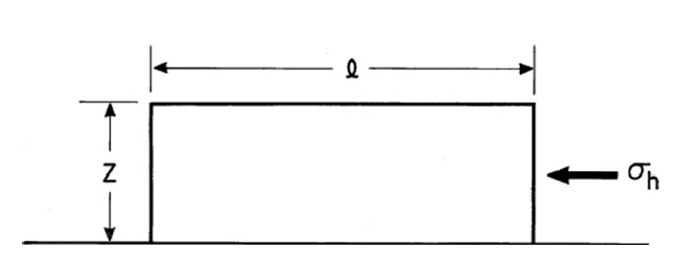

Hubbert-Rubey theory of overthrust faulting
Definition:
  Reverse fault with very low angle
  Horizontal movement and not vertical movement
  Directions does not match Anderson’s theory
Theory:
  Stress law → $F=σ_{h}z=\left(σ_{v}−p\right)lμ$
  $σ_{h}=\left(1−λ\right)ρglμ$
Problem:
  Wrong order of $l$
Hubbert-Rubbey: pore pressure reach lithostatic pressure → $λ \sim 1$ → The sliding resistance vanish
  Compaction of saturated sediments
  Dehydratation reaction

Slide 3
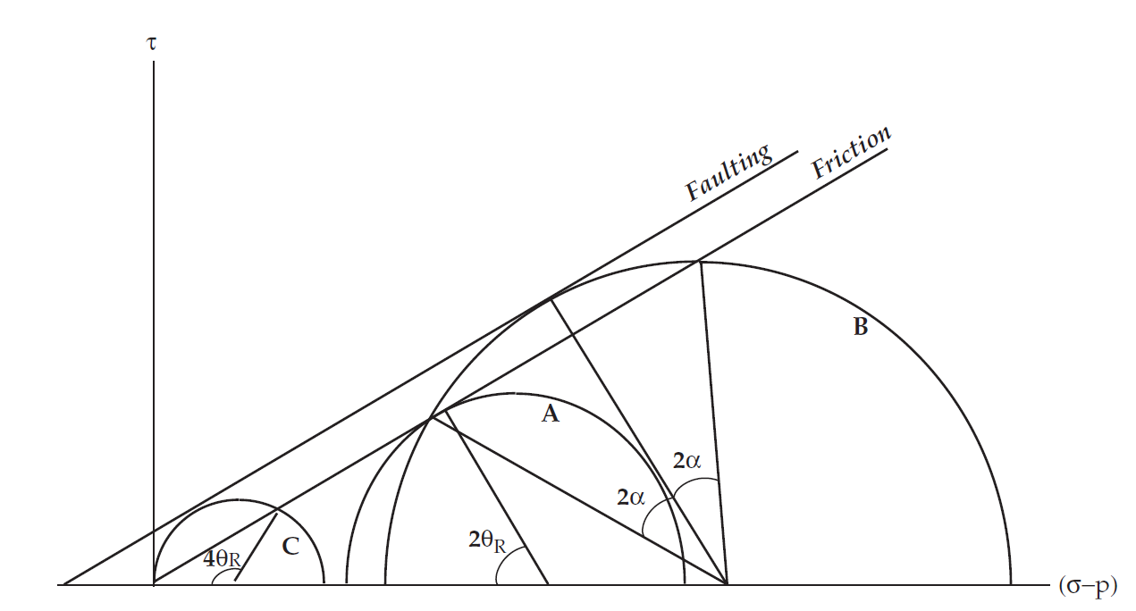
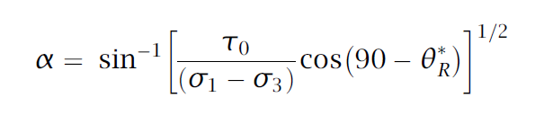
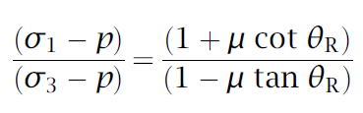
Fault rotation, reactivation, and friction
Anderson ‘s theory → predicts orientation of faults referring to stresses in which they formed
Faults may become misoriented with respect to the stress field due to:
- Internal rotation→ as faults slip they rotate with surrounding rock (Martel 1999)
conditions not to rotate: - uniform shear stress drop along fault
- isotropic surrounding rock
- uniform far-field stress state
External rotation →stress field orientation rotates with respect to the fault
Will more favorably oriented faults form?
Will preexisting faults reactivate?
Formation
Re-activation
Critical angle for new fault formation (~10-20) Scholz et al 2010
case B
Stress condition for reactivation Sibson et al 1985
=min case A
∞ case C
A= most favorably oriented fault
B= first order splay fault
C=lock-up limiting condition

Slide 4
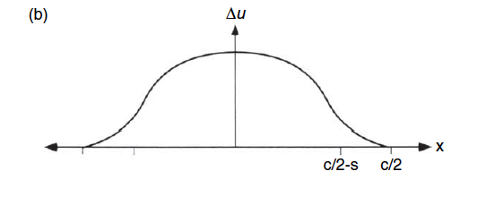
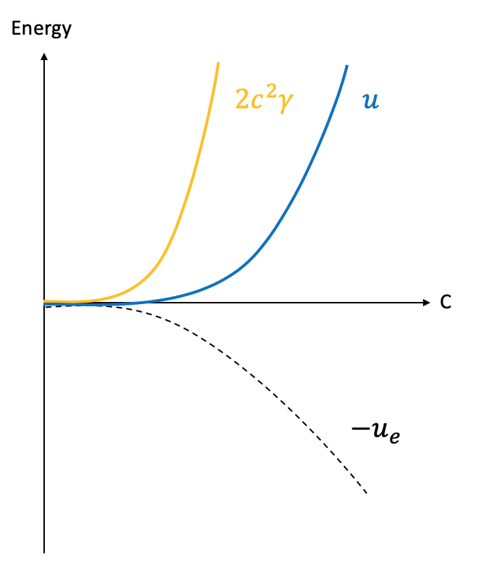
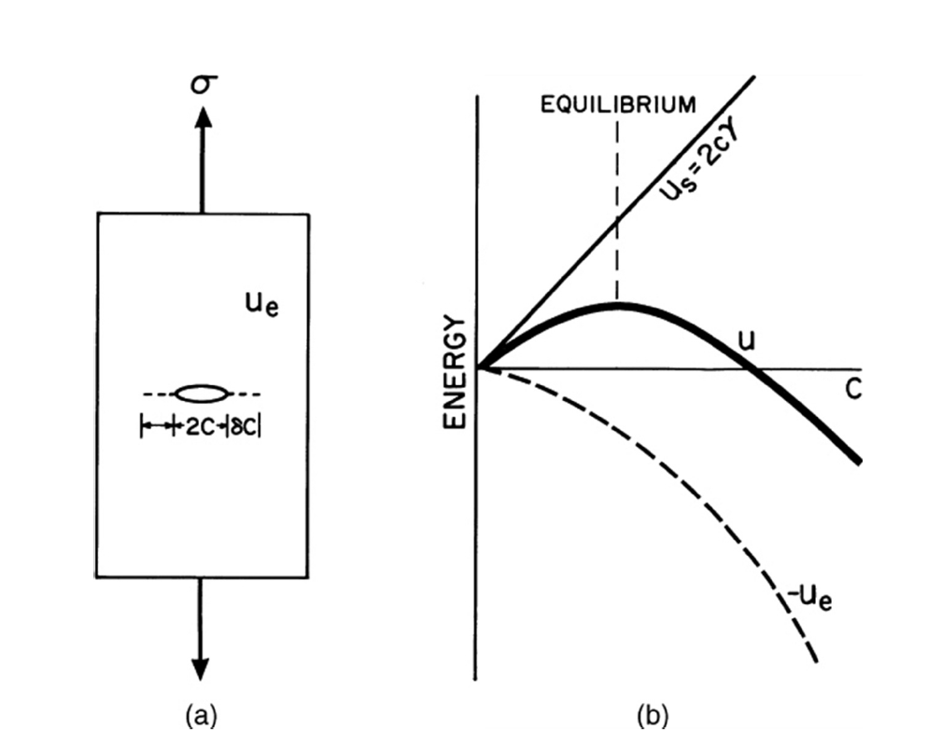

Fault formation and growth
Dugdale model:
  $\frac{D_{max}}{L}=\frac{\left(1−ν\right)\left(σ_{0}−σ_{f}\right)}{2πμ}\cos\left(θ_{2}\right)ln\frac{{\left(\sin\left(θ_{2}\right)+1\right)}^{2}}{{\left(\sin\left(θ_{2}\right)−1\right)}^{2}}$ → D $∝$L
  $G=\frac{2\left(1−ν\right)L{\left(σ_{o}−σ_{f}\right)}^{2}cos⁡(θ_{2})}{πμ}ln⁡(sec⁡(θ_{2}))$ → G $∝$L → K $∝√L$
Griffith instability:
Notes:
Inalibility of shear cracks to propagate within their own plan → how crack form and growth ?

Slide 5
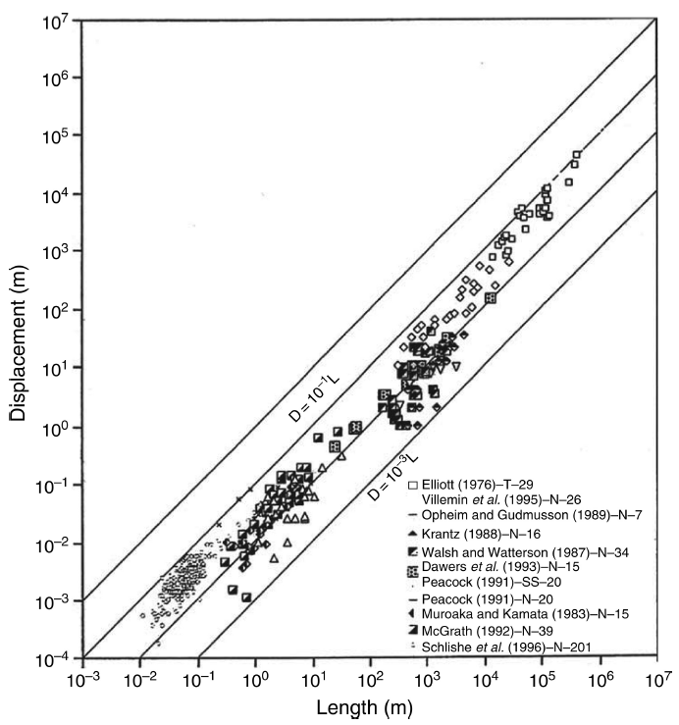
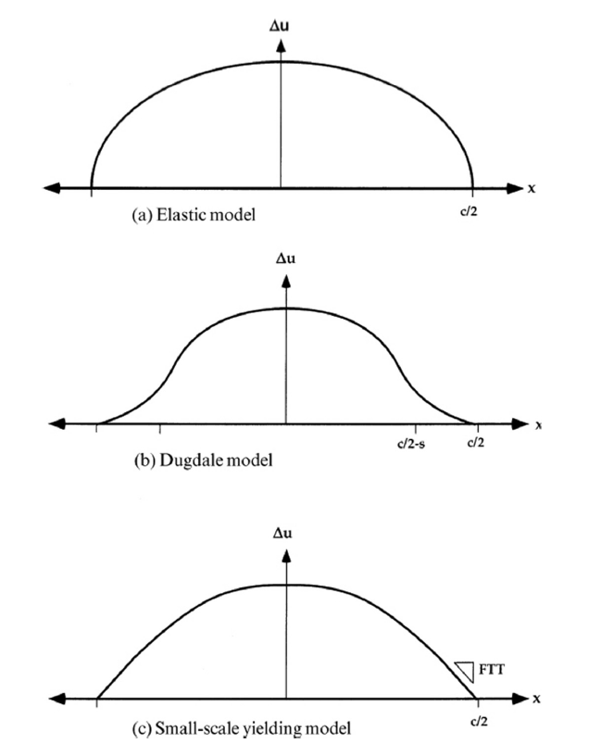
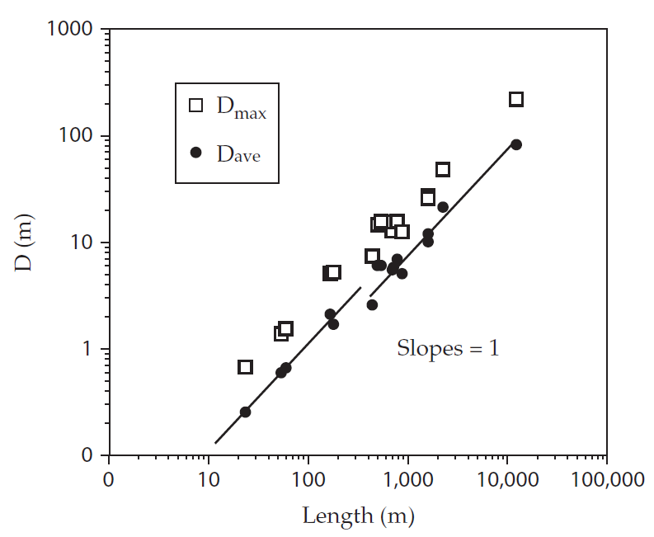
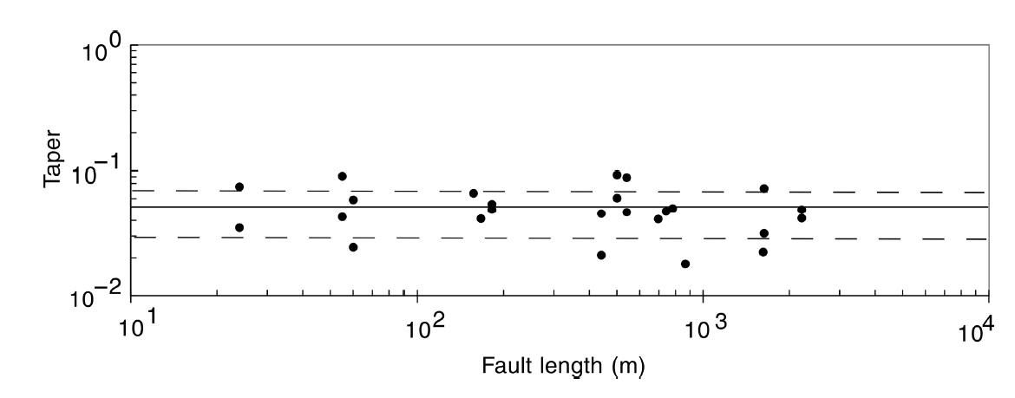
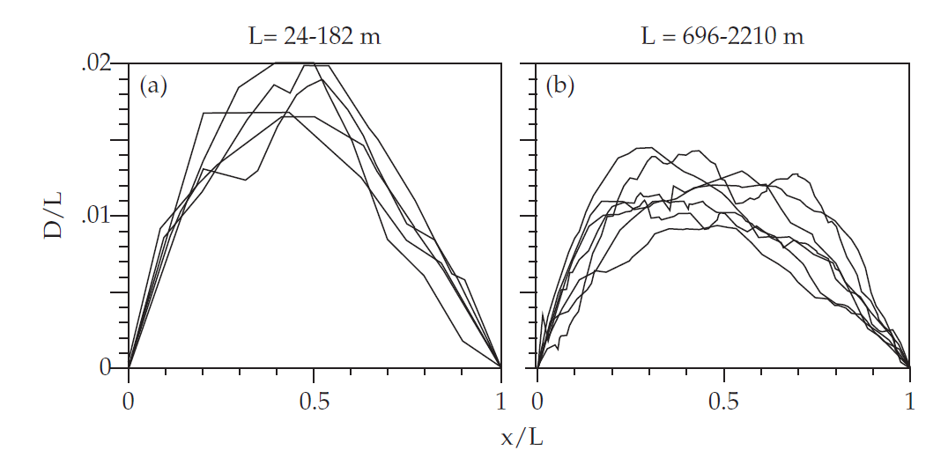
The problem of fault formation
Dawers et al 1993
Schlische et al. 1996
Inelastic deformation occurring in the crack plane
NON REALISTIC
Inelastic deformation occurring in volume around crack tip
Length<200m→Dav/L~1.1x10^-2
Length>600m→Dav/L~8x10^-3
Displacement profiles along normal faults
Dawers et al 1993
Dawers et al 1993
FTT scale independent over the two orders of magnitude range of fault length.
Small fault length big fault length
D/L ratio and FTT increase with rock strength. Both parameters for earthquake ruptures are about two orders of magnitude less than for faults.
→ There is a difference in strength of the rock and residual frictional strength.
Displacement profiles collapse for each set → self-similarity

Slide 6
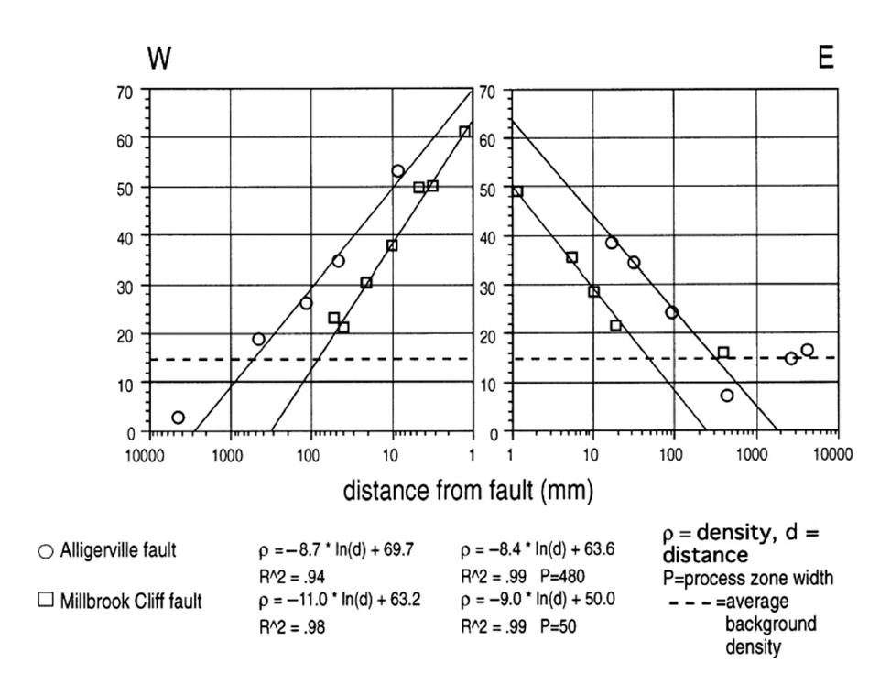
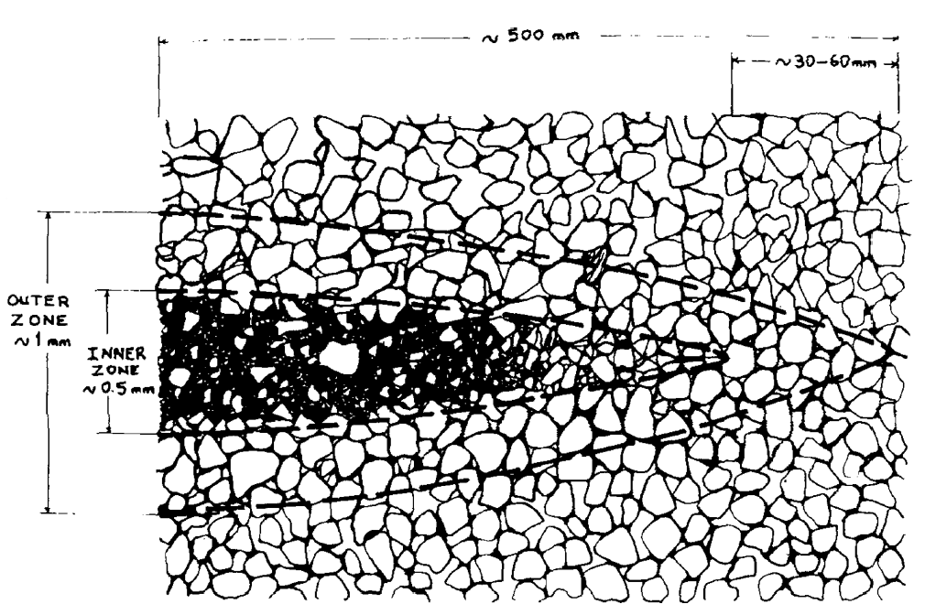
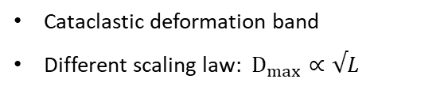
The problem of fault formation
For low porosity rocks→ process zone: dilation
For high porosity rocks→ process zone compaction
Cataclastic deformation band
Different scaling law: $D_{max}∝√L$
Porosity reduction:
Grains rotation and shifting
Undeformed rock
Rock densification:
Grains crushing
40 m long
~1m long
Vermilye and Scholz 1998 → process zone created by grainsize scale dilatant mode I microcracks
Microcrack density at the edge of fault core is scale independent
The width of the damage zone Does depend on the fault length (linear scaling)
But the densification part responds in strain hardening acting like a stiff inclusion
Stress concentration makes the deformation band grow
Once reached big difference in elastic properties→ slip

Slide 7
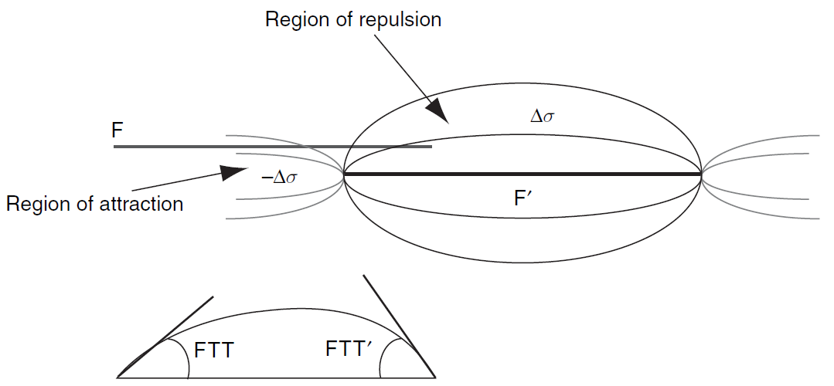
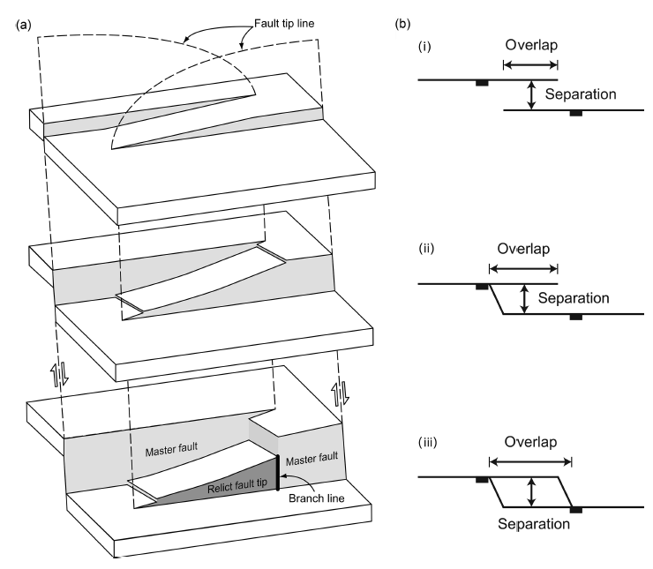
Fault interactions
If faults are close enough, they can interact through their stress field.
Relay ramp= volume of rock in which faults overlap and transfer displacement
Pinning: restricts the lengthening but not slip accumulation
Stress concentration must increase to overcome:
Rock strength and stress drop
→ Steeper FTT
Asymmetric displacement profile
In CFTT model FTT ∝ stress concentration
Relay ramps may occur at different scales
But
Overlap/Spacing ~= 1-10 m (scale indipendent)

Slide 8
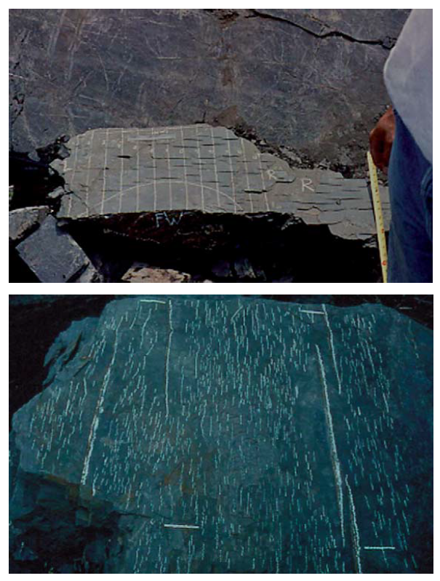
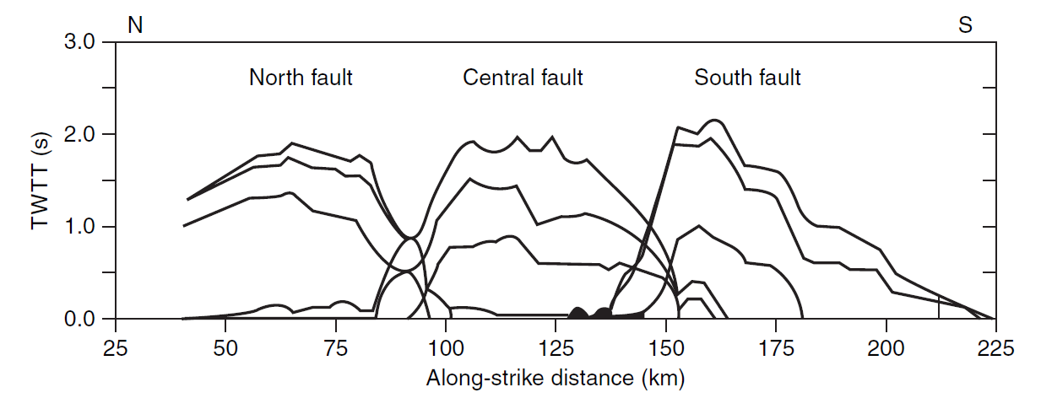
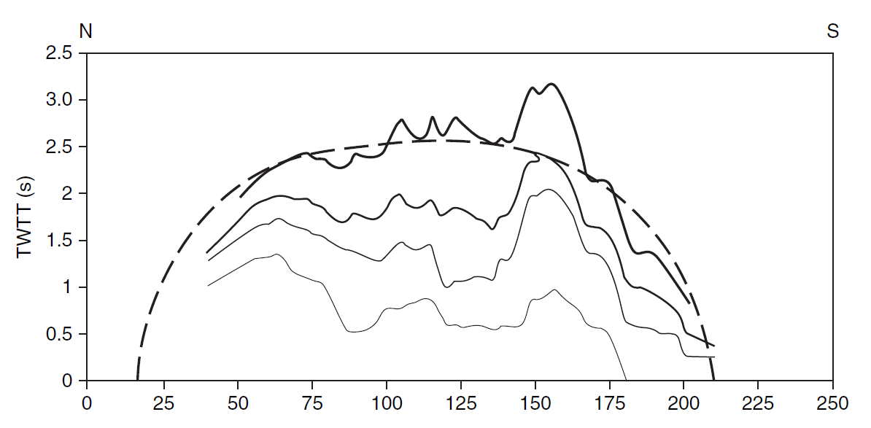
Fault interactions
Coalescence: building longer units
Nucleation inhibition – stress shadowing
Contreas et al 2000
Fault growth
Expected profile for fault with net length = L1+L2+L3
Soft linkage→ overall behaviour
Hard linkage → secondary faults creation
If a fault lies entirely within the stress-drop region of another, larger, fault, it will become inactive

Slide 9
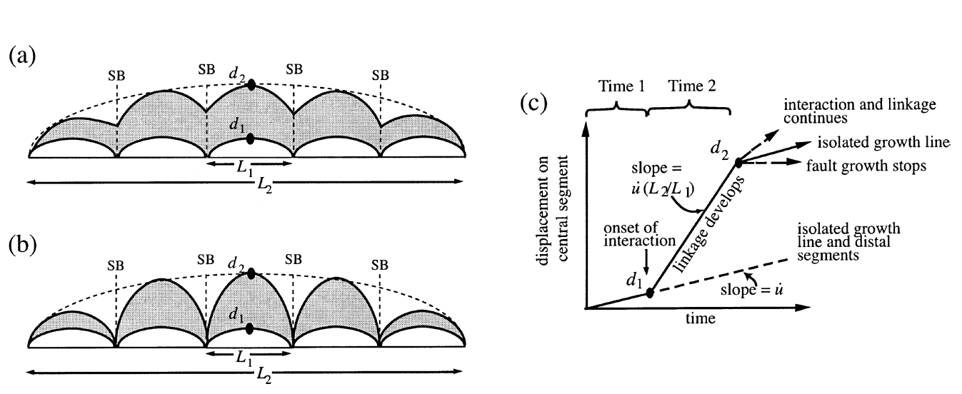
Fault interactions
Conventional growth models → faults become larger due to systematic increases in both maximum displacement and length
Walsh et al 2002 → alternative growth model where fault lengths are near-constant from an early stage (underdisplaced) and growth is achieved mainly by increase in cumulative displacement.
Requirement for readjustment: slip rates at the central segment are higher than others
“ The model predicts that faults within a system will rapidly acquire displacement/length scaling properties that are consistent with previously established fault-growth trends, even though the growth of individual faults differs from those trends.”
Walsh et al 2002
Cowie and Roberts 2001
Faults grow by accumulation of slip, with no growth in length
Slip accumulates in each fault (D/L increases),
until equilibrium slip profile is reached for the linked fault

Slide 10
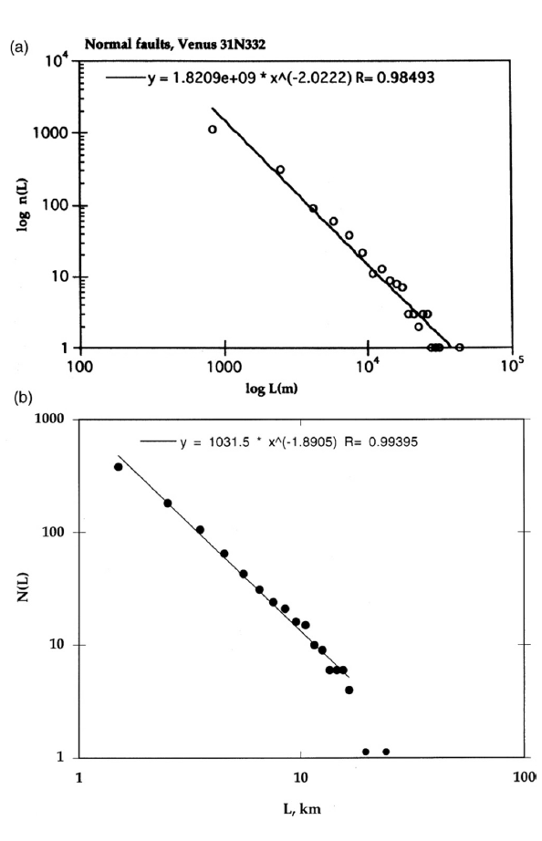
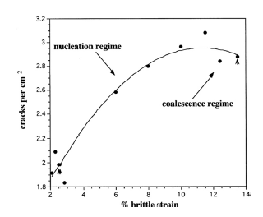
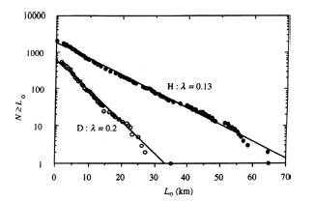
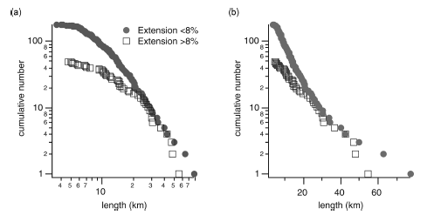

Fault population
Observations:
Numerical model: extension of a brittle layer on ductile substrate→ different fracture populations evolving with strain
Faults
Spyropoulos et al (1999)
Power law: $N\left(L\right)=aL^{−c}$
C=1
Subfaults
C=2
But not all faults follow power-law distribution…
Power-law Exponential
Cracks start to interact (stress shadowing and coalescence)
→ Decrease of total number of fractures
Gupta and Scholz (2000)
Exponential distribution
Low-strain high-strain

