Slide 1
Chapter 2:Rock Friction
Part 1
Andreas Möri (GEL)
Eleanor Mak(LAMMM)

Slide 2
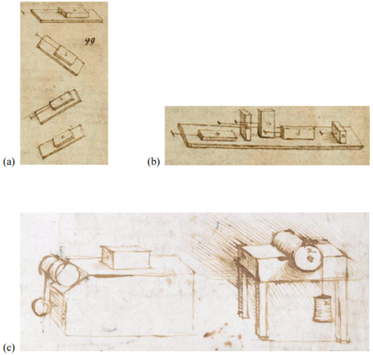
2.1 History
Da Vinci (1400s) and Amontons (1600s)
Frictional force independent of size of contact surface
Friction is proportional to normal load
Coulomb (1700s)
Surface roughness
Asperities: rigid (riding) or elastic (bending) springs
Static vs kinetic friction
A
N
N
F
Energy dissipation and frictional wear
Original sketches from Da Vinci’s experiments on friction

Slide 3
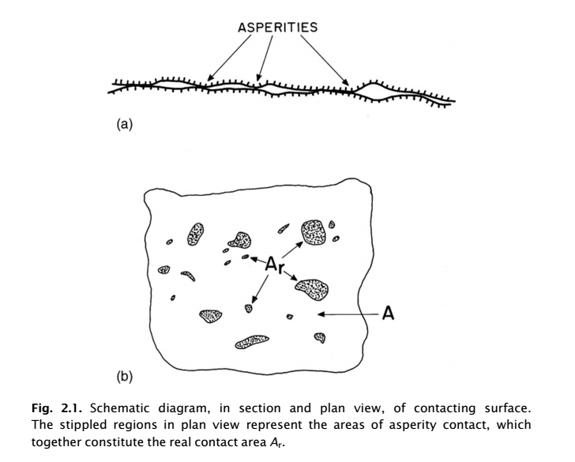

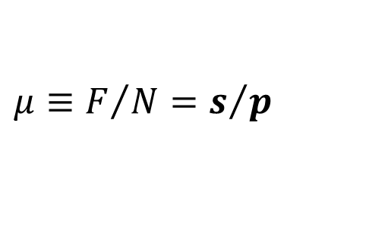


2.1 Theoretical Concepts: Adhesion theory
Topography
$$A_{r}≪A$$
$$N=pA_{r}$$
(Junctions form plastically)
$$F=sA_{r}$$
$$μ≡F/N=s/p$$
s, p dependent on material, temp. sliding velocity
s proportional to p via μ

Slide 4
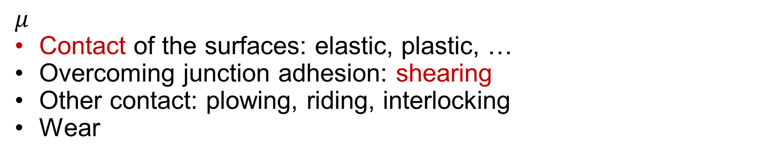
2.1 cont’d
$$μ$$
Contact of the surfaces: elastic, plastic, …
Overcoming junction adhesion: shearing
Other contact: plowing, riding, interlocking
Wear

Slide 5
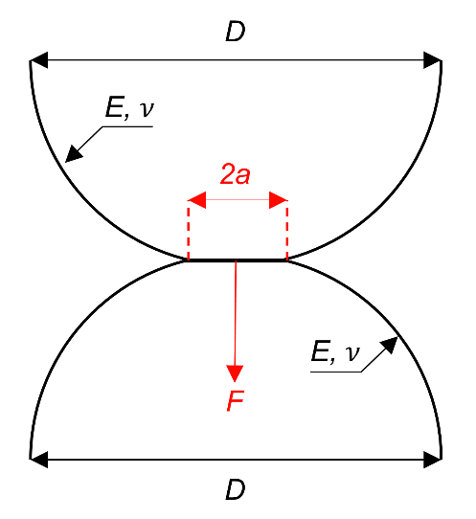
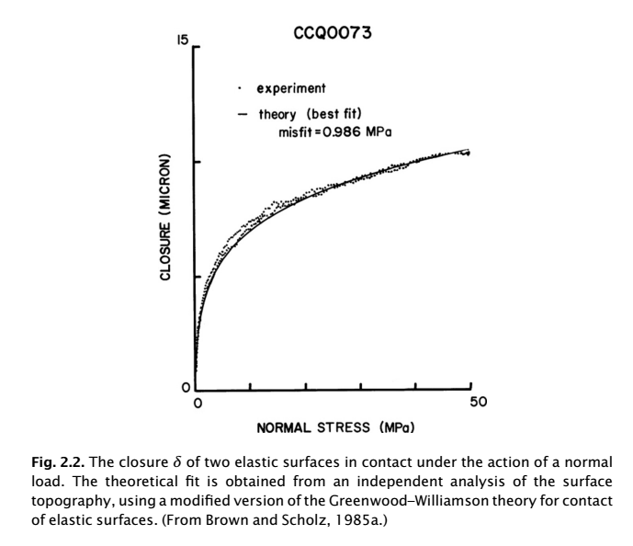




2.1 cont’d: Elastic theory
Elastic behavior in harder materials (silicates)
Greenwood & Williamson (1966): Rough surface with flat surface
Permanent closure due to brittle fracture or plastic low of asperity tips
$$δ=B+Dlogσ_{n}$$
$$δ_{p}=δ_{p}(p, ρ, E^{′},k_{3})$$
Hertzian contact between two spheres
$$μ=sk_{1}N^{{−1}/3}$$
$$A_{r}=k_{1}N^{2/3}$$

Slide 6
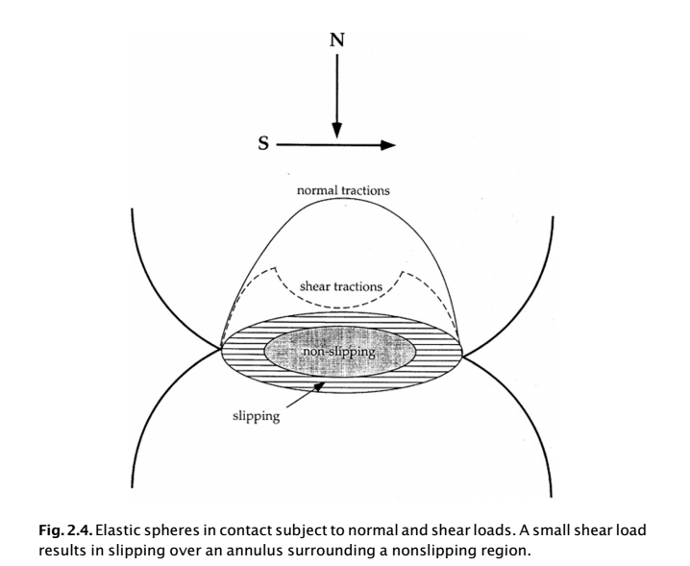
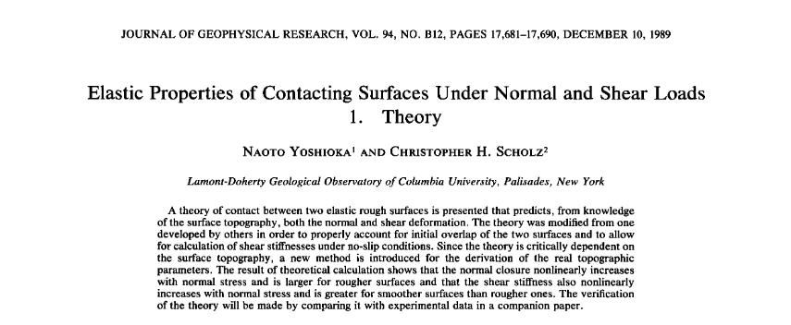
2.1 cont’d: Elastic contact: normal + shear
Propagation of slip over annulus

Slide 7
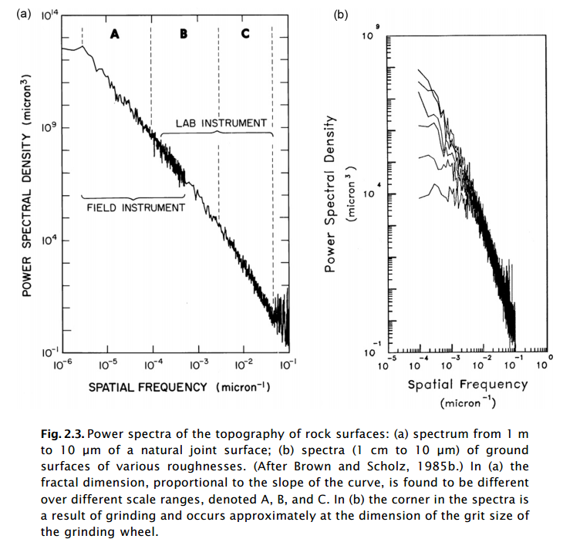
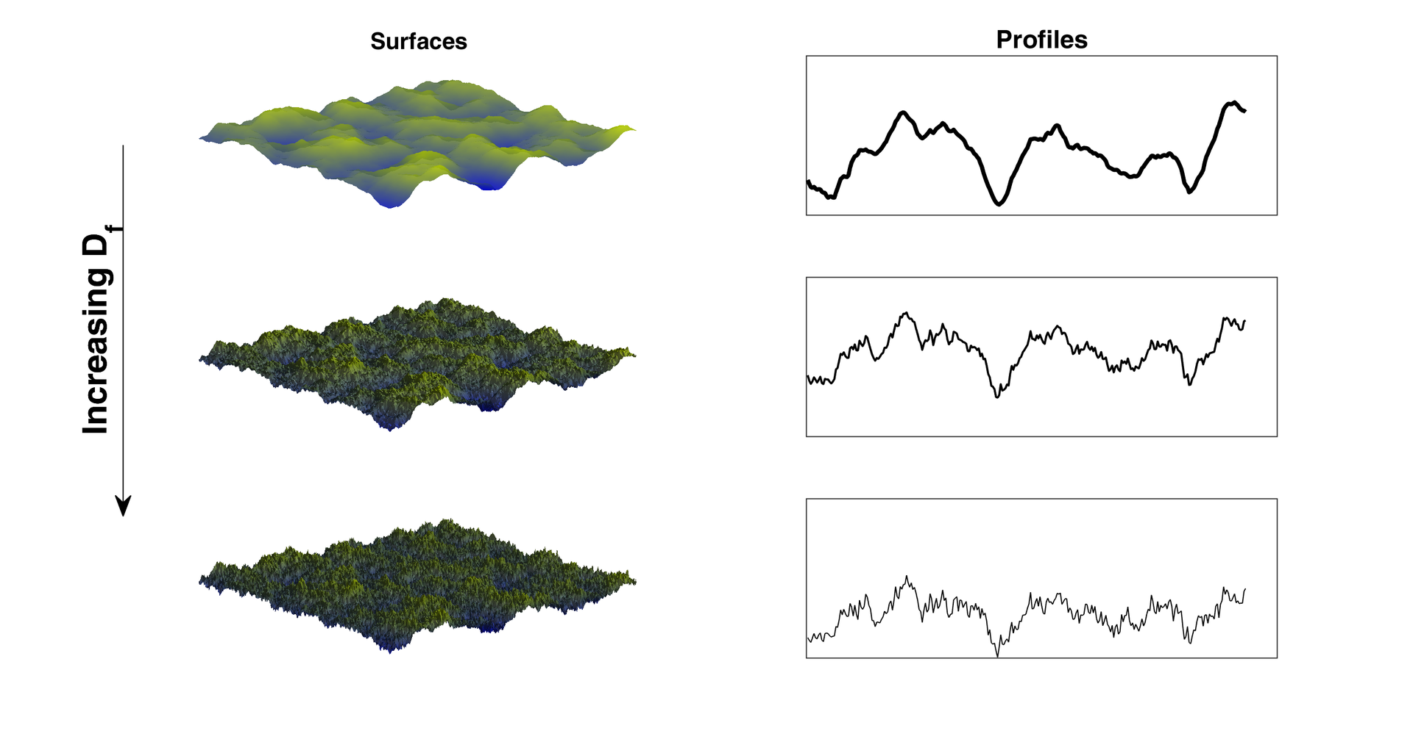


2.1 cont’d: Rough surfaces
$$ω$$
$D=D\left(λ\right) λ=spatial wavelength$

Slide 8
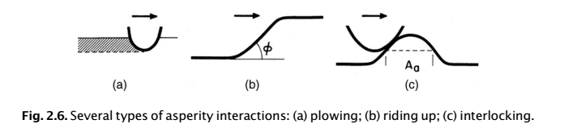
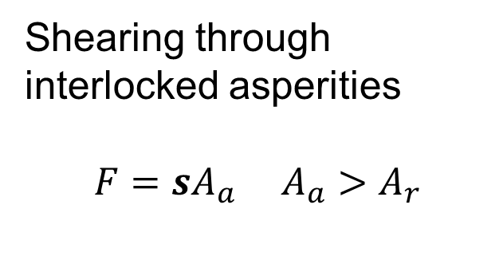
2.1 cont’d: Frictional interactions
Shallow topography (long λ)
“joint dilatancy” in normal direction
Shearing through interlocked asperities
$$F=sA_{a} A_{a}>A_{r}$$
Hard-soft contact
Gouging of softer material

Slide 9
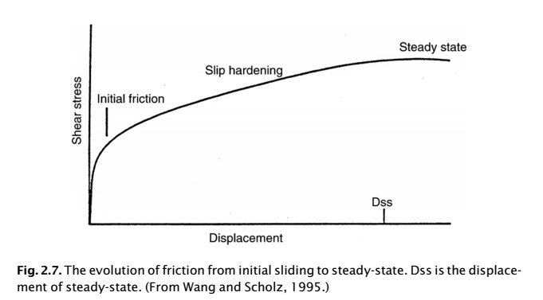
2.1 cont’d: Frictional evolution
Full sliding: increasingly interlocking surfaces from wear (increase in real area) = hardening
Complex competition (at different scales) between different frictional mechanisms
Stiffness of material, roughness of surface and asperity geometry
Normally contacting “low friction” asperities

Slide 10
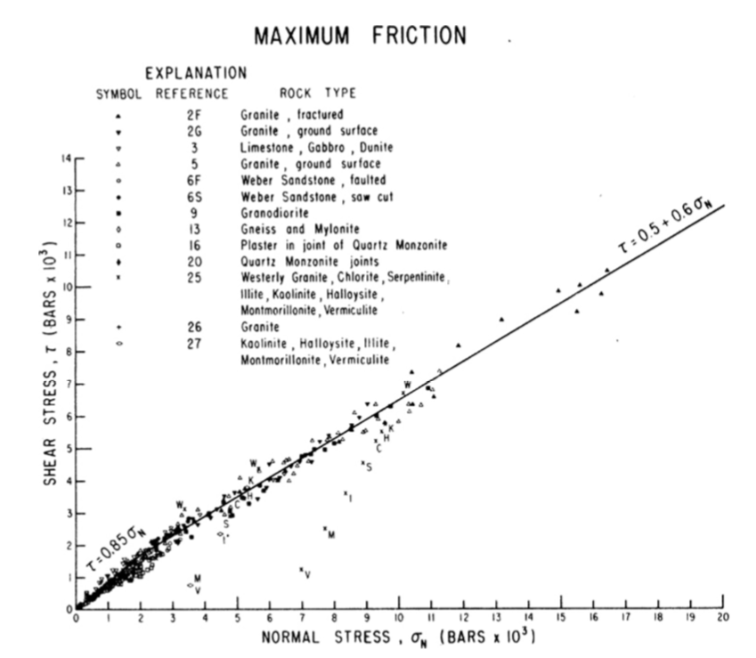
2.2 Experimental Observations
Byerlee’s law
Lamellar minerals
  Constituents of fault gouge
colinsdictionary.com
Byerlee, 1978
Notes:
Byerlee’s for bulk structure and purely empirical-Law (it’s inversed in the book the 0.85 sigma_n should be for values below 200 MPA !!)
Fittet line from experimental results.
Independent of lithology for bulk structure rocks and minerals
Holdes for wide range of harness and ductility, first order independent of sliding velocity and roughness and temperatures. Expected from equation 2.3
Universal and often used to estimate rock strength.
Lamellar minerals (sheet/plate like) → Low friction. Hydtorhermal alteration of bulk structure minerals
10

Slide 11
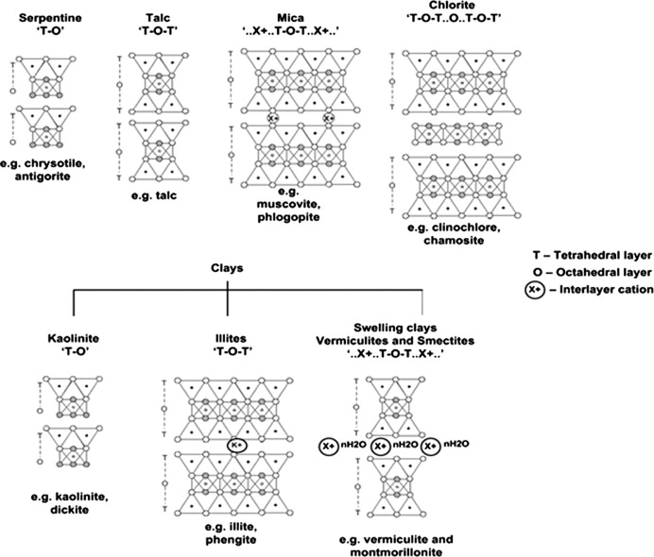
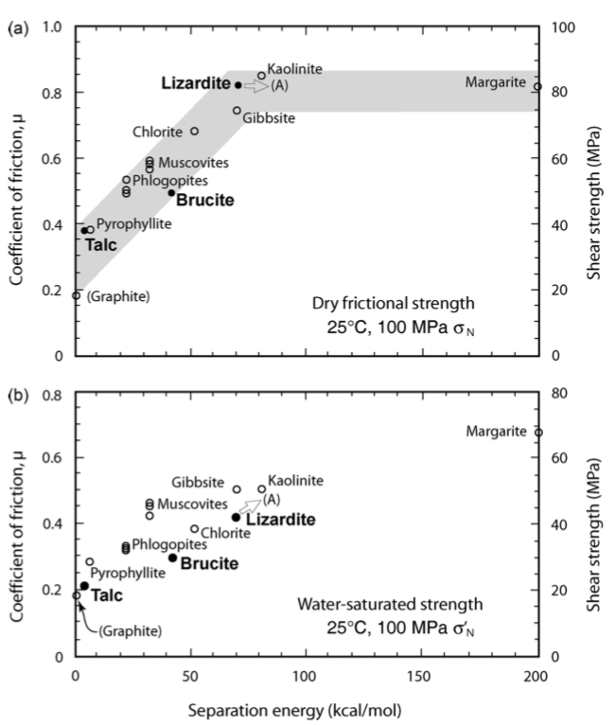
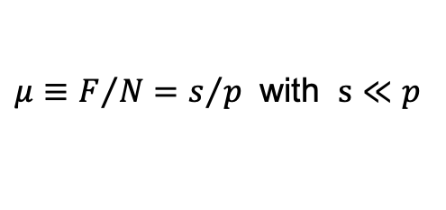
  Different planes
  Resistance dependent on separation energy
$μ≡F/N=s/{p }$ with $s≪p$
Moore and Lockner, 2007
Notes:
Structure of phyllosilicates:
Silica-tetrahedra (thetrahedral layer)
Cations in six-coordination (oxygen, hydroxyl anions -> octahedral layer
Tetrahedral strong compared to bonding to octahedral layer -> cleavage (tendency of a mineral to break along flat planar surfaces due to crystal lattice organisation) here along the interface octa-tetra
Randomly in bluk but aligne with shear plane → preferential rupture along cleavage
The more energy required to seperate the planes the higher the resistance to shearing
Water:
Most have charged surfaces → hydrophilic (adsorbe water)
Water films resisting important normal forces (shearing in this water films)

Slide 12
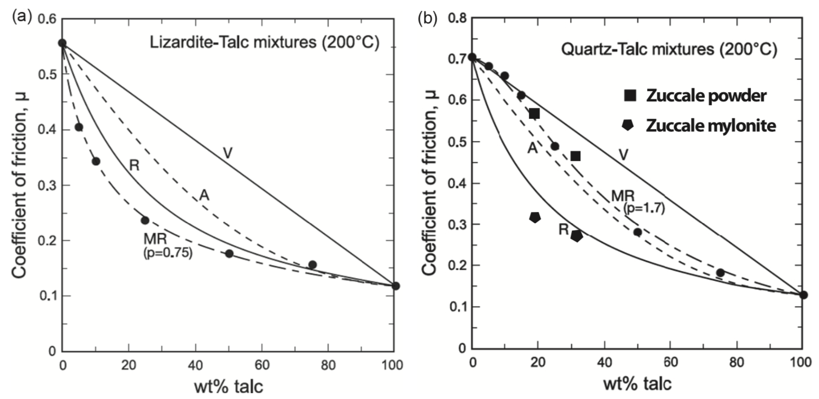

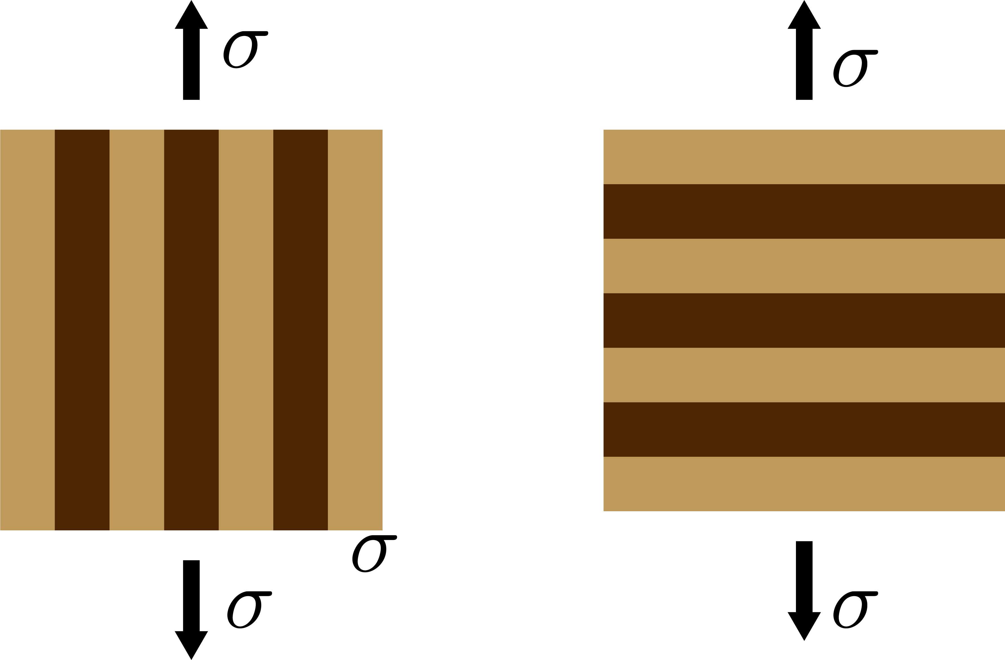









(a) mixture of two phyllosilicates
(b) mixture of a bulk-material with phyllosilicates
Modified-Reuss (Moore and Lockner 2011)
Area model
Voight model
Reuss model
Notes:
Mu’s are friction coefficients of components and x2 is the concentration of talk
Area is based on the assumption that the total contact area is eiter m1-m1, m2-m2, or m1-m2 → only contact m1-m1 with strength one. Area proportional to concentration means contact area proportional to concentration squared.
Decreasing the p from one (normal reuss) enhances the influence of the weaker material.
Zucalle faullt is a low angle normal fault that is exposed on the island of elba.
A) always with phillitic strucutre → B) only above a given content phyllitic structure.

Slide 13
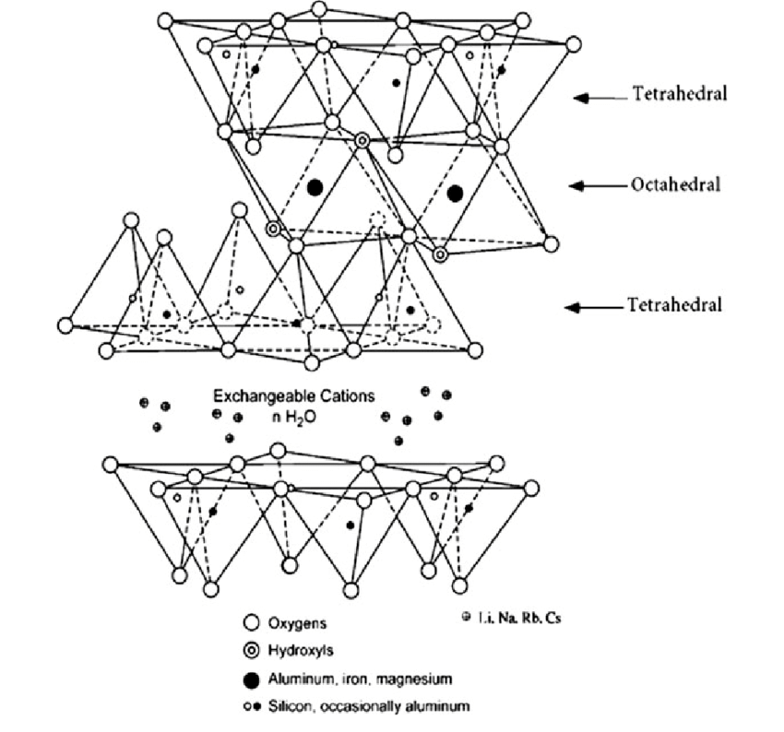


2.3 Temperature and pressure effects
 | Bulk-structure | Lamellar-structure phyllosilicates
Temperature | Insensitive | Increasing (depleting water layer)
Pressure | Insensitive | Increasing (compression of water layer increases shear resistance)
Water saturation | Insensitive (silicates) | Decreasing (water layer decreases shear resistance)
Humidity | Reduced (water layer on surface reduces adhesion)
Pore pressure | Reduced Consider an effective normal and frictional stress:
Pore pressure
$$τ=μ\left(σ_{n}−p\right)$$
$$σ_{n}A=p\left(A−A_{r}\right)+σ_{c}A_{r}$$
Asperities

Slide 14
2.4 Wear
Damage and erosion of the surfaces (Archard, 1953)
  Adhesive vs. abrasive
  Gouge zone of thickness
Experimental results
Notes:
Friction always accompanied by wear (damage and erosion)
Archard quantitative not specific about mechanism
h (unspecific hardness parameter) → replace p
Assuming circular contacts of diameter d, effective working distance de = alpha* d
Assuming a fragment hemisphere of diameter d.
Steady-state wear follows instead experimental results. (m is typically in the range 1-4 for slip rates <= 0.11m/s)
Increase of wear by power law with porosity
Adhesive: part of the asperity breaks and not the junction.
Abrasive: abrasive, one plows through the other -> often more important for rocks
Gouge: brittle fracture of asperities forming angular forms
Adhesive for ductile conditions (ductile faulting)
Velocity over 0.2m/s → Granite and diabase with exponential sigma → Frictional heating important (thermal cracking)
For carbonates Archade (up to 0.1m/s) then drop
B close to one.
Error in function 2.19 ; lowercase is uppercase K in 2.20 and 2.21
14

Slide 15
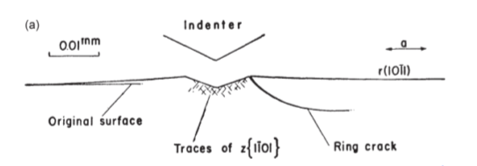
Deformation of frictional contacts by plastic flow
Wear volumetrically dominated by brittle fracture
Brace, 1963
Notes:
Detrius is angular fragments, deformation under indenter is low temp. plastic flow
Ring Crack by stress-corrosion power law of before.
15

Slide 16
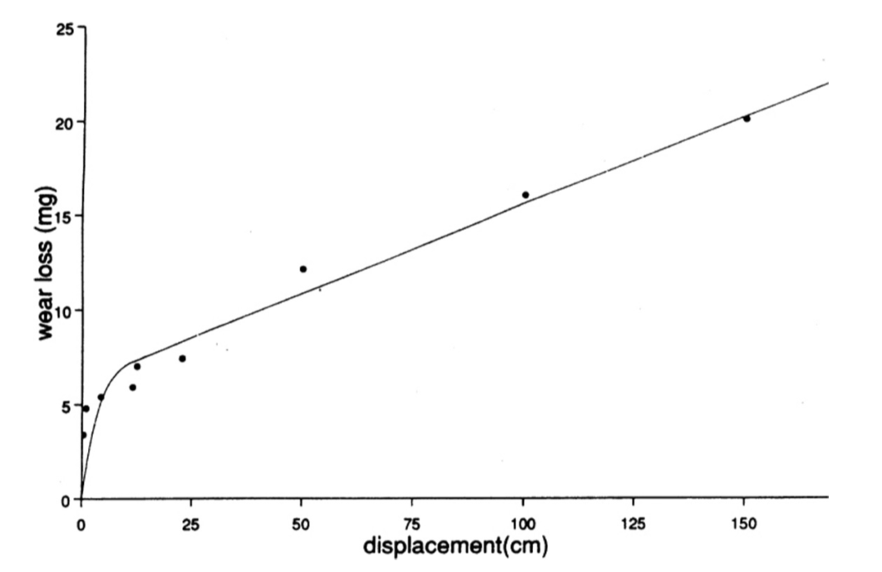
Cataclastic gouge flow (comminution and dilatancy)
Reidel shears or shear bands
Notes:
Until now normally removed.
Now no longer removed.
Three-Body-Wear (without removal gouge will seperate surfaces and shear will be granualr flow in the gouge [wear of surfaces is then reduced])
16

Slide 17
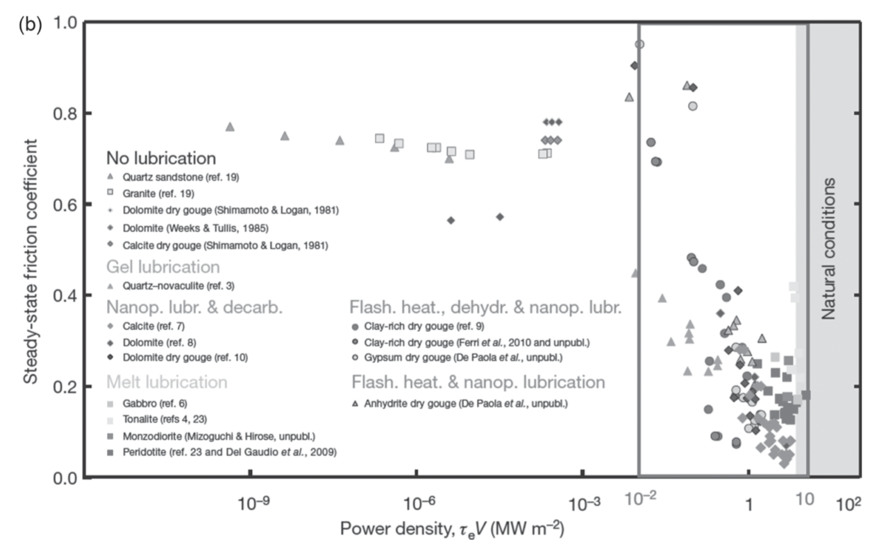
2.5 High velocities
Effects of frictional heating (typical velocity in earthquakes ~1ms⁻¹)
Di Toro et al., 2011
Notes:
Effects like thermal pressurization or melting (weakening the strength).
Gradual decrease at velocities above 10^-4
Figure demonstrates the thermal origin of this effect.
Drop over a so called thermal slip distance. Decreasing with power law in stress (however only measured in low stresses) → order of 10cm
17

Slide 18
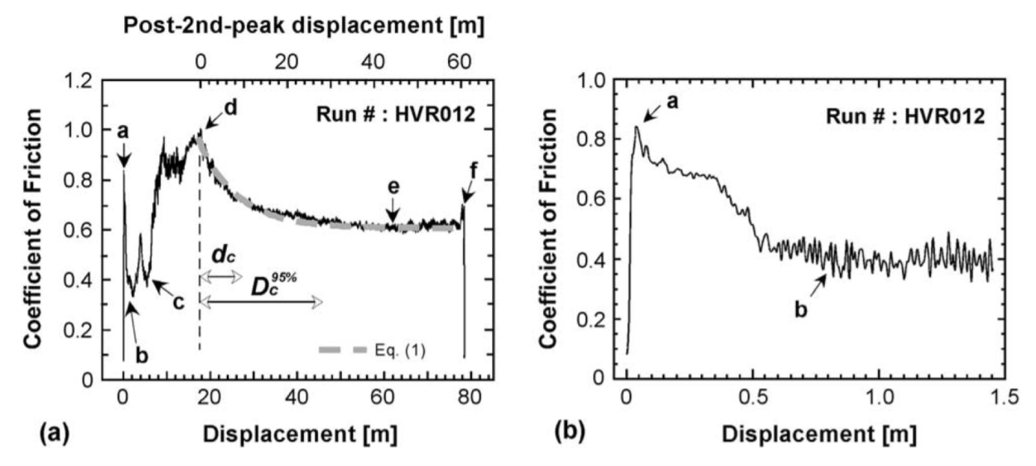
Notes:
Many possible mechanisms. Gabbro experiment schown.
A to B: flash heating (thermal slip distance!, melting or another phase transition before bulk melting.)
C to D: melt pools ( «viscous breacking» )
After D: continuous melt
Stabilisation when shear is localized in thin layer.
«Hot spots» : Heterogeneity in normal stress will preferentially heat.
All mechanisms are self limiting → tending to a steady state.
Quartz-Rich rocks: Silica gel. Strong weakening at high velocities (poorly understood). Granite intermediate (powder lubrication of gouge → contracdicted)
Carbonate rocks: CO2 decomposition. 1) No sigma n dependency (CO2 layer with high pressure) 2) strengthening (CO2 Release) 3) plateau(sigma n dependent) 4) second weakening due to nanoparticles?
Saturated Clay: weak further weakened → dilatancy, water thermal pressurization (trapped)
18

Slide 19
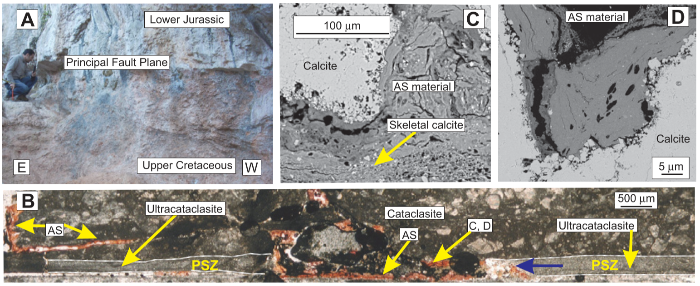
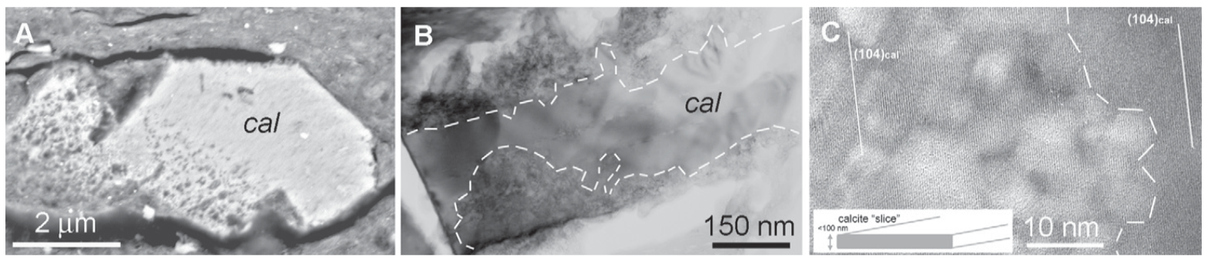
Colletini et al., 2013
Notes:
Paper of Colletini et al. 2013
Only unambiguous signs are frictional melts or pseudotachylytes
Spoleto Thrust
Lower Jurassic (carbonates)
(A) Upper cretaceous (Layered limestone with clay-rich intercalations [millimetric])
(B) White carbon cataclasite 0-20cm [hanging wall], red carbonate cataclasites (>20cm thick) clay-rich from footwall
(B) Closely packed micrometer grain sized ultracataclasite (0.1 -10 microm); patches of clay (<1mm); calcite extension veins (<1mm); re worked ultracataclasite and veins → Fluid pressure build up
(B) Amorphous silicate (AS) also parallel and perpendicular → temperature rise induced by earthquake slip from phyllosilicates from footwall cataclasite
AS→calcite decarbonation and illite-smectite (clay) dehydration
Figure 2 lower part:
(A) Calcite crystal fading grain boundaries and high concentration of bubbles (pores)
(B) unreacted inner, and reacted outer part. Late recrystallization or cataclastic fragmentation at boundaries.
19

Slide 20
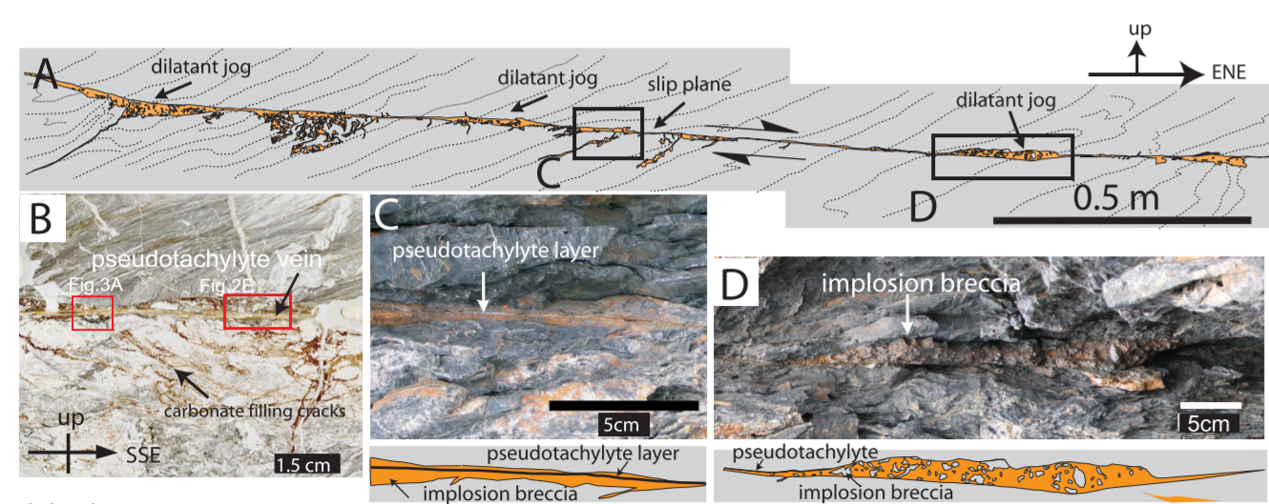
Okamoto et al., 2006
Shimanto accretionary complex, Japan
Breccio from host rock implosion and pseudotachylyte from frictional melting.
Notes:
Okamoto et al. 2006
Fossilized out-of-sequence thrust in the Shimanto accretionary complex Japan.
Implosion of host rock due to interstitial fluid pressure increase and asymmetric fracturing; Carbonate Precipitation; Frictional Melting
Probably one event
Coexistense of implosion breccia and pseudotachylyte probably characteristig from hydrous seismogenic faults
Conflict between thermal pressurization and frictional melting.
The pseudotachylyte is inside precipitated carbonate matrix
Hanging wall: plastically deformed shales and sandstones.
Foot wall: shale matrix with sandstone and basaltic blocks (brittaly deformed)
Cataclastic core of about 20cm with brittle damage one tens of meters in the hanging-wall and 100meters in the foot wall.(containing subsidiary shears)
Picture is a subsidiary fault (not the cataclastic main part) narrow planar slip sections combined with dilatant jogs.
Mainly surrounded by host rock (some times small cataclastic zones) 8see figure D
Breccia inside matrix of precipitated carbonates (not found in host rock)
Crystal size smaller than a few tens of micrometers

Slide 21
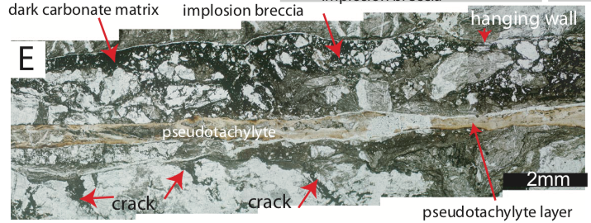
Okamoto et al., 2006
Notes:
Mm thick fault core
Pseudotachylyte is palygroskite (no idea what this is) and amorphous material. Where palygorskite is never found in the host rocks.
Fluid implosion first occurered then frictional melting
As pseudotachylytes are simply separated in upper and lower domains → Gravity
Dilation jogs indicate also hydro fracturing not only simply mode 3
Fluid pressure rise due to small slip and impermeable host-rock. Implosion (extensional fracturing) dropping fluid pressure recovering shear strength → shear heating allowing for melting.

Slide 22
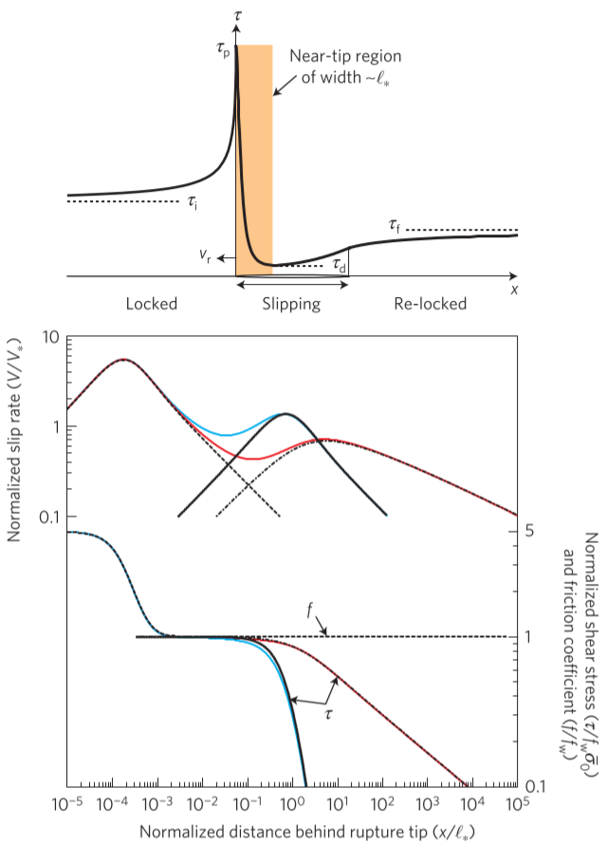
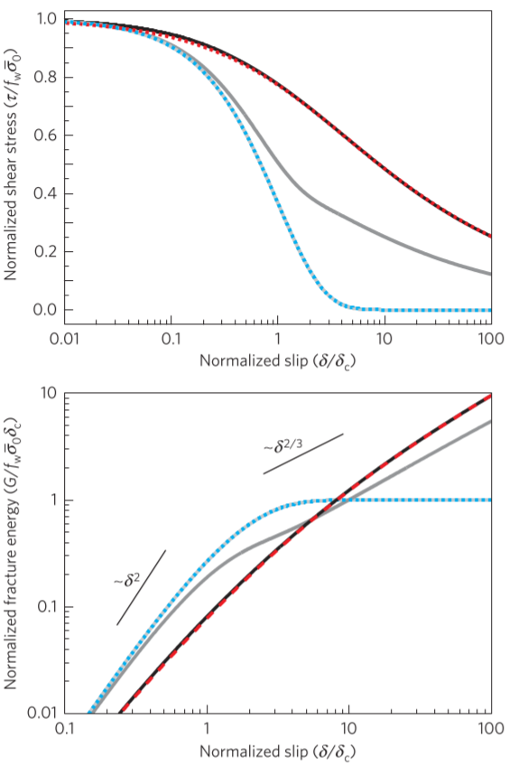
Fracture energy scales with event size
Different mechanisms for small and large events
Undrained pressurization
Heating due to slip on a plane
Viesca and Garagash, 2015
Notes:
Figure 1 | Cascade of weakening at the tip of a dynamic shear rupture.
a, Schematic of a slip-pulse mode of rupture: re-locking follows fault rupture during rupture propagation. b, Evolution of the fault slip rate and strength at the rupture tip (for example, shaded region in a), with the parameter set in Supplementary Table 2. Initial weakening occurs through reduction of the friction coefficient by flash weakening. Subsequently, thermal pressurization of fault gouge pore fluid reduces the effective normal stress. Two endmembers are considered: negligible (cyan lines) and non-negligible (red lines) flux of heat and pore fluid. Broken lines follow the evolution under flash weakening of friction without thermal pressurization (dashed line) or thermal pressurization under a flash-weakened coefficient of friction (dotted and dash-dotted lines).
Figure 2 | Fault fracture energy and gradual fault weakening with slip.
a, Inferred dependence of fault shear strength on slip at the tip of a propagating rupture. Weakening here occurs by thermal pressurization under a flash-weakened or an otherwise (approximately) constant coefficient of friction. b, Implications of the strength–slip relation for the slip dependence of fault fracture energy. Increasing darkness of the greyscale lines corresponds to increasing efficiency of heat and pore fluid drainage. Dashed lines assume weakening under either undrained-adiabatic (cyan) or ‘drained’, slip-on-a-plane (red) conditions.
Flash heating (if active) reduces friction coefficient before substantial thermal pressurization occurs then ratio Lstar delta c is decisif. (big [above unity]: slip on a plane pressurization, small gives undrained adiabatic pressurization (more efficient) → small slip)

Slide 23
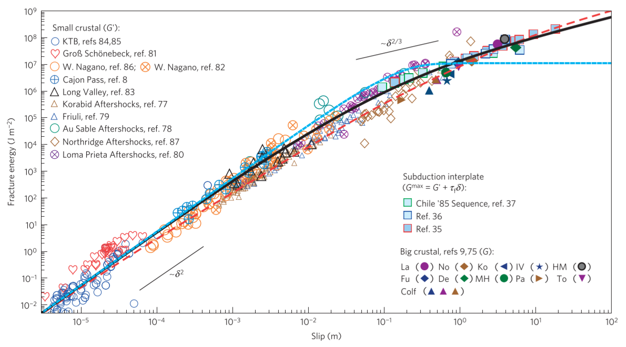
Notes:
Figure 3 | Variation of inferred event fracture energy with event slip. a, Inferred fracture energy (G) and slip for events within continental crust and along subduction interplate interfaces. b, For subduction events, comparison of fracture energy based on seismological observations alone (G′) with those incorporating pre-event shear stress estimates and assuming near-complete coseismic strength drop (Gmax). c, For large crustal events, comparison of G′ with G inferred from kinematic inversions of fault slip history. In a–c the curves are three predictions for ruptures whose fracture energy are dominated by thermal pressurization. Dashed curves represent scenarios of negligible (cyan) and significant (red) diffusion of pore fluid and heat. The black curve represents an intermediate scenario.
Slip scale L is small so flash heating has negligible contribution
Predictions use a single value of delta c (0.1m) and fault strength f sigma bar 0 = 110 MPA
Thermal pressuriation may be the dominant contributor to fault fracture energy

Slide 24
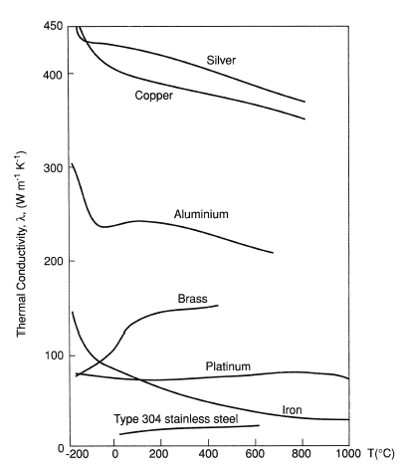
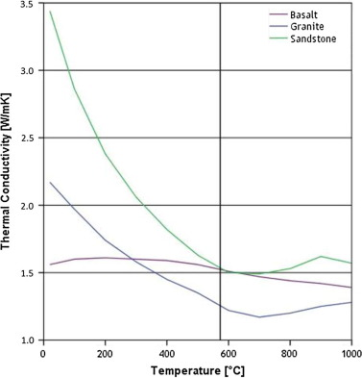
Hartlieb et al., 2015

