Slide 1
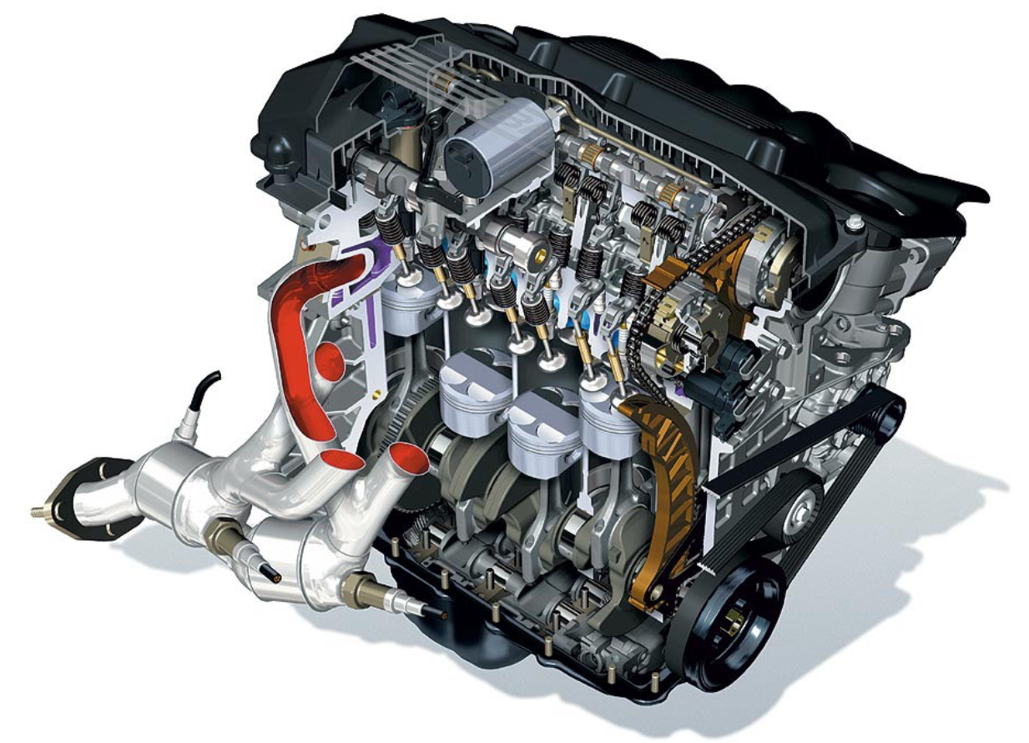
Engines and Fuel cells
Exercise ENG1

Slide 2
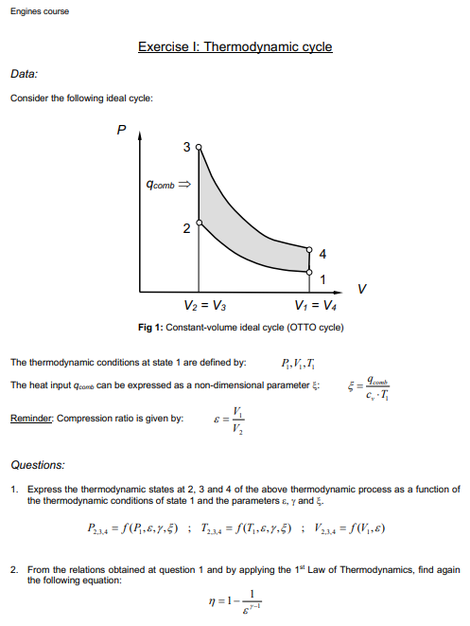
Exercise ENG1: Thermodynamic cycle
Reference:
1. Formula Memento, Page 3
2. Lecture 2, page 4-10
Process 1-2: Isentropic compression (no heat exchange, just compression of the working fluid)
Process 2-3: Isochoric heat addition (where combustion occurs, adding heat to the system)
Process 3-4: Isentropic expansion (the system expands, performing work)
Process 4-1: Isochoric heat rejection (cooling the system down to complete the cycle).

Slide 3
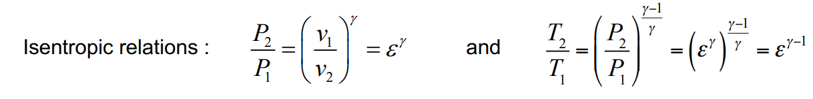
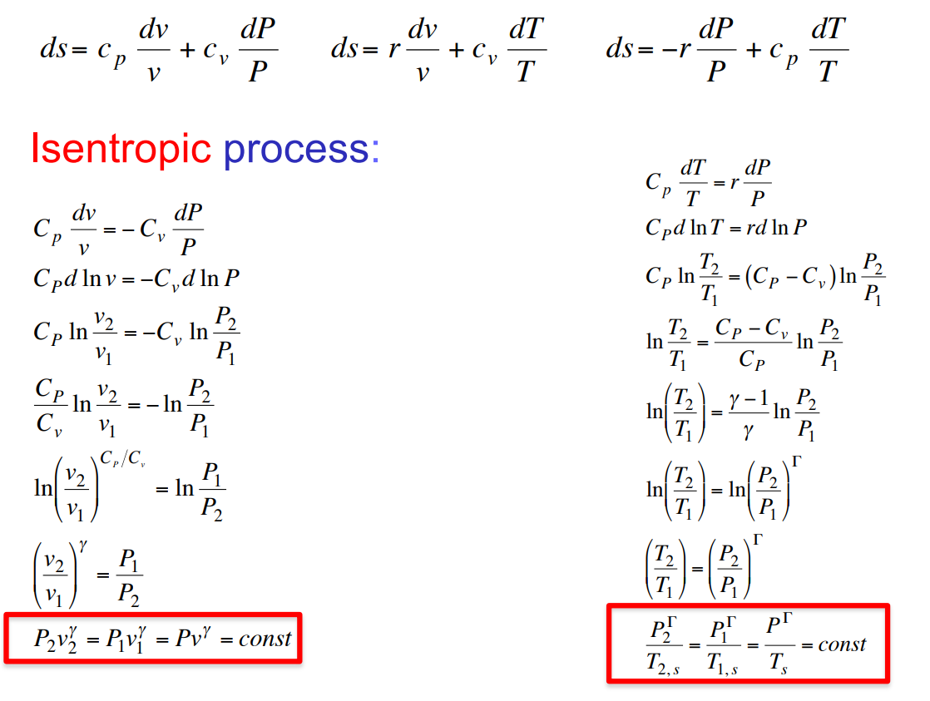
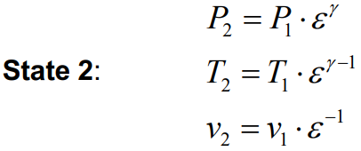
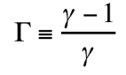
Exercise ENG1: Thermodynamic cycle
Reference:
1. Formula Memento, Page 3
2. Lecture 2, page 4-10
State 2: isentropic compression from state 1

Slide 4
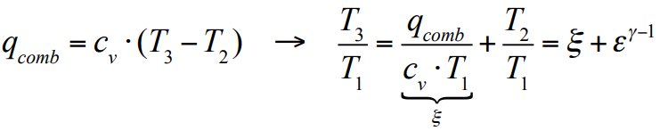

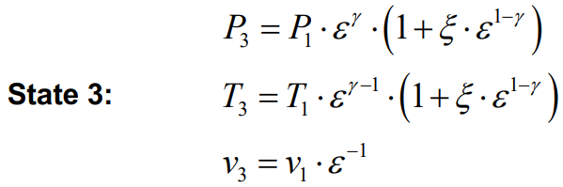




Exercise ENG1: Thermodynamic cycle
Reference:
1. Formula Memento, Page 3
2. Lecture 2, page 4-10
State 3: Isochoric fuel-combustion heat injection from state 2
$${\text{T}}_{\text{3}}\text{=}\frac{{\text{q}}_{\text{comb}}}{{\text{c}}_{\text{v}}}\text{+}{\text{T}}_{\text{2}}$$
$$\frac{{\text{P}}_{\text{3}}}{{\text{P}}_{\text{2}}}\text{=}\frac{{\text{T}}_{\text{3}}}{{\text{T}}_{\text{2}}}$$
$$\frac{{\text{P}}_{\text{3}}}{{\text{ε}}^{\text{γ}}⋅{\text{P}}_{\text{1}}}\text{=}\frac{{\text{T}}_{\text{3}}}{{\text{ε}}^{\text{γ}\text{−1}}⋅{\text{T}}_{\text{1}}}$$
$${\text{P}}_{\text{3}}\text{=}\frac{{\text{T}}_{\text{3}}}{{\text{T}}_{\text{1}}}\text{⋅}\frac{{\text{ε}}^{\text{γ}}}{{\text{ε}}^{\text{γ}\text{−1}}}$$

Slide 5
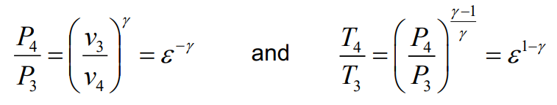
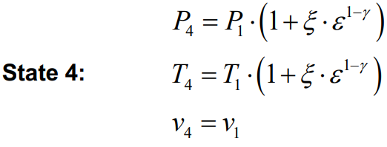
Exercise ENG1: Thermodynamic cycle
Reference:
1. Formula Memento, Page 3
2. Lecture 2, page 4-10
State 4: isentropic expansion from state 3

Slide 6
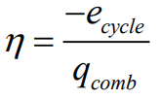
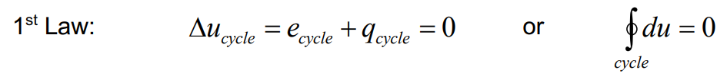
Exercise ENG1: Thermodynamic cycle
Reference:
1. Formula Memento, Page 3
2. Lecture 2, page 4-10
Mechanical power generated by the engine
Energy Can Neither Be Created Nor Destroyed, but always balanced

Slide 7
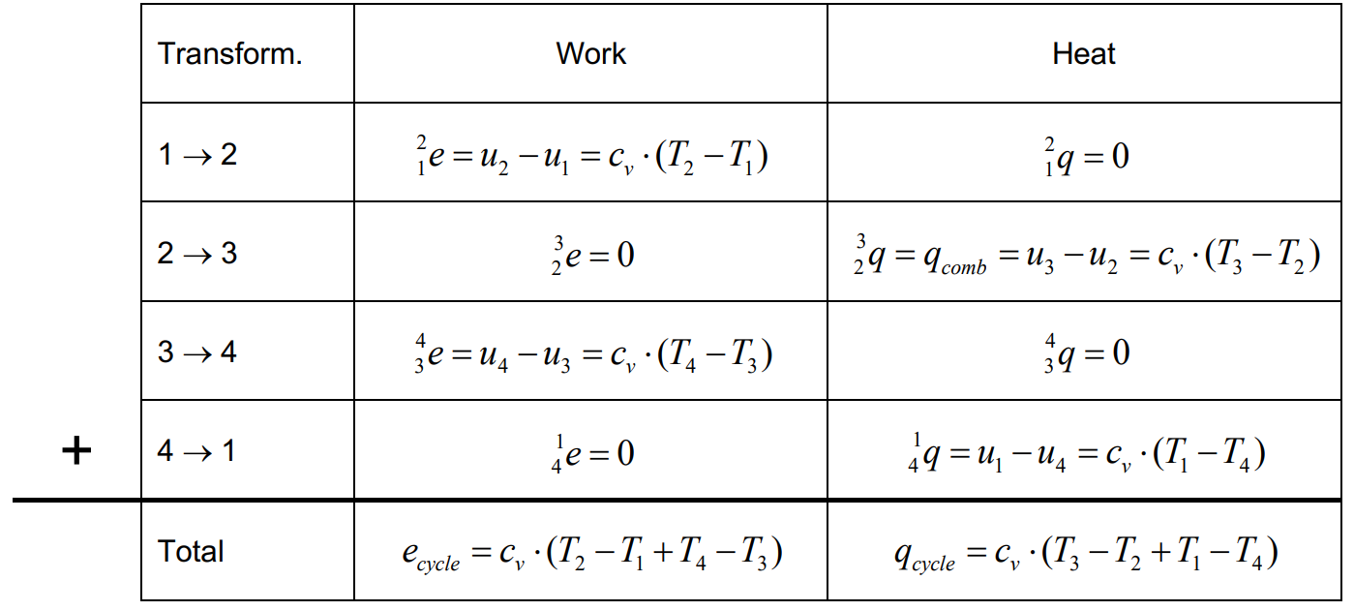
Exercise ENG1: Thermodynamic cycle
Reference:
1. Formula Memento, Page 3
2. Lecture 2, page 4-10
Energy balance considering heat and work

Slide 8
Exercise ENG1: Thermodynamic cycle
Reference:
1. Formula Memento, Page 3
2. Lecture 2, page 4-10
Energy balance considering heat and work

Slide 9
Exercise ENG1: Thermodynamic cycle
Reference:
1. Formula Memento, Page 3
2. Lecture 2, page 4-10
Energy balance considering heat and work

Slide 10
Exercise ENG1: Thermodynamic cycle
Reference:
1. Formula Memento, Page 3
2. Lecture 2, page 4-10
Energy balance considering heat and work

Slide 11
Exercise ENG1: Thermodynamic cycle
Reference:
1. Formula Memento, Page 3
2. Lecture 2, page 4-10
Energy balance considering heat and work

Slide 12
Exercise ENG1: Thermodynamic cycle
Reference:
1. Formula Memento, Page 3
2. Lecture 2, page 4-10
Energy balance considering heat and work

Slide 13
Exercise ENG1: Thermodynamic cycle
Reference:
1. Formula Memento, Page 3
2. Lecture 2, page 4-10

Slide 14
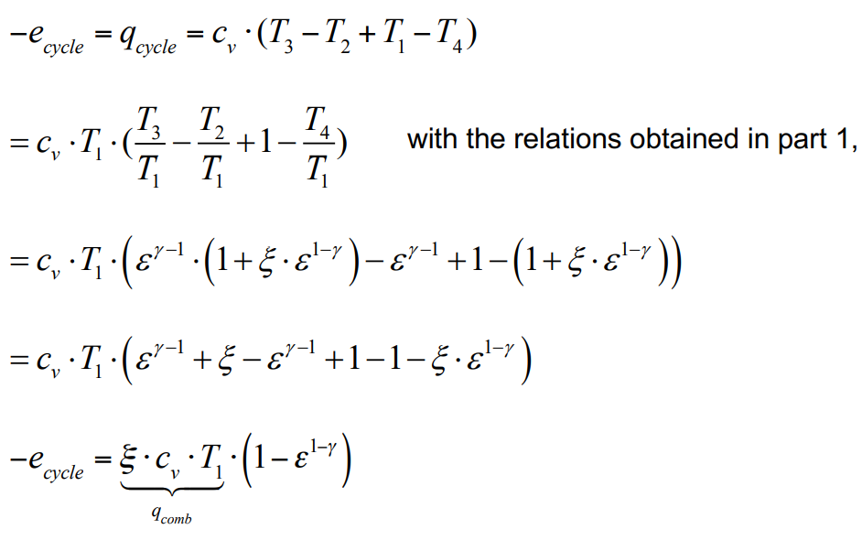
Exercise ENG1: Thermodynamic cycle
Reference:
1. Formula Memento, Page 3
2. Lecture 2, page 4-10

Slide 15
Exercise ENG1: Thermodynamic cycle
Reference:
1. Formula Memento, Page 3
2. Lecture 2, page 4-10

Slide 16
Exercise ENG1: Thermodynamic cycle
Reference:
1. Formula Memento, Page 3
2. Lecture 2, page 4-10

Slide 17
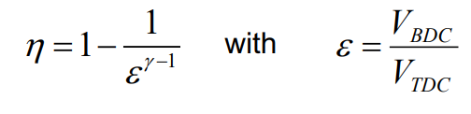
Exercise ENG1: Thermodynamic cycle
Reference:
1. Formula Memento, Page 3
2. Lecture 2, page 4-10

Slide 18
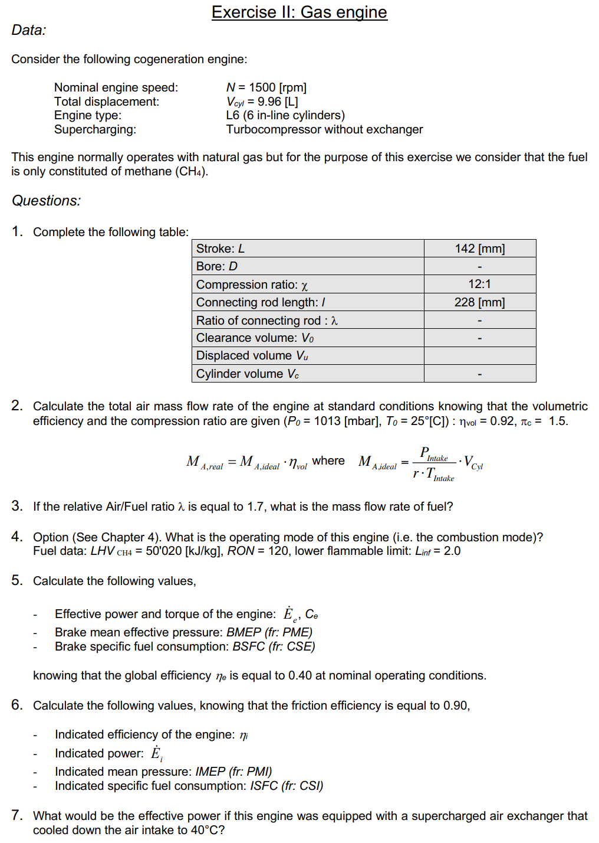
Exercise ENG2: Gas engine
Notes:
Engine geometry: The physical dimensions of the engine, including stroke, bore, and connecting rod length, affect the displacement volume and clearance volume.
• Air-fuel ratio and fuel consumption: Calculating the flow rates of air and fuel is essential for understanding engine performance and emissions.
• Volumetric efficiency: A key parameter affecting how much air can be inducted into the engine, influencing power output.
• Engine efficiency and power: Understanding the relationship between the brake mean effective pressure, indicated pressure, and overall efficiency helps in calculating engine performance metrics such as BSFC and ISFC.
• Thermal management: The influence of intake temperature on engine efficiency, especially with the use of a supercharger, is important in optimizing engine performance.

