Slide 1
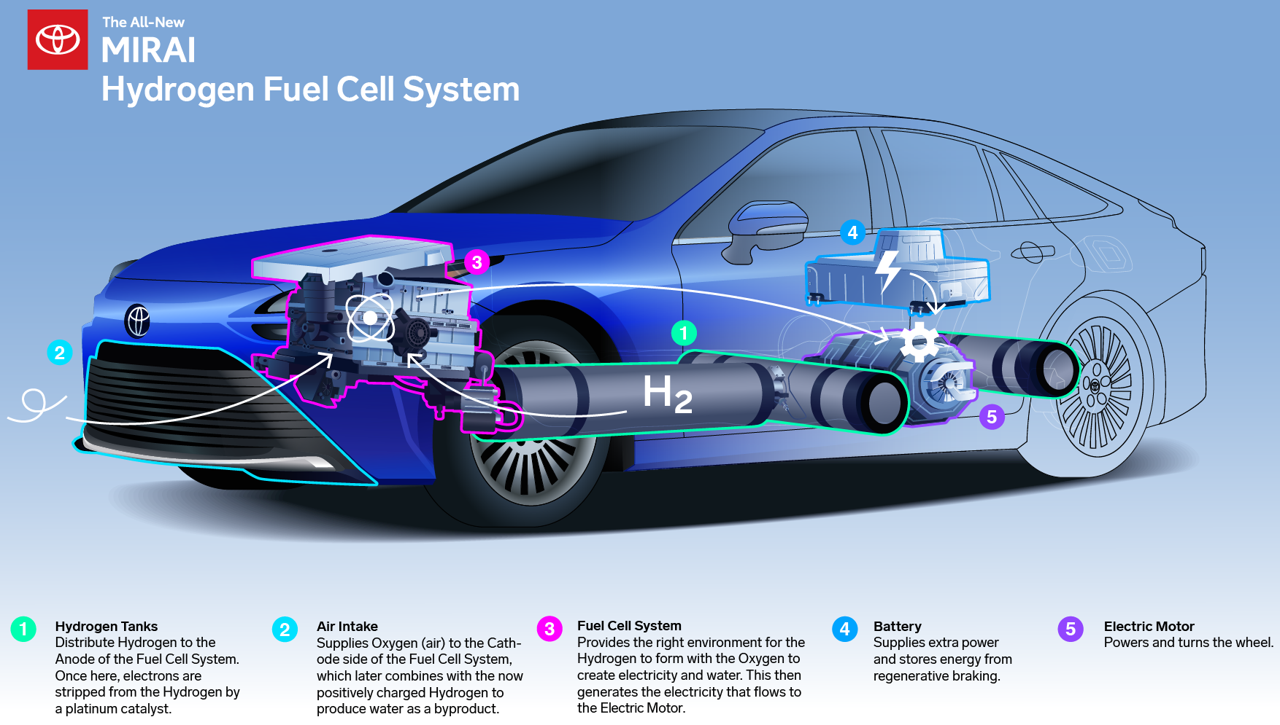
Engines and Fuel cells
Exercise FC1

Slide 2
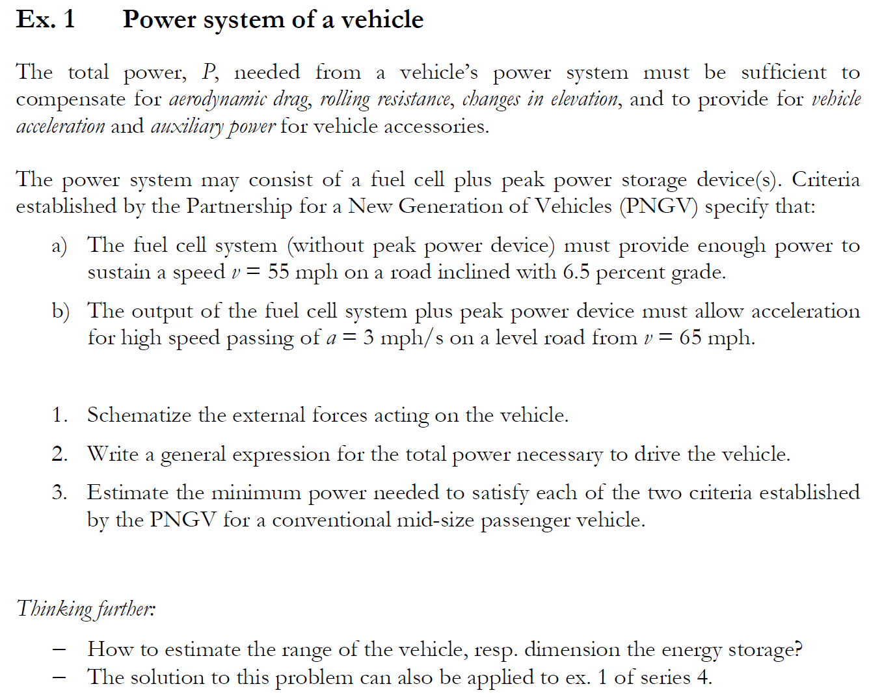
Exercise FC1: Power System of a vehicle

Slide 3
Exercise FC1: Power System of a vehicle

Slide 4
Exercise FC1: Power System of a vehicle

Slide 5
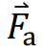











Exercise FC1: Power System of a vehicle
Considering the PNGV parameters, let the grade be defined through $x$ and $y$
Grade =$\frac{y}{x}$
$y$ is increase in elevation with distance $x$
$$y$$
α
The weight of the vehicle =
  The component of the weight acts on the road, while a normal reaction is also established.
  is the force due to changes in elevation
$$x$$
Force is exerted on the vehicle/wheel to move uphill
The vehicle has to overcome rolling resistance and aerodynamic drag
The net external force would then be proportional to the acceleration

Slide 6
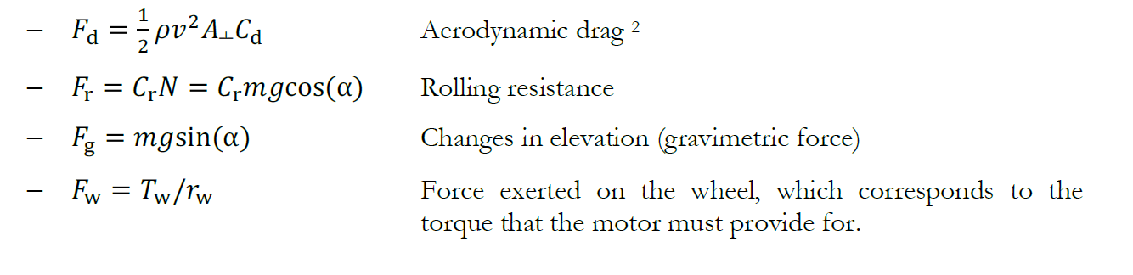
Exercise FC1: Power System of a vehicle
Net velocity
Cross sectional area
Air Density
Drag Coeff.
Rolling Friction Coeff.
Wheel Torque
Wheel radius
Remarks
It is considered all forces apply to an equivalent single wheel, which is the sum of all four
Dynamic pressure of air times a surface, which is expressed as a reference area 𝐴┴ times a coefficient 𝐶d

Slide 7
Exercise FC1: Power System of a vehicle
Net velocity
Cross sectional area
Air Density
Drag Coeff.
Rolling Friction Coeff.
Wheel Torque
Wheel radius
Remarks
It is considered all forces apply to an equivalent single wheel, which is the sum of all four
Dynamic pressure of air times a surface, which is expressed as a reference area 𝐴┴ times a coefficient 𝐶d

Slide 8
Exercise FC1: Power System of a vehicle
Net velocity
Cross sectional area
Air Density
Drag Coeff.
Rolling Friction Coeff.
Wheel Torque
Wheel radius
Remarks
It is considered all forces apply to an equivalent single wheel, which is the sum of all four
Dynamic pressure of air times a surface, which is expressed as a reference area 𝐴┴ times a coefficient 𝐶d

Slide 9
Exercise FC1: Power System of a vehicle
Questions?

Slide 10
Exercise FC1: Power System of a vehicle

Slide 11
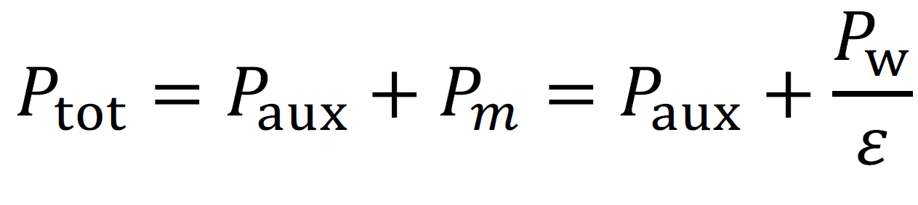
Exercise FC1: Power System of a vehicle

Slide 12
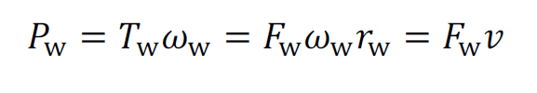
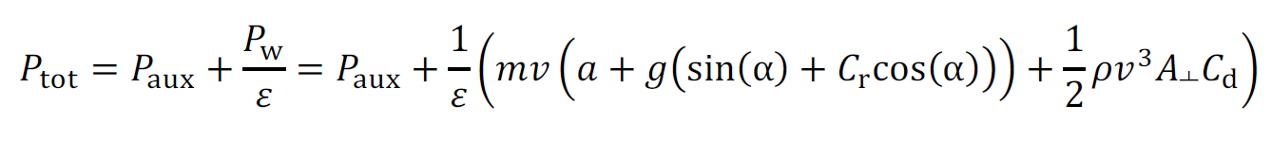

Exercise FC1: Power System of a vehicle
Auxiliary
Motor
Efficiency:
Motor to wheel
Power is energy (work) per unit time;
Work is Force (𝐹) * Displacement (𝑙) (assume constant 𝐹 aligned with 𝑙 ) => Power = $\text{F}⋅ \frac{l}{t}=\text{F}⋅v$
Also,
Then,

Slide 13
Exercise FC1: Power System of a vehicle
Auxiliary
Motor
Efficiency:
Motor to wheel
Power is energy (work) per unit time;
Work is Force (𝐹) * Displacement (𝑙) (assume constant 𝐹 aligned with 𝑙 ) => Power = $\text{F}⋅ \frac{l}{t}=\text{F}⋅v$
Also,
Then,

Slide 14
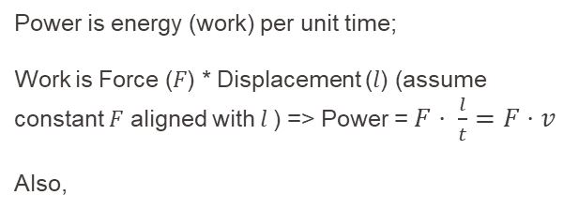
Exercise FC1: Power System of a vehicle
Auxiliary
Motor
Efficiency:
Motor to wheel
Power is energy (work) per unit time;
Work is Force (𝐹) * Displacement (𝑙) (assume constant 𝐹 aligned with 𝑙 ) => Power = $\text{F}⋅ \frac{l}{t}=\text{F}⋅v$
Also,
Then,

Slide 15
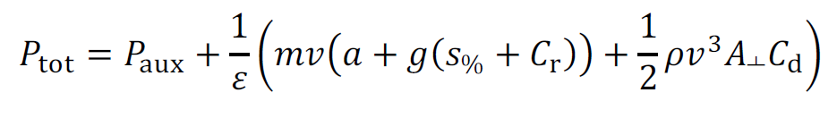
Exercise FC1: Power System of a vehicle
Rigorously, α = atan (slope in %)
but for small angles cos(α) ≃ 1 & sin(α) ≃ α (radians)
=> S% ≈ sin(α).
Therefore, good estimate is

Slide 16
Exercise FC1: Power System of a vehicle
Rigorously, α = atan (slope in %)
but for small angles cos(α) ≃ 1 & sin(α) ≃ α (radians)
=> S% ≈ sin(α).
Therefore, good estimate is

Slide 17
Exercise FC1: Power System of a vehicle
Rigorously, α = atan (slope in %)
but for small angles cos(α) ≃ 1 & sin(α) ≃ α (radians)
=> S% ≈ sin(α).
Therefore, good estimate is

Slide 18
Exercise FC1: Power System of a vehicle
Rigorously, α = atan (slope in %)
but for small angles cos(α) ≃ 1 & sin(α) ≃ α (radians)
=> S% ≈ sin(α).
Therefore, good estimate is

Slide 19
Exercise FC1: Power System of a vehicle
Questions?

Slide 20
Exercise FC1: Power System of a vehicle

Slide 21
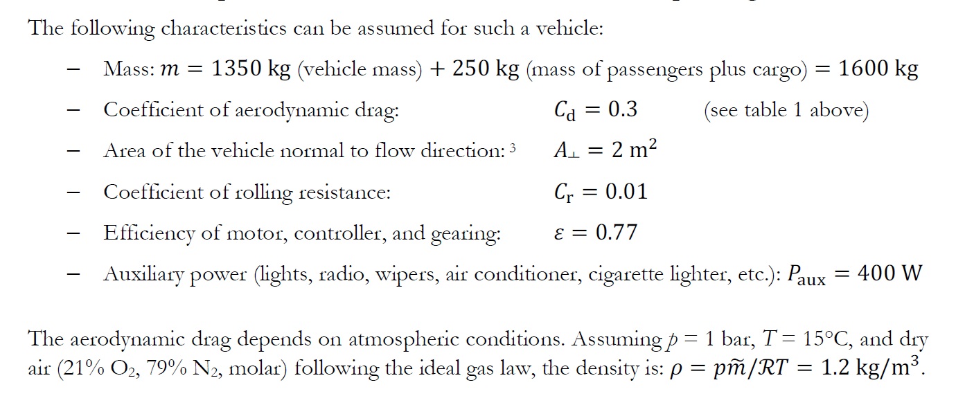
Exercise FC1: Power System of a vehicle
Given
Assumption

Slide 22
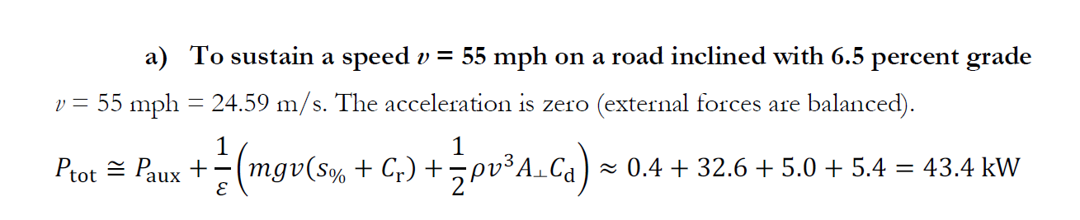
Exercise FC1: Power System of a vehicle
1 mph = 1.609 km/h = 0.447 m/s
a = 0

Slide 23
Exercise FC1: Power System of a vehicle
1 mph = 1.609 km/h = 0.447 m/s
$$400+ \frac{1}{0.77} \left\{1600⋅9.81⋅24.59⋅\left(0.065+0.01 \right)+ \frac{1}{2}⋅1.2⋅{\left(24.59\right)}^{3}⋅2⋅0.3\right\}$$
W

Slide 24
Exercise FC1: Power System of a vehicle
1 mph = 1.609 km/h = 0.447 m/s
$$400+ \frac{1}{0.77} \left\{1600⋅9.81⋅24.59⋅\left(0.065+0.01 \right)+ \frac{1}{2}⋅1.2⋅{\left(24.59\right)}^{3}⋅2⋅0.3\right\}$$
W
Vehicle weight largest contributor ≈ 75% of total

Slide 25
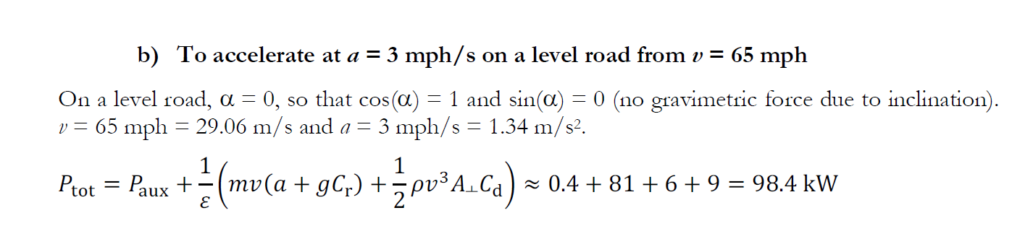
Exercise FC1: Power System of a vehicle
$$400+ \frac{1}{0.77} \left\{1600⋅29.06⋅\left(1.34+9.81⋅0.01 \right)+ \frac{1}{2}⋅1.2⋅{\left(29.06\right)}^{3}⋅2⋅0.3\right\}$$
W

Slide 26
Exercise FC1: Power System of a vehicle
$$400+ \frac{1}{0.77} \left\{1600⋅29.06⋅\left(1.34+9.81⋅0.01 \right)+ \frac{1}{2}⋅1.2⋅{\left(29.06\right)}^{3}⋅2⋅0.3\right\}$$
W

Slide 27
Exercise FC1: Power System of a vehicle
$$400+ \frac{1}{0.77} \left\{1600⋅29.06⋅\left(1.34+9.81⋅0.01 \right)+ \frac{1}{2}⋅1.2⋅{\left(29.06\right)}^{3}⋅2⋅0.3\right\}$$
W
Vehicle weight largest contributor ≈ 82% of total

Slide 28
Exercise FC1: Power System of a vehicle

Slide 29
Exercise FC1: Power System of a vehicle
energetic point of view; elevation related changes neglected; due to KE-PE recovery.
Part of acceleration can be recovered with regenerative braking
Major losses due to rolling resistance and aerodynamic resistance; as energy is dissipated to heat

Slide 30

Exercise FC1: Power System of a vehicle
Assuming
  fuel cell of average efficiency 45%
  Required range = 200km
  Average speed = 70 kmph
  Hydrogen energy content (LHV) = 120 MJ / kg

Slide 31
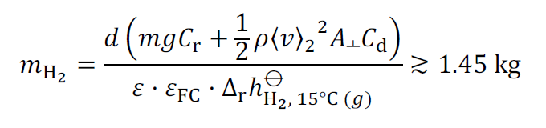

Exercise FC1: Power System of a vehicle
$$ε_{FC}=\frac{Energy required}{Energy available}=\frac{{(F}_{r}+F_{d})⋅d}{m_{H_{2}}⋅ε⋅LHV }$$

Slide 32
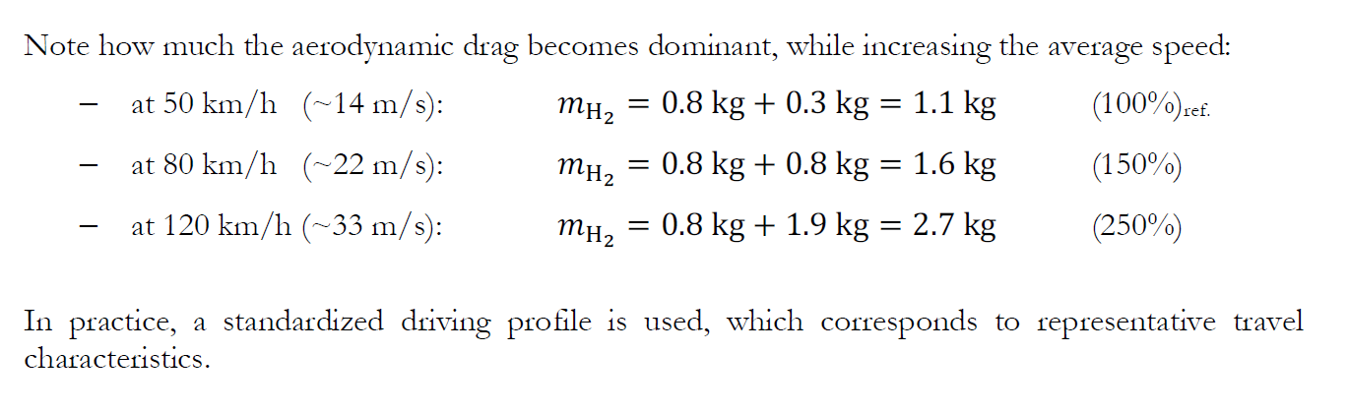
Exercise FC1: Power System of a vehicle

