Slide 1

Engines and fuel cells
Exercise 5

Slide 2
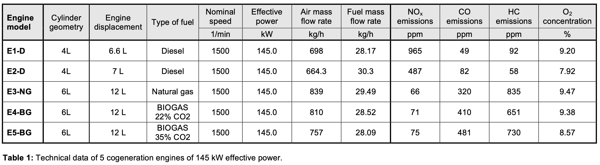
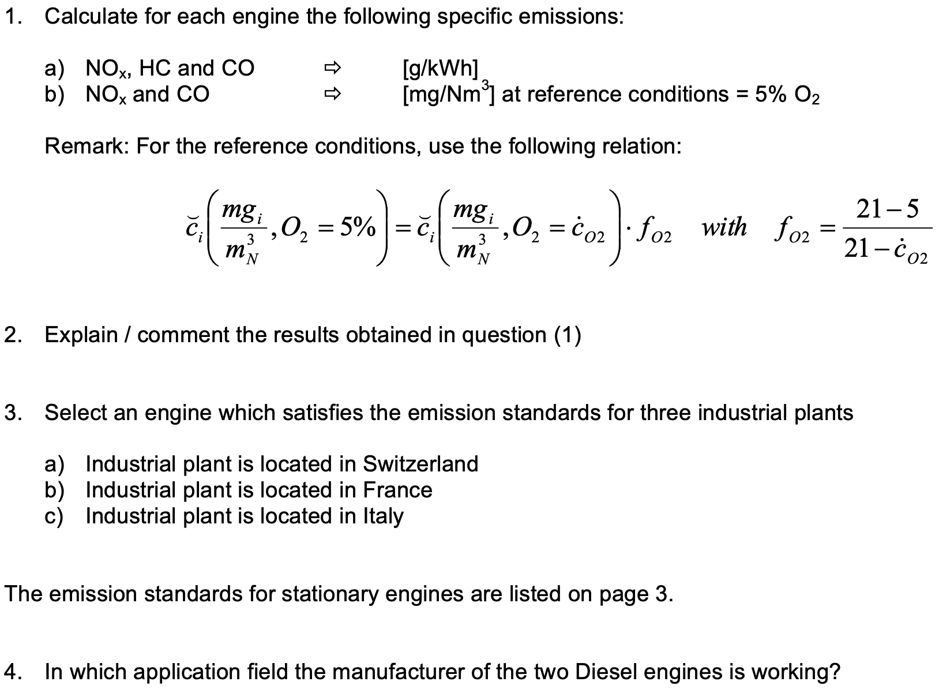
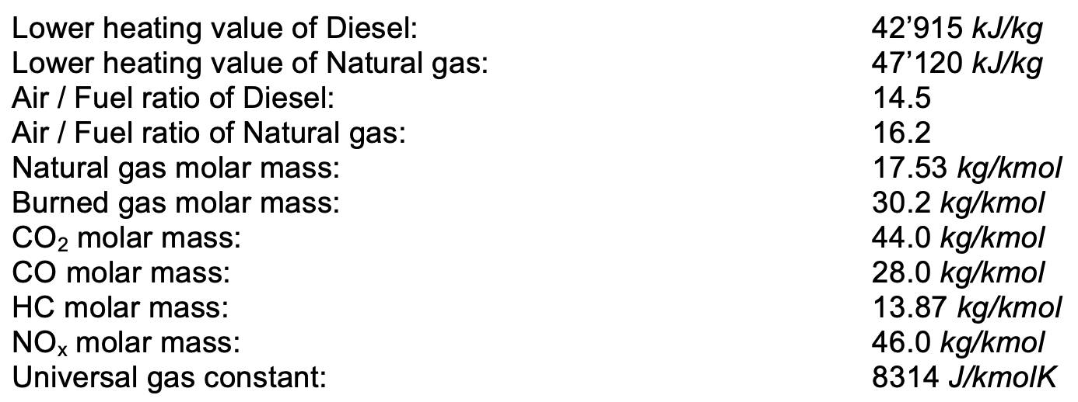
Exercise 5

Slide 3
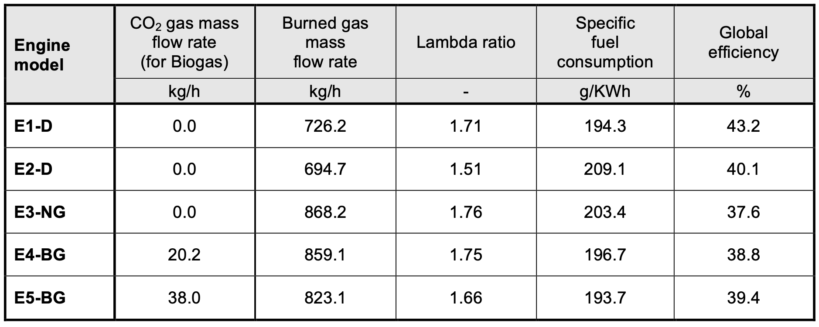
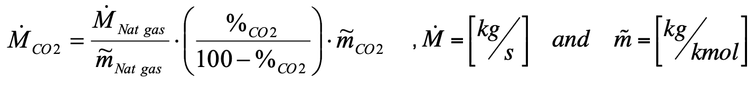
Exercise 5
Volume/mole %
Without CO₂
CO₂ mass flow rate calculation for biogas fuel inlet
x
Mole of
nature gas
Fraction of
nature gas
e.g. $\dot{M_{CO2,E4−BG}=\frac{28.52 kg/h}{17.53 kg/kmol}}×\left(\frac{22\%}{1−22\%}\right)×44 kg/kmol≈20.2 kg/h$

Slide 4
Exercise 5
Volume %
Without CO₂
Total burned gas mass flow rate (Mass balance)
e.g. $\dot{M_{Exg,E4−BG}=810 kg/h}+28.52 kg/h+20.2 kg/h≈859.1 kg/h$

Slide 5
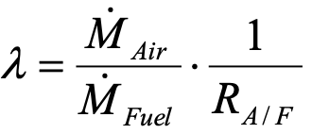

Exercise 5
Volume %
Without CO₂
Lambda ratio (excess air ratio)
e.g. $\dot{λ_{E4−BG}=}\frac{810 kg/h}{28.52 kg/h}×\frac{1}{16.2}≈1.75$

Slide 6
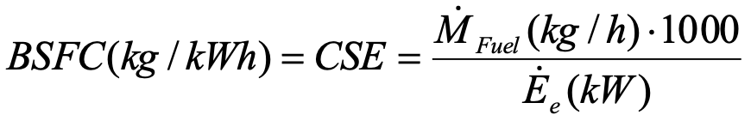

Exercise 5
Volume %
Without CO₂
Specific fuel consumption
e.g. ${BSFC}_{E4−BG}=\frac{28.52 kg/h×{10}^{3}g/kg}{145 kW}≈196.7 g/kWh$

Slide 7
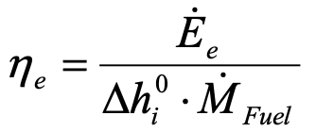

Exercise 5
Volume %
Without CO₂
Global efficiency
Total energy from the fuel
e.g. $η_{e,E4−BG}=\frac{145 kW}{47120 kJ/kg×28.52kg/h×\frac{1}{3600}h/s}≈38.8\%$

Slide 8
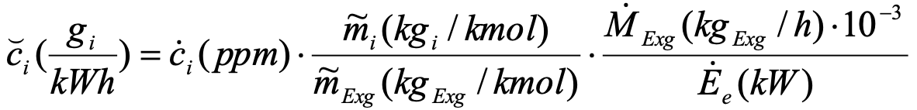
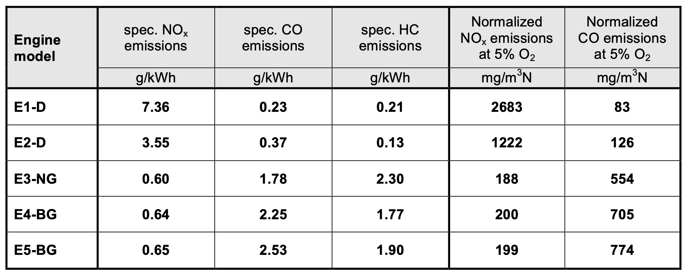


Exercise 5
Effective specific emission
$$\breve{c_{i}}\left(\frac{g_{i}}{kWh}\right)=\frac{{\dot{M}}_{i}\left(g/h\right)}{{\dot{E}}_{e}\left(kW\right)}=\frac{\dot{n_{i}}\left(mol/h\right)×{\tilde{m}}_{i} (g/mol)}{{\dot{E}}_{e}\left(kW\right)}=\frac{{\frac{\dot{c_{i}}\left(ppm\right)}{{10}^{6} ppm}\dot{×n}}_{Exg}\left(mol/h\right)×{\tilde{m}}_{i} (g/mol)}{{\dot{E}}_{e}\left(kW\right)}$$
5
$$=\frac{\frac{\dot{c_{i}}\left(ppm\right)}{{10}^{6} ppm}×\frac{{\dot{M}}_{Exg}(kg_{Exg}/h)}{{\tilde{m}}_{Exg}(kg/kmol)}×{\tilde{m}}_{i} \left(\frac{{kg}_{i}}{kmol}\right)×{10}^{3}g/kg}{{\dot{E}}_{e}\left(kW\right)}$$
e.g., ${\breve{c}}_{NO_{x},E4−BG}=71ppm×\frac{46 kg/kmol}{30.2 kg/kmol}×\frac{859.1kg/h×{10}^{−3}}{145 kW}≈0.64 g/kWh$

Slide 9
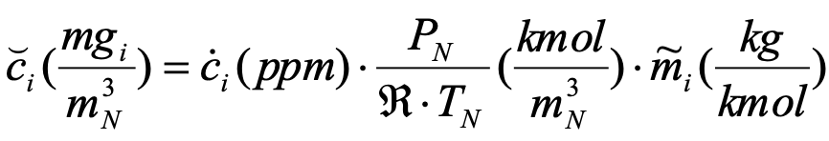

Exercise 5
Conversion between mole to volume in standard condition (1 bar, 273.15 K) with ideal gas
$$PV=nRT\underset{⇒}{n=1 mol}\frac{V}{1}=\frac{RT}{P}\underset{⇒}{P=101325 Pa, T=273.15 K}V_{N}=\frac{V}{1}≈22.4 L_{N}/mol(m_{N}^{3}/kmol)$$
Emission concentration based on the reference condition
$\breve{c_{i}}\left(\frac{{mg}_{i}}{m_{N}^{3}},O_{2}=5\%\right)=\frac{{\dot{M}}_{i}\left(g/h\right)}{{\dot{F}}_{Exg}(m_{N}^{3}/h)}=\frac{\dot{n_{i}}\left(mol/h\right)×{\tilde{m}}_{i} (g/mol)}{{\dot{n}}_{Exg}(kmol/h)×V_{N}(m_{N}^{3}/kmol)}=\dot{c_{i}}\left(ppm\right)×$ $\frac{1}{V_{N}(m_{N}^{3}/kmol)}×{\tilde{m}}_{i} (g/mol)$
$\breve{c_{i}}\left(\frac{{mg}_{i}}{m_{N}^{3}},O_{2}={\dot{c}}_{O2}\right)=\dot{c_{i}}(ppm)×f_{O2}×$ $\frac{1}{V_{N}(m_{N}^{3}/kmol)}×{\tilde{m}}_{i} (g/mol)$
$=\dot{c_{i}}(ppm)×\frac{21−5}{21−{\dot{c}}_{O2}}×$ $\frac{1}{V_{N}(m_{N}^{3}/kmol)}×{\tilde{m}}_{i} (g/mol)$
e.g., ${\breve{c}}_{NO_{x},E4−BG}=71ppm×\frac{21−5}{21−9.38}×\frac{1}{22.4(m_{N}^{3}/kmol)}×46kg/kmol≈200.76 mg_{NOx}/m_{N}^{3}$

Slide 10
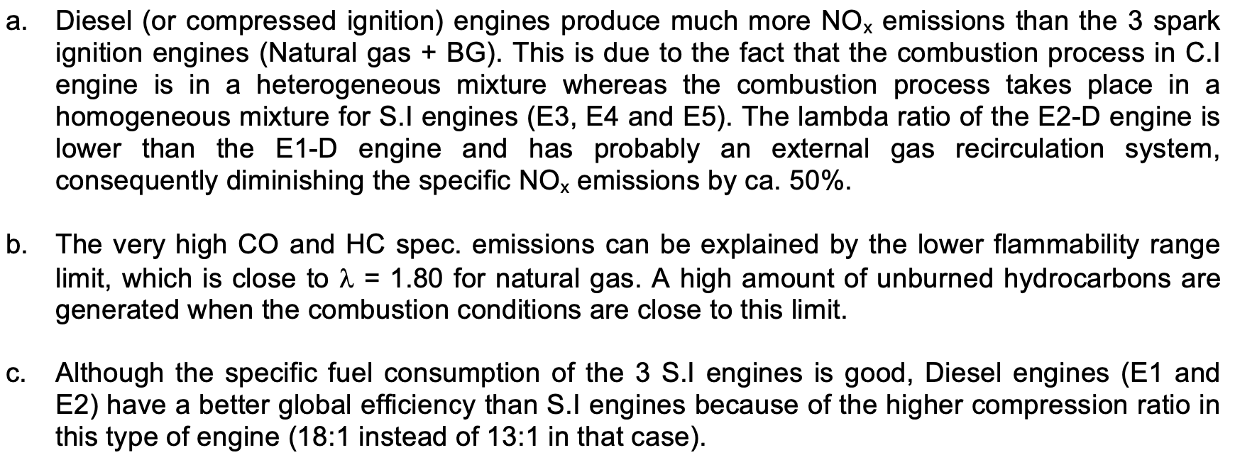
Exercise 5

Slide 11
Exercise 5

Slide 12
Exercise 5

Slide 13
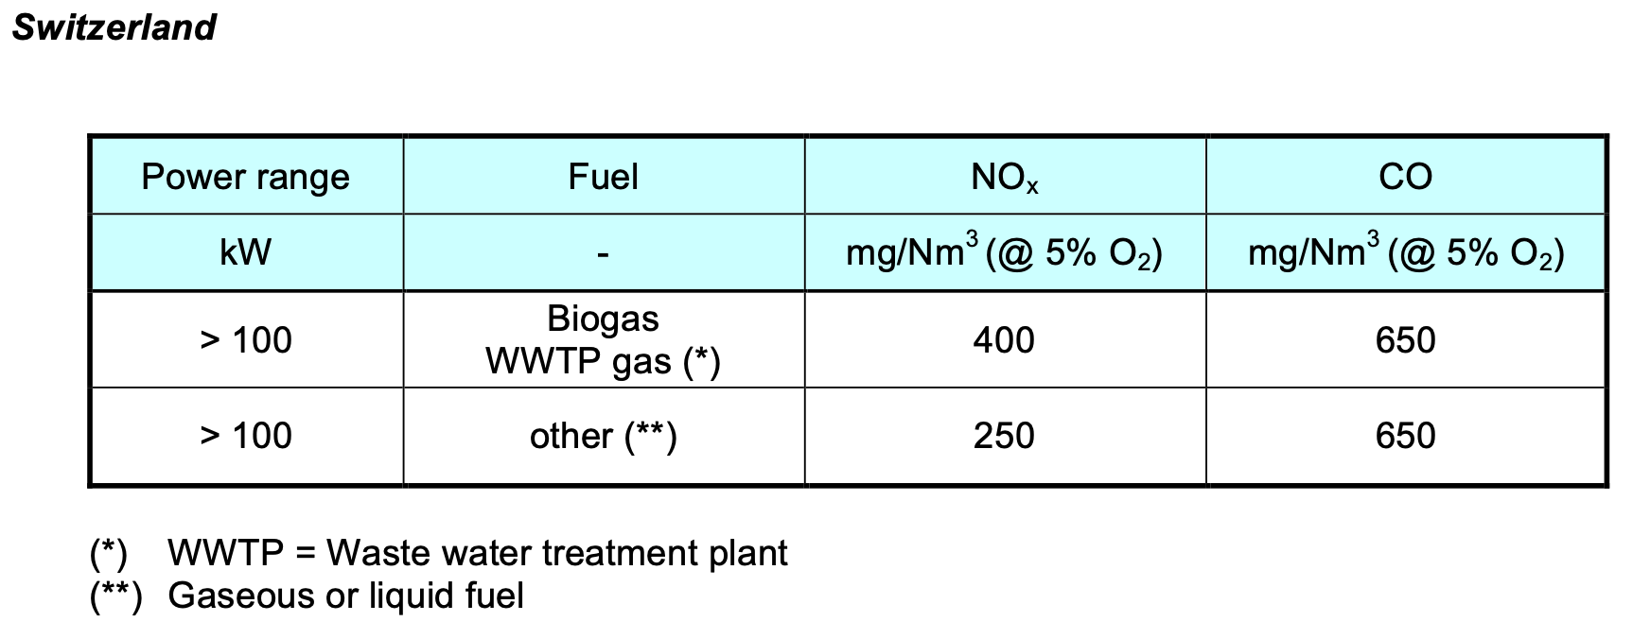
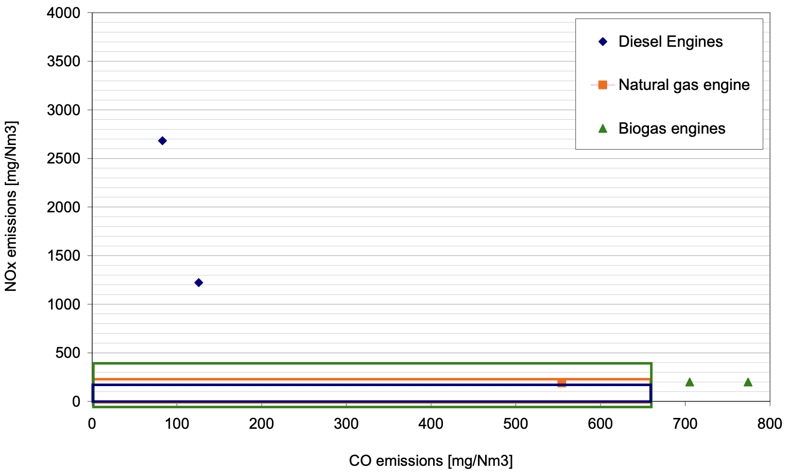
Exercise 5
E1-D
E2-D
E3-NG
E4-BG
E5-BG

Slide 14
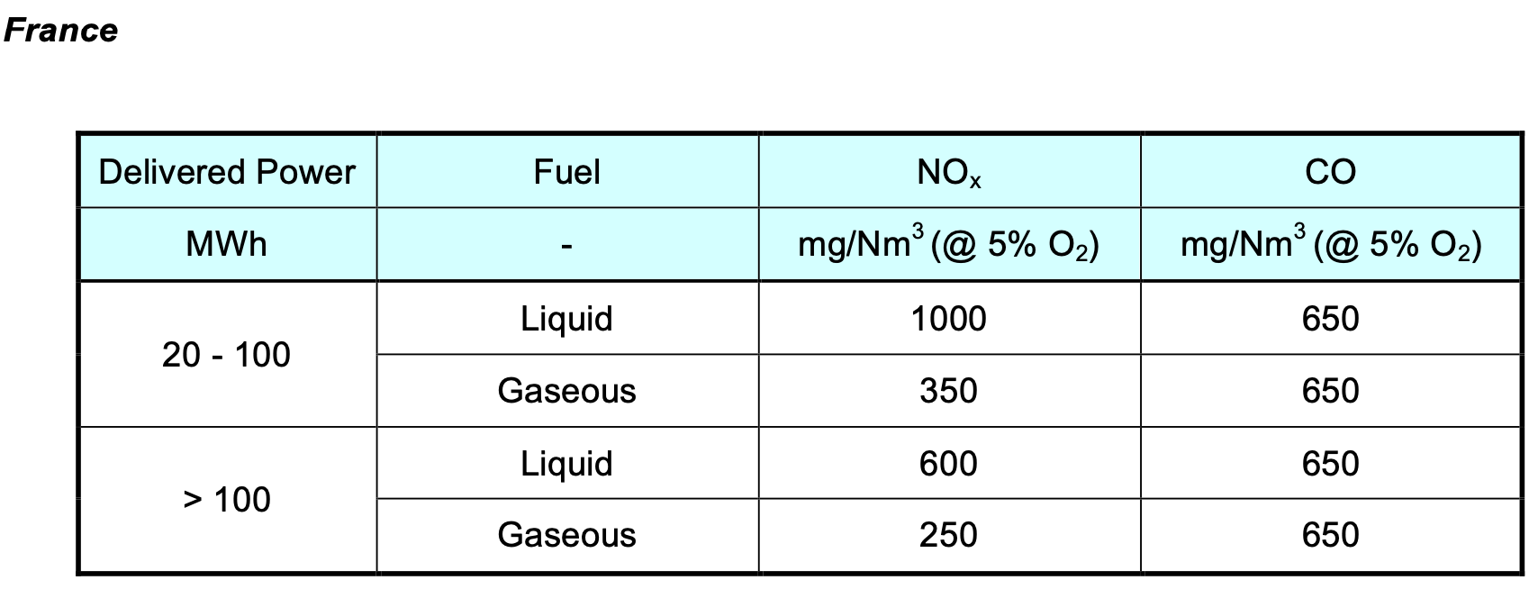
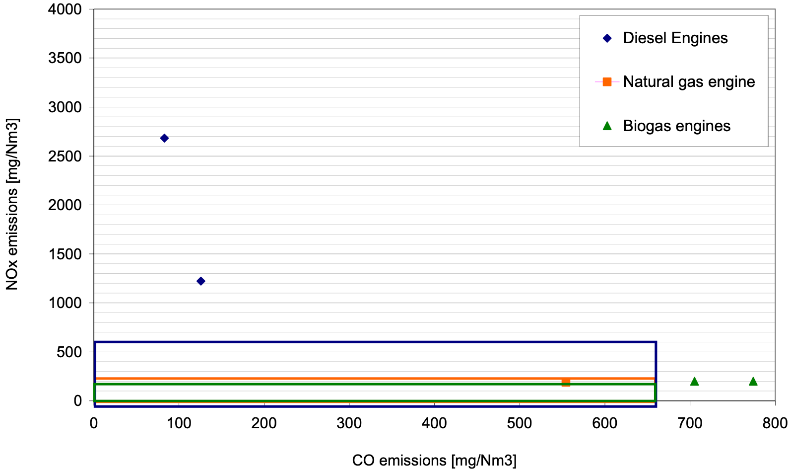
Exercise 5
E1-D
E2-D
E3-NG
E4-BG
E5-BG
France doesn’t gve advantage to Biofuel and
NO_{x} emission will be close to the limit

Slide 15
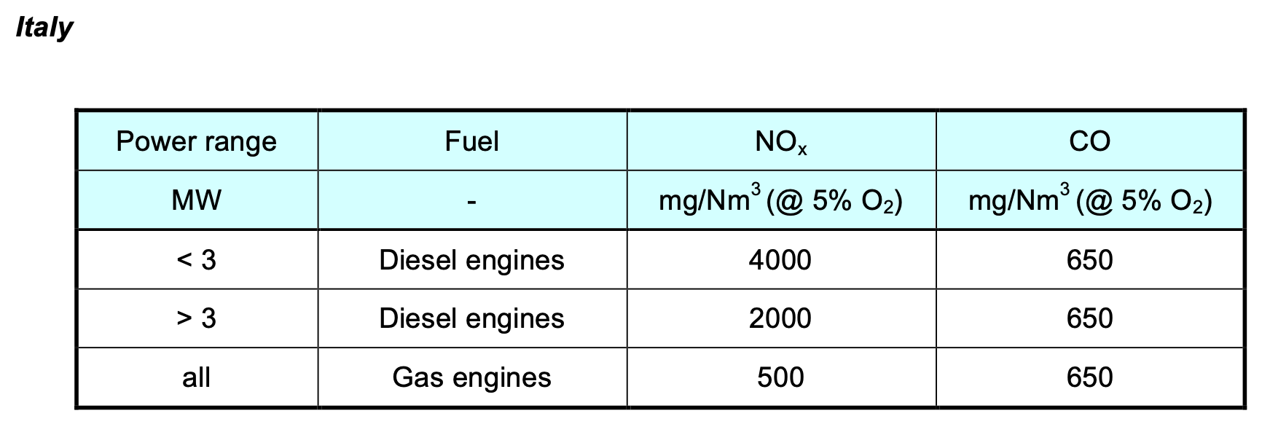
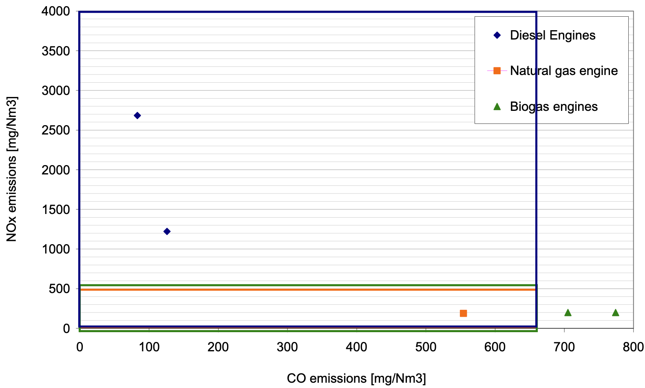
Exercise 5
E1-D
E2-D
E3-NG
E4-BG
E5-BG
- Only the total cost (investment cost + operational cost) will influence the choice of the engine.
- High production volume of such engine types.

Slide 16
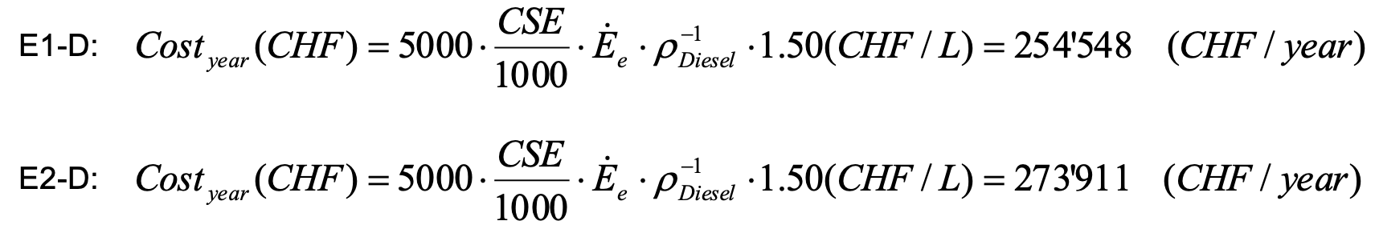
Exercise 5
Parameters | Values
Operating hours per year [h/year] | 5000
Diesel cost [CHF/L] | 1.5
ρ_{Diesel} [L/kg] | 0.83
E1-D is more profitable

Slide 17
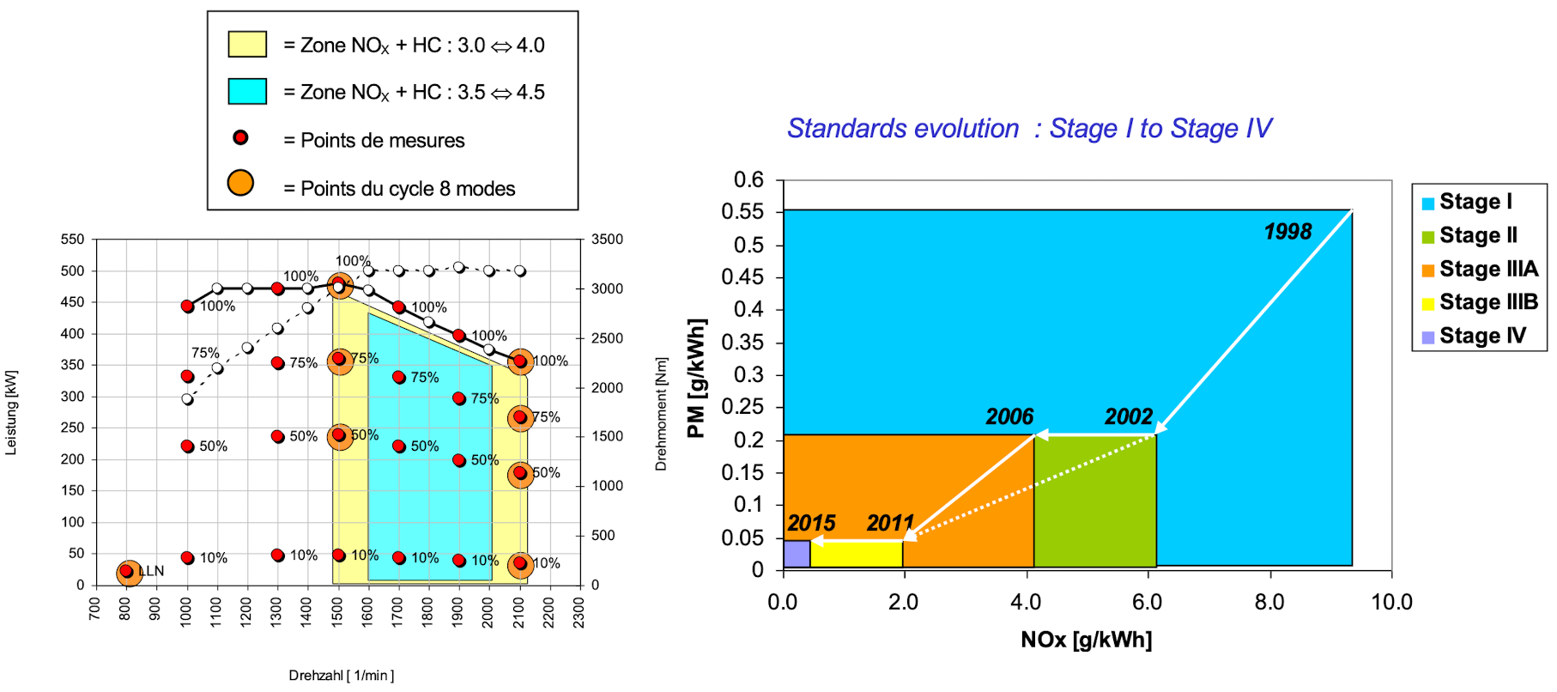
Exercise 5

Slide 18
Exercise 5
Questions?

