Slide 1

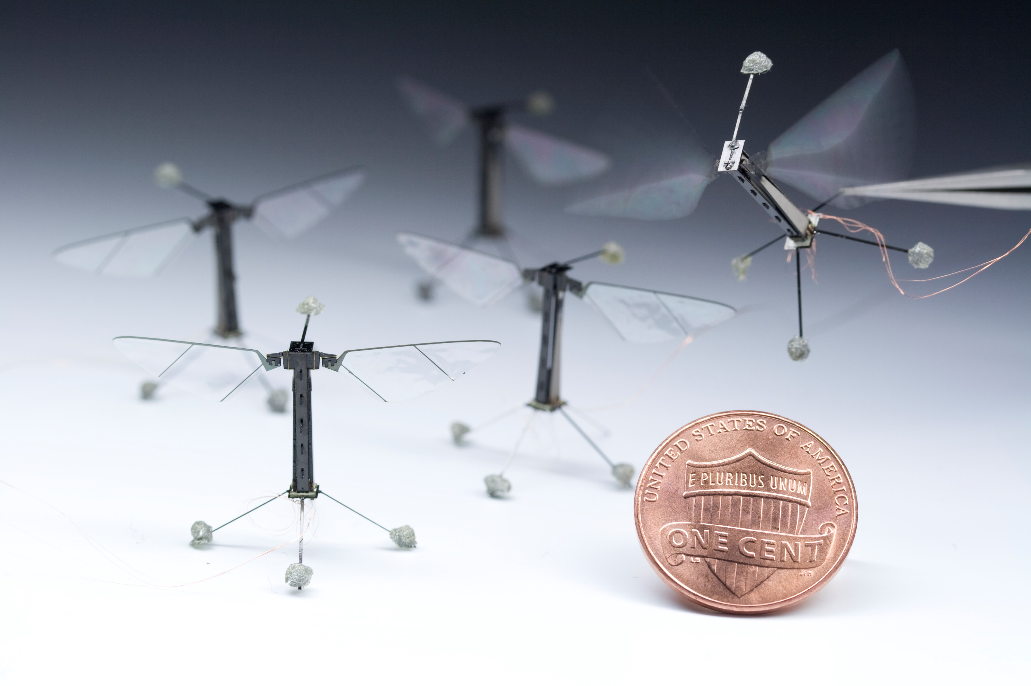
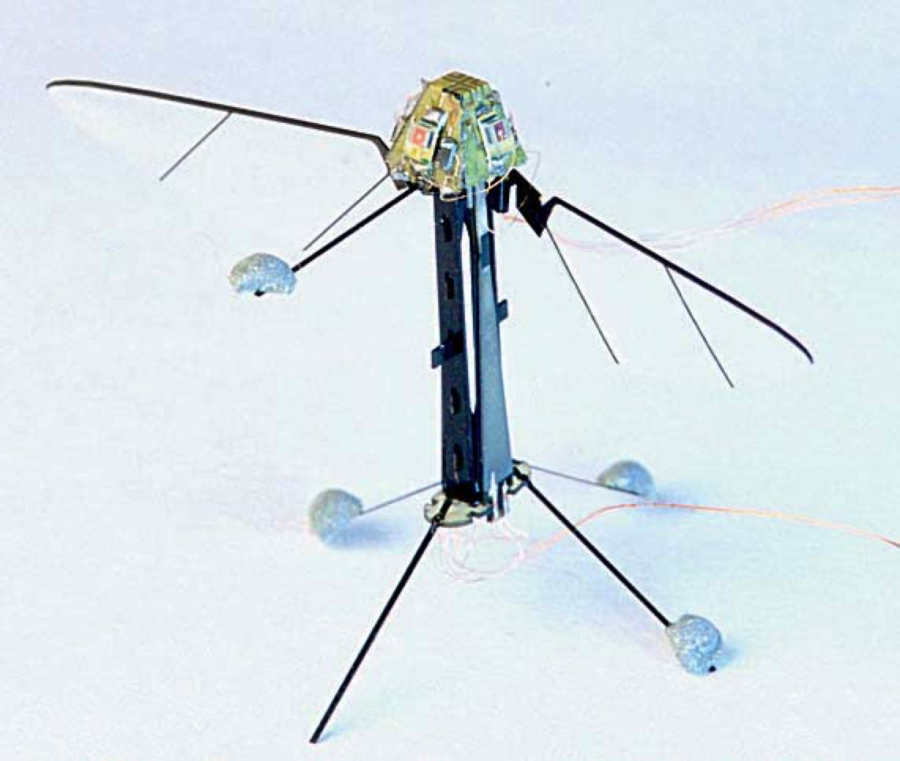
ME-420: Advanced Design for Sustainable Future
Name of the Project
Jane Doe, John Doe
Reconfigurable Robotics Lab, EPFL, Lausanne, Switzerland
Motivation
You introduce the topic and your motivation to improve it and what are the broad targets.
State-of-the-art
You explain here the current state-of-the-art .
Design
You explain your designs.
Performance
You explain your designs.
Summary and Future Development
Conclude.
References:
Ref #1
Ref #1
Ref #3

