Slide 1
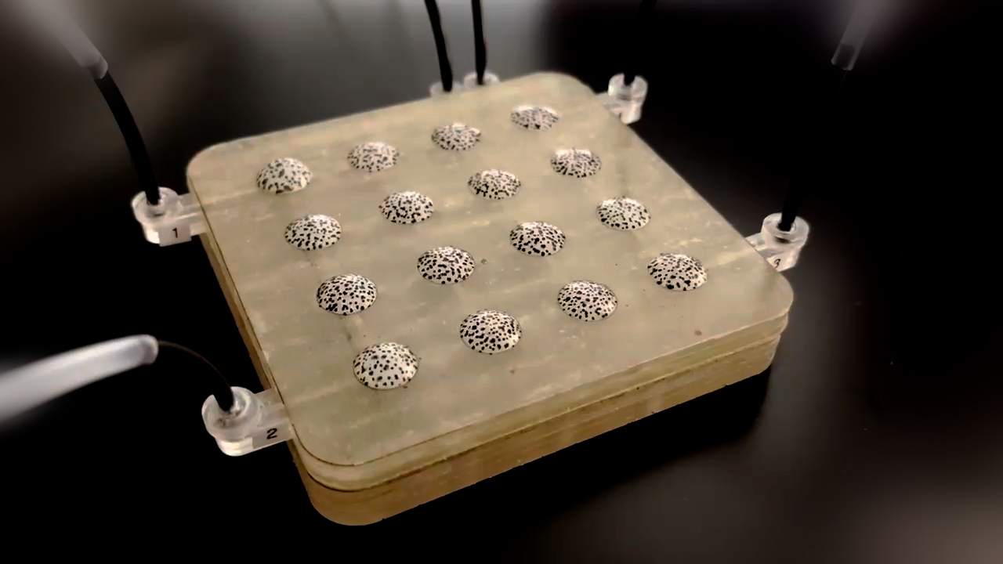



ME-420: Advanced Design for Sustainable Future
Tool for
Haptic Interface
Tool for
Haptic Interface
Group #:[Title]
[Member Names]
[Intro …..]
WATCH THE
VIDEO

Slide 2
ME-420: Advanced Design for Sustainable Future
Tool for
Haptic Interface
Tool for
Haptic Interface
Viscosity-controlled sequential pattern generator
Hwayeong Jeong and Jamie Paik
This project introduces a novel control strategy that generates a wide range of patterns using multiple pneumatic actuators, even with a limited number of input channels. By controlling the viscosity map, the system is able to dynamically adjust how air is distributed across the actuators, allowing for the creation of complex and diverse patterns.
WATCH THE
VIDEO

