Slide 1



ENV 501 / GR A3 30
Organization of exercises
Teaching assistant:
Jair Campfens & Léonard Léchot
• Laboratory on Human-
Environment Relations in Urban Systems

Slide 2

Exercise Schedule
Nr. | Date | BLOCKS | EXERCISE SESSION 13:15 - 14:00
1 | 11-sept | Block I: EW-MFA global/national | Exercise 1: a. Interpretation questions Industrial Ecology b. Introduction Python - Notebook 1
2 | 18-sept | Block I: EW-MFA global/national | Exercise2: a. EW_MFA country comparison handwritten b. EW-MFA indicators country comparisons - Notebook 2
3 | 25-sept | Block I: EW-MFA global/national | Exercise 3: MFA using Phyton, Notebook 3
4 | 02-oct | Block I: EW-MFA global/national | Exercise 4: Social metabolic indicators and risks for recycling and CE
5 | 09-oct | Block II: MFA regional/urban | Exercise 5: a. Handwritten MFA on the board (MFA system boundaries, what are the stocks and flows?) b. STAN/Umberto
6 | 16-oct | Block II: MFA regional/urban | Exercise 6: Dynamic MFA exercise
 | 23-oct | Autumn break | Autumn break
7 | 30-oct | Block II: MFA regional/urban | Exercise 7: Discussion on application of dynamic MFA
8 | 06-nov | Block II: MFA regional/urban | Exercise 8: a. Exercise with IOA b. IOA and MRIO - Notebook 4 and 5
9 | 13-nov | Block II: MFA regional/urban | Exercise 9: Software Quantum GIS linked to case study
10 | 20-nov | Block II: MFA regional/urban | Exercise 10: a. Adjust to lecture of week 10
11 | 27-nov | Block II: MFA regional/urban | Exercise11: a. Overview of different data visualizations b. Data visualization - Notebook 6
12 | 04-déc | Block III: Social science and public policy | Past exam practice
13 | 11-déc | Block III: Social science and public policy | Past exam solutions
14 | 18-déc |  | Presentations
  Material for 13 weeks
  11 Exercises overall, 2 weeks of exam training
  In every week, focus on interpretation, handwritten and discussion questions.
  6 Python Notebook exercises
Laboratory on Human-Environment Relations in Urban Systems

Slide 3
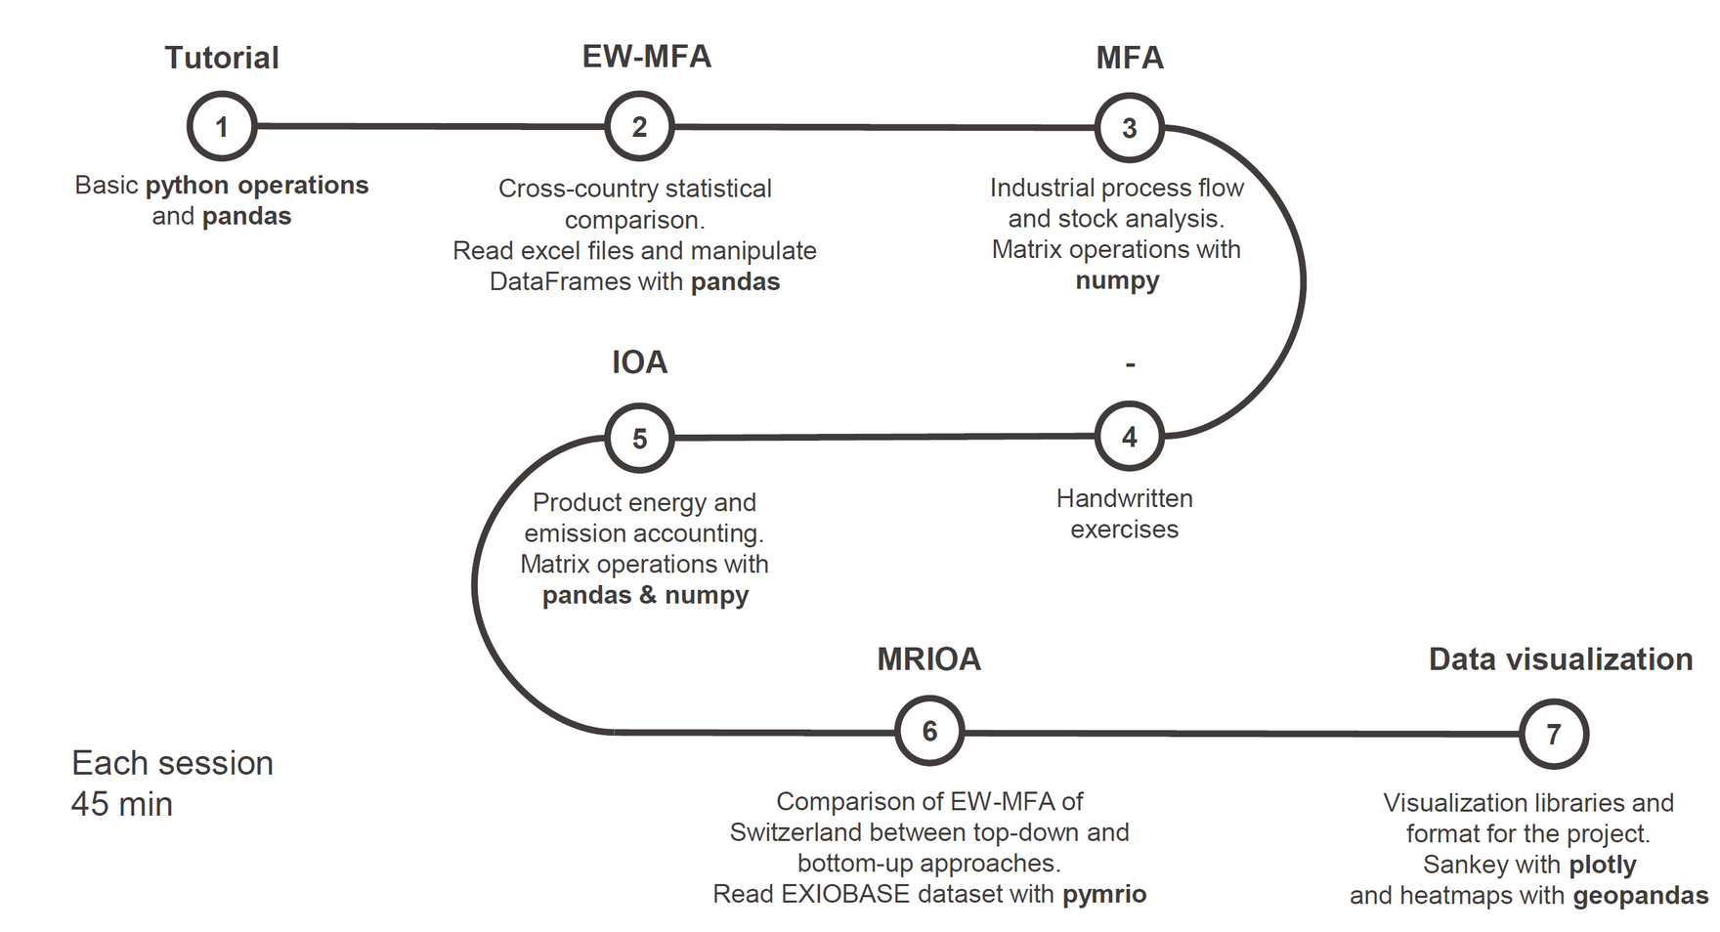


Python notebooks: step by step design
Laboratory on Human-Environment Relations in Urban Systems

