Slide 1
Exercise session #8
Science of
Climate Change
Nov. 3, 2022

Slide 2
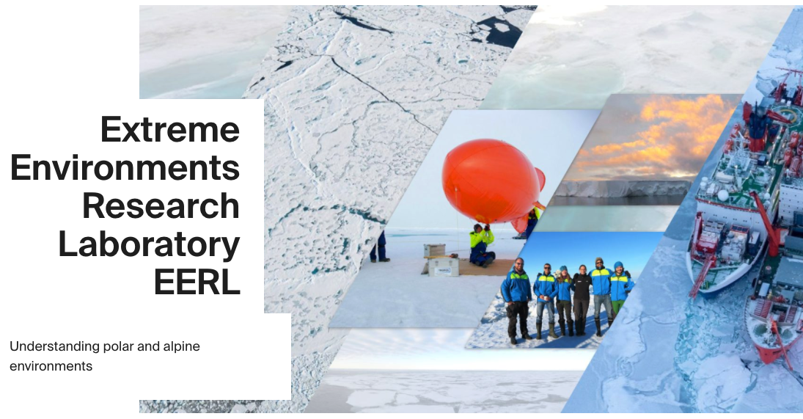
Berkay Dönmez
Teaching Assistant
BSc in Meteorological Engineering
MSc in Atmospheric Sciences
Focus on modeling aerosol-cloud interaction in the Arctic
Also TA for lectures next week
https://www.epfl.ch/labs/eerl/

Slide 3
Today’s plan
Key points from this morning’s lecture and any questions
Exercise using Mentimeter
Reminder about posters and conference day

Slide 4
Overview/Take-home from Lecture 8
IPCC - Intergovernmental panel on climate change
Providing information for policy makers on the current and future state of the environment
Estimating environmental and socio-economic consequences under different emission scenarios
IPCC report published every 5 years approx
3 working groups of IPCC
UNFCC - United Nations Framework Convention on Climate Change
In contrast to IPCC – a political body with 198 member countries
Aim: Preventing dangerous human intervention with climate system

Slide 5
Overview/Take-home from Lecture 8
Climate Agreements:
Kyoto Protocol
”Reducing GHG emissions by an average of 5% below 1990 levels”
Many major emitters not part of the agreement
Paris Agreement
Keeping global temperature rise to below 2 degrees and aiming for 1.5 degrees
Legally binding agreement by 196 of 198 countries
Achieving climate neutral world by 2050

Slide 6
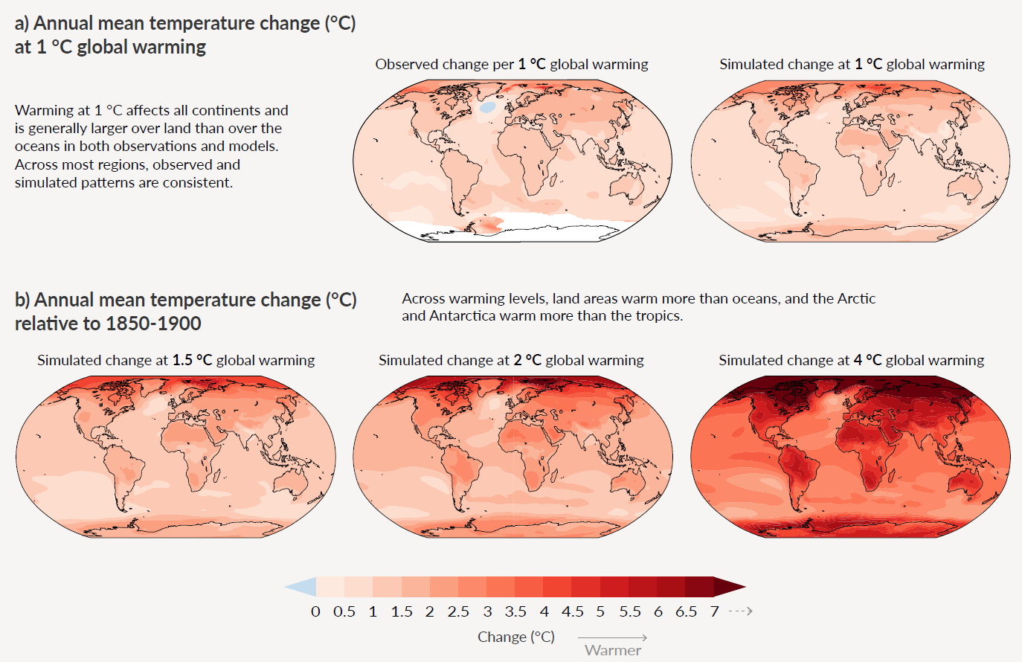
Overview/Take-home from Lecture 8
Present climate change:
IPCC AR6, Figure SPM.5

Slide 7
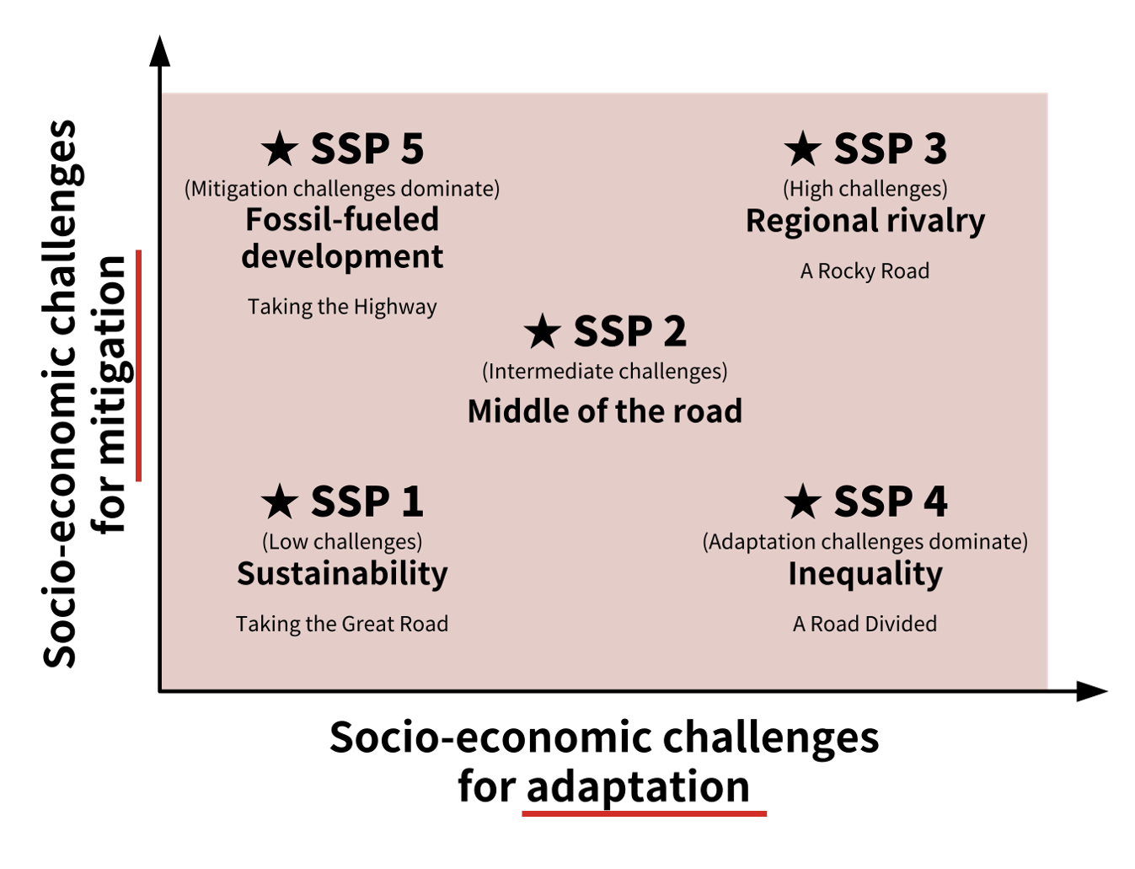
Overview/Take-home from Lecture 8
SSPs are scenarios of projected socioeconomic global changes up to 2100. They are used to derive greenhouse gas emissions scenarios with different climate policies.
Used since IPCC AR6
SSPs are:
  narratives describing alternative socio-economic developments.
  qualitative description of logic relating elements of the narratives to each other.
  quantitative elements: they provide data accompanying the scenarios on national population, urbanization and GDP (per capita).

Slide 8
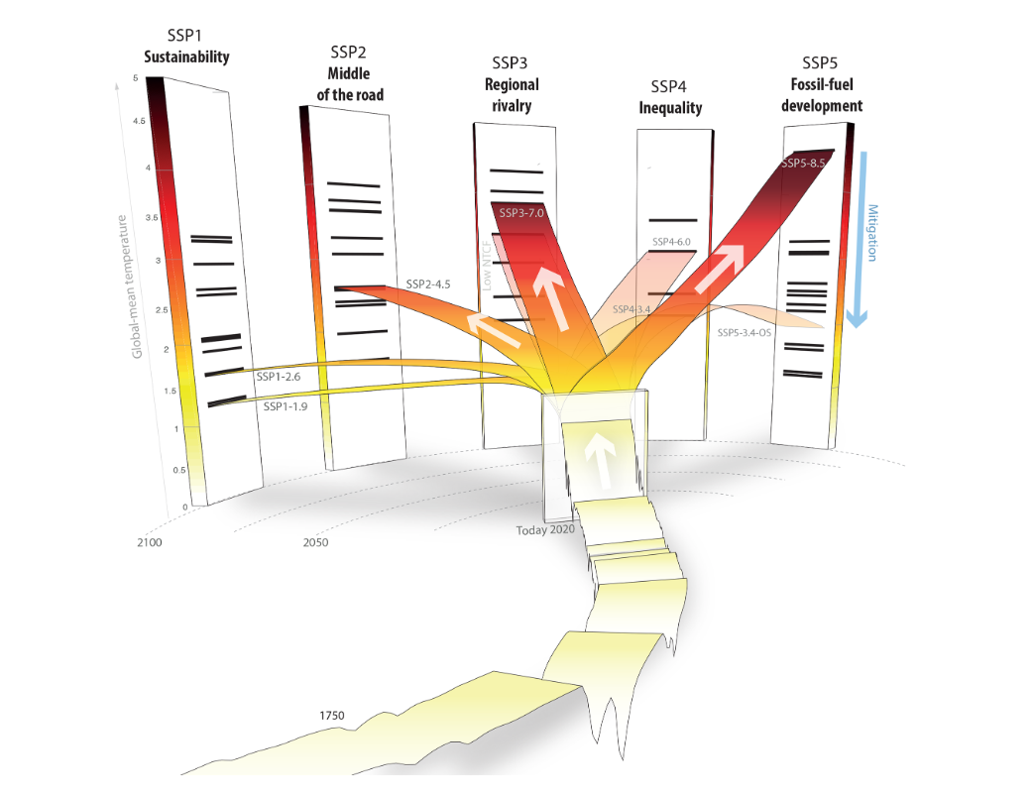
IPCC priority scenarios
There are 23 SSP “marker” scenarios. These are the 5 IPCC priority scenarios.
SSP5-8.5 represents the high end of the range of future pathways, corresponding to RCP8.5.
SSP3-7.0 lies between RCP6.0 and
RCP8.5, and represents the medium to high end of the range of future forcing pathways.
SSP2-4.5 represents the medium part
of the range of future forcing pathways and updates RCP4.5.
SSP1-2.6 is similar to RCP2.6. It is anticipated that it will produce a multi-model mean of less than 2°C warming by 2100.
SSP1-1.9 are scenarios with very low and low GHG emissions, and CO2 emissions declining to net zero around or after 2050, followed by varying levels of net negative CO2 emissions.
Less
warming
https://doi.org/10.5194/gmd-13-3571-2020
Notes:
Figure 1. The SSP scenarios and their five socio-economic SSP families. Shown are illustrative temperature levels relative to pre-industrial
levels with historical temperatures (front band), current (2020) temperatures (small block in middle), and the branching of the respective
scenarios over the 21st century along the five different socio-economic families. The small black horizontal bars on the 2100 pillars for
each SSP indicate illustrative temperature levels (obtained by the MAGICC7.0 default setting used to produce the GHG concentrations)
for the range of SSP scenarios that were available from the IAM community at the time of creating the benchmark SSP scenarios. The
more opaque bands over the 21st century indicate the five SSP scenarios SSP1-1.9, SSP1-2.6, SSP2-4.5, SSP3-7.0, and SSP5-8.5 that are
used as priority scenarios in IPCC. The more transparent bands indicate the remaining “Tier 2” SSP scenarios, namely SSP3-7.0-LowNTCF
(used in AerChemMIP), SSP4-3.4, SSP4-6.0, and SSP5-3.4-OS. Also shown is a blue indicative bar on the right side, indicating the effect of
mitigation action, which reduces temperature levels in 2100 and throughout the 21st century – depending on the respective reference scenario
and level of mitigation

Slide 9
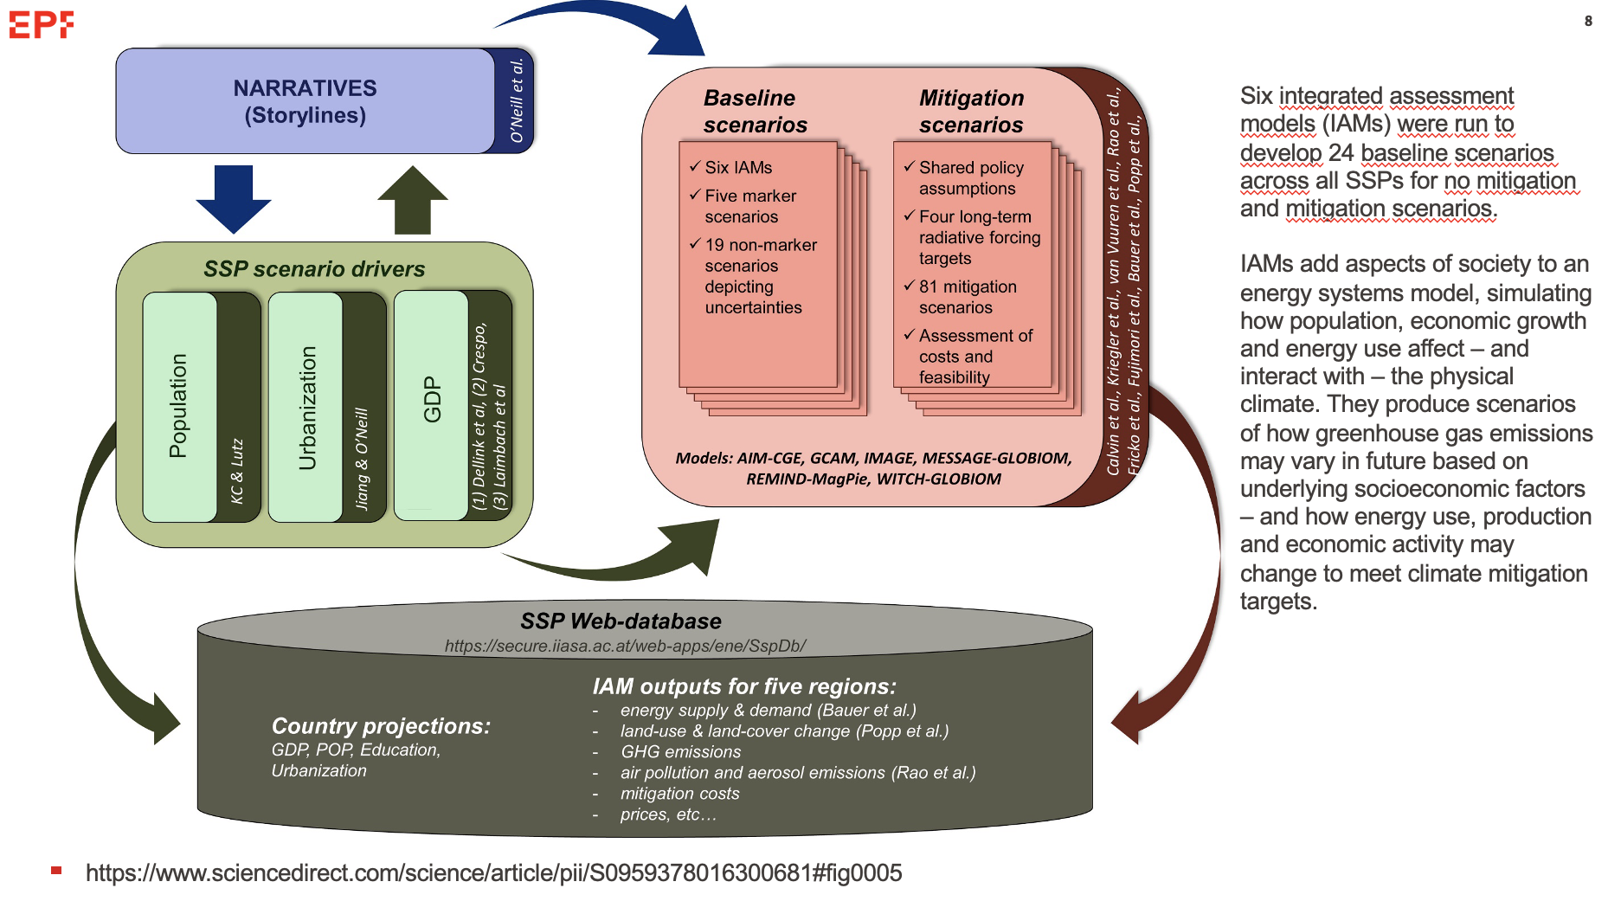

Slide 10
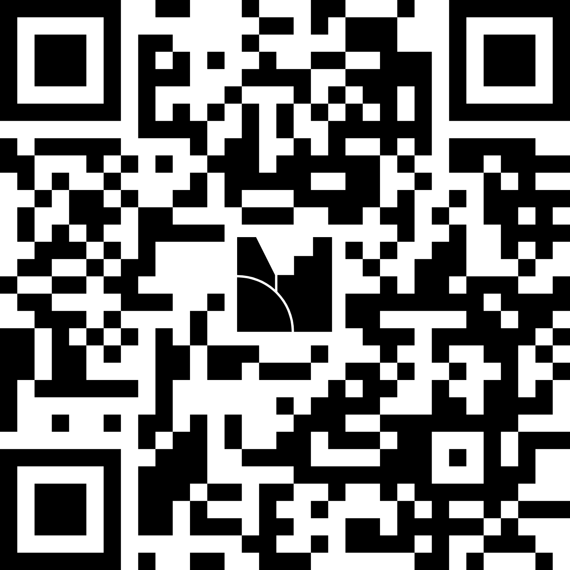
Exercise Connection
Connect to Mentimeter

Slide 11
Exercise Solutions
Which of the following is not considered as a natural factor that can warm/cool the Earth? (Solar radiation, Earth’s orbital changes, Volcanic activity, GHG emissions)
Aerosols always lead to warming of the Earth. (True or False)
The land acts as the largest heat sink, absorbing and storing excess energy. (True or False)
Both RCPs and SSPs incorporate projections of socioeconomic developments to model future climate scenarios. (False)
Which one of the following is not included in the SSP priority scenarios? (SSP4-8.5)
An SSP scenario can only be associated with a single radiative forcing outcome. (False)
Integrated Assessment Models are directly used to simulate projected changes in global atmospheric temperature (False)
Climate Impact Drivers (CIDs) are physical climate conditions (events, extremes) that affect society or ecosystems. (True)
The IPCC classifies CIDs into seven types. What are they? (Heat/Cold; Wet/Dry; Wind; Snow/Ice, Coastal, Open Ocean, Other)
Specific indices used to analyze each type to inform risk management and adaptation (True)

Slide 12
Exercise Solutions
NDCs outline the efforts a country intends to make to reduce national greenhouse gas emissions and adapt to the impacts of climate change (TRUE)
In the context of NDCs, targets that depend on external financial support are identified as "conditional NDCs" (TRUE)
The Paris Agreement requests each country to outline and communicate their post-2020 climate actions, known as their NDCs every seven years (FALSE)
What is the emission gap (Word Cloud)
  The emission gap is the difference between the emissions reductions countries have committed to and the reductions needed to meet global climate goals, like limiting warming to 1.5°C or 2°C.
Beyond temperature changes, what other events do you think are linked to climate change? (Word Cloud)
Which period is typically used to represent the preindustrial period in climate calculations? (1850-1900)
Where will the next COP30 take place? (Belém, Brazil)

Slide 13
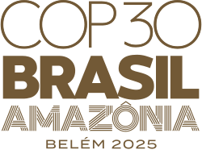
Reminder about COP30
UNFCCC annual Conference of the Parties
When - annually; 10 to 21 November 2025
Where - Belém, Brazil
Who - World leaders and scientists from leading institutions globally
Key detail – presentation of new national climate action plans (NDCs) under the Paris agreement (NDCs)
Illustration: United Nations Department of Global Communications

Slide 14
Reminder about posters
Poster submission deadline
13 November, 2025
Feedback on posters by 19 November, 2025
Poster conference date
18 December, 2024

Slide 15
Time to work on the assignment/poster

