Slide 1
Exercise session #11
27th November
Science of Climate Change
CO2 equivalent metrics
23.11.2023

Slide 2
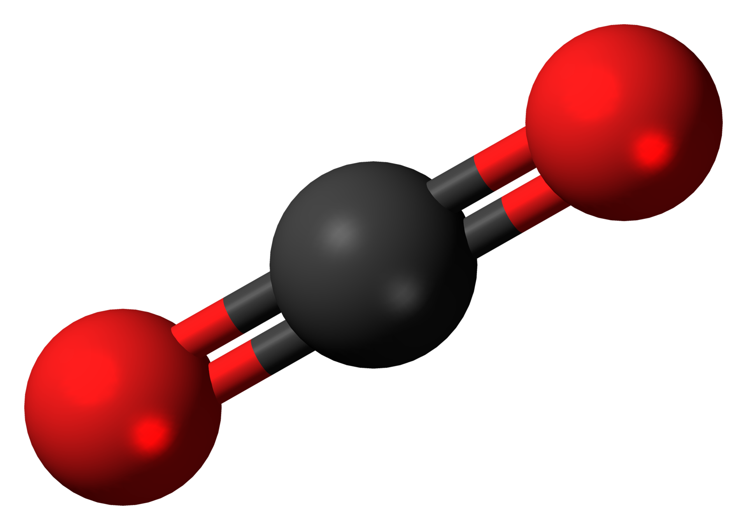
Today’s goal
Understand the concepts of CO₂ equivalent metrics and what they imply for decision making!
Plan:
Recap Metrics and carbon offsets lecture
  CO₂ equivalent metrics
    Global Warming Potential (GWP, GWP*)
    Limitations and advantages
12
C
O
Molar mass = 12g/mol
16
12
16
O
C
O
Molar mass = 44g/mol

Slide 3
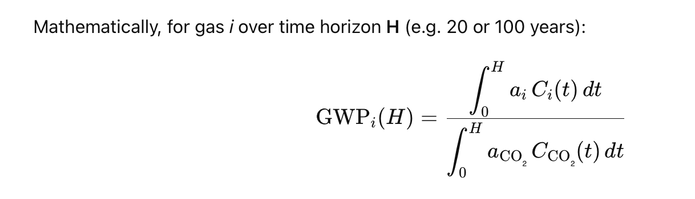
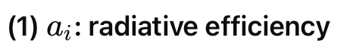
Global warming potential is calculated relative to CO₂. So…
How do we convert other species to CO₂ equivalent?
how strong is 1 kg of this gas
at trapping heat right now?
*Slide 20/60 in Lecture 11

Slide 4
Taking into consideration
Time horizon i.e. the time over which you are calculating the metric
  Usually 20,100 or 500 years
  This is dependant on the residence time of gases in the atmosphere. i.e. how long they stick around and can impact our atmosphere
  Radiative efficiency – how effectively a gas absorbs energy in the form of heat and re-emits it back towards earth
  Atmospheric lifetime – the average time a gas phase molecule will remain in the atmoshpere without being removed by chemical reaction or other processes.
    longer lifetime usually equals more warming effect on the atmosphere
    Simply put … we are interested in the total energy absorbed by a specific quantity of GHG over a chosen period….we can then compare this to CO₂

Slide 5
If we look at the most known GHGs we can see that:
Greenhouse gas | Role | GWP over 100 years
CO₂ | Primary GHG Responsible for most of Earths warming Remains in the atmosphere longer than other GHG | 1
CH₄ | More effective than CO₂ at trapping heat in the atmosphere Breaks down much faster than CO₂ | 28 - 36
N₂O | Over 100 year period N₂O has a much greater impact than CO₂ Also depletes stratospheric O₃ | 298
Fluorinated gases (HFCs,PFCs,SF₆) | Synthetic gases that have a higher GWB than CO₂ Used in various industrial applications such as refridgeration | Varies a lot, but can be up to and over 23,000
https://www.minimum.com/resources/global-warming-potential

Slide 6
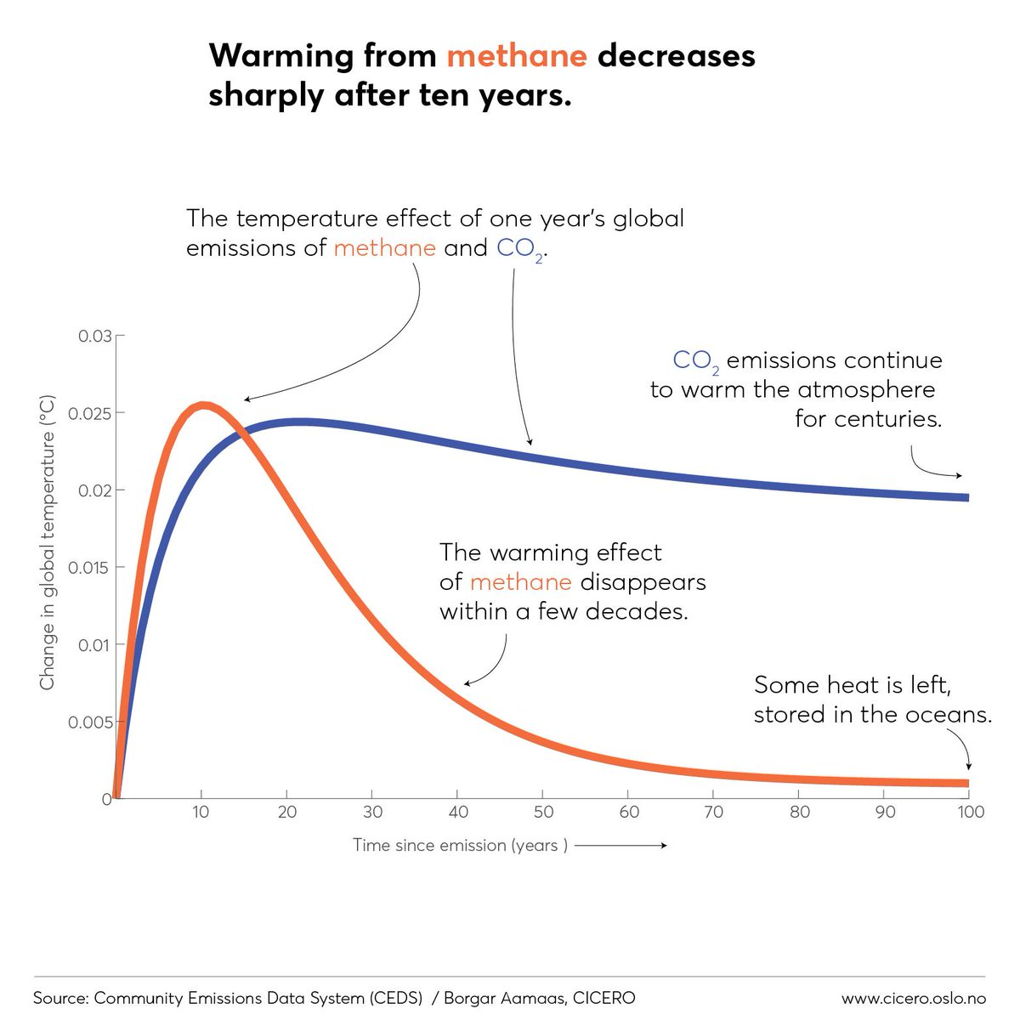
Different greenhouse gases have different effects
*Slide 16/60 in Lecture 11
Difference depends on:
Efficacy of the greenhouse gas (how powerful is the gas?)
Lifetime of the gas in the atmosphere
  CH₄: ~12 years
  CO₂: ~100 years
Notes:
https://twitter.com/hausfath/status/1183813162795032577

Slide 7
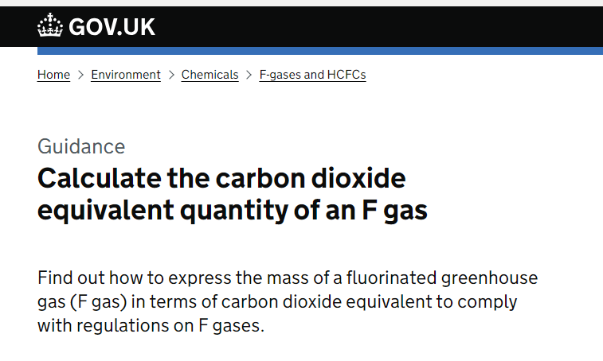
Calculate GWP
The UK government requires that you calculate the CO₂ equivalent mass if you import or produce F gas into the UK
You work for a refrigerant company and have produced 15 kg of HFC-404a and 10 kg of HFC-407a
If the GWP of HFC-404A is 3922 and the GWP of HFC-407a is 2107, calculate the equivalent tonnes of CO₂.
https://www.gov.uk/guidance/fluorinated-gases-f-gases

Slide 8
Calculate GWP
You work for a refridgerant company and have produced 15 kg of hydrofluorocrabon 404a and 10kg of HFC-407a.
If the GWP of HFC-404A is 3922 and the GWP of HFC-407a is 2107, calculate the equivalent tonnes of CO₂.
First we want the mass of the HFCs in tonnes
10/1000 = 0.01 tonnes
15/1000 = 0.015 tonnes
Then, we multiply this by the GWP of each gas:
0.01 x 3922 = 39.2 tonnes CO₂ equivalent for HFC-404A
0.015 x 2107 = 31.6 tonnes CO₂ equivalent for HFC-407A
https://www.gov.uk/guidance/fluorinated-gases-f-gases

Slide 9
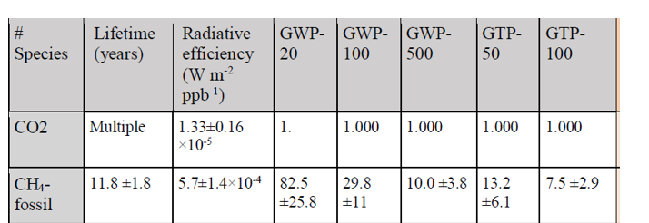
Limitations of GWP
The selected time horizon has a large impact on the value of
the metric and does not represent long or short-term effects of specific GHGs.
GWP over-simplifies complex interactions of various gases in the atmosphere by converting them to the single metric relative to CO₂
Does not account for indirect effects of GHG such as their influence on cloud formation and the albedo effect.
There is a degree of uncertainty due to the uncertainty in the atmospheric models and assumptions used in the calculation of GWP values
Despite its name, it does not compare gases against their effect on global temperature.
Notes:
Show slide

Slide 10
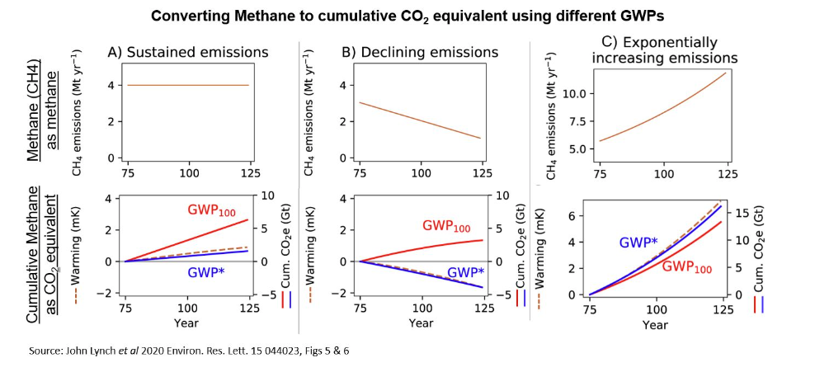
GWP*
https://ahdb.org.uk/knowledge-library/what-is-gwp#:~:text=GWP*%20aims%20to%20better%20model,well%20below%20that%20from%20GWP100.
GWP* aims to better model the impact of methane and compare the warming effect it has
Condition 1:
CH₄ emissions remain constant
Condition 2:
CH₄ emissions decline
Condition 3:
CH₄ emissions increase
GWP* - additional warming effects are negligible with older CH₄ breaking down balancing out the warming impact of newly emitted CH₄
GWP* - if CH₄ emissions noticeably decrease GWP* better takes into account this decrease in warming effect, unlike GWP100
GWP* - methane emissions have a stronger impact than under GWP100

Slide 11

Calculating GWP*
*from slide 28/60 of lecture 11
Under the new GWP*, the CO₂ equivalent emission rate for short-lived species is calculated as the change in emission rates across the reference period multiplied by the warming potential over the time horizon:
$$E_{{CO}_{2}e∗}= \frac{∆E}{∆t}×{GWP}_{H}×H$$
Time horizon
CO₂ equivalents
Warming potential over time horizon
Change in emission rate

Slide 12
GWP* vs GWP100
GWP100 | GWP*
Includes all GHGs | For CH₄ only, possibility to expand to short’lived GHGs
Average warming potential over 100 years | Warming effect over time, but acounts for the breakdown of CH₄
Focuses on fixed quantities of emissions | Focuses on the change in the rate of emissions over time
Can use emissions data over any timespan | Requires 20 years of emissions data
Less accurate representation of CH₄ impact | More accurate representation of the impact of CH₄ specifically
Formally adopted in international climate policy | Growing recognition as a metric, recognised by IPCC but so far no national or international level adoption
https://ahdb.org.uk/knowledge-library/what-is-gwp#:~:text=GWP*%20aims%20to%20better%20model,well%20below%20that%20from%20GWP100.

Slide 13
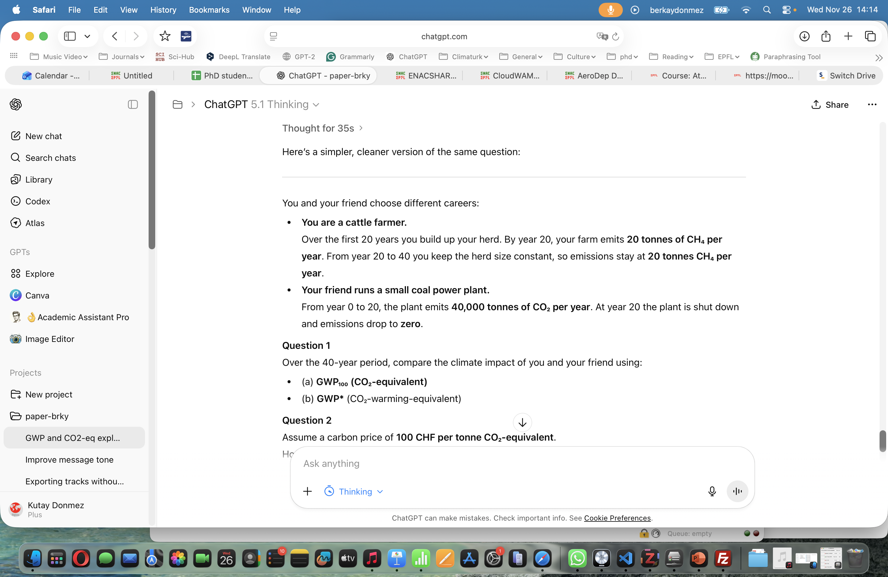
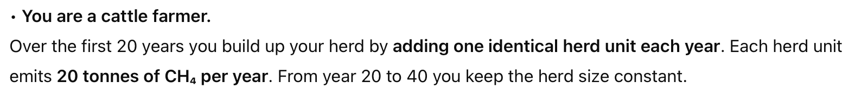

Carbon Offset
Use (GWP20 of CH4) as 81

Slide 14
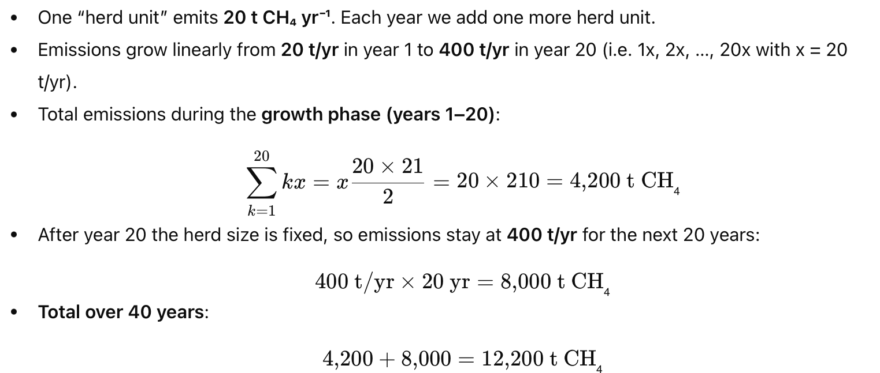
Carbon Offset
Question 1:
Compare the emitted CO_{2eq} for yourself and your CEO friend, with GWP and GWP*.

Slide 15
Carbon Offset
Question 1:
Compare the emitted CO_{2eq} for yourself and your CEO friend, with GWP and GWP*, and discuss the result.
For the Farmer
Total emission = 12,200 tonnes over 40 years
Using GWP:
12,200 * 81 (GWP20 of CH4) = 988200 tonnes CO_{2eq}
Using GWP*:
20 tonnes yr⁻¹ (change in emission rate) * 81 (GWP20 of CH4) * 20 (time horizon) = 32400 tonnes CO_{2eq}
For the power plant CEO:
Use GWP as there is no change in emission rates over the time:
40,000 tonnes yr⁻¹ were emitted by the power plant * 20 years = 800,000 tonnes CO_{2eq}
Question 2:
1 tonne of CO2_{eq} costs 100 CHF. What then is the cost of the 2 different careers if carbon emissions are taxed based on GWP and GWP*?
For the Farmer
Cost using GWP:
988200 tonnes CO2eq * 100CHF = 98,820,000 CHF
Cost using GWP*:
32400 tonnes CO2eq * 100 CHF = 3,240,000 CHF
For the power plant CEO:
Cost using GWP:
80,000,000 tonnes CO2eq * 100 CHF = 80,000,000 CHF

