Slide 1
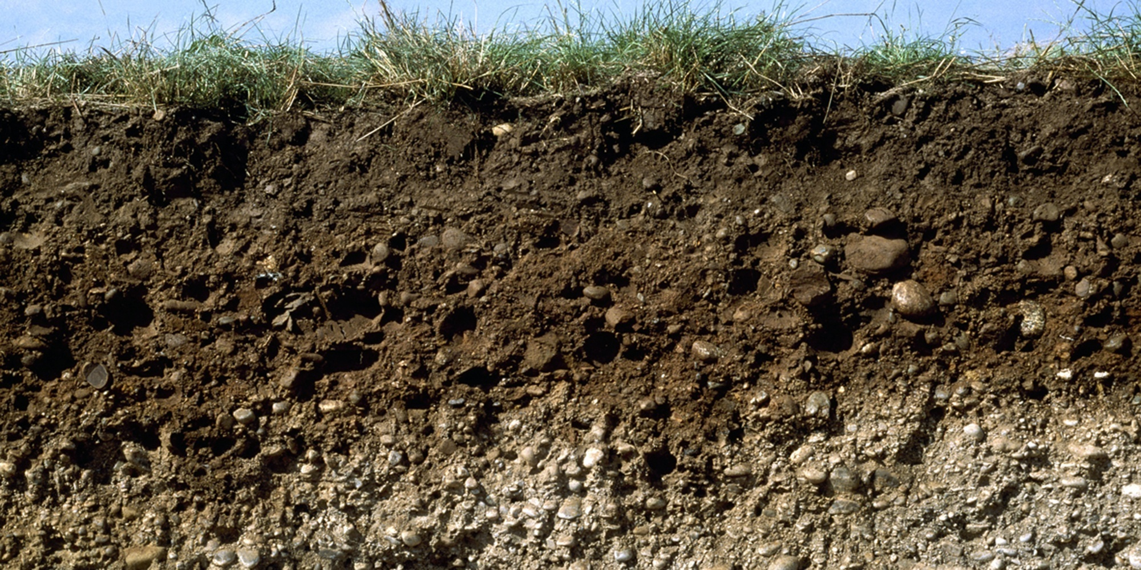
Soil science
Computer lab 3
Guo-Shiuan Lin (Steven)
URBES lab, EPFL

Slide 2
Schedule of computer lab
Date | Subject
13. Oct | Introduction
20. Oct | Break
27. Oct | Exercise 1: Pedotransfer functions
3. Nov | Exercise 2: Soil water retention curves
10. Nov | Report/Academic writing
17. Nov | Exercise 3: Richards equation
24. Nov | Bonus exercise: Soil data challenge
1. Dec | Group work and consultation time
5. Dec | Report submission deadline

Slide 3
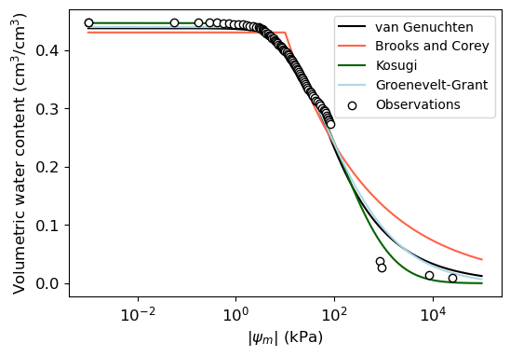
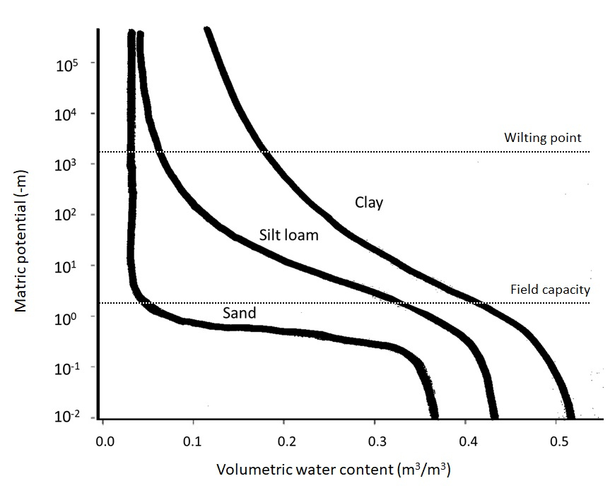
Can you find these values in the figure?
Saturated water content
Porosity
Residual water content
Notes:
Field capacity (the potential matric where water content starts to drop)
Wilting point (the potential matric where water content drops to residual zone, close to the residual water content)

Slide 4
How was the fitting done?

Slide 5
Fitting the soil water retention curve with different models
Measurements
Change this line of code to:
x_curve = np.logspace(-3,5,1000)
Which model is better?
Fitted line

Slide 6
Uncertainty

Slide 7
How many of these are compulsory inputs for using scipy.optimize.curve_fit()?
A. Function/model used for fitting
B. X values
C. Y values
D. Bounds for the parameters
Notes:
Ans: Except D

Slide 8
Why do we need to set the bounds?
To get realistic values
To save some computation time
Notes:
Save time

Slide 9
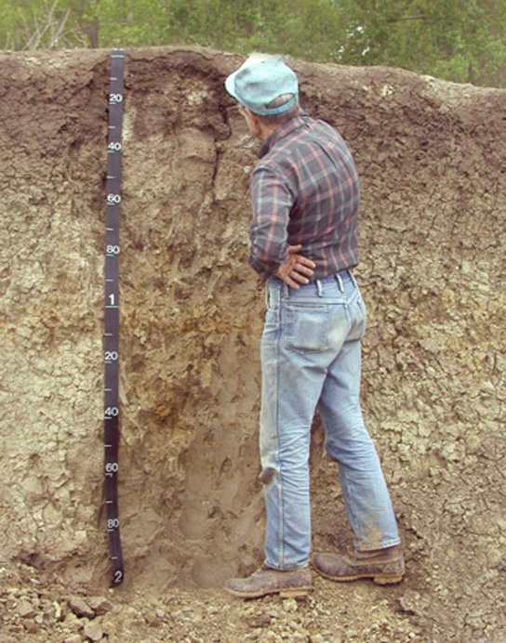
Soil science
Observing and measuring the soil
Understanding the physical processes
Parameterizing the processes (i.e., equations)
Validating the equations
Modeling and predicting

Slide 10
Assignment 3: 1D infiltration model

Slide 11
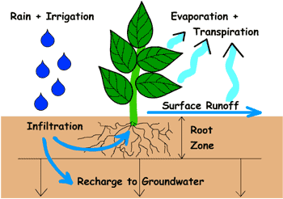
Infiltration, runoff, and groundwater recharge
https://www2.hawaii.edu/~dennis/GeoBook/chapter_7/balance.htm

Slide 12
Richard’s equation
How water infiltrate in unsaturated soils
Movement of water

Slide 13






Richard’s equation
2 common expressions of Richard’s equation
Moisture-content form
(mass balance)
Chain rule
Darcy’s law
Pressure-head form
Specific moisture capacity

Slide 14
Richard’s equation: how it is done in the code
def RichardsModel(psi,t,dz,n,p,vg,qTop,qBot,psiTop,psiBot)
return dpsidt
def CFun(psi,pars)
def KFun(psi,pars)
Use scipy.odeint to Integrate
Get the variables at different time steps

Slide 15
1.Download Richards Equation.ipynb and vanGenuchten.py
3.Put in the same folder
4.Follow the video tutorial together (16 mins)

Slide 16
How many soil types to choose?
(Tips: in the vanGenuchten.py file)
Notes:
6

Slide 17
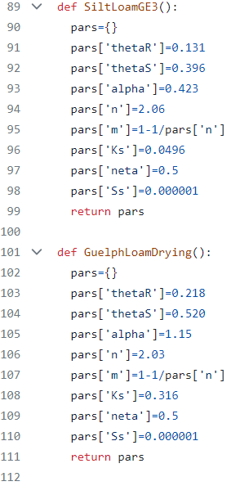
To change the soil type
p=vg.SoilType()

Slide 18
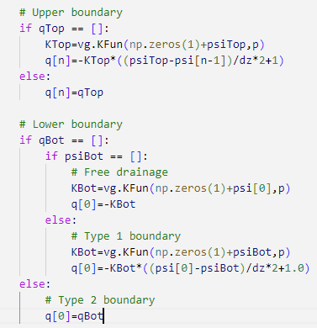
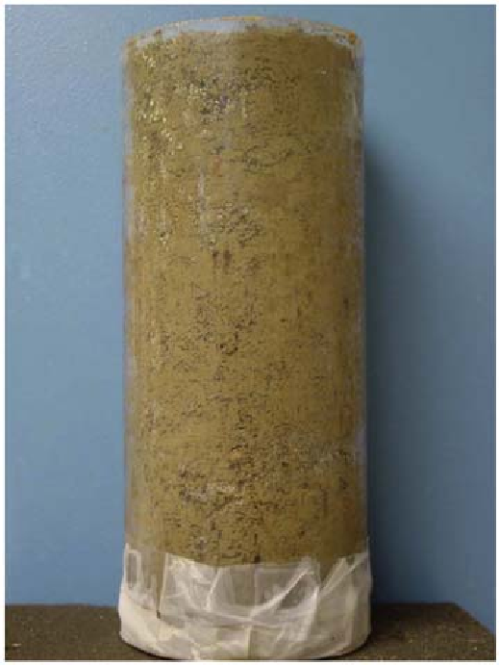
How are upper and lower boundary conditions defined and what they are?
Flow in (Infiltration)
Upper boundary
Lower boundary
Flow out (discharge)

Slide 19
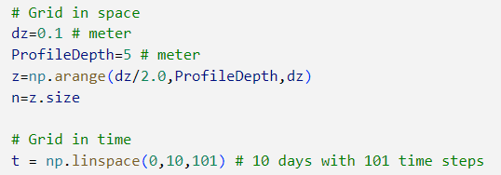
How many levels (z) and time steps?
50
101

Slide 20
Start to run the notebook
The first group to achieve these will get a prize
Get Figure 1, 2, 3 for the soil type vg.GuelphLoamDrying() with simulation period (t) up to 100 days
Correctly explain to me what are the different lines in Fig 2 (vertical profile)
Correctly explain to me, in Fig 3 (temporal profile), when does ‘change in storage’ start to reduce? Why does it become zero at the end?

Slide 21
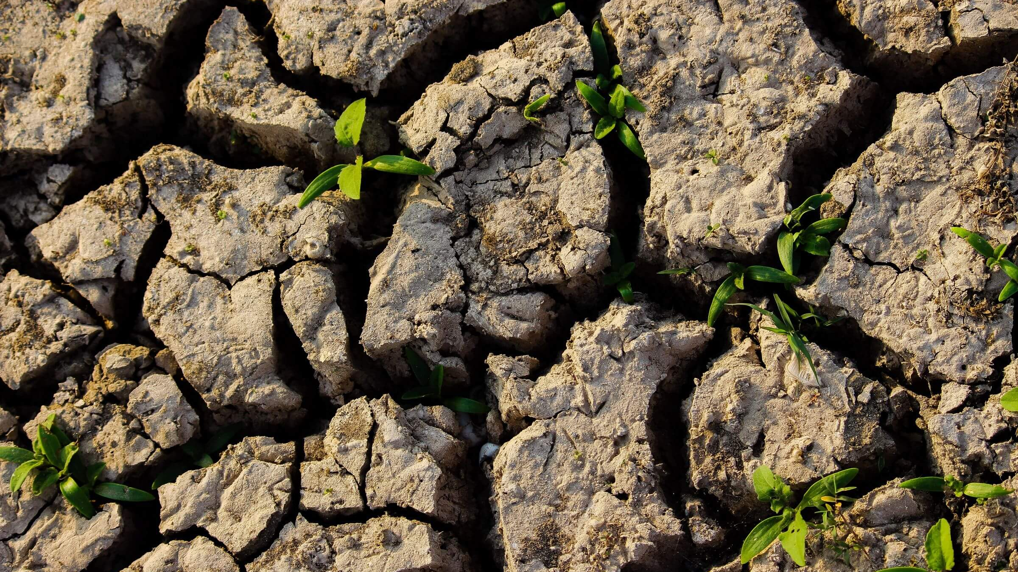
知識是生命的土壤
Science du sol 2025
zhi shi shi sheng ming de tu rang
Knowledge is the soil of life

Slide 22
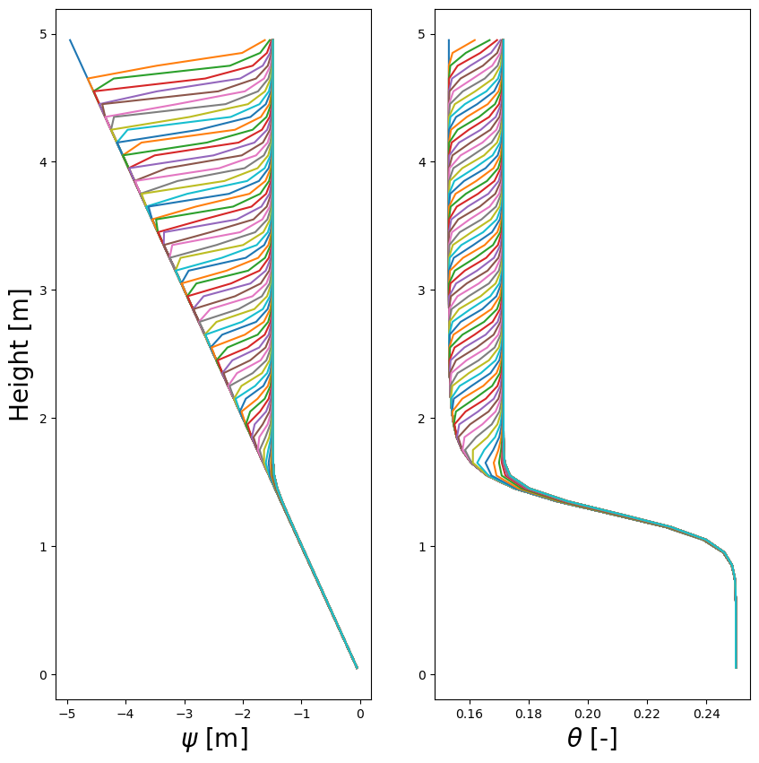
Where is the bottom of the soil?
Which is the curve (t=0)?
Notes:
the top of the soil column 5 meters above the ground is height (elevation)=5

Slide 23
How to adjust the plot?
1.Change frequency to plot a line to, e.g., every 10 timesteps
for i in range(0, t.size, 10):
pl.subplot(121)
pl.plot(psi[i,:],z)
2.Zoom in/out to a certain range
pl.ylim((0,0.02))
pl.xlim((5,10))
3. Change figure size
pl.figure(figsize=(4,5))

Slide 24

Next week: soil data challenge 2025
Bonus points for the assignment
Useful to have all team members present

Slide 25
Appendix

Slide 26
Explaining the code

Slide 27
Import a .py file
1.
import vanGenuchten as vg
Have to type vg. when calling a function or variable from vanGenuchten.py
vg.CFun()
vg.KFun()
Just like what you are already familiar with:
import numpy as np
2.
from vanGenuchten import Cfun, Kfun
from vanGenuchten import *
CFun()
KFun()
No need to type vg.
* means everything

Slide 28
Next week
Time for group work
Questions answering
Tips on report writing

Slide 29
Assignment submission
1.Moodle link opens in December
2. Upload by December x th per group
3.Merge all 3 assignments in one PDF
4.Team members’ names in the report

Slide 30
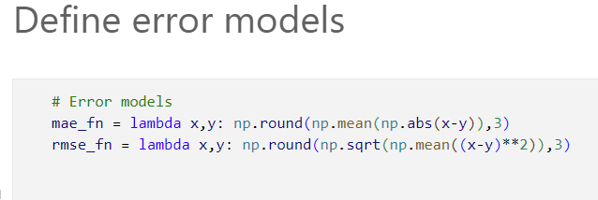
What is the shortcut key for running current cell?
1. Ctrl + Enter
2. Enter
3. Shift + Enter

Slide 31
What is the shortcut key for commenting code?
1. Ctrl + Enter
2. Ctrl + A
3. Ctrl + /

