Slide 1
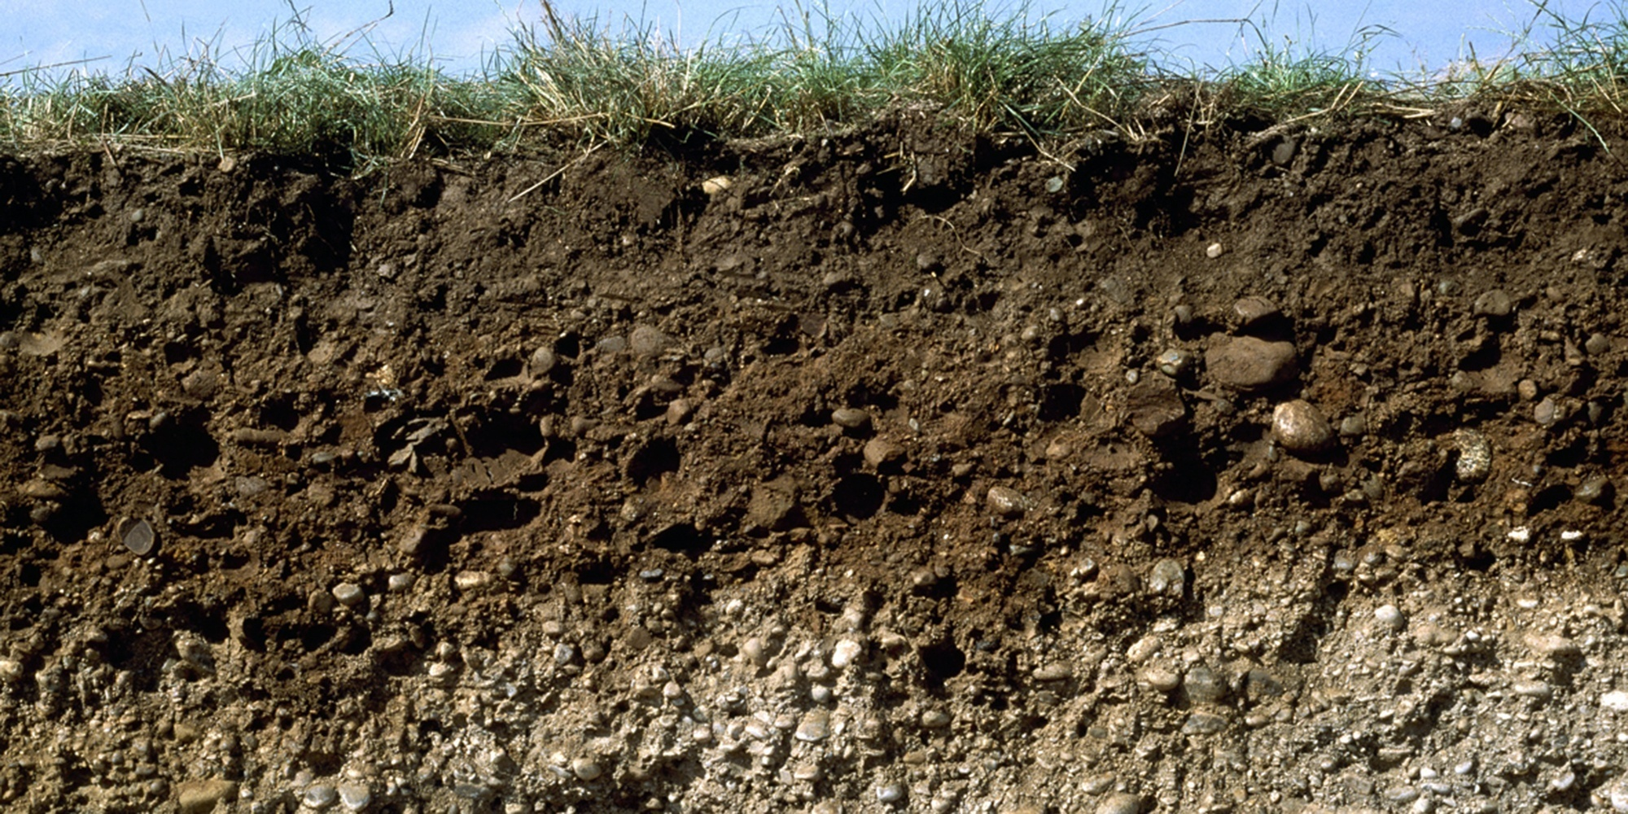
Soil science
Computer lab 2
Guo-Shiuan Lin (Steven)
URBES lab, EPFL

Slide 2
Plants
Soil
Water
Microorganisms
Chemicals

Slide 3
What 2 plot did we make in the last assignment?

Slide 4
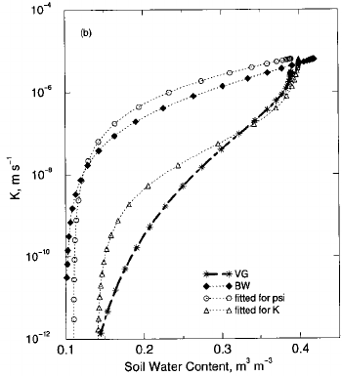
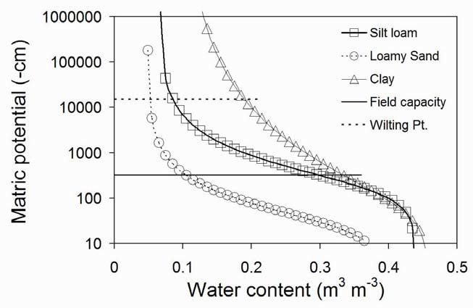
Soil water permeability changes with water content
Hydraulic conductivity increases with water content
Matric potential decreases with water content
Soil water retention curves
Non-linear
Different models exist
Shao et al. On the Choice of Soil Hydraulic Models in Land-Surface Schemes
https://www.researchgate.net/publication/227084293_On_the_Choice_of_Soil_Hydraulic_Models_in_Land-Surface_Schemes
S.Evett
https://www.researchgate.net/publication/286825639_Soil_Water_and_Monitoring_Technology
Notes:
QA: what are the dots, what are the lines?

Slide 5
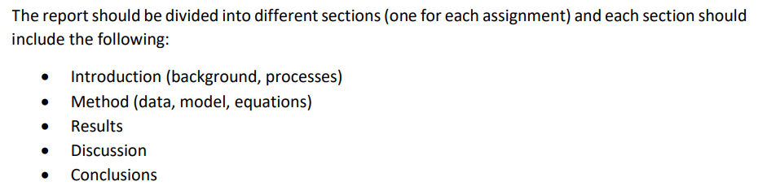
Report format
Figures + description
Compare different soil, why the results are
like this, interesting thing on the plot, limitation
of the model, etc.

Slide 6
Assignment 2: Water Retention curve

Slide 7
- Take a look at the assignment code (without running)
- Google Van Genuchten model
10 mins

Slide 8
It is a relationship between which variables?
1. Water content and tension
2. Hydraulic conductivity and tension
3. Water content and hydraulic conductivity
Notes:
A

Slide 9
How many free parameters in Van Genuchten model?
A. 4
E.g.,
y = ax + b
has 2 free parameters: a, b
B. 5
C. 6

Slide 10

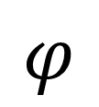
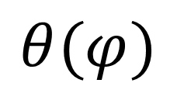
Van Genuchten model
def van_genuchten_model(x,alpha,n,theta_r,theta_s)
Free parameters
$$θ(φ)$$
$$φ$$

Slide 11
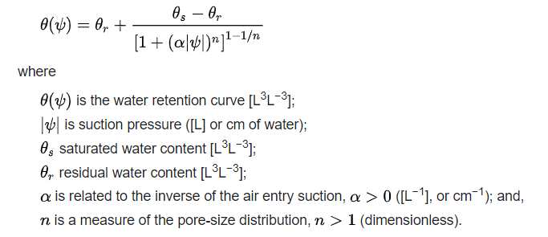
Van Genuchten model

Slide 12
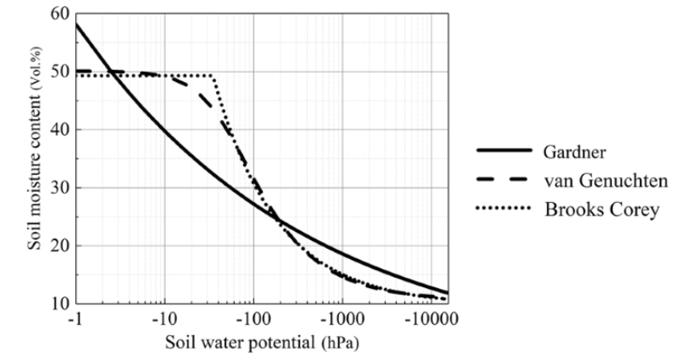
Different models for water retention curve
Pan, T., Hou, S., Liu, Y., & Tan, Q. (2019). Comparison of three models fitting the soil water retention curves in a degraded alpine meadow region. Scientific Reports, 9(1), 18407.

Slide 13
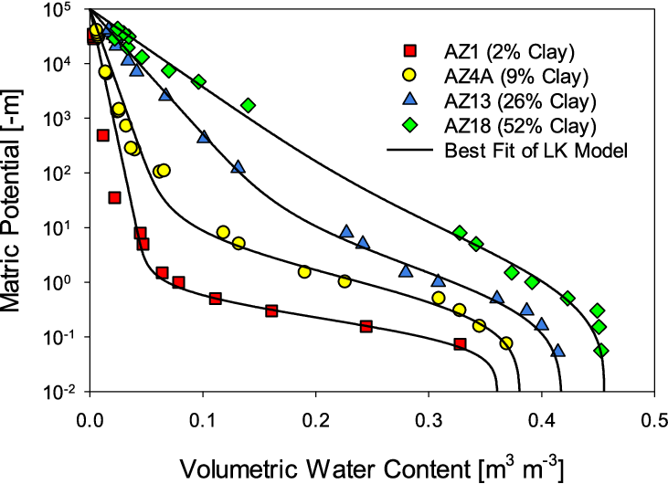
Why do we want to fit model to the measurements?
Apply for future use
Allows prediction
Get continuous functions
Get parameters that summarizes soil behaviour
α → relates to air-entry pressure
n → reflect pore-size distribution
θr, θs → range of soil water storage
Norouzi et al. A Physics-Driven Spectroscopic Approach for Rapid Estimation of the Soil Water Retention Curve
researchgate.net/publication/380214349_A_Physics-Driven_Spectroscopic_Approach_for_Rapid_Estimation_of_the_Soil_Water_Retention_Curve

Slide 14
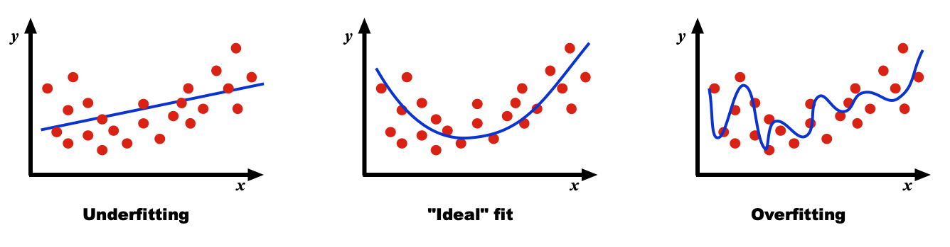
Are more parameters always better?
Source: https://mriquestions.com/data-prep-and-fitting.html
What are the problems?
Notes:
In underfitting, the model has an insufficient number of parameters to fully learn the data. (some parameters or terms that would appear in a correctly specified model are missing). an underfitted model would ignore some important replicable (i.e., conceptually replicable in most other samples) structure in the data and thus fail to identify effects that were actually supported by the data.
In overfitting the model is too complex and contains too many parameters. The computational burden is excessive and even though it fits the sample data with high precision, the model is highly optimized for the particular training data and will not generalize well to other data sets.

Slide 15
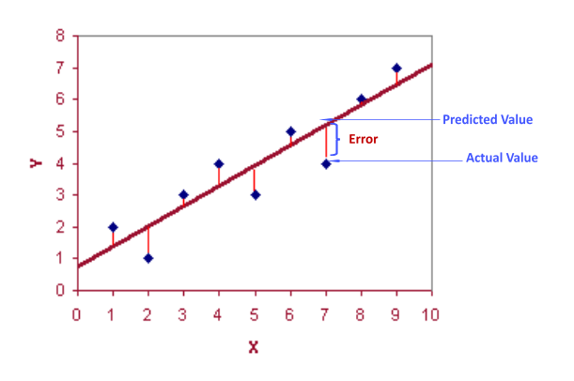
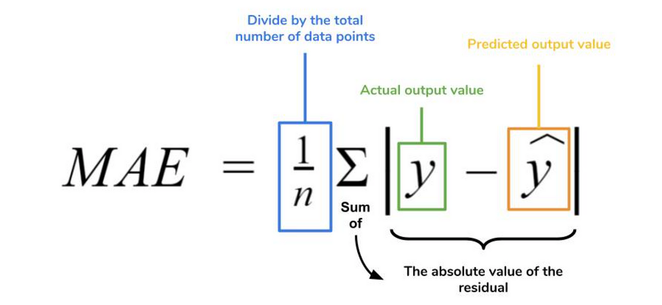
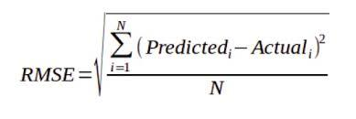
How good is the fitting?
Mean absolute error (MAE)
Root mean squared error (RMSE)

Slide 16
Keep in mind when fitting data
Observe the data I have:
  What do the possible functions look like? Linear/nonlinear?
  What is the theory and process behind the observations?
  Are there outliers in my data?
Applications:
  What purposes will I use the fitted functions for?
  What precision is needed?
  Having the same error, models with fewer parameters is better

Slide 17
Explaining the code

Slide 18
I got the error message: ModuleNotFoundError
When running from scipy.optimize import curve_fit
On the top of the notebook, create another cell, type and run
!pip install scipy
If pip not found, type this line first:
!python3 -m pip install --upgrade pip
After installation, delete the cell
Alternative:
In the terminal (at the bottom of the VS Code)
pip install scipy
If pip not found, type this line first:
python3 -m pip install --upgrade pip

Slide 19
Useful shortcut keys
A
B
DD
Ctrl + /
Ctrl + Enter
Add cell above
Add cell below
Delete the cell
Comment the current/selected lines
Run the current cell
Mac users:
Replace Ctrl with Cmd

Slide 20
1.Download the data
2.Download the code
3.Put in the same folder
4.Run the code: 20 mins
5.First group to make the correct plot with 4 models will get a prize

Slide 21
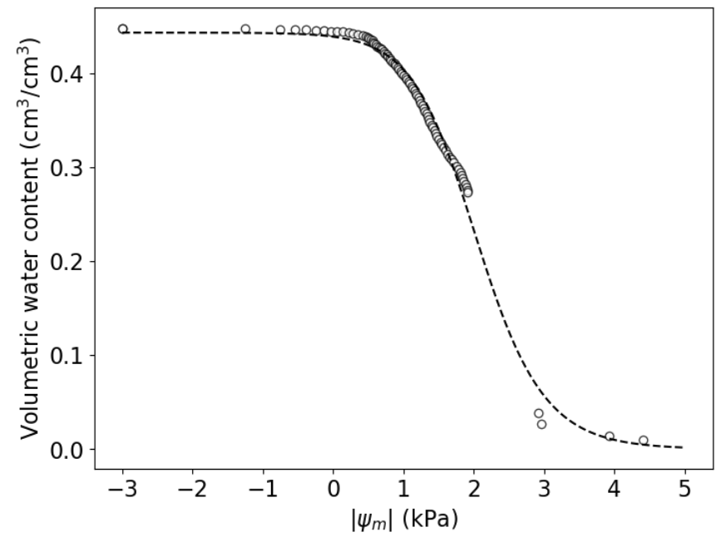
Can you find these values in the figure?
Saturated water content
Porosity
Residual water content

Slide 22
Questions?

Slide 23
Default arguments of a function
Default values are given
# Define my function
def ptf(clay, sand, om=0.02, ec=0, rho=np.nan):
…
return …
# Scerario 1
ptf(clay=0.4, sand=0.4)
ptf(clay=0.4, sand=0.4, om=0.02, ec=0, rho=np.nan)
# Scenario 2
ptf(clay=0.4, sand=0.4, om=0.05, ec=0.02, rho=0.8)
# Scenario 3 (error)
ptf(clay=0.4, sand=0.4, om)
correct
om = 0.08
ptf(clay=0.4, sand=0.4, om)

Slide 24
Appendix

Slide 25
Correct soil type 3
20% clay, 60% sand, 0.5% organic matter

Slide 26
As matric potential increases, water content in soil …
1. Reduce
2. Increase
3. Depends

Slide 27
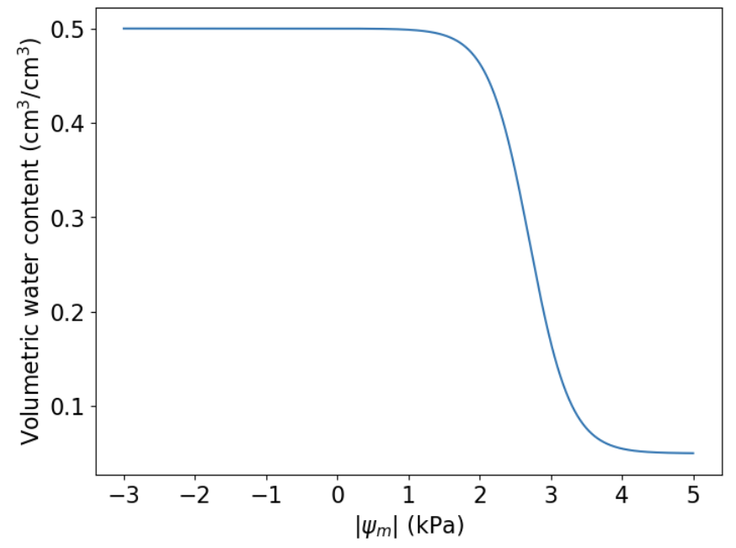

Slide 28
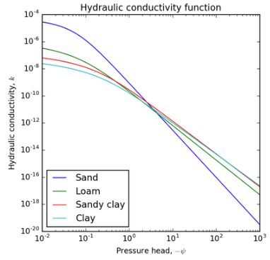
Plotting hydraulic conductivity (K) against pressure head (psi)
K_theta
Just an example
NOT the answer
Plt.xscale(‘log’)
Plt.yscale(‘log’)

