Slide 1
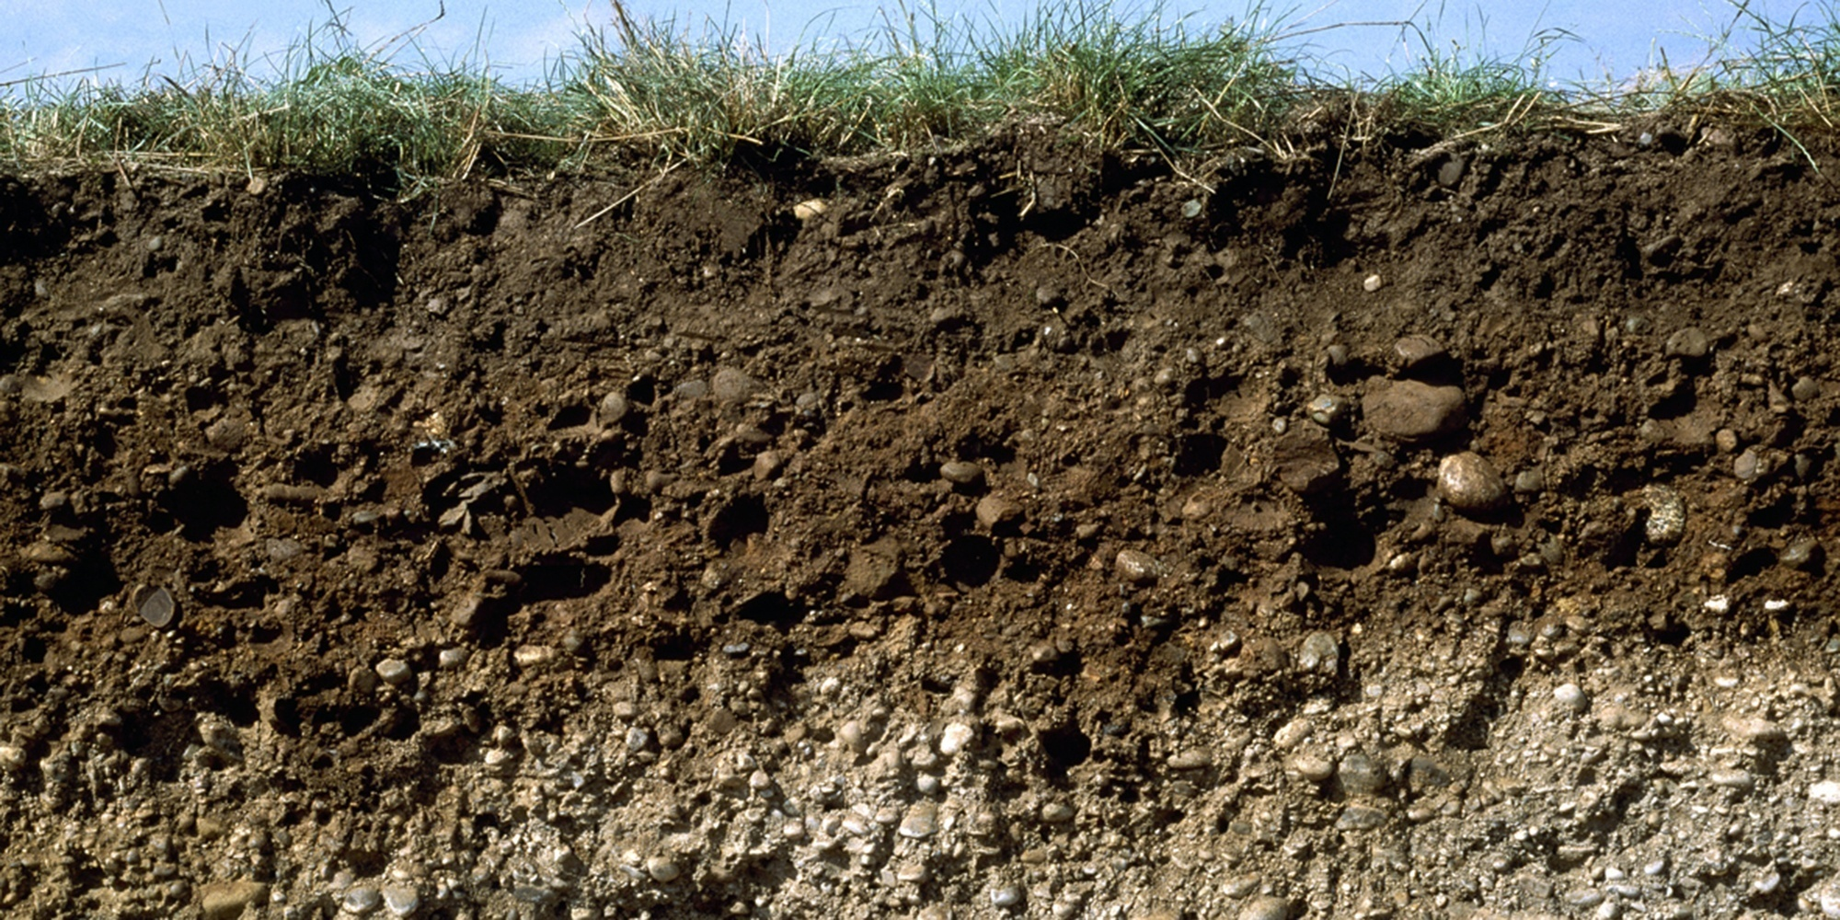

Soil science
Computer lab 1
Guo-Shiuan Lin (Steven)
URBES lab, EPFL

Slide 2
Plants
Soil
Water
Microorganisms
Chemicals

Slide 3
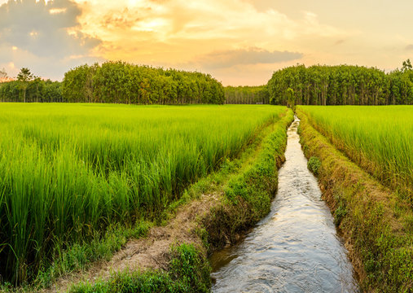
Support growth of plants
Support life in the soil
Transport of nutrients
Regulate soil temperature
Like blood to human body

Slide 4
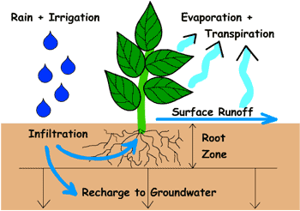
The relationship between soil and water
Today’s exercise:
How water
enters soil,
fills up the pores,
transports in the soil, and
exits out the soil
Permeability or Hydraulic Conductivity (K):
Ability of a soil to allow water to pass through it
Units: Length/Time
Water retention curve
https://www2.hawaii.edu/~dennis/GeoBook/chapter_7/balance.htm

Slide 5
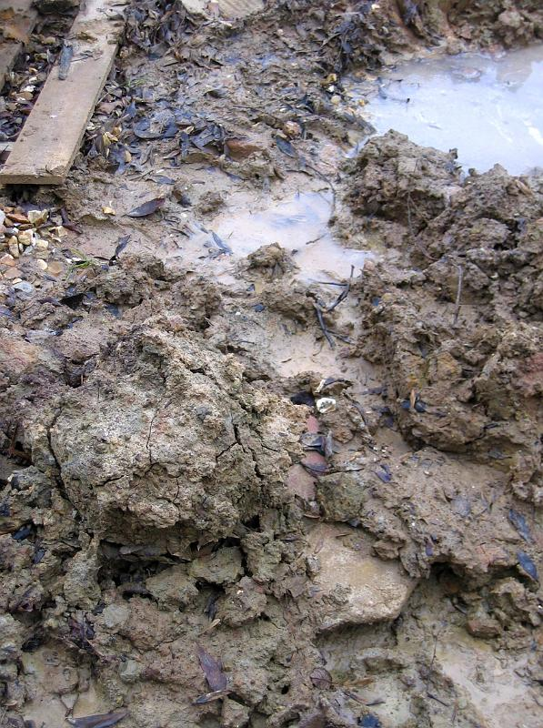

Water permeability depends on: soil types
Clay
Sand

Slide 6
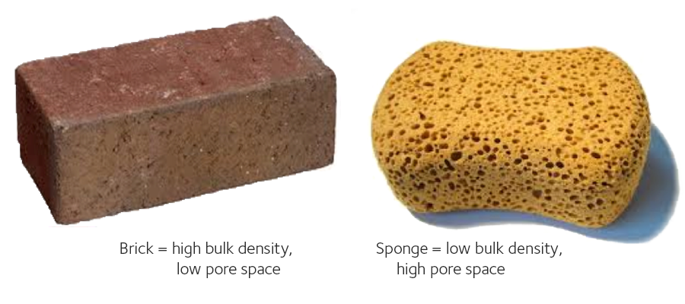
Water permeability depends on: porosity
1

Slide 7
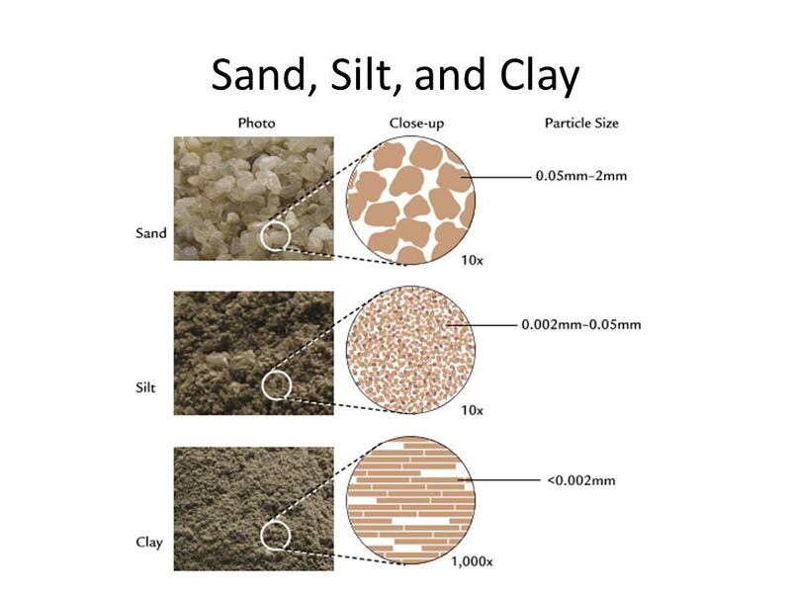
Water permeability depends on: connectivity of pores
link.springer.com/chapter/10.1007/978-981-19-2775-1_20

Slide 8
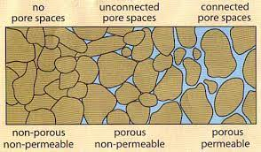
https://soil.evs.buffalo.edu/index.php/Porosity

Slide 9
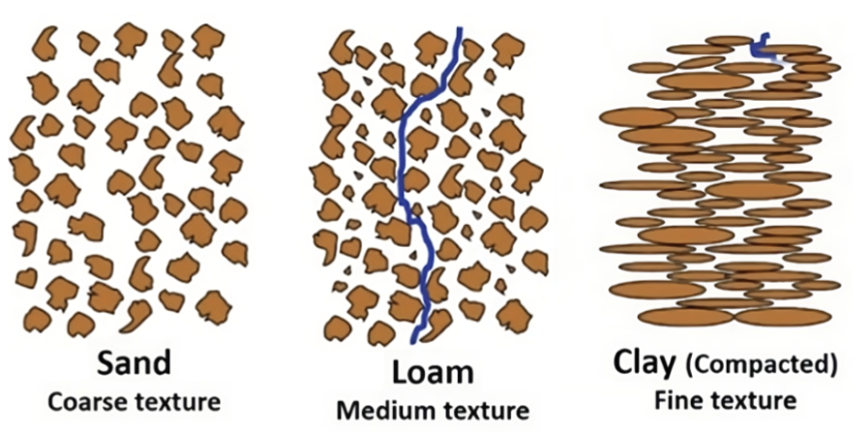
https://octopus-training.solidarites.org/topics/4-3-what-soil-is-suitable-for-infiltration-and-what-factors-influence-the-soil/

Slide 10
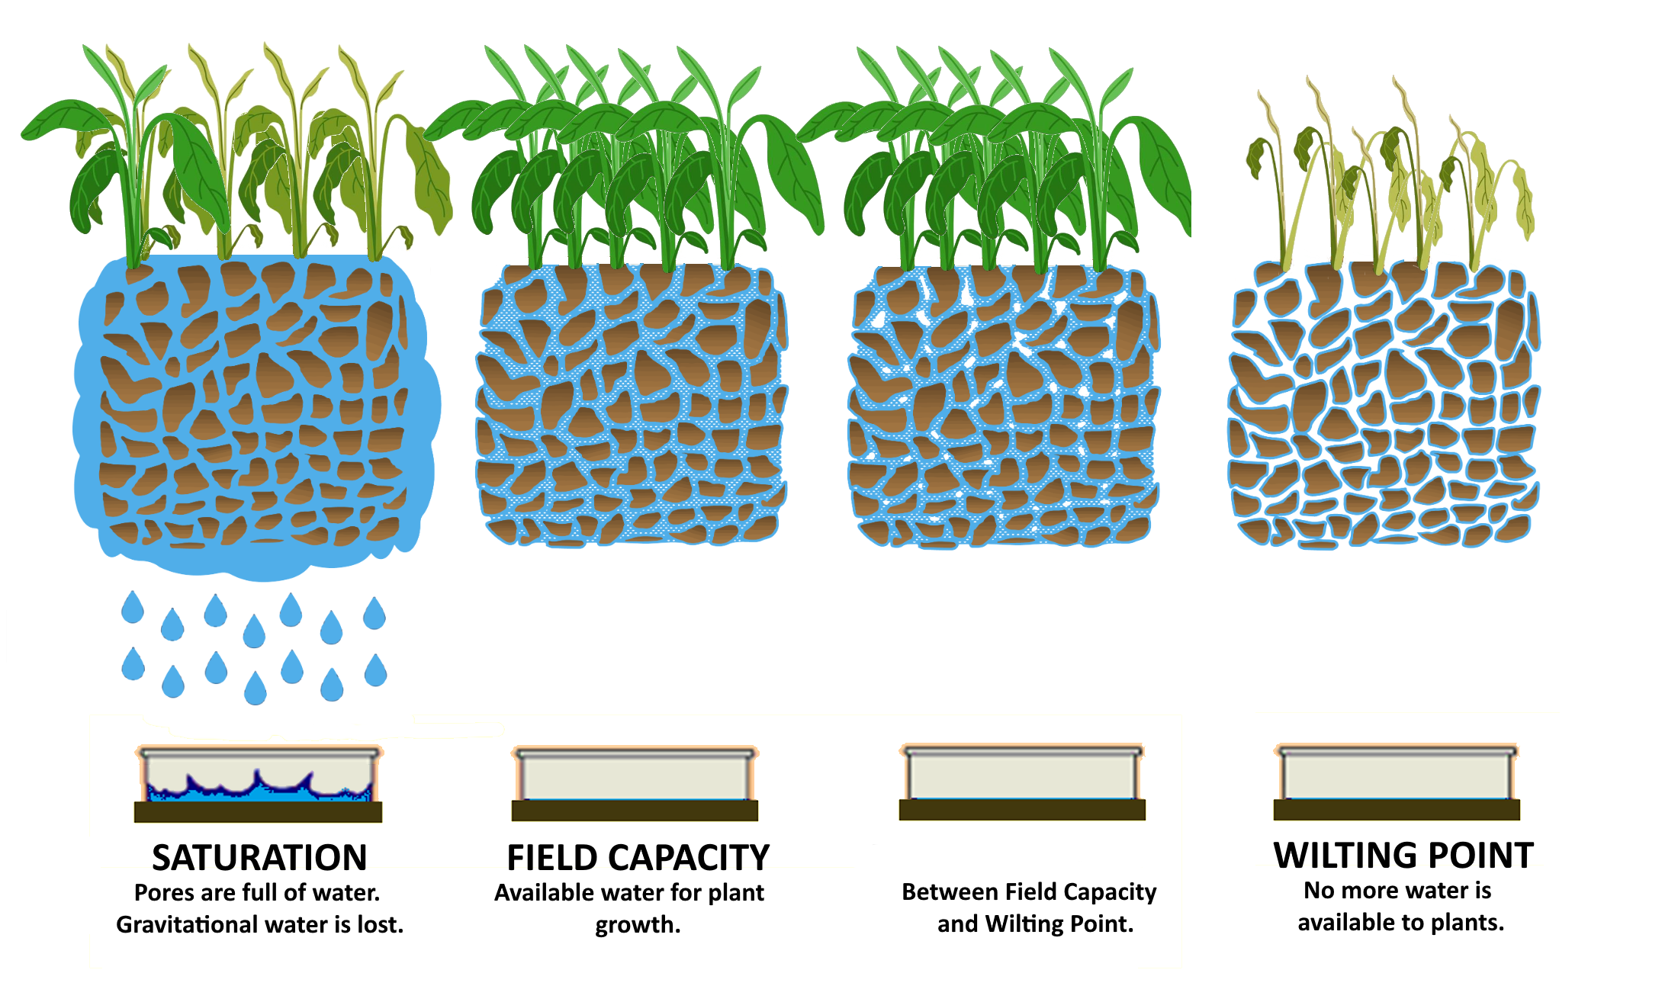
Water permeability depends on: how much water is already in the soil
Why is it easy for water to pass down?
https://connectedcrops.ca/the-ultimate-guide-to-soil-moisture/

Slide 11
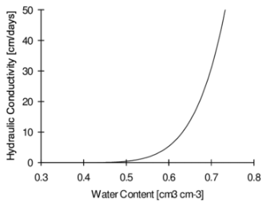
Hydraulic conductivity depends on soil water content
More saturated soil has higher conductivity
Pores are connected by water. Imagine like bridges
F.A.L. Soares et al. https://www.researchgate.net/publication/301377381_HYDRAULIC_CONDUCTIVITY_AND_WATER_CONTENT_OF_AN_OXISOL_CULTIVATED_WITH_SUGARCANE_UNDER_DIFFERENT_WATER_REPLACEMENTS
Notes:
At saturation, all soil pores are filled with water, and the hydraulic conductivity is at its maximum. This is known as saturated hydraulic conductivity (
$$K_{sat}$$
𝐾𝑠𝑎𝑡
)

Slide 12
Water permeability depends on: how much water is already in the soil
Why is it difficult for water to pass down or for plants to uptake?

Slide 13
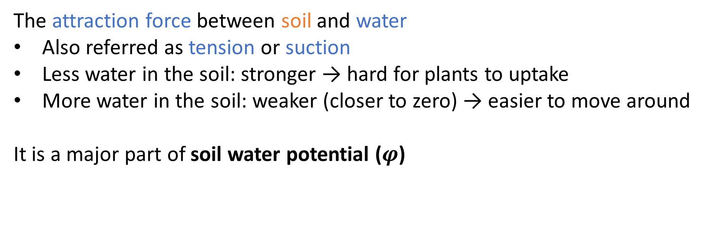
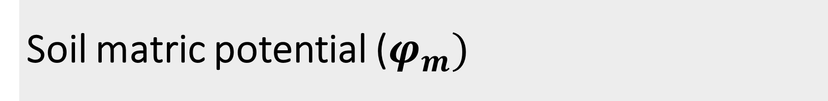
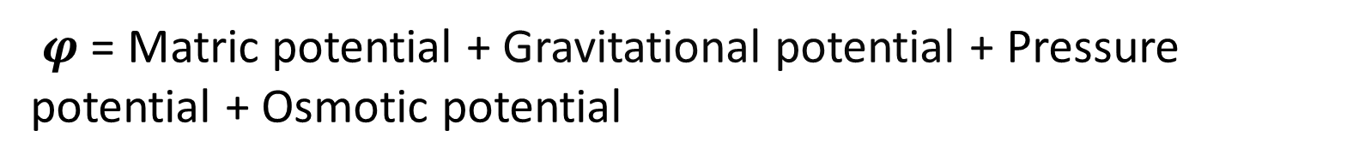
Soil matric potential ($φ_{m})$
The attraction force between soil and water
Also referred as tension or suction
Less water in the soil: stronger → hard for plants to uptake
More water in the soil: weaker (closer to zero) → easier to move around
It is a major part of soil water potential ($φ$)
$φ$= Matric potential + Gravitational potential + Pressure potential + Osmotic potential

Slide 14
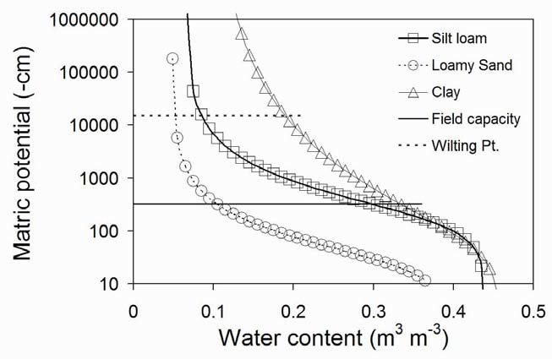
Matric potential depends on water content
Much stronger at low water content!
S.Evett
https://www.researchgate.net/publication/286825639_Soil_Water_and_Monitoring_Technology

Slide 15
Assignment 1: Pedotransfer functions

Slide 16
Form teams of 3 for the assignments

Slide 17
Read the paper: 15 mins
Focus on the first 3 pages, especially
Abstract
Table 1 and 2
Methodology

Slide 18
Recap of last week

Slide 19
What is the correct equation for bulk density of soil?
A. Soil mass / Soil Volume
B. Soil dry mass / Soil Volume
C. Soil mass / soil dry volume
Notes:
B

Slide 20
What is the common unit for volumetric water content?
A. g/ L
B. cm3/ cm3
C. kg/ m3
Notes:
B

Slide 21
What are Pedotransfer functions?

Slide 22
Separate the properties that are easier and those that are harder to measure
Hydraulic conductivity
Bulk density
Density
Air-entry pressure
Field capacity
Soil texture
Volume fraction of gravel
Weight fraction of gravel

Slide 23
Separate the properties that are easier and those that are harder to measure
Hydraulic conductivity
Harder to measure
Bulk density
Density
Air-entry pressure
Field capacity
Soil texture
Volume fraction of gravel
Weight fraction of gravel

Slide 24

What does $θ_{s}$ commonly represent?
A. Water content
B. Saturated water content
C. Permanent wilting point
Notes:
B

Slide 25
How many of the following can adjust soil retention curve?
A. Gravel content
B. Salinity
C. Density
D. Organic matter
Notes:
All

Slide 26
Download and run the code : 10 mins
Take a look at the main structure
Run the code
Start the assignment when done

Slide 27
Testing different soil types
# Define my function
def ptf(clay, sand, om=0.02, ec=0, rho=np.nan):
…
return …
# Soil type 1
clay=0.4, sand=0.4
ptf(clay, sand)
ptf(clay=clay, sand=sand)
ptf(clay=0.4, sand=0.4)
ptf(0.4, 0.4)
# Soil type 2
clay=0.35, sand=0.35
ptf(clay, sand)

Slide 28
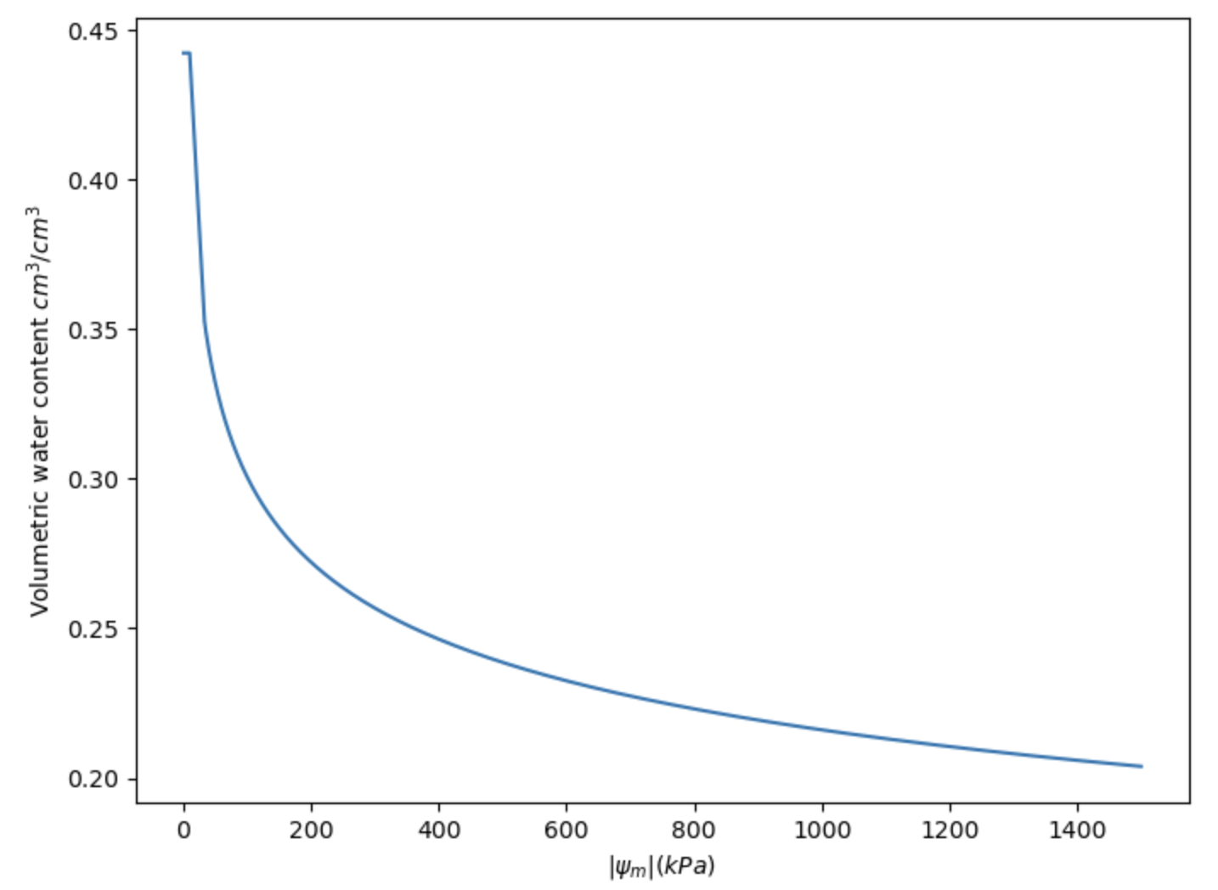
Can the figures be improved?

Slide 29
Appendix

Slide 30
If radius of tube becomes larger, capillary rise becomes
A. Smaller
B. Larger
C. Unchanged

Slide 31
If liquid density becomes larger, capillary rise becomes
A. Smaller
B. Larger
C. Unchanged

Slide 32
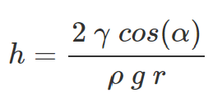

Slide 33
I got the error message: ModuleNotFoundError
When running import matplotlib.pyplot as plt
What does it mean?
A. The code is wrong
B. Matplotlib is not installed properly
C. I will try it another day

Slide 34
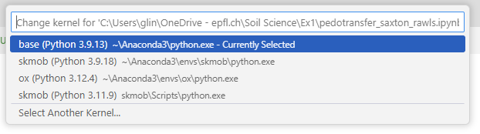


Select the right environment
Different environments are like different toolboxes

