Slide 1
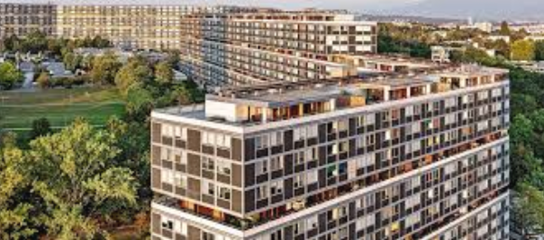
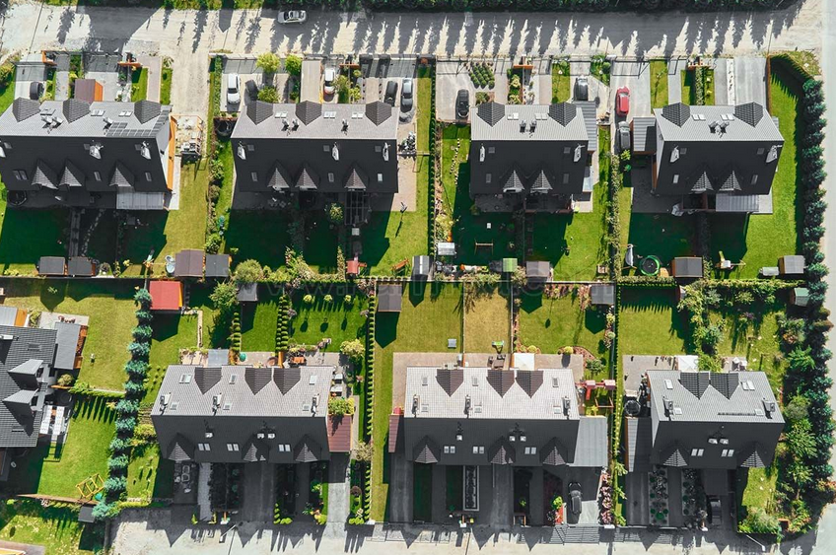
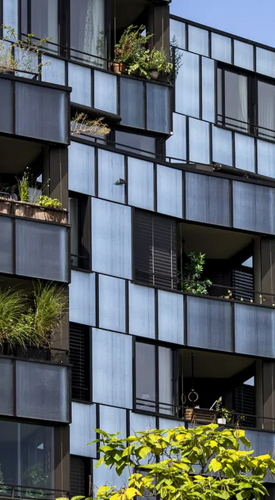
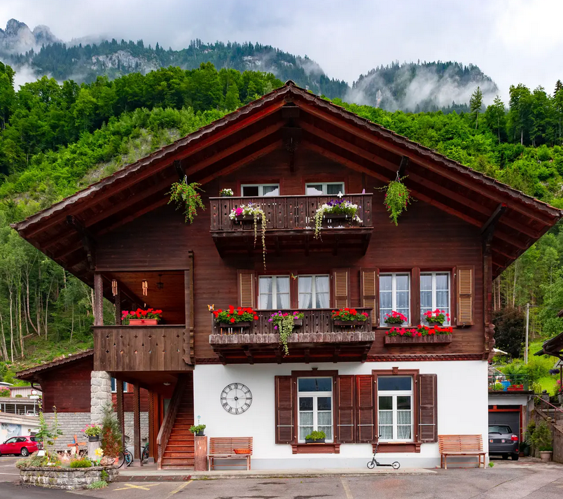
Systems perspectives on transforming Swiss housing by 2040: wellbeing, shared spaces, sufficiency, and de-sprawl
Sascha Nick et al.
Kamila & Laure
September 29, 2025

Slide 2








The challenges today
Swiss human habitat: buildings, open spaces between buildings and daily mobility
Every single one of these issues is a sustainability issue, affecting both current and future generations’ ability to meet their needs
High use of materials and Low circularity rate (6.9%)
High mobility
accidents
30% of Swiss energy use, 17% of GHGs (of total Swiss energy)
air pollution
noise
Urban sprawl accelerating
travel time
Ecological habitat degradation
Habitant related issues
Wellbeing outcomes are mixed
Systems perspectives on transforming Swiss housing by 2040: wellbeing, shared spaces, sufficiency, and de-sprawl

Slide 3

Systems thinking
Different perspective on the public good
Cities
Communes
CO₂ emission
Climate plans
Housing shortage
Low vacancies
Rising rental prices
Builders
General population
Investors
Farmers
Companies
urban sprawl
car dependency
increasing floor space per capita, wellbeing
needs and satisfiers
Sufficiency
use of public, private, or shared spaces
Nature protection groups
Students
Workers
Scientists
Systems perspectives on transforming Swiss housing by 2040: wellbeing, shared spaces, sufficiency, and de-sprawl

Slide 4

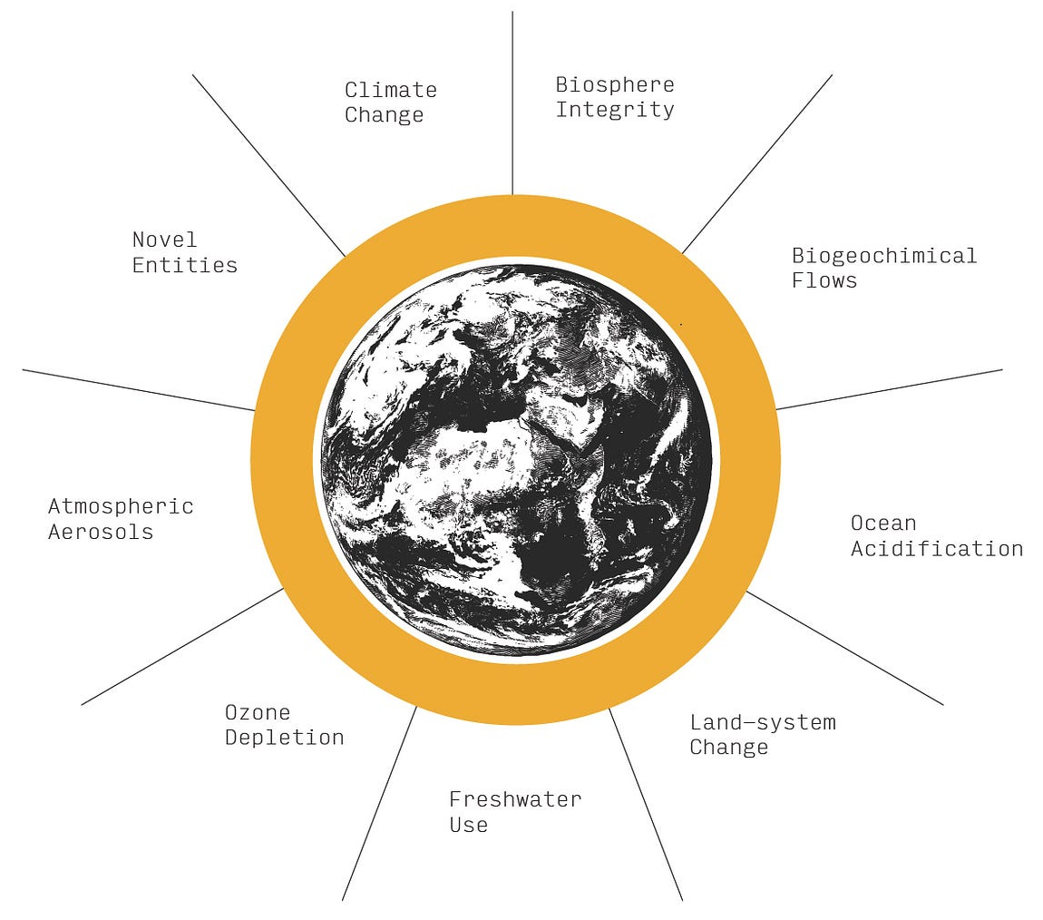

Wellbeing & respecting planetary boundaries
What is the link between housing resource use and resulting wellbeing?
What are the current dynamics?
What would be the resource impact, in terms of labor, building stocks, and energy, of transforming Swiss housing?
What is the potential to reverse urban sprawl?
Systems perspectives on transforming Swiss housing by 2040: wellbeing, shared spaces, sufficiency, and de-sprawl

Slide 5
Core proposal
Designing a system intervention to solve all major housing issues
Nationwide moratorium on new construction until 2100.
The climate and biodiversity emergency - one decade
climate neutrality and wide-area ecosystem restoration - two decades.
Limitation factor
Focus on renovation
Limit on total building space
Reduced urban sprawl
This moratorium is complemented by additional policies to ensure coordination, renovation quality, de-sprawl and material reuse, availability of essential services, and support for people during the transition.
Low risk intervention
Systems perspectives on transforming Swiss housing by 2040: wellbeing, shared spaces, sufficiency, and de-sprawl

Slide 6
Four interventions
Designing a system intervention to solve all major housing issues
Renovate to class A efficiency
Complete renovation to highest efficiency standards of the whole Swiss habitat in <20 years
Create shared spaces
Build a new culture of sharing spaces
Usage of materials
Reduce the need for new materials, extraction, embodied energy, reuse materials available from the deconstruction of existing urban sprawl
Positive feedback loop of de-sprawl
Available skilled labor, culture of sharing, and widespread reuse of materials reinforce each other, and accelerate the deconstruction of car dependency, based or reversing the process described above.
Systems perspectives on transforming Swiss housing by 2040: wellbeing, shared spaces, sufficiency, and de-sprawl

Slide 7
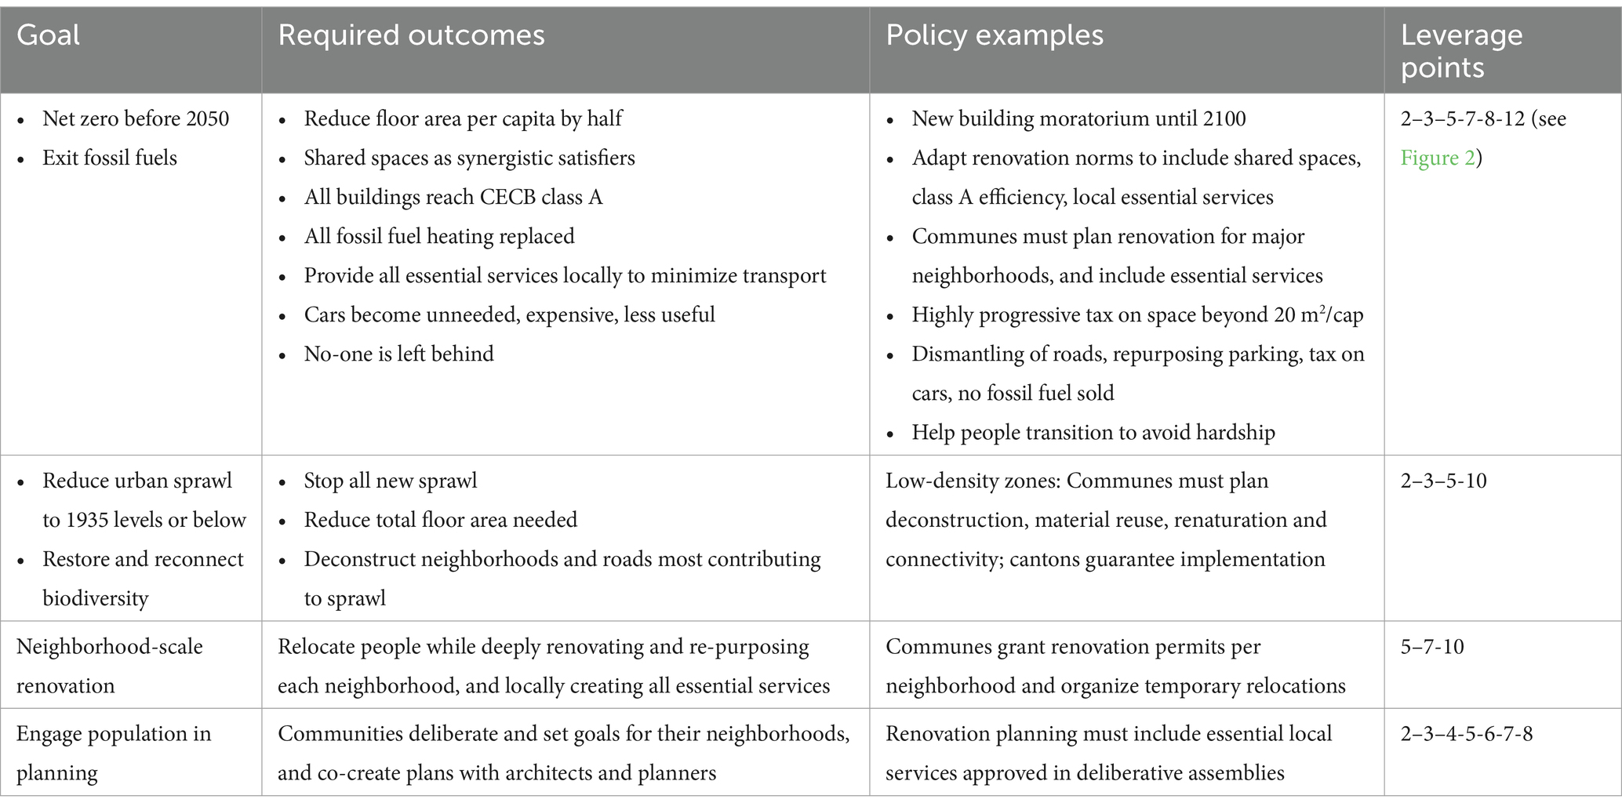
Four interventions
Designing a system intervention to solve all major housing issues
Systems perspectives on transforming Swiss housing by 2040: wellbeing, shared spaces, sufficiency, and de-sprawl
The actual implementation would require several additional policies and measures beyond the moratorium, with an illustrative overview in

Slide 8






Low vacancy rates
Workforce
Long-term population growth
Methods & Model Constraints
A stock-flow simulation model from 2025 to 2100
INPUT
MODEL
OUTPUT
Assumes
Renovation productivity improves when done at scale
Calculates
floor space per capita
Energy demand
Potential to reduce sprawl
Stock-flow simulation
Keep track of
Changes/year
Systems perspectives on transforming Swiss housing by 2040: wellbeing, shared spaces, sufficiency, and de-sprawl

Slide 9
Methods & Model Constraints
A stock-flow simulation model from 2025 to 2100
Reinforce each other
Changes = faster & more resilient
MODEL
LEVERAGE POINTS
System rules
New building moratorium until 2100 changes the “rules of the game.”
Stops new construction and redirects.
Stock-flow simulation
System goals
Reorienting housing toward wellbeing within planetary boundaries rather
than maximizing growth.
System structure
Communities set neighborhood governance rules, shifting who has power.
Feedback loops
Breaking car-dependency and urban sprawl while creating reinforcing loops of
renovation, sharing, and reuse.
Material flows
Renovation, reuse of materials, and limits on per capita space (35 m²).
Systems perspectives on transforming Swiss housing by 2040: wellbeing, shared spaces, sufficiency, and de-sprawl

Slide 10
Results
Full renovation possible in 14-18years
Per capita space stabilizes at 35m² (down from 76m²)
Energy use decreased to 82% by 2039
Urban sprawl reversible to 1935 or even 1885 levels
Deconstruction 20-30% of current floor space no longer needed
Systems perspectives on transforming Swiss housing by 2040: wellbeing, shared spaces, sufficiency, and de-sprawl

Slide 11
Results
Full renovation possible in 14-18years
Existing workforce
Proven technologies
Per capita space stabilizes at 35m² (down from 76m²)
Demand-side focus
Sufficiency + sharing
Energy use decreased to 82% by 2039
Builds resilience
Energy, mobility, ecosystems
Urban sprawl reversible to 1935 or even 1885 levels
Cultural redefinition
From growth to sufficiency
Deconstruction 20-30% of current floor space no longer needed
Systems perspectives on transforming Swiss housing by 2040: wellbeing, shared spaces, sufficiency, and de-sprawl

Slide 12





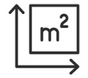

Policy examples
Needed to make this happen.
Equity & sufficiency
Mobility shift
Governance & Trust
Supply resilience
Systems perspectives on transforming Swiss housing by 2040: wellbeing, shared spaces, sufficiency, and de-sprawl

Slide 13


Conclusion
Demand-side sufficiency = wellbeing + climate action
Technically & Economically feasible
With technology and workforces of today
Low risk transformation
Reduces the risk instead of increasing it.
High resilience transformation
Moves our culture from endless growth to sufficiency and wellbeing with planetary boundaries.
Systems perspectives on transforming Swiss housing by 2040: wellbeing, shared spaces, sufficiency, and de-sprawl

Slide 14
Thank you for
your attention
Systems perspectives on transforming Swiss housing by 2040: wellbeing, shared spaces, sufficiency, and de-sprawl

Slide 15
Discussion
How to manage relocation during renovations?
Systems perspectives on transforming Swiss housing by 2040: wellbeing, shared spaces, sufficiency, and de-sprawl

Slide 16
Discussion
Could this approach transfer to other countries?
Systems perspectives on transforming Swiss housing by 2040: wellbeing, shared spaces, sufficiency, and de-sprawl

Slide 17
Discussion
Can shared spaces really improve wellbeing in Swiss culture?
Systems perspectives on transforming Swiss housing by 2040: wellbeing, shared spaces, sufficiency, and de-sprawl

Slide 18
Discussion
Social & Political feasibility of building moratorium?
Systems perspectives on transforming Swiss housing by 2040: wellbeing, shared spaces, sufficiency, and de-sprawl

