Slide 1

Introduction to
Data Science

Slide 2
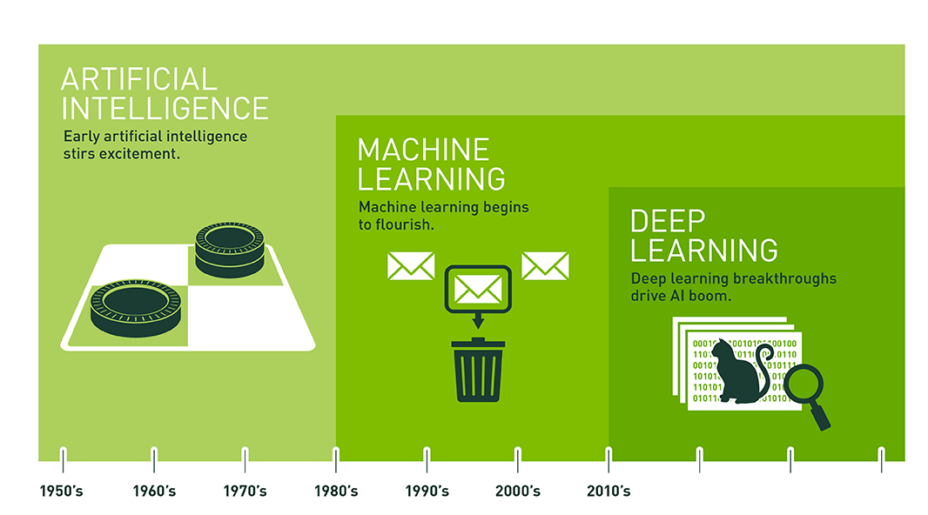
A glimpse of history
www.nvidia.com

Slide 3
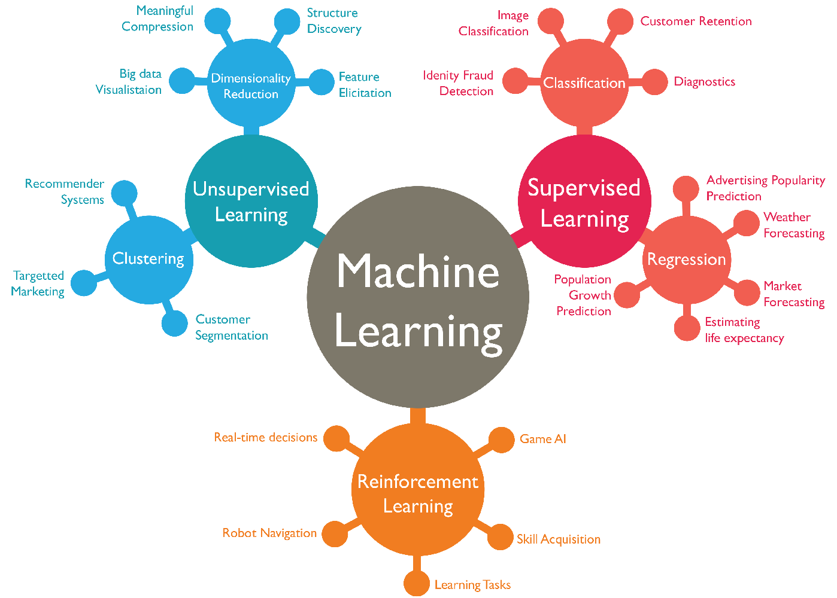
Types of learning
Notes:
Supervised learning: The computer is presented with example inputs and their desired outputs, given by a "teacher", and the goal is to learn a general rule that maps inputs to outputs.
Unsupervised learning: No labels are given to the learning algorithm, leaving it on its own to find structure in its input. Unsupervised learning can be a goal in itself (discovering hidden patterns in data) or a means towards an end (feature learning).
Reinforcement learning: A computer program interacts with a dynamic environment in which it must perform a certain goal (such as driving a vehicle or playing a game against an opponent). As it navigates its problem space, the program is provided feedback that's analogous to rewards, which it tries to maximize.^{[3]}

Slide 4

Supervised learning
Cat
Notes:
Supervised learning is the machine learning task of learning a function that maps an input to an output based on example input-output pairs. It infers a function from labeled training data consisting of a set of training examples.

Slide 5
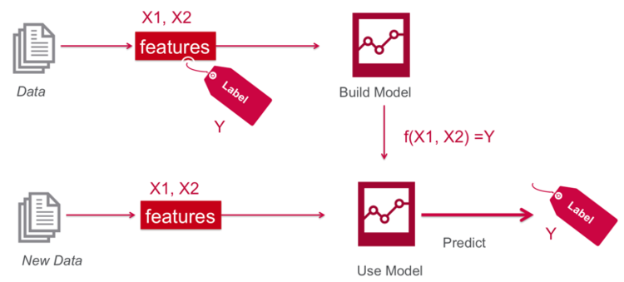
Supervised learning
Notes:
Supervised learning is the machine learning task of learning a function that maps an input to an output based on example input-output pairs. It infers a function from labeled training data consisting of a set of training examples.

Slide 6
Supervised learning
Notes:
Supervised learning is the machine learning task of learning a function that maps an input to an output based on example input-output pairs. It infers a function from labeled training data consisting of a set of training examples.

Slide 7
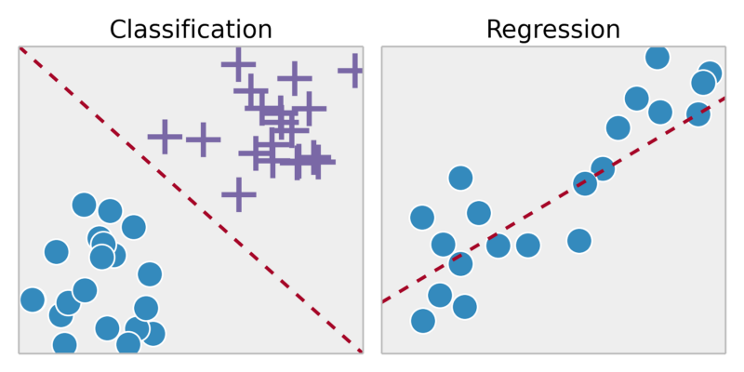
Classification vs Regression
Classification: predicting a discrete class label (categorical) output for an example
Regression: predicting a continuous variable output for an example
X₂
Y
Y₁
Y₂
X₁
X₁
Notes:
How high can a human jump?
Classification: X1: height, X2: speed. Y: Categorical; e.g. Y1: High. Y2: Low
Regression: X1: height, Y: actual jump height (continuous)
Note: Converted regression problem into two-class (binary) classification

Slide 8
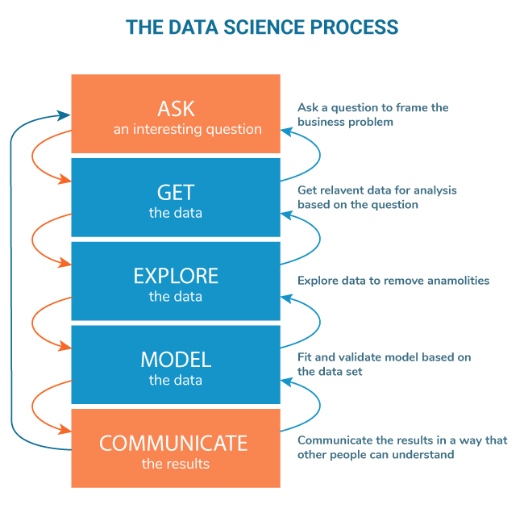
Machine Learning Process

Slide 9
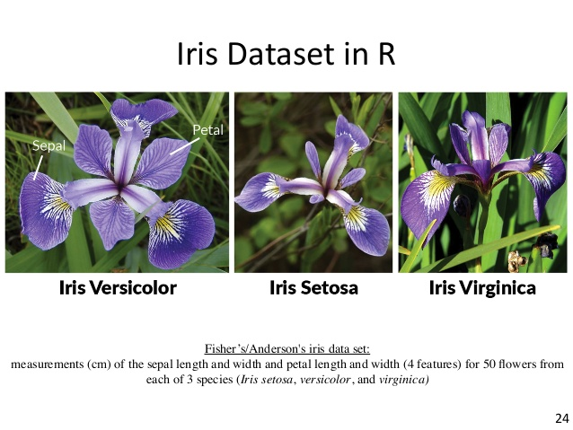

Ask, Get and Explore
Hands-on example
UCI Machine Learning Repository
Notes:
Width -> 0.8
Width -> 1.75
Length -> 4.95

Slide 10
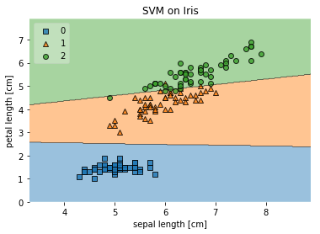
Back to our Iris dataset (UCI)
Linear Support Vector Machines

Slide 11
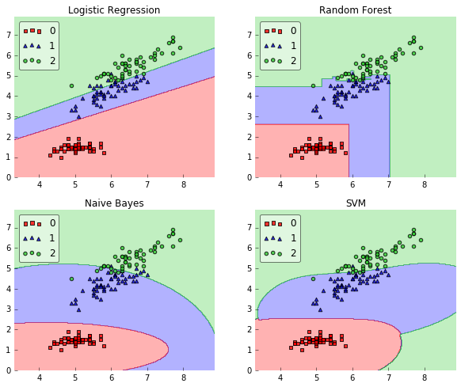
Back to our Iris dataset (UCI)
Other common classifiers
Logistic regression Deeper decision tree
Naïve Bayes Kernel SVM

Slide 12
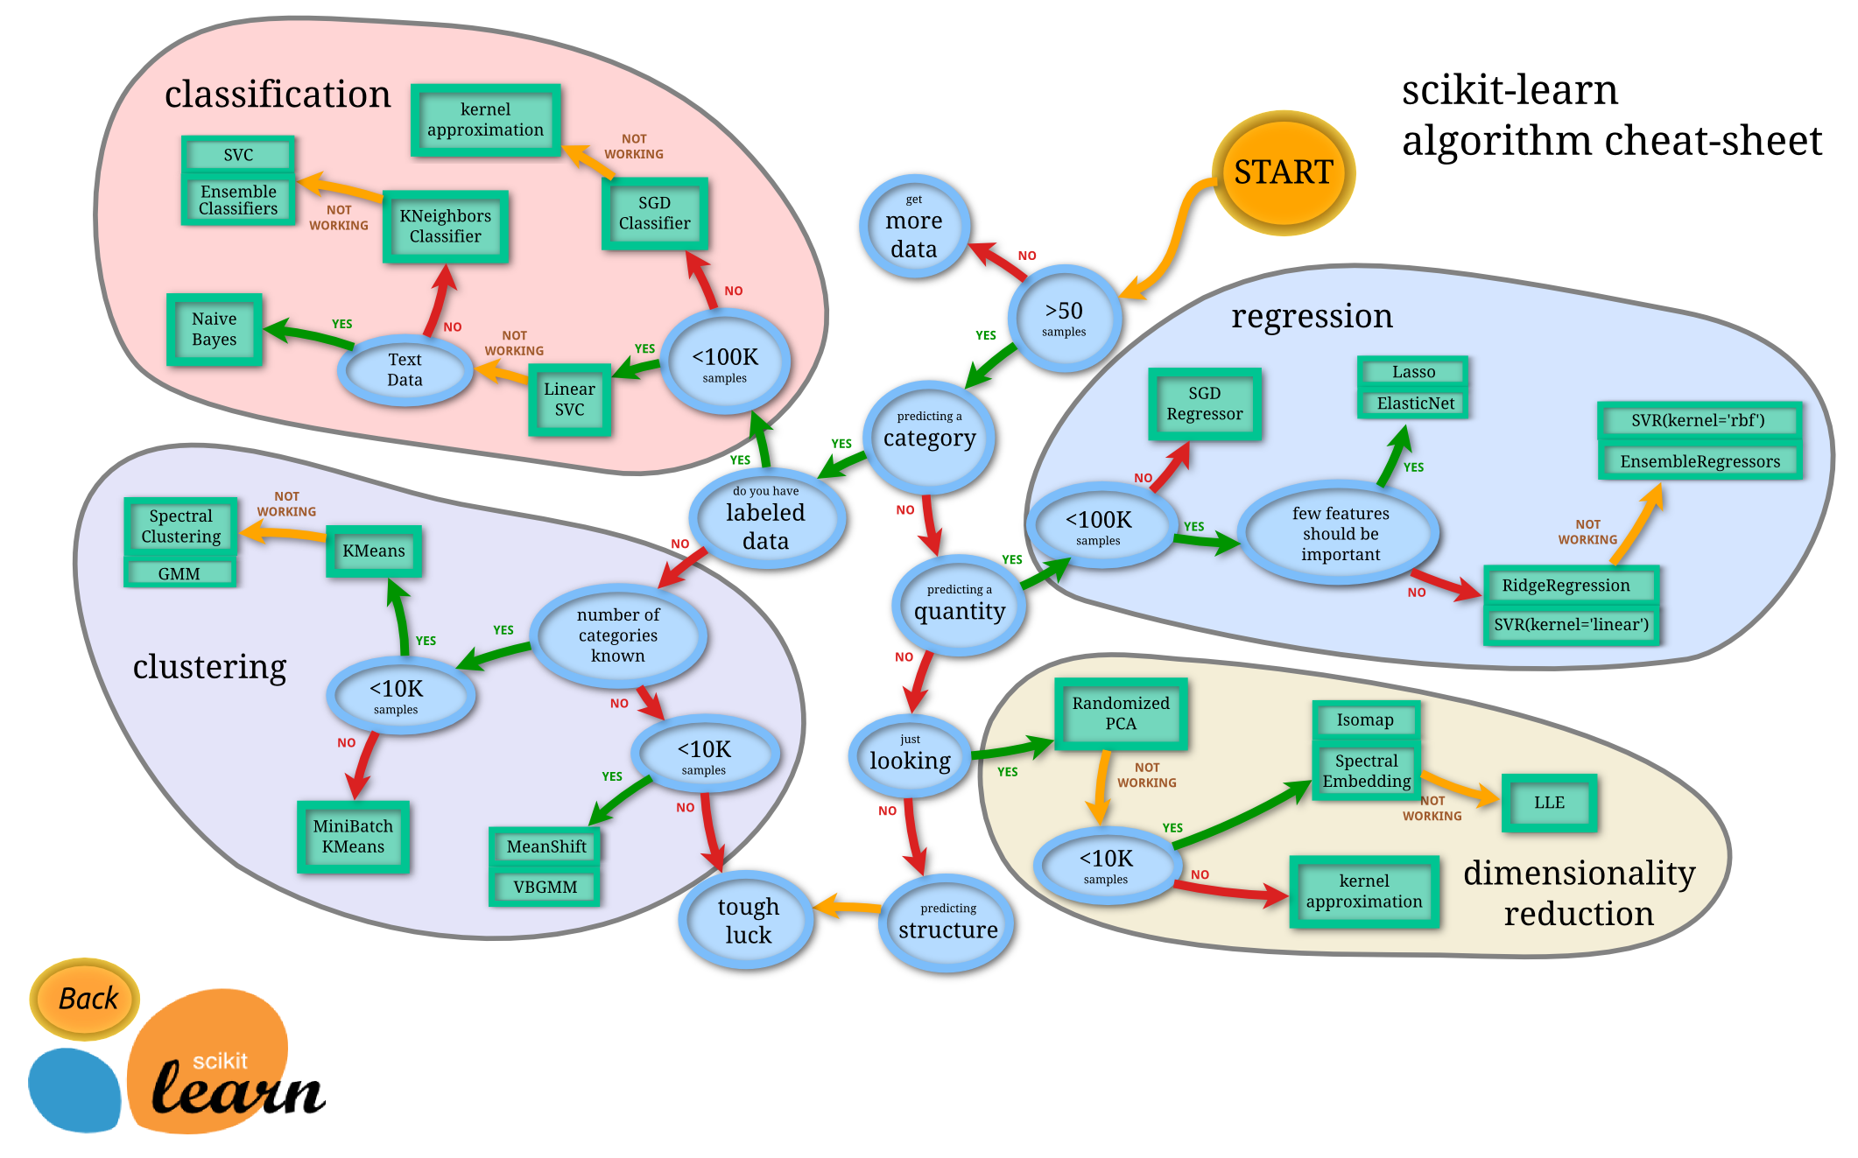
Choosing the right model

Slide 13
QUESTIONS?

