Slide 1
Neural TTS Overview

Slide 2
TTS Overview

Slide 3
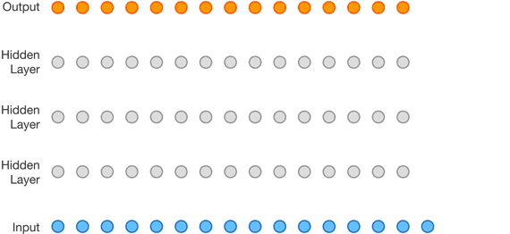

Towards Neural TTS: WaveNet
  Introduced by DeepMind in 2016
  Replaces the Acoustic Model and Vocoder
  Still needs to be connected to an independent, pre-trained Linguistic Model/Text Encoder
  —> Not End-to-End
  Set a new standard for speech synthesis
  However, it was slow due to its auto-regressive, sample-level generation
Oord, Aaron van den, et al. "Wavenet: A generative model for raw audio." arXiv preprint arXiv:1609.03499 (2016).

Slide 4
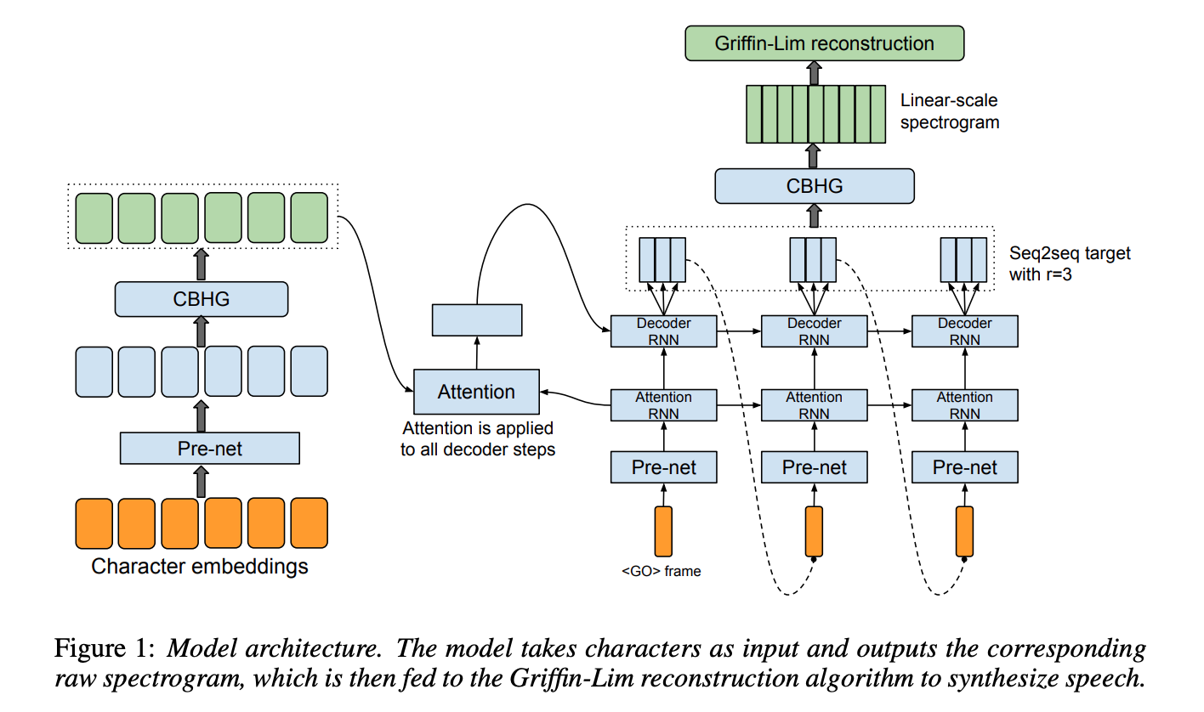
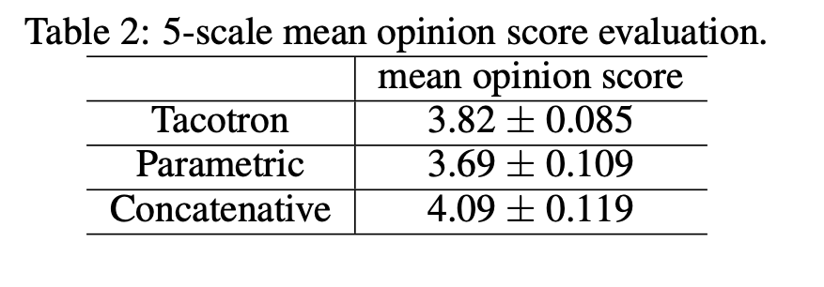
Two-stage Models: Tacotron
  Introduced by Google in 2017
  Sequence-to-sequence framework trained to
  generate Mel-spectrograms from input text
  Text encoder and Acoustic model are trained end-to-end
  However, the vocoder is still not trained as part of the framework:
  - Uses Griffin-Lim, a Fourier transform based algorithm to reconstruct an audio waveform from a spectrogram
  Concatenative systems still outperform it
Wang, Yuxuan, et al. "Tacotron: Towards end-to-end speech synthesis." arXiv preprint arXiv:1703.10135 (2017).

Slide 5
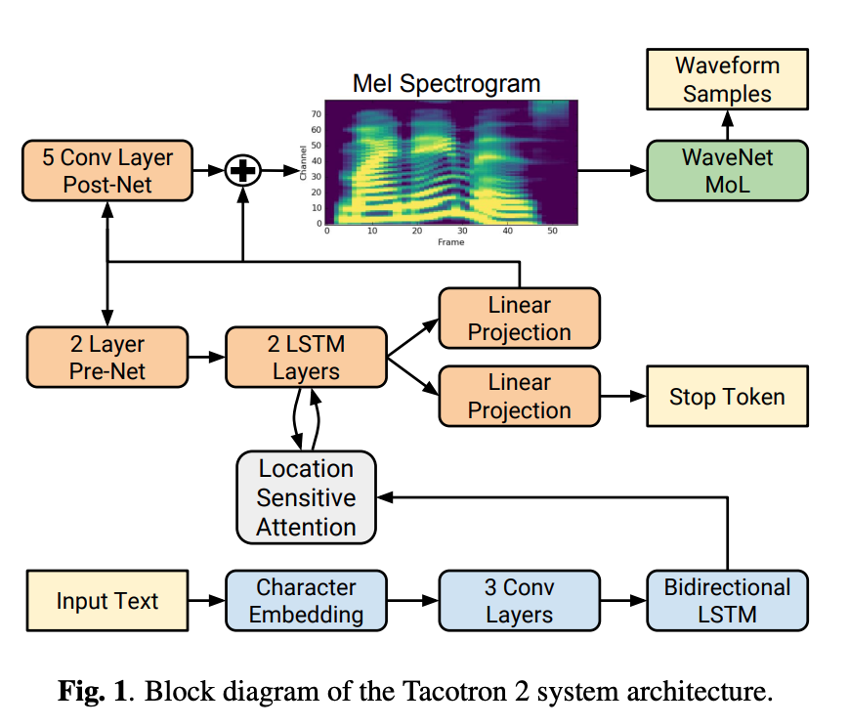
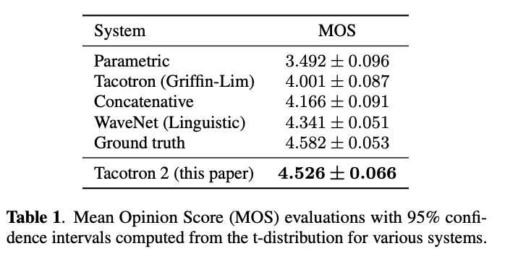
Two-stage Models: Tacotron 2
  Uses WaveNet as the vocoder
  Achieved very natural results that surpass concatenative methods
  Still not completely end-to-end as the WaveNet vocoder is pre-trained separately
Shen, Jonathan, et al. "Natural tts synthesis by conditioning wavenet on mel spectrogram predictions." 2018 IEEE international conference on acoustics, speech and signal processing (ICASSP). IEEE, 2018.

Slide 6
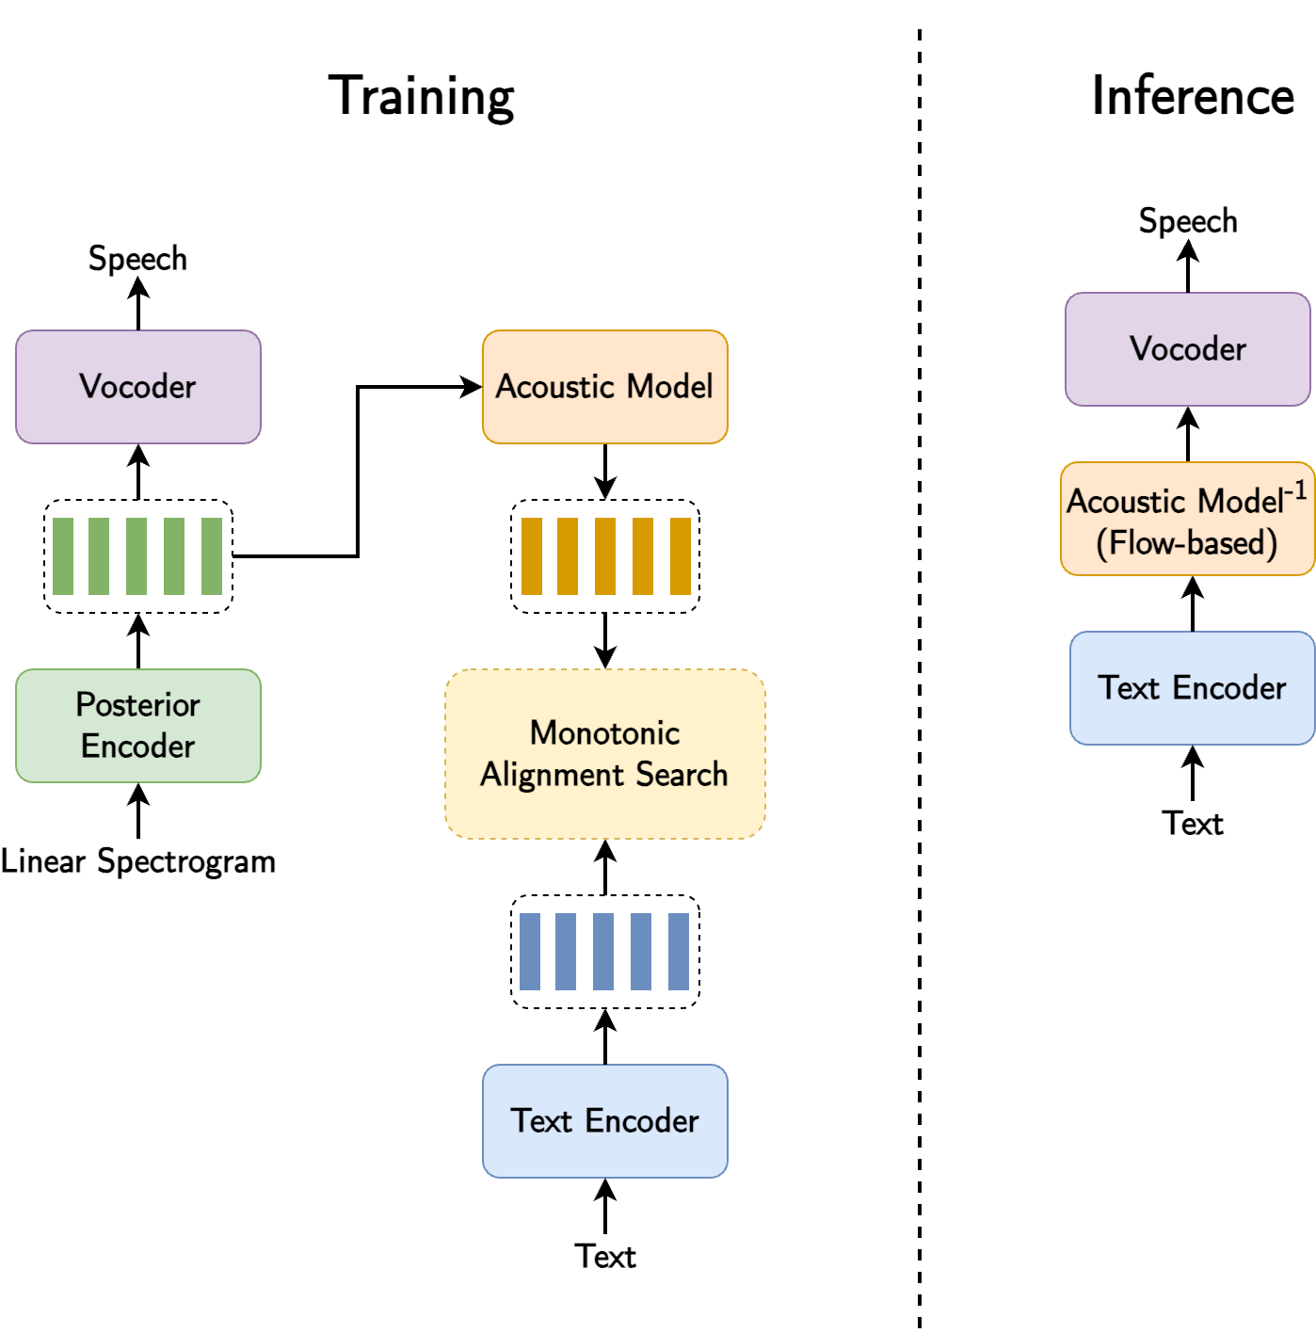
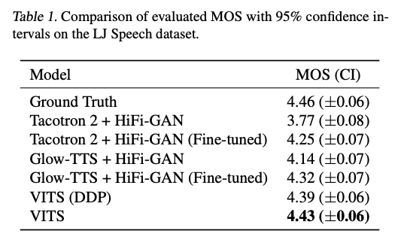
End-to-end Models: VITS
  Trained end-to-end to generate a speech waveform from input text
  During training, a speech-to-speech task is used to encode speech into an intermediate representation, and learn to decode it back to waveform using the vocoder
  There is also a text-to-embedding task to map from task to the same intermediate representation
  Both are trained jointly
  Surpasses two-stage models in terms
  of naturalness
Kim, Jaehyeon, Jungil Kong, and Juhee Son. "Conditional variational autoencoder with adversarial learning for end-to-end text-to-speech." International Conference on Machine Learning. PMLR, 2021.

Slide 7
Two-stage vs End-to-end
  Both two-stage and end-to-end models have pros and cons
  Two-stage:
    Pros: intermediate representation is interpretable, blocks can be replaced in a modular way, vocoder can be trained on untranscribed speech data
    Cons: can suffer from error propagation, handcrafted intermediate representations have limitations (e.g. spectral features)
  End-to-end:
    Pros: simplified training pipeline, components are tuned jointly leading to less error propagation, achieve higher naturalness
    Cons: reduced flexibility, intermediate representation is less interpretable, can suffer from oversmoothing and mispronunciation

Slide 8
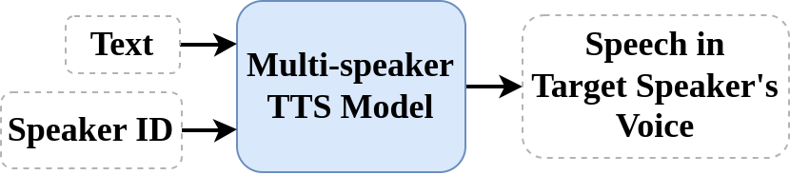
Multi-speaker TTS

Slide 9
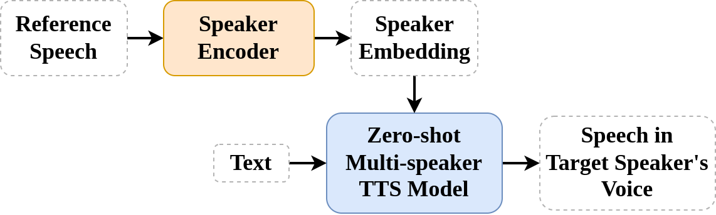
Zero-shot Multi-speaker TTS

Slide 10
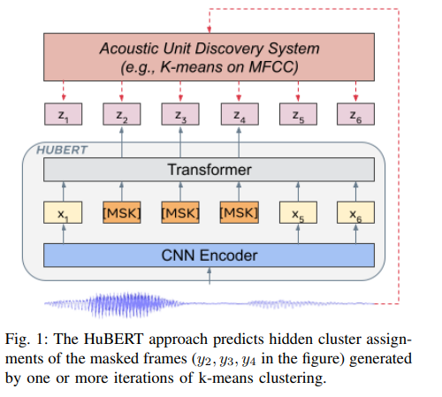
Neural embeddings as Intermediate Representations
  Recently, two-stage models that use features from Speech Foundation Models (aka Self-Supervised Learning models) as intermediate representations
  They enjoy the flexibility of two-stage models, while not suffering from limitations due to handcrafted intermediate representations
  Speech foundation model embeddings have very interesting properties which enable new use cases and possibilities
Hsu, Wei-Ning, et al. "Hubert: Self-supervised speech representation learning by masked prediction of hidden units." IEEE/ACM transactions on audio, speech, and language processing 29 (2021): 3451-3460.

Slide 11
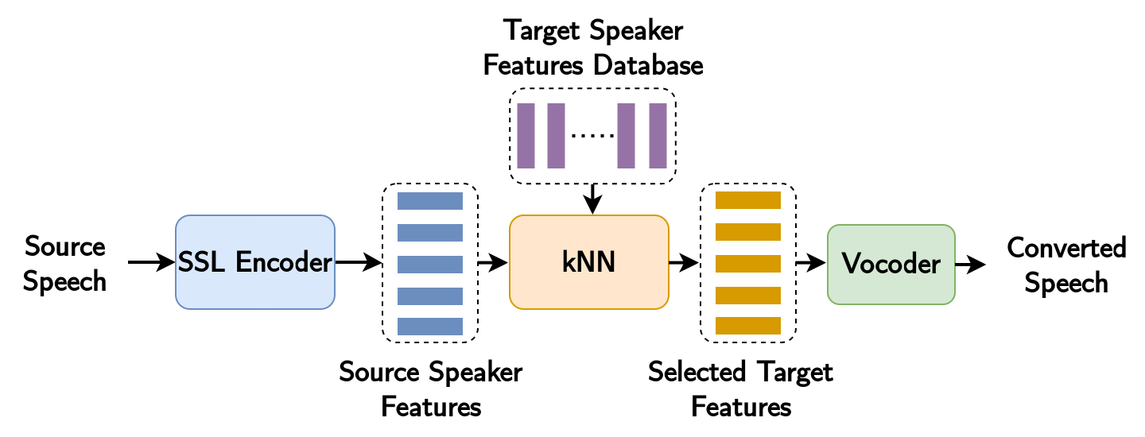
Example: kNN-VC
  SSL models such as Wav2Vec2, HuBERT, WavLM, encode speech into a sequence of frames, each corresponding to a window of 25ms of speech, with a 20ms hop between windows.
  Property: frames are linearly close if they contain similar phonetic, linguistic information, even if they are spoken by very different voices
  This enables very simple Voice Conversion: kNN-VC
  Source (VITS)
  Reference speaker
  Converted output
Baas, Matthew, Benjamin van Niekerk, and Herman Kamper. "Voice conversion with just nearest neighbors." arXiv preprint arXiv:2305.18975 (2023).

Slide 12
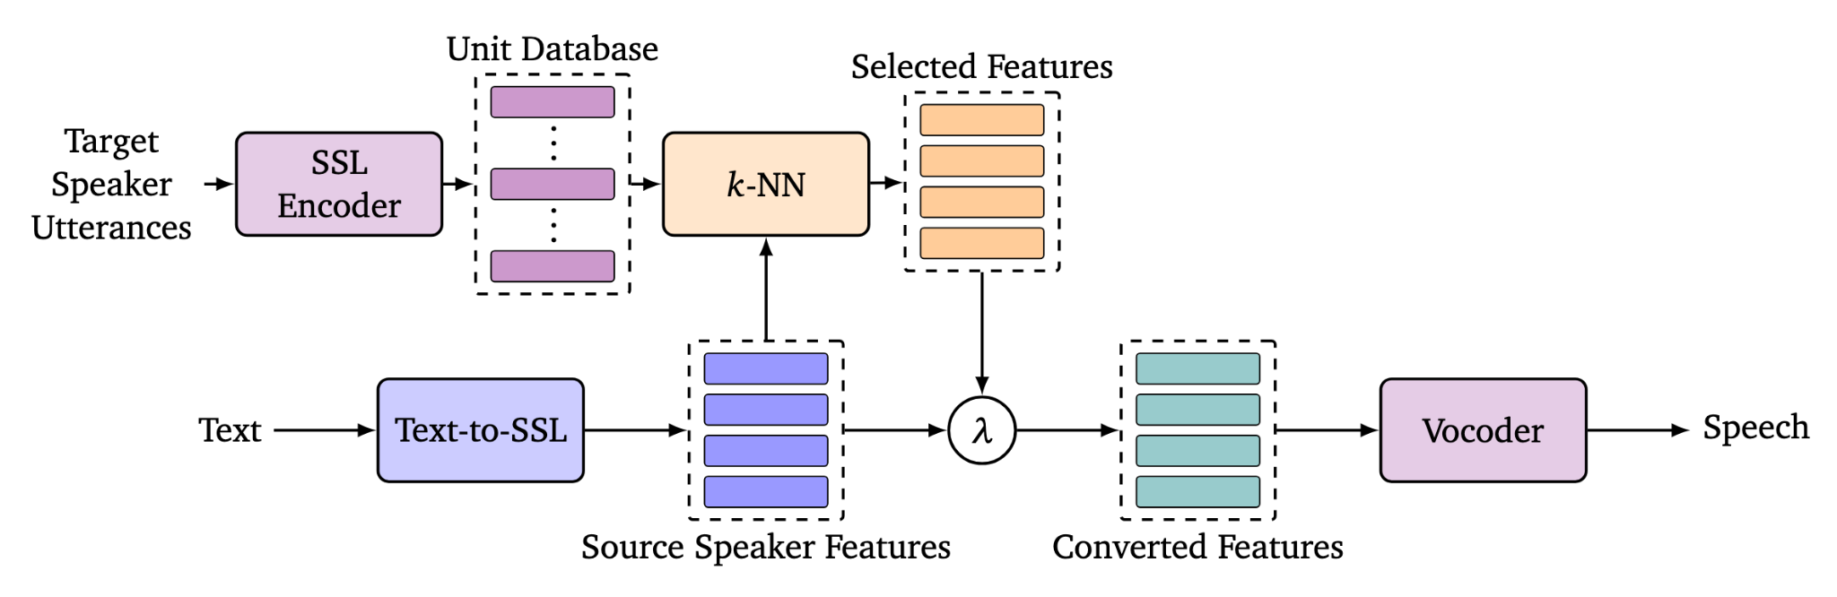


kNN-TTS
  Can extend the same idea to TTS
  Two-stage framework which uses SSL embeddings as intermediate representations
  Using SSL features + kNN enables simple zero-shot multi-speaker TTS with no need for speaker embeddings
  Can also linearly interpolate between features to achieve Voice Morphing
  λ = 0
  λ = 0.25
  λ = 0.5
  λ = 0.75
  λ = 1
El Hajal, Karl, et al. "kNN retrieval for simple and effective zero-shot multi-speaker text-to-speech." Proceedings of the 2025 Conference of the Nations of the Americas Chapter of the Association for Computational Linguistics: Human Language Technologies (Volume 2: Short Papers). 2025.

Slide 13
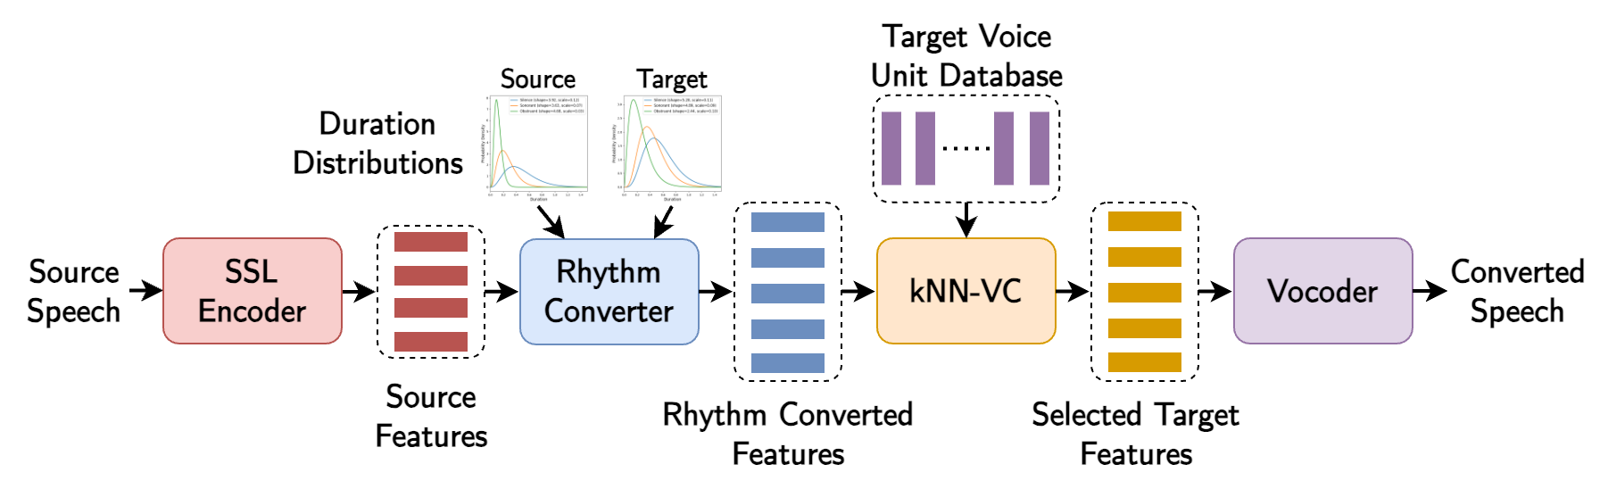

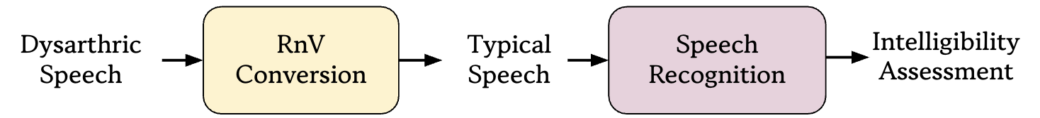
RnV: Rhythm and Voice Conversion
El Hajal, K., Hermann, E., Hovsepyan, S., Doss, M.M. (2025) Unsupervised Rhythm and Voice Conversion to Improve ASR on Dysarthric Speech. Proc. Interspeech 2025, 2760-2764, doi: 10.21437/Interspeech.2025-2069

Slide 14
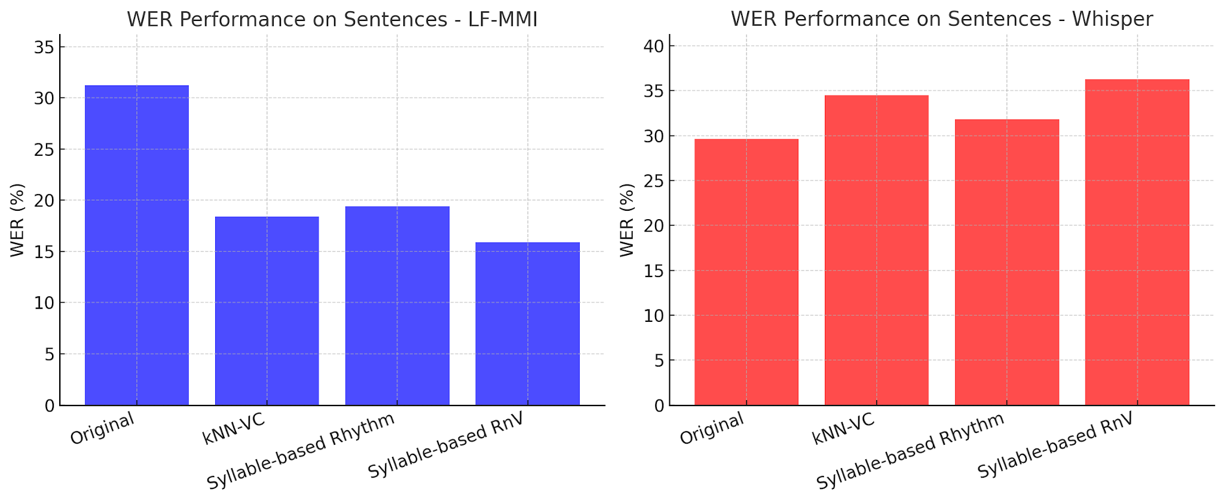
RnV: Rhythm and Voice Conversion
El Hajal, K., Hermann, E., Hovsepyan, S., Doss, M.M. (2025) Unsupervised Rhythm and Voice Conversion to Improve ASR on Dysarthric Speech. Proc. Interspeech 2025, 2760-2764, doi: 10.21437/Interspeech.2025-2069

Slide 15
Back to Concatenative Synthesis?
  Concatenative synthesis could produce natural-sounding speech.
  Limitation: Systems were hard to modify, or update. Units were fixed recordings, so changing prosody, emotion, or style was difficult.
  Statistical methods emerged to address these limitations, starting with HMM-based synthesis.
  SSL-based representations have shown strong properties for voice modification and re-synthesis
  They can re-enable concatenative-style methods, but now with
  - More flexible modification of prosody, speaker identity, and style
  - Higher quality synthesis
Can be implemented using Concatenative methods
—> Neural Zero-shot TTS with no training required!

Slide 16
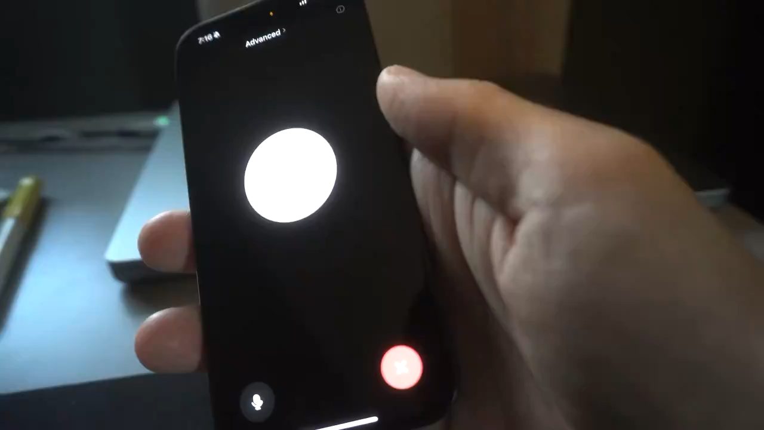
Future
  Neural TTS models have reached a naturalness level comparable to human speech
  However, it is still challenging to generate highly expressive speech (e.g. sports commentator)
  Defining and generating the subtle nuances of human expressiveness is difficult, making it challenging to guide models in a practical and versatile manner
  Many approaches are being explored, such as using text prompts to specify the desired speech style or tone
  Seamless context-switching between different languages is another use case that is still challenging
Example: ChatGPT Advanced Voice

