Slide 1
Designing XTAL and MEMS oscillators from MHz to GHz
David Ruffieux, senior expert & head of system-on-chip research
Swiss Center for Electronics and Microtechnology, CSEM
david.ruffieux@csem.ch
Lausanne, 28.06.2018

Slide 2
Outline
Motivations: Why do we need high performance XOs?
Introduction on the two main families of XTALs
Electrical model of the resonator, handling series parallel transformations
Two classes of XTAL oscillators: TIA and gm-based
Detailed analyses of the Pierce oscillator: open loop gain, impedance locus
Drive level, start-up time
Phase noise, timing jitter, Allan deviation
Temperature compensation
Differential oscillator structure
Silicon resonators, anything better?
Examples of timing modules

Slide 3
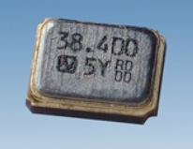
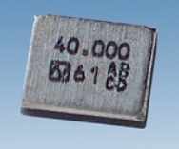
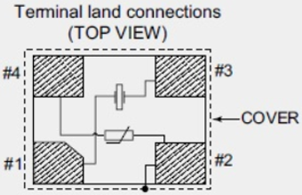
Miniature advanced AT-XTAL from NDK
http://www.ndk.com/images/products/catalog/c_NX1612SB_e.pdf (NX1210AB_e.pdf)
1612
1210
Parameter | 1612 Spec | 1210 Spec | Unit
Nominal Frequency | 26 to 76.8 | 26 to 52 | MHz
Package size | 1.6x1.2x0.45 | 1.2x1.0x0.3 | mm
Ftol | ±10 | ±10 | ppm
Operating temp | -30 to 85 | -30 to 85 | °C
Temp stability | ±12 | ±15 | ppm
MAX ESR (freq in MHz) | 80 (<38.4) 50 (>38.4) | 150 (26-32) 100 (32-40) 60 (40-52) | Ω Ω
CL | 7 | 8 | pF
Drive level | 10 (max 100) | 10 | μW
Footprints
(1612 includes thermistor)
Missing Cm, Co parameters !

Slide 4
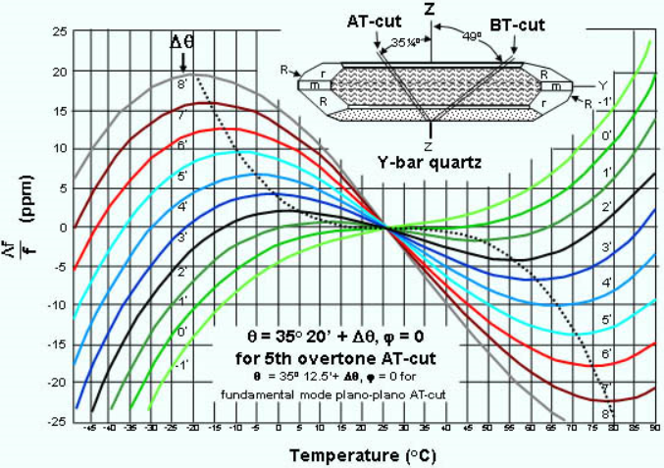
AT-cut XTAL temperature stability versus cut angle
3rd order TCF dominates (α=β=0 cut); strong sensitivity to XTAL cut
20
10
-10
-20
-40 -25 0 50 75 85

Slide 5

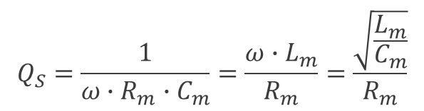
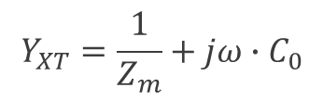
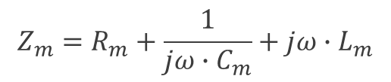
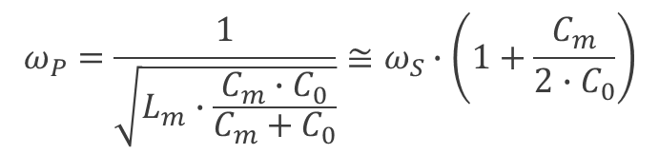
XTAL resonator equivalent model and analysis
Impedance/admittance calculation
Series & parallel resonance calculation
Q-factor
$$Q_{S}=\frac{1}{ω∙R_{m}∙C_{m}}=\frac{ω∙L_{m}}{R_{m}}=\frac{\sqrt{\frac{L_{m}}{C_{m}}}}{R_{m}}$$
$$Z_{m}=R_{m}+\frac{1}{jω∙C_{m}}+jω∙L_{m}$$
$$Y_{XT}=\frac{1}{Z_{m}}+jω∙C_{0}$$
$$ω_{S}=\frac{1}{\sqrt{L_{m}∙C_{m}}}$$
$$ω_{P}=\frac{1}{\sqrt{L_{m}∙\frac{C_{m}∙C_{0}}{C_{m}+C_{0}}}}≅ω_{S}∙\left(1+\frac{C_{m}}{2∙C_{0}}\right)$$

Slide 6
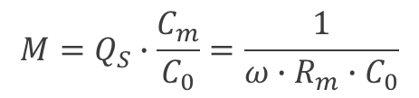

Coupling of mode and FOM
Coupling of mode is defined by the ratio of the motional over dielectric capacitances
It is the ratio of the strain over dielectric energies when a static bias is applied across the resonator electrodes
It is typically a few ‰ to % for quartz and BAW resonators resp.
Resonator Figure of Merit (FOM)
$$M=Q_{S}∙\frac{C_{m}}{C_{0}}=\frac{1}{ω∙R_{m}∙C_{0}}$$
$$k^{2}=\frac{C_{m}}{C_{O}}$$
Equal to i_{m}/i_{O} @ ω_{S}

Slide 7


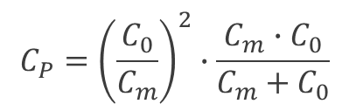

Mag and φ of Z_{XT}(ω_{s}[1+df/f])/Rm with Cm/Co=1‰, Q=64k, M=64
For ω<<ω_{S} or ω>>ω_{S}
Z_{XT}=1/ω·Co
(Anti-)Resonances are symmetrically located
To get fP
Q conservation ?
Rp
Zp
M
1/ω·Co
Zs=Zm
Rm
M
$$R_{P}=M^{2}∙R_{m}$$
$$C_{P}={\left(\frac{C_{0}}{C_{m}}\right)}^{2}∙\frac{C_{m}∙C_{0}}{C_{m}+C_{0}}$$
$$L_{P}={\left(\frac{C_{m}}{C_{0}}\right)}^{2}∙L_{m}$$
Inductive region
Cm/2Co
$$Q=\frac{ω}{2}∙\frac{dφ}{dω}$$
f=f_{S} df=f_{P}-f_{S}

Slide 8
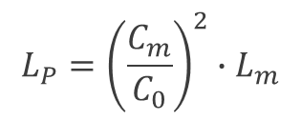
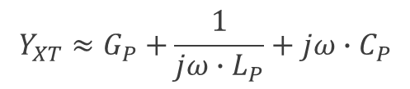
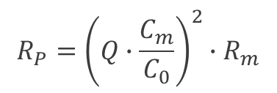

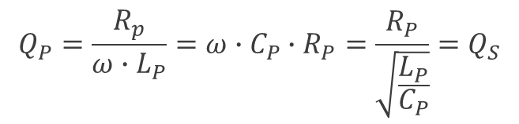




Approximation of XTAL resonances to calculate XO loop gain
XTAL is phase selective component
Series or parallel XOs can be built at ω_{S} or ω_{P}
Trans Impedance Amplifier
R_{TIA}
-
+
$$Q=\frac{ω}{2}∙\left|\frac{dφ}{dω}\right|$$
-1
Transconductance Amplifier
$$R_{P}={\left(Q∙\frac{C_{m}}{C_{0}}\right)}^{2}∙R_{m}$$
$$L_{P}={\left(\frac{C_{m}}{C_{0}}\right)}^{2}∙L_{m}$$
$$Q_{P}=\frac{R_{p}}{ω∙L_{P}}=ω∙C_{P}∙R_{P}=\frac{R_{P}}{\sqrt{\frac{L_{P}}{C_{P}}}}=Q_{S}$$
$$V_{XT}$$
$$C_{P}={\left(\frac{C_{0}}{C_{m}}\right)}^{2}∙\frac{C_{m}∙C_{0}}{C_{m}+C_{0}}$$
$$Y_{XT}≈G_{P}+\frac{1}{jω∙L_{P}}+jω∙C_{P}$$
$$G_{P}=1/R_{P}$$
$$gm∙V_{XT}$$

Slide 9


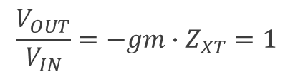
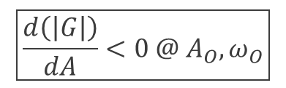

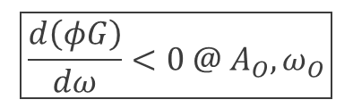
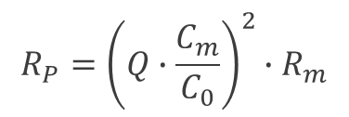
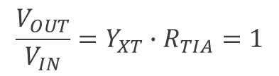


Determining oscillation conditions via open loop gain
Trans Impedance Amplifier
Provided Zin of OPA is << R_{TIA}
OPA input is virtual GND
Transconductance Amplifier
Provided Zin of gm stage is >> R_{P}
A_{O}·sin(ω_{O}·t) ω_{O} = ω_{S}
R_{TIA} = R_{m}
-
+
$$\frac{V_{OUT}}{V_{IN}}=Y_{XT}∙R_{TIA}=1$$
$$\frac{d\left(φY_{XT}\right)}{dω}<0 @ ω_{S}$$
-1
Barkhausen criterion for stable oscillations: G(ω_{O}, A_{O})=1
Amplitude stability
via non-linearity
Phase stability
A_{O}·sin(ω_{O}·t) ω_{O} = ω_{P}
$$\boxed{\frac{d\left(φG\right)}{dω}<0 @ A_{O},ω_{O}}$$
$$\boxed{\frac{d\left(\left|G\right|\right)}{dA}<0 @ A_{O},ω_{O}}$$
$$R_{P}={\left(Q∙\frac{C_{m}}{C_{0}}\right)}^{2}∙R_{m}$$
$$V_{XT}$$
$$\frac{d\left(φZ_{XT}\right)}{dω}<0 @ ω_{P}$$
$$\frac{V_{OUT}}{V_{IN}}=−gm∙Z_{XT}=1$$
$$gm∙V_{XT}$$
$$gm=−{1/R}_{P}$$

Slide 10


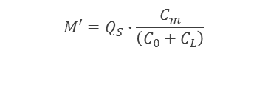
Effect of a parallel capacitor, C_{L}, on the XTAL impedance: ω_{P} Tuning!
--- R_{P}’(C_{L}) fit, reduces proportionally to 1/(C_{O} + C_{L})²
Use C_{O}’=C_{O}+C_{L} to calc
C_{L}=C_{O}
C_{L}=0
$$M′=Q_{S}∙\frac{C_{m}}{\left(C_{0}+C_{L}\right)}$$
C_{L}=3C_{O}
M’=32
M=64
$$R_{P}′={M′}^{2}∙R_{m}$$
$$ω_{P}′≅ω_{S}∙\left(1+\frac{C_{m}}{2∙\left(C_{0}+C_{L}\right)}\right)$$
C_{L}=7C_{O}
C_{L}=31C_{O}
No effect on ω_{S}, R_{m}
50% of overall tunning with 0<C_{L}<C₀
LIMIT
M’=2 !
Q=0
@ φ=0
Cm/2(Co+C_{L})
frequency tuning
with C_{L}

Slide 11


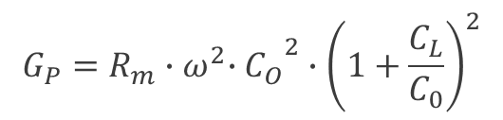

Frequency tuning, sensitivity and impact on G_{P} vs C_{L}/C_{O} ratio
Custom
designs
achievable
Frequency
Frequency sensitivity
Equivalent conductance
VCXO
REF XO
$$\frac{∆f}{f}=\frac{C_{m}}{2{∙C}_{0}∙\left(1+\frac{C_{L}}{C_{0}}\right)}$$
50% of C_{m}/2C_{O}
$$\frac{\frac{∆f}{f}}{\frac{∆C_{L}}{C_{L}}}=\frac{C_{m}}{2∙C_{0}}∙\frac{\frac{C_{L}}{C_{0}}}{{\left(1+\frac{C_{L}}{C_{0}}\right)}^{2}}$$
C_{LMAX}/C_{Lmin}=9
10⁻³
HIGH
POWER
$$G_{P}=R_{m}{{∙ω}^{2}∙C_{O}}^{2}∙{\left(1+\frac{C_{L}}{C_{0}}\right)}^{2}$$
16/1.7 ratio
$$\frac{ω∙C_{0}}{M}$$
10⁻⁷

Slide 12
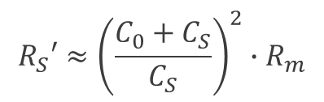

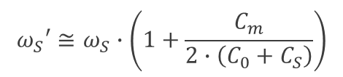
Effect of a series capacitor, C_{S}, on the XTAL impedance: ω_{S} Tuning!
--- R_{S}(C_{L}) fit
No effect on ω_{P} , R_{P} !
Series res freq shifted by
Easy to get Rs nested in a capacitive tap
$$ω_{S}′≅ω_{S}∙\left(1+\frac{C_{m}}{2∙\left(C_{0}+C_{S}\right)}\right)$$
C_{S}=7C_{O}
$$Z_{XT}+\frac{1}{jω∙C_{S}}=\frac{jω∙C_{S}+Y_{XT}}{jω∙C_{S}∙Y_{XT}}$$
C_{S}=0.33C_{O}
C_{S}=31C_{O}
C_{S}=3C_{O}
C_{S}=C_{O}
Rm Lm Cm
Zm
CO CS
ZXT_EQ_S
Cm/2(Co+C_{S})
frequency tuning with C_{S}
$$R_{S}′≈{\left(\frac{C_{0}+C_{S}}{C_{S}}\right)}^{2}∙R_{m}$$

Slide 13
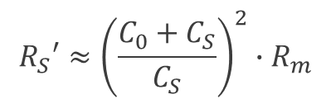
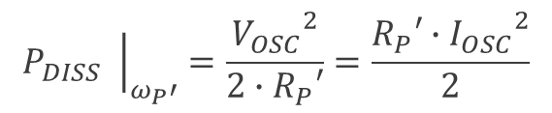
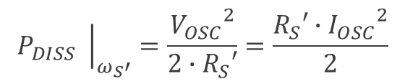
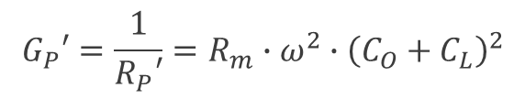
Drive level calculation (Max P_{DISS} limit derived by manufacturer)
Non-linearity of XTALs determine admissible drive level (shift of parameters)
Overdriving reduces MTBF and can lead to destruction
$${\left.P_{DISS} \right|}_{ω_{S}′}=\frac{{V_{OSC}}^{2}}{{2∙R}_{S}′}=\frac{R_{S}′∙{I_{OSC}}^{2}}{2}$$
$${\left.P_{DISS} \right|}_{ω_{P}′}=\frac{{V_{OSC}}^{2}}{{2∙R}_{P}′}=\frac{R_{P}′∙{I_{OSC}}^{2}}{2}$$
$$R_{S}′≈{\left(\frac{C_{0}+C_{S}}{C_{S}}\right)}^{2}∙R_{m}$$
$$G_{P}′=\frac{1}{R_{P}′}=R_{m}∙ω^{2}{∙\left(C_{O}+C_{L}\right)}^{2}$$

Slide 14
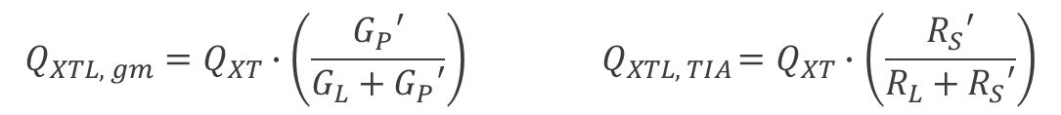
Loaded-Q calculation or approximation
XTALs may have Q-factor of up to 1 million! How to preserve it? Effect of LOAD ?
Use tap and series parallel transformation to determine equivalent conductance (G_{L}, gm-based) or resistance (R_{S}, TIA) of load
Perform similarly te determine loading reactive part
Determine the operating frequency of the XTAL according to the reactive load and get either R_{S}’ or R_{P}’ to see how R_{m} is transformed
Sum the series resistances (TIA) or the conductances (gm-based)
Loaded-Q is readily obtained via calculation using provided formulas!
Rule of thumb: limit added losses to 10% to avoid significative Q-degradation
$$Q_{XTL, gm}=Q_{XT}∙\left(\frac{G_{P}′}{G_{L}+G_{P}′}\right){ Q}_{XTL, TIA}=Q_{XT}∙\left(\frac{R_{S}′}{R_{L}+R_{S}′}\right)$$

Slide 15

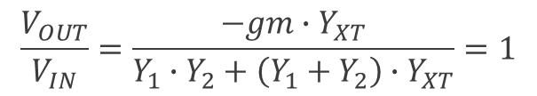
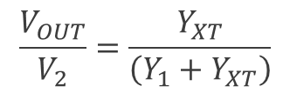
Pierce XO open loop gain (derivation)
Set of 2 Kirschoff equations (∑i=0 at all nodes)
With Y₁, admittance at gate including pad & gate cap, biasing resistor, ESD clamp
Y₂, admittance at drain including output conductance from gain and biasing MOST
Y_{XT}, XTAL admittance including MOS C_{GD}, R_{GD} biasing resistor
One gets:
$$gm∙V_{IN}+\left(Y_{2}+Y_{XT}\right)∙V_{2}−Y_{XT}∙V_{OUT}=0$$
$$\left(Y_{1}+Y_{XT}\right)∙V_{OUT}−Y_{XT}∙V_{2}=0$$
Open loop gain transfer function
$$\frac{V_{OUT}}{V_{2}}=\frac{Y_{XT}}{\left(Y_{1}+Y_{XT}\right)}$$
$$\frac{V_{OUT}}{V_{IN}}=\frac{−{gm∙Y}_{XT}}{Y_{1}∙Y_{2}+\left(Y_{1}+Y_{2}\right)∙Y_{XT}}=1$$

Slide 16
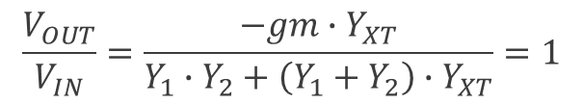
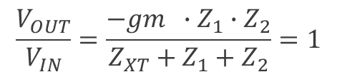
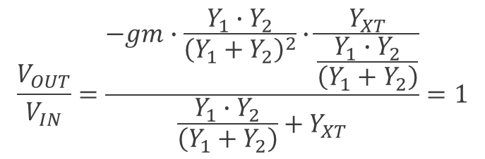
Pierce XO open loop gain (some analysis)
XO OLG
Rearranging one gets:
Alternative form:
$$\frac{V_{OUT}}{V_{IN}}=\frac{−{gm∙Y}_{XT}}{Y_{1}∙Y_{2}+\left(Y_{1}+Y_{2}\right)∙Y_{XT}}=1$$
$$\frac{V_{OUT}}{V_{IN}}=\frac{−gm∙\frac{Y_{1}∙Y_{2}}{{\left(Y_{1}+Y_{2}\right)}^{2}}∙\frac{Y_{XT}}{\frac{Y_{1}∙Y_{2}}{\left(Y_{1}+Y_{2}\right)}}}{\frac{Y_{1}∙Y_{2}}{\left(Y_{1}+Y_{2}\right)}+Y_{XT}}=1$$
=Y_{L}
$$\frac{V_{OUT}}{V_{IN}}=\frac{−gm ∙Z_{1}∙Z_{2}}{Z_{XT}+Z_{1}+Z_{2}}=1$$

Slide 17



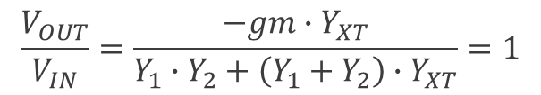

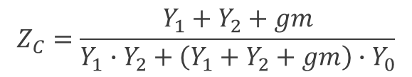
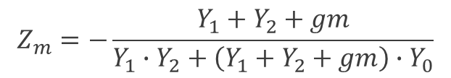
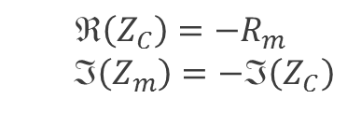
Pierce XO open loop gain (more analysis)
With XO OLG
And knowing that
The oscillation conditions become
It is a bilinear function of gm hence the Z locus is a circle in the complexe plane
Defining the circuit impedance as
Simple oscillation conditions
Which one can rewrite as
$$\frac{V_{OUT}}{V_{IN}}=\frac{−{gm∙Y}_{XT}}{Y_{1}∙Y_{2}+\left(Y_{1}+Y_{2}\right)∙Y_{XT}}=1$$
$$Z_{C}=−Z_{m}$$
$$Y_{XT}=\left(Y_{0}+\frac{1}{Z_{m}}\right)$$
$$\left(Z_{C}\right)=−R_{m}$$
ℑ$\left(Z_{m}\right)=−\text{ℑ}\left(Z_{C}\right)$
L_{P}’ C_{P}’
Rm Lm Cm
Zm
$$Z_{m}=−\frac{Y_{1}+Y_{2}+gm}{Y_{1}∙Y_{2}+\left(Y_{1}+Y_{2}+gm\right)∙Y_{0}}$$
ZC
CO
CIRCUIT
$$\lim_{gm→0}{Z_{c}}=\frac{1}{\frac{Y_{1}∙Y_{2}}{Y_{1}+Y_{2}}+Y_{0}}$$
$$\lim_{gm→∞}{Z_{c}}=\frac{1}{Y_{0}}$$
$$Z_{C}=\frac{Y_{1}+Y_{2}+gm}{Y_{1}∙Y_{2}+\left(Y_{1}+Y_{2}+gm\right)∙Y_{0}}$$
one gets

Slide 18

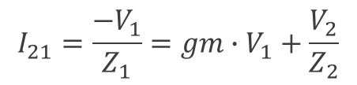
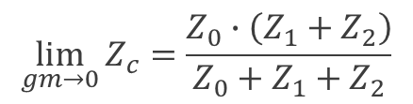




Circuit impedance calculation
Do this in AC simulation !
Remove R_{m}L_{m}C_{m}
Apply unit AC current
Plot V₂₁(φ,⎜⎟,ℑ,ℜ)
$$Z_{21}=\frac{V_{2}−V_{1}}{I_{21}}$$
$$I_{21}=\frac{{−V}_{1}}{Z_{1}}=gm∙V_{1}+\frac{V_{2}}{Z_{2}}$$
$$\frac{V_{2}}{V_{1}}=−\left(gm∙Z_{2}+\frac{Z_{2}}{Z_{1}}\right)$$
$$Z_{21}=Z_{1}+Z_{2}+gm∙Z_{1}∙Z_{2}$$
$$Z_{c}=\frac{Z_{0}∙\left(Z_{1}+Z_{2}+gm∙Z_{1}∙Z_{2}\right)}{Z_{0}+Z_{1}+Z_{2}+gm∙Z_{1}∙Z_{2}}$$
$$\lim_{gm→0}{Z_{c}}=\frac{Z_{0}∙\left(Z_{1}+Z_{2}\right)}{Z_{0}+Z_{1}+Z_{2}}$$
$$\lim_{gm→∞}{Z_{c}}=Z_{0}$$

Slide 19



Solving graphically the Pierce circuit oscillation condition
Losless case
$$Z_{C}=−Z_{m}$$
Let’s define g_{m,CRIT} as the g_{m} value yielding
Distance from horizontal axis (X_{C}) yields
Circle radius & max –R_{c} are defined by
  C_{O} (and any added C_{P}!)
  C₁₂= C₁·C₂/(C₁+C₂) with 2 S-E caps !
Avoid any differential capacitor ! (at IC, layout, routing, IO & PCB levels)
Higher C₁₂ reduces sensitivity of ω_{O} to gm (hence losses variations) leading to improved frequency stability
Z_{C}=R_{C}+j·X_{C}
$$R_{C}\left(g_{m,CRIT}\right)=−R_{m}$$
$$p=\frac{ω_{O}−ω_{S}}{ω_{S}}=\frac{X_{C}}{2}∙ω_{S}∙C_{m}$$
Co≡C3

Slide 20








Expliciting the circuit impedance while neglecting losses
The circuit impedance Z_{C}=R_{C}+j·X_{C} may be further decomposed into its ℜ & ℑ parts
Sensitivity of f to Q varation is given by
The maximum negative resistance is given by
To guaranty oscillations, the equivalent capacitance should satisfy
$$R_{C}=\frac{−gm∙C_{1}∙C_{2}}{{\left(gm∙C_{O}\right)}^{2}+ω^{2}∙{\left(C_{1}∙C_{2}+C_{O}∙C_{1}+C_{O}∙C_{2}\right)}^{2}}$$
$$R_{C}\left(g_{m,CRIT}\right)=−R_{m}$$
$$X_{C}=−\frac{{gm}^{2}∙C_{O}+ω^{2}∙\left(C_{1}+C_{2}\right)∙\left(C_{1}∙C_{2}+C_{O}∙C_{1}+C_{O}∙C_{2}\right)}{ω∙\left[{\left(gm∙C_{O}\right)}^{2}+ω^{2}∙{\left(C_{1}∙C_{2}+C_{O}∙C_{1}+C_{O}∙C_{2}\right)}^{2}\right]}$$
$$\frac{df}{f}=\frac{X_{C}}{2}∙ω_{S}∙C_{m}$$
$$\frac{df}{f}=\frac{dQ}{Q}∙\frac{ω_{S}∙C_{m}∙g_{m,CRIT}}{2}∙\frac{d}{dg_{m}}\left(X_{C}\right)$$
$$R_{C,MAX}=\frac{−1}{2∙ω∙C_{0}∙\left({1+C}_{0}∙\frac{\left(C_{1}+C_{2}\right)}{C_{1}∙C_{2}}\right)}$$
$$g_{m,RMAX}=ω∙\left(C_{1}+C_{2}+\frac{C_{1}∙C_{2}}{C_{0}}\right)$$
@
$$C_{12}=\frac{C_{1}∙C_{2}}{\left(C_{1}+C_{2}\right)}>\frac{C_{0}}{\left(\frac{M}{2}−1\right)}$$
M is unloaded resonator FOM

Slide 21








Start-up time, time constants
Solving damped oscillator differential equation yields
With time constant, τ, given by
3 cases to consider:
Start-up Steady-State Self damping (IC off)
$$A\left(t\right)=A_{0}∙e^{−\frac{t}{τ}}∙\sin\left(ω∙t\right)$$
$$τ=\frac{2∙L_{m}}{R_{C}+R_{m}}$$
$$R_{C}=0 τ=\frac{2∙Q}{ω}$$
$$−R_{C}≫R_{m}$$
$$R_{C}+R_{m}=0 τ→∞$$
$$\hat{A}\left(t\right)=A_{0}∙e^{\frac{{−R}_{C}}{2∙L_{m}}∙t}$$
$$A\left(t\right)=A_{0}∙\sin\left(ω∙t\right)$$
$$\hat{A}\left(t\right)=A_{0}∙e^{−\frac{ω}{2∙Q}∙t}$$
Exponential grow
starting from noise
Non-linearity of circuit
must ensure R_{C} = -R_{m}
Amplitude is attenuated
by ‘e’ every Q/π periods

Slide 22





Start-up time calculation
The RMS noise in the resonator when the circuit is turned on is given by
The growth of oscillation is given by
Neglecting the dependency of R_{C} on A, one gets as an approximate start-up time until an amplitude A is attained
Startup duration is typically about 15·τ so as to reach ~150mV
$$A_{0,RMS}=\sqrt{\int_{0}^{∞}{4∙k∙T∙\frac{\left(g_{P}′{+γ∙g}_{m}\right)}{{\left|jω∙C_{P}′+\frac{1}{jω∙L_{P}′}+g_{P}′−g_{m}\right|}^{2}}}∙dω}$$
$$\hat{A}\left(t\right)=A_{0}∙e^{\frac{{−R}_{C}−R_{m}}{2∙L_{m}}∙t}$$
$$\frac{dA}{dt}=−\frac{A}{τ}$$
$$\frac{1}{τ}=\frac{R_{C}+R_{m}}{2∙L_{m}}$$
at a rate with
$$τ_{START}=\int_{A_{O}}^{A}{−\frac{\frac{2∙L_{m}}{R_{C}+R_{m}}}{A}∙dA}≅−\frac{2∙L_{m}}{R_{C}+R_{m}}∙ln\left(\frac{A}{A_{O}}\right)$$

Slide 23

Amplitude limitation via transconductance non-linearity
Motional branch is equivalent to a high-Q bandpass resonator
  Electrical current flowing through it is hence mostly at fundamental frequency
  The gate voltage is then mostly sinusoidal
Since that current flows through Z_{C}, the large signal circuit impedance, Z_{C,LS} is the ratio of the fundamental voltage, V_{1ω} divided by the motional current
As Z_{C} depends on g_{m}, non-linearity eventually leads to a gain reduction
The large signal characteristic of the circuit should be investigated
$$Z_{C,LS}=\frac{V_{1ω}}{I_{m}}$$

Slide 24












Biasing the XO in sub-threshold regime to spare power
$$−R_{C}≫R_{m}$$
To ensure reliable and fast start-up one needs
R_{C} is non-linear function of gm; in strong inversion g_{m} ∝ (I_{BIAS})^{0.5}
  would require excessive overdrive voltage and very large current
Bias the transistor in sub-threshold regime instead (IC<<1)
  where the inversion coefficient, IC, is the drain over specific current
  g_{m} is given by with
With an oscillation amplitude A, the transistor drain current and its mean are given by
where , , I_{BO} is the 0th order mod. Bessel function
$$I_{D}=IS∙e^{\frac{V_{G}−V_{T}}{n∙U_{T}}}$$
$$β=μ∙C_{OX}∙\frac{W}{L}$$
$$U_{T}=\frac{k∙T}{Q}=25mV @ 25°C$$
$$IS=2∙n∙β∙{U_{T}}^{2}$$
$$IC=\frac{I_{D}}{IS}$$
$$g_{m}=\frac{I_{D}}{n∙U_{T}}∙g\left(IC\right)$$
$$g\left(IC\right)=\frac{2}{1+\sqrt{1+4∙IC}}$$
$$I_{D}\left(A,t\right)=IS∙e^{\frac{V_{G,DC}+A∙\cos\left(ω∙t\right)−V_{T}}{n∙U_{T}}}$$
$$\overline{I_{D}}\left(A\right)=\frac{I_{D0}}{T}\int_{0}^{T}{e^{\frac{A∙\cos\left(ω∙t\right)}{n∙U_{T}}}∙dt}=I_{D0}∙I_{ℬ0}\left(\frac{A}{n∙U_{T}}\right)$$
$$I_{D0}=I_{S}∙e^{\frac{V_{G,DC}−V_{T}}{n∙U_{T}}}$$
$$\overline{I_{D}}\left(A\right)=I_{BIAS}$$

Slide 25

Evolution of the gate voltage as a function of the XO amplitude A
$$V_{G,DC}\left(A\right)=V_{T}+ n∙U_{T}∙ln\left(\frac{I_{BIAS}}{I_{S}∙I_{ℬ0}\left(\frac{A}{n∙U_{T}}\right)}\right)$$
Solving for V_{G,DC} yields:
The positive peak XO gate voltage barely depends on A
The DC voltage almost drop by A due to the non-linear MOS behaviour
The negative peak XO gate voltage reaches ~-2·A
May use high-V_{T} core or even IO MOS transistors to avoid reaching the supply rail

Slide 26





I(V) behaviour of the XO operated in sub-threshold
$${I_{D}}_{1ω}\left(A\right)=\frac{2∙I_{D0}}{T}\int_{0}^{T}{e^{\frac{A∙\cos\left(ω∙t\right)}{n∙U_{T}}}∙\cos\left(ω∙t\right)∙dt}=I_{D0}∙2∙I_{ℬ1}\left(\frac{A}{n∙U_{T}}\right)$$
I at H1 is:
Using
And in steady-state
The XO I(V) behaviour is given by
I_{B1} is the 1st order mod. Bessel function
$$g_{m}=\frac{I_{BIAS}}{n∙U_{T}}$$
$$R_{C}\left(g_{m,CRIT}\right)=−R_{m}$$
$$\frac{{I_{D}}_{1ω}\left(A\right)}{A}=g_{m,CRIT}$$
$${I_{D}}_{1ω}\left(A\right)\frac{I_{ℬ0}\left(\frac{A}{n∙U_{T}}\right)}{2∙I_{ℬ1}\left(\frac{A}{n∙U_{T}}\right)}=\overline{I_{D}}\left(A\right)$$

Slide 27




Large signal circuit transconductance
Non-linear conductance for diff. gm/gcrit ratios
The large signal gm is:
As A -> 0, one gets the small-signal gm
I_{BIAS}=8*I_{CRIT}
$$g_{m,1ω}=\frac{{I_{D}}_{1ω}\left(A\right)}{A}$$
$$g_{m,1ω}=\frac{2∙I_{ℬ1}\left(\frac{A}{n∙U_{T}}\right)}{I_{ℬ0}\left(\frac{A}{n∙U_{T}}\right)}∙\frac{\frac{\overline{I_{D}}\left(A\right)}{n∙U_{T}}}{\frac{A}{n∙U_{T}}}$$
I_{BIAS}=4*I_{CRIT}
---
$$\frac{{I_{D}}_{1ω}\left(A\right)}{A}=g_{m,CRIT}$$
$$\lim_{A→0}{g_{m,1ω}}=\frac{I_{BIAS}}{n∙U_{T}}$$
I_{BIAS}=2*I_{CRIT}
I_{BIAS}=I_{CRIT}

Slide 28
Simulated Z_{C} locus for different load capacitance values

Slide 29

Simplified XO circuit including an AGC loop
PTAT biasing circuit defines start-up current I_{M4}=L·U_{T}/R₁·ln(K·L) with L, M mirror ratios
Non-linearity induced VG drop is sensed by M₂ via R₂C₃ LPF, hence
Biasing current is reduced until ℜ(Z_{C})=-R_{m}
Gate biasing with MOS or R
Coupling on gate may lead to large drain ringing (severe at 32kHz)
  Avoid diff amplifier
Power gate amp during start-up
  Added losses via Miller cap
$$I_{M4}\left(A\right)= \frac{{L∙U}_{T}}{R_{1}}∙ln\left(\frac{K∙L}{I_{ℬ0}\left(\frac{A}{n∙U_{T}}\right)}\right)$$
L:1
1:K

Slide 30
XO with AGC loop characteristic
Use C divider
for larger A
Adjust K, L
to get desired A
Axis scales
M·g_{m,CRIT}
A/(M·n·U_{T})
or
M=g(IC) in strong inversion
C_{A}
C_{B}
K·L=64
M=C_{A}/(C_{A}+C_{B})
K·L=16
K·L=4
Adjust
I_{START}
to get safe
start-up
ℜ(Z_{C})=-R_{m}
I start variations
lead to min A ones
±20% R VAR

Slide 31
VI temperature dependency of the XO with AGC loop
I_{START} ∝ TEMP
I_{CRIT} ∝ TEMP if R_{m} cst
±21% over -40 to 85°C
Ratio I_{START}/I_{CRIT} cst
XO amplitude & 85°C current hence PTAT
Swing needed to switch current source in OTA is also PTAT
ℜ(Z_{C})=-R_{m}
25°C
-40°C

Slide 32





Deriving the XO noise PSD using the parallel equivalent circuit
The XO current noise PSD at steady state is given by
It is shaped into a voltage PSD by the reactance presented by the XTAL and circuit
where
After rearranging the terms, one obtains
That could also be rewritten as a fonction of the XTAL mode coupling and Q-factor
$${i_{n}}^{2}=4∙k∙T∙\left(g_{P}{+γ∙g}_{m,CRIT}\right)$$
$${v_{n}}^{2}=4∙k∙T∙\frac{\left(g_{P}{+γ∙g}_{m,CRIT}\right)}{{G_{LC}}^{2}}$$
$$G_{LC}=2∙j∆ω∙{\left(\frac{C_{0}+C_{L}}{C_{m}}\right)}^{2}∙C_{m}$$
$${v_{n}}^{2}=\left(1+γ\right)∙k∙T∙\frac{R_{m}∙{C_{m}}^{2}}{{\left(C_{0}+C_{L}\right)}^{2}}∙\frac{ω^{2}}{{∆ω}^{2}}$$
$${v_{n}}^{2}=\left(1+γ\right)∙k∙T∙\frac{\frac{C_{m}}{C_{0}}}{Q∙ω∙C_{0}∙{\left(1+\frac{C_{L}}{C_{0}}\right)}^{2}}∙\frac{ω^{2}}{{∆ω}^{2}}$$

Slide 33


Deriving the XO phase noise
Assuming ${v_{n}}^{2}$ is split equally between amplitude & phase noise, the later is given by
where V_{OSC}=A is the signal amp.
A weakly coupled, high-Q, low impedance XTAL leads to the best phase noise
  High-end Telecom applications do hence rely on bulky, high-Q, special XTALs
The XO designer can play on the amplitude and C_{L} to improve the phase noise up to the recommended drive level
One should note that apart very close to carrier, the XO phase noise will however be mostly limited by the thermal noise of the amplifier generating a rail to rail signal
This noise source is not filtered by the resonator and defines a plateau
$${φ_{n}}^{2}=\frac{\left(1+γ\right)}{{V_{OSC}}^{2}}∙k∙T∙\frac{\frac{C_{m}}{C_{0}}}{Q∙ω∙C_{0}∙{\left(1+\frac{C_{L}}{C_{0}}\right)}^{2}}∙\frac{ω^{2}}{{∆ω}^{2}}$$

Slide 34



Phase noise impact on power dissipation
The phase noise is given by
The power consumption of the XO will be proportional to
The phase noise power product, which should be mininized then depends on
Best performances are hence obtained when the loaded Q-factor and the XO amplitude are both maximized
$${φ_{n}}^{2}=\frac{\left(1+γ\right)}{{V_{OSC}}^{2}}∙k∙T∙\frac{\frac{C_{m}}{C_{0}}}{Q∙ω∙C_{0}∙{\left(1+\frac{C_{L}}{C_{0}}\right)}^{2}}∙\frac{ω^{2}}{{∆ω}^{2}}$$
$$P_{XO}∝{\frac{ω∙C_{0}}{Q∙\frac{C_{m}}{C_{0}}}∙\left(1+\frac{C_{L}}{C_{0}}\right)}^{2}∙V_{DD}∙V_{OSC}$$
$$P_{XO}∙{φ_{n}}^{2}∝\frac{1}{Q^{2}}∙\frac{V_{DD}}{V_{OSC}}$$
Does not depend on load !

Slide 35





Phase noise to jitter conversion
C. Liu and J. McNeill, “Jitter in Oscillators with 1/f Noise Sources,” in Proc. IEEE Int. Symp. Circuits and Systems (ISCAS), 2004, pp. 773-776.
The accumulated jitter can be derived from phase noise using
The accumulated jitter is composed of a term growing proportionaly with time resulting from a correlated 1/f noise source and a term growing with the square root of time resulting from an uncorrelated, thermal noise source
With fc, the 1/f³ corner frequency and ${φ_{n}}^{2}\left(∆f\right)$ the phase noise at any offset Δf where the phase noise decays in Δf⁻², the two terms can be computed as
In a log-log plot, the jitter grows with a slope equal to ½ at first and then 1
$${σ_{ACC}}^{2}\left(τ\right)=\frac{2}{π^{2}∙{f_{O}}^{2}}∙\int_{0}^{∞}{{φ_{n}}^{2}\left(∆f\right)∙\sin^{2}}\left(π∙∆f∙τ\right)∙d∆f$$
$${σ_{ACC}}^{2}\left(τ\right)={\frac{τ}{T}∙σ_{CTC_UNC}}^{2}+{{\left(\frac{τ}{T}\right)}^{2}∙σ_{CTC_COR}}^{2}$$
$${σ_{CTC_UNC}}^{2}=\frac{{∆f}^{2}}{{f_{O}}^{3}}∙{φ_{n}}^{2}\left(∆f\right)$$
$${σ_{CTC_COR}}^{2}={\frac{25∙f_{C}}{f_{O}}∙σ_{CTC_UNC}}^{2}$$

Slide 36


Allan deviation from accumulated jitter and freq measurement
The Allan deviation is a measure of the distribution of the frequency instability over an observation time τ
One can get the Allan deviation from the accumulated jitter by dividing the time axis by τ
The slopes in a log-log plot becomes -1/2 and 0 for the regions dominated by thermal and 1/f noise respectively
The Allan variance at a time $τ$ is given by
where ${\overline{y}}_{n}$ is the n^{th} fractional frequency average sample measured over an
Frequency meter can log consecutive measured samples to permit the Allan deviation calculation; specific meas. equipments are required for low jitter XO
$${σ_{ALL}}^{2}\left(τ\right)=\frac{1}{2}∙<{\left({\overline{y}}_{n+1}−{\overline{y}}_{n}\right)}^{2}>$$
observation time τ and <> corresponds to further averaging n such several samples

