Slide 1
EE-426
RF circuits design techniques
4. Intermodulation and distortion
David Ruffieux & Christian Enz
Swiss Federal Institute of Technology, Lausanne (EPFL), Switzerland

Slide 2
Outline
Effects of nonlinearity
  Single tone input
    Harmonic distortion
    Gain compression
  Two-tone input
    Desensitization and blocking
    Cross modulation
    Intermodulation
    Third-order Intercept Point
Cascade of nonlinear stages

Slide 3
Effects of Nonlinearity
Distinction between single tone input and multiple (two) tone input
Single tone input
  Harmonic distortion
  Gain compression
Two-tone input
  Desensitization and blocking
  Cross modulation
  Intermodulation

Slide 4
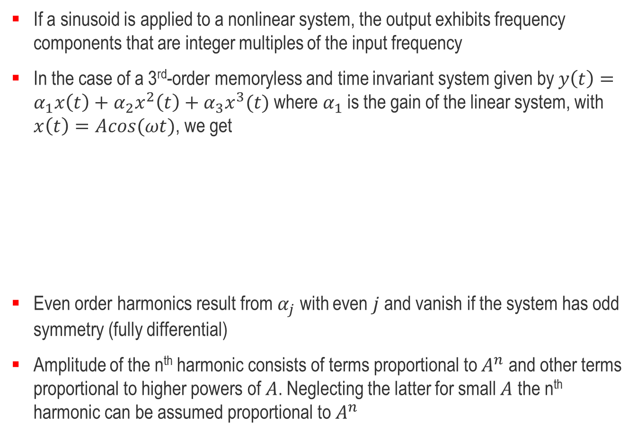
Single Tone Input – Harmonic Distortion
If a sinusoid is applied to a nonlinear system, the output exhibits frequency components that are integer multiples of the input frequency
In the case of a 3rd-order memoryless and time invariant system given by $y\left(t\right)=α_{1}x\left(t\right)+α_{2}x^{2}\left(t\right)+α_{3}x^{3}(t)$ where $α_{1}$ is the gain of the linear system, with $x\left(t\right)=Acos(ωt)$, we get
Even order harmonics result from $α_{j}$ with even $j$ and vanish if the system has odd symmetry (fully differential)
Amplitude of the n^{th} harmonic consists of terms proportional to $A^{n}$ and other terms proportional to higher powers of $A$. Neglecting the latter for small $A$ the n^{th} harmonic can be assumed proportional to $A^{n}$

Slide 5
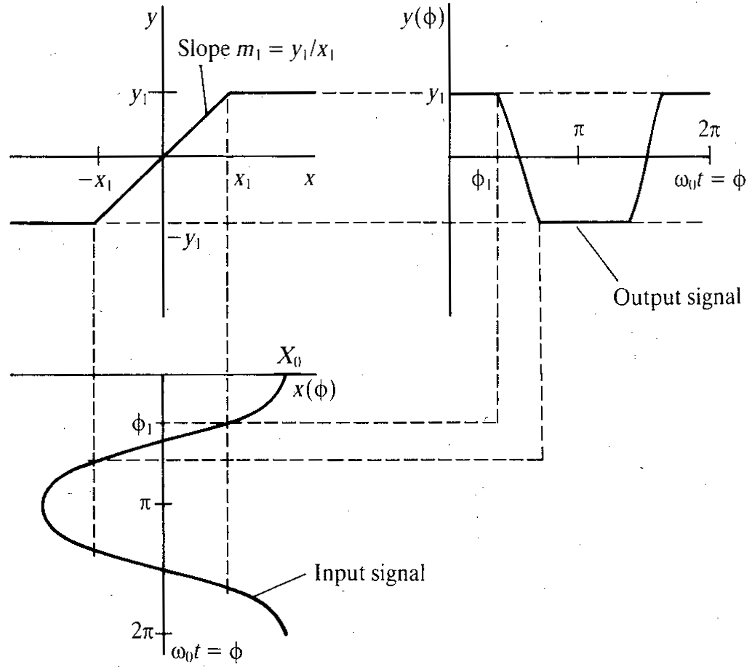

Single Tone Input – Harmonic Distortion
Output still periodic and can therefore be expressed as a Fourier series
$a_{0}=0$ since $y(φ)$ signal has no dc component
$b_{n}=0$ since $y(φ)$signal is an even function (i.e. $y\left(−φ\right)=y(φ)$)
Only odd-order harmonics since $y(φ)$ is an odd function (i.e. $y\left(−φ\right)=−y(φ)$)
gain α₁=Y_{max}/X_{max}
Y_{max}
−X_{max}
X_{max}
−Y_{max}
A

Slide 6
Single Tone Input – Gain Compression
The coefficient $a_{1}$ corresponding to the fundamental is given by
The compression rate is defined as

Slide 7
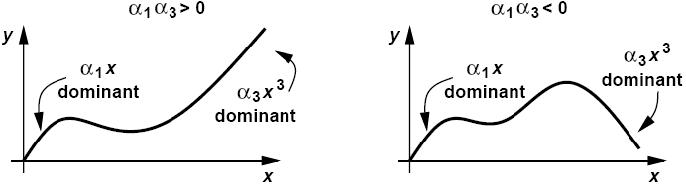
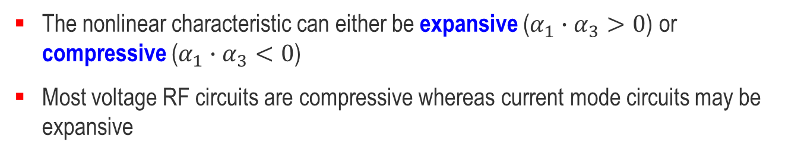
Single Tone Input – Sign of $α_{1}$and $α_{3}$
Expansive
(for example MOSFET current)
Compressive
(for example differential pair)
The nonlinear characteristic can either be expansive ($α_{1}∙α_{3}>0$) or compressive ($α_{1}∙α_{3}<0$)
Most voltage RF circuits are compressive whereas current mode circuits may be expansive

Slide 8
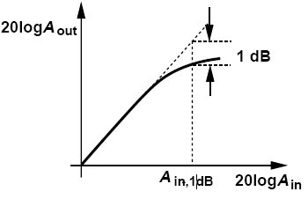

Single Tone Input – 1-dB Compression Point
In most circuits of interest, the output is a compressive (or saturating) function of the input, i.e. the gain approaches zero for sufficiently high input levels. In this case coefficient $α_{3}<0$. The gain for the fundamental is therefore a decreasing function of $A$
The 1dB compression point is defined as the amplitude for which the gain drops by 1dB compared to the linear asymptote and can be approximated by

Slide 9
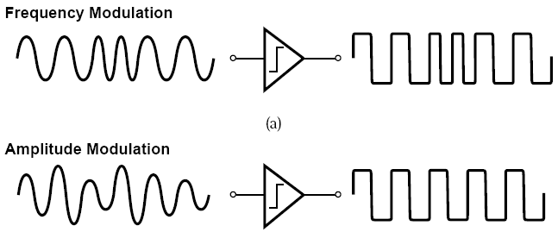
Gain Compression: Effect on FM and AM Waveforms
FM signal carries no information in its amplitude and hence tolerates compression
AM contains information in its amplitude, hence distorted by compression

Slide 10

Two-tone Input – Intermodulation Products
Input signal with two sinusoidal components at two different frequencies $ω_{1}$ and $ω_{2}$
The output of a memoryless and time invariant nonlinear system defined by
The linear term is simply equal to the input multiplied by the gain $α_{1}$
The 2nd-order term is given by

Slide 11

Two-tones Input – Intermodulation Products
The 3rd-order term is given by
The 3rd-order term produces fundamentals, 3rd-order harmonics and 3rd-order intermodulation (IM) products at ${2ω}_{1}+ω_{2}$, ${2ω}_{1}−ω_{2}$, ${2ω}_{2}+ω_{1}$ and ${2ω}_{2}−ω_{1}$
If $ω_{1}$ and $ω_{2}$ are close, IM products at ${2ω}_{1}−ω_{2}$ and ${2ω}_{2}−ω_{1}$ can be troublesome because they are close to $ω_{1}$ and $ω_{2}$ and might fall in the passband

Slide 12
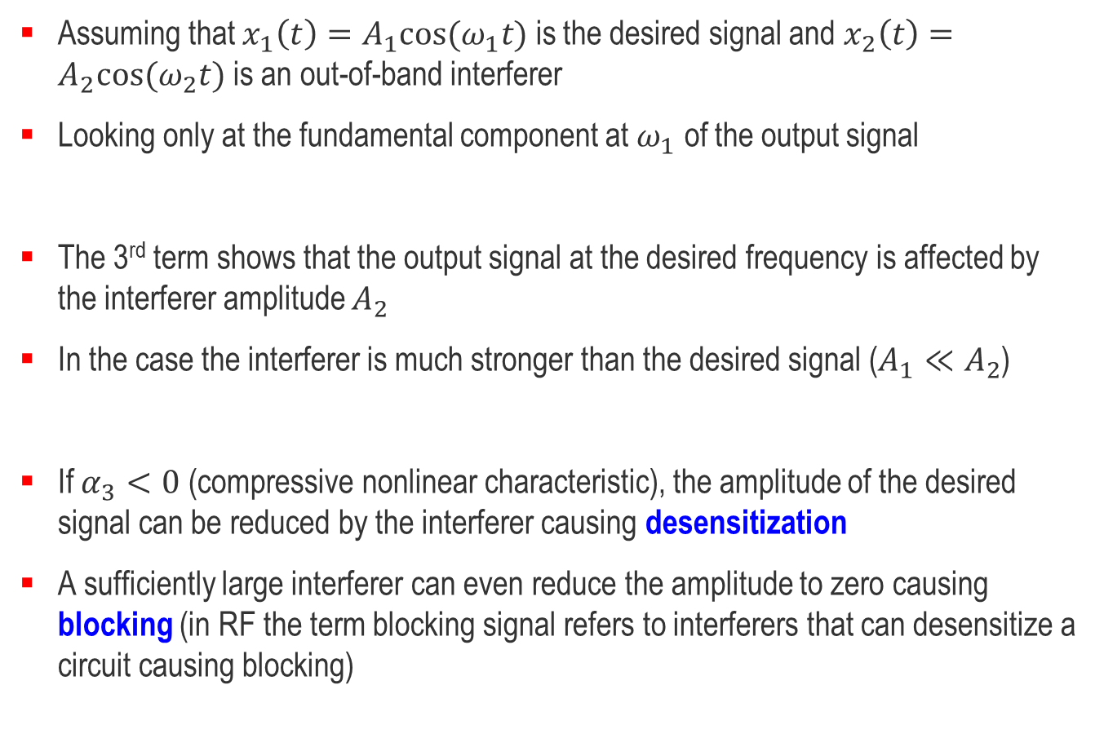
Two-tones Input – Desensitization and Blocking
Assuming that $x_{1}\left(t\right)=A_{1}cos⁡(ω_{1}t)$ is the desired signal and $x_{2}\left(t\right)=A_{2}cos⁡(ω_{2}t)$ is an out-of-band interferer
Looking only at the fundamental component at $ω_{1}$ of the output signal
The 3rd term shows that the output signal at the desired frequency is affected by the interferer amplitude $A_{2}$
In the case the interferer is much stronger than the desired signal ($A_{1}≪A_{2}$)
If $α_{3}<0$ (compressive nonlinear characteristic), the amplitude of the desired signal can be reduced by the interferer causing desensitization
A sufficiently large interferer can even reduce the amplitude to zero causing blocking (in RF the term blocking signal refers to interferers that can desensitize a circuit causing blocking)

Slide 13

Desensitization and Blocking – Example
Consider an odd-order memoryless nonlinear system defined by
The output signal $y_{1}$ at $ω_{1}$ for $A_{1}<2$ (no saturation) is given by
In the case the interferer is much stronger than the desired signal ($A_{1}≪A_{2}$)
Blocking occurs for $A_{2}=2.83$ (not consistent with assumption that $A_{1}$ and $A_{2}<2$)
y
+16
−2
x
+2
−16

Slide 14
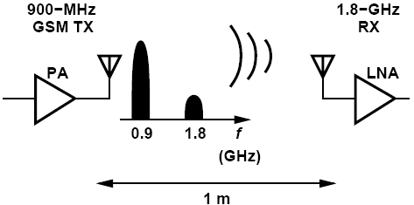
Example of Gain Compression
Problem:
A 900-MHz GSM transmitter delivers a power of 1 W to the antenna. By how much must the second harmonic of the signal be suppressed (filtered) so that it does not desensitize a 1.8-GHz receiver having P1dB = -25 dBm? Assume the receiver is 1 m away and the 1.8-GHz signal is attenuated by 10 dB as it propagates across this distance.
Solution:
The output power at 900 MHz is equal to +30 dBm. With an attenuation of 10 dB, the second harmonic must not exceed -15 dBm at the transmitter antenna so that it is below P1dB of the receiver. Thus, the second harmonic must remain at least 45 dB below the fundamental at the TX output. In practice, this interference must be another several dB lower to ensure the RX does not compress.

Slide 15
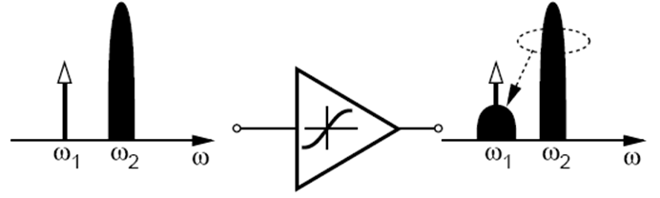

Two-tone Input – Cross Modulation
Another phenomenon that occurs when a weak signal and a strong interferer pass through a nonlinear system is the transfer of modulation (or noise) on the amplitude of the interferer to the amplitude of the weak signal
For example if the amplitude of the interferer is modulated by a sinusoid $A_{2}\left(1+m∙cos⁡(ω_{m}t)\right)$ where $m$ is the modulation index ($m<1$), assuming $A_{1}≪A_{2}$, the output is given by

Slide 16

Two-tone Input – Cross Modulation
The desired signal at the output contains amplitude modulation at $ω_{m}$ and ${2ω}_{m}$
A common case of cross modulation arises in amplifiers that must simultaneously process many independent signal channels (e.g. in cable television transmitters). Nonlinearities in the amplifier corrupt each signal with the amplitude variations in other channels

Slide 17
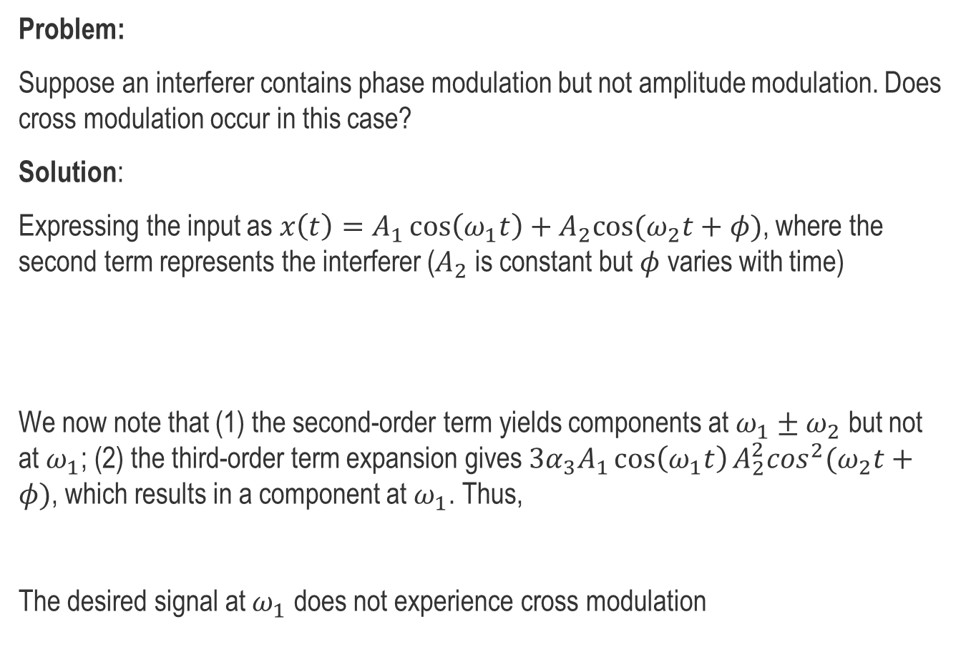
Example of Cross Modulation
Problem:
Suppose an interferer contains phase modulation but not amplitude modulation. Does cross modulation occur in this case?
Solution:
Expressing the input as $x\left(t\right)=A_{1}\cos\left(ω_{1}t\right)+A_{2}cos⁡(ω_{2}t+φ)$, where the second term represents the interferer ($A_{2}$ is constant but $φ$ varies with time)
We now note that (1) the second-order term yields components at $ω_{1}±ω_{2}$ but not at $ω_{1}$; (2) the third-order term expansion gives $3α_{3}A_{1}\cos\left(ω_{1}t\right)A_{2}^{2}\cos^{2}⁡(ω_{2}t+φ)$, which results in a component at $ω_{1}$. Thus,
The desired signal at $ω_{1}$ does not experience cross modulation

Slide 18
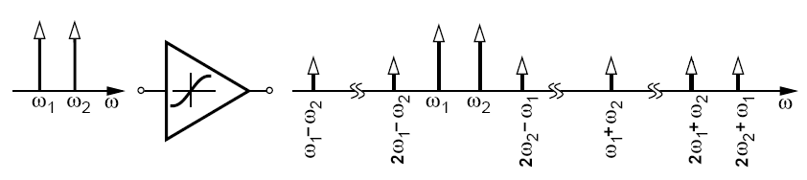
Two-tones Input – Intermodulation Products
Discarding the DC and harmonics we obtain the following IM products
And these fundamental components
Δω
Δω=ω₂−ω₁
Δω
Δω
2ω₁−ω₂=ω₁−Δω
2ω₂−ω₁=ω₂+Δω

Slide 19
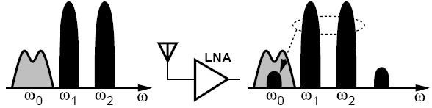
Two-tone Input – Intermodulation
The 3rd-order IM product of two strong out-of-band interferers may fall in the band of interest corrupting the desired weak signal
While operating on the amplitude, this effect degrades the performance even if the modulation is on the phase (zero-crossing points are still affected)
This phenomenon cannot be quantized by harmonic distortion
It requires another characterization called third-order intercept point (IP3)

Slide 20
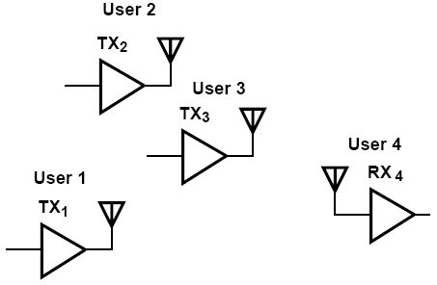
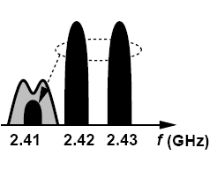
Example of Intermodulation
Problem:
Suppose four Bluetooth users operate in a room as shown in the above figure. User 4 is in the receive mode and attempts to sense a weak signal transmitted by User 1 at 2.410 GHz. At the same time, Users 2 and 3 transmit at 2.420 GHz and 2.430 GHz, respectively. Explain what happens.
Solution:
Since the frequencies transmitted by Users 1, 2, and 3 happen to be equally spaced, the intermodulation in the LNA of RX4 corrupts the desired signal at 2.410 GHz

Slide 21
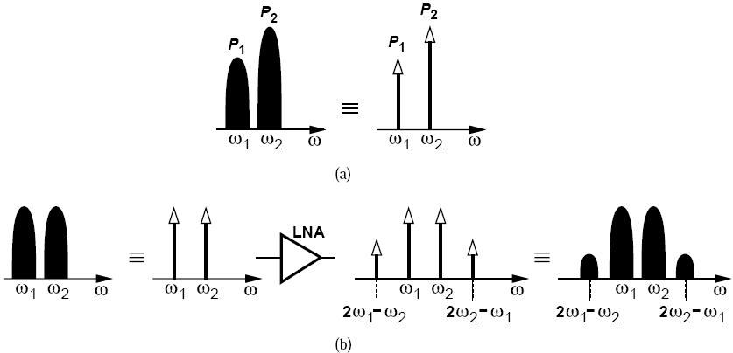
Intermodulation: Tones and Modulated Interferers
In intermodulation analysis:
  approximate the interferers with tones
  calculate the level of intermodulation products at the output
  mentally convert the intermodulation tones back to modulated components so as to see the corruption.

Slide 22
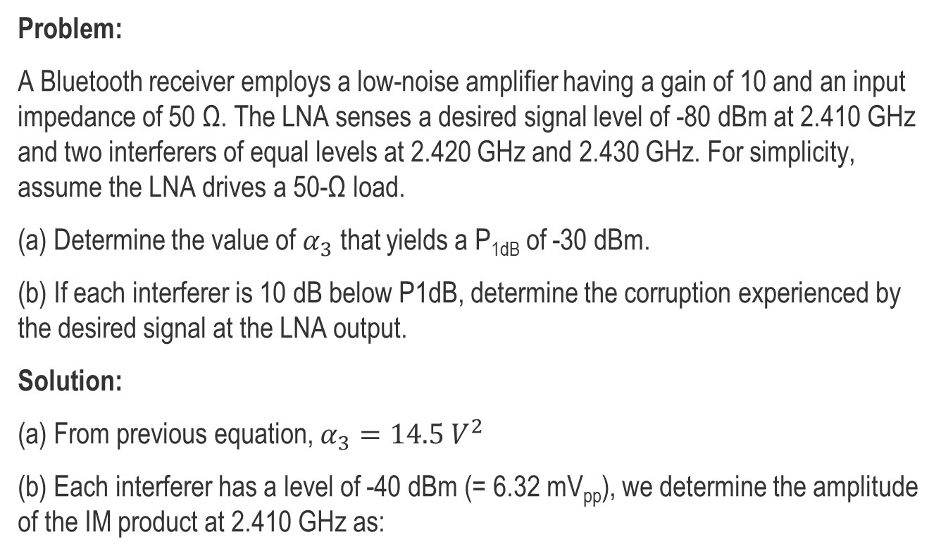
Example of Gain Compression and Intermodulation
Problem:
A Bluetooth receiver employs a low-noise amplifier having a gain of 10 and an input impedance of 50 Ω. The LNA senses a desired signal level of -80 dBm at 2.410 GHz and two interferers of equal levels at 2.420 GHz and 2.430 GHz. For simplicity, assume the LNA drives a 50-Ω load.
(a) Determine the value of $α_{3}$ that yields a P_{1dB} of -30 dBm.
(b) If each interferer is 10 dB below P1dB, determine the corruption experienced by the desired signal at the LNA output.
Solution:
(a) From previous equation, $α_{3}=14.5 V^{2}$
(b) Each interferer has a level of -40 dBm (= 6.32 mV_{pp}), we determine the amplitude of the IM product at 2.410 GHz as:

Slide 23
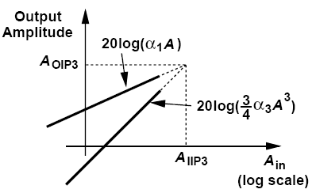

Two-tone Input – Third-order Intercept Point
Allows to characterize nonlinearity by a two-tone test signal with each tone having equal amplitude $A_{1}=A_{2}=A$
The amplitude of the fundamental and of the 3rd-order IM products at $2ω_{1}±ω_{2}$ and at $2ω_{2}±ω_{1}$ are given by
If $α_{1}≫9α_{3}{A^{2}}/4$, the input level for which the output components at $ω_{1}$ and $ω_{2}$ have the same amplitude as those at $2ω_{1}−ω_{2}$ and $2ω_{2}−ω_{1}$ is given by

Slide 24
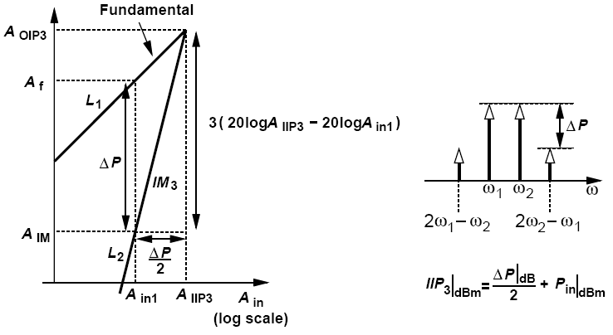
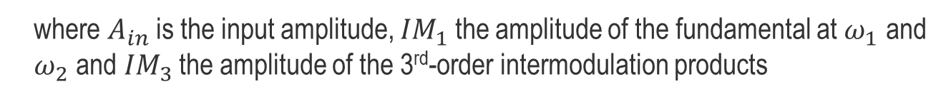
Two-tone Input – Third-order Intercept Point
IP3 can be measured at a single input level chosen well below the -1dB compression point, considering that
where $A_{in}$ is the input amplitude, ${IM}_{1}$ the amplitude of the fundamental at $ω_{1}$ and $ω_{2}$ and ${IM}_{3}$ the amplitude of the 3rd-order intermodulation products
If all signals levels are expressed in dBm, the input 3rd-order intercept point is equal to half the difference between the magnitudes of the fundamentals and the IM3 product at the output plus the corresponding input level

Slide 25
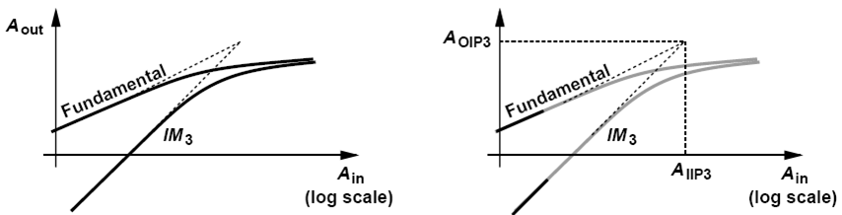
Two-tone Input – Third-order Intercept Point
Because fundamental and IM3 components are both subject to compression, the IP3 is not a directly measureable quantity, but a point obtained by extrapolation of measurements made at low amplitude (as shown on the right)

Slide 26
Comparison Between Single Tone and Two-tone
Y_{n}
IM_{n}
[dBm]
−1dB
−1dB
slope=3
slope=1
4.8 dB
9.6 dB
4.8 dB
P_{in} [dBm]
P_{-1dB}
(two-tone)
P_{-1dB}
(single-tone)
P_{IIP3}
P_{HDI}
Single tone −1 dB compression point:
Two tones IIP3:

Slide 27
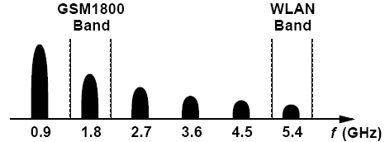
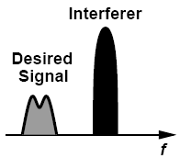
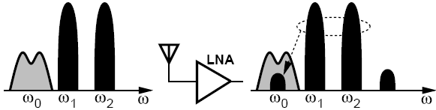
Effects of nonlinearity – Summary
Single signal leading to harmonic distortion
Single + one large interferer leading to desensitization
Single + two large interferers leading to intermodulation

Slide 28
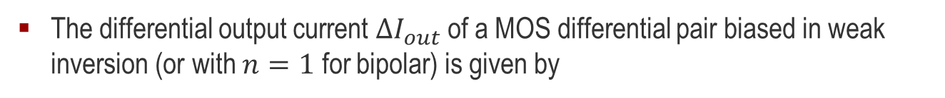
Examples: Differential Pair in Weak Inversion
The differential output current ${∆I}_{out}$ of a MOS differential pair biased in weak inversion (or with $n=1$ for bipolar) is given by
Taylor series expansion:
and hence:

Slide 29
Examples: Differential Pair in WI – Single and Two-tone

Slide 30
Examples: Differential Pair in WI – HB Simulations
These results are confirmed by harmonic balanced (HB) simulations (Aplac)
Single tone analysis for diff. pair in weak inversion tanh(x)
For large amplitude, the output becomes a square wave with Y₁=4/π and Y₃=4/(3*π)
20
Yx/dB
10
0
-10
-20
-30
Dual tone analysis for diff. pair in weak inversion tanh(x)
-40
10
-50
IMx
0
-60
dB
-10
-70
-80
-20
0.1
0.3
1.0
3.0
10.0
-30
x=A/(2nUT)
-40
-50
-60
-70
0.1
0.3
1.0
3.0
10.0
x=A/(2nUT)

Slide 31
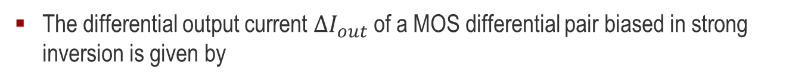
Examples: Differential Pair in Strong Inversion
The differential output current ${∆I}_{out}$ of a MOS differential pair biased in strong inversion is given by
Taylor series expansion (in linear range):
and hence:

Slide 32
Examples: DP in Strong Inversion – HB Simulations
alpha1 and alpha3 versus overdrive voltage
IIP3 versus versus overdrive voltage
40.00
50.00
ax
IIP3
20.00
40.00
0.00
dB
-20.00
30.00
-40.00
20.00
-60.00
-80.00
10.00
-100.00
0.00
-120.00
-140.00
-10.00
0.1
0.3
1.0
3.0
10.0
30.0
100.0
0.1
0.3
1.0
3.0
10.0
30.0
100.0
(VG-VT0)/(nUT)
(VG-VT0)/(nUT)
alpha1 (sim)
alpha1 (th)
IIP3 (sim)
IIP3 (th)
alpha3 (sim)
alpha3 (th)

Slide 33
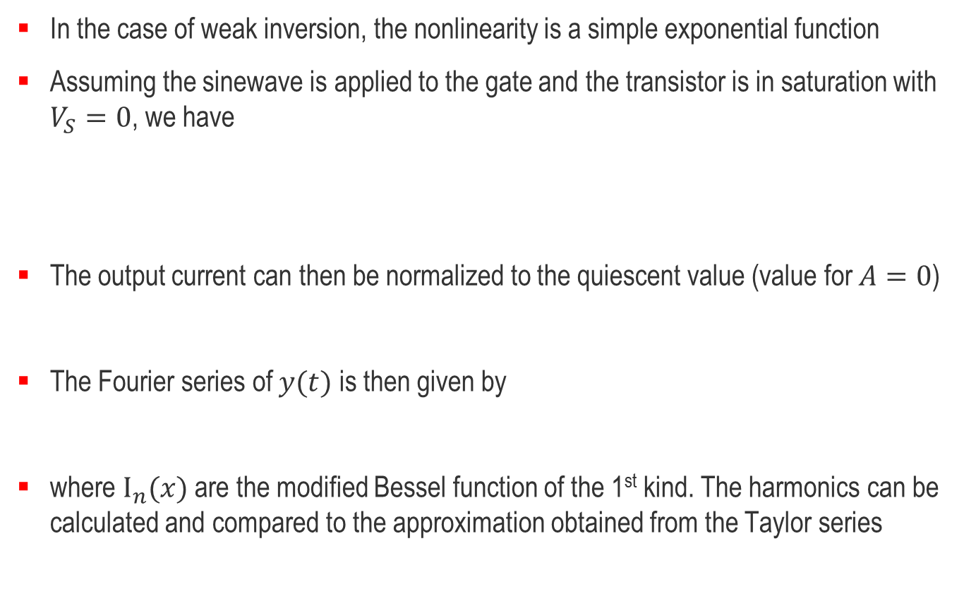
Examples: MOST in Weak Inversion
In the case of weak inversion, the nonlinearity is a simple exponential function
Assuming the sinewave is applied to the gate and the transistor is in saturation with $V_{S}=0$, we have
The output current can then be normalized to the quiescent value (value for $A=0$)
The Fourier series of $y(t)$ is then given by
where $I_{n}(x)$ are the modified Bessel function of the 1st kind. The harmonics can be calculated and compared to the approximation obtained from the Taylor series

Slide 34
Examples: MOST in Weak Inversion – Single Tone
Since the characteristic is expanding instead of compressing, the −1dB compression point becomes a +1dB expansion point

Slide 35
Examples: MOST in Weak Inversion – Two-tone
The two-tone characteristics are plotted below and compared to the single tone

Slide 36
Examples: MOST in Weak Inversion – HB Simulations
These results are confirmed by harmonic balanced (HB) simulations (Aplac)
Single tone analysis for transistor in weak inversion exp(x)
Dual tone analysis for MOS transistor in weak inversion exp(x)
40
40
Yx/dB
IMx
30
30
20
dB
20
10
10
0
0
-10
-20
-10
-30
-20
-40
-30
-50
-40
-60
-50
0.3
1.0
3.0
0.3
1.0
3.0
x=A/(nUT)
x=A/(nUT)

Slide 37

Examples: MOST in Strong Inversion
In the case of strong inversion and assuming a long channel and constant mobility, the nonlinearity is a simple quadratic function. Therefore there is no 3rd-order term and hence the IP3 is infinite!
A more realistic model accounting for mobility reduction due to the vertical field is given by
For $V_{S}=0$ it can be written in simple normalized form as
Adding the sine wave at the gate it becomes
where parameter Θ is typically 0.1 1/V

Slide 38
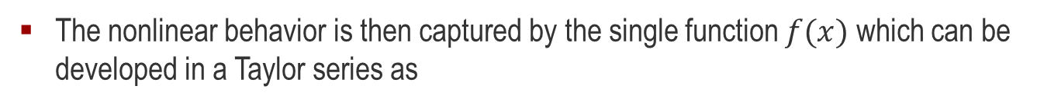
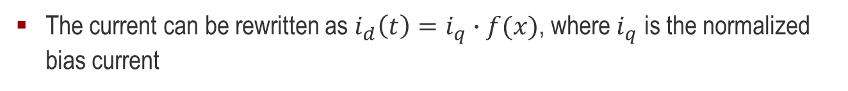
Examples: MOST in Strong Inversion
The current can be rewritten as $i_{d}\left(t\right)=i_{q}∙f(x)$, where $i_{q}$ is the normalized bias current
The nonlinear behavior is then captured by the single function $f(x)$ which can be developed in a Taylor series as
Usually $θ′≪1$ and the coefficients can be simplified as

Slide 39
Examples: MOST in Strong Inversion
The IIP3 and -1dB points are then given by

Slide 40

Examples: MOST in Strong Inversion – HB Simulations
HB simulations (Aplac) for $Θ=0.1 1/V$ for ideal MOST in strong inversion
alpha1 and alpha3 versus overdrive voltage
IIP3 versus versus overdrive voltage
40.00
60.00
ax
IIP3
20.00
50.00
0.00
dB
-20.00
40.00
-40.00
30.00
-60.00
-80.00
20.00
-100.00
10.00
-120.00
-140.00
0.00
0.1
0.3
1.0
3.0
10.0
30.0
100.0
0.1
0.3
1.0
3.0
10.0
30.0
100.0
(VG-VT0)/(nUT)
sim.
(VG-VT0)/(nUT)
si
alpha1 (sim)
alpha1 (th)
si asymptote
alpha1 (as)
alpha3 (sim)
alpha3 (th)
alpha3 (as)

Slide 41

Examples: Continuous Model of MOST– HB Simulations
HB simulations (Aplac) for $Θ=0.1 1/V$ for ideal MOST from weak to strong inversion
alpha1 versus inversion coefficient
alpha3 versus inversion coefficient
10.00
0.00
ax
ax
0.00
-20.00
-10.00
-40.00
-60.00
-20.00
-80.00
-30.00
-100.00
-40.00
-120.00
1.0m
10.0m
0.1
1.0
10.0
100.0
1.0k
1.0m
10.0m
0.1
1.0
10.0
100.0
1.0k
sim.
IC
wi
sim.
IC
wi
si
si asymptote
si
si asymptote

Slide 42
Examples: Continuous Model of MOST– HB Simulations
HB simulations (Aplac) for $Θ=0.1 1/V$ for ideal MOST from weak to strong inversion
IIP3 versus inversion coefficient
50.00
IIP3
40.00
dB
30.00
20.00
10.00
0.00
1.0m
10.0m
0.1
1.0
10.0
100.0
1.0k
sim.
IC
wi
si
si asymptote

Slide 43
Examples: Compact Model of MOST– HB Simulations
Simulations with complete EKV v2.6 model for a generic 0.18µm CMOS process
IIP3 versus inversion coefficient
50.00
IIP3
V_{S}=0 V
W=3µm
L=3µm
40.00
dB
30.00
20.00
10.00
0.00
1.0m
10.0m
0.1
1.0
10.0
100.0
1.0k
IC

Slide 44
Outline
General considerations
Nonlinearity and time variance
Effects of nonlinearity
  Single tone input
    Harmonic distortion
    Gain compression
  Two-tone input
    Desensitization and blocking
    Cross modulation
    Intermodulation
    Third-order Intercept Point
Cascade of nonlinear stages

Slide 45
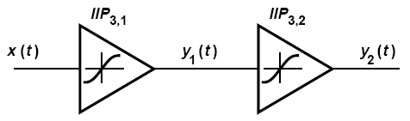

Cascade of Nonlinear Stages
Considering only the 1st- and 3rd-order terms
The overall IIP3 is then given by
In worst case the above expression reduces to
As the 1st-stage gain $α_{1}$ increases, the overall IIP3 decreases

Slide 46
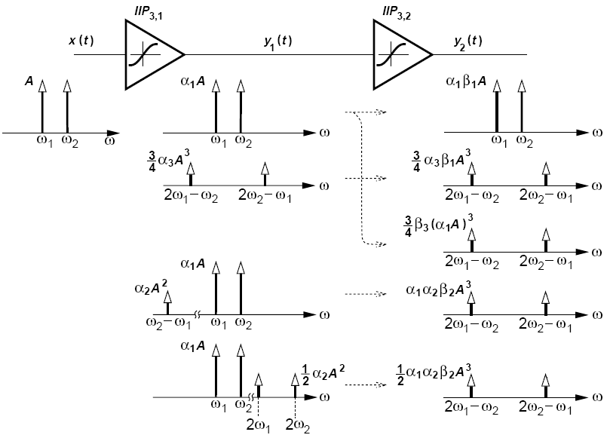
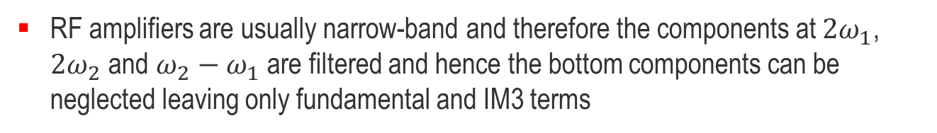
Cascade of Nonlinear Stages
Fundamental terms
IM3 of 1st-stage
amplified by 2nd stage
IM3 of 2nd-stage
IM2 of 1st-stage
and IM2 of 2nd stage
2nd-harmonics of 1st-stage and IM2 of 2nd stage
RF amplifiers are usually narrow-band and therefore the components at $2ω_{1}$, $2ω_{2}$ and $ω_{2}−ω_{1}$ are filtered and hence the bottom components can be neglected leaving only fundamental and IM3 terms

Slide 47
Cascade of Nonlinear Stages
Considering only the 1st- and 3rd-order terms, we have
Assuming that the 2nd harmonics and IM2 are filtered before the 2nd stage, the 2nd term in front of the 3rd-order term can usually be neglected, resulting in considering only the IM3 of the 1st and 2nd stage
The IIP3 for two stages is then given by
Finally the general relation for cascaded stages under the above assumptions is given by

Slide 48
References
Most of this Chapter is based on Chapter 2 of Reference [1]
[1] B. Razavi, RF Microelectronics, 2nd ed. Pearson, 2012.
[2] T. H. Lee, The Design of CMOS Radio-Frequency Integrated Circuits, 2nd ed. Cambridge University Press, 2004.
[3] G. D. Vendelin, A. M. Pavio and U. L. Rohde, Microwave Circuit Design Using Linear and Nonlinear Techniques, 2nd ed. Wiley, 2006.

Slide 49
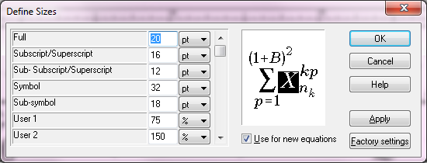
Equation Size Definition
The L symbol used for phase noise comes from the Mathematica5 font

