Slide 1
PLL system and blocks overview
David Ruffieux, Alexandre Vouilloz, Simon Berner

Slide 3
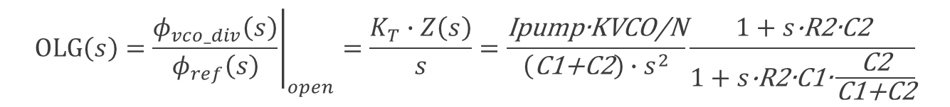
PLL loop equation
KPFD=1/(2∙π)= phase gain of the three-state PFD
Ipump= pumping current for a 360°phase error
KVCO= VCO voltage-to-frequency conversion gain
KT=KPFD∙Ipump∙2∙π∙KVCO/N=Ipump∙KVCO/N
$$OLG\left(s\right)={\left.\frac{φ_{vco_div}\left(s\right)}{φ_{ref}\left(s\right)}\right|}_{open}=\frac{K_{T}∙Z\left(s\right)}{s}=\frac{\text{Ipump}\text{∙}\text{KVCO}\text{/}\text{N}}{\left(\text{C}\text{1+}\text{C}\text{2}\right)∙s^{2}}\frac{1+s\text{∙}\text{R}\text{2∙}\text{C}\text{2}}{1+s\text{∙}\text{R}\text{2∙}\text{C}\text{1∙}\frac{\text{C}\text{2}}{\text{C}\text{1+}\text{C}\text{2}}}$$
With R3=C3=0
~1 if C2>>C1

Slide 4
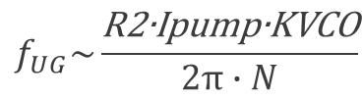
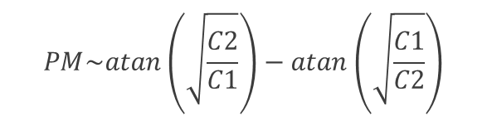

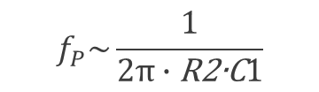
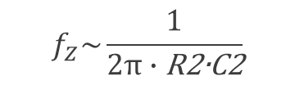
Open loop gain of the PLL (magnitude and phase)
Quick design steps
MAX Phase Margin
> C2/C1 to > PM
R3 = C3 = 0
$$f_{UG}\sim \frac{\text{R}\text{2∙}\text{Ipump}\text{∙}\text{KVCO}}{2π∙N}$$
45° 45°
$$f_{Z}\sim \frac{1}{2π∙\text{R}\text{2∙}\text{C}\text{2}}$$
PM
$$f_{P}\sim \frac{1}{2π∙\text{R}\text{2}\text{∙}\text{C}1}$$
-40dB/dec -20dB/dec
$$f_{UG}\sim \sqrt{f_{Z∙}f_{P}}$$
f_{Z} f_{UG} f_{P}
-60dB/dec
$$PM\sim atan\left(\sqrt{\frac{C2}{C1}}\right)−atan\left(\sqrt{\frac{C1}{C2}}\right)$$

Slide 5
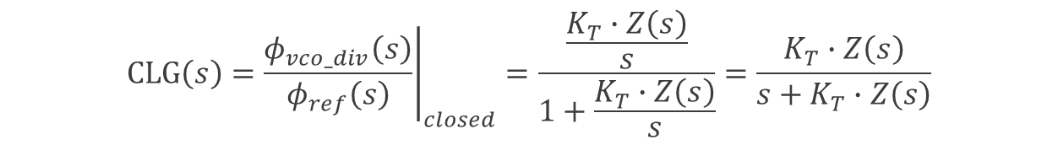

PLL loop equation
KPFD=1/(2∙π)= phase gain of the three-state PFD
Ipump= pumping current for a 360°phase error
KVCO= VCO voltage-to-frequency conversion gain
KT=KPFD∙Ipump∙2∙π∙KVCO/N=Ipump∙KVCO/N
$$CLG\left(s\right)={\left.\frac{φ_{vco_div}\left(s\right)}{φ_{ref}\left(s\right)}\right|}_{closed}=\frac{\frac{K_{T}∙Z\left(s\right)}{s}}{1+\frac{K_{T}∙Z\left(s\right)}{s}}=\frac{K_{T}∙Z\left(s\right)}{s+K_{T}∙Z\left(s\right)}$$
$$\frac{K_{T}∙Z\left(s\right)}{s}>1$$
~1 if
OLG > 1

Slide 6
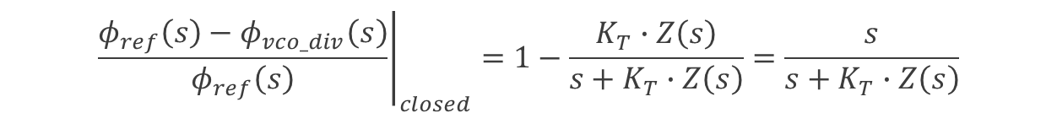

PLL loop equation
KPFD=1/(2∙π)= phase gain of the three-state PFD
Ipump= pumping current for a 360°phase error
KVCO= VCO voltage-to-frequency conversion gain
KT=KPFD∙Ipump∙2∙π∙KVCO/N=Ipump∙KVCO/N
$${\left.\frac{φ_{ref}\left(s\right)−φ_{vco_div}\left(s\right)}{φ_{ref}\left(s\right)}\right|}_{closed}=1−\frac{K_{T}∙Z\left(s\right)}{s+K_{T}∙Z\left(s\right)}=\frac{s}{s+K_{T}∙Z\left(s\right)}$$
$$\frac{K_{T}∙Z\left(s\right)}{s}<1$$
~1 if

Slide 7
LP and HF transfer function of the PLL in closed loop
REF signal/noise is LP filtered
Some peaking though
  HP(s)+LF(s)=1
Single-point modulation up to PLL BW
Pre-emphasis to compensate limited BW
VCO noise is HP filtered
Two-point modulation with proper gain cal.
-40dB/dec
-60dB/dec
wi R3٠C3
40dB/dec

Slide 8
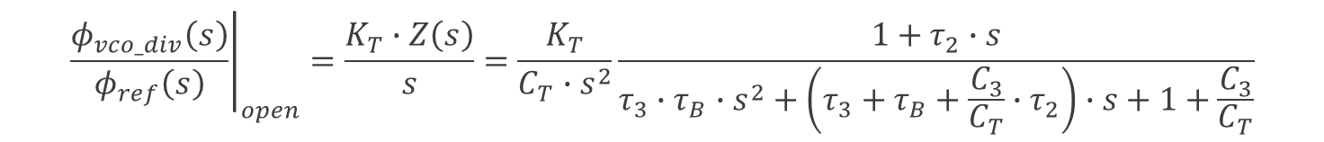
PLL loop equation
KPFD=1/(2∙π)= phase gain of the three-state PFD
Ipump= pumping current for a 360°phase error
KVCO= VCO voltage-to-frequency conversion gain
KT=KPFD∙Ipump∙2∙π∙KVCO/N=Ipump∙KVCO/N
$${\left.\frac{φ_{vco_div}\left(s\right)}{φ_{ref}\left(s\right)}\right|}_{open}=\frac{K_{T}∙Z\left(s\right)}{s}=\frac{K_{T}}{C_{T}∙s^{2}}\frac{1+τ_{2}∙s}{τ_{3}∙τ_{B}∙s^{2}+\left(τ_{3}+τ_{B}+\frac{C_{3}}{C_{T}}∙τ_{2}\right)∙s+1+\frac{C_{3}}{C_{T}}}$$
CT=C1+C2
τ2=R2∙C2
τ3=R3∙C3
τB=τ2∙C1/CT

Slide 9

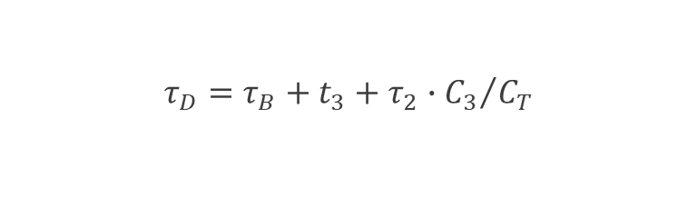

PLL loop equation
KPFD=1/(2∙π)= phase gain of the three-state PFD
Ipump= pumping current for a 360°phase error
KVCO= VCO voltage-to-frequency conversion gain
KT=KPFD∙Ipump∙2∙π∙KVCO/N=Ipump∙KVCO/N
$${\left.\frac{φ_{vco}\left(s\right)}{φ_{ref}\left(s\right)}\right|}_{closed}=\frac{1+τ_{2}∙s}{\frac{C_{T}∙τ_{C}^{2}}{K_{T}}∙s^{4}+\frac{C_{T}∙τ_{D}}{K_{T}}∙s^{3}+\frac{C_{T}+C_{3}}{K_{T}}∙s^{2}+τ_{2}∙s+1}∙N$$
CT=C1+C2
τ2=R2∙C2
τ3=R3∙C3
τB=τ2∙C1/CT
$$τ_{C}^{2}=τ_{3}∙τ_{B}$$
$$τ_{D}=τ_{B}+t_{3}+τ_{2}∙{C_{3}}/{C_{T}}$$

Slide 10







PLL phase noise equation
S(φ_{n,i}) is the i^{th} noise source, equivalent input phase noise PSD
Alternatively compute forward gain up to VCO to replace numerator
Phase noise is 20 log ׀φ_{VCO} ׀
$$4kTR3$$
+
+
+
+
$${Sφ}_{n.PFD}$$
$$i_{n,PUMP}^{2}$$
$${Sφ}_{n.vco}\left(s\right)$$
$${\left.\frac{φ_{vco}\left(s\right)}{φ_{n,i}\left(s\right)}\right|}_{closed}=\frac{\frac{{N∙K}_{T}∙Z\left(s\right)}{s}}{1+\frac{K_{T}∙Z\left(s\right)}{s}}$$
+
$$4kTR2$$
+
$${Sφ}_{n.DIV}$$

Slide 11
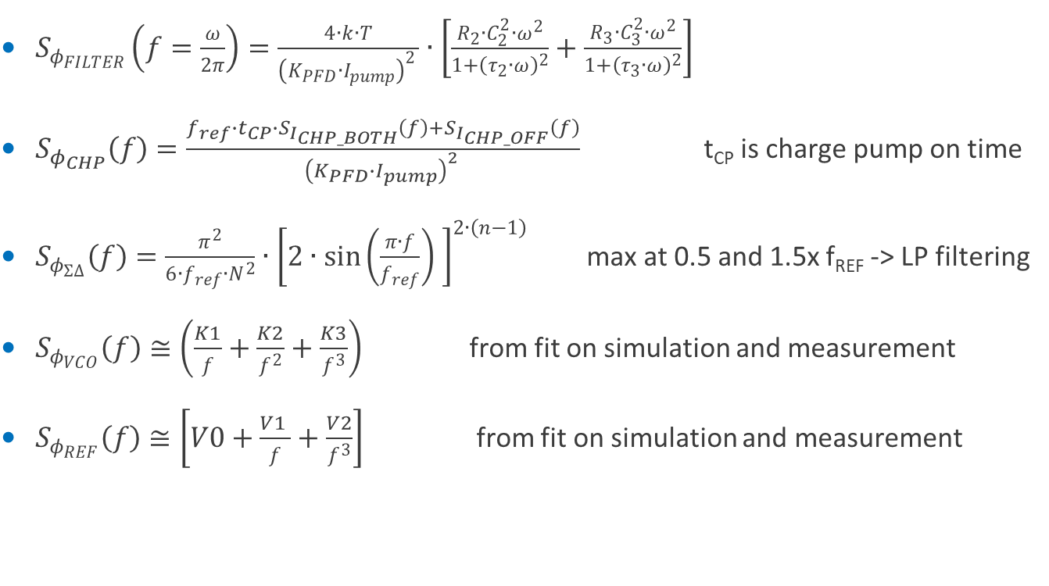
$S_{φ_{FILTER}}\left(f=\frac{ω}{2π}\right)=\frac{4∙k∙T}{{\left(K_{PFD}∙I_{pump}\right)}^{2 }}∙\left[\frac{R_{2}∙C_{2}^{2}∙ω^{2}}{1+{\left(τ_{2}∙ω\right)}^{2}}+\frac{R_{3}∙C_{3}^{2}∙ω^{2}}{1+{\left(τ_{3}∙ω\right)}^{2}}\right]$
$S_{φ_{CHP}}\left(f\right)=\frac{{f_{ref}∙t_{CP}∙S}_{I_{CHP_BOTH}}\left(f\right)+S_{I_{CHP_OFF}}\left(f\right)}{{\left(K_{PFD}∙I_{pump}\right)}^{2 }}$ t_{CP} is charge pump on time
$S_{φ_{Σ∆}}\left(f\right)=\frac{π^{2}}{6∙f_{ref}∙N^{2}}∙{\left[2∙\sin\left(\frac{π∙f}{f_{ref}}\right) \right]}^{2∙\left(n−1\right)}$ max at 0.5 and 1.5x f_{REF} -> LP filtering
$S_{φ_{VCO}}\left(f\right)≅\left(\frac{K1}{f}+\frac{K2}{f^{2}}+\frac{K3}{f^{3}}\right)$ from fit on simulation and measurement
$S_{φ_{REF}}\left(f\right)≅\left[V0+\frac{V1 }{f}+\frac{V2}{f^{3}}\right]$ from fit on simulation and measurement

Slide 12
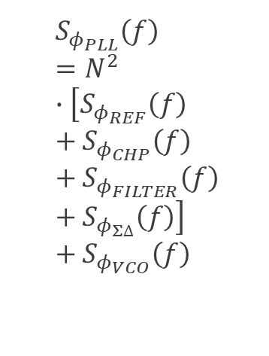
Open loop phase noise contribution with total CL PN
$$S_{φ_{PLL}}\left(f\right)=N^{2}∙\left[S_{φ_{REF}}\left(f\right)+S_{φ_{CHP}}\left(f\right)+S_{φ_{FILTER}}\left(f\right)+S_{φ_{Σ∆}}\left(f\right)\right]+S_{φ_{VCO}}\left(f\right)$$

Slide 13
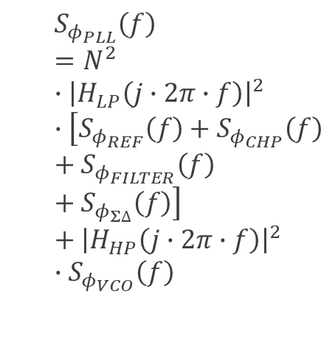
Closed loop phase noise contribution with total CL PN
$$S_{φ_{PLL}}\left(f\right)=N^{2}∙{\left|H_{LP}\left(j∙2π∙f\right)\right|}^{2}∙\left[{S_{φ_{REF}}\left(f\right)+S}_{φ_{CHP}}\left(f\right)+S_{φ_{FILTER}}\left(f\right)+S_{φ_{Σ∆}}\left(f\right)\right]+{\left|H_{HP}\left(j∙2π∙f\right)\right|}^{2}∙S_{φ_{VCO}}\left(f\right)$$

Slide 14
Phase frequency detector with dynamic D=1 DFF
VCO is late -> delay measured -> up
VCO is early, -> reduce its freq
Delay ensures that up/down
both @’1’ during a short τ
No dead zone for small φ_{ERR}

Slide 15
Charge pump implementation
Matched current sources with switches
Switches between power/sources easier
Max current density to reduce C_{STRAY}
Balance WL and IC for N & P
  Min charge injection
Different CP current in RX/TX
Common mode ctrl
  Not necessary
  GDS/desat enough
Offset current in Δ∑ mode to avoid supply pushing
  Will delay vco_div edges (e.g. N-3..N+4) so that they all come after f_{REF}

Slide 16
Loop filter
Mostly differential
  >> PSRR
Thick MOSCAP
  < gate leakage
Arranged flipped //
  << C(V) dep
Prog R2
  UG ctrl
  TX vs RX BW
Large area …
  PM margin trade-off

Slide 17
VCO to highlight symmetry of varactor arrangement
100MHz/V differential gain
Minimize common mode gain
  Dummy R3 and C3 added to lower CM gain
  A bit more noise but >60dB difference
  Note dummy cap on L midpoint !
Core
2x
3.0
/ 2x 0.08
16
: 1
32x 3.0/0.08
5x 45fF
out_N
out_P
tune_p
2x
45fF
TX switch
24k
Ω
24x 3.0/0.12
16x 3.0/0.34
8k
Ω
LOM
LOP
16
: 1
720fF
720fF
mid
720fF
720fF
3x
3.0
/ 2x 0.12
8k
Ω
24k
Ω
TX switch
tune_n

Slide 18
VCO gain and how to keep it well under control
PCAP/NCAP varactor
  PMOS in PW
  NMOS in NW
KVCO is df/dV
  C(V) ~ atan(x)
  Bell shaped curve
  MAX @ small offset
Comparator measures VTUNE for sub-band control
Good sub-band overlap to limit KVCO variations (BW)

Slide 19
Multi-modulus divider: a key building block
Based on injection locked ring oscillator

Slide 20
Generic arrangement with cascade of 2/3 dividers
Recursive behavior
Some logic to (dis)connect
Watch out for leakage
  Slow cells could fail
  Use LVT/MVT/HVT
  Replace with static DFF
Retiming to avoid jitter acc
  Resynch on fast clock

Slide 21
RF sinusoid to rail-to-rail variable divider
Div by 4 with one pure inverting stage combined to
Alternative polarity sinus-controlled current starved inverters (bias with IDAC)
  Balanced load on LO
Shorting logic to divide by 3 (4 + 2 half cycles instead of 4 + 4)

Slide 22
Complete divider
Boolean divider by 3 to determine remainder (0, 1 or 2 div by 4 cycles)
Retiming with DFF (both static and dyn), CK_MASH to modulator

Slide 23
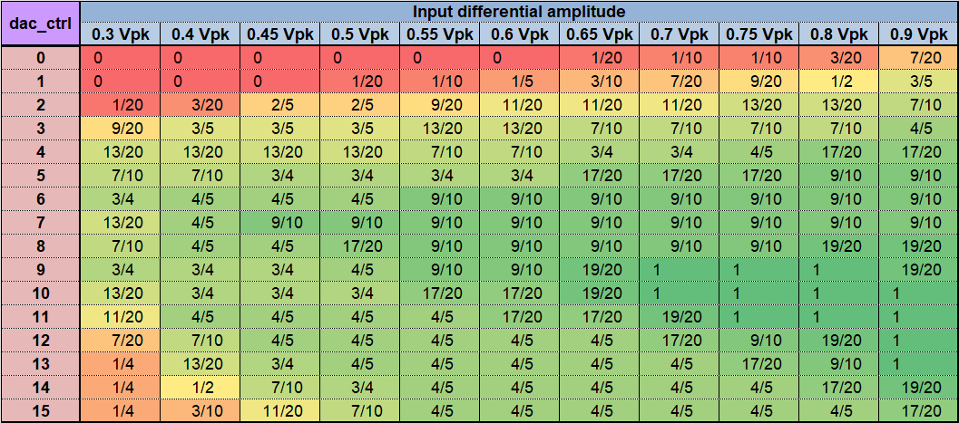
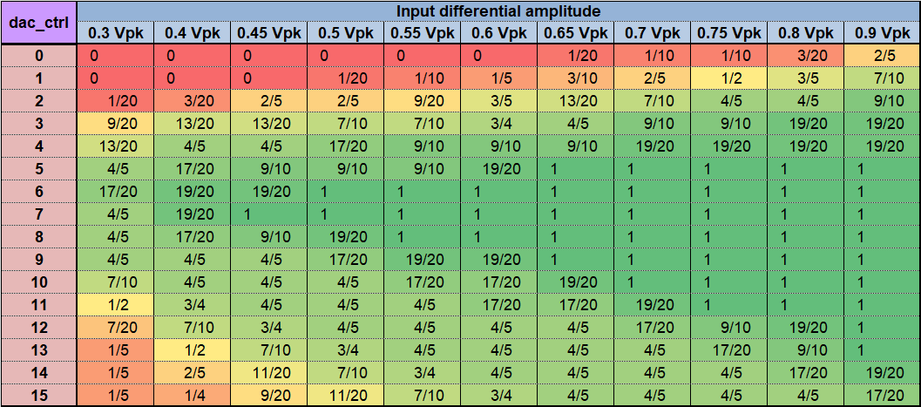
Schmoo plot over PVT variations at 3.417 GHz input
VDD 1.08 to 1.32V
-40 to 105°C
VDD 1.2 to 1.32V
-40 to 105°C

Slide 24
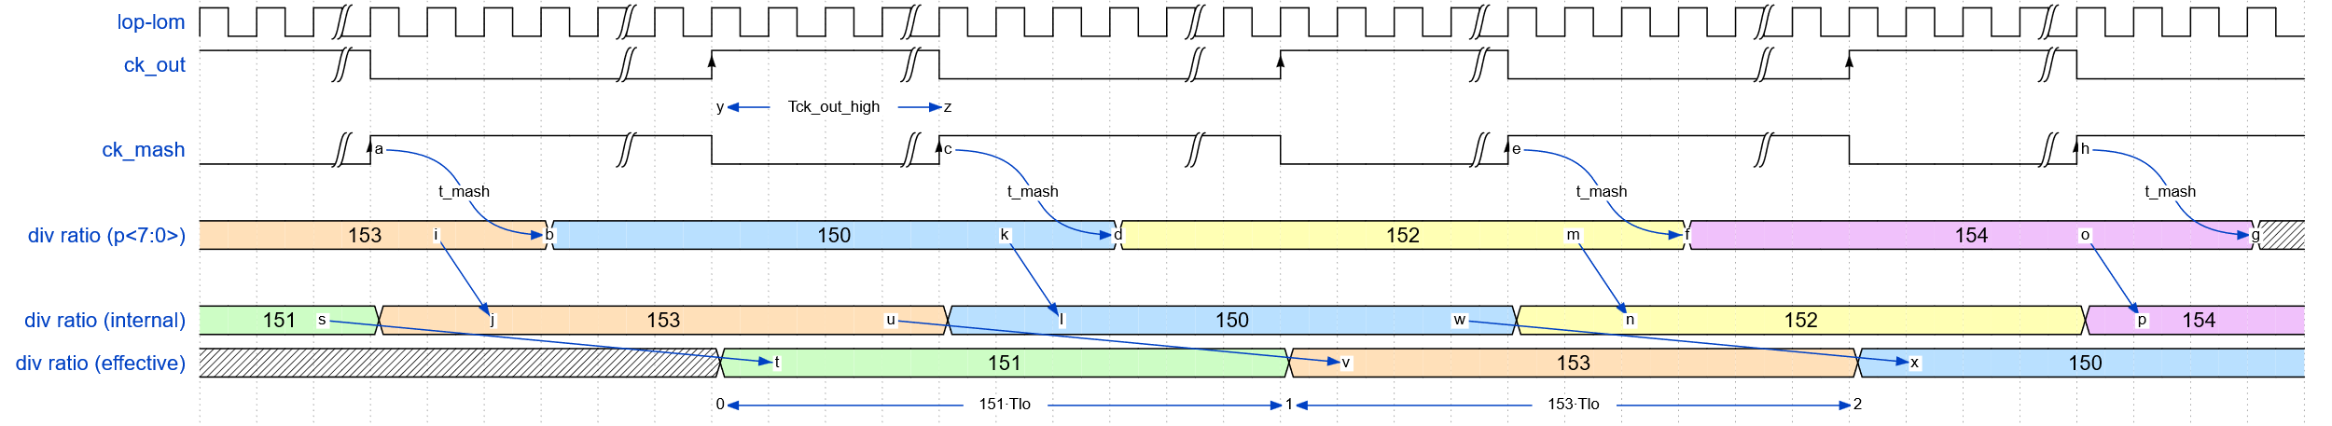
Timing signals

Slide 25
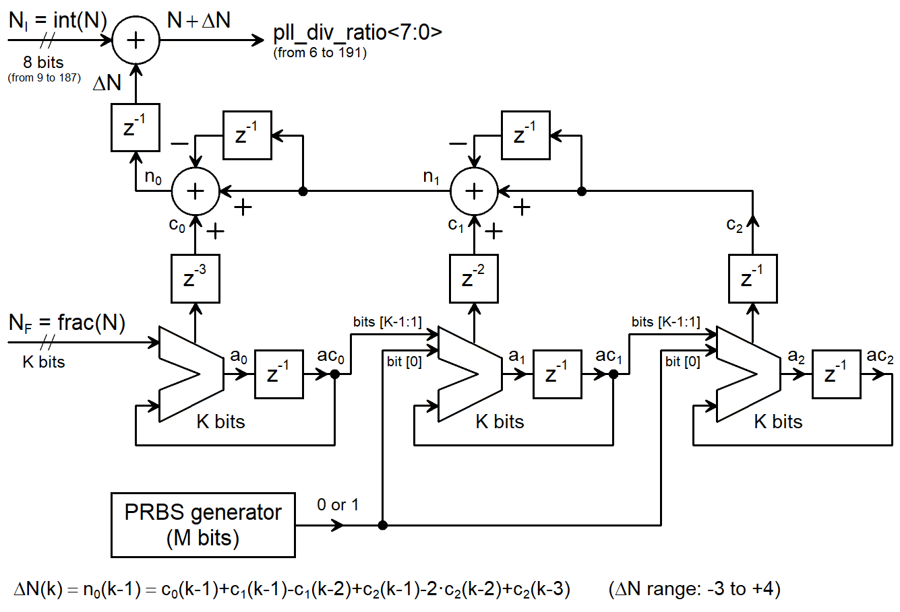
Frequency Control Word
Quantization error/noise shaping with MASH modulator
FCW (N_{T})
N_{INT}+N_{FRAC}
ACC(N_{FRAC})
OVFL -> N+1
ACC_{K} is QE
  -> 2nd ACC
  -> 3rd ACC
  OVFL x (1-z⁻¹)
    no STF error
    NTF= (1-z⁻¹) ^{n-1}
2^{n} consecutive ratios
Pipelining/realignment to reduce setup time
K=19

