Slide 1
EE-426
RF circuits design techniques
6. Noise, the fundamentals only
David Ruffieux & Christian Enz

Slide 2
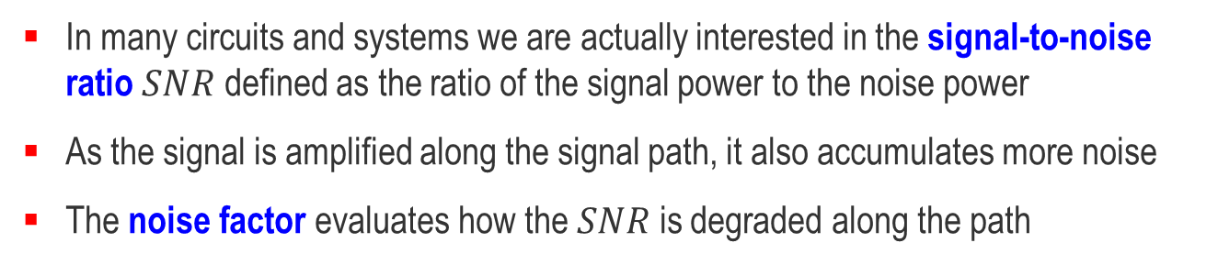
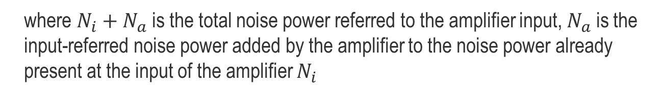
Noise Factor Definition
In many circuits and systems we are actually interested in the signal-to-noise ratio $SNR$ defined as the ratio of the signal power to the noise power
As the signal is amplified along the signal path, it also accumulates more noise
The noise factor evaluates how the $SNR$ is degraded along the path
=
For an amplifier having a power gain $G$ we can write
where $N_{i}+N_{a}$ is the total noise power referred to the amplifier input, $N_{a}$ is the input-referred noise power added by the amplifier to the noise power already present at the input of the amplifier $N_{i}$

Slide 3
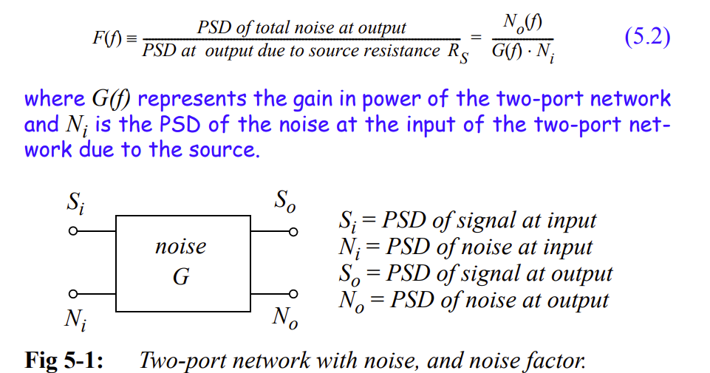
May be calculated at output node

Slide 4
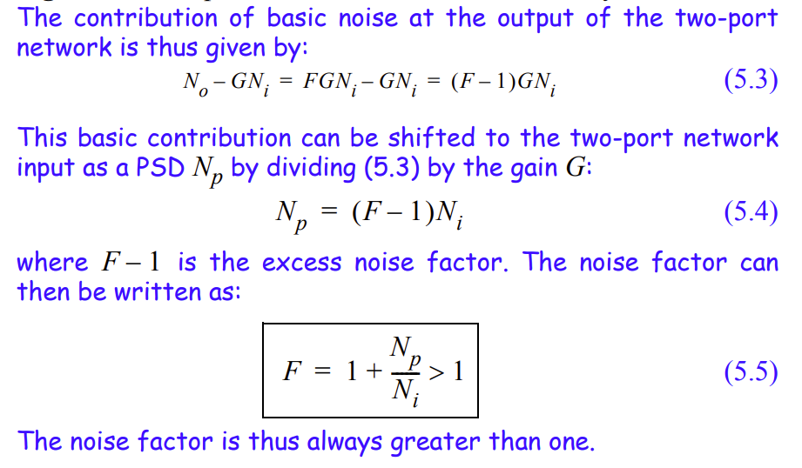
Intrinsic noise of the circuit without input noise
NF is 10log(F) in dB

Slide 5
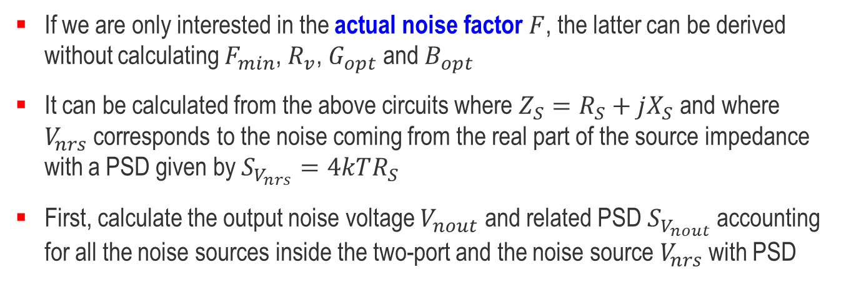
Simplified Calculation of the Actual Noise Factor
If we are only interested in the actual noise factor $F$, the latter can be derived without calculating $F_{min}$, $R_{v}$, $G_{opt}$ and $B_{opt}$
It can be calculated from the above circuits where $Z_{S}=R_{S}+jX_{S}$ and where $V_{nrs}$ corresponds to the noise coming from the real part of the source impedance with a PSD given by $S_{V_{nrs}}=4kTR_{S}$
First, calculate the output noise voltage $V_{nout}$ and related PSD $S_{V_{nout}}$ accounting for all the noise sources inside the two-port and the noise source $V_{nrs}$ with PSD

Slide 6
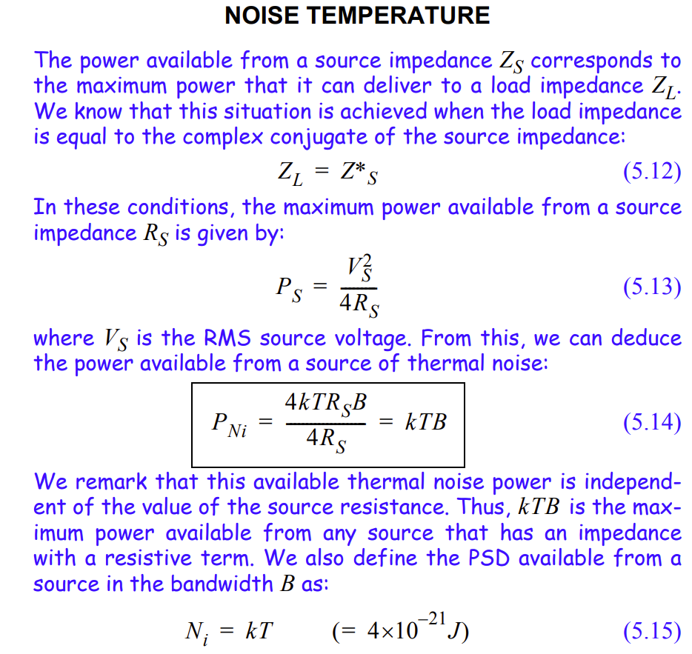
-174dBm

Slide 7
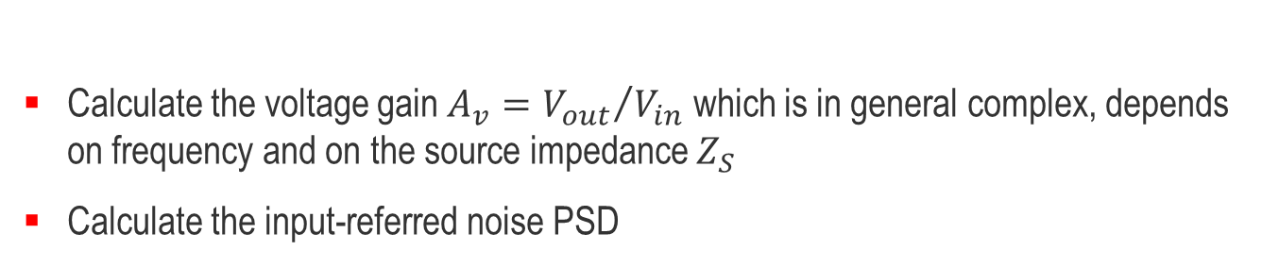
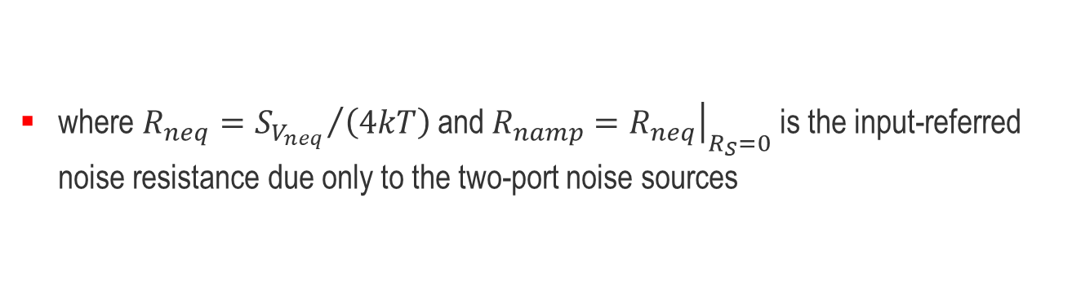
Simplified Calculation of the Actual Noise Factor
Calculate the voltage gain $A_{v}={V_{out}}/{V_{in}}$ which is in general complex, depends on frequency and on the source impedance $Z_{S}$
Calculate the input-referred noise PSD
The noise factor is then given by
where $R_{neq}={S_{V_{neq}}}/{\left(4kT\right)}$ and $R_{namp}={\left.R_{neq}\right|}_{R_{S}=0}$ is the input-referred noise resistance due only to the two-port noise sources

Slide 8

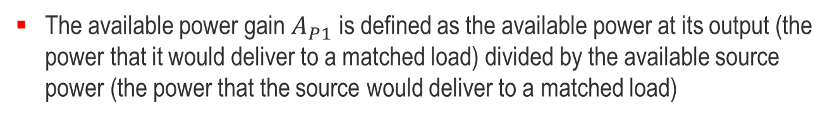
The Friis Formula
The noise factor $F_{tot}$ of a cascade of two amplifiers each characterized by their noise factors $F_{1}$ and $F_{2}$ and their available power gains $A_{P1}$ and $A_{P2}$ is given by
The available power gain $A_{P1}$ is defined as the available power at its output (the power that it would deliver to a matched load) divided by the available source power (the power that the source would deliver to a matched load)
Can be generalized to the cascade of $m$ stages

Slide 9
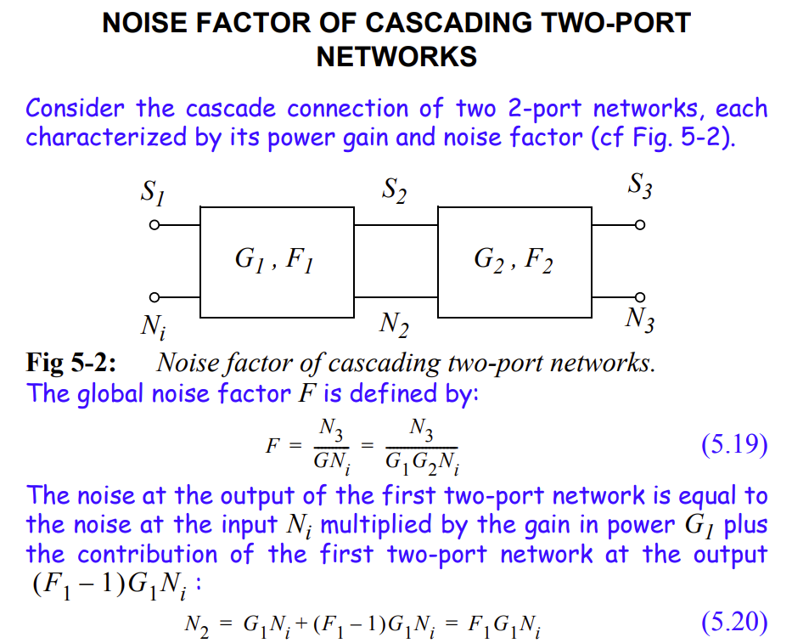

Slide 10
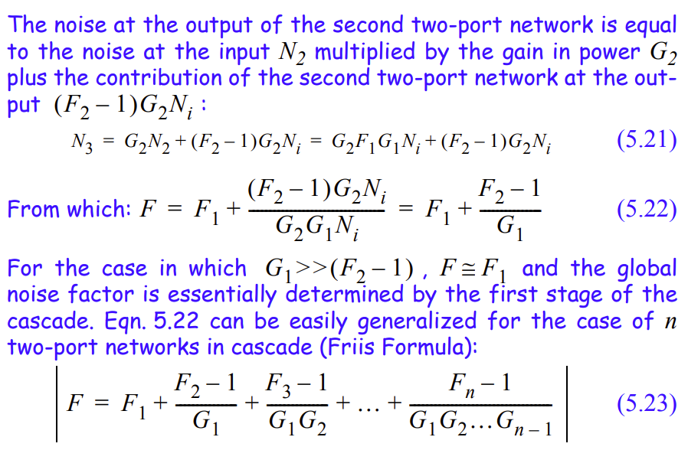

Slide 11
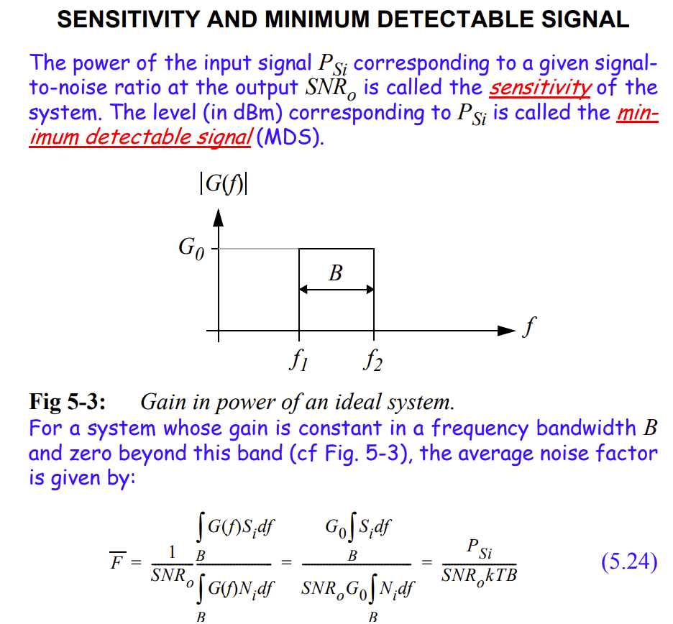

Slide 12
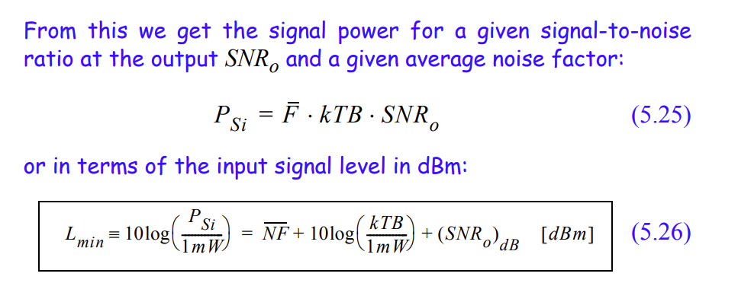
Sensitivity equation

