Slide 1

Fundamentals of Electrical Circuits and Systems
Chapter 6: AC Circuits 3
Farhad Rachidi
École Polytechnique Fédérale de Lausanne
Lausanne, Switzerland

Slide 2
AC Circuits 3
Source with internal impedance
Impedance networks
  Impedance in series
  Impedance in parallel
Phasor and impedance diagram
Voltage and current dividers
Thévenin and Norton theorems in AC circuits
Examples
Instantaneous power in AC circuits
Active power P
Reactive power Q
P and Q for a resistor, an inductor, a capacitor
P and Q for an impedance
Apparent power S
Power factor
Power factor correction
Example

Slide 3
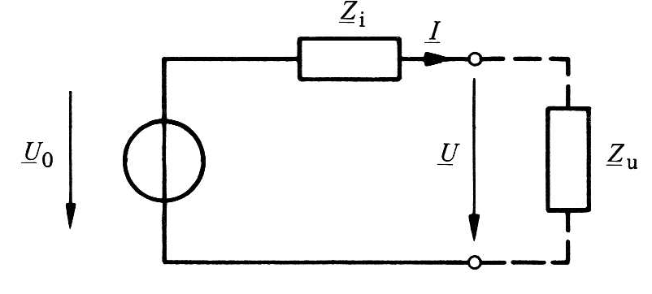
Source with internal impedance
Generalization of the notion of internal resistance: internal impedance

Slide 4
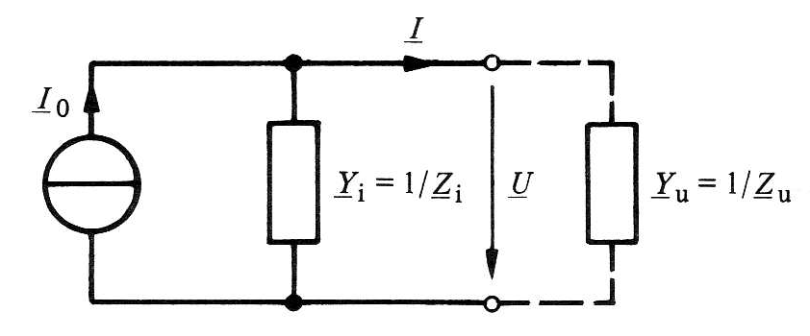
Source with internal impedance
Equivalent representation in terms of current source

Slide 5
Equivalence voltage/current sources

Slide 6
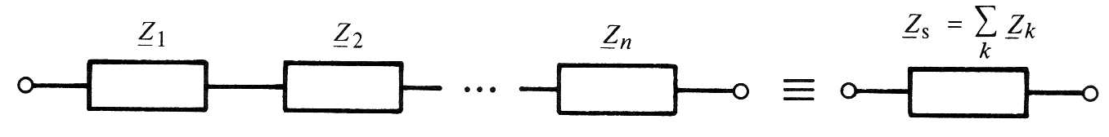
Impedance / admittance in series

Slide 7
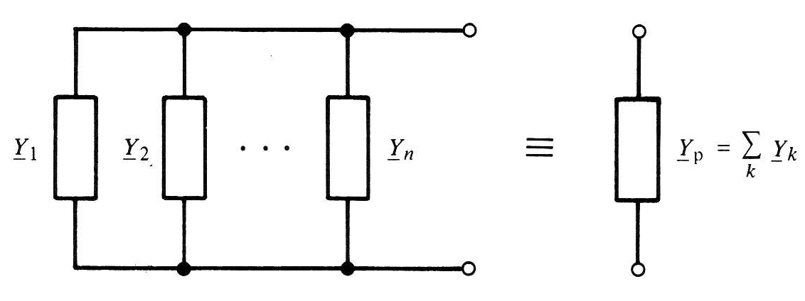
Impedance / admittance in parallel

Slide 8
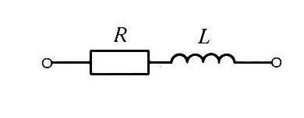
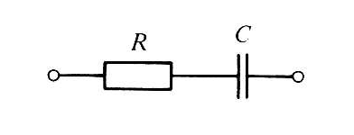
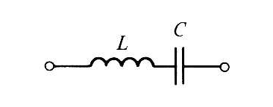
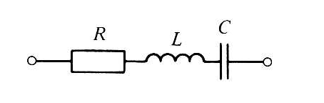
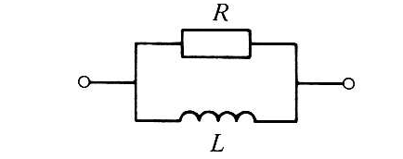
Elementary Composite Bipoles
Circuit | Impedance | Admittance

Slide 9
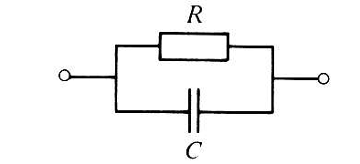
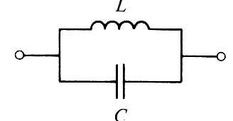
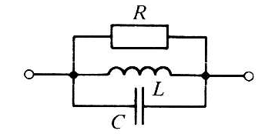
Elemental Composite Bipoles (continued)
Circuit | Impedance | Admittance

Slide 10
Impedance diagram
Resistance
Inductance
Im
Im
Re
Re
Im
Capacitance
Re

Slide 11
Impedance diagram
RLC circuit in series
Im
Re

Slide 12
Impedance diagram
RLC circuit in series
Im
Re

Slide 13
Phasor diagram
RLC circuit in series
Im
Given: current I
Problem: calculate U
Re

Slide 14
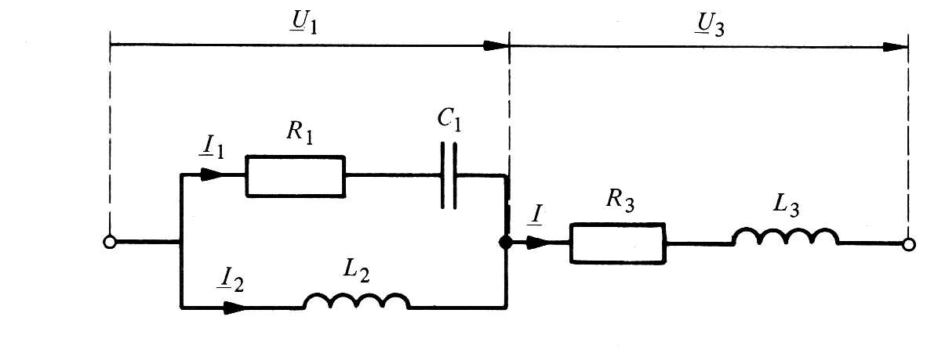
Phasor diagram: series-parallel circuit
Given: current I₁
Problem: calculate U= U₁+U₃
Im
0

Slide 15
Question
We have two impedances in series Z₁ and Z₂. The module of the equivalent impedance is the sum of the modules.
A: True
B: False

Slide 16
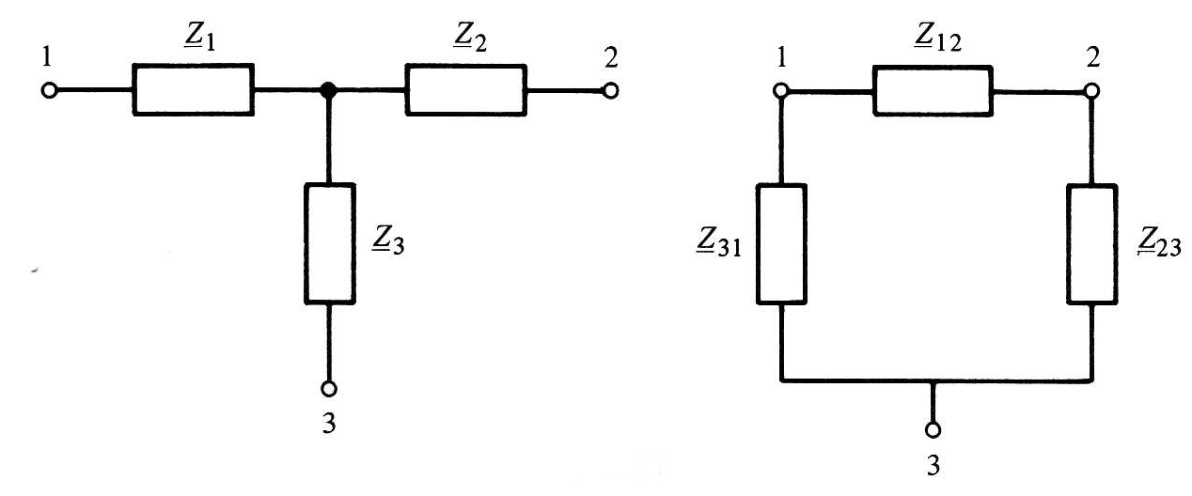
Equivalent tripoles

Slide 17
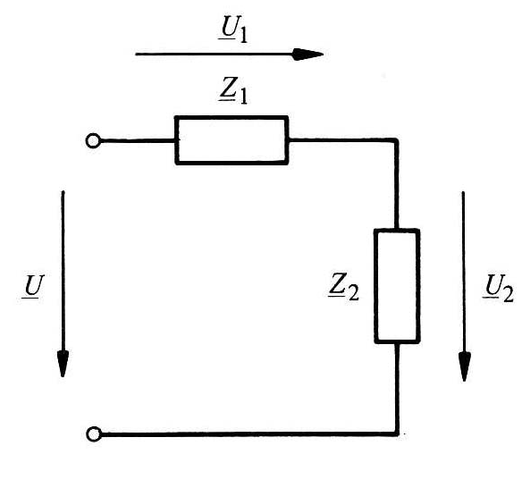
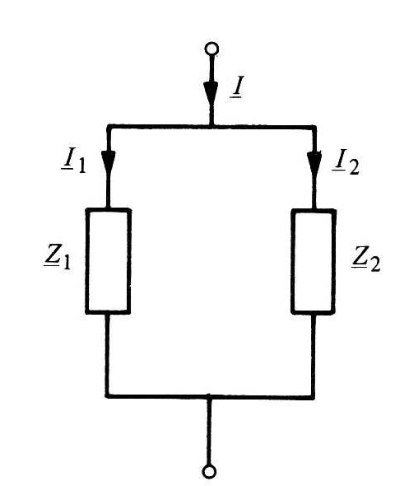
Voltage and current dividers

Slide 18
Thévenin’s theorem in AC circuits
a
b
All sources have the same frequency

Slide 19
Norton’s theorem in AC circuits
a
b
All sources have the same frequency

Slide 20
Example 1: RL circuit in series
Determine I, U_{R} and U_{L}

Slide 21
Example 2: RC circuit in series
Determine I, U_{R} and U_{C}

Slide 22
Example 3: RLC circuit
Determine the current i(t)

Slide 23
Example 4: Thévenin’s theorem
Determine the voltage U

Slide 24

Question
The resistance of the following impedence is
A:
B:
C:

Slide 25
Instantaneous power in AC circuits
Voltage
Current

Slide 26
Instantaneous power in AC circuits
Im
Re

Slide 27
Instantaneous power in AC circuits
Instantaneous power:
Constant
component
Sinusoidal component
(double frequency)

Slide 28
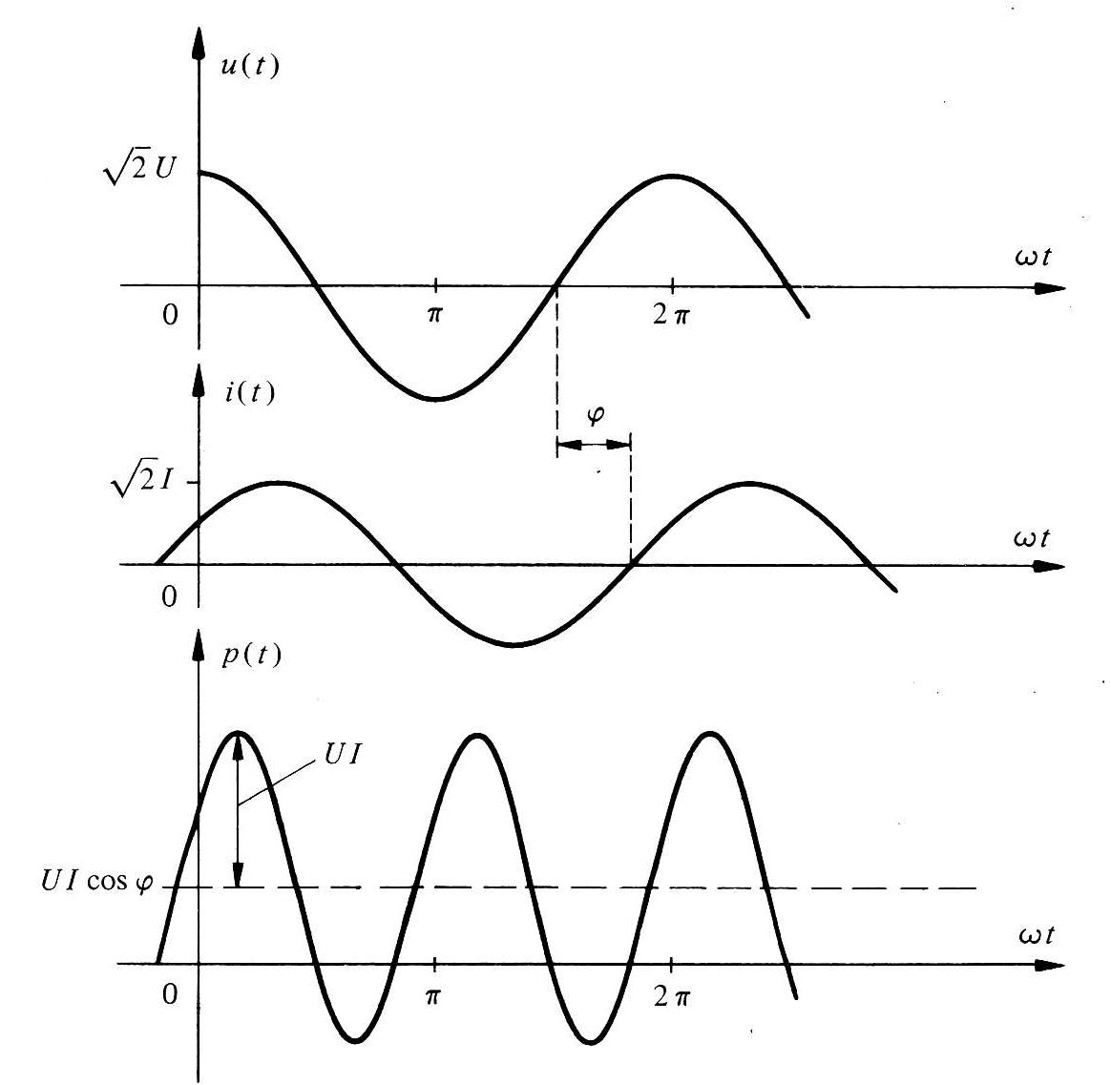
Instantaneous power in AC circuits

Slide 29
Instantaneous power in AC circuits
Using the following trigonometric identity:
Instantaneous power becomes:
Pulsed component, positive,
which oscillates around UIcosφ
Alternative component with
average value of zero
Translates a unidirectional
energy exchange
Translates an oscillatory
energy exchange

Slide 30
Active and reactive power
Active power
W
Reactive power
var (volt-ampere-reactive)
Reactive power : storage and periodic return of energy at twice the frequency of current and voltage

Slide 31
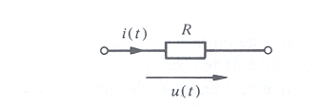
P and Q for a resitor
Active power
Reactive power
Instantaneous power :

Slide 32
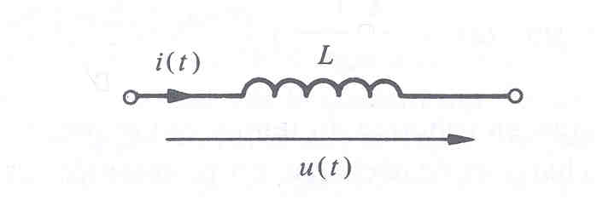
P and Q for an inductor
Active power
Reactive power
Instantaneous power :
An inductor does not dissipate energy: energy is absorbed during
one half of each half cycle and returned during the other half.

Slide 33
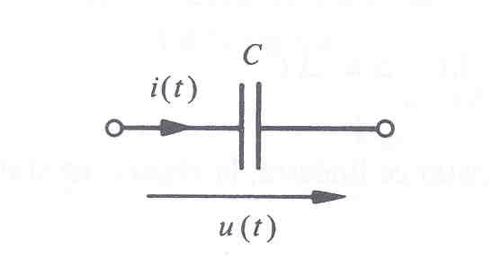
P and Q for a capacitor
Active power
Reactive power
Instantaneous power :

Slide 34
P and Q for an impedance
Active power
Reactive power
Instantaneous power :

Slide 35
Question
What would be the expression of the active power expressed as a function of the voltage?
Can not express it according to the voltage
B.
C.
D. None of the above
Notes:
c

Slide 36
Complex apparent power
The complex apparent power, noted S:
The real part of S corresponds to P
The imaginary part of S corresponds to Q
Used to represent P and Q in complex form
The apparent power unit is the voltampere (VA)

Slide 37
S for an impedance

Slide 38
S for an impedance
Taking the voltage as reference:
We can write :
And then :

Slide 39
Apparent power
Triangle of impedances
And of powers
Z
X
S
Q
R
P

Slide 40
Reactive power: example
Single-phase line, RL charge in series
source
line
charge

Slide 41
Reactive power: example (continued)

Slide 42
Reactive power: example (continued)
Losses in the line:
Losses in the line are worth, to a factor, the reactive power

Slide 43
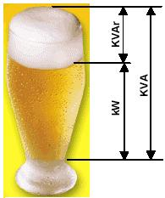
Power: analogy

Slide 44
Power factor
The power factor is defined by
φ being between –π/2 and π/2, the power factor is always
positive and between 0 and 1
Resistance:
Inductance:
Capacitance:

Slide 45
Improving the power factor
In general, in industry, charges are inductive in nature
To get the most out of the equipment, the actual power must be as close as possible to the apparent power, i.e. the reactive power must be minimized

Slide 46
Improving the power factor
In the triangle of powers, the length S must tend towards the one of P and φ must be as small as possible.
This angle is reduced by adding capacitors in parallel with the charge: this is the correction of the power factor.

Slide 47
Active and reactive powers: example
An industrial charge is represented by an impedance formed by the series setting of a resistor and an inductor. The voltage across the charge is U_{L}= 250e^{j0} (V).
Calculate the current I_{L}, Q, P, S and F_{p} of the charge.
b) Calculate the voltage of the source if the line connecting the source to the charge has a given impedance Z_{l}. Calculate the power lost in the line.
c) If we add a capacitor of X_{C} =-12.5 Ω in parallel, calculate the current taken by the C, the new current supplied by the source and F_{p} of the entire charge and capacity (for the same voltage across the charge).
d) Calculate the new voltage of the source and the new power loss in the line.

Slide 48
Solution
a)

Slide 49
Active and reactive powers: example
An industrial charge is represented by an impedance formed by the series setting of a resistor and an inductor. The voltage across the charge is U_{ch}= 250e^{j0} (V).
Calculate the current I_{ch}, Q, P, S and F_{p} of the charge.
b) Calculate the voltage of the source if the line connecting the source to the charge has a given impedance Z_{l}. Calculate the power lost in the line.
c) If we add a capacitor of X_{C} =-12.5 Ω in parallel, calculate the current taken by the C, the new current supplied by the source and F_{p} of the entire charge and capacity (for the same voltage across the charge).
d) Calculate the new voltage of the source and the new power loss in the line.

Slide 50
Solution (continued)
b)

Slide 51
Active and reactive powers: example
An industrial charge is represented by an impedance formed by the series setting of a resistor and an inductor. The voltage across the charge is U_{ch}= 250e^{j0} (V).
Calculate the current I_{ch}, Q, P, S and F_{p} of the charge.
b) Calculate the voltage of the source if the line connecting the source to the charge has a given impedance Z_{l}. Calculate the power lost in the line.
c) If we add a capacitor of X_{C} =-12.5 Ω in parallel, calculate the current taken by the C, the new current supplied by the source and F_{p} of the entire charge and capacity (for the same voltage across the charge).
d) Calculate the new voltage of the source and the new power loss in the line.

Slide 52
Solution (continued)
c)

Slide 53
Active and reactive powers: example
An industrial charge is represented by an impedance formed by the series setting of a resistor and an inductor. The voltage across the charge is U_{ch}= 250e^{j0} (V).
Calculate the current I_{ch}, Q, P, S and F_{p} of the charge.
b) Calculate the voltage of the source if the line connecting the source to the charge has a given impedance Z_{l}. Calculate the power lost in the line.
c) If we add a capacitor of X_{C} =-12.5 Ω in parallel, calculate the current taken by the C, the new current supplied by the source and F_{p} of the entire charge and capacity (for the same voltage across the charge).
d) Calculate the new voltage of the source and the new power loss in the line.

Slide 54
Solution (continued)
d)

