Slide 1

Fundamentals of Electrical Circuits and Systems
Chapter 5: AC Circuits 2
Farhad Rachidi
École Polytechnique Fédérale de Lausanne
Lausanne, Switzerland

Slide 2
AC Circuits 2
Phasors and complex numbers
Complex numbers
  Notions of complex algebra
  Euler's formula
  Derivation and integration
Phasors
  Definition
  Basic operations
Impedance and admittance

Slide 3

Phasors and complex numbers
Phasor : simple way to represent sinusoidal voltages and currents. This method has been proposed by C.P. Steinmetz and is based on Euler's relation.
Charles Proteus Steinmetz (1865-1923), American electrical engineer of German origin. He developed the symbolic method for AC calculations.

Slide 4
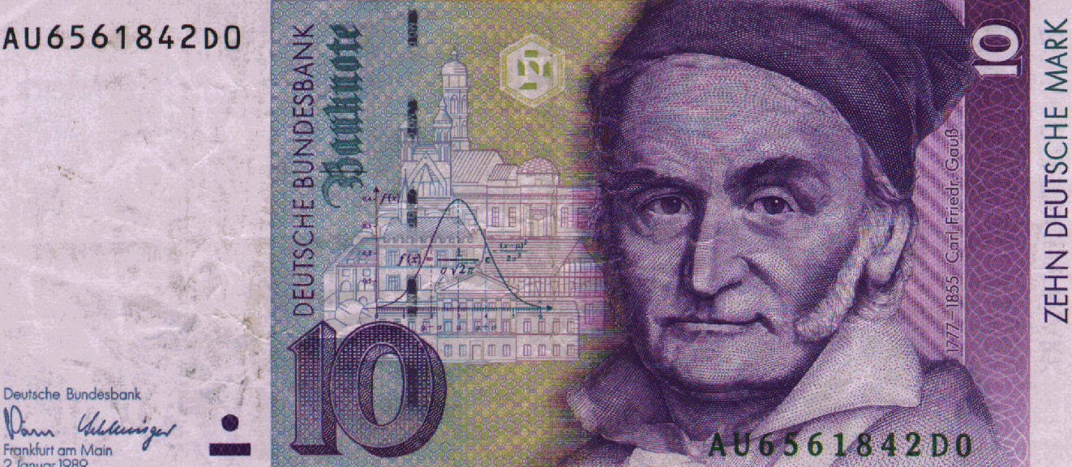
Complex numbers: definition
We call complex number z any expression of the form
where
and
Etc.
Carl Friedrich Gauss (1777-1855), astronomer, mathematician and German physicist. He introduced the complex calculus in 1801.

Slide 5
Notions of complex algebra
Equality of two complex numbers
Complex conjugate of

Slide 6
Notions of complex algebra
Addition and substraction
Multiplication

Slide 7
Notions of complex algebra
Division
Complex Conjugate of Elementary Operations

Slide 8
Complex Numbers: Geometric Representation
We call a the real part, and b the imaginary part of the complex number z.
Representation in the complex plane:
Imaginary axis
Real axis

Slide 9
Complex Numbers: Geometric Representation
Imaginary axis
Real axis
: complex number modulus
: argument of the complex number

Slide 10
Complex numbers: Other properties
Distance between two complex numbers:

Slide 11
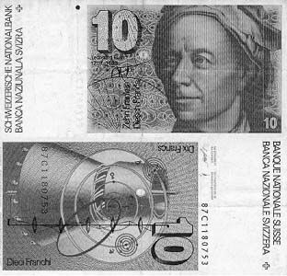
Complex numbers: Euler’s Formula
Leonhard Euler (1707-1783), Swiss mathematician died in St. Petersburg.

Slide 12
Complex numbers: Euler’s Formula
Imaginary axis
Real axis
Particular case:

Slide 13
Complex numbers: Derivation from the argument
Im
Re

Slide 14
Complex numbers: Integration with the argument
Im
Re

Slide 15
Complex Numbers: Powers and Roots
Power :
Roots:

Slide 16
Complex representation of a sinusoidal quantity
Reminder: Euler's formula
Let a sinusoidal function
: complex instantaneous value

Slide 17
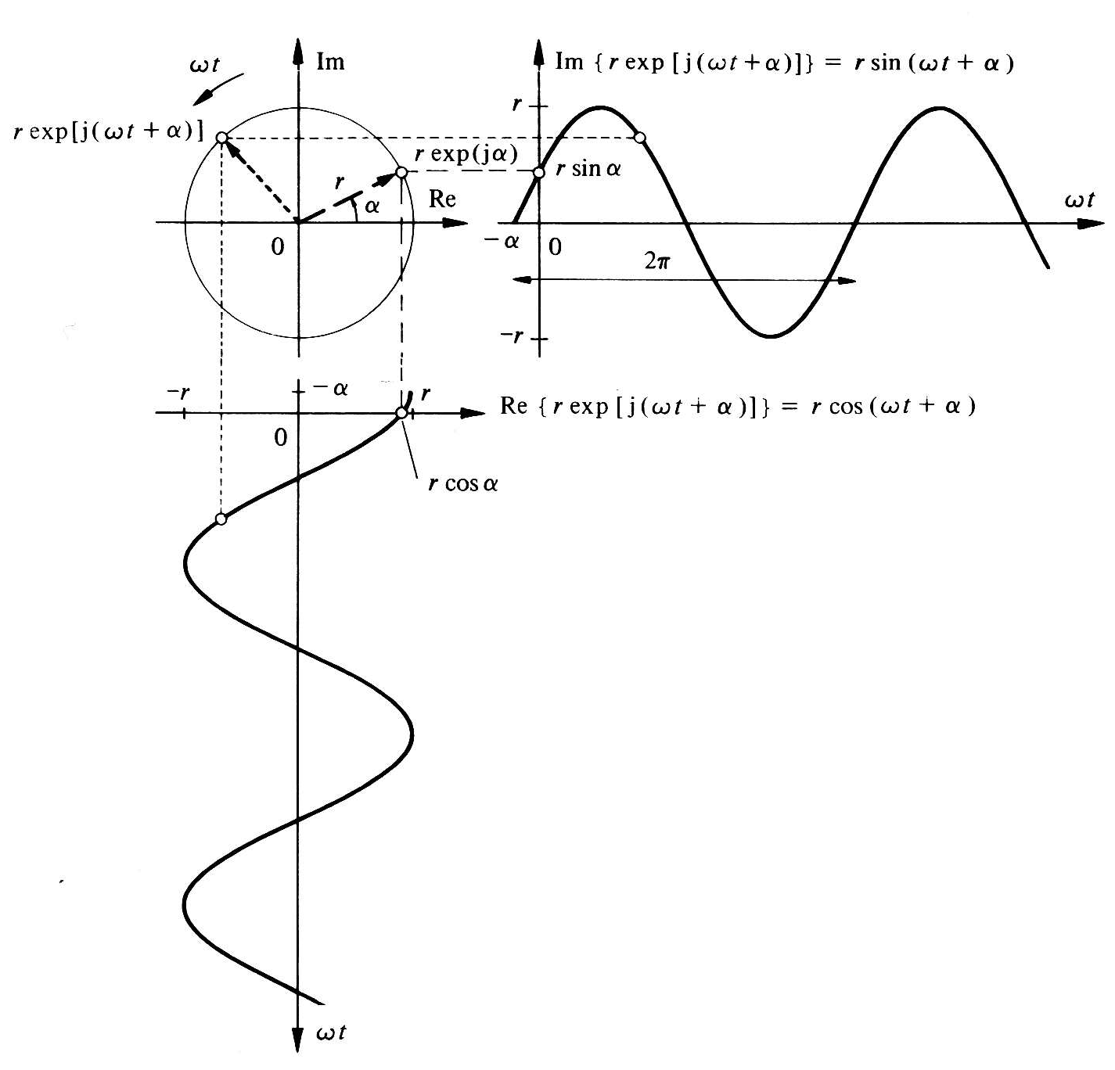
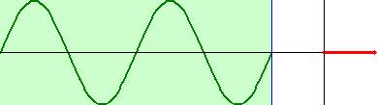
Complex representation of a sinusoidal quantity
Animation

Slide 18
The Phasor
In a linear electrical circuit with sinusoidal sources, all currents and voltages have the same pulsation ω. The term exp(jωt) is therefore common to all quantities (currents and tensions) of the circuit. Any size can be characterized only by its amplitude (rms value) X and its phase θ.
The phasor associated with x(t):

Slide 19
The Phasor
Phasor does not depend on time
In a linear electrical circuit with sinusoidal sources, all currents and voltages have the same pulsation ω. The term exp(jωt) is therefore common to all quantities (currents and tensions) of the circuit. Any size can be characterized only by its amplitude (rms value) X and its phase θ.
The phasor associated with x(t):

Slide 20
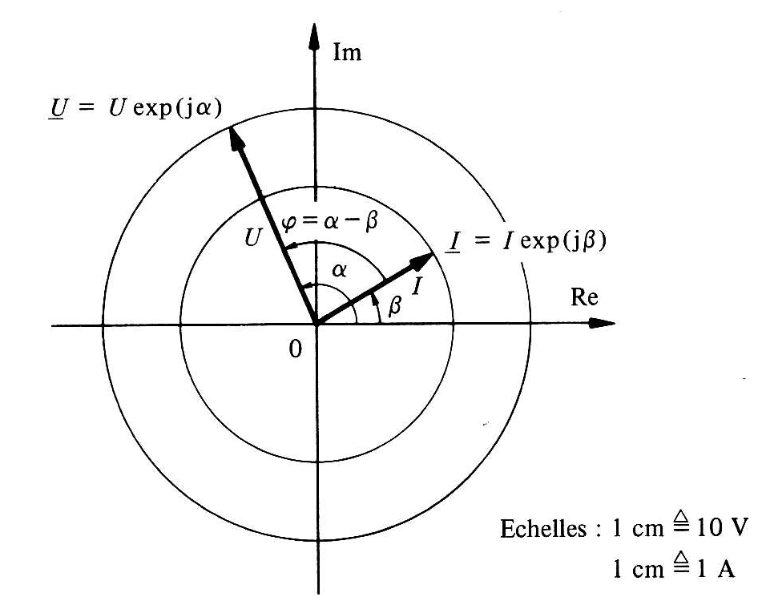
Phasor diagram
Scale:

Slide 21
Basic operations on phasors
Addition
Im
Re

Slide 22
Basic operations on phasors
Substraction
Im
Re

Slide 23
Basic operations on phasors
Multiplication
with
and

Slide 24
Basic operations on phasors
Quotient
with
and

Slide 25
Derivation of a sinusoidal quantity
Sinusoidal quantity
Complex instantaneous value
Phasor
Derivation with respect to time:
Equivalent to a multiplication by jω !

Slide 26
Derivation of a sinusoidal quantity
Generalization :

Slide 27
Integration of a sinusoidal quantity
Integration with respect to time:
Equivalent to a division by jω !

Slide 28
Derivation and integration of a sinusoidal quantity
The use of a complex representation of sinusoidal quantities makes it possible to replace the derivation and integration operations by multiplication or division by jω.
Thus an integro-differential equation is transformed into an algebraic equation !

Slide 29
Geometric interpretation
Im
Re

Slide 30
Geometric interpretation
Im
Re

Slide 31
Impedance and admittance
The complex impedance of a bipole in a sinusoidal circuit :
The complex admittance of a bipole in a sinusoidal circuit :

Slide 32
Impedance and admittance
Z expressed in ohm
Y expressed in siemens

Slide 33
Impedance and admittance
R: resistance
X: reactance
G: conductance
B: susceptance

Slide 34
Impedance and admittance
Im
Re

Slide 35
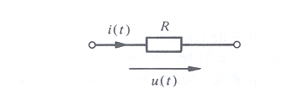
Application to the resistance
Instantaneous values
Phasors

Slide 36
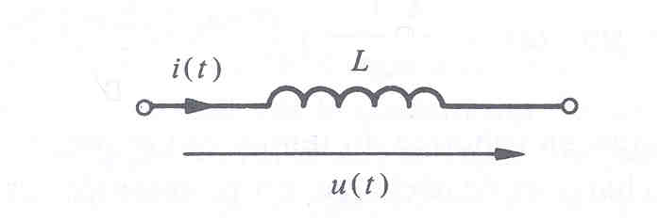
Application to inductance
Instantaneous values
Phasors

Slide 37
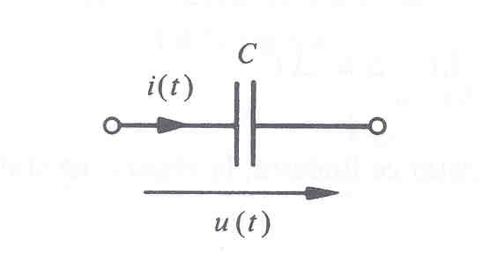
Application to capacitance
Instantaneous values
Phasors

Slide 38
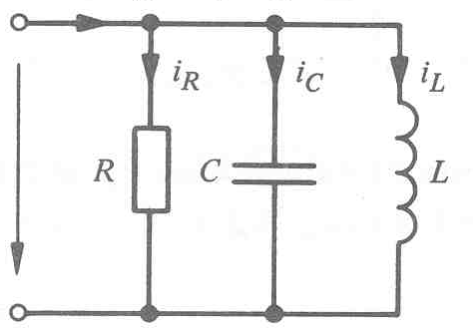
Example
Evaluate rms value, frequency and period of total current i(t)
Analytically determine the current in each element and that provided by the source
Draw each of these currents

Slide 39
Example
Evaluate rms value, frequency and period of total current i(t)
Analytically determine the current in each element and that provided by the source
Draw each of these currents
Calculation on the board!
But this time using phasors!

