Slide 1

Fundamentals of Electrical Circuits and Systems
Chapter 4: AC Circuits 1
Farhad Rachidi
École Polytechnique Fédérale de Lausanne
Lausanne, Switzerland

Slide 2
AC Circuits 1
Periodic functions
Sinusoidal quantities
Importance of AC circuits
Response of a linear circuit to a sinusoidal excitation
Example

Slide 3
Periodic functions
A periodic function is a function that satisfies the relation f(t) = f(t + nT), where n is an integer and T is the period measured in unit of time.
x(t)
t
T

Slide 4
Some definitions
Peak value or amplitude A :
maximum value of a periodic function
x(t)
A
t
T

Slide 5
Some definitions
Peak-to-peak value :
maximum amplitude difference reached during a period
x(t)
Peak-to-peak
t
T

Slide 6
Some definitions
Mean value:
x(t)
X
t
T

Slide 7
Some definitions
Root Mean Square (RMS):
The rms value is always positive!

Slide 8
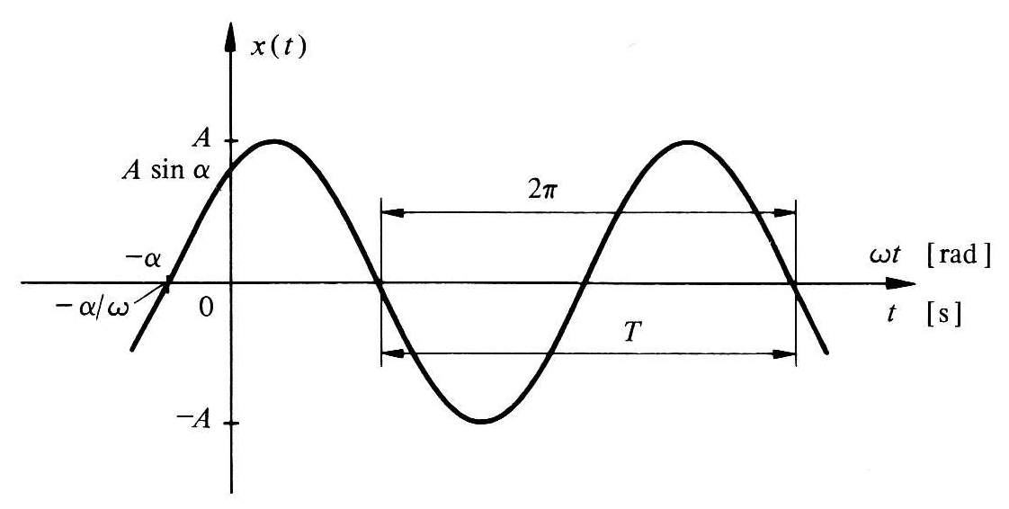
Sinusoidal function

Slide 9
Sinusoidal function: frequency
Frequency: Number of cycles per unit of time

Slide 10
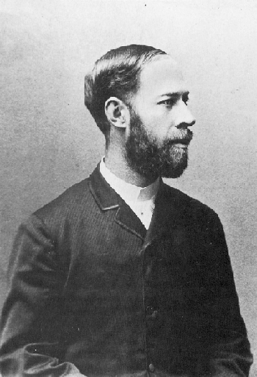
Sinusoidal function: frequency
The unit of measure of the frequency: hertz (Hz)
A hertz corresponds to the frequency of a periodic phenomenon whose period T is a second
Heinrich Hertz (1857-1894), German physicist. His work confirmed Maxwell's electromagnetic theory of light.

Slide 11
Sinusoidal function: angular frequency or pulsation
Angular frequency or pulsation : ω
Unit rad/s

Slide 12
Sinusoidal function: mean and rms values
Mean value
Rms value

Slide 13
Rms value of a sinusoidal quantity:
Rms values

Slide 14
Question
When we talk about a sinusoidal voltage of 230 V, it is about
Its peak value
Its mean value
Its rms value
None of the above
Notes:
A

Slide 15
Phase difference between two sinusoidal quantities
Phase difference between u(t) and i(t):
Note: we always consider the main value of the phase difference between -π and π.
: voltage ahead of the current
: voltage behind the current

Slide 16
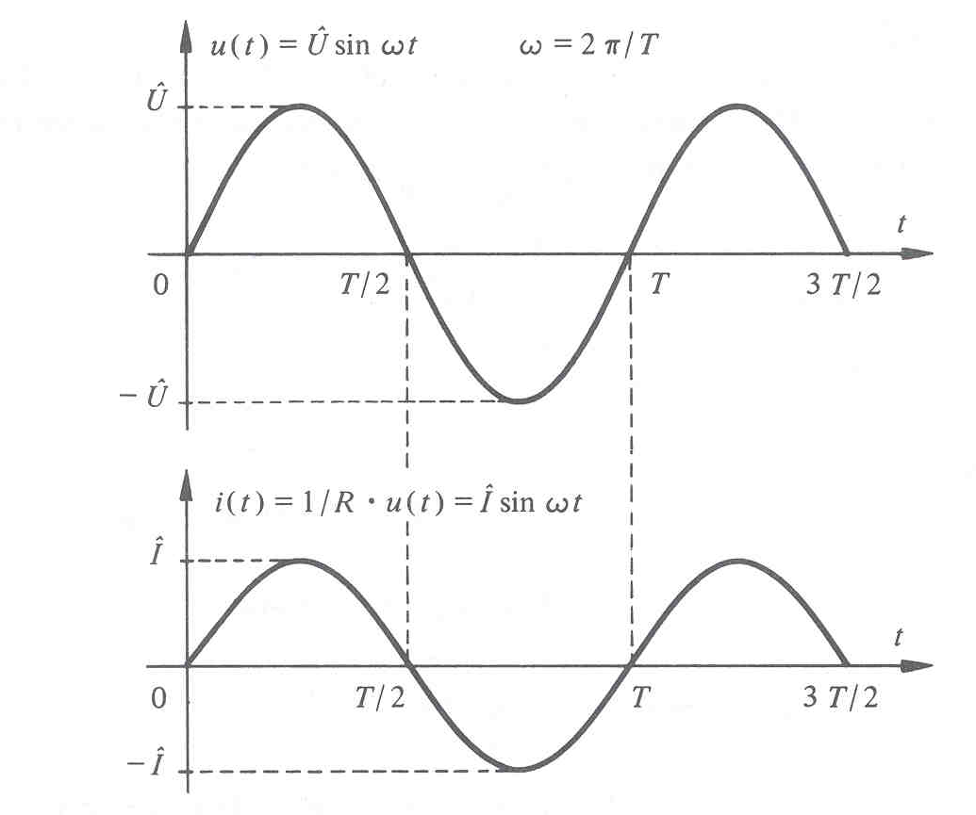
Heating of a resistor
When the voltage is sinusoidal, the average power dissipated in a resistor is equal to the integral, over a period of time, of the product of instantaneous current and voltage.

Slide 17
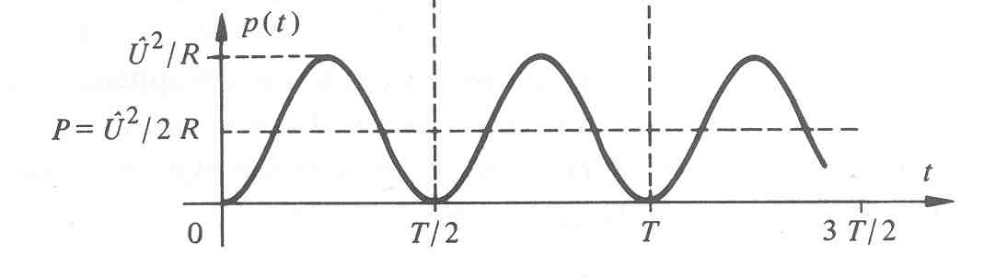
Heating of a resistor

Slide 18
Heating of a resistor

Slide 19
Heating of a resistor
The rms value has been defined so that a continuous volt or 1 volt alternating produces the same heating in a resistor!

Slide 20
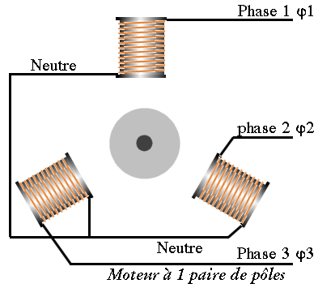
Importance of AC circuits
Classical production of electrical energy provides a sinusoidal voltage: conversion mechanical energy - electrical energy: rotation of a coil placed in a magnetic field
ω
B

Slide 21
Importance of AC circuits
The only periodic function that has a derivative and a similar integral

Slide 22
Importance of AC circuits
The sum of two sinusoidal functions is a sinusoidal function

Slide 23
Importance of AC circuits
Fourier series development: representation of a periodic signal f(t) by sinusoidal functions
with

Slide 24
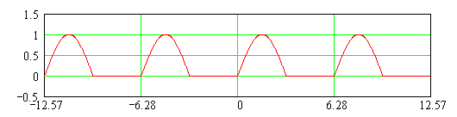
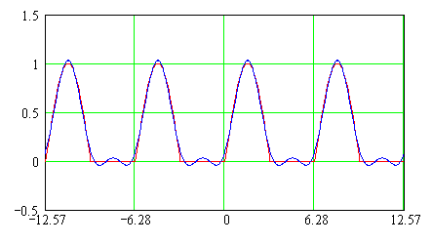
Representation of a periodic signal by sinusoidal functions: Example 1
Rectified sinusoidal function:
2 first terms of the Fourier series:

Slide 25
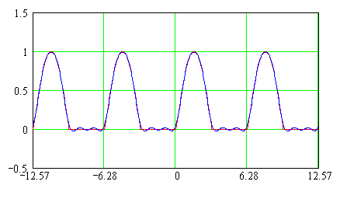
Representation of a periodic signal by sinusoidal functions: Example 1
Rectified sinusoidal function:
4 first terms of the Fourier series:

Slide 26
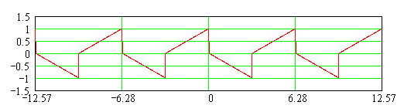
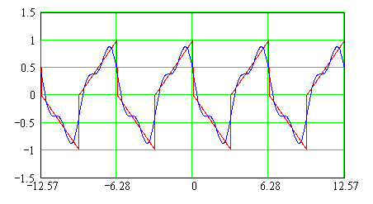
Representation of a periodic signal by sinusoidal functions: Example 2
Triangular function:
4 first terms of the Fourier series:

Slide 27
Representation of a periodic signal by sinusoidal functions
- Java Applet
http://www.jhu.edu/~signals/fourier2/index.html

Slide 28
Importance of AC circuits
Fourier transform:
Generalization of the Fourier series
Frequency analysis of non-periodic signals

Slide 29
Question
A sinusoidal voltage is applied to a linear circuit (R, L, C). What can be said of the currents and voltages in the circuit?
They are all sinusoidal
They are all sinusoidal with the same frequency (as that of the source)
They are all periodic
None of the above
Notes:
A

Slide 30
Response of a linear circuit to a sinusoidal excitation

Slide 31
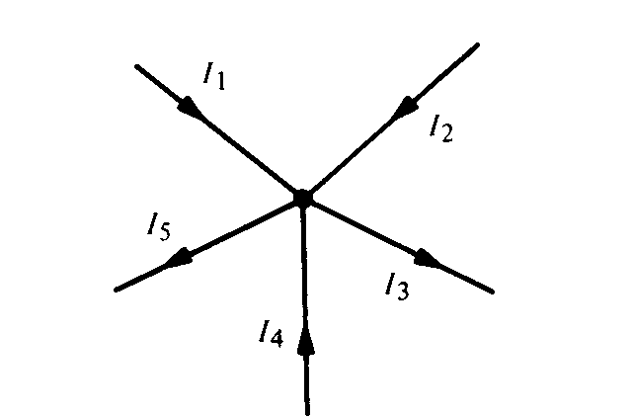
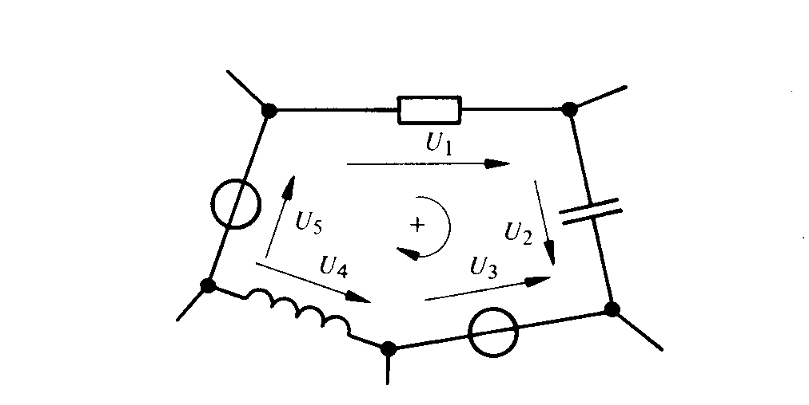
Response of a linear circuit to a sinusoidal excitation

Slide 32
Response of a linear circuit to a sinusoidal excitation
All currents and all voltages of the circuit will be sinusoidal with the same frequency.

Slide 33
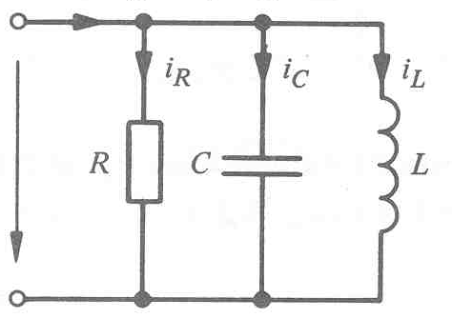
Example
Evaluate rms value, frequency and period of total current i(t)
Analytically determine the current in each element and that provided by the source
Draw each of these currents

Slide 34
Example
Evaluate rms value, frequency and period of total current i(t)
Analytically determine the current in each element and that provided by the source
Draw each of these currents
Calculation on the board!

Slide 35
Example

Slide 36
Example
This example shows us that the solution for a simple circuit is already laborious and would quickly become unusable for complex problems.
Phasors!

