Slide 1

Fundamentals of Electrical Circuits and Systems
Chapter 1: Basic Concepts
Farhad Rachidi
Electromagnetic Compatibility Laboratory
École Polytechnique Fédérale de Lausanne
Lausanne, Switzerland

Slide 2
Charge and electric current
The electric current is the time rate of change of the charge, measured in Ampere (A).
The relationship between the charge q and the current i is given by

Slide 3
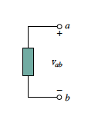
Voltage and energy/electric field
u_{ab}

Slide 4
Power and Energy

Slide 5
Passive elements

Slide 6
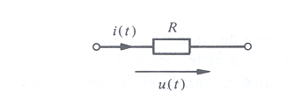
Resistance (Ohm)
G is the conductance (Siemens)

Slide 7
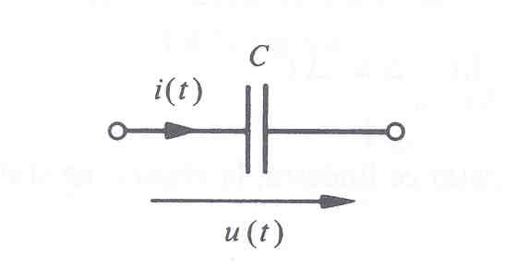
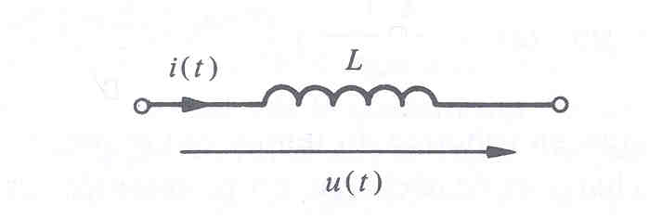
Capacitance (Farad)
Inductance (Henry)

Slide 8
Active circuit elements

Slide 9
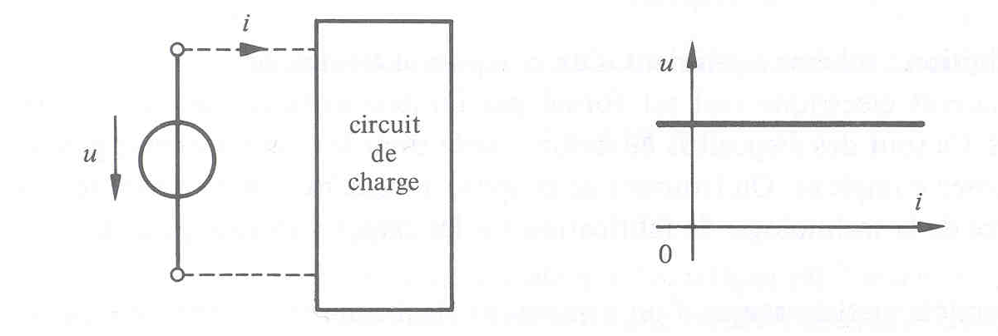
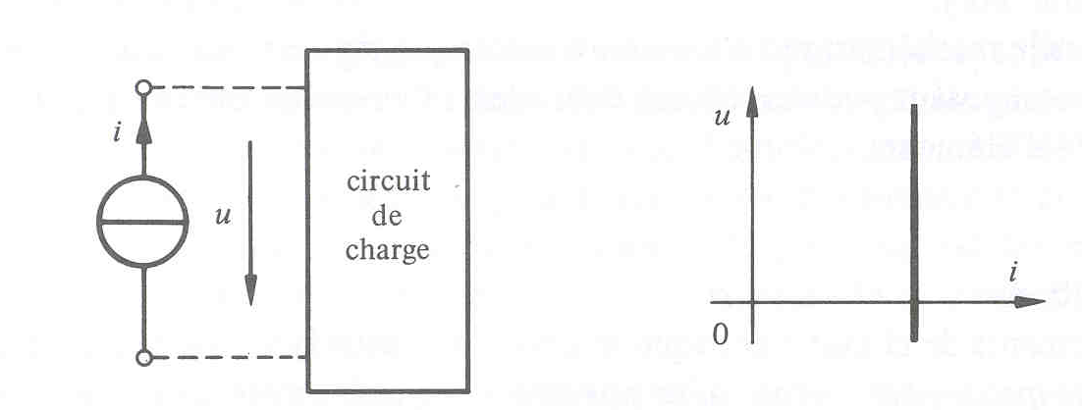
Ideal voltage and current sources

Slide 10
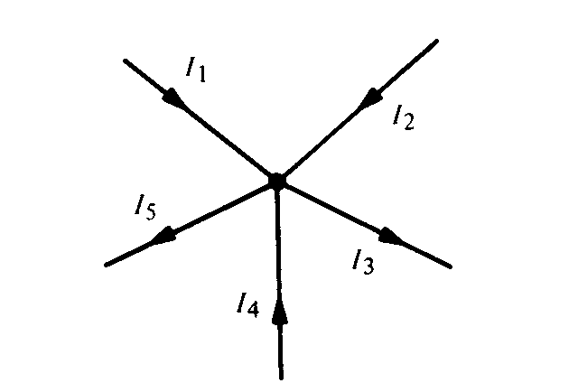
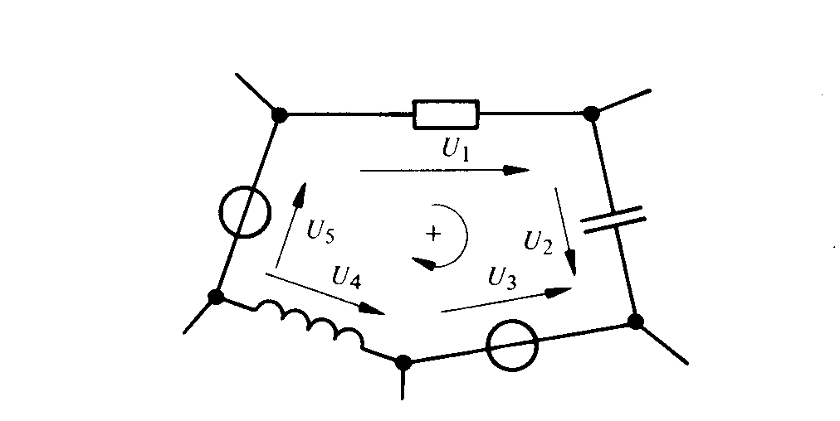
Kirchhoff’s Laws
Fundamental laws of electrical circuits

Slide 11
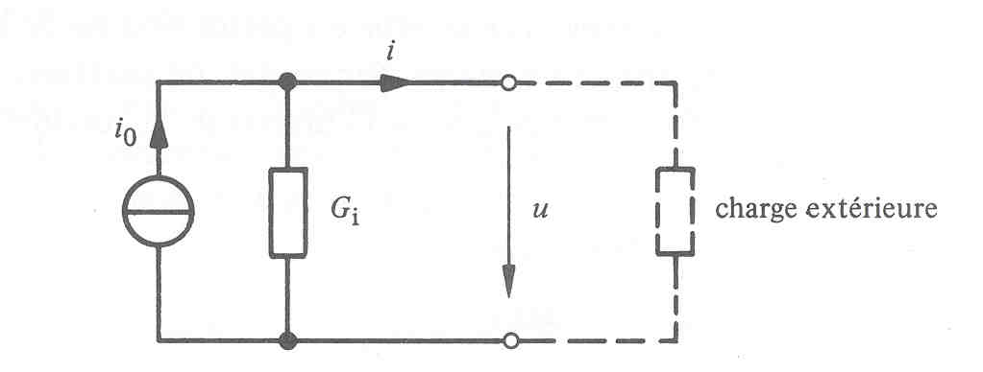
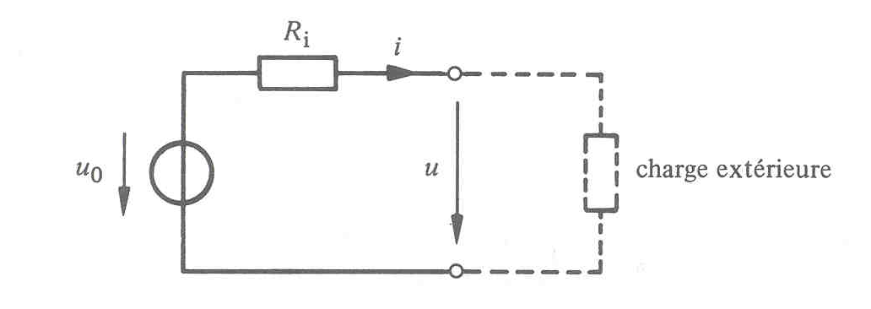
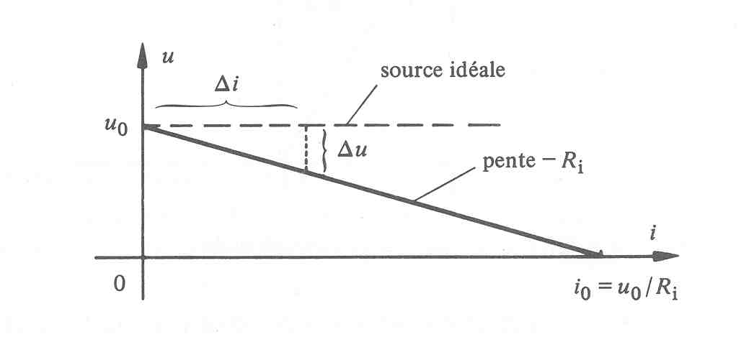
'Real' voltage and current sources
external
load
External load

Slide 12
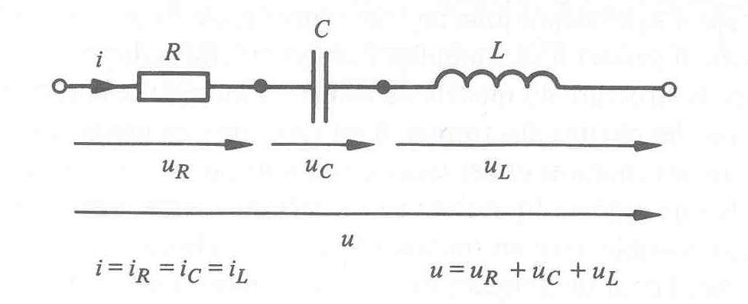
Elements in series
Elements connected in series are traversed by the same current. The voltage across the circuit is equal to the sum of the voltages relative to each element.

Slide 13
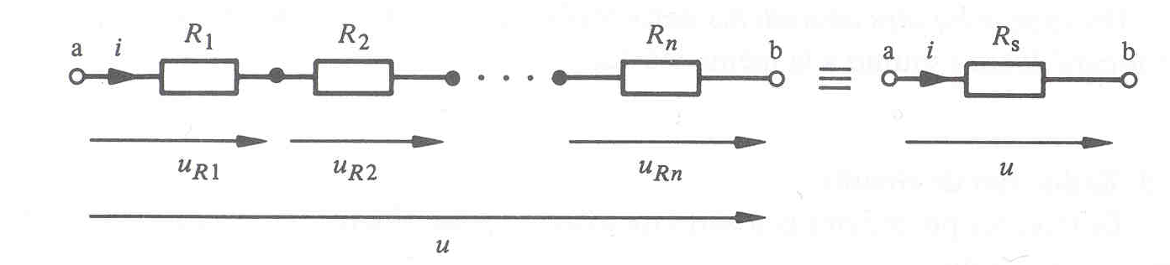
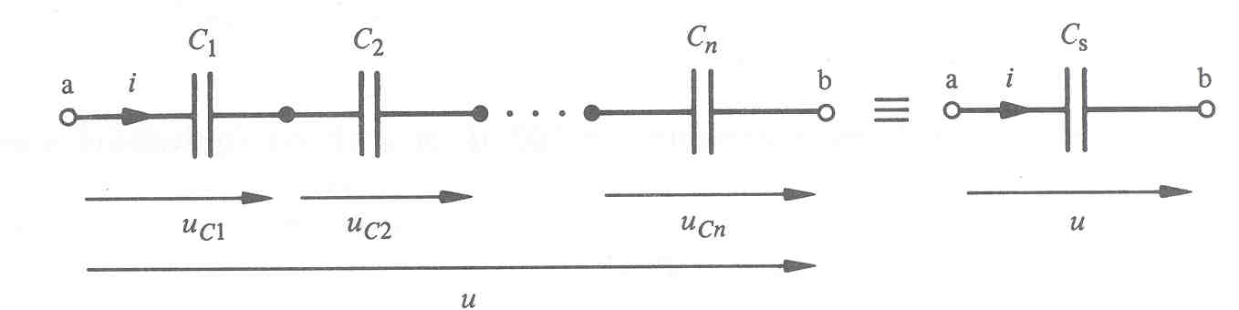
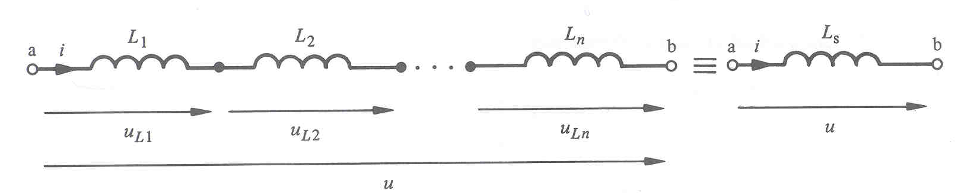

Slide 14
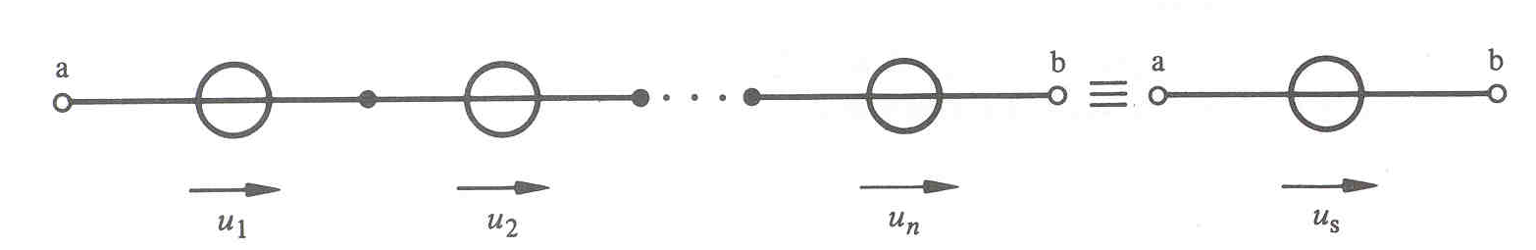
Voltage sources in series

Slide 15
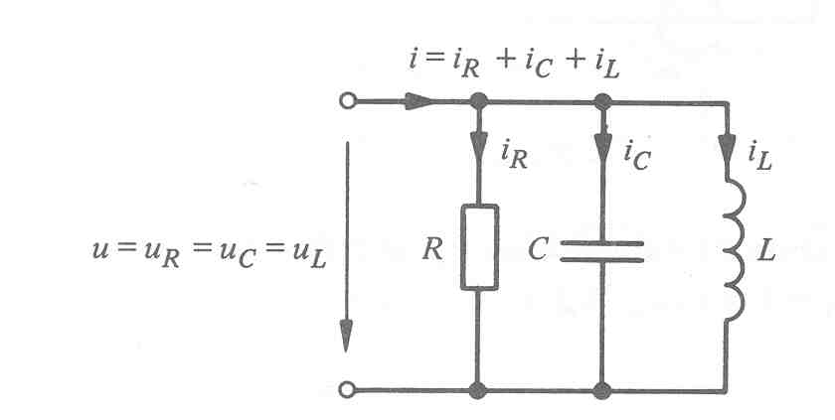
Elements in parallel
Elements connected in parallel are subjected to the same voltage. The total current is the sum of the individual currents.

Slide 16
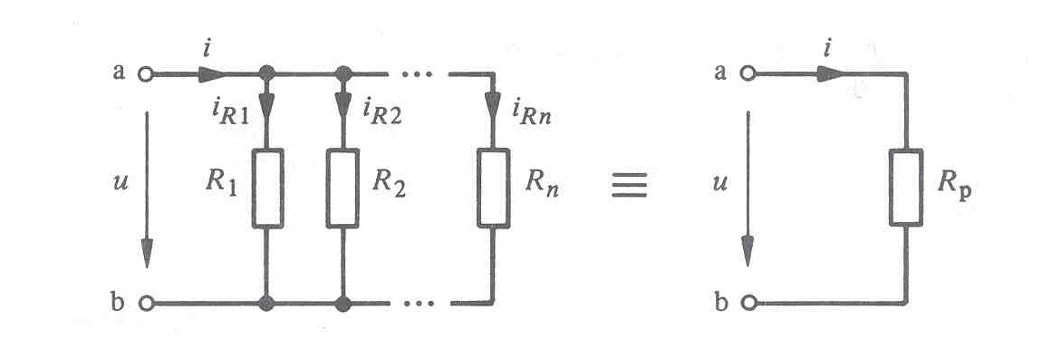
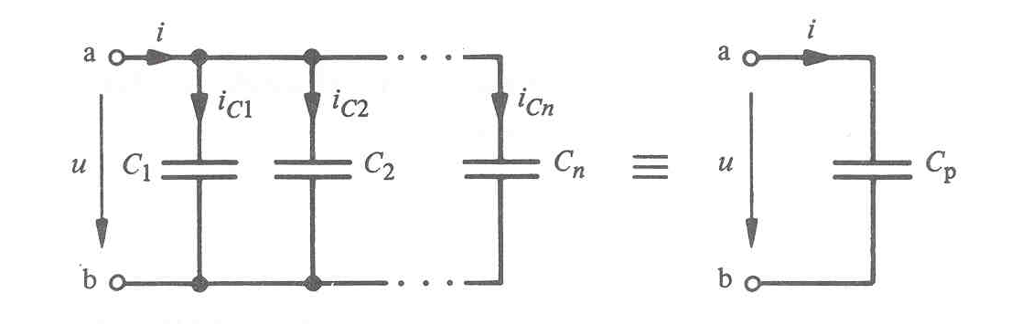
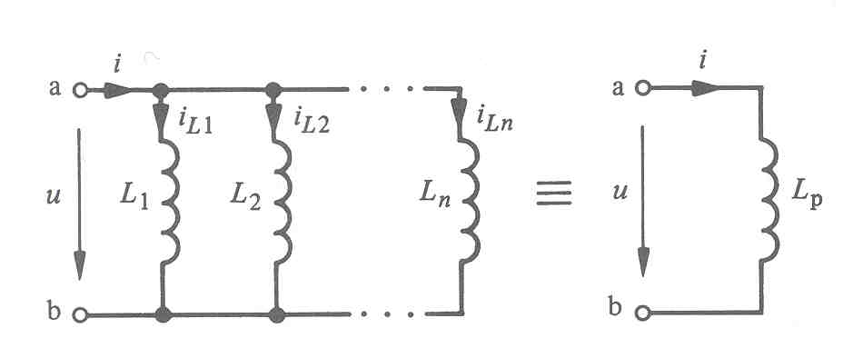

Slide 17
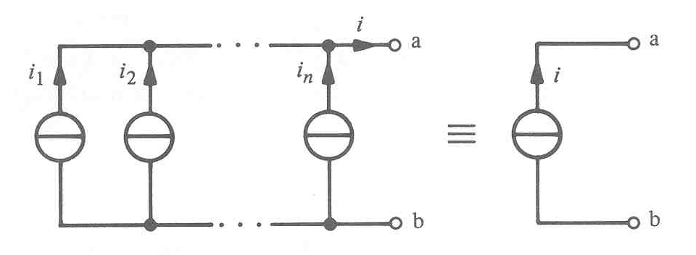
Current sources in parallel

Slide 18
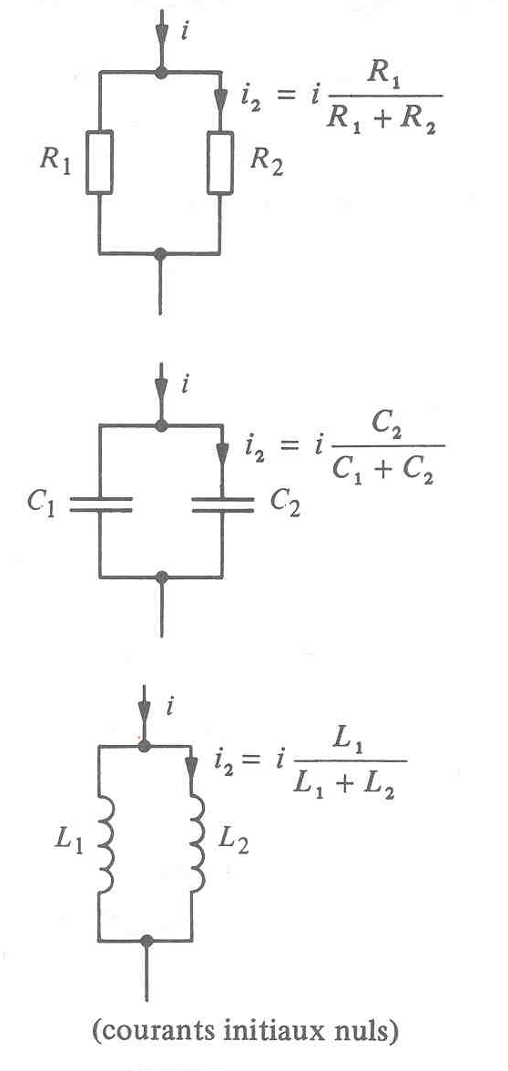
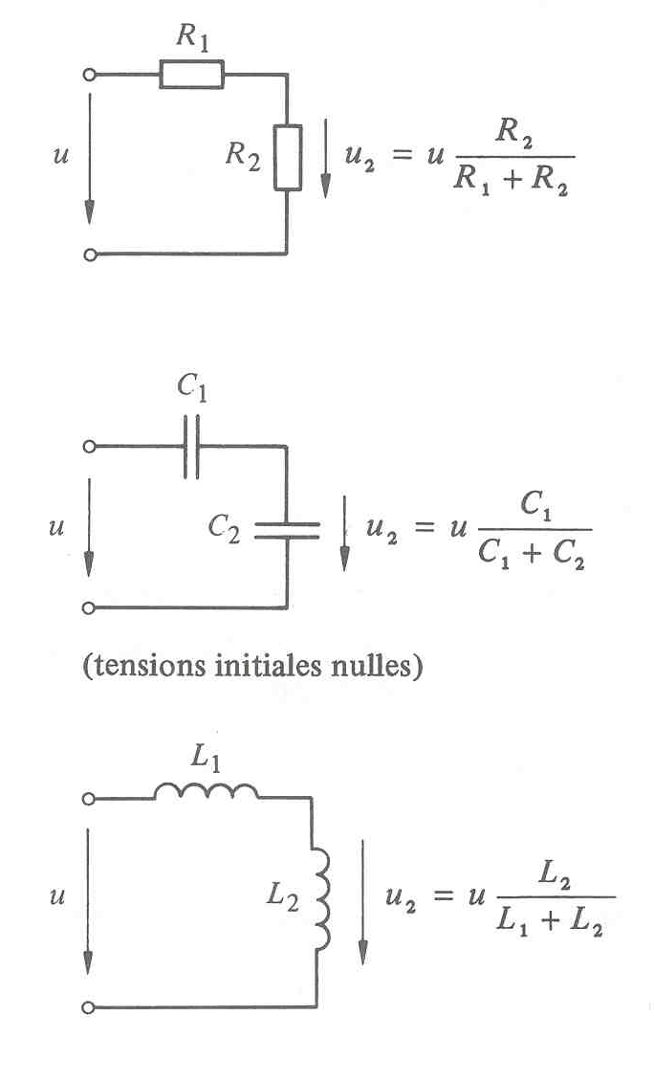
Voltage and current dividers
(No initial voltages)
(No initial currents)

