Slide 1

Fundamentals of Electrical Circuits and Systems
Chapter 7: Three-Phase Circuits
Farhad Rachidi
École Polytechnique Fédérale de Lausanne
Lausanne, Switzerland

Slide 2
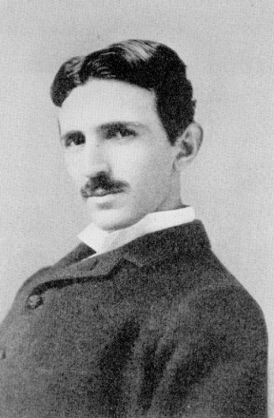
Three-Phase circuits
Three-phase circuits allow an optimal use of the electrical networks both at the source and the charge.
They were proposed by Tesla in 1888 and commercially implemented for the first time at Niagara Falls on November 16, 1896.
Nicola Tesla (1856-1943),
Serbian engineer and physicist.

Slide 3
Three-Phase circuits
Circuits powered by three sinusoidal sources out of phase with each other by 120º.
Symmetrical (balanced) source: the three source voltages have the same amplitude (rms value)
Balanced load: the three loads connected to the three-phase source consume the same active and reactive powers.

Slide 4
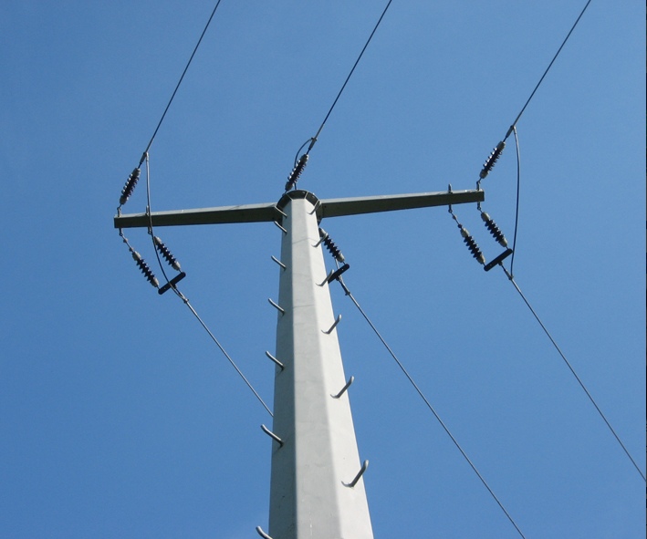

Slide 7
?

Slide 8
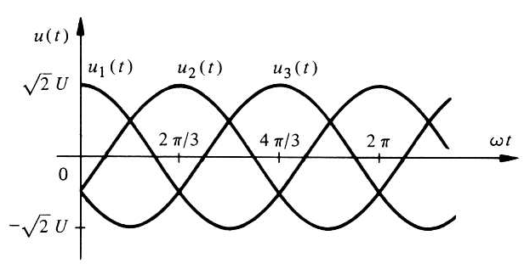
Balanced three-phase systems
Direct system:

Slide 9
Balanced three-phase systems
Direct system:
Notes:
Dans le sens des aiguilles d’une montre

Slide 10
Balanced three-phase systems
Reverse system:
Notes:
Dans le sens trigonométrique

Slide 11
Homopolar system

Slide 12
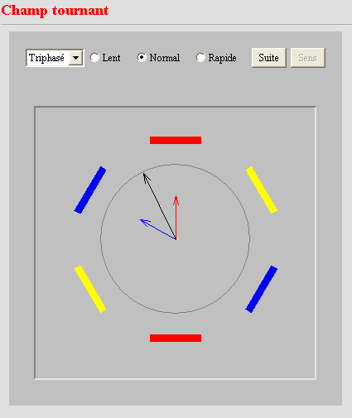
How to generate a balanced three-phase system?
Winding 1
Winding 3
Rotating
field
Winding 2

Slide 13
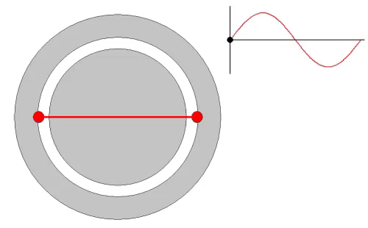
How to generate a balanced three-phase system?

Slide 14
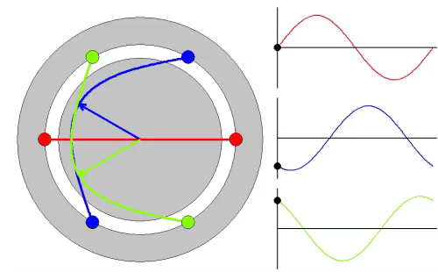
How to generate a balanced three-phase system?

Slide 15
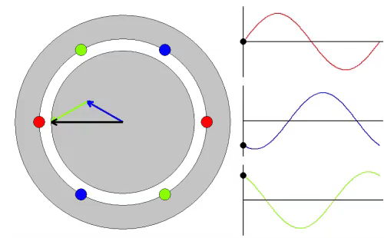
How to generate a balanced three-phase system?

Slide 16
How to generate a balanced three-phase system?
The total magnetic field generated by the 3 windings is a rotating field
A rotating field (produced by a magnet fixed on the rotor) will induce three-phase currents in the coils arranged symmetrically.
N
S

Slide 17
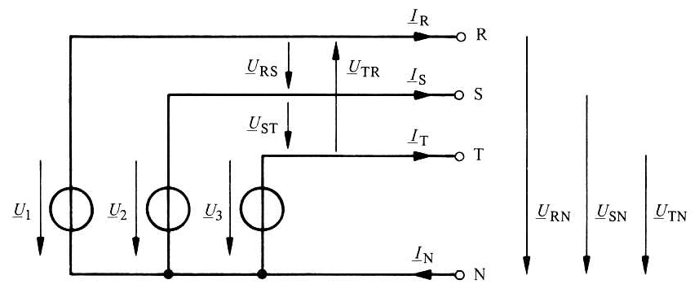
Three-phase source
(Wye connection)
R, S, T: phase conductors
N: neutral conductor

Slide 18
Three-phase source
Phase voltages and line voltages
Phase voltages
or line-to-neutral voltages:
with:

Slide 19
Three-phase source
Phase voltages and line voltages
Line-to-line voltages or
line voltages:
Relationships between phase voltages and line voltages

Slide 20
Three-phase source
Phase voltages and line voltages
Balanced three-phase system
Compared to phase voltages :
- Ahead of 30º,
- Module is times the one of phase voltages

Slide 21
Three-phase source
Line currents
Line currents:
Return current:

Slide 22
Balanced three-phase load
A balanced three-phase load is characterized by three identical impedances (same module and argument) that we call the three phases of the user.
The three impedances can be connected in ‘wye (star)’ or ‘delta (triangle)’.

Slide 23
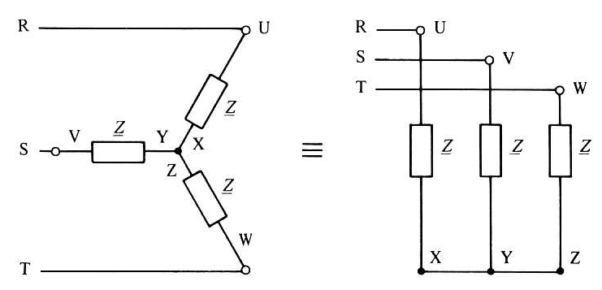
Balanced three-phase load
Wye connection

Slide 24
Balanced three-phase load
Wye connection
Load voltages are the same as the line-to-neutral voltages

Slide 25
Balanced three-phase load
Wye connection
Load currents:

Slide 26
Balanced three-phase load
Wye connection
The line current is equal to
load current and they have as module:

Slide 27
Balanced three-phase load
Wye connection
Thus in the case of a symmetrical source with balanced load, it is not necessary to connect the neutral point of the load to the one of the source.

Slide 28
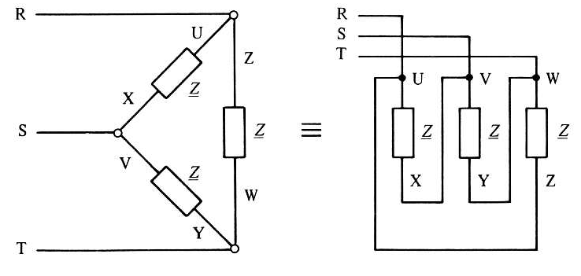
Balanced three-phase load
Delta connection

Slide 29
Balanced three-phase load
Delta connection
Phase voltages:
Load voltages are the same as line voltages

Slide 30
Balanced three-phase load
Delta connection
Load currents:

Slide 31
Balanced three-phase load
Delta connection
Line currents:
with

Slide 32
Summary
Load quantities expressed in terms of line quantities

Slide 33
Power in a three-phase systems
Delta load
Wye load
Instantaneous power:
Active and reactive powers:

Slide 34
Power in balanced three-phase systems
Phase UX:
Phase VY:
Phase WZ:

Slide 35
Power in balanced three-phase systems
=0
Instantaneous power has no pulsed component and
it is equal to the active power.

Slide 36
Power in balanced three-phase systems
Active, reactive and apparent power
In the same way:
being the rms values of the phase voltages and
phase currents
Complex apparent power:

Slide 37
Power in balanced three-phase systems
Active, reactive and apparent power
The powers expressed according to the line quantities:
Notes:
Réduction momentanée de la puissance (démarrage de moteur)
Adaptation à un niveau ayant une tension sqrt(3)* plus élevée

Slide 38
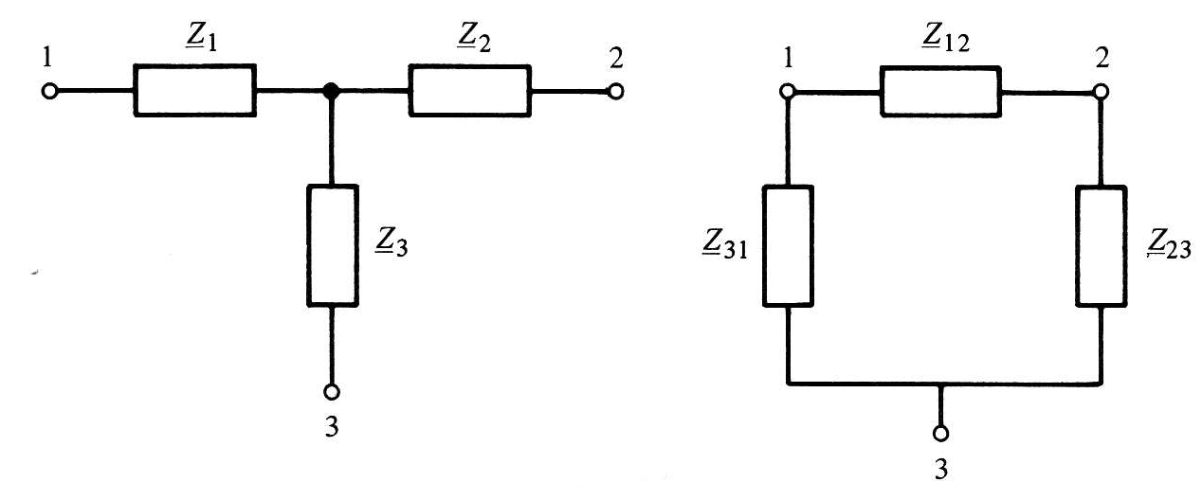
Power in balanced three-phase systems
Delta-Wye conversion
Reminder: Equivalent tripoles

Slide 39
Power in balanced three-phase systems
Delta-Wye conversion
Equivalent tripoles
(equal impedances)

Slide 40
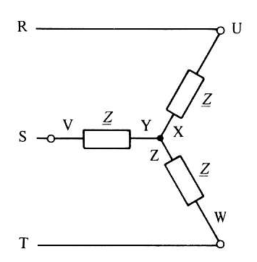
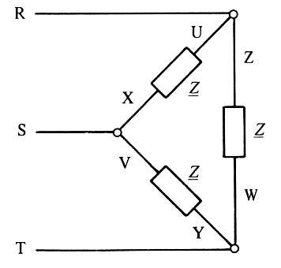
Power in balanced three-phase systems
Delta-Wye conversion
Both charges are equivalent provided that:
ou
Case of a capacitor bank:

Slide 41
Example 1
A balanced three-phase load is connected in wye on a direct three-phase network at 6kV. The active power consumed is 48 kW, with a power factor of 0.94. Calculate the rms value of the line current. Repeat the calculation for the case where the load is connected in delta (with the same active power and the same power factor) and determine the rms value of the current flowing in the user's phases.

Slide 42
Example 2
The phase impedance of a balanced three-phase load is formed of a resistor R = 10 Ω in series with a capacitor C = 185 μF. This load is connected in star to a 50 Hz network whose line voltage is 380 V. Determine the load voltage, the load current and the phase shift. Also calculate the active and reactive powers absorbed by each load and by the total load.

Slide 43
Example 3
The active power and the apparent power consumed by a user having a balanced three-phase load are known: P = 20 kW and S = 30 kVA. The supply voltage (line) is 500 V. It is asked to calculate the impedance Z for the two connection modes (wye and delta).

Slide 44
Example 4
A balanced three-phase load in delta is formed by putting in series a resistor R = 15 Ω and an inductor L = 32 mH. The network supply is 380 V (line voltage). Determine the active power P supplied by the network.

Slide 45
Unbalanced three-phase systems
An unbalanced state occurs when the impedances of the load are not identical.
Such a situation is caused by the connection of single-phase loads connected either between a phase conductor and the neutral conductor, or between two phase conductors.
It can also intervene in case of disturbances such as short-circuit, lightning strike on a phase conductor, etc.

Slide 46
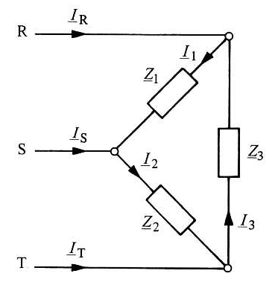
Unbalanced three-phase systems
Delta load

Slide 47
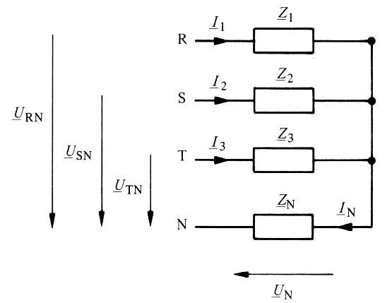
Unbalanced three-phase systems
Wye load
And the return current:

Slide 48
Unbalanced three-phase systems
Wye load
On the other hand, from Kirchhoff’s
law on currents :

Slide 49
Unbalanced three-phase systems
Wye load
By eliminating I_{N} in the last two equations, we obtain the expression of the voltage U_{N} :
with:
et
The impedance Z_{p} is equivalent to putting in parallel all impedances of the charge, including the neutral conductor.
The current I_{N0} represents the return current in the neutral that we would observe if the impedance Z_{N} of the neutral was zero.

Slide 50
Unbalanced three-phase systems
Wye load
In summary, we first calculate:
et
then:
et
and finally:

Slide 51
Example: Unbalanced three-phase circuit
Between the line conductors R, S and T are connected two identical receivers whose active powers are P₁=P₂= 70 kW for a power factor of 0.92 (inductive). The third receiver connected between the T and R conductors has a power factor cos φ = 1 and an active power P₃ = 30.4 kW. Determine the active power of the circuit, as well as the currents I₁, I₂, I₃ and I_{R}, if the line voltages are equal to 380 V.
R
S
T

Slide 52
Example: Unbalanced three-phase circuit
Total active power:
R
S
T

Slide 53
Example: Unbalanced three-phase circuit
and
are in phase delay of an angle
φ₁=arccos 0.92=23º relative to the corresponding voltages.
is in phase with

Slide 54
Example: Unbalanced three-phase circuit

Slide 55
Example: Unbalanced three-phase circuit
R
S
T

Slide 56
Symmetrical components method
A non-symmetric system can be broken down into three symmetrical systems: a direct system, an inverse system and a homopolar system.

Slide 57
Symmetrical components method

Slide 58
Symmetrical components method
denoting
and noticing that
the following relationships can be established

Slide 59
Symmetrical components method
Denoting for simplicity
The system of equations is then written:
In matrix form:

Slide 60
Symmetrical components method

