Slide 1

Fundamentals of Electrical Circuits and Systems
Chapter 1: Basic Concepts
Farhad Rachidi
Electromagnetic Compatibility Laboratory
École Polytechnique Fédérale de Lausanne
Lausanne, Switzerland

Slide 2
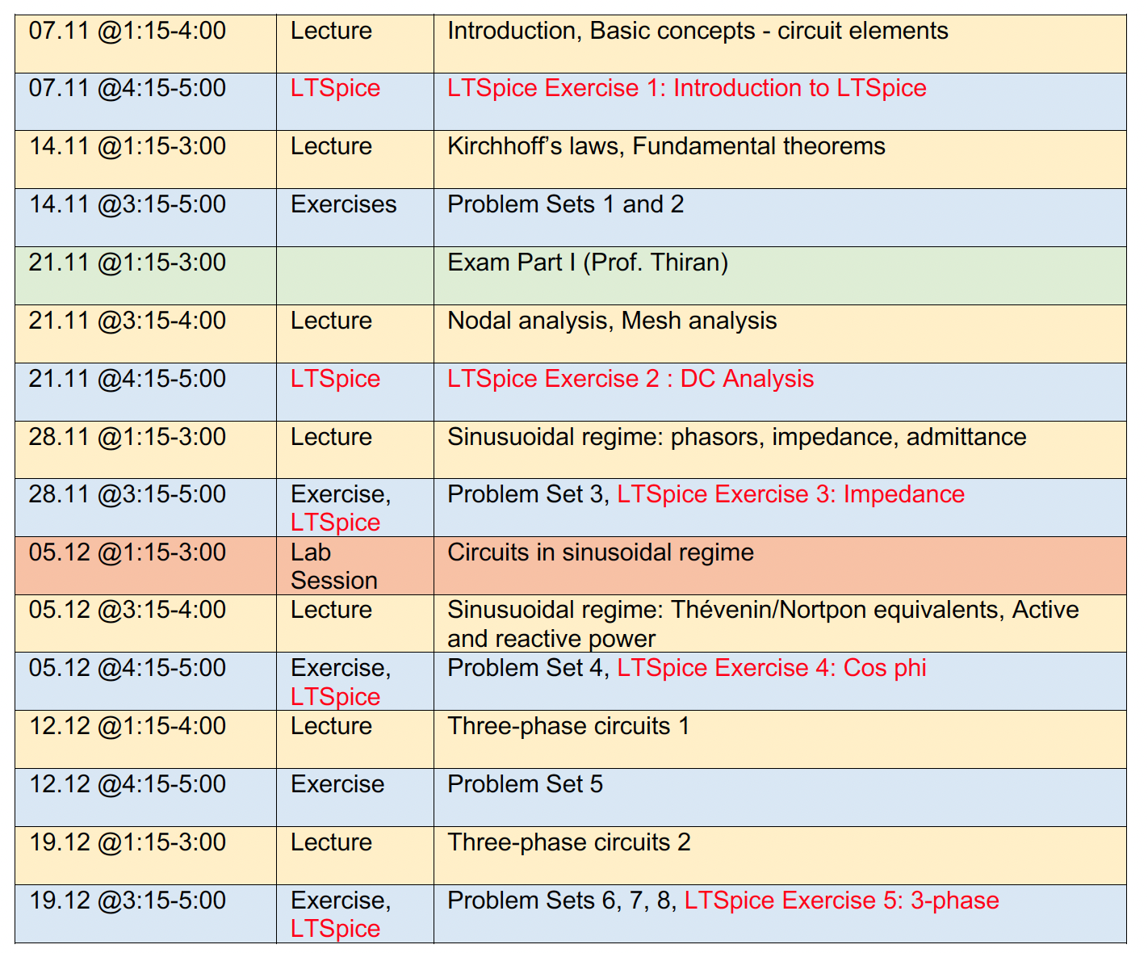

Slide 3
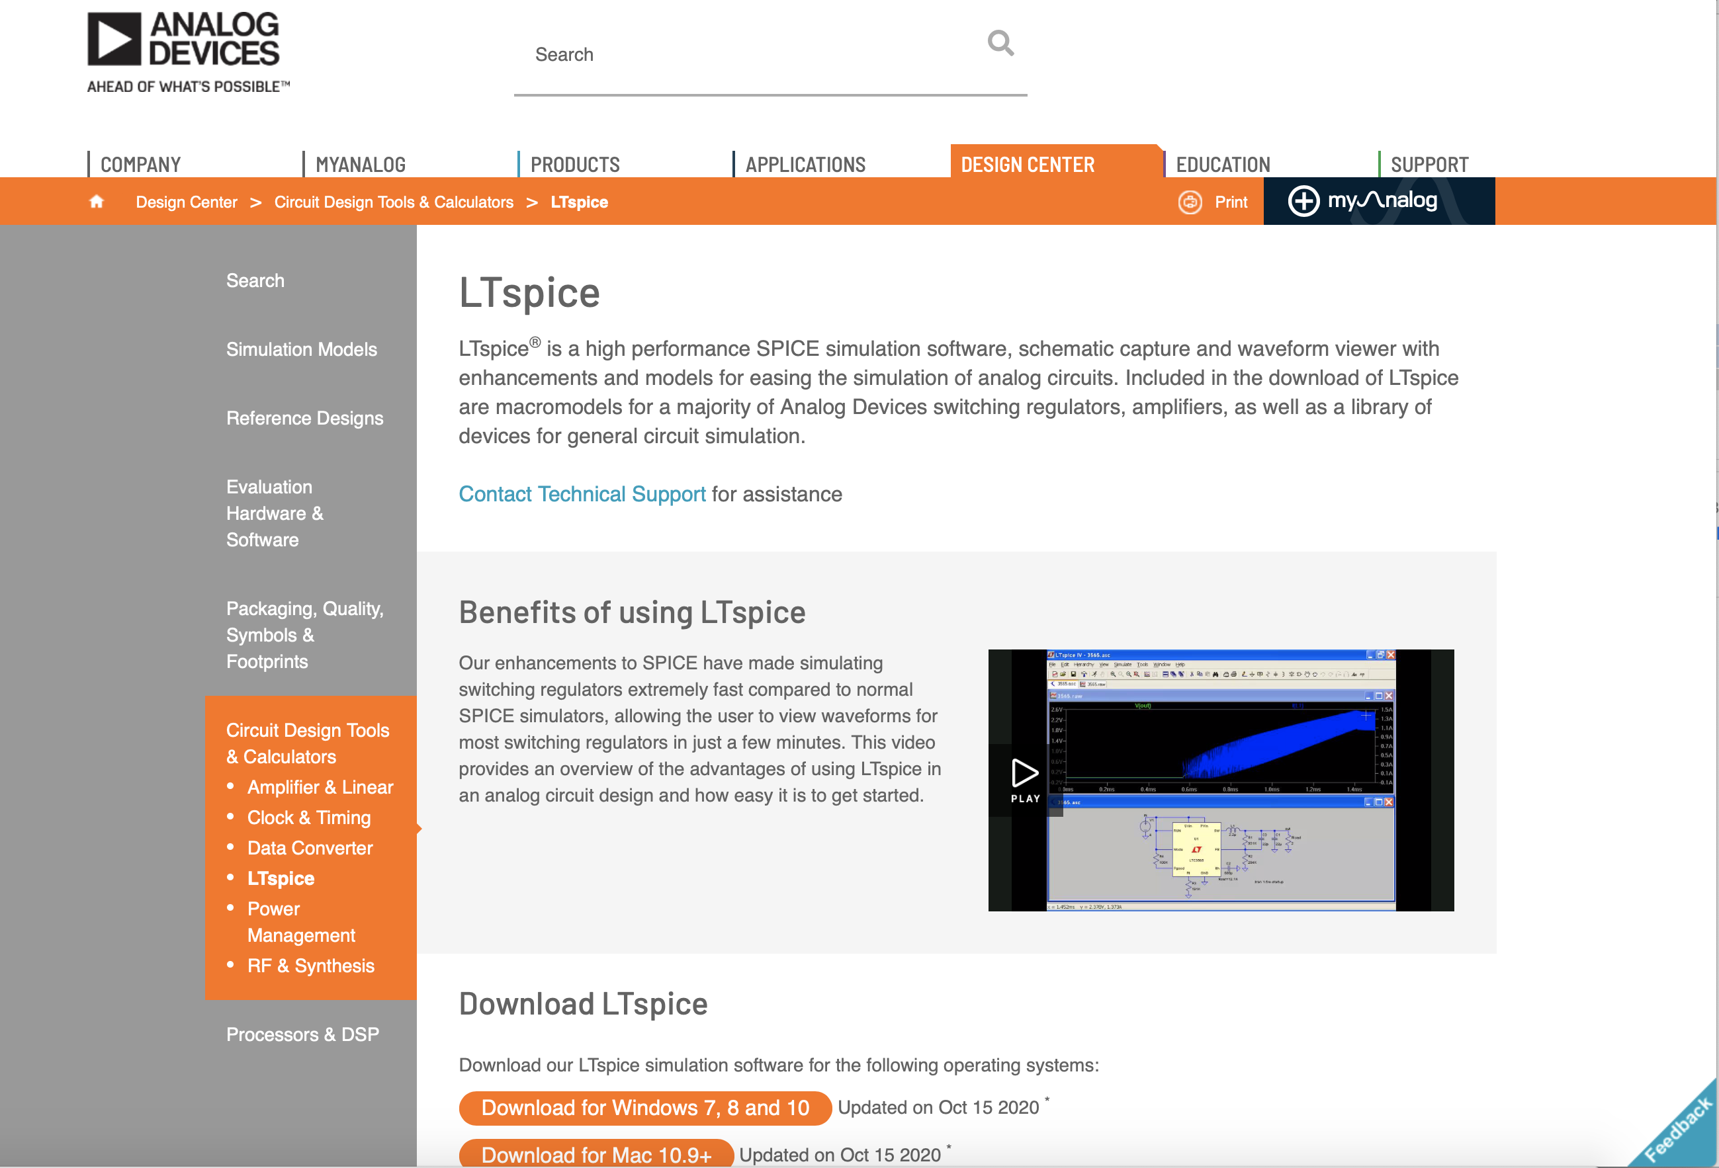

Slide 4
Evaluation
  Final exams during the winter session
  EE-407: 60% exam, 30% LTSpice simulations, 10% lab

Slide 5
Electrical circuits: Fundamentals
What is an electrical circuit ?
Unit systems
Usual quantities
  Charge, current, voltage
  Power and energy
Basic circuit elements
  Resistance
  Capacitance
  Inductance
  Voltage and current sources
Kirchhoff’s law
Combination of elements
Voltage / current dividers

Slide 6
Electrical circuits: Fundamentals
What is an electrical circuit ?
Unit systems
Usual quantities
  Charge, current, voltage
  Power and energy
Basic circuit elements
  Resistance
  Capacitance
  Inductance
  Voltage and current sources
Kirchhoff’s law
Combination of elements
Voltage / current dividers

Slide 7
What is an electrical circuit ?
An electrical circuit allows
  to transport energy from one point to another

Slide 8
What is an electrical circuit ?
An electrical circuit allows
  to transport energy from one point to another
  to transmit information
Wiring in an airplane
Notes:
Plus d’une tonne dans les avions modernes.

Slide 9
What is an electrical circuit ?
An electrical circuit allows
  to transport energy from one point to another
  to transmit information
  to process information

Slide 10
What is an eletrical circuit ?
An electrical circuit is an interconnection between electrical elements (components).

Slide 11
What is an electrical circuit ?
An electrical circuit is an interconnection between electrical elements (components).
It is formed of
branches

Slide 12
What is an electrical circuit ?
An electrical circuit is an interconnection between electrical elements (components).
It is formed of
nodes

Slide 13
What is an electrical circuit ?
Passive linear elements

Slide 14
What is an electrical circuit ?
An electrical circuit is an interconnection between electrical elements (components).
It is formed of branches and nodes
Passive linear elements are resistors, inductors and capacitors.

Slide 15
What is an electrical circuit ?
An electrical circuit is an interconnection between electrical elements (components).
It is formed of branches and nodes
Passive linear elements are resistors, inductors and capacitors.
Active elements (sources) are sources of voltage and current.

Slide 16
What is an electrical circuit ?
Active elements (sources)

Slide 17
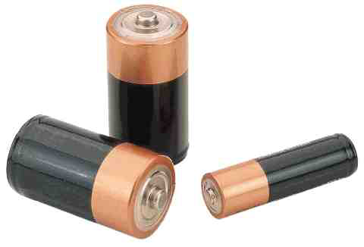
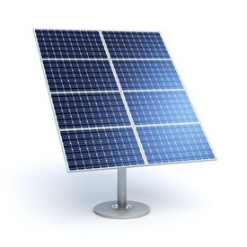
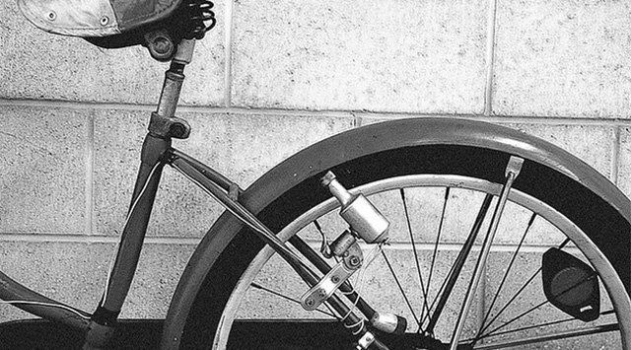
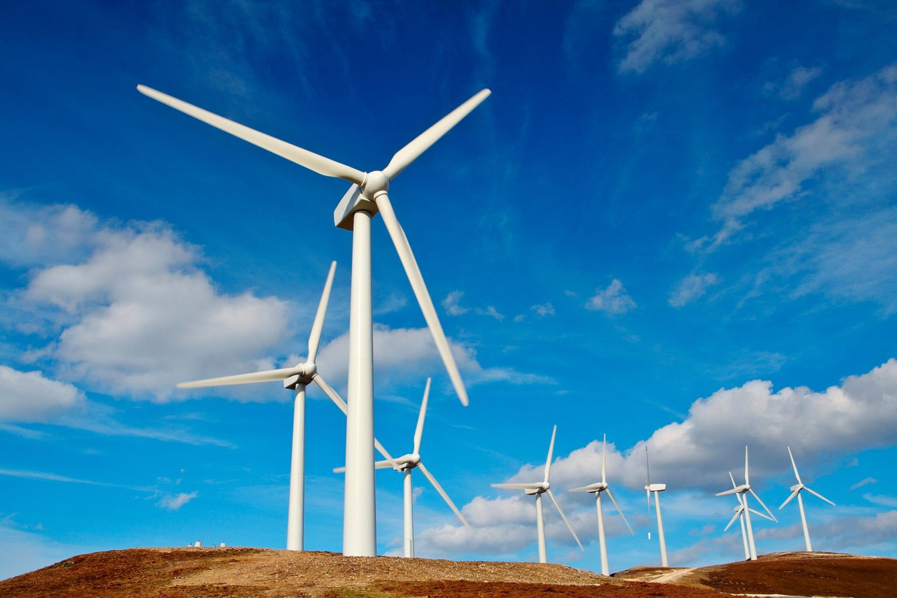
Examples of sources
Notes:
Bicycle dynamo generator

Slide 18
What is an electrical circuit ?
An electrical circuit is an interconnection between electrical elements (components).
It is formed of branches and nodes
Passive linear elements are resistors, inductors and capacitors.
Active elements are sources of voltage and current.
The circuits are expressed in terms of two basic quantities: current and voltage.

Slide 19
Electrical circuits: Fundamentals
What is an electrical circuit ?
Unit systems
Usual quantities
  Charge, current, voltage
  Power and energy
Basic circuit elements
  Resistance
  Capacitance
  Inductance
  Voltage and current sources
Kirchhoff’s law
Combination of elements
Voltage / current dividers

Slide 20
Unit systems
International system of units (coherent and universal)
Base units: meter (m), second (s), kilogram (kg), kelvin (K), mol (mol), candela (cd), ampere (A).
Derived electrical units: volt (V), coulomb (C), ohm (W), siemens (S), henry (H), farad (F), watt (W), joule (J), hertz (Hz) ...
Other units used: degree Celsius (oC), hour (h), kilowatt hour (kWh)

Slide 21
Prefixes
Prefix | Symbol | Multiplier
pico | p | 10⁻¹²
nano | n | 10⁻⁹
micro | μ | 10⁻⁶
milli | m | 10⁻³
kilo | k | 10³
mega | M | 10⁶
giga | G | 10⁹
Examples:
milliampere: mA
kiloampere: kA
picofarad: pF

Slide 22
Time, Mass
The second (s): duration of 9 192 631 770 periods of the radiation corresponding to the transition between two hyperfine levels of the ground state of the cesium 133 atom!
The kilogram (kg): mass of the 1889 prototype in platinum deposited at the International Bureau of Weights and Measures.

Slide 23
Length
The meter (m): length of the path traveled in the vacuum by the light in 1/299 792 458 seconds (1983).
Previously :
- one quarter of the ten millionth of the terrestrial meridian (1889-1960)
- compared to the emission lines of a discharge lamp containing krypton 86 (1960-1983).

Slide 24

Electric charge
The electric charge is an electrical property of the atomic particles that make up the matter, it is measured in Coulomb (C).
1 C = 1/1.602x10⁻¹⁹ = 6.24x10¹⁸ electrons
The only charges that exist in nature at our scale are integer multiples of the elementary charge
e = -1.602x10⁻¹⁹ C.
Charles de Coulomb (1736-1806),
French physicist.

Slide 25
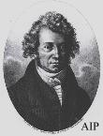
Charge and electric current
The electric current is the time rate of change of the charge, measured in Ampere (A).
André-Marie Ampère (1775-1836),
French physicist, founder of electrodynamics. We owe him the terms of voltage and current.

Slide 26
Charge and electric current
The electric current is the time rate of change of the charge, measured in Ampere (A).
The relationship between the charge q and the current i is given by

Slide 27
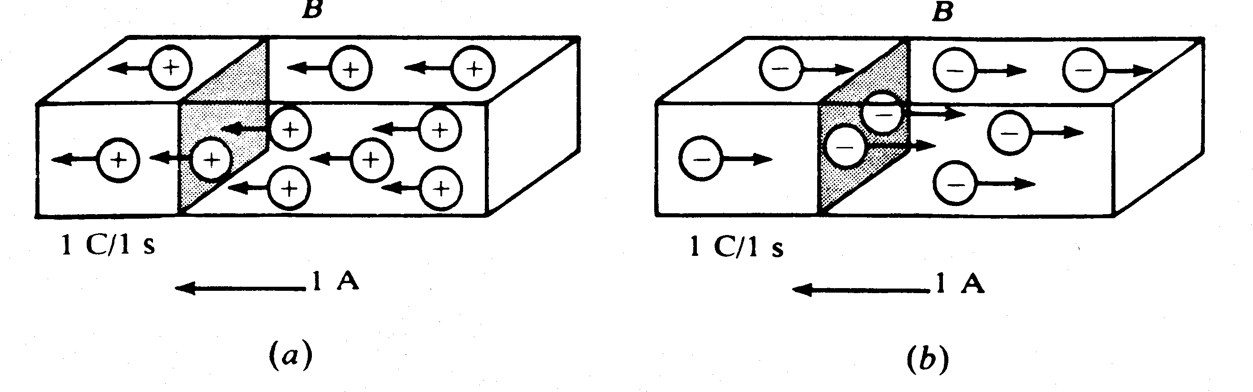
The direction of the electric current
By convention, the direction of the current is given by the movement of positive charges

Slide 28
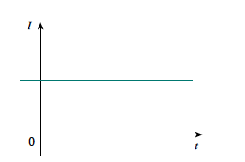
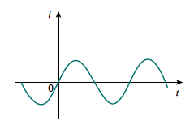
Charge and electric current
A direct current I is a current independent of time.
An alternating current is a current that periodically changes direction.
Sinusoidal alternating current

Slide 29
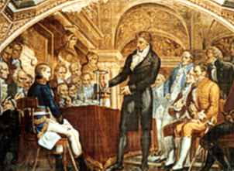
Voltage, potential difference, electromotive force
Moving electrons in a conductor in a particular direction requires some work or energy transfer.
This work is performed by an external force to the charge provided by a power source and called electromotive force, voltage or potential difference.
The voltage or potential difference v_{ab} between two points of a circuit is the energy required to move a unit of electric charge from point a to point b.
Comte Alessandro Volta (1745-1827), italian physicist, inventor of the electric battery (1800).

Slide 30
Analogy
Water - Flow
at a given moment, we measure the amount of water flowing (the flow)
at a given moment, we measure the number of electrons circulating
(= CURRENT)
Electricity - current

Slide 31
Analogy
Water – Slope
the slope or difference in height pushes the water down
a force pushes the current in the electric circuits
( = VOLTAGE)
Electricity - voltage

Slide 32
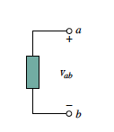
Voltage, potential difference, electromotive force
Mathematically :
w is the energy (J) and q is the charge(C).
The voltage u_{ab} is defined between two points of the circuit a and b.
if u_{ab}>0: the potential of point a is greater than the potential of point b
if u_{ab}<0: the potential of point a is smaller than the potential of point b
u_{ab}

Slide 33

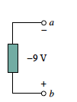
Voltage, potential difference, electromotive force
u_{ab}
u_{ba}
u_{ab}= 9 V
u_{ba}= -9 V

Slide 34
Voltage and electric field
The voltage between two points a and b can also be defined as the integral of the electric field between these two points

Slide 35
Power and Energy
Power is the rate at which you consume energy.
The watt (W), unit of power, corresponding to the transfer of 1 joule of energy over one second.
Mathematically :

Slide 36
Power and Energy
Power is the rate at which you consume energy.
The watt (W), unit of power, corresponding to the transfer of 1 joule of energy over one second.
Mathematically :

Slide 37
Power and Energy
Power is the rate at which you consume energy.
The watt (W), unit of power, corresponding to the transfer of 1 joule of energy over one second.
Mathematically :

Slide 38
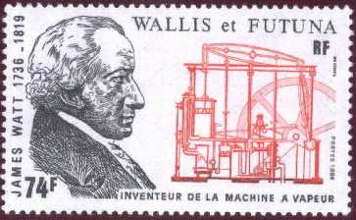
Power and Energy
Power is the rate at which you consume energy.
The watt (W), unit of power, corresponding to the transfer of 1 joule of energy over one second.
Mathematically :
James Watt (1736-1819), mechanical engineer and British inventor. We owe him the steam engine.

Slide 39
Power and Energy
In an electrical circuit, the instantaneous power p(t) is equal to the product of the instantaneous voltage and the instantaneous current, and the average power P is equal to the mean value of the instantaneous power
ou

Slide 40
Power and Energy
The energy absorbed or supplied by an element during the time interval from 0 to t is :
The law of energy conservation implies that the algebraic sum of the power in a circuit, at any instant, must be zero :

Slide 41
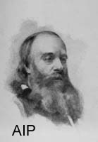
Joule
The Joule (J) is equivalent to the work produced by a force of 1 N whose point of application moves one meter in the direction of the force.
James prescott Joule (1818-1890), British physicist. He studied the heat released by the electric currents (Joule heating).

Slide 42
Passive elements

Slide 43
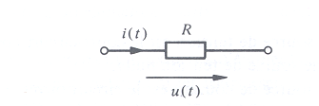
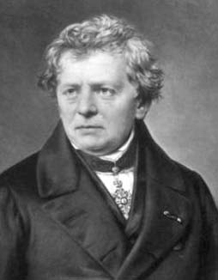
Resistance/Resistor
Circuit element that satisfies Ohm's law
The unit of resistance is the ohm (Ω)
Georg Simon Ohm (1789-1854), German physicist. He discovered in 1827 the fundamental laws of electric currents.

Slide 44
Ohm’s Law and Resistance
L
i
R
u
Material with resistivity ρ
Section a
Ohm’s law :
J: Current density A/m²
S

Slide 45
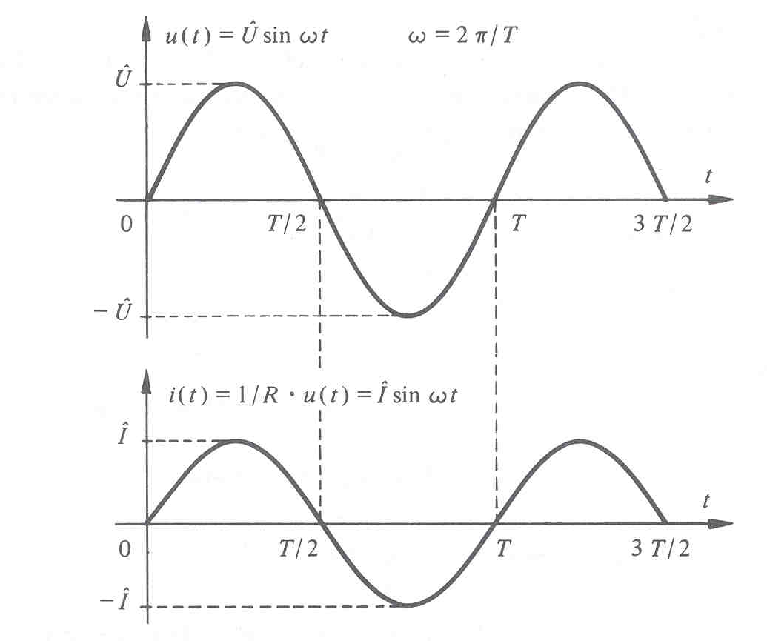
Resistance: current and voltage

Slide 46
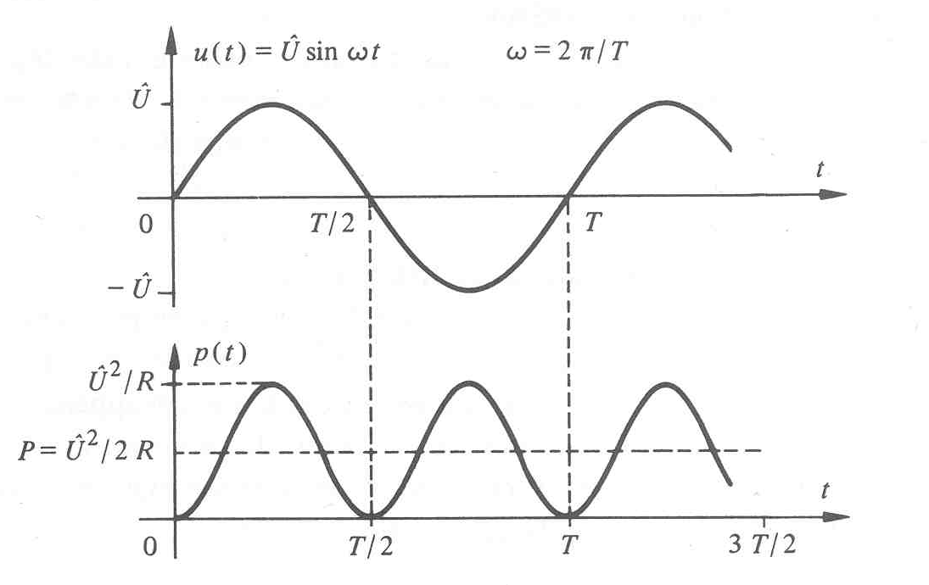
Resistance: dissipated power

Slide 47
Resistance: dissipated energy
The electrical energy supplied to a resistor for a duration t is dissipated in the form of heat
Continuous regime:

Slide 48
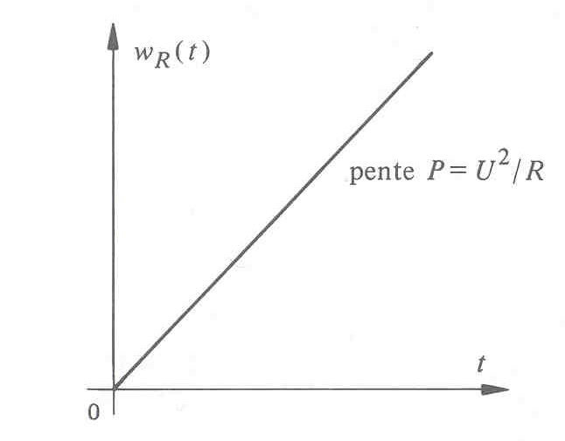
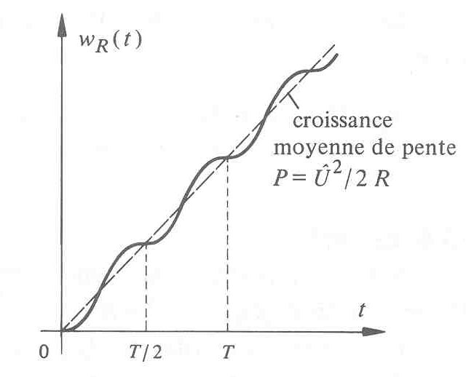
Resistance: dissipated energy
Continuous regime :
slope
Sinusoidal regime:
mean growth of
slope

Slide 49
Short circuit
Let a circuit whose two points are connected by a resistor. If the value of this resistance tends to zero, these two points become short circuited.
In practice, a piece of wire is often (not always!) a short circuit.

Slide 50
Open circuit
Let a circuit whose two points are connected by a resistor. If one makes the value of this resistance tend towards infinity, these two points become in open circuit.
In practice, an open circuit is realized by removing all the elements that connect the two points of the circuit.

Slide 51
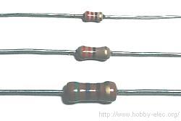
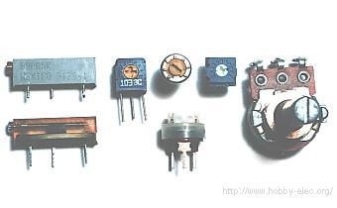
Resistor: physical element
1/8 W
1/4 W
1/2 W
Variables resistors

Slide 52
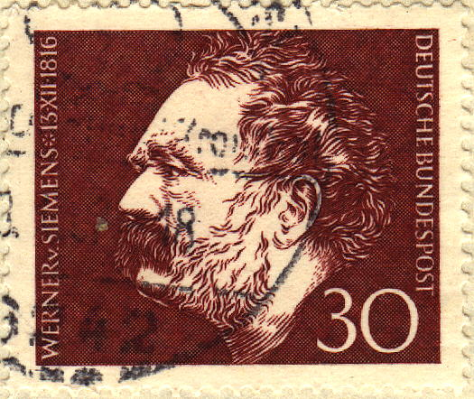
Conductance
Inverse of resistance G=1/R
The unit of conductance is the Siemens (S)
Werner von Siemens (1816-1892), German engineer and industrialist.

Slide 53
Capacitance/Capacitor
Circuit element that obeys the following
relationship :
Knowing that the current is the flow of charges :

Slide 54
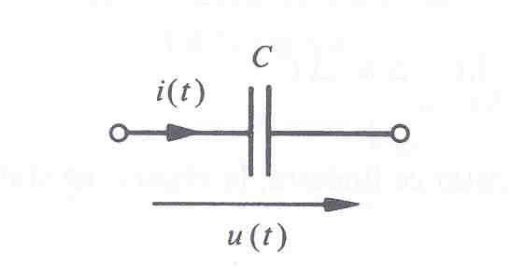
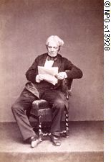
Capacitance
The value C of the capacitance is expressed in farad (F).
Michael Faraday (1791-1867), British physicist.

Slide 55
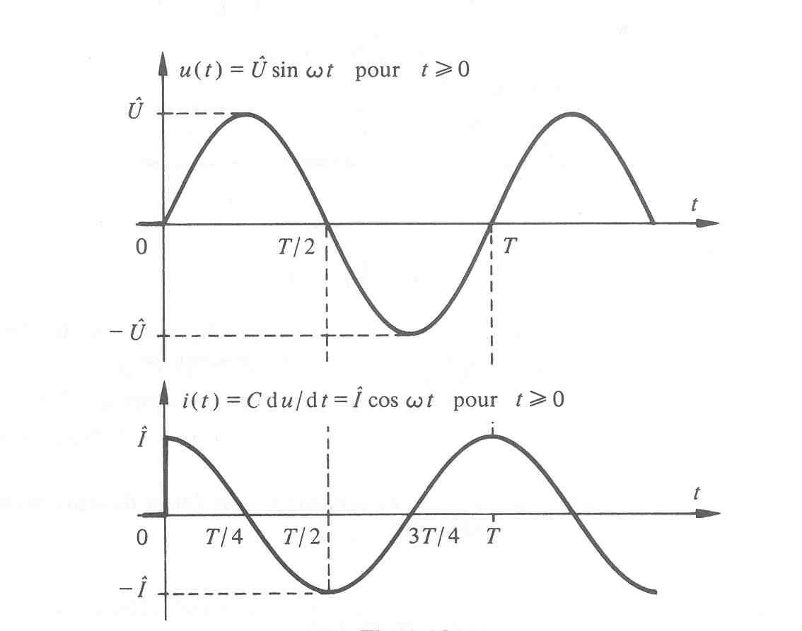
Capacitance: current and voltage
In continuous regime : open circuit
In sinusoidal regime :
for
for

Slide 56
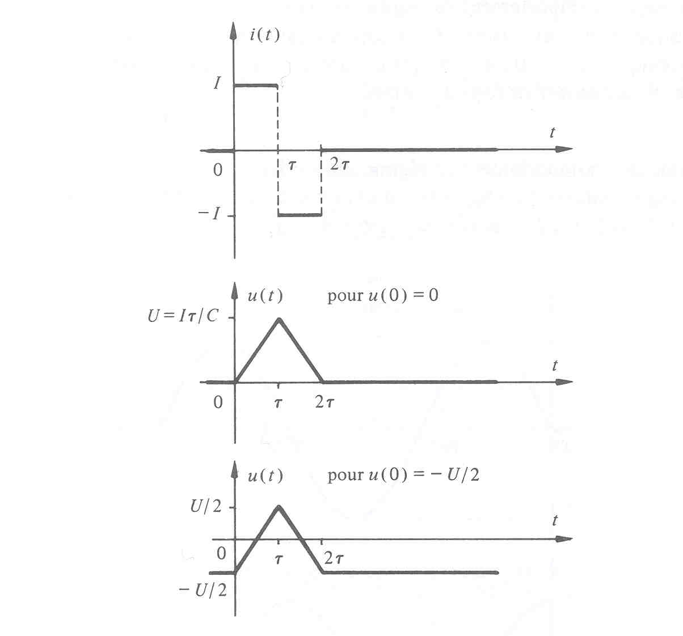
Capacitance: no voltage step!

Slide 57
Capacitance: electrostatic energy
Sinusoidal regime:

Slide 58
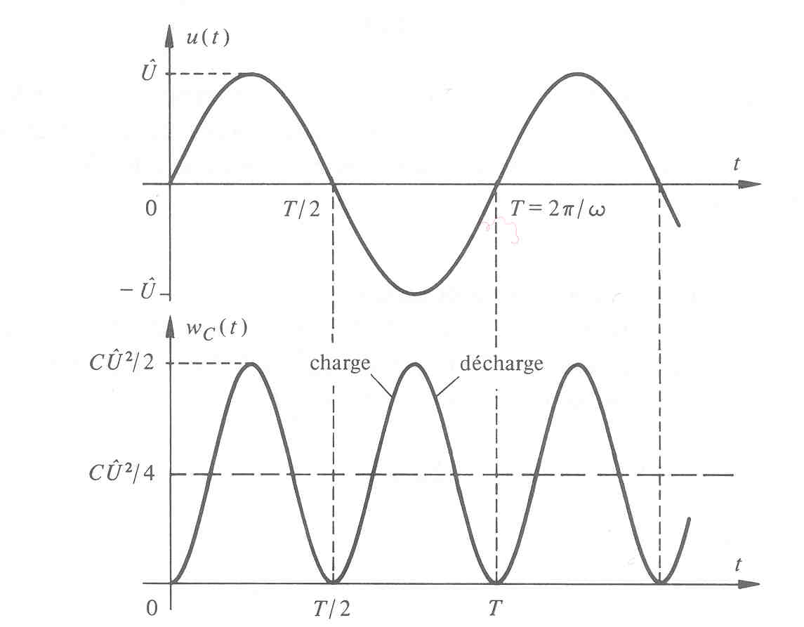
Capacitance: electrostatic energy
Sinusoidal regime:

Slide 59
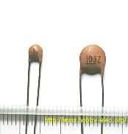
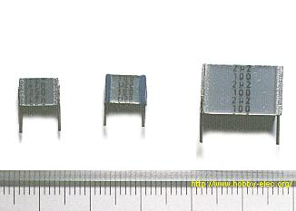
Capacitor: physical element
Ceramic (100 pF, 10 nF)
Metallic polyester film
(1 nF, 220 nF, 2.2 mF)

Slide 60
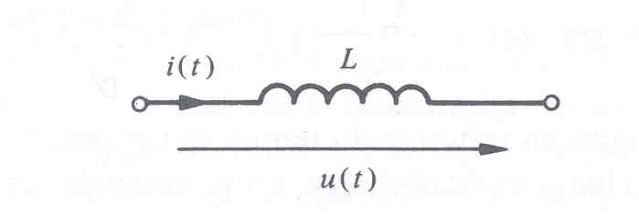
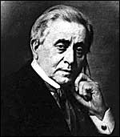
Inductance/Inductor
Circuit element that obeys the following
relationship :
The unit of inductance is henry (H).
Joseph Henry (1797-1878), american physicist.

Slide 61
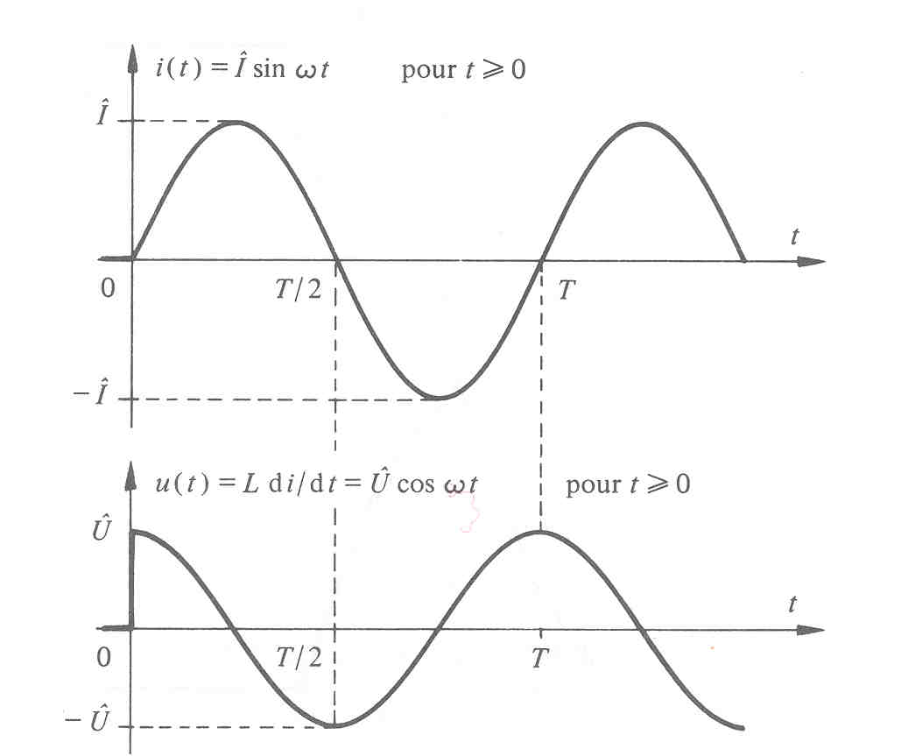
Inductance: current and voltage
In continuous regime: short circuit
In sinusoidal regime:
x
x

Slide 62
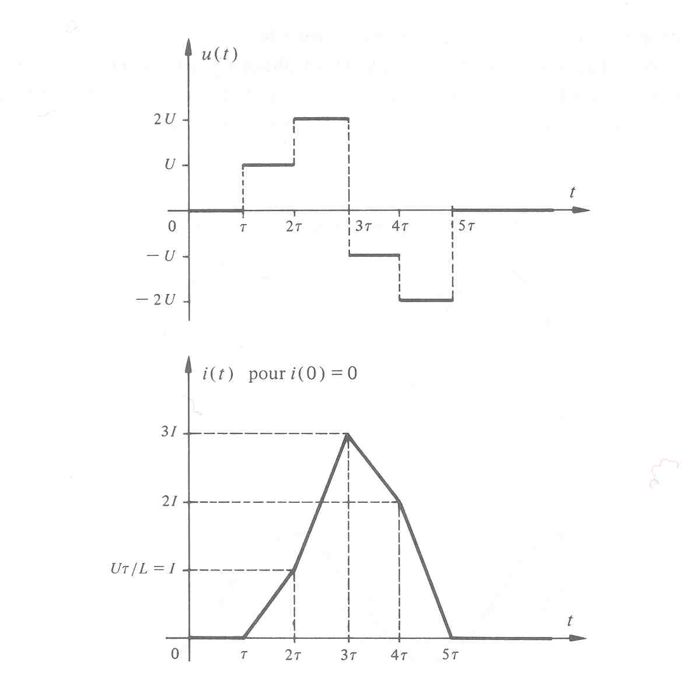
Inductance: no current step!

Slide 63
Inductance: magnetic energy
Sinusoidal regime:

Slide 64
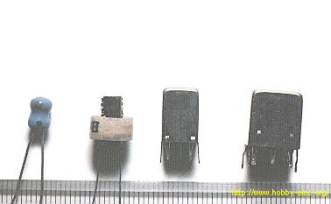
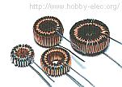
Inductor: physical element
1-100 mH
Toroidal coils

Slide 65
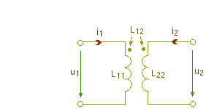
Coupled (Mutual) inductors
Coupled inductors constitute a biporte defined by the constitutive relations :

Slide 66
Coupled (Mutual) inductors
Coupled inductors constitute a biporte defined by the constitutive relations :
Inductors

Slide 67
Coupled (Mutual) inductors
Coupled inductors constitute a biporte defined by the constitutive relations :
Mutual inductances

Slide 68
Active circuit elements

Slide 69
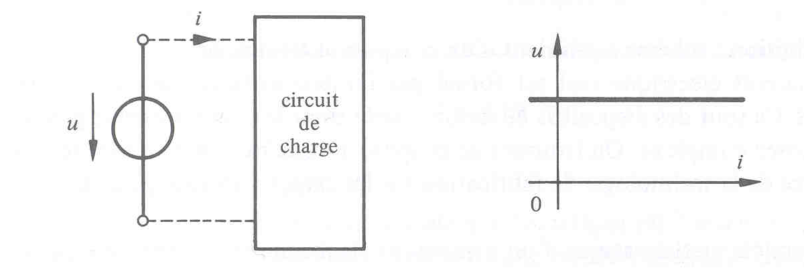
Ideal voltage source
Circuit element capable of supplying or absorbing electrical energy and whose voltage across its terminals is constant and independent of the charge connected to it.
A voltage source provides no energy when it is in open circuit.
Symbol :

Slide 70
Examples of sources

Slide 71
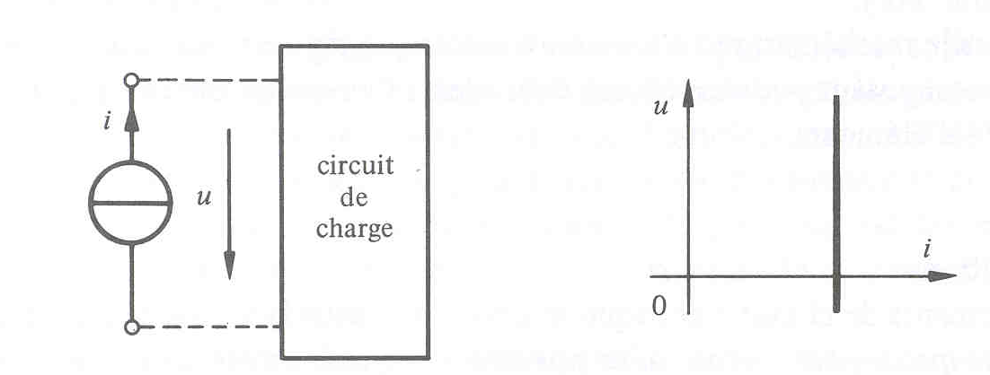
Ideal current source
Circuit element capable of supplying or absorbing electrical energy and whose current flowing through it is constant and independent of the charge connected to it.
A current source provides no energy when it is short-circuited.
Symbol :

Slide 72
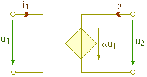
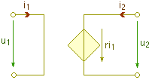
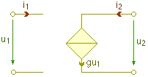
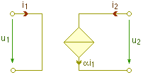
Dependent sources
Voltage source controlled by a voltage
Source de courant commandée par une tension
Source de courant commandée par un courant

Slide 73
Dependent sources
Voltage source controlled by a voltage
Voltage source controlled by a current
Source de courant commandée par un courant

Slide 74
Dependent sources
Voltage source controlled by a voltage
Voltage source controlled by a current
Current source controlled by a voltage

Slide 75
Dependent sources
Voltage source controlled by a voltage
Voltage source controlled by a current
Current source controlled by a voltage
Current source controlled by a current

Slide 76
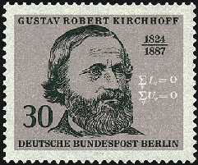
Kirchhoff’s Laws
Fundamental laws of electrical circuits
Gustav Robert Kirchhoff (1824-1897), German physicist.

Slide 77
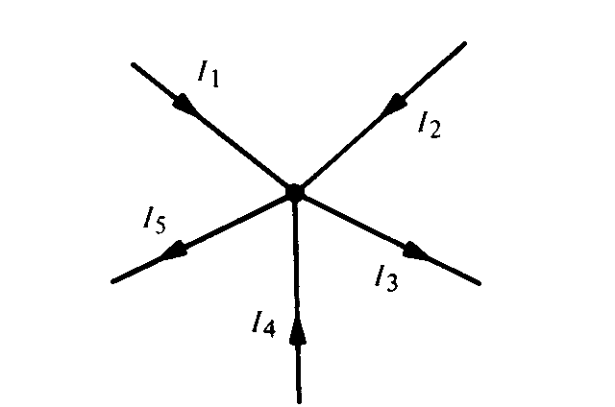
Kirchhoff’s current Law

Slide 78
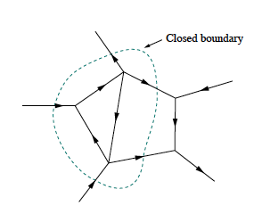
Kirchhoff’s current Law
The sum of currents in a closed boundary is zero

Slide 79
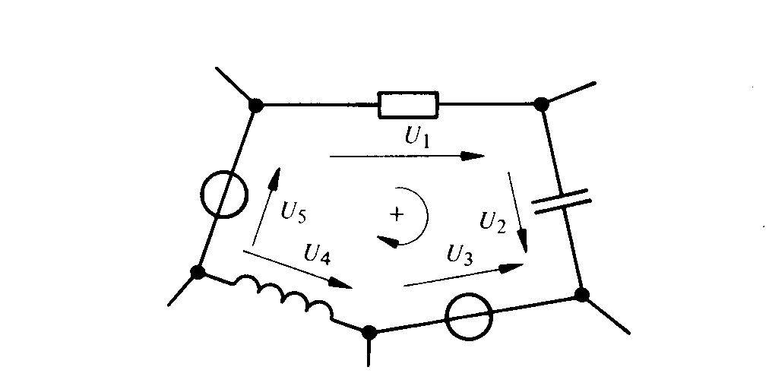
Kirchhoff’s voltage Law
Notes:
Example

Slide 81
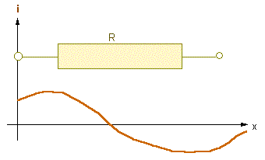
Limitations of the Kirchhoff model
Kirchhoff's model is a special case of a more general model, the Maxwell model.
Maxwell's equations describe the phenomenon of wave propagation. A basic assumption of Kirchhoff's model is the equality of the current entering and leaving a node.
For example, the current at both ends of a resistor is the same at all times. This is no longer the case if a wave propagates along the resistance.
However, if the wavelength is much greater than the length of the resistance, the Kirchhoff model remains valid.

Slide 82
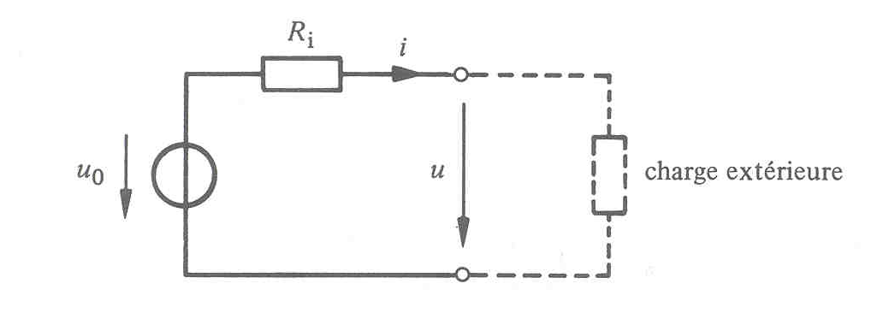

'Real' voltage source
The voltage of a real voltage source such as a battery decreases with the current it provides. We can model such a source by an ideal source in series with a resistance :
Ideal source
external
load
slope

Slide 83


'Real' current source
Current-voltage characteristic and equivalent circuit
slope
Ideal source
External load

Slide 84

Elements in series
Elements connected in series are traversed by the same current. The voltage across the circuit is equal to the sum of the voltages relative to each element.

Slide 85

Resistors in series

Slide 86

Capacitors in series
and

Slide 87

Inductors in series
and

Slide 88


Voltage sources in series

Slide 89
Current sources in series
Impossible unless all individual sources produce the same current

Slide 90

Series circuit: example

Slide 91

Elements in parallel
Elements connected in parallel are subjected to the same voltage. The total current is the sum of the individual currents.

Slide 92

Resistors in parallel

Slide 93

Capacitors in parallel
and

Slide 94

Inductors in parallel
and

Slide 95
Voltage sources in parallel
Impossible unless all individual sources produce the same voltage

Slide 96


Current sources in parallel

Slide 97

Series-parallel circuits

Slide 98

Series-parallel circuits

Slide 99
Series-parallel circuits

Slide 100

Series-parallel circuits

Slide 101

Series-parallel circuits

Slide 102

Voltage divider
(No initial voltages)

Slide 103

Current divider
(No initial currents)

Slide 104

Voltage / current divider : example
Solution on the board

