Slide 1
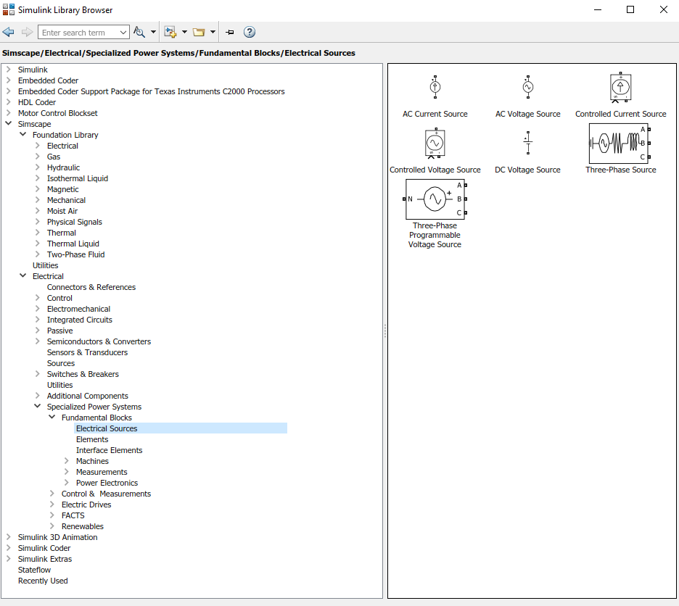
If you don’t have already installed MATLAB:
During the MATLAB setup make sure you install Simulink and alongside with Simscape and Simscape Electrical block sets.
Because, during the class, we will use these items to build our converter.

Slide 2
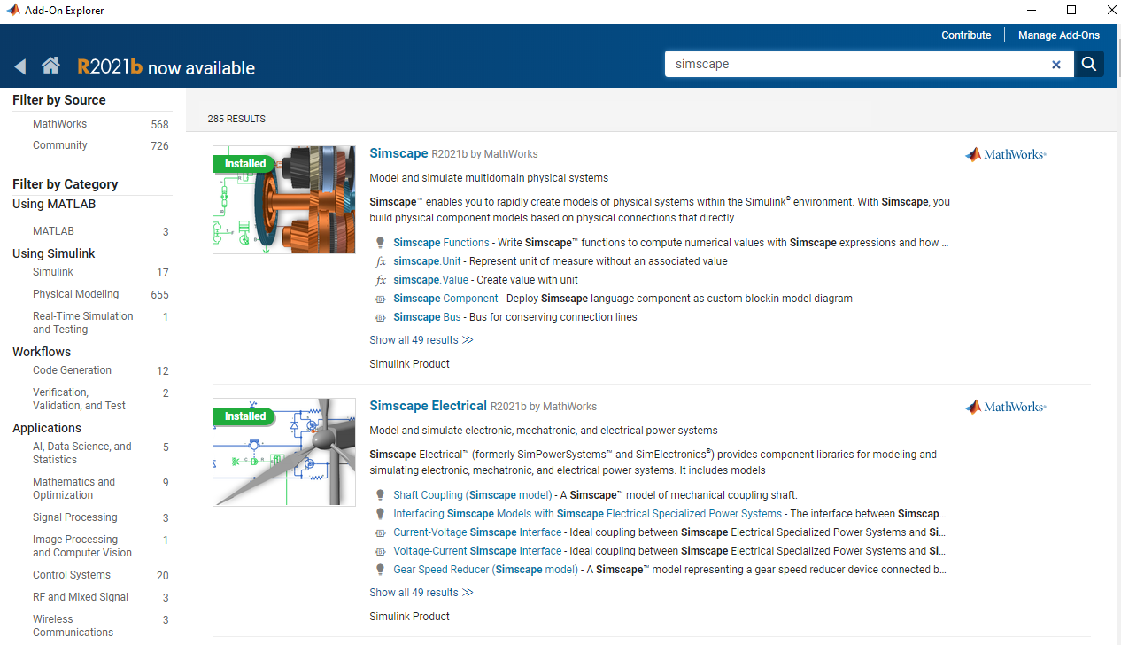
If you have already installed MATLAB and Simulink and don’t have Simscape, then add it through Add-ons in MATLAB main Page.

