Slide 1
Lattice Agreement
Fall 2025
Beatrice Shokry

Slide 2
Informal Definition
Lattice agreement is much weaker than consensus. It can be solved in asynchrony.
Intuitively, this is true because processes’ decisions need to form a chain but not necessarily agree on the same value.
Ex: p1:{a}, p2:{b}, p3:{c}. A valid decision output is:
  p1 decides {a}
  p2 decides {a,b}
  p3 decides {a,b,c}

Slide 3
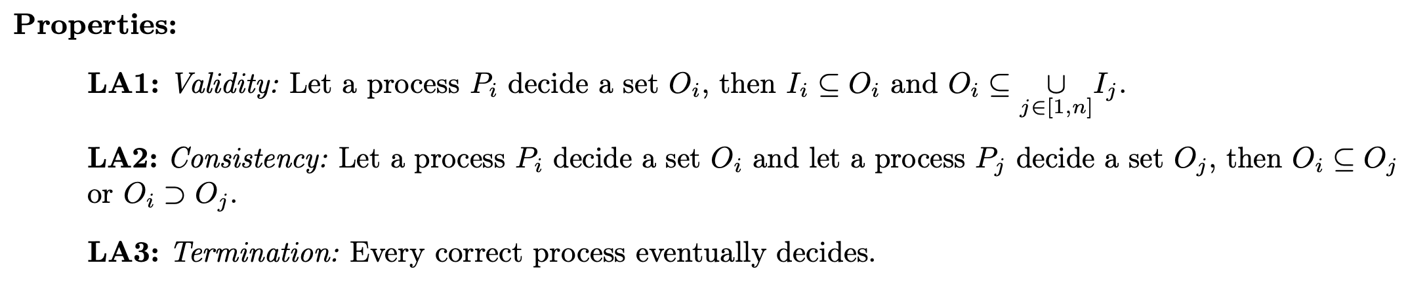
Formal Definition
1
2
3
  (1) → Whatever I decide needs to at least include my proposal (lower bound)
  (2) → Whatever I decide can at most be the union of all other processes proposals (upper bound)
  (3) → All decisions needs to be comparable (chain concept)

Slide 4
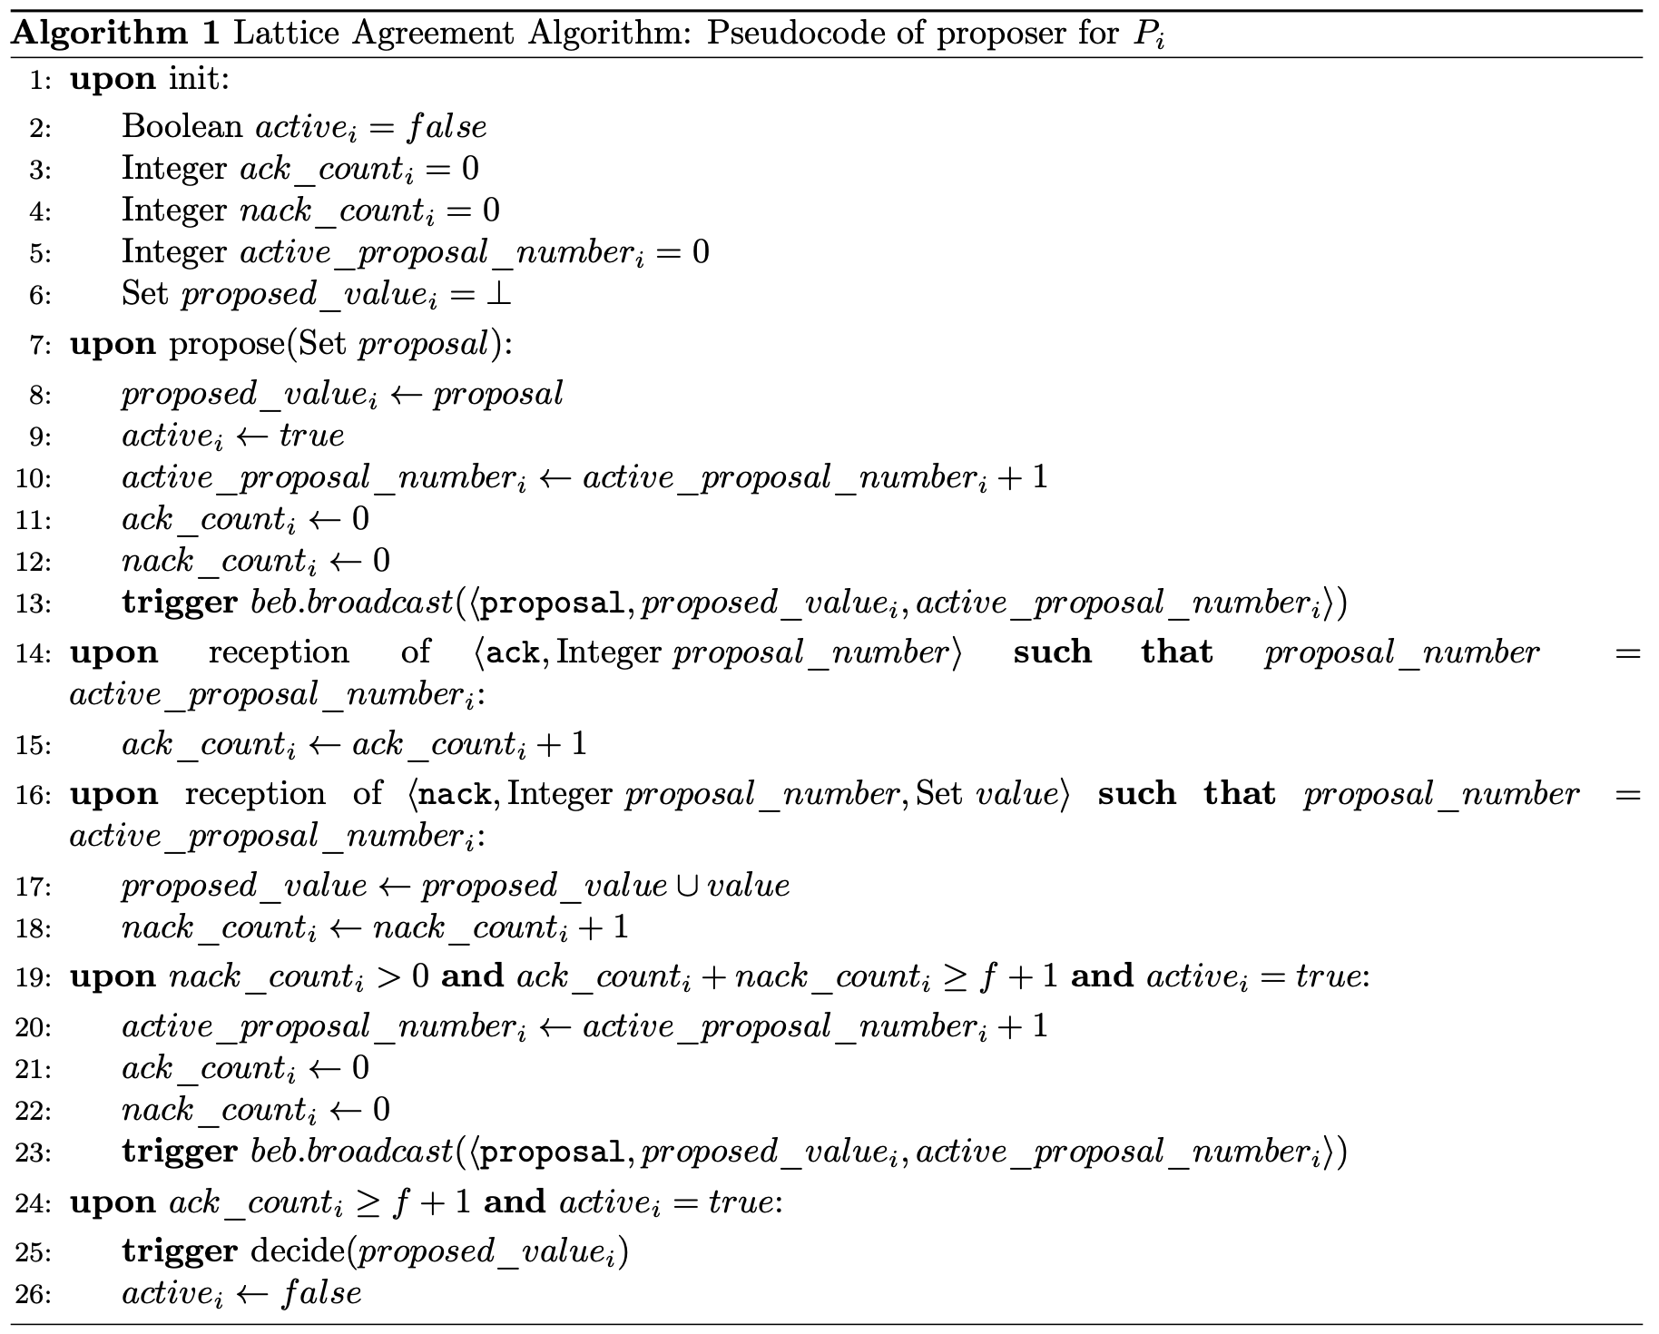
Algorithm (1)
Each process plays two roles concurrently: proposer and decider.
For a process to decide, it may need to go through n iterations identified by the active_proposal_number. The lower bound of n is 1.
At each iteration, the process beb its proposal (line 13).
If it collects majority of ACKs, it can decide (lines 24-26).
It it receives a NACK, it updates its proposal (lines 16-18).
If it collects enough feedback and at least one of them was a NACK, it starts a new iteration (lines 19-23).

Slide 5
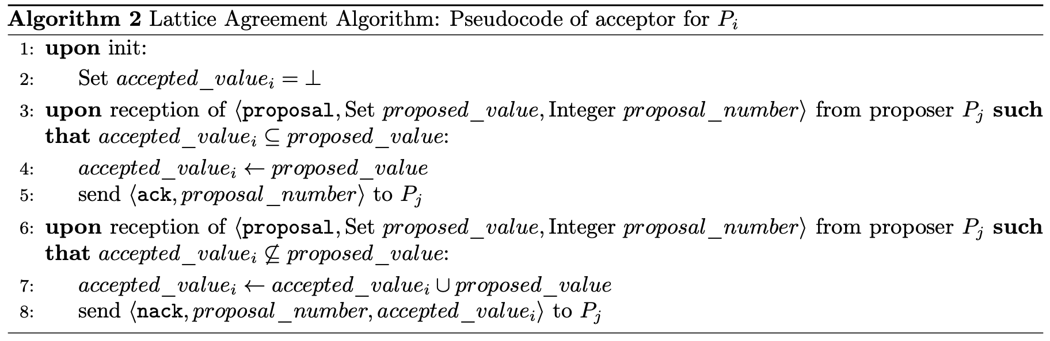
A decider process only updates its proposal only if the accepted value is not a subset of its proposal. If that is the case, it also sends a NACK to the sender process (i.e., tells it I do not agree with your set, please update it so that we can reach agreement).

Slide 6
Use Case
Any replication of monotonically growing state where it is acceptable that some replicas lead, as long as others only move forward and never contradict it.
EX: a feature service for a SaaS product
  Using lattice agreement, replicas decide states that form a chain of growing sets of feature events; some replicas may be ahead (they see more features enabled) and others may lag, but no two replicas ever disagree about whether a feature that one has seen is enabled—newer states only add information.

