Slide 1



COM-405: Mobile Networks
Lecture 8.0: Radar
Haitham Hassanieh
Laboratory of SEnsing
& Networking Systems

Slide 2
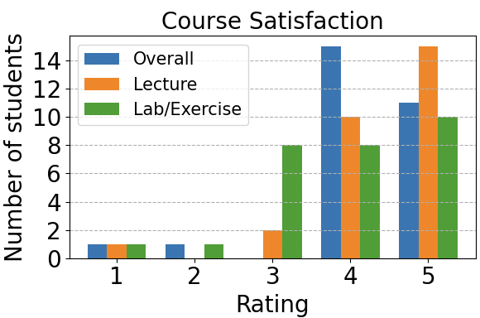
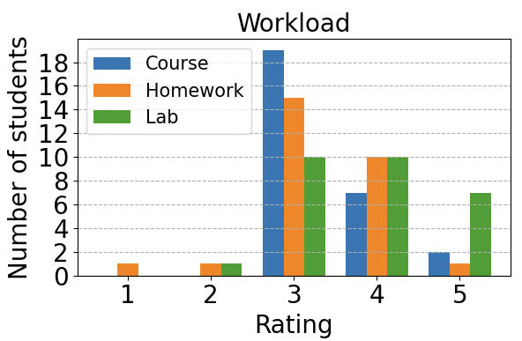
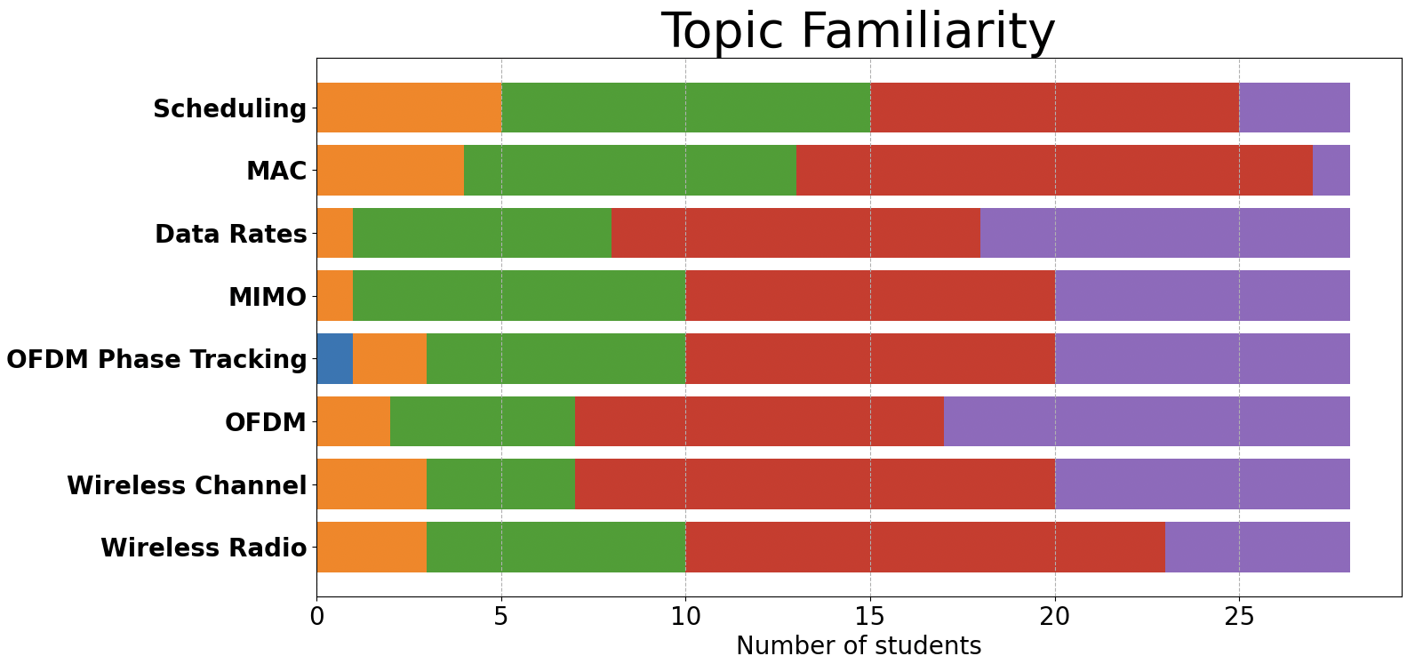

Feedback Survey Results

Slide 3
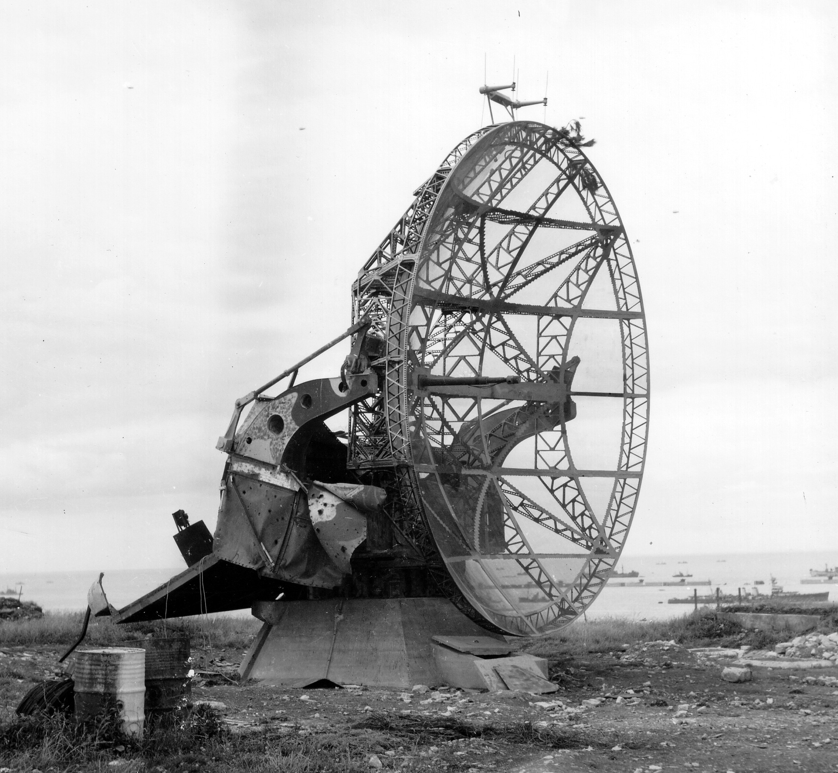
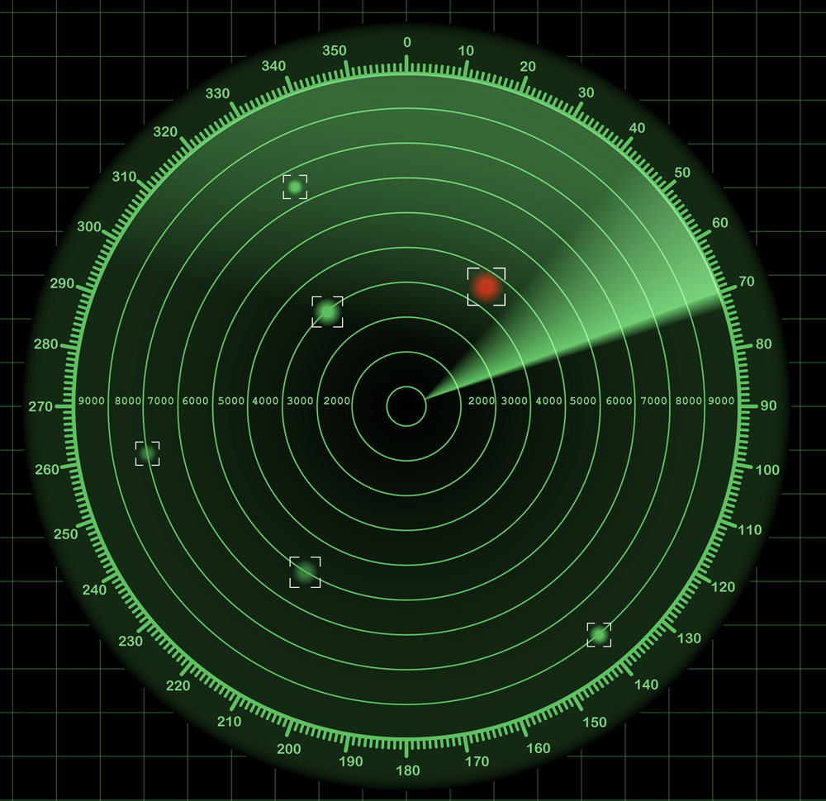
RADAR: RAdio Detection And Ranging
Invented during world war 2 to detect planes
Changed the course of the war
Transmit wireless signals, detect the reflections

Slide 4
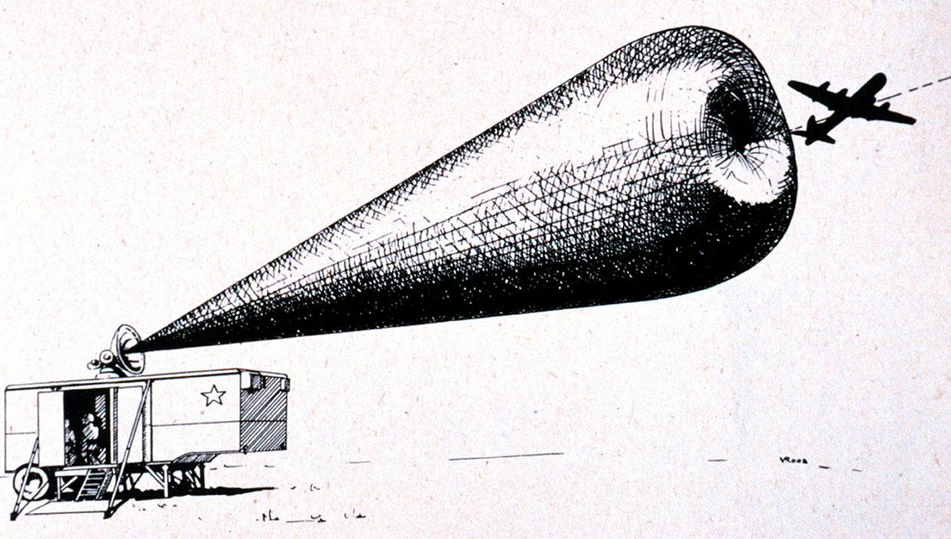

Slide 5
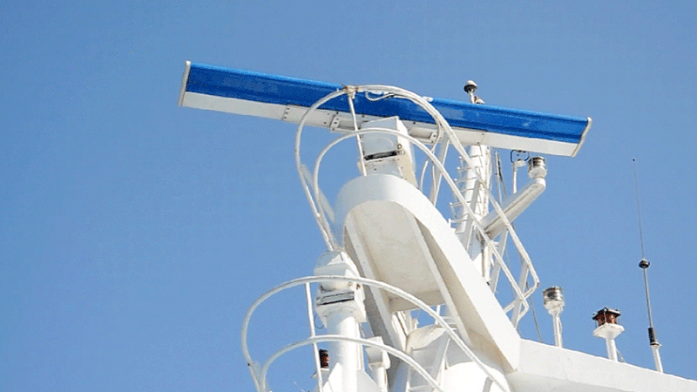
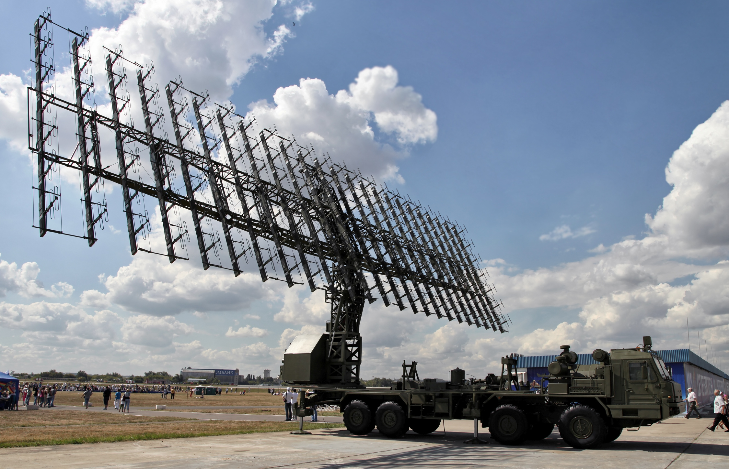
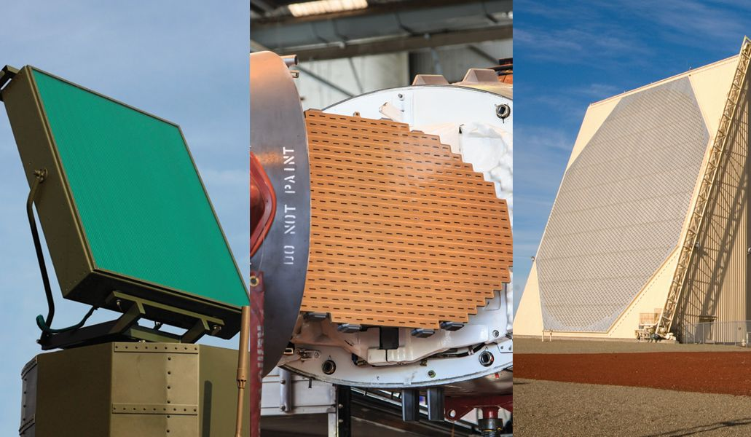
Radar: Interested in Detecting
Range: Distance from the radar
  UWB: Ultra Wide Band
  FMCW: Frequency Modulated Carrier Wave
Direction: Angle from which the object is coming
Directional antenna that is rotating.
Phased Antenna Array that is always Scanning.

Slide 6

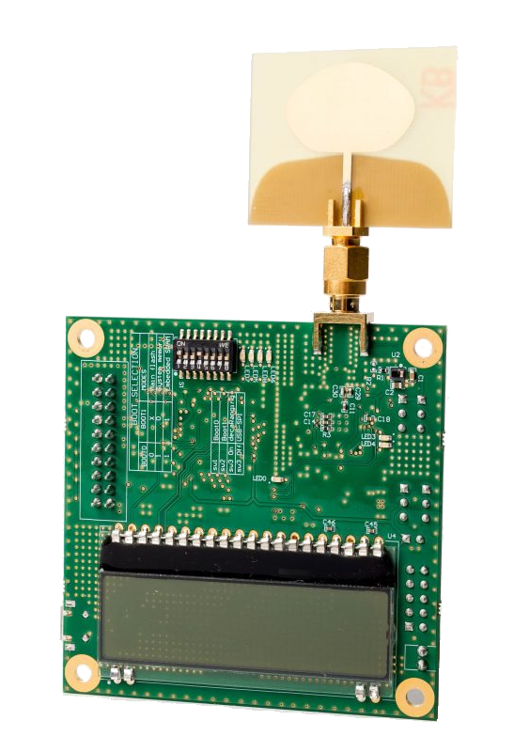
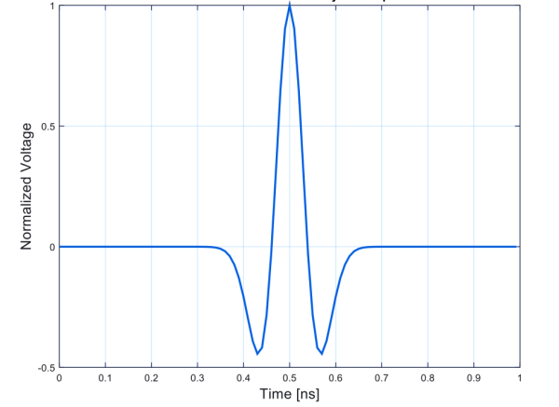
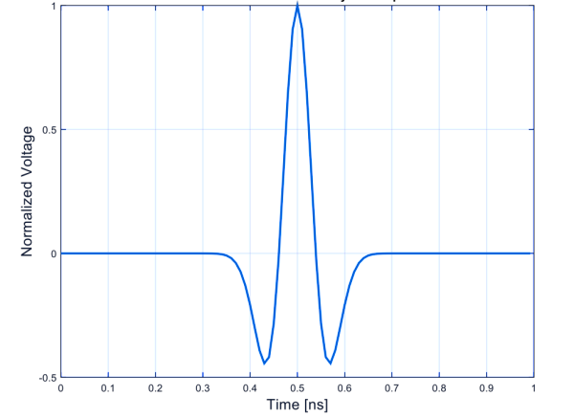
UWB: Ultra Wide Band
Transmit a Narrow Pulse in Time (1 ns)
x
x
Reflection Time
time
1ns
1ns

Slide 7
UWB: Ultra Wide Band
Transmit a Narrow Pulse in Time (1 ns)
x
x
Distance =$($Reflection Time $/2) ×$Speed of Light
Reflection Time
time
1ns
1ns

Slide 8
UWB: Ultra Wide Band
Transmit a Narrow Pulse in Time (1 ns)
Bandwidth = 1/pulse time = 1 GHz → UWB
To detect pulse need to sample at Multi-GigaSample/sec
Distance =$($Reflection Time $/2) ×$Speed of Light
Reflection Time
time
1ns
1ns

Slide 9
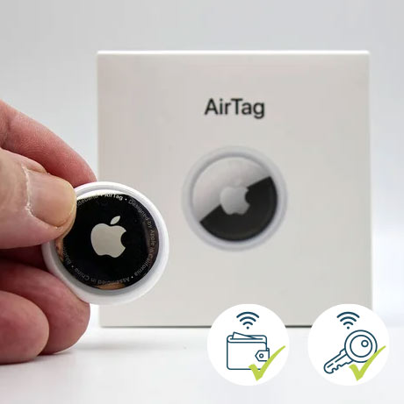
UWB: Ultra Wide Band
Pros:
High resolution
Simple idea
Used also for communication (UWB 802.15.3a, 3 - 10 GHz)
Cons:
Very High Speed Sampling Rate!

Slide 10
FMCW: Frequency Modulated Carrier Wave
Use chirps: signals where the frequency changes with time
Measure time using a frequency change
Transmitted
Received
ΔF
Frequency
=
ΔF
slope
Reflection Time
Time
t
t+ΔT

Slide 11
How do we measure ΔF ?
Subtracting frequencies is easy (e.g., removing carrier in WiFi)
Done using a mixer (low-power; cheap)
Power
Transmitted
Mixer
FFT
Received
ΔF
Signal whose frequency is ΔF
ΔF ➔Reflection Time ➔ Distance

Slide 12
FMCW: Frequency Modulated Carrier Wave
Slope
$$x\left(t\right)=e^{j2π\left( \frac{α}{2} t^{2}+f_{0}t+φ_{0}\right)}$$
FMCW Transmitted Signal:
Reflection Time
FMCW Received Signal: (Single reflector)
$$y\left(t\right)=Ae^{j2π\left( \frac{α}{2} {(t−τ)}^{2}+f_{0}\left(t−τ\right)+φ_{0}\right)}$$
$$=Ae^{j2π\left( \frac{α}{2} t^{2}−ατt+\frac{α}{2}τ^{2}+f_{0}t−f_{0}τ+φ_{0}\right)}$$
Phase
Mix TX and RX Signal:
$$y_{b}\left(t\right)=y\left(t\right)× x^{∗}(t)=$$
$$Ae^{−j2π\left(ατt +f_{0}τ\right)}$$
Frequency at $f=ατ$

Slide 13
FMCW: Frequency Modulated Carrier Wave
Slope
$$x\left(t\right)=e^{j2π\left( \frac{α}{2} t^{2}+f_{0}t+φ_{0}\right)}$$
FMCW Transmitted Signal:
Reflection Time
FMCW Received Signal: (Multiple reflectors)
$$y\left(t\right)=\sum_{i}{A_{i}e^{j2π\left( \frac{α}{2} {(t−τ_{i})}^{2}+f_{0}\left(t−τ_{i}\right)+φ_{0}\right)} }$$
Phase
$$\sum_{i}{A_{i}e^{−j2π\left(ατ_{i}t +f_{0}τ_{i}\right)}}$$
Mix TX and RX Signal:
$$y_{b}\left(t\right)=y\left(t\right)× x^{∗}(t)=$$
Frequencies at $f=ατ_{i}$

Slide 14
FMCW: Frequency Modulated Carrier Wave
$$x\left(t\right)=e^{j2π\left( \frac{α}{2} t^{2}+f_{0}t+φ_{0}\right)}$$
FMCW Transmitted Signal:
$$\sum_{i}{A_{i}e^{−j2π\left(ατ_{i}t +f_{0}τ_{i}\right)}}$$
Mix TX and RX Signal:
$$y_{b}\left(t\right)=y\left(t\right)× x^{∗}(t)=$$
Sweep Time $T_{s}$
$$Slope:α=\frac{B_{s}}{T_{s}}$$
B
ΔF
Sweep Bandwidth $B_{s}$
$$ΔF=αΔT=ατ_{i}$$
Frequency
ΔT
$$Sampling Rate:B≪B_{s}$$
Time
t
t+ΔT
$$FFT Window:T=T_{s}$$

Slide 15
FMCW: Frequency Modulated Carrier Wave
Sweep Time $T_{s}$
$$Slope:α=\frac{B_{s}}{T_{s}}$$
B
ΔF
$$ΔF=αΔT=ατ_{i}$$
Sweep Bandwidth $B_{s}$
Frequency
ΔT
$$Sampling Rate:B≪B_{s}$$
Time
$$FFT Window:T=T_{s}$$
t
t+ΔT
Max Range:
$$ΔF<B$$
$$⇒τ_{max}<B/α$$
$$=B T_{s}/B_{s}$$
$$⇒d_{max}<c B T_{s}/{2B}_{s}$$
Resolution:
$$δF=1/T$$
$$=1/T_{s}$$
$$⇒τ_{min}=1/αT_{s}$$
$$=1/B_{s}$$
$$⇒d_{min}=c/2B_{s}$$

Slide 16
Radar: Interested in Detecting
Range: Distance from the radar
  UWB: Ultra Wide Band
  FMCW: Frequency Modulated Carrier Wave
Direction: Angle from which the object is coming
Directional antenna that is rotating.
Phased Antenna Array that is always Scanning.

Slide 17
Phased Arrays Primer
$$θ$$
$$h_{k}=α_{1}e^{−j2π\frac{d_{1}−k s\cos{θ_{1}}}{λ}}$$

Slide 18
Phased Arrays Primer
Digital Phased Arrays
$$θ$$

Slide 19
Phased Arrays Primer
Digital Phased Arrays
$$θ$$

Slide 20

Phased Arrays Primer
Digital Phased Arrays
$$θ$$
RX
RX
RX
RX
RX
RX
RX
RX
RX
RX
RX
RX
RX
RX
Mixer
BPF
LPF
ADC
$$I$$
PLL
$$+$$
Digital Processing
LNA
$${90}^{o}$$
$$jQ$$
BPF
Mixer
LPF
ADC
Every antenna connected to full fledged RX
Sample & Process Signals in Digital

Slide 21

Phased Arrays Primer
Digital Phased Arrays
Analog Phased Arrays
$$θ$$
$$θ$$
RX
RX
RX
RX
RX
RX
RX
RX
RX
RX
RX
RX
RX
RX
RX
Mixer
All antennas connected to a single receiver
BPF
LPF
ADC
$$I$$
PLL
Each antenna connected to a phase shifter.
Phase shifter changes the phase of the signal on each antenna by multiplying with $e^{jφ}$.
Steer the beam electronically by changing the phases of the signals.
Get the sum along a certain direction.
$$+$$
Digital Processing
LNA
$${90}^{o}$$
$$jQ$$
BPF
Mixer
LPF
ADC
Every antenna connected to full fledged RX
Sample & Process Signals in Digital
Very expensive and high power for large arrays & mmWave
Cheap & low power but requires scanning

Slide 22
Analog Phased Arrays
$$θ$$
$$h_{k}=αe^{−j2π\frac{d−k s\cos{θ}}{λ}}$$
RX
$$y\left(t\right)=\sum_{1}^{N}{y_{k}\left(t\right)e^{jφ_{k}}}$$
$$=\sum_{1}^{N}{h_{k}x\left(t\right)e^{jφ_{k}}}$$
$$=\sum_{1}^{N}{αe^{−j2π\frac{d−k s\cos{θ}}{λ}}x\left(t\right)e^{jφ_{k}}}$$
$$=x\left(t\right)αe^{−j2π\frac{d}{λ}}\sum_{1}^{N}{e^{jπk \cos{θ}}e^{jφ_{k}}}$$
To get signal along direction $θ_{1}$, set the phases on the phase shifters to $φ_{k}=−πk cos θ$

Slide 23
Analog Phased Arrays
$$θ$$
$$h_{k}=αe^{−j2π\frac{d−k s\cos{θ}}{λ}}$$
RX

Slide 24
Analog Phased Arrays
$$θ$$
$$h_{k}=αe^{−j2π\frac{d−k s\cos{θ}}{λ}}$$
RX
Set the phase shifters to receive signals from a given direction.
Send FMCW signals.
Receiver FMCW reflections, down convert, sample and compute range FFT.
Repeat until you get 2D range image: AoA + Range

Slide 25
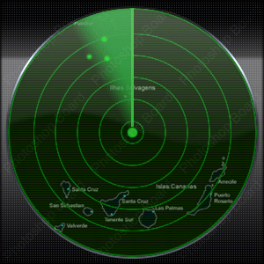
Analog Phased Arrays
$$θ$$
$$h_{k}=αe^{−j2π\frac{d−k s\cos{θ}}{λ}}$$
RX

Slide 26
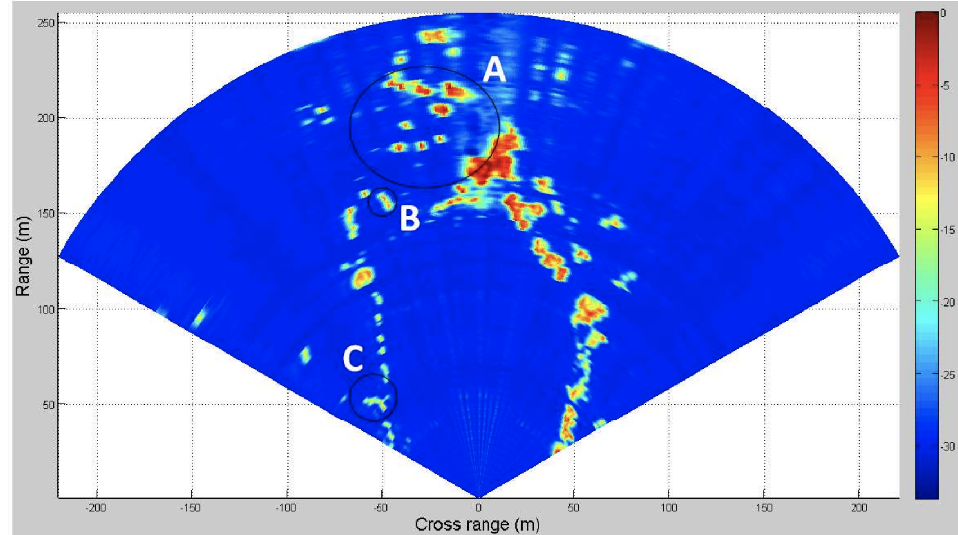
Analog Phased Arrays
$$θ$$
$$h_{k}=αe^{−j2π\frac{d−k s\cos{θ}}{λ}}$$
RX

Slide 27
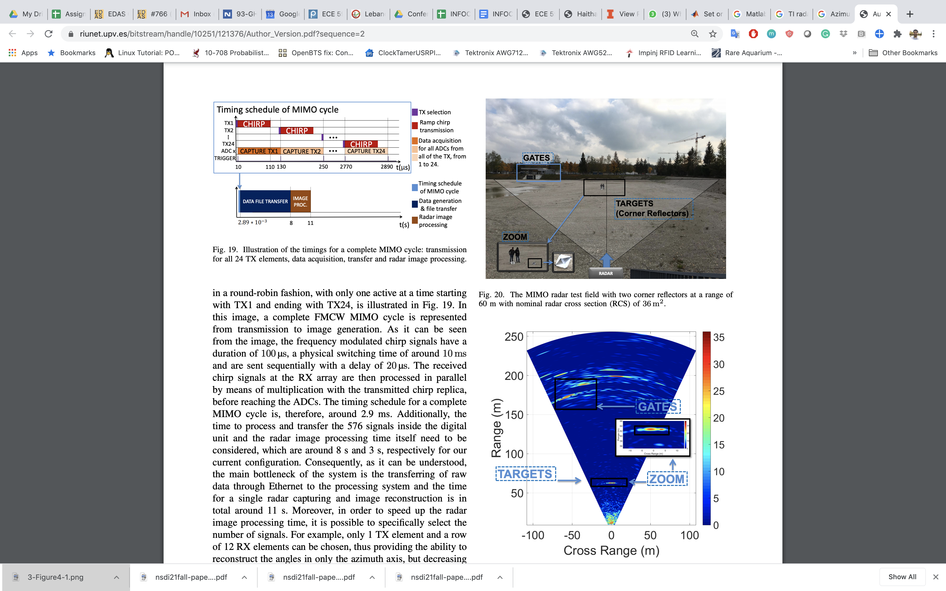
Analog Phased Arrays
Ganis, A.; Miralles-Navarro, E.; Schoenlinner, B.; Prechtel, U.; Meusling, A.; Heller, C.; Spreng, T.... (2018). A portable 3D Imaging FMCW MIMO Radar Demonstrator with a 24x24 Antenna Array for Medium Range Applications. IEEE Transactions on Geoscience and Remote Sensing. 56(1):298-312. https://doi.org/10.1109/TGRS.2017.2746739

Slide 28
Analog Phased Arrays
$$θ$$
$$h_{k}=αe^{−j2π\frac{d−k s\cos{θ}}{λ}}$$
RX
8 Antenna
16 Antenna
32 Antenna
Larger Array → Narrower Beams → Higher Resolution

Slide 29
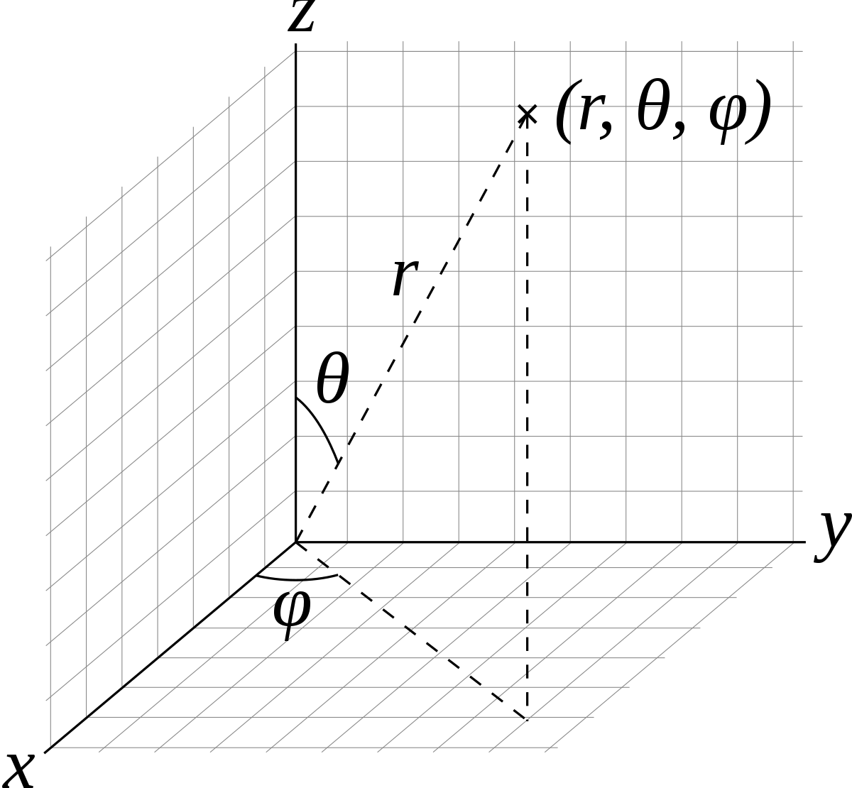


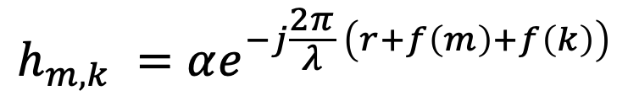

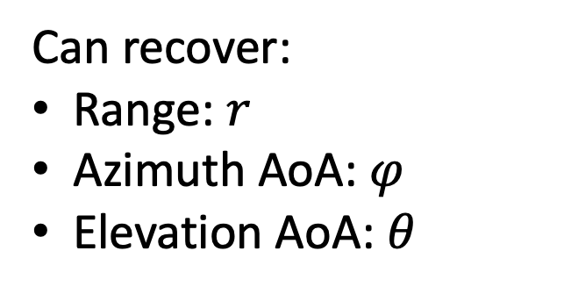


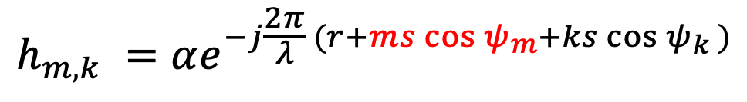

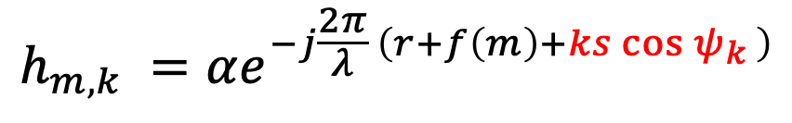
2D Phased Arrays
$$ψ_{k}$$
$$k$$
$$ψ_{m}$$
$$m$$
$$h_{m,k} =αe^{−j\frac{2π}{λ} \left(r+f\left(m\right)+f\left(k\right)\right)}$$
Can recover:
Range: $r$
Azimuth AoA: $φ$
Elevation AoA: $θ$
$$h_{m,k} =αe^{−j\frac{2π}{λ} \left(r+f\left(m\right)+ks\cos{ψ_{k}} \right)}$$
Fix $m$:
$$h_{m,k} =αe^{−j\frac{2π}{λ} (r+ms\cos{ψ_{m}}+ks\cos{ψ_{k}} )}$$
Fix $k$:

Slide 30
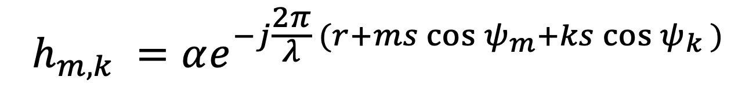
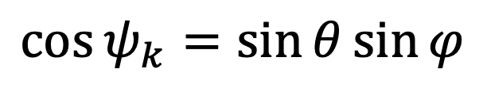
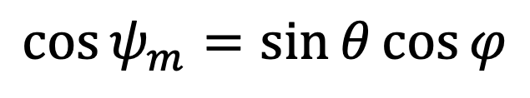
2D Phased Arrays
$$ψ_{k}$$
$$k$$
$$ψ_{m}$$
$$m$$
$$h_{m,k} =αe^{−j\frac{2π}{λ} (r+ms\cos{ψ_{m}}+ks\cos{ψ_{k}} )}$$
Can recover:
Range: $r$
Azimuth AoA: $φ$
Elevation AoA: $θ$
$$\cos{ψ_{m}}=\sin{θ}\cos{φ}$$
$$\cos{ψ_{k}}=\sin{θ}\sin{φ}$$

Slide 31
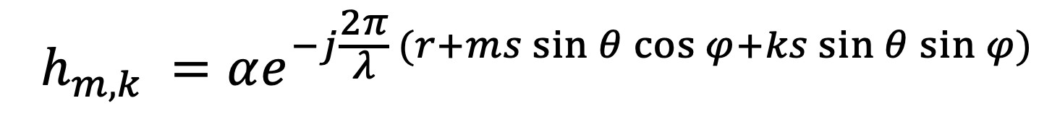
2D Phased Arrays
$$ψ_{k}$$
$$k$$
$$ψ_{m}$$
$$m$$
Can recover:
Range: $r$
Azimuth AoA: $φ$
Elevation AoA: $θ$
$$h_{m,k} =αe^{−j\frac{2π}{λ} (r+ms\sin{θ}\cos{φ}+ks\sin{θ}\sin{φ})}$$

Slide 32
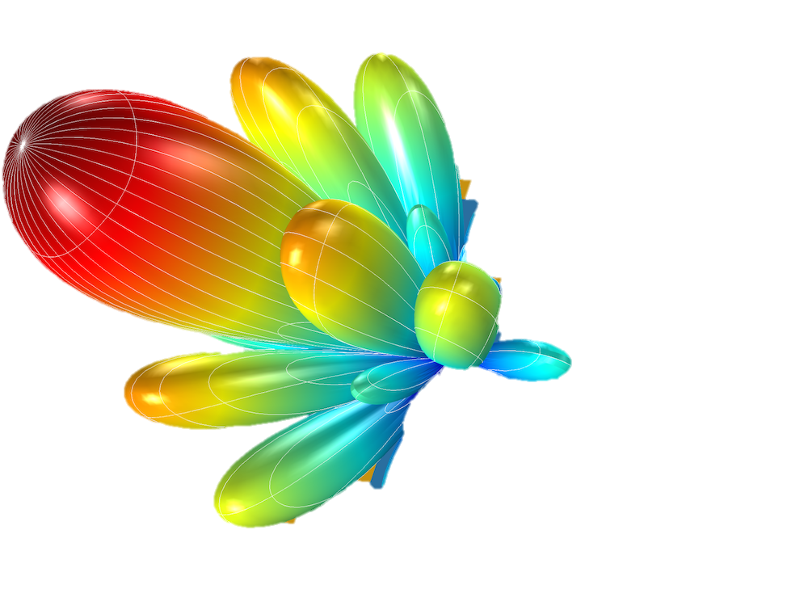
2D Phased Arrays
$$ψ_{k}$$
$$k$$
$$ψ_{m}$$
$$m$$
Can recover:
Range: $r$
Azimuth AoA: $φ$
Elevation AoA: $θ$
$$h_{m,k} =αe^{−j\frac{2π}{λ} (r+ms\sin{θ}\cos{φ}+ks\sin{θ}\sin{φ})}$$

Slide 33
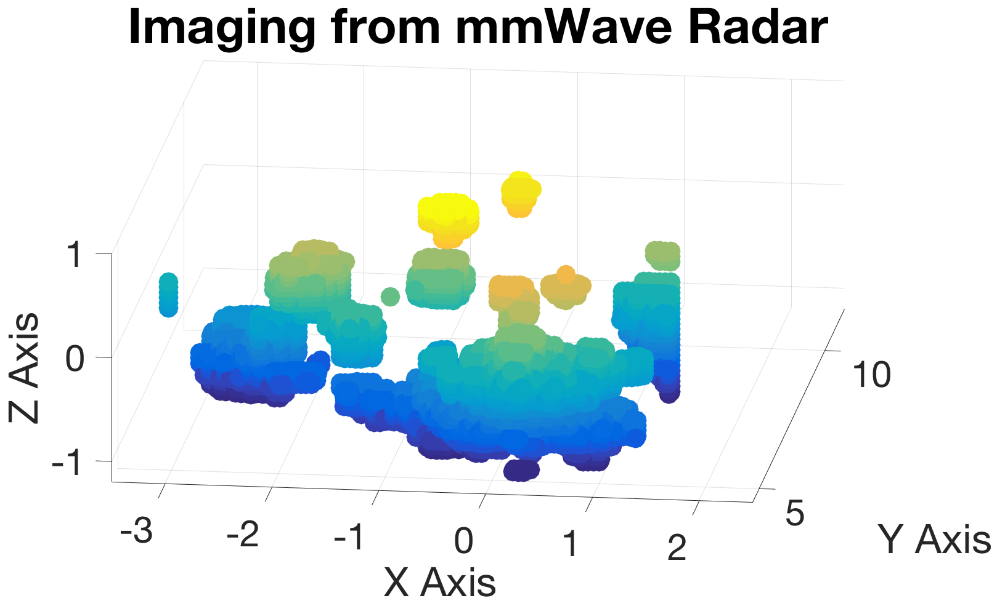
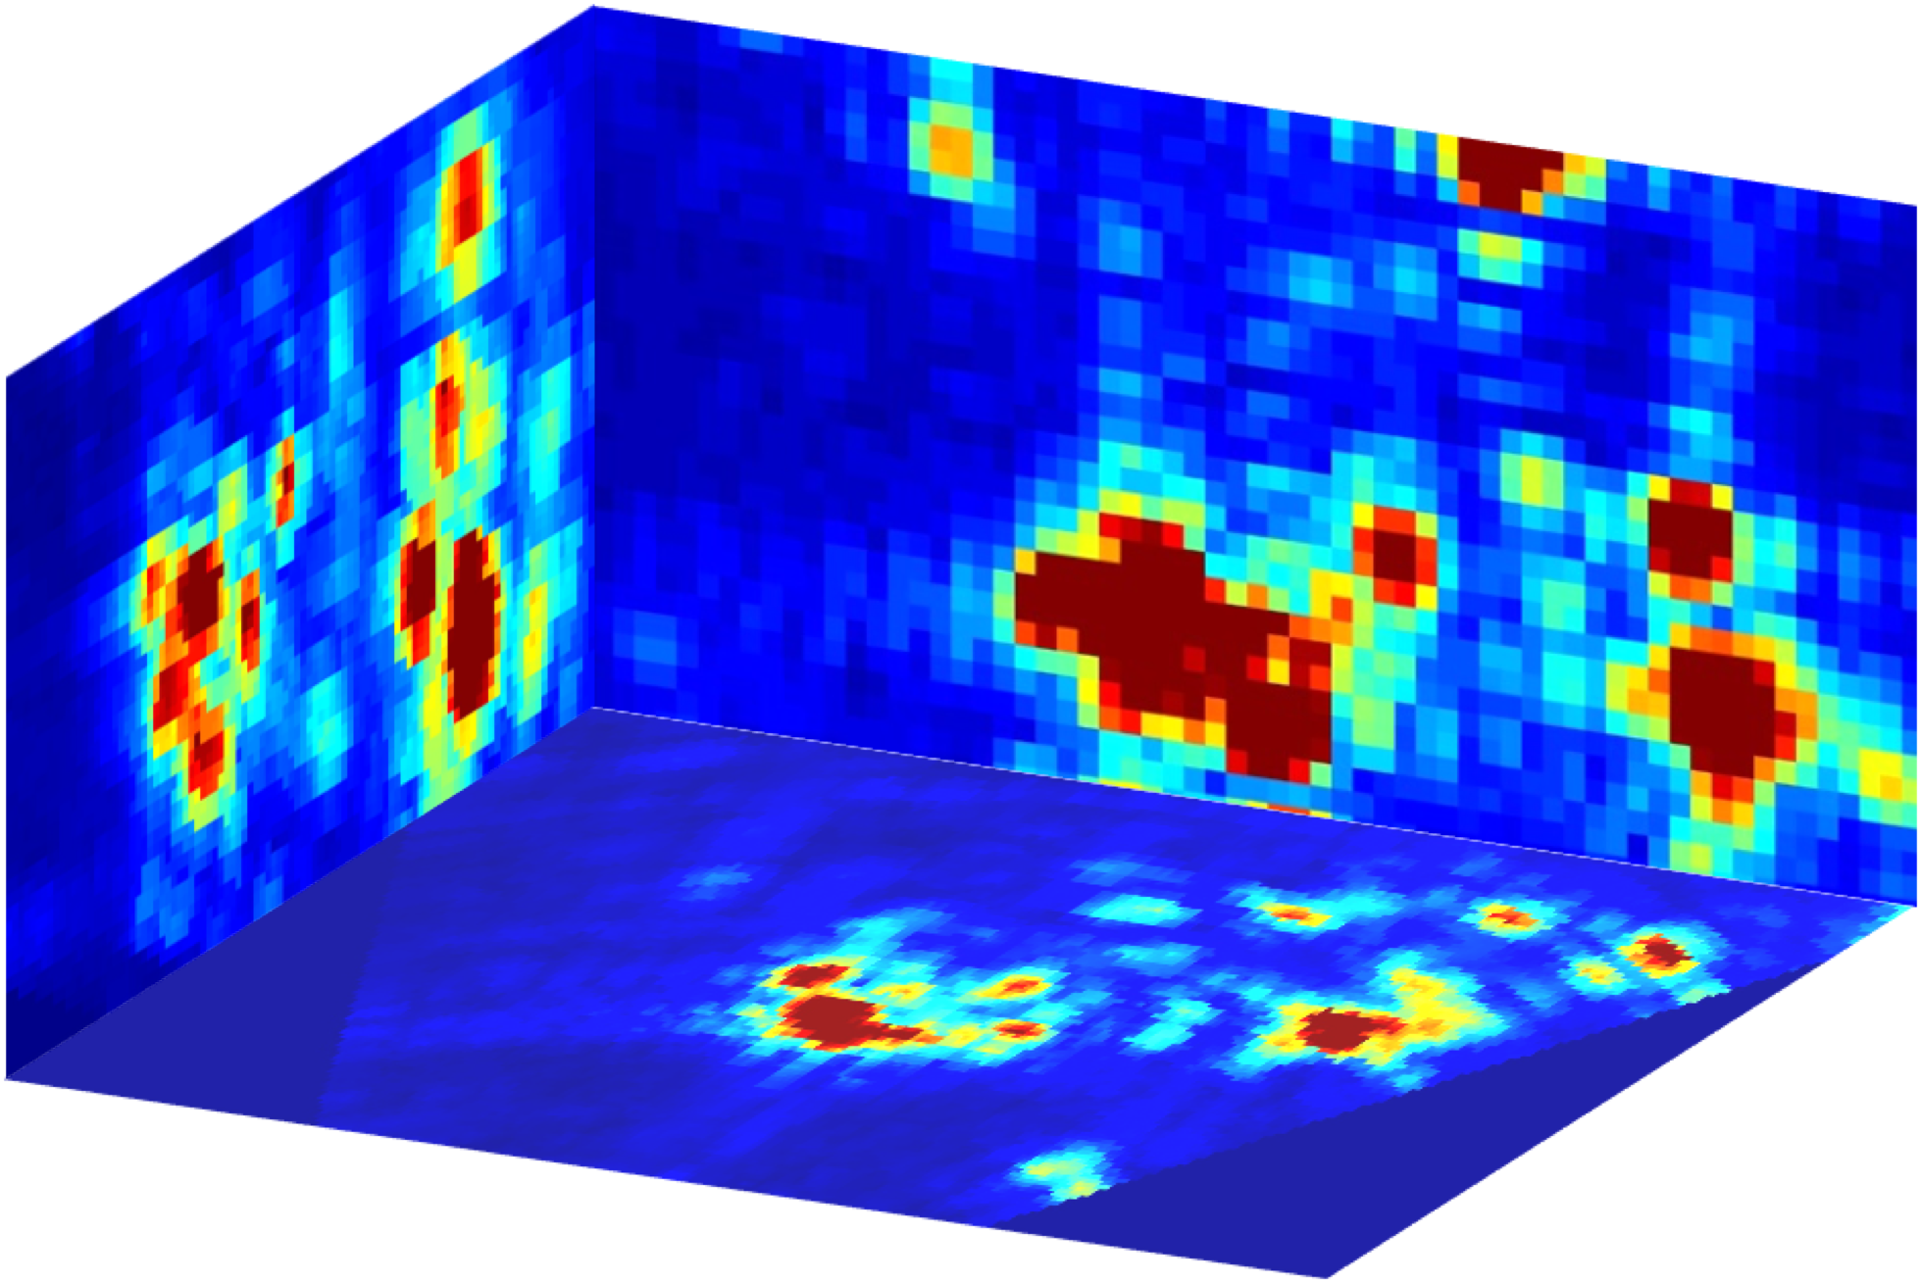

2D Phased Arrays
Pick the phase shift on each antenna to create a beam in each 3D direction.
Transmit FMCW signals and receive reflections.
Mix RX signal with TX and take range FFT .
Repeat in every direction.
$$ψ_{k}$$
$$k$$
$$ψ_{m}$$
$$m$$
3D Heatmap Image
3D Point Cloud

Slide 34


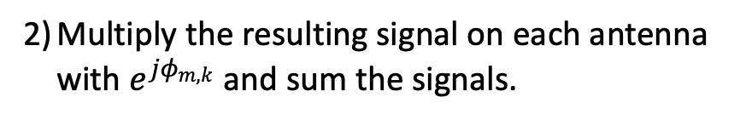





Phased Arrays Primer
Digital Phased Arrays
Analog Phased Arrays
Single RX Chain
$N×N$ RX Chains
Could Potentially Do the Same thing:
Pick the phase shift on each antenna to create a beam in each 3D direction.
Transmit FMCW signals and receive reflections.
Mix RX signal with TX and take range FFT .
Repeat in every direction.
Mix the RX signal with TX.
Multiply the resulting signal on each antenna with $e^{jφ_{m,k}}$ and sum the signals.
Compute Range FFT.
Repeat in every direction.
3D Heatmap Image
$$($$
$$N×N×T$$
$$+T\log{T}$$
$$)$$
$$×N×N$$
$$=O\left(N^{4}T+N^{2}T\log{T}\right)$$

Slide 35

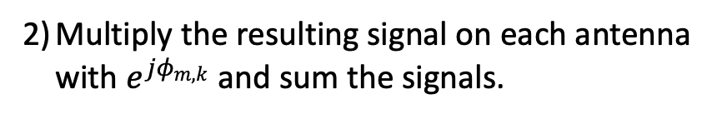




Phased Arrays Primer
Digital Phased Arrays
Analog Phased Arrays
Single RX Chain
$N×N$ RX Chains
Could Potentially Do the Same thing:
Pick the phase shift on each antenna to create a beam in each 3D direction.
Transmit FMCW signals and receive reflections.
Mix RX signal with TX and take range FFT .
Repeat in every direction.
Mix the RX signal with TX.
Compute Range FFT.
Multiply the resulting signal on each antenna with $e^{jφ_{m,k}}$ and sum the signals.
Repeat in every direction.
3D Heatmap Image
$$N×N×T\log{T}$$
$$+N×N×T$$
$$×N×N$$
$$=$$
$$O\left(N^{4}T+N^{2}T\log{T}\right)$$

Slide 36
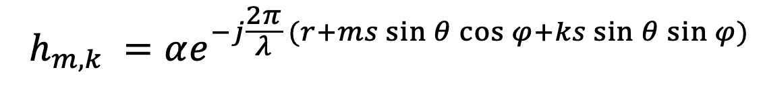

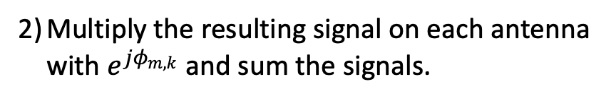
Phased Arrays Primer
Digital Phased Arrays
Algorithm 1:
$$O\left(N^{4}T+N^{2}T\log{T}\right)$$
Mix the RX signal with TX.
Compute Range FFT.
Multiply the resulting signal on each antenna with $e^{jφ_{m,k}}$ and sum the signals.
Repeat in every direction.
$N×N$ RX Chains
Algorithm 2: (Faster)
IDEA: antenna arrays are Fourier Transforms
$$h_{m,k} =αe^{−j\frac{2π}{λ} (r+ms\sin{θ}\cos{φ}+ks\sin{θ}\sin{φ})}$$

Slide 37
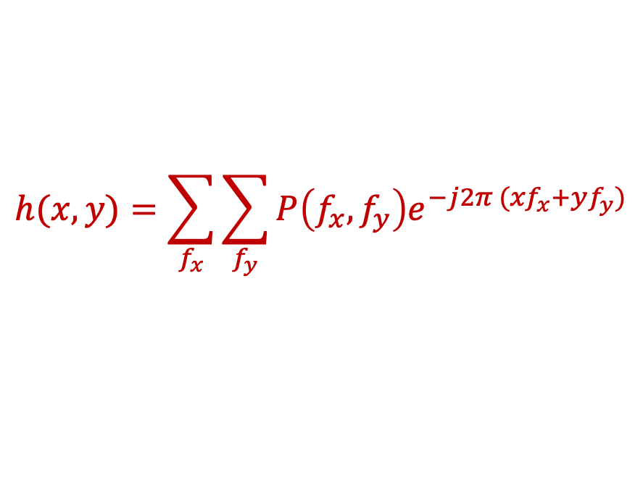
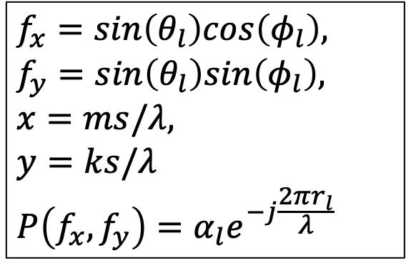
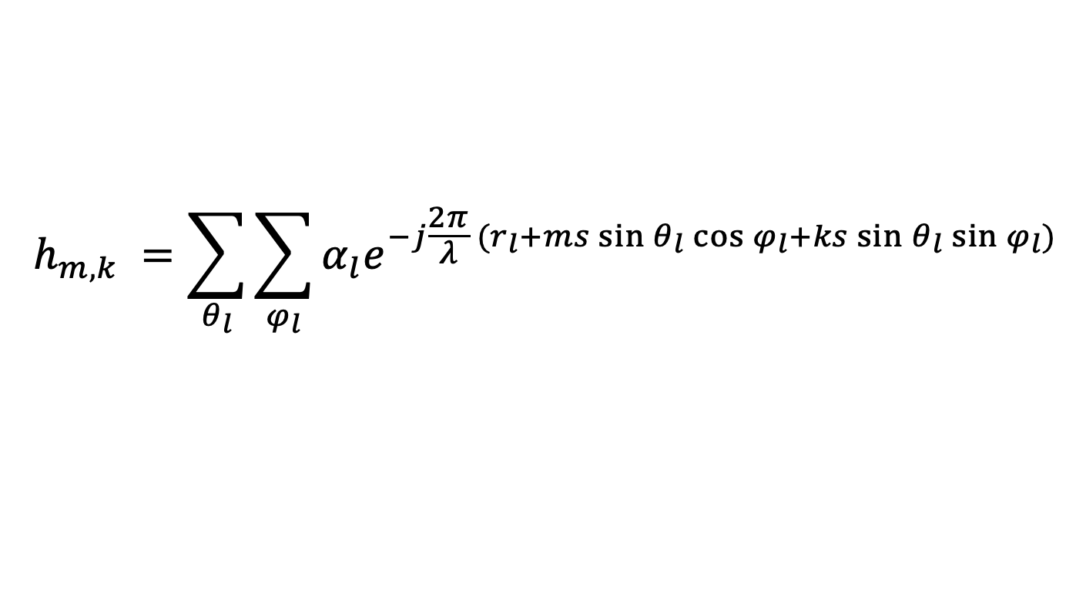
Phased Arrays Primer
Digital Phased Arrays
Algorithm 1:
$$O\left(N^{4}T+N^{2}T\log{T}\right)$$
Mix the RX signal with TX.
Compute Range FFT.
Multiply the resulting signal on each antenna with $e^{jφ_{m,k}}$ and sum the signals.
Repeat in every direction.
$N×N$ RX Chains
Algorithm 2: (Faster)
IDEA: antenna arrays are Fourier Transforms
$$h_{m,k} =\sum_{θ_{l}}{\sum_{φ_{l}}{α_{l}e^{−j\frac{2π}{λ} (r_{l}+ms\sin{θ_{l}}\cos{φ_{l}}+ks\sin{θ_{l}}\sin{φ_{l}})}}}$$
$$f_{x}=sin\left(θ_{l}\right)cos\left(φ_{l}\right),$$
$$f_{y}=sin\left(θ_{l}\right)sin\left(φ_{l}\right),$$
$$x=ms/λ,$$
$$y=ks/λ$$
$$P\left(f_{x}, f_{y}\right)=α_{l}e^{−j\frac{2πr_{l}}{λ} }$$
$$h(x,y)=\sum_{f_{x}}{\sum_{f_{y}}{P\left(f_{x}, f_{y}\right)e^{−j2π ({xf}_{x}+yf_{y})}}}$$
Use 2D FFT

Slide 38




Phased Arrays Primer
Digital Phased Arrays
Algorithm 1:
$$O\left(N^{4}T+N^{2}T\log{T}\right)$$
Mix the RX signal with TX.
Compute Range FFT.
Multiply the resulting signal on each antenna with $e^{jφ_{m,k}}$ and sum the signals.
Repeat in every direction.
$N×N$ RX Chains
Algorithm 2: (Faster)
IDEA: antenna arrays are Fourier Transforms
Mix the RX signal with TX.
Compute 2D FFT across antennas
3D FFT
Compute Range FFT.
$$N^{2}\log{N^{2}}× T$$
$$+N×N× T log T$$
$$=$$
$$O\left(N^{2}T\log{N^{2}T}\right)$$

Slide 39

Phased Arrays Primer
Digital Phased Arrays
Algorithm 1:
$$O\left(N^{4}T+N^{2}T\log{T}\right)$$
Mix the RX signal with TX.
Compute Range FFT.
Multiply the resulting signal on each antenna with $e^{jφ_{m,k}}$ and sum the signals.
Repeat in every direction.
$N×N$ RX Chains
Algorithm 2: (Faster)
$$O\left(N^{2}T\log{NT}\right)$$
3D FFT
Algorithm 3: (More Accurate)
Mix the RX signal with TX.
Compute 2D FFT across antennas
Compute Range FFT.

Slide 40
Phased Arrays Primer
Assumes parallel waves
Reflector is far away
$N×N$ RX Chains
Algorithm 3: (More Accurate)

Slide 41

Phased Arrays Primer
Assumes parallel waves
Reflector is far away
$N×N$ RX Chains
$N×N$ RX Chains
Algorithm 3: (More Accurate)

Slide 42





Phased Arrays Primer
Assumes parallel waves
Reflector is far away
Reflector is not far
$N×N$ RX Chains
$N×N$ RX Chains
Algorithm 3: (More Accurate)
IDEA: use the exact equation
$p$: FMCW Slope
$$s_{m,k}\left(t\right)$$
$$=α_{l}e^{−j2π(pτ_{l}t+f_{0}τ_{l}) }$$
$$=α_{l}e^{−j2π(p{2d}_{l}t/c+{2d}_{l}/λ) }$$
Received FMCW signal from reflector $l$after mixing with TX

Slide 43
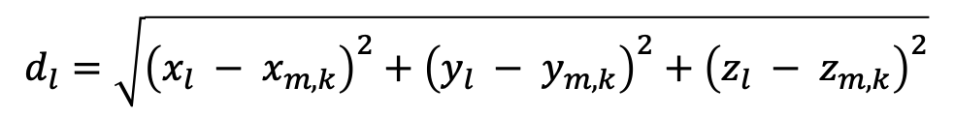
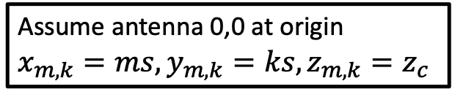


Phased Arrays Primer
Assumes parallel waves
Reflector is far away
Reflector is not far
$N×N$ RX Chains
$N×N$ RX Chains
Algorithm 3: (More Accurate)
Assume antenna 0,0 at origin
$$x_{m,k}=ms,y_{m,k}=ks, z_{m,k}=z_{c}$$
IDEA: use the exact equation
$$s_{m,k}\left(t\right)$$
$$=α_{l}e^{−j2π(pτ_{l}t+f_{0}τ_{l}) }$$
$$=α_{l}e^{−j2π(p{2d}_{l}t/c+2d_{l}/λ) }$$
$$d_{l}=\sqrt{{\left(x_{l} − x_{m,k}\right)}^{2}+{\left(y_{l} − y_{m,k}\right)}^{2}+{\left(z_{l} − z_{m,k}\right)}^{2}}$$
$$=\sqrt{{\left(x_{l} −ms\right)}^{2}+{\left(y_{l} −ks\right)}^{2}+{\left(z_{l} −z_{c}\right)}^{2}}$$

Slide 44
Phased Arrays Primer
Assumes parallel waves
Reflector is far away
Reflector is not far
$N×N$ RX Chains
$N×N$ RX Chains
Algorithm 3: (More Accurate)
Assume antenna 0,0 at origin
$$x_{m,k}=ms,y_{m,k}=ks, z_{m,k}=z_{c}$$
IDEA: use the exact equation
$$s_{m,k}\left(t\right)$$
$$=α_{l}e^{−j2π(pτ_{l}t+f_{0}τ_{l}) }$$
$$=α_{l}e^{−j2π(p{2d}_{l}t/c+2d_{l}/λ) }$$
$$=α_{l}e^{−j4π(pt/c+1/λ)\sqrt{{\left(x_{l} −ms\right)}^{2}+{\left(y_{l} −ks\right)}^{2}+{\left(z_{l} −z_{c}\right)}^{2}}}$$

Slide 45
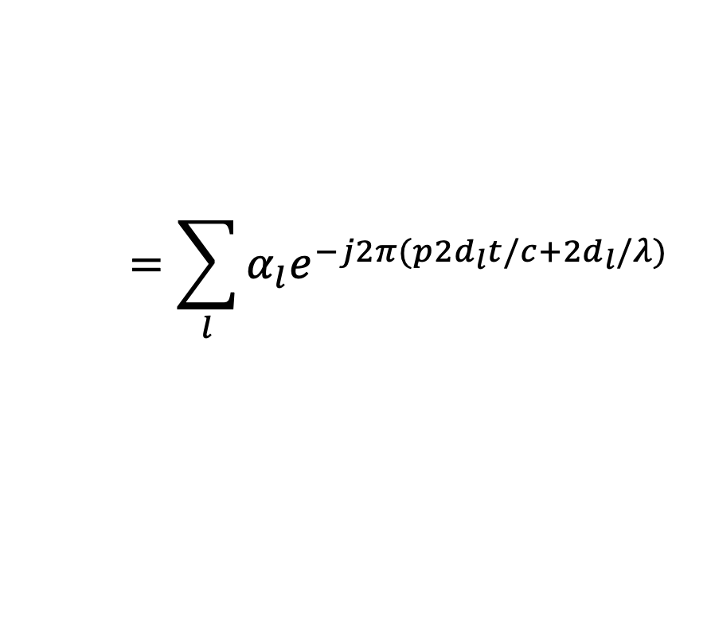
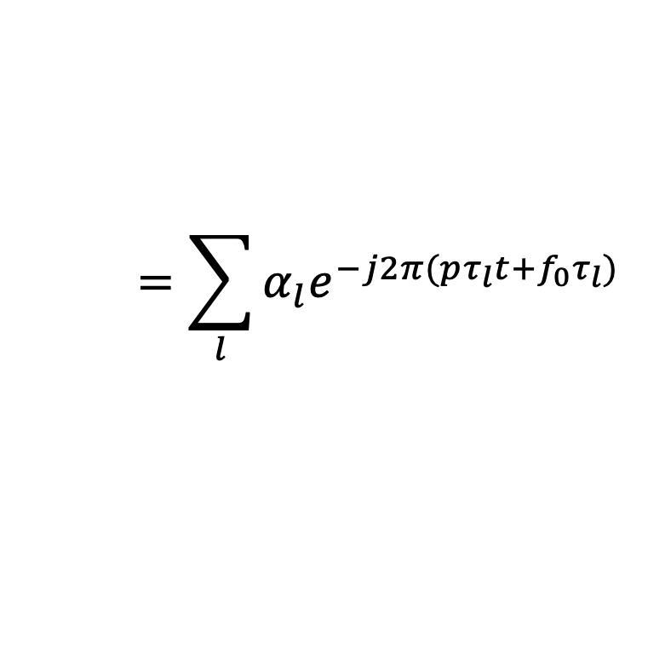
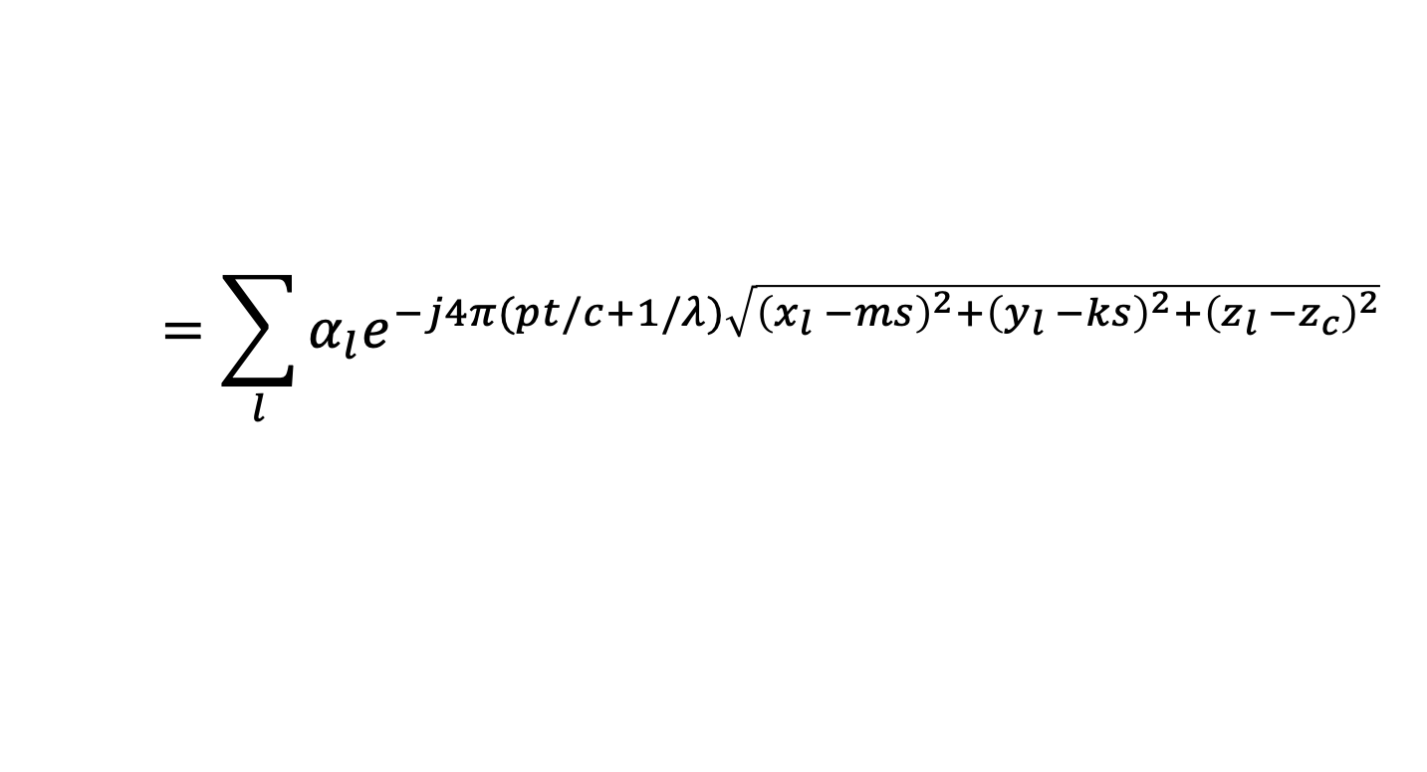
Phased Arrays Primer
Assumes parallel waves
Reflector is far away
Reflector is not far
$N×N$ RX Chains
$N×N$ RX Chains
Algorithm 3: (More Accurate)
Assume antenna 0,0 at origin
$$x_{m,k}=ms,y_{m,k}=ks, z_{m,k}=z_{c}$$
IDEA: use the exact equation
$$=\sum_{l}{α_{l}e^{−j2π(pτ_{l}t+f_{0}τ_{l}) } }$$
$$=\sum_{l}{α_{l}e^{−j2π(p{2d}_{l}t/c+{2d}_{l}/λ) } }$$
$$s_{m,k}\left(t\right)$$
$$=\sum_{l}{α_{l}e^{−j4π(pt/c+1/λ)\sqrt{{\left(x_{l} −ms\right)}^{2}+{\left(y_{l} −ks\right)}^{2}+{\left(z_{l} −z_{c}\right)}^{2}}} }$$

Slide 46
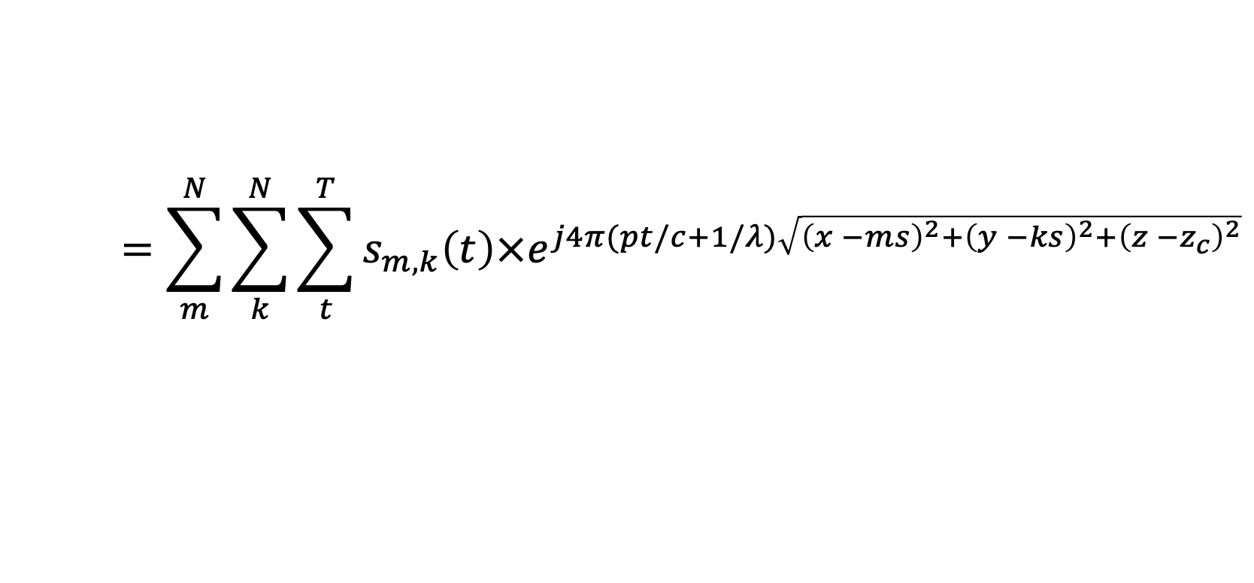

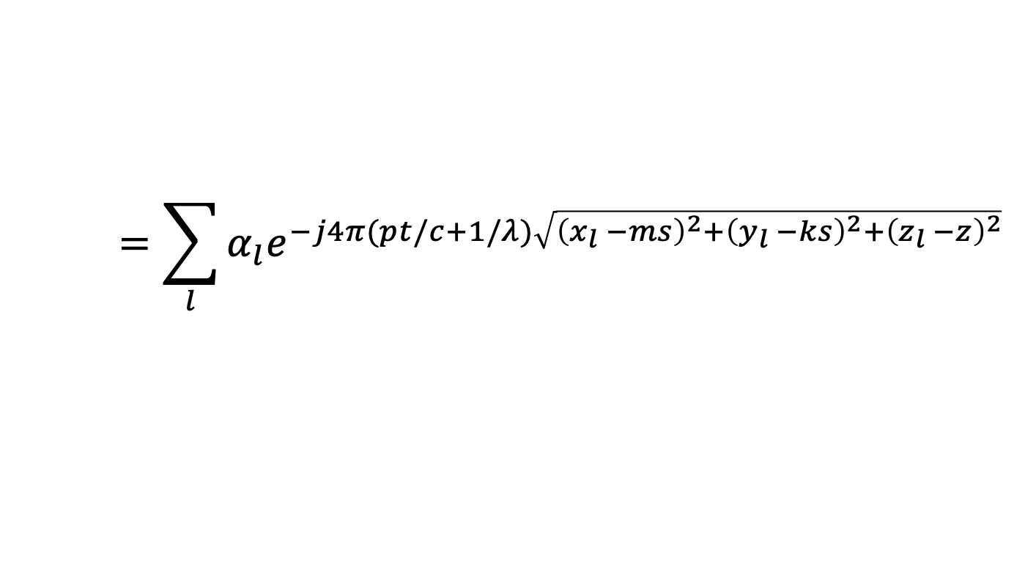

Phased Arrays Primer
Assumes parallel waves
Reflector is far away
Reflector is not far
$N×N$ RX Chains
$N×N$ RX Chains
Algorithm 3: (More Accurate)
Assume antenna 0,0 at origin
$$x_{m,k}=ms,y_{m,k}=ks, z_{m,k}=z_{c}$$
IDEA: use the exact equation
$$=\sum_{l}{α_{l}e^{−j4π(pt/c+1/λ)\sqrt{{\left(x_{l} −ms\right)}^{2}+{\left(y_{l} −ks\right)}^{2}+{\left(z_{l} −z\right)}^{2}}} }$$
$$s_{m,k}\left(t\right)$$
$$=\sum_{m}^{N}{\sum_{k}^{N}{\sum_{t}^{T}{s_{m,k}\left(t\right)×e^{j4π(pt/c+1/λ)\sqrt{{\left(x −ms\right)}^{2}+{\left(y −ks\right)}^{2}+{\left(z −z_{c}\right)}^{2}}}}}}$$
$$P\left(x,y,z\right)$$
$$=N^{2}Tα_{l}$$

Slide 47
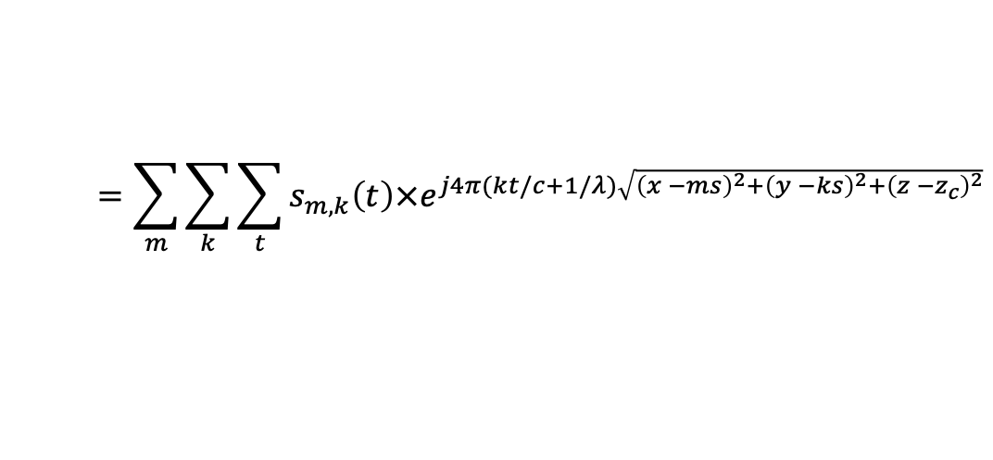



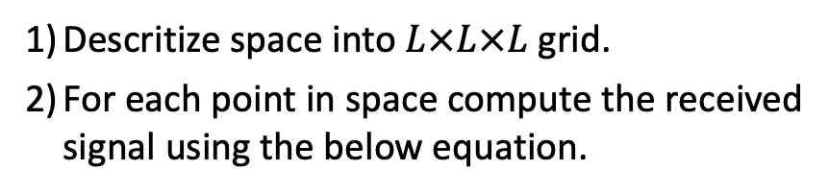
Phased Arrays Primer
Digital Phased Arrays
Algorithm 1:
$$O\left(N^{4}T+N^{2}T\log{T}\right)$$
Mix the RX signal with TX.
Compute Range FFT.
Multiply the resulting signal on each antenna with $e^{jφ_{m,k}}$ and sum the signals.
Repeat in every direction.
$N×N$ RX Chains
Algorithm 2: (Faster)
$$O\left(N^{2}T\log{NT}\right)$$
3D FFT
Algorithm 3: (More Accurate)
$$O\left(L^{3}N^{2}T\right)$$
$$=o\left(N^{5}T\right)$$
Mix the RX signal with TX.
Descritize space into $L×L×L$ grid.
For each point in space compute the received signal using the below equation.
Compute 2D FFT across antennas
Compute Range FFT.
$$P\left(x,y,z\right)$$
$$=\sum_{m}{\sum_{k}{\sum_{t}{s_{m,k}\left(t\right)×e^{j4π(kt/c+1/λ)\sqrt{{\left(x −ms\right)}^{2}+{\left(y −ks\right)}^{2}+{\left(z −z_{c}\right)}^{2}}}}}}$$

Slide 48




Phased Arrays Primer
Digital Phased Arrays
Analog Phased Arrays
Single RX Chain
$N×N$ RX Chains
Algorithm 1:
Pick the phase shift on each antenna to create a beam in each 3D direction.
Transmit FMCW signals and receive reflections.
Mix RX signal with TX and take range FFT .
Repeat in every direction.
$$O\left(N^{4}T+N^{2}T\log{T}\right)$$
Similar to Analog
Algorithm 2: (Faster)
$$O\left(N^{2}T\log{NT}\right)$$
3D FFT
Algorithm 3: (More Accurate)
$$O\left(L^{3}N^{2}T\right)$$
$$=o\left(N^{5}T\right)$$
3D Heatmap Image

Slide 49
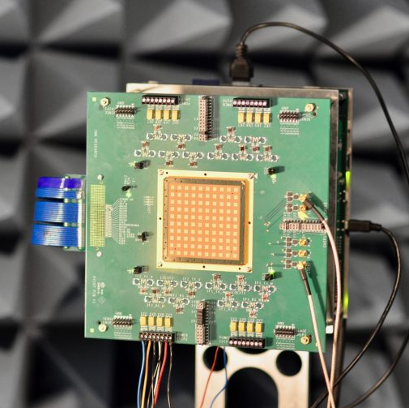
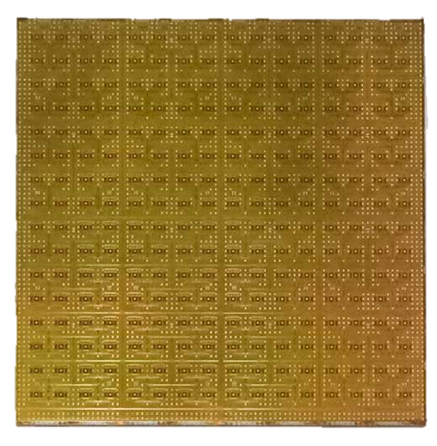
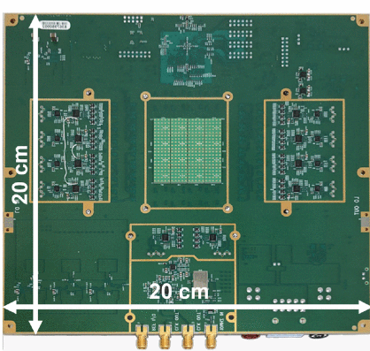
2D Phased Arrays
IBM
Anokiwave
Fujitsu
64 elements
256 elements
64 elements
Nokia & National Instruments
UCSD
UCSD
Bell Labs
256 elements
64 elements
384 elements

Slide 50
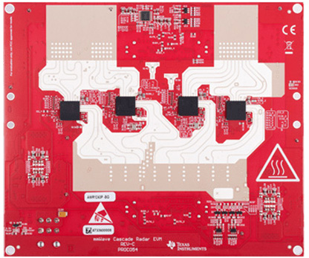
MIMO Radar
Receiver
Array
(16 elements)
TI
MIMO Radar
Transmitter
Array
（9 elements）
Angular resolution of radar is proportional to antenna array size.
50

Slide 51
Virtual Antenna Array
Physical TX Array
Physical RX Array
Location
Time
51

Slide 52
Virtual Antenna Array
Physical TX Array
Physical RX Array
Location
Time
52

Slide 53
Virtual Antenna Array
Physical TX Array
Physical RX Array
Location
Time
53

Slide 54
Virtual Antenna Array
Physical TX Array
Physical RX Array
Location
Time
86-element array
1.8º azimuth resolution 10x higher than single-chip radars
54

Slide 55
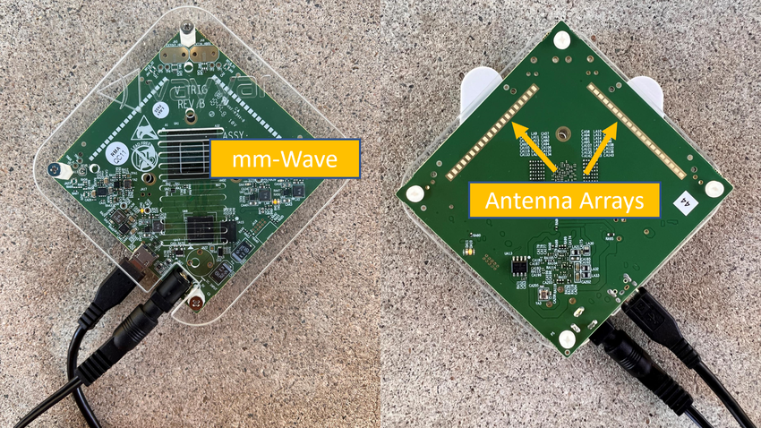
MIMO Radar
Receiver
Array
(20 elements)
Transmitter
Array
（20 elements）
55

