Slide 1


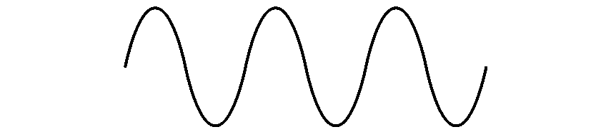
COM-405: Mobile Networks
Lecture 4.1: Scheduling
Haitham Hassanieh
slides shamelessly stolen from Prof. JP Hubaux with minor modifications
Laboratory of SEnsing
& Networking Systems

Slide 2
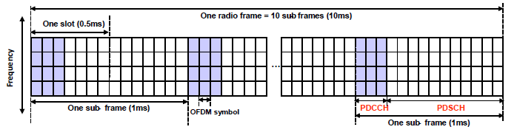
A Reservation-based Protocol
Physical Downlink Control Channel (PDCCH): conveys control information for each user.
Physical Downlink Shared Channel (PDSCH): multiplex the data of all terminals:
  Each user will transmit on a unique set of Orthogonal Frequency Division Multiplexing (OFDM) symbols and frequency blocks.
Reservation phase: PDCCH. Data phase: PDSCH.

Slide 3
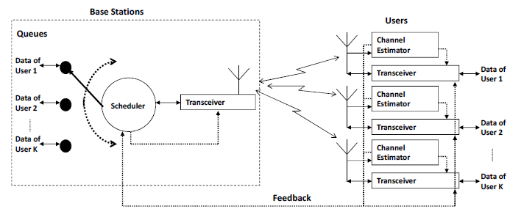
Role of Scheduling
Reservation phase:
  Estimate channel Feedback Scheduling

Slide 4
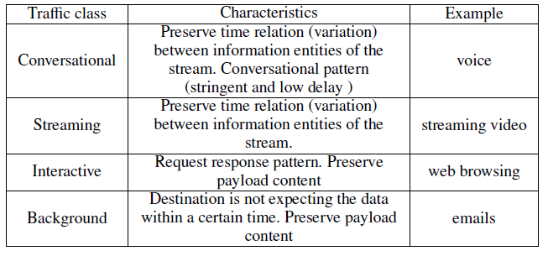
Issues in Wireless Scheduling
Need to support mixed classes of traffic with different characteristics:

Slide 5
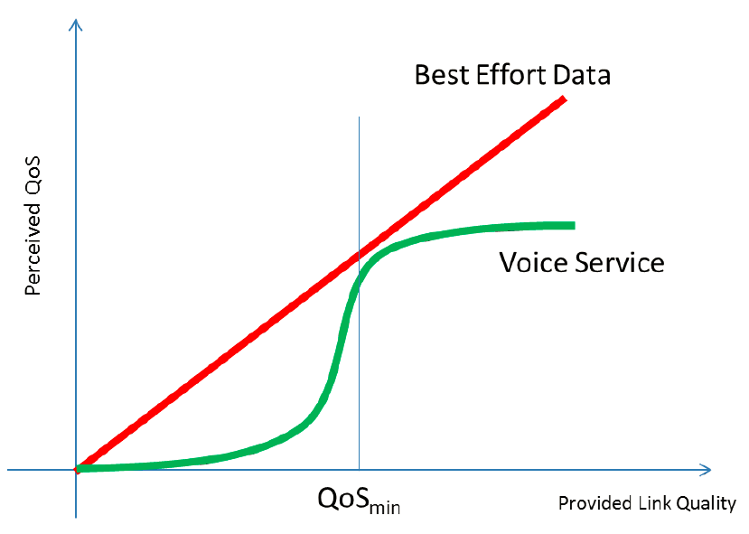
Perceived QoS

Slide 6
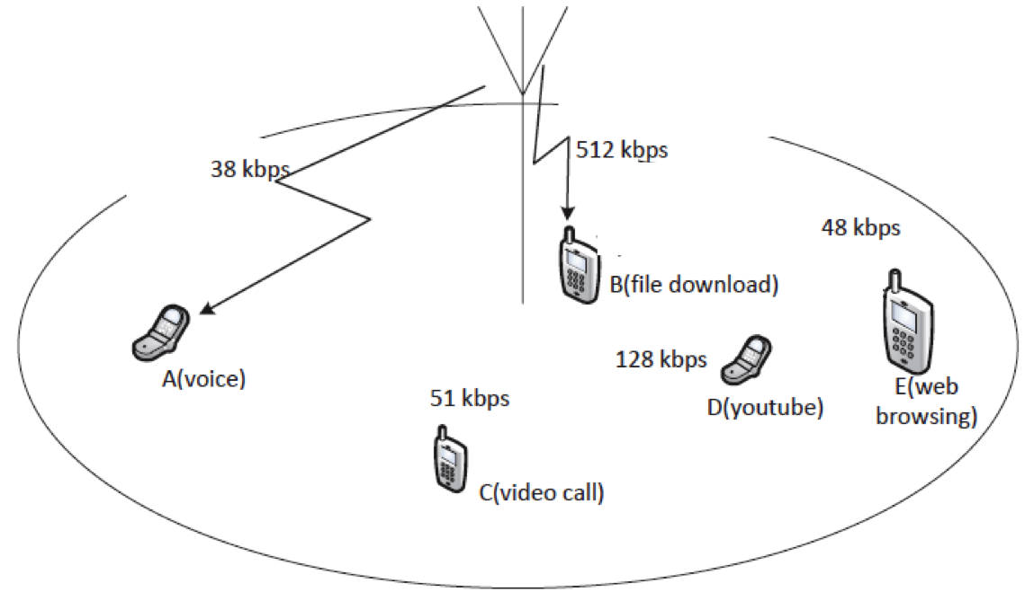
Issues in Wireless Scheduling
Need to be flexible in allocating network resources
  Achieved using scheduling algorithms
Note: In modern cellular networks, bitrates can be much higher than those in the picture

Slide 7
Issues in Wireless Scheduling
Channel variation
  Shadowing, fading, noise, interference, and user mobility
  Unstable, error-prone, and hard to predict
  Capacity of each link varies significantly in different time periods and locations
Even if the scheduler knows QoS requirements
  Difficult to estimate the amount of resources needed
  An adaptive procedure is needed to assure QoS, taking into account the requirements and channel variations

Slide 8
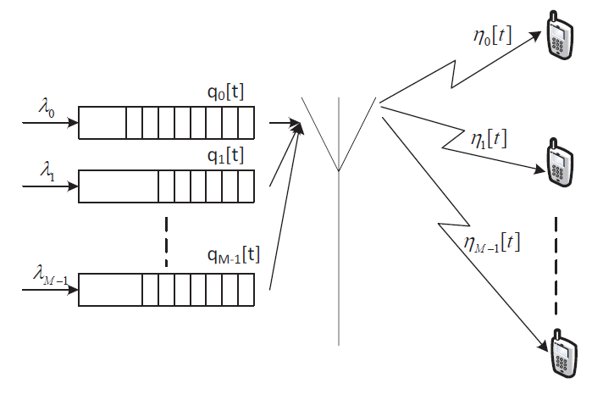
Downlink Scheduling

Slide 9
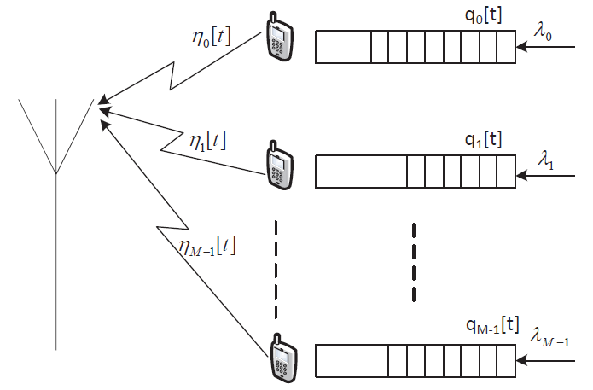
Uplink Scheduling

Slide 10

Queue Modeling
At timeslot t, the queue of user i changes as follows:
$$q_{i}\left[t+1\right]=q_{i}\left[t\right]+δ_{i}\left[t\right]−η_{i}[t]$$
Number of new bits arriving
Number of bits scheduled to transmit, determined by the scheduling algorithm
Number of bits in the queue

Slide 11
Round-Robin (RR) Scheduling
Users are scheduled in a round robin, i.e. cyclic order
i[t]: user scheduled at time t. RR scheduler:
i[t+1]=i[t]+1 (mod M -1)
The algorithm is fair: all users are given the same amount of time resources

Slide 12
Round-Robin Scheduling
Performance
  All users are allocated the same amount of network resources
  What is the throughput of all users in the following network?

Slide 13
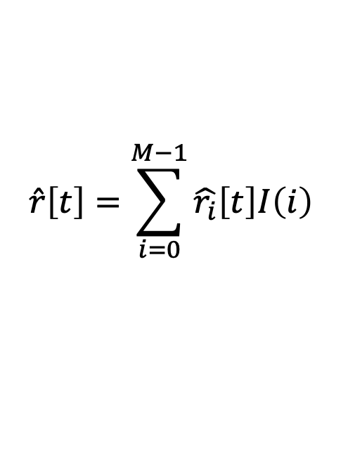
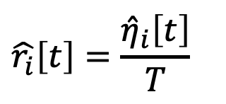
Max Throughput Scheduling
Objective: maximize total network throughput
If user i is scheduled, the expected data rate is:
The total expected network throughput is
$$\hat{r_{i}}\left[t\right]=\frac{{\hat{η}}_{i}\left[t\right]}{T}$$
Expected number of bits that can be successfully delivered
Slot length
$$\hat{r}\left[t\right]=\sum_{i=0}^{M−1}{\hat{r_{i}}\left[t\right]I\left(i\right)}$$
I(i): Scheduling indicator:
1 scheduled, 0 otherwise.

Slide 14
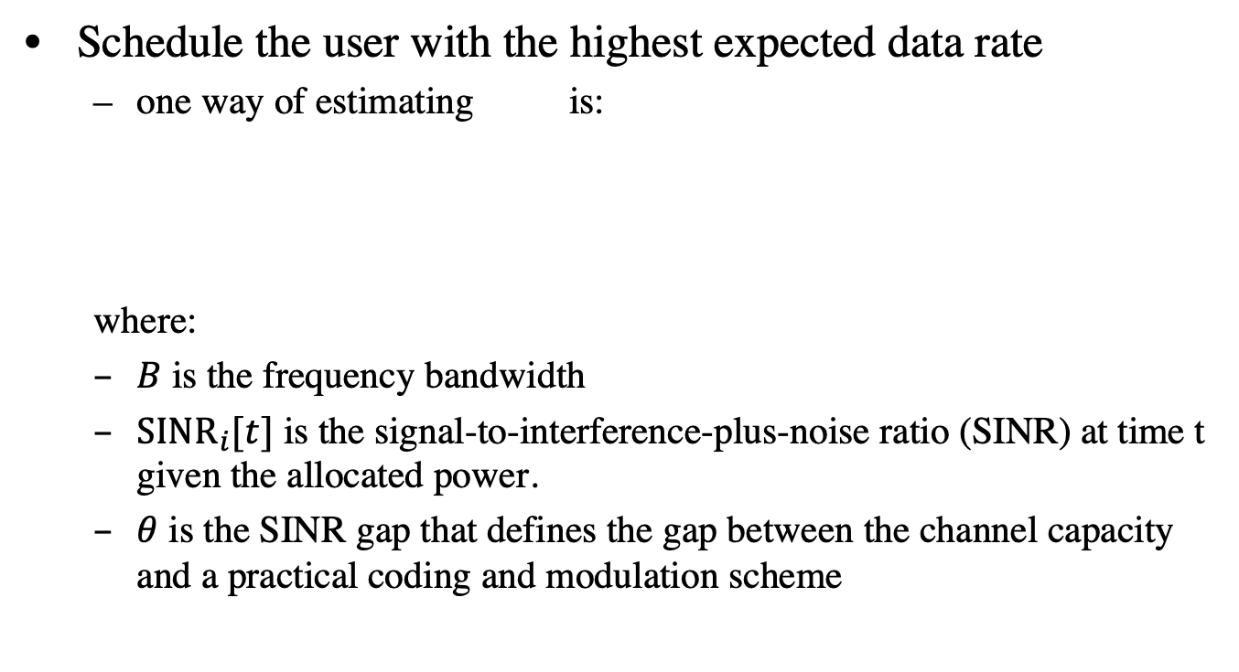
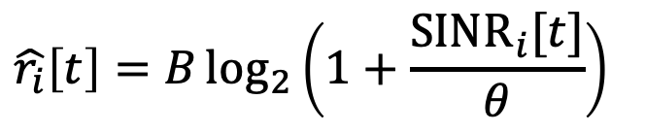

Max Throughput Scheduling
Schedule the user with the highest expected data rate
  one way of estimating is:
  where:
  $B$ is the frequency bandwidth
  ${SINR}_{i}[t]$ is the signal-to-interference-plus-noise ratio (SINR) at time t given the allocated power.
  $θ$ is the SINR gap that defines the gap between the channel capacity and a practical coding and modulation scheme
$$\hat{r_{i}}\left[t\right]$$
$$\hat{r_{i}}\left[t\right]=B\log_{2}\left(1+\frac{{SINR}_{i}[t]}{θ}\right)$$
Notes:
Bigger SINR → smaller the gap theta → bigger r_i[t]. This means the terminal with the highest estimated throughput r_i[t] is also the terminal with the highest SINR.

Slide 15
Max Throughput Scheduling
Main drawbacks
  Unfairness
  Coverage limitation
  Most users may never be served

Slide 16
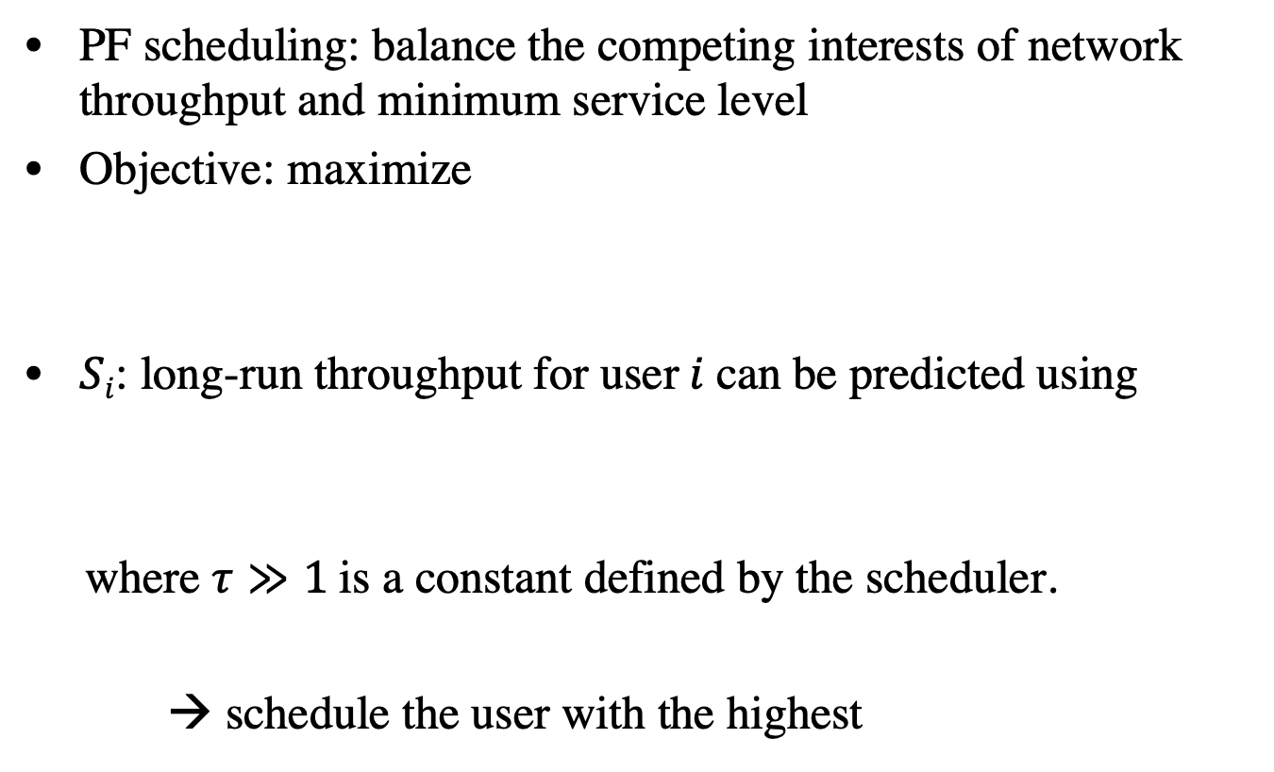
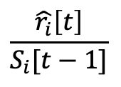
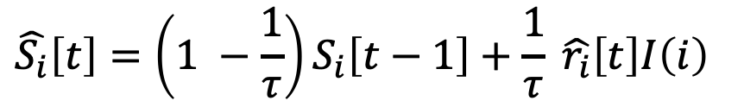
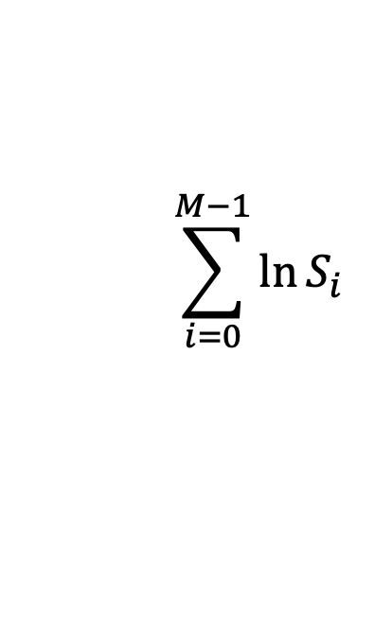
Proportional Fair Scheduling
PF scheduling: balance the competing interests of network throughput and minimum service level
Objective: maximize
$Si$: long-run throughput for user$i$can be predicted using
where $τ≫1$is a constant defined by the scheduler.
→ schedule the user with the highest
$$\sum_{i=0}^{M−1}{\ln{S_{i}}}$$
$$\hat{S_{i}}\left[t\right]=\left(1 −\frac{1}{τ}\right)S_{i}\left[t−1\right]+\frac{1}{τ} \hat{r_{i}}\left[t\right]I\left(i\right)$$
$$\frac{\hat{r_{i}}\left[t\right]}{S_{i}[t−1]}$$
Notes:
Intuitively: if a user does not have much throughput in the previous rounds, then he should be scheduled in this round.

Slide 17
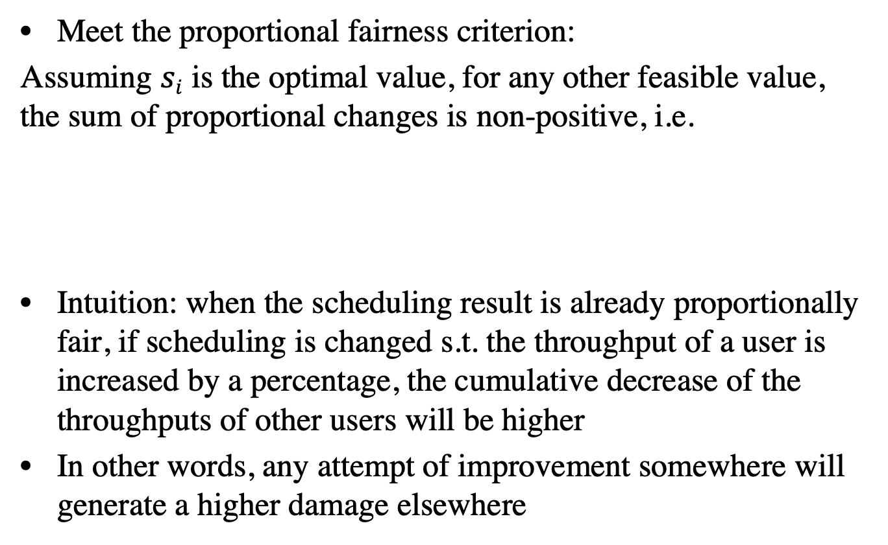
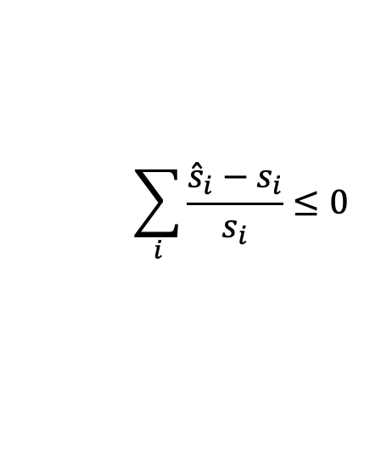
Proportional Fair Scheduling
Meet the proportional fairness criterion:
Assuming $si$ is the optimal value, for any other feasible value, the sum of proportional changes is non-positive, i.e.
Intuition: when the scheduling result is already proportionally fair, if scheduling is changed s.t. the throughput of a user is increased by a percentage, the cumulative decrease of the throughputs of other users will be higher
In other words, any attempt of improvement somewhere will generate a higher damage elsewhere
$$\sum_{i}{\frac{{\hat{s}}_{i}−s_{i}}{s_{i}}}≤0$$

Slide 18
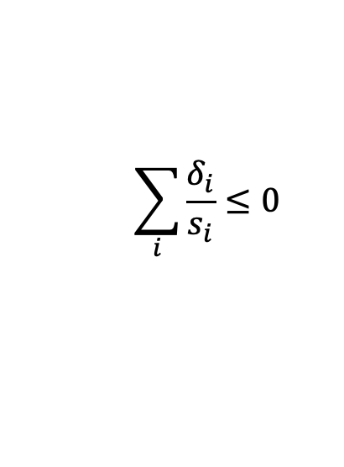
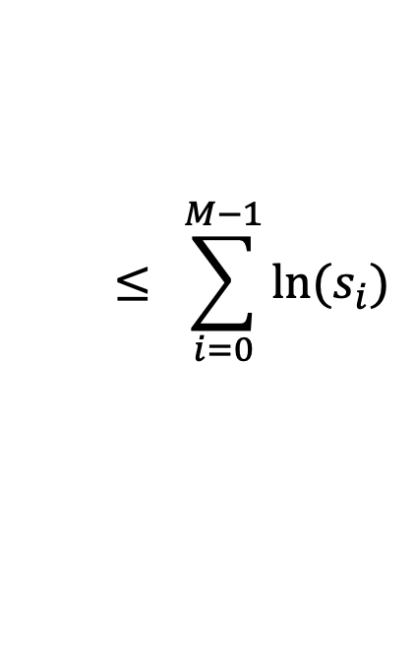
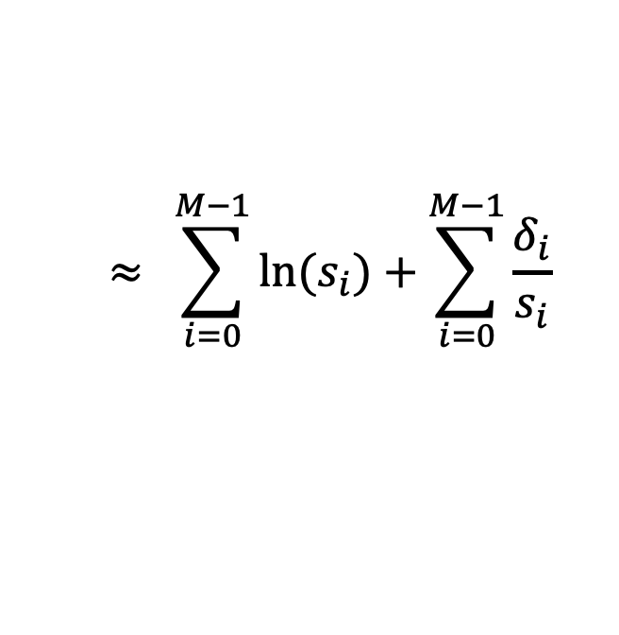


Proportional Fair Scheduling
Why proportional fair
Assume $δ_{i}≪s_{i}$
$$\sum_{i=0}^{M−1}{\ln{{(s}_{i}+δ_{i})}}= \sum_{i=0}^{M−1}{\ln{{(s}_{i})}}+\sum_{i=0}^{M−1}{\ln\left(1+\frac{δ_{i}}{s_{i}}\right)}$$
$$≈ \sum_{i=0}^{M−1}{\ln{{(s}_{i})}}+\sum_{i=0}^{M−1}{\frac{δ_{i}}{s_{i}}}$$
$$\sum_{i}{\frac{δ_{i}}{s_{i}}}≤0$$
but
$$≤ \sum_{i=0}^{M−1}{\ln{{(s}_{i})}}$$
Notes:
Because the sum of ln(x_i) is already the maximum, it cannot be higher than the maximum.

Slide 19


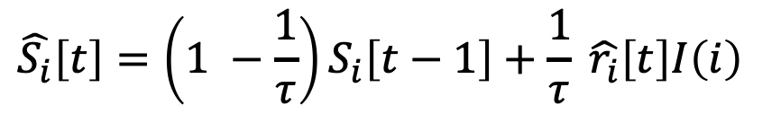
Max-Min Scheduling
Objective: maximize the minimum user throughput
A scheduling result is max-min fair if and only if a further increase of throughput of one user will result in the decrease of a user with a smaller throughput
Schedule the user with the minimum , i.e. the one with the smallest throughput at time t-1.
$$\hat{S_{i}}\left[t\right]=\left(1 −\frac{1}{τ}\right)S_{i}\left[t−1\right]+\frac{1}{τ} \hat{r_{i}}\left[t\right]I\left(i\right)$$

Slide 20
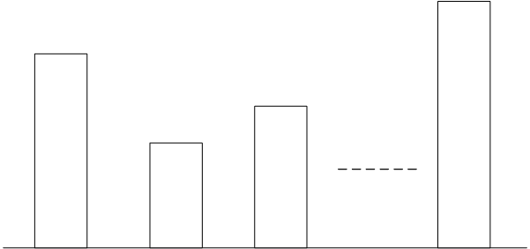
Max-Min Scheduling
M empty cylindrical buckets (users), all with the same radius but different heights.
Allocate water

Slide 21
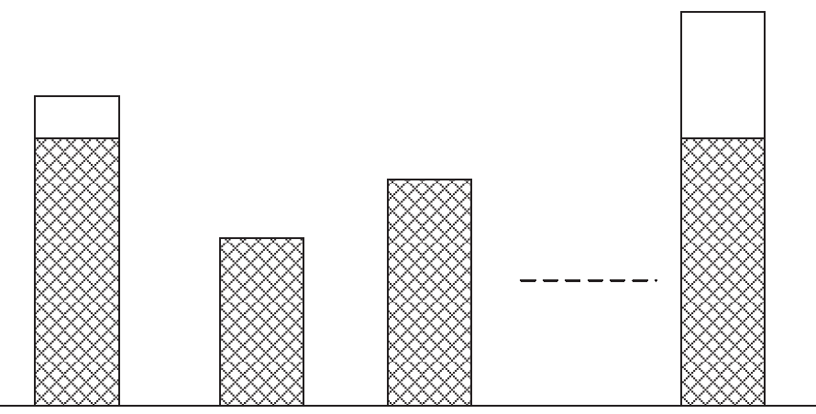
Max-Min Scheduling
M empty cylindrical buckets (users), all with the same radius but different heights.
Allocate water

Slide 22
Can these schedulers deal with QoS?

Slide 23
Max Utility Scheduling
Previous schedulers do not consider QoS
Utility-based scheduling
  Utility quantifies the satisfaction of each user given the allocated resources
  Model the QoS perception of users
  Objective: maximize the sum utility of all users, i.e. total network satisfaction
Utility functions: model how user perceives services

Slide 24



Max Utility Scheduling
Different utility functions can be designed.
In addition to QoS modeling, different utility functions can be designed to reflect fairness and efficiency.
Max-throughput (highest efficiency):
Proportional fair:

Slide 25


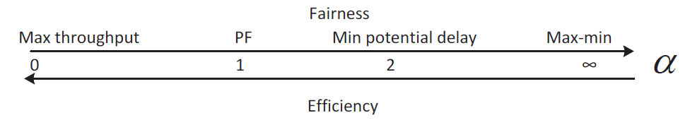
Max Utility Scheduling - Alpha Fair Utility
More generic definition: fair scheduling
measures how fair the scheduling result is
  0: Max throughput;
  1: Proportional fair;
  2: equivalent to minimizing
    Minimize the total potential delay
  Infinity: Most fair, max-min scheduler.

Slide 26
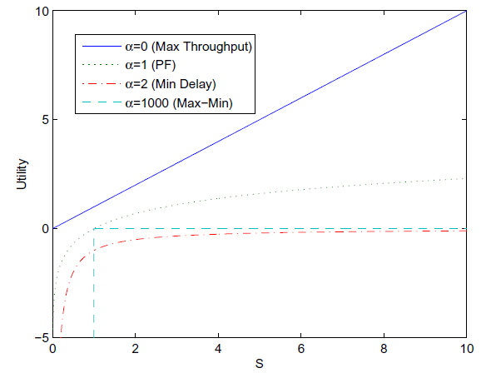
Alpha Fair Utility
PF: proportional fairness
Resource

Slide 27
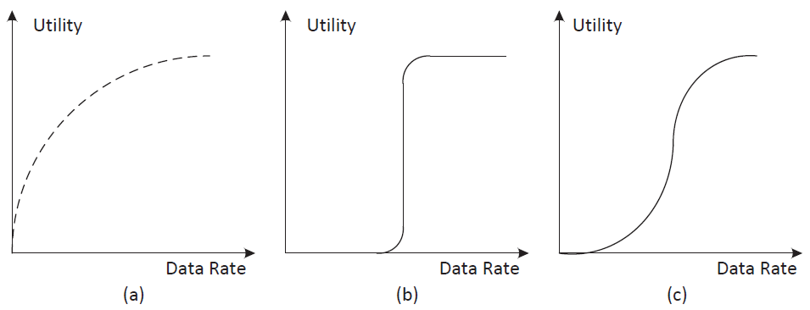
Utility Functions with QoS Consideration
Determined based on traffic characteristics
(a) best effort; (b) real time with tight delay requirement;
(c) real time with loose delay requirement.

