Slide 1
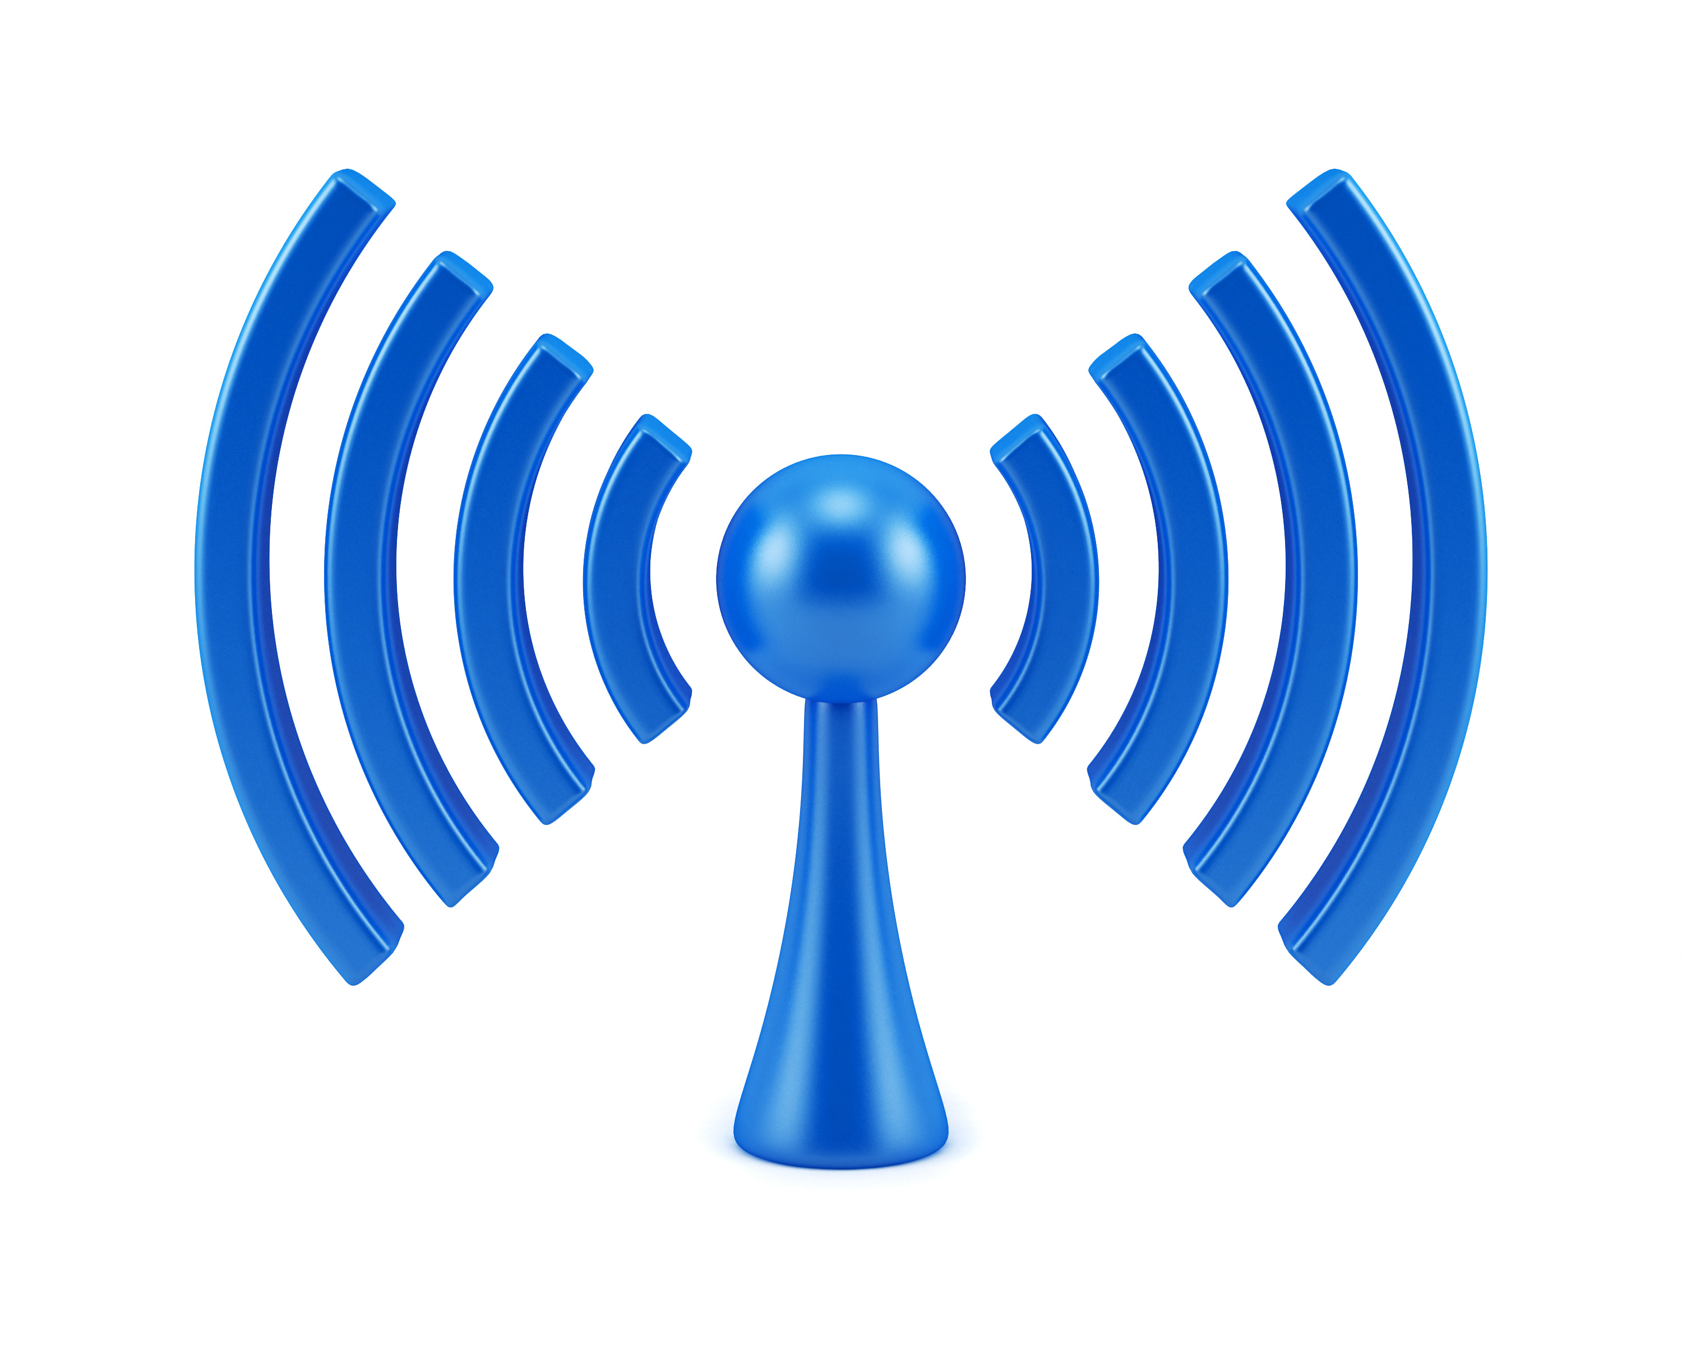

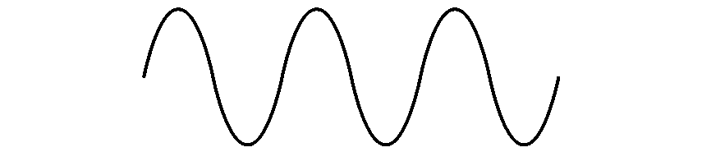
COM-405: Mobile Networks
Lecture 3.1: MIMO
Haitham Hassanieh
Laboratory of SEnsing
& Networking Systems

Slide 2
MIMO: Multiple Input Multiple Output
So far: single input single output
MIMO: multiple input multiple output
Increase capacity of channel using multiple TX and RX antennas.

Slide 3











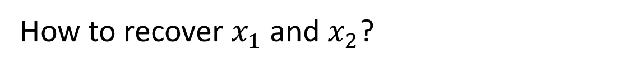














MIMO: Multiple TX-RX streams
$$x_{1}$$
$$h_{11}$$
$$y_{1}$$
$$=h_{11}x_{1}$$
$$+ h_{12}x_{2}$$
$$h_{21}$$
$$x_{2}$$
$$h_{12}$$
$$y_{2}$$
$$=h_{21}x_{1}$$
$$+ h_{22}x_{2}$$
$$h_{22}$$
$$y_{1}$$
$$h_{11}$$
$$h_{12}$$
$$x_{1}$$
$$n_{1}$$
$$=$$
$$+$$
$$y=Hx+n$$
$$y_{2}$$
$$h_{21}$$
$$h_{22}$$
$$x_{2}$$
$$n_{2}$$
How to recover $x_{1}$ and $x_{2}$?
Estimate $H$, compute $H^{−1}$ and invert the channel!
$$\tilde{x}=H^{−1}y=H^{−1}Hx+H^{−1}n=x+H^{−1}n$$
Transmit 2 packets at the same time!

Slide 4
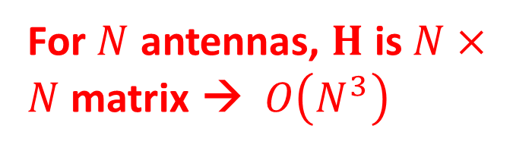
MIMO: Multiple TX-RX streams
$$x_{1}$$
$$h_{11}$$
$$y_{1}$$
$$=h_{11}x_{1}$$
$$+ h_{12}x_{2}$$
$$h_{21}$$
$$x_{2}$$
$$h_{12}$$
$$y_{2}$$
$$=h_{21}x_{1}$$
$$+ h_{22}x_{2}$$
$$h_{22}$$
$$y_{1}$$
$$h_{11}$$
$$h_{12}$$
$$x_{1}$$
$$n_{1}$$
$$=$$
$$+$$
$$y=Hx+n$$
$$y_{2}$$
$$h_{21}$$
$$h_{22}$$
$$x_{2}$$
$$n_{2}$$
For $N$ antennas, $H$ is $N×N$ matrix → $O\left(N^{3}\right)$
How to recover $x_{1}$ and $x_{2}$?
Estimate $H$, compute $H^{−1}$ and invert the channel!
$$\tilde{x}=H^{−1}y=H^{−1}Hx+H^{−1}n=x+H^{−1}n$$
Noise amplification

Slide 5


MIMO Channel
$$x_{1}$$
$$h_{11}$$
$$y_{1}$$
$$=h_{11}x_{1}$$
$$+ h_{12}x_{2}$$
$$h_{21}$$
$$x_{2}$$
$$h_{12}$$
$$y_{2}$$
$$=h_{21}x_{1}$$
$$+ h_{22}x_{2}$$
$$h_{22}$$
How to estimate the channels: $h_{11}$, $h_{12}$, $h_{21}$, $h_{22}$?
TX 1:
Preamble
$$x_{1}$$
TX 2:
Preamble
$$x_{2}$$

Slide 6


MIMO Channel
$$x_{1}$$
$$h_{11}$$
$$y_{1}$$
$$=h_{11}x_{1}$$
$$+ h_{12}x_{2}$$
$$h_{21}$$
$$x_{2}$$
$$h_{12}$$
$$y_{2}$$
$$=h_{21}x_{1}$$
$$+ h_{22}x_{2}$$
$$h_{22}$$
How to estimate the channels: $h_{11}$, $h_{12}$, $h_{21}$, $h_{22}$?
TX 1:
Preamble
$$x_{1}$$
TX 2:
Preamble
$$x_{2}$$

Slide 7
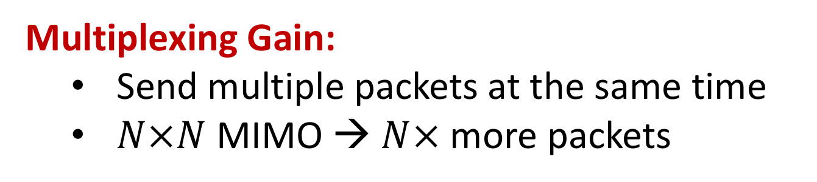
MIMO Gains
Multiplexing Gain:
  Send multiple packets at the same time
  $N×N$ MIMO → $N×$ more packets
Diversity Gain:
  Send/Receive the same packet on multiple antennas
  Increase SNR of the received packets → transmit at higher data rates

Slide 8







Receiver Diversity
$$x$$
$$h_{1}$$
$$y_{1}$$
$$=h_{1}x+n_{1}$$
$$h_{2}$$
$$y_{2}$$
$$=h_{2}x+n_{2}$$
How to best decode $x$?
Option 1: Add the received signals
$$y_{1}+y_{2}=h_{1}x+n_{1}+h_{2}x+n_{2}$$
$=\left(h_{1}+h_{2}\right)x+n_{1}+n_{2}$
Channels can sum up destructively! $h_{1}+h_{2}≈0$

Slide 9
Receiver Diversity
$$x$$
$$h_{1}$$
$$y_{1}$$
$$=h_{1}x+n_{1}$$
$$h_{2}$$
$$y_{2}$$
$$=h_{2}x+n_{2}$$
How to best decode $x$?
Option 1: Add the received signals
Option 2: Decode independently
Sub-optimal!

Slide 10
Receiver Diversity
$$x$$
$$h_{1}$$
$$y_{1}$$
$$=h_{1}x+n_{1}$$
$$h_{2}$$
$$y_{2}$$
$$=h_{2}x+n_{2}$$
How to best decode $x$?
Option 1: Add the received signals
Option 2: Decode independently
Optimal Solution: Maximum Ratio Combining (MRC)

Slide 11












Maximum Ratio Combining
$$x$$
$$h_{1}$$
$$y_{1}$$
$$=h_{1}x+n_{1}$$
$$h_{2}$$
$$y_{2}$$
$$=h_{2}x+n_{2}$$
$${α_{1}y}_{1}$$
$${+ α_{2}y}_{2}$$
$$={h_{1}^{∗}y}_{1}$$
$${+ h_{2}^{∗}y}_{2}$$
$$=h_{1}^{∗}h_{1}x+h_{1}^{∗}n_{1}+h_{2}^{∗}h_{2}x+h_{2}^{∗}n_{2}$$
$$=\left({\left|h_{1}\right|}^{2}+{\left|h_{2}\right|}^{2}\right)x+h_{1}^{∗}n_{1}+h_{2}^{∗}n_{2}$$
Let $P=𝔼\left[{\left|x\right|}^{2}\right]$ and $σ^{2}=𝔼\left[{\left|n_{1}\right|}^{2}\right]=𝔼\left[{\left|n_{2}\right|}^{2}\right]$
$$Signal Power=𝔼\left[{\left|\left({\left|h_{1}\right|}^{2}+{\left|h_{2}\right|}^{2}\right)x\right|}^{2}\right]$$
$$={\left({\left|h_{1}\right|}^{2}+{\left|h_{2}\right|}^{2}\right)}^{2} 𝔼\left[{\left|x\right|}^{2}\right]$$
$$={\left({\left|h_{1}\right|}^{2}+{\left|h_{2}\right|}^{2}\right)}^{2} P$$

Slide 12





Maximum Ratio Combining
$$x$$
$$h_{1}$$
$$y_{1}$$
$$=h_{1}x+n_{1}$$
$$h_{2}$$
$$y_{2}$$
$$=h_{2}x+n_{2}$$
$${α_{1}y}_{1}$$
$${+ α_{2}y}_{2}$$
$$={h_{1}^{∗}y}_{1}$$
$${+ h_{2}^{∗}y}_{2}$$
$$=h_{1}^{∗}h_{1}x+h_{1}^{∗}n_{1}+h_{2}^{∗}h_{2}x+h_{2}^{∗}n_{2}$$
$$=\left({\left|h_{1}\right|}^{2}+{\left|h_{2}\right|}^{2}\right)x+h_{1}^{∗}n_{1}+h_{2}^{∗}n_{2}$$
Let $P=𝔼\left[{\left|x\right|}^{2}\right]$ and $σ^{2}=𝔼\left[{\left|n_{1}\right|}^{2}\right]=𝔼\left[{\left|n_{2}\right|}^{2}\right]$
$$Signal Power={\left({\left|h_{1}\right|}^{2}+{\left|h_{2}\right|}^{2}\right)}^{2} P$$
$$Noise Power=𝔼\left[{\left|h_{1}^{∗}n_{1}+h_{2}^{∗}n_{2}\right|}^{2}\right]$$
$$=𝔼\left[{\left|h_{1}^{∗}n_{1}\right|}^{2}\right]+𝔼\left[{\left|h_{2}^{∗}n_{2}\right|}^{2}\right]$$
$$={\left|h_{1}\right|}^{2}𝔼\left[{\left|n_{1}\right|}^{2}\right]+{\left|h_{2}\right|}^{2}𝔼\left[{\left|n_{2}\right|}^{2}\right]$$
$$=\left({\left|h_{1}\right|}^{2}+{\left|h_{2}\right|}^{2}\right)σ^{2}$$

Slide 13
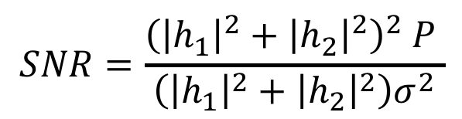


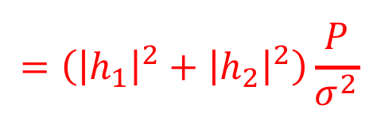
Maximum Ratio Combining
$$x$$
$$h_{1}$$
$$y_{1}$$
$$=h_{1}x+n_{1}$$
$$h_{2}$$
$$y_{2}$$
$$=h_{2}x+n_{2}$$
$${α_{1}y}_{1}$$
$${+ α_{2}y}_{2}$$
$$={h_{1}^{∗}y}_{1}$$
$${+ h_{2}^{∗}y}_{2}$$
$$=h_{1}^{∗}h_{1}x+h_{1}^{∗}n_{1}+h_{2}^{∗}h_{2}x+h_{2}^{∗}n_{2}$$
$$=\left({\left|h_{1}\right|}^{2}+{\left|h_{2}\right|}^{2}\right)x+h_{1}^{∗}n_{1}+h_{2}^{∗}n_{2}$$
Let $P=𝔼\left[{\left|x\right|}^{2}\right]$ and $σ^{2}=𝔼\left[{\left|n_{1}\right|}^{2}\right]=𝔼\left[{\left|n_{2}\right|}^{2}\right]$
$$Signal Power={\left({\left|h_{1}\right|}^{2}+{\left|h_{2}\right|}^{2}\right)}^{2} P$$
$$Noise Power=\left({\left|h_{1}\right|}^{2}+{\left|h_{2}\right|}^{2}\right)σ^{2}$$
$$SNR=\frac{{\left({\left|h_{1}\right|}^{2}+{\left|h_{2}\right|}^{2}\right)}^{2} P }{\left({\left|h_{1}\right|}^{2}+{\left|h_{2}\right|}^{2}\right)σ^{2}}$$
$$=\left({\left|h_{1}\right|}^{2}+{\left|h_{2}\right|}^{2}\right)\frac{ P }{σ^{2}}$$

Slide 14
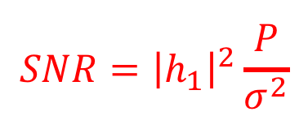
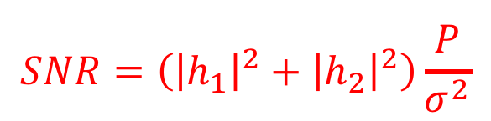
Maximum Ratio Combining
$$x$$
$$h_{1}$$
$$y_{1}$$
$$=h_{1}x+n_{1}$$
$$h_{2}$$
$$y_{2}$$
$$=h_{2}x+n_{2}$$
$${α_{1}y}_{1}$$
$${+ α_{2}y}_{2}$$
$$={h_{1}^{∗}y}_{1}$$
$${+ h_{2}^{∗}y}_{2}$$
$$=h_{1}^{∗}h_{1}x+h_{1}^{∗}n_{1}+h_{2}^{∗}h_{2}x+h_{2}^{∗}n_{2}$$
$$=\left({\left|h_{1}\right|}^{2}+{\left|h_{2}\right|}^{2}\right)x+h_{1}^{∗}n_{1}+h_{2}^{∗}n_{2}$$
$$SNR=\left({\left|h_{1}\right|}^{2}+{\left|h_{2}\right|}^{2}\right)\frac{ P }{σ^{2}}$$
With Receiver Diversity:
$$SNR={\left|h_{1}\right|}^{2}\frac{ P }{σ^{2}}$$
Single Receiver:

Slide 15
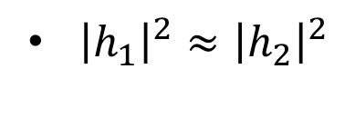
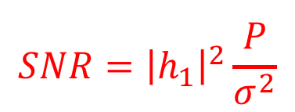
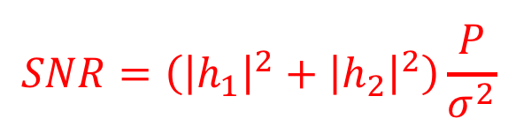
Receiver Diversity Gain
$$x$$
$$h_{1}$$
$$y_{1}$$
$$=h_{1}x+n_{1}$$
$$h_{2}$$
$$y_{2}$$
$$=h_{2}x+n_{2}$$
$$SNR=\left({\left|h_{1}\right|}^{2}+{\left|h_{2}\right|}^{2}\right)\frac{ P }{σ^{2}}$$
With Receiver Diversity:
$$SNR={\left|h_{1}\right|}^{2}\frac{ P }{σ^{2}}$$
Single Receiver:
${\left|h_{1}\right|}^{2}≈{\left|h_{2}\right|}^{2}$
→ Can double SNR!

Slide 16
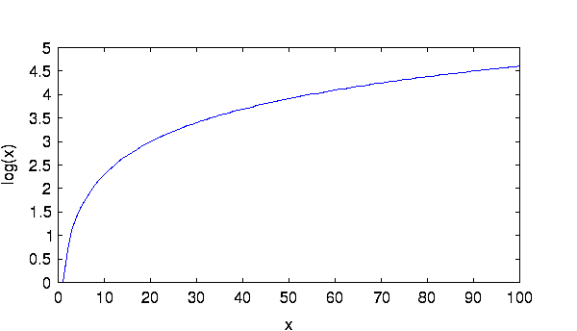
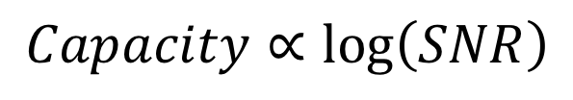
Receiver Diversity Gain
Do we care about doubling the SNR?
$$Capacity∝\log\left(SNR\right)$$
Rate
SNR

Slide 17
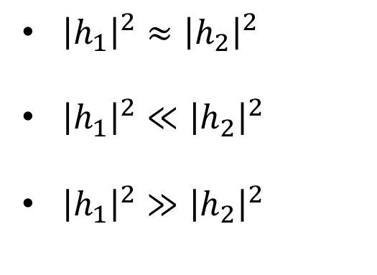
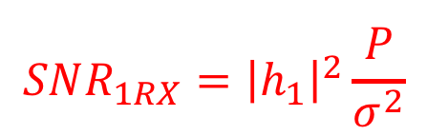
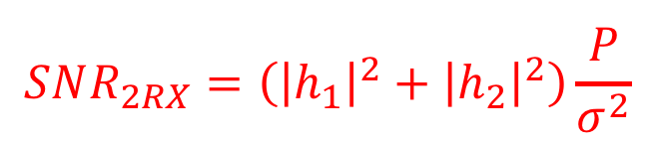
Receiver Diversity Gain
$$x$$
$$h_{1}$$
$$y_{1}$$
$$=h_{1}x+n_{1}$$
$$h_{2}$$
$$y_{2}$$
$$=h_{2}x+n_{2}$$
$$SNR_{2RX}=\left({\left|h_{1}\right|}^{2}+{\left|h_{2}\right|}^{2}\right)\frac{ P }{σ^{2}}$$
With Receiver Diversity:
$$SNR_{1RX}={\left|h_{1}\right|}^{2}\frac{ P }{σ^{2}}$$
Single Receiver:
${\left|h_{1}\right|}^{2}≈{\left|h_{2}\right|}^{2}$
${\left|h_{1}\right|}^{2}≪{\left|h_{2}\right|}^{2}$
${\left|h_{1}\right|}^{2}≫{\left|h_{2}\right|}^{2}$
→ Can double SNR!
It is unlikely that both antennas experience
channel fading.
→ Huge Gain in SNR
→ Little Gain in SNR

Slide 18

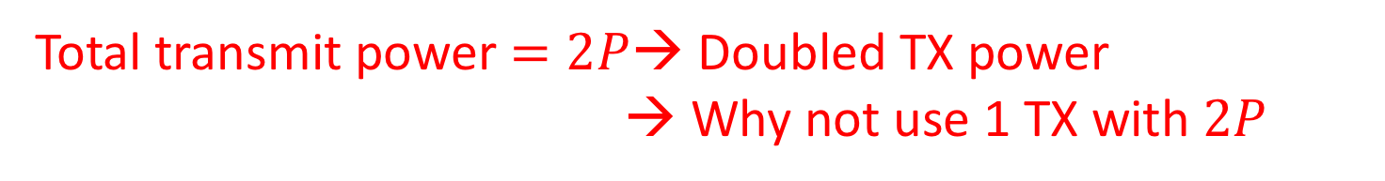




Transmitter Diversity
$x_{1}$
$$h_{1}$$
$$y=h_{1}x_{1}+h_{2}x_{2}+n$$
$x_{2}$
$$h_{2}$$
What should we transmit on each antenna?
Option 1: transmit the same thing $x$ on both antennas
$$y=\left(h_{1}+h_{2}\right)x+n$$
Channels can sum up destructively! $h_{1}+h_{2}≈0$
Total transmit power $=2P$→ Doubled TX power
→ Why not use 1 TX with $2P$

Slide 19
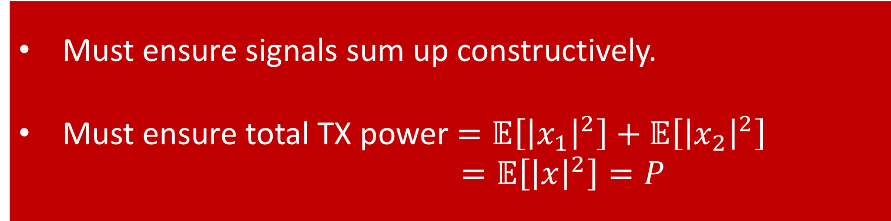
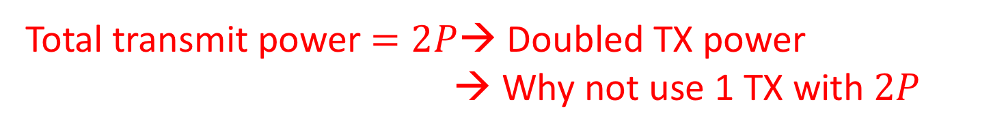
Transmitter Diversity
$x_{1}$
$$h_{1}$$
$$y=h_{1}x_{1}+h_{2}x_{2}+n$$
$x_{2}$
$$h_{2}$$
What should we transmit on each antenna?
Option 1: transmit the same thing $x$ on both antennas
$$y=\left(h_{1}+h_{2}\right)x+n$$
Must ensure signals sum up constructively.
Must ensure total TX power $=𝔼\left[{\left|x_{1}\right|}^{2}\right]+𝔼\left[{\left|x_{2}\right|}^{2}\right]$
$$=𝔼\left[{\left|x\right|}^{2}\right]=P$$
Channels can sum up destructively! $h_{1}+h_{2}≈0$
Total transmit power $=2P$→ Doubled TX power
→ Why not use 1 TX with $2P$

Slide 20
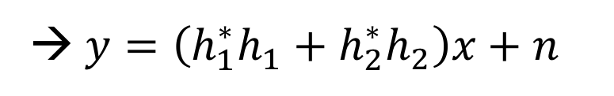
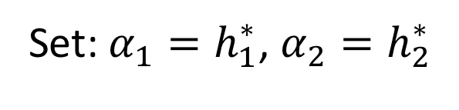


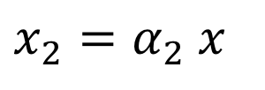

Transmitter Diversity
$x_{1}$
$$h_{1}$$
$$y=h_{1}x_{1}+h_{2}x_{2}+n$$
$x_{2}$
$$h_{2}$$
What should we transmit on each antenna?
Option 2: Maximum Ratio Combining (MRC)
$$x_{1}=α_{1}x$$
$$y=\left(α_{1}h_{1}+α_{2}h_{2}\right)x+n$$
$$x_{2}=α_{2} x$$
Set: $α_{1}=h_{1}^{∗}$, $α_{2}=h_{2}^{∗}$
→ $y=\left(h_{1}^{∗}h_{1}+h_{2}^{∗}h_{2}\right)x+n$
$$=\left({\left|h_{1}\right|}^{2}+{\left|h_{2}\right|}^{2}\right)x+n$$

Slide 21
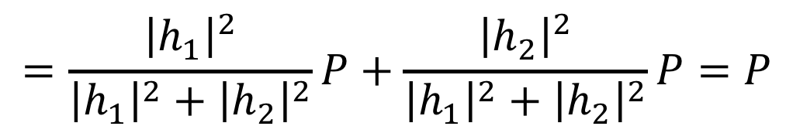
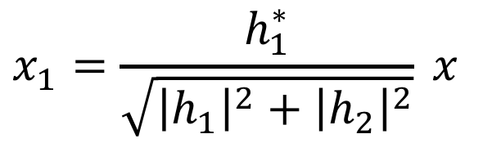
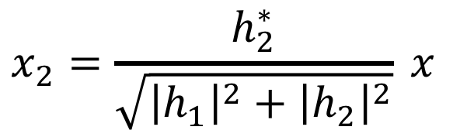
Transmitter Diversity
$x_{1}$
$$h_{1}$$
$$y=h_{1}x_{1}+h_{2}x_{2}+n$$
$x_{2}$
$$h_{2}$$
What should we transmit on each antenna?
Option 2: Maximum Ratio Combining (MRC)
$$x_{1}=\frac{h_{1}^{∗}}{\sqrt{{\left|h_{1}\right|}^{2}+{\left|h_{2}\right|}^{2}}} x$$
$$x_{2}=\frac{h_{2}^{∗}}{\sqrt{{\left|h_{1}\right|}^{2}+{\left|h_{2}\right|}^{2}}} x$$
$$Total TX Power=𝔼\left[{\left|x_{1}\right|}^{2}\right]+𝔼\left[{\left|x_{2}\right|}^{2}\right]$$
$$=\frac{{\left|h_{1}\right|}^{2}}{{\left|h_{1}\right|}^{2}+{\left|h_{2}\right|}^{2}}P+\frac{{\left|h_{2}\right|}^{2}}{{\left|h_{1}\right|}^{2}+{\left|h_{2}\right|}^{2}}P=P$$

Slide 22
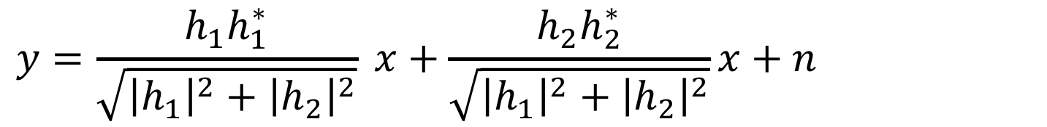
Transmitter Diversity
$x_{1}$
$$h_{1}$$
$$y=h_{1}x_{1}+h_{2}x_{2}+n$$
$x_{2}$
$$h_{2}$$
What should we transmit on each antenna?
Option 2: Maximum Ratio Combining (MRC)
$$x_{1}=\frac{h_{1}^{∗}}{\sqrt{{\left|h_{1}\right|}^{2}+{\left|h_{2}\right|}^{2}}} x$$
$$x_{2}=\frac{h_{2}^{∗}}{\sqrt{{\left|h_{1}\right|}^{2}+{\left|h_{2}\right|}^{2}}} x$$
$$y=\frac{h_{1}h_{1}^{∗}}{\sqrt{{\left|h_{1}\right|}^{2}+{\left|h_{2}\right|}^{2}}} x+\frac{h_{2}h_{2}^{∗}}{\sqrt{{\left|h_{1}\right|}^{2}+{\left|h_{2}\right|}^{2}}}x+n$$

Slide 23
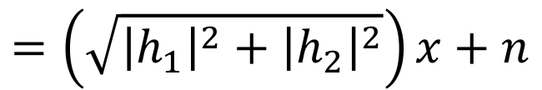
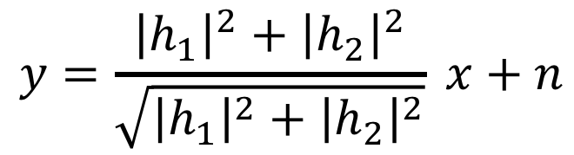
Transmitter Diversity
$x_{1}$
$$h_{1}$$
$$y=h_{1}x_{1}+h_{2}x_{2}+n$$
$x_{2}$
$$h_{2}$$
What should we transmit on each antenna?
Option 2: Maximum Ratio Combining (MRC)
$$x_{1}=\frac{h_{1}^{∗}}{\sqrt{{\left|h_{1}\right|}^{2}+{\left|h_{2}\right|}^{2}}} x$$
$$x_{2}=\frac{h_{2}^{∗}}{\sqrt{{\left|h_{1}\right|}^{2}+{\left|h_{2}\right|}^{2}}} x$$
$$y=\frac{{\left|h_{1}\right|}^{2}+{\left|h_{2}\right|}^{2}}{\sqrt{{\left|h_{1}\right|}^{2}+{\left|h_{2}\right|}^{2}}} x+n$$
$$=\left(\sqrt{{\left|h_{1}\right|}^{2}+{\left|h_{2}\right|}^{2}}\right)x+n$$

Slide 24

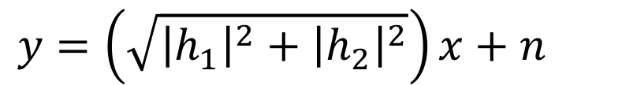
Transmitter Diversity
$x_{1}$
$$h_{1}$$
$$y=h_{1}x_{1}+h_{2}x_{2}+n$$
$x_{2}$
$$h_{2}$$
What should we transmit on each antenna?
Option 2: Maximum Ratio Combining (MRC)
$$y=\left(\sqrt{{\left|h_{1}\right|}^{2}+{\left|h_{2}\right|}^{2}}\right)x+n$$
$$SNR=\left({\left|h_{1}\right|}^{2}+{\left|h_{2}\right|}^{2}\right)\frac{P}{σ^{2}}$$
→ Similar SNR Gain to RX Diversity
Caveat: MRC at TX Requires Feedback from the Receiver!

Slide 25

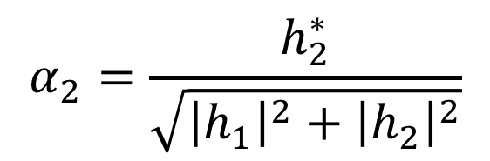


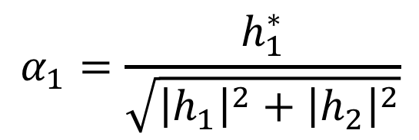




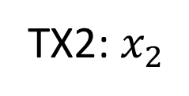

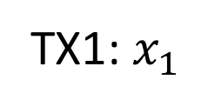


Transmitter Diversity
$x_{1}$
$$h_{1}$$
$$y=h_{1}x_{1}+h_{2}x_{2}+n$$
$x_{2}$
$$h_{2}$$
What should we transmit on each antenna?
Solution: Use Space-Time Codes
MRC codes across space only (Requires Channel Feedback):
$$α_{1}=\frac{h_{1}^{∗}}{\sqrt{{\left|h_{1}\right|}^{2}+{\left|h_{2}\right|}^{2}}}$$
TX1: $x_{1}$
$$α_{1}$$
$$x\left[1\right]$$
$$α_{1}$$
$$x\left[2\right]$$
TX2: $x_{2}$
$$α_{2}$$
$$x\left[1\right]$$
$$α_{2}$$
$$x\left[2\right]$$
$$α_{2}=\frac{h_{2}^{∗}}{\sqrt{{\left|h_{1}\right|}^{2}+{\left|h_{2}\right|}^{2}}}$$
$$t=1$$
$$t=2$$

Slide 26








Transmitter Diversity
$x_{1}$
$$h_{1}$$
$$y=h_{1}x_{1}+h_{2}x_{2}+n$$
$x_{2}$
$$h_{2}$$
What should we transmit on each antenna?
Solution: Use Space-Time Codes
Alamouti Codes:
TX1: $x_{1}$
$$x\left[1\right]$$
$$−x^{∗}\left[2\right]$$
$$y[1]=h_{1}x[1]+h_{2}x[2]$$
TX2: $x_{2}$
$$x\left[2\right]$$
$$x^{∗}\left[1\right]$$
$$y\left[2\right]=−h_{1}x^{∗}[2]+h_{2}x^{∗}[1]$$
$$t=1$$
$$t=2$$

Slide 27






Transmitter Diversity
$x_{1}$
$$h_{1}$$
$$y=h_{1}x_{1}+h_{2}x_{2}+n$$
$x_{2}$
$$h_{2}$$
What should we transmit on each antenna?
Solution: Use Space-Time Codes
Alamouti Codes:
$$y[1]=h_{1}x[1]+h_{2}x[2]$$
$$y\left[2\right]=−h_{1}x^{∗}[2]+h_{2}x^{∗}[1]$$
$$h_{1}^{∗}y\left[1\right]+h_{2}y^{∗}\left[2\right]$$
$$=h_{1}^{∗}h_{1}x\left[1\right]+h_{1}^{∗}h_{2}x\left[2\right]$$
$$−h_{2}h_{1}^{∗}x\left[2\right]+h_{2}h_{2}^{∗}x\left[1\right]$$
$$=\left({\left|h_{1}\right|}^{2}+{\left|h_{2}\right|}^{2}\right)x\left[1\right]$$

Slide 28




Transmitter Diversity
$x_{1}$
$$h_{1}$$
$$y=h_{1}x_{1}+h_{2}x_{2}+n$$
$x_{2}$
$$h_{2}$$
What should we transmit on each antenna?
Solution: Use Space-Time Codes
Alamouti Codes:
$$y[1]=h_{1}x[1]+h_{2}x[2]$$
$$y\left[2\right]=−h_{1}x^{∗}[2]+h_{2}x^{∗}[1]$$
$$h_{2}^{∗}y\left[1\right]−h_{1}y^{∗}\left[2\right]$$
$$=h_{2}^{∗}h_{1}x\left[1\right]+h_{2}^{∗}h_{2}x\left[2\right]$$
$$+h_{1}h_{1}^{∗}x\left[2\right]−h_{1}h_{2}^{∗}x\left[1\right]$$
$$=\left({\left|h_{1}\right|}^{2}+{\left|h_{2}\right|}^{2}\right)x\left[2\right]$$

Slide 29




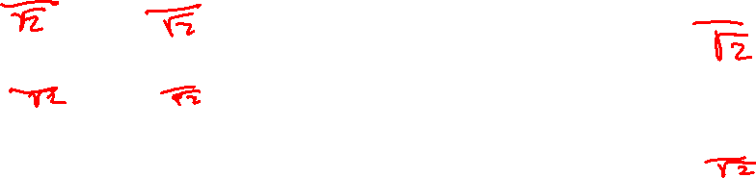
Transmitter Diversity
$x_{1}$
$$h_{1}$$
$$y=h_{1}x_{1}+h_{2}x_{2}+n$$
$x_{2}$
$$h_{2}$$
What should we transmit on each antenna?
Solution: Use Space-Time Codes
Alamouti Codes:
$$h_{1}^{∗}y\left[1\right]+h_{2}y^{∗}\left[2\right]$$
TX1: $x_{1}$
$$x\left[1\right]$$
$$−x^{∗}\left[2\right]$$
$$=\left({\left|h_{1}\right|}^{2}+{\left|h_{2}\right|}^{2}\right)x\left[1\right]$$
TX2: $x_{2}$
$$x\left[2\right]$$
$$x^{∗}\left[1\right]$$
$$h_{2}^{∗}y\left[1\right]−h_{1}y^{∗}\left[2\right]$$
$$=\left({\left|h_{1}\right|}^{2}+{\left|h_{2}\right|}^{2}\right)x\left[2\right]$$
$$t=1$$
$$t=2$$

Slide 30
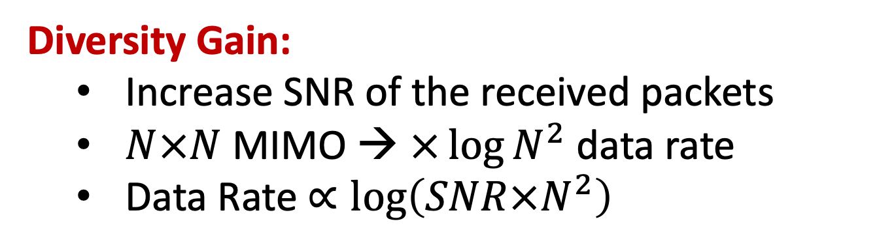
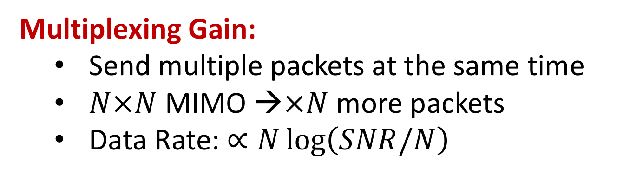
MIMO Gains
Multiplexing Gain:
  Send multiple packets at the same time
  $N×N$ MIMO →$×N$ more packets
  Data Rate: $∝N\log\left(SNR/N\right)$
Diversity Gain:
  Increase SNR of the received packets
  $N×N$ MIMO → $×{\log{N}}^{2}$ data rate
  Data Rate $∝\log\left(SNR×N^{2}\right)$

Slide 31
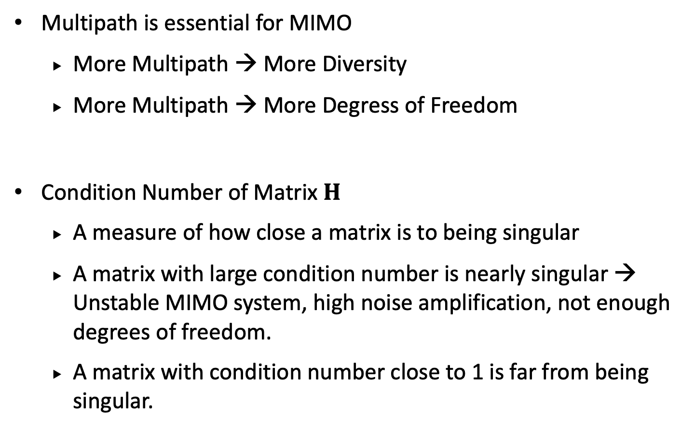
MIMO Gains
Multipath is essential for MIMO
  More Multipath → More Diversity
  More Multipath → More Degress of Freedom
Condition Number of Matrix $H$
  A measure of how close a matrix is to being singular
  A matrix with large condition number is nearly singular → Unstable MIMO system, high noise amplification, not enough degrees of freedom.
  A matrix with condition number close to 1 is far from being singular.

Slide 32
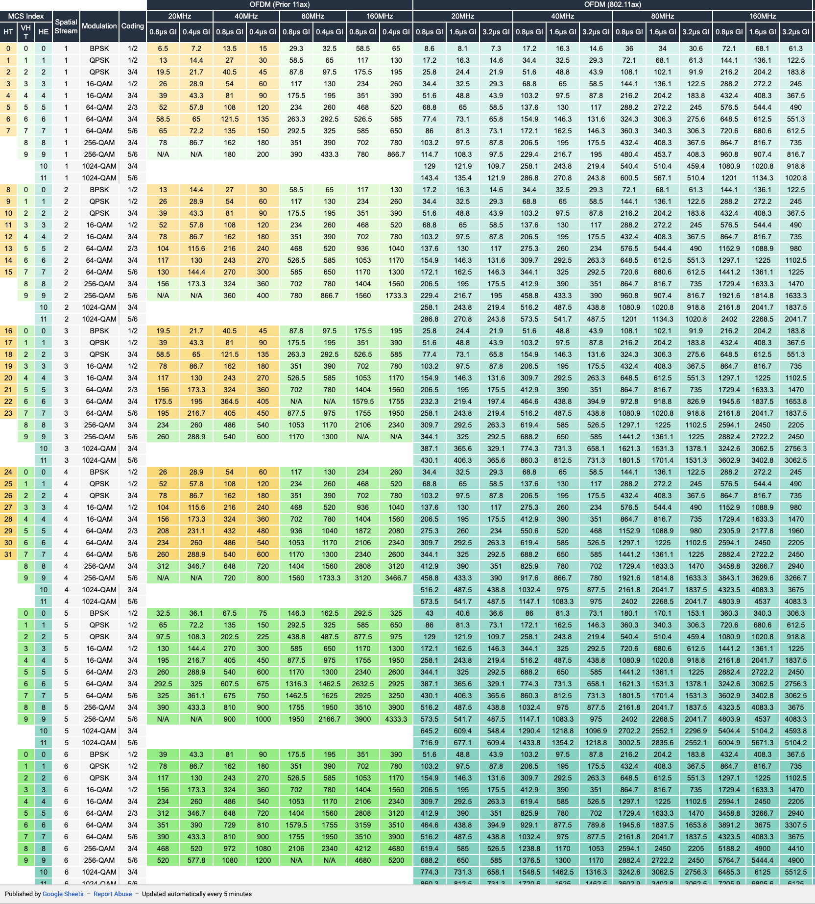
Here is a link to the full MCS Table: ​http://bit.ly/2G0DIcD

Slide 33
MIMO: Multiple TX-RX streams
WiFi Access Points 2 to 8 MIMO
WiFi Devices 1 to 2 MIMO
Power
Form Factor & Antenna Separation
Most mobile phones support 2 MIMO

Slide 34

MIMO
$$x_{1}$$
$$h_{11}$$
$$y_{1}$$
$$=h_{11}x_{1}$$
$$+ h_{12}x_{2}$$
$$h_{21}$$
$$x_{2}$$
$$h_{12}$$
$$y_{2}$$
$$=h_{21}x_{1}$$
$$+ h_{22}x_{2}$$
$$h_{22}$$
$$y=Hx+n$$
$$\tilde{x}=H^{−1}y=H^{−1}Hx+H^{−1}n=x+H^{−1}n$$

Slide 35
Multi-User MIMO
$$x_{1}$$
$$h_{11}$$
$$y_{1}$$
$$=h_{11}x_{1}$$
$$+ h_{12}x_{2}$$
$$h_{21}$$
$$x_{2}$$
$$h_{12}$$
$$y_{2}$$
$$=h_{21}x_{1}$$
$$+ h_{22}x_{2}$$
$$h_{22}$$
$$y=Hx+n$$
$$\tilde{x}=H^{−1}y=H^{−1}Hx+H^{−1}n=x+H^{−1}n$$
Does not work. Receivers do not have access to each other’s signals

Slide 36
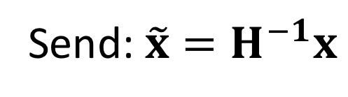
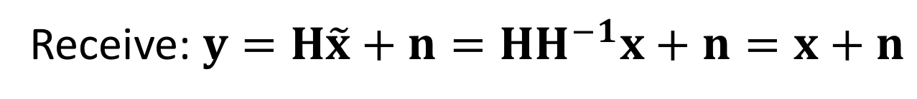
Precoding
$$x_{1}$$
$$h_{11}$$
$$y_{1}$$
$$=h_{11}x_{1}$$
$$+ h_{12}x_{2}$$
$$h_{21}$$
$$x_{2}$$
$$h_{12}$$
$$y_{2}$$
$$=h_{21}x_{1}$$
$$+ h_{22}x_{2}$$
$$h_{22}$$
Send: $\tilde{x}=H^{−1}x$
Receive: $y=H\tilde{x}+n=HH^{−1}x+n=x+n$
Also known as Beamforming or Zero-Forcing
Requires Channel Feedback!

Slide 37
What about distributed transmitters?
$$x_{1}$$
$$h_{11}$$
$$y_{1}$$
$$=h_{11}x_{1}$$
$$+ h_{12}x_{2}$$
$$h_{21}$$
$$x_{2}$$
$$h_{12}$$
$$y_{2}$$
$$=h_{21}x_{1}$$
$$+ h_{22}x_{2}$$
$$h_{22}$$
Send: $\tilde{x}=H^{−1}x$
Receive: $y=H\tilde{x}+n=HH^{−1}x+n=x+n$
Does not work. Transmitters do not have access to each other’s signals
False: what if transmitters are APs connected over Ethernet?

Slide 38

























Clock Synchronization in MIMO
$$x_{1}$$
$$h_{11}$$
$$y_{1}$$
$$h_{21}$$
$$x_{2}$$
$$h_{12}$$
$$y_{2}$$
$$h_{22}$$
$$y_{1}$$
$$=h_{11}x_{1}e^{−j2πΔf_{11}t}$$
$$+ h_{12}x_{2}e^{−j2πΔf_{12}t}$$
$$y_{2}$$
$$=h_{21}x_{1}e^{−j2πΔf_{21}t}$$
$$+ h_{22}x_{2}e^{−j2πΔf_{22}t}$$
$$y_{1}$$
$$h_{11}$$
$$h_{12}$$
$$x_{1}$$
$$n_{1}$$
$$=$$
$$+$$
$$y_{2}$$
$$h_{21}$$
$$h_{22}$$
$$x_{2}$$
$$n_{2}$$

Slide 39

























Clock Synchronization in MIMO
$$x_{1}$$
$$h_{11}$$
$$y_{1}$$
$$h_{21}$$
$$x_{2}$$
$$h_{12}$$
$$y_{2}$$
$$h_{22}$$
$$y_{1}$$
$h_{11}$ $e^{−j2πΔf_{11}t}$
$$h_{12}e^{−j2πΔf_{12}t}$$
$$x_{1}$$
$$n_{1}$$
$$=$$
$$+$$
$$y_{2}$$
$$h_{21}e^{−j2πΔf_{21}t}$$
$$h_{22}e^{−j2πΔf_{22}t}$$
$$x_{2}$$
$$n_{2}$$
On chip MIMO: $Δf_{11}$= $Δf_{21}$= $Δf_{12}$= $Δf_{22}$= $Δf$
$$y_{1}$$
$$h_{11}$$
$$h_{12}$$
$$x_{1}$$
$$n_{1}$$
$$=$$
$$e^{−j2πΔft}$$
$$+$$
$$y_{2}$$
$$h_{21}$$
$$h_{22}$$
$$x_{2}$$
$$n_{2}$$

Slide 40









Clock Synchronization in MIMO
$$x_{1}$$
$$h_{11}$$
$$y_{1}$$
$$h_{21}$$
$$x_{2}$$
$$h_{12}$$
$$y_{2}$$
$$h_{22}$$
$$y_{1}$$
$h_{11}$ $e^{−j2πΔf_{11}t}$
$$h_{12}e^{−j2πΔf_{12}t}$$
$$x_{1}$$
$$n_{1}$$
$$=$$
$$+$$
$$y_{2}$$
$$h_{21}e^{−j2πΔf_{21}t}$$
$$h_{22}e^{−j2πΔf_{22}t}$$
$$x_{2}$$
$$n_{2}$$
MU-MIMO: $Δf_{11}$= $Δf_{12}$ and $Δf_{21}$= $Δf_{22}$
$$y_{1}$$
$h_{11}$ $e^{−j2πΔf_{1}t}$
$$h_{12}e^{−j2πΔf_{1}t}$$
$$x_{1}$$
$$n_{1}$$
$$=$$
$$+$$
$$y_{2}$$
$$h_{21}e^{−j2πΔf_{2}t}$$
$$h_{22}e^{−j2πΔf_{2}t}$$
$$x_{2}$$
$$n_{2}$$

Slide 41








Clock Synchronization in MIMO
$$x_{1}$$
$$h_{11}$$
$$y_{1}$$
$$h_{21}$$
$$x_{2}$$
$$h_{12}$$
$$y_{2}$$
$$h_{22}$$
$$y_{1}$$
$h_{11}$ $e^{−j2πΔf_{11}t}$
$$h_{12}e^{−j2πΔf_{12}t}$$
$$x_{1}$$
$$n_{1}$$
$$=$$
$$+$$
$$y_{2}$$
$$h_{21}e^{−j2πΔf_{21}t}$$
$$h_{22}e^{−j2πΔf_{22}t}$$
$$x_{2}$$
$$n_{2}$$
MU-MIMO: $Δf_{11}$= $Δf_{12}$ and $Δf_{21}$= $Δf_{22}$
$$y_{1}$$
$$e^{−j2πΔf_{1}t}$$
$$0$$
$$h_{11}$$
$$h_{12}$$
$$x_{1}$$
$$n_{1}$$
$$=$$
$$+$$
$$y_{2}$$
$$0$$
$$e^{−j2πΔf_{2}t}$$
$$h_{21}$$
$$h_{22}$$
$$x_{2}$$
$$n_{2}$$

Slide 42
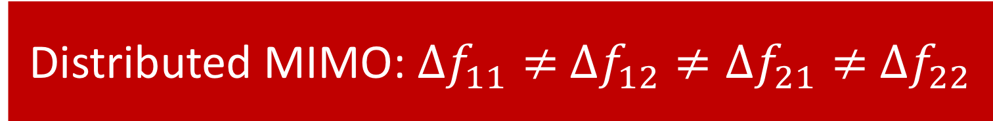
Clock Synchronization in MIMO
$$x_{1}$$
$$h_{11}$$
$$y_{1}$$
$$h_{21}$$
$$x_{2}$$
$$h_{12}$$
$$y_{2}$$
$$h_{22}$$
$$y_{1}$$
$h_{11}$ $e^{−j2πΔf_{11}t}$
$$h_{12}e^{−j2πΔf_{12}t}$$
$$x_{1}$$
$$n_{1}$$
$$=$$
$$+$$
$$y_{2}$$
$$h_{21}e^{−j2πΔf_{21}t}$$
$$h_{22}e^{−j2πΔf_{22}t}$$
$$x_{2}$$
$$n_{2}$$
Distributed MIMO: $Δf_{11}≠$ $Δf_{12}≠Δf_{21}≠$ $Δf_{22}$
Advanced Topics!

