Slide 1
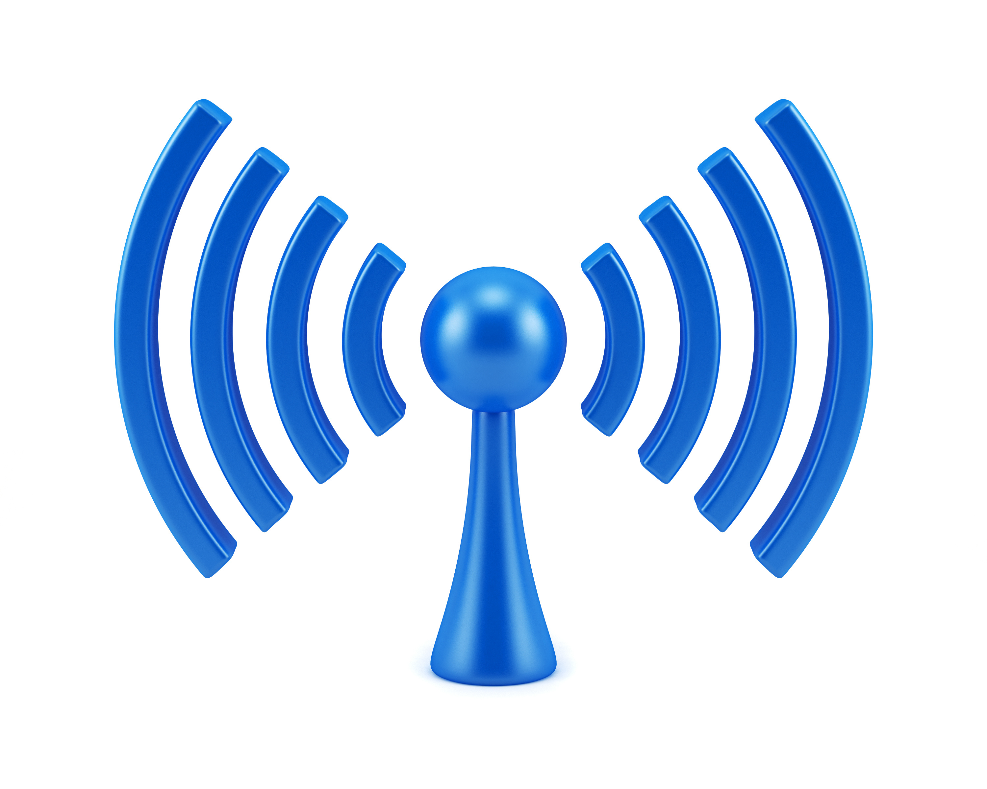
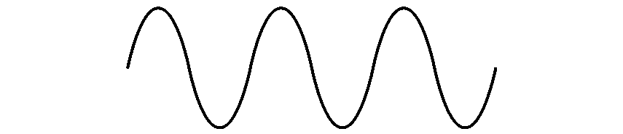

COM-405: Mobile Networks
Lecture 2.0: Modulation & OFDM
Haitham Hassanieh
Laboratory of SEnsing
& Networking Systems

Slide 2
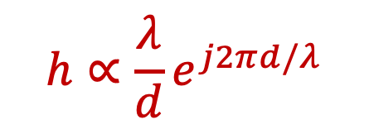


Wireless Channel
1011010110011001
1011010110011001
Digital Input
Digital Output
TX
RX
1011010110
1011010110
Channel
Modulation
$$x\left(t\right)$$
$$y\left(t\right)$$
Demodulation
Channel (Single Path):
Adds Noise
Delays the Signal
Attenuates the Signal
Rotates the Phase of the Signal
Multipath Channel:
ISI: Inter-Symbol-Interference
Frequency Selective Fading
Difficult to estimate and correct for
$$h∝\frac{λ}{d}e^{j2πd/λ}$$

Slide 3
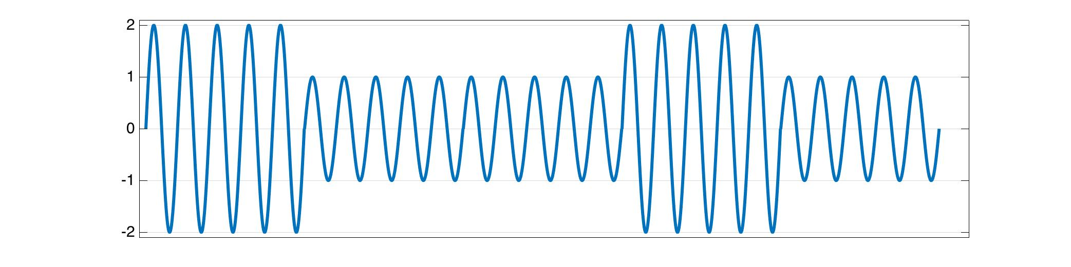



Modulation
Based on how the bits are encoded
ASK
Amplitude
Shift Keying
Bits:

Slide 4



Modulation
Based on how the bits are encoded
ASK
Amplitude
Shift Keying

Slide 5
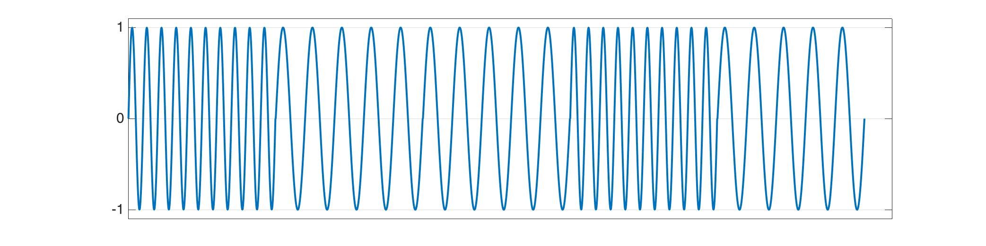



Modulation
Based on how the bits are encoded
ASK
FSK
Amplitude
Shift Keying
Frequency
Shift Keying
Bits:

Slide 6




Modulation
Based on how the bits are encoded
ASK
FSK
Amplitude
Shift Keying
Frequency
Shift Keying

Slide 7
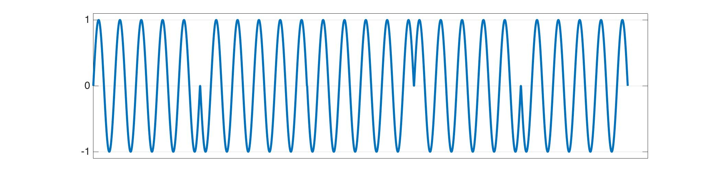
Modulation
Based on how the bits are encoded
ASK
FSK
PSK
Amplitude
Shift Keying
Frequency
Shift Keying
Phase
Shift Keying
Bits:

Slide 8





Modulation
Based on how the bits are encoded
ASK
FSK
PSK
Amplitude
Shift Keying
Frequency
Shift Keying
Phase
Shift Keying
BPSK

Slide 9


Modulation
Based on how the bits are encoded
ASK
FSK
PSK
Amplitude
Shift Keying
Frequency
Shift Keying
Phase
Shift Keying
4-PSK

Slide 10




Modulation
Based on how the bits are encoded
ASK
FSK
PSK
Amplitude
Shift Keying
Frequency
Shift Keying
Phase
Shift Keying
4-PSK

Slide 11








Modulation
Based on how the bits are encoded
ASK
FSK
PSK
Amplitude
Shift Keying
Frequency
Shift Keying
Phase
Shift Keying
8-PSK

Slide 12
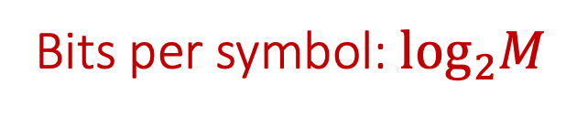
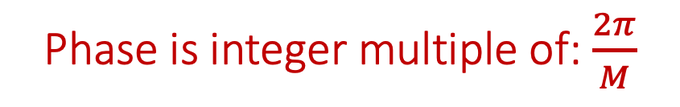
Modulation
Based on how the bits are encoded
ASK
FSK
PSK
Amplitude
Shift Keying
Frequency
Shift Keying
Phase
Shift Keying
M-PSK
Phase is integer multiple of: $\frac{2π}{M}$
Bits per symbol: $\log_{2}M$

Slide 13
Modulation
Based on how the bits are encoded
ASK
FSK
PSK
QAM
Amplitude
Shift Keying
Frequency
Shift Keying
Phase
Shift Keying
Phase & Amplitude
Modulation
(APSK)

Slide 14


Modulation
Based on how the bits are encoded
ASK
FSK
PSK
QAM
Amplitude
Shift Keying
Frequency
Shift Keying
Phase
Shift Keying
Phase & Amplitude
Modulation
(APSK)
4-QAM

Slide 15
Modulation
Based on how the bits are encoded
ASK
FSK
PSK
QAM
Amplitude
Shift Keying
Frequency
Shift Keying
Phase
Shift Keying
Phase & Amplitude
Modulation
(APSK)
16-QAM

Slide 16
Modulation
Based on how the bits are encoded
ASK
FSK
PSK
QAM
Amplitude
Shift Keying
Frequency
Shift Keying
Phase
Shift Keying
Phase & Amplitude
Modulation
(APSK)
64-QAM

Slide 17
Modulation
Based on how the bits are encoded
ASK
FSK
PSK
QAM
Amplitude
Shift Keying
Frequency
Shift Keying
Phase
Shift Keying
Phase & Amplitude
Modulation
(APSK)
256-QAM

Slide 18
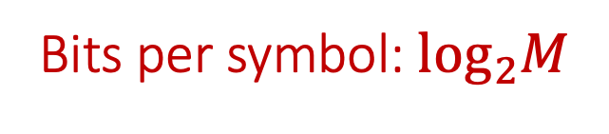
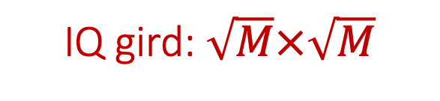
Modulation
Based on how the bits are encoded
ASK
FSK
PSK
QAM
Amplitude
Shift Keying
Frequency
Shift Keying
Phase
Shift Keying
Phase & Amplitude
Modulation
(APSK)
M-QAM
IQ gird: $\sqrt{M}×\sqrt{M}$
Bits per symbol: $\log_{2}M$

Slide 19
Modulation
Based on how the bits are encoded
ASK
FSK
PSK
QAM
Amplitude
Shift Keying
Frequency
Shift Keying
Phase
Shift Keying
Phase & Amplitude
Modulation
(APSK)
OOK, ASK
CFSK, MSK, GMSK
BPSK, QPSK, CPM
PAM, M-QAM

Slide 20
Modulation
Based on how the bits are encoded
ASK
FSK
PSK
QAM
Amplitude
Shift Keying
Frequency
Shift Keying
Phase
Shift Keying
Phase & Amplitude
Modulation
(APSK)
PPM
Pulse Position
Modulation

Slide 21
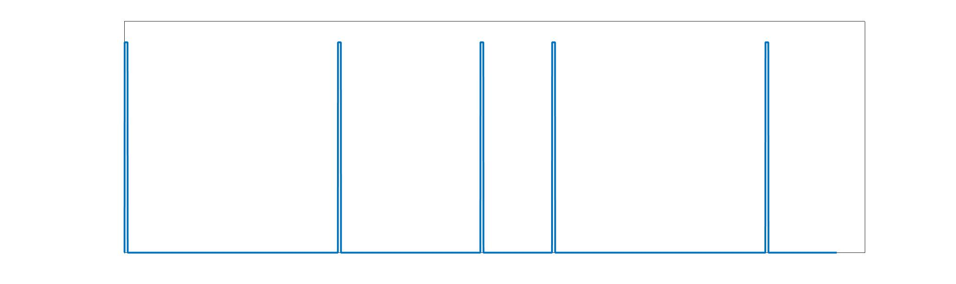
Modulation
Based on how the bits are encoded
ASK
FSK
PSK
QAM
Amplitude
Shift Keying
Frequency
Shift Keying
Phase
Shift Keying
Phase & Amplitude
Modulation
(APSK)
PPM
Pulse Position
Modulation
Bits:

Slide 22
Modulation
Based on how the bits are encoded
ASK
FSK
PSK
QAM
Amplitude
Shift Keying
Frequency
Shift Keying
Phase
Shift Keying
Phase & Amplitude
Modulation
(APSK)
PPM
Pulse Position
Modulation

Slide 23
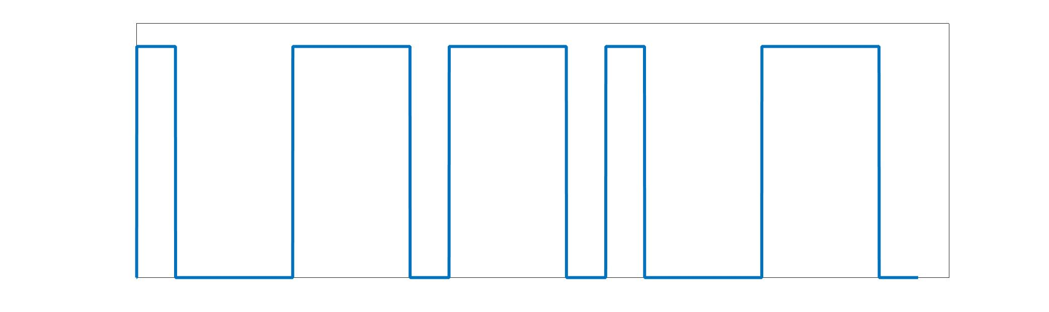
Modulation
Based on how the bits are encoded
ASK
FSK
PSK
QAM
Amplitude
Shift Keying
Frequency
Shift Keying
Phase
Shift Keying
Phase & Amplitude
Modulation
(APSK)
PPM
PWM
Pulse Position
Modulation
Pulse Width
Modulation
Bits:

Slide 24
Modulation
Based on how the bits are encoded
ASK
FSK
PSK
QAM
Amplitude
Shift Keying
Frequency
Shift Keying
Phase
Shift Keying
Phase & Amplitude
Modulation
(APSK)
PPM
PWM
Pulse Position
Modulation
Pulse Width
Modulation

Slide 25
Modulation
Based on how the bits are encoded
ASK
FSK
PSK
QAM
Amplitude
Shift Keying
Frequency
Shift Keying
Phase
Shift Keying
Phase & Amplitude
Modulation
(APSK)
PPM
PWM
Pulse Position
Modulation
Pulse Width
Modulation

Slide 26
Modulation
Based on how the bits are encoded
ASK
FSK
PSK
QAM
Amplitude
Shift Keying
Frequency
Shift Keying
Phase
Shift Keying
Phase & Amplitude
Modulation
(APSK)
PPM
PWM
DQPSK
DQAM
Pulse Position
Modulation
Pulse Width
Modulation
Differential QPSK
Differential QAM
Encode bits as difference between consecutive symbols

Slide 27
Modulation
Based on how the bits are encoded
ASK
FSK
PSK
QAM
Amplitude
Shift Keying
Frequency
Shift Keying
Phase
Shift Keying
Phase & Amplitude
Modulation
(APSK)
OOK, ASK
CFSK, MSK, GMSK
BPSK, QPSK, CPM
PAM, M-QAM
PPM
PWM
DQPSK
DQAM
Pulse Position
Modulation
Pulse Width
Modulation
Differential QPSK
Differential QAM
DBPSK, DQPSK,
DQAM

Slide 28








Wireless Communication
1011010110011001
1011010110011001
Digital Input
Digital Output
TX
RX
1011010110
1011010110
Channel
Modulation
$$x\left(t\right)$$
$$y\left(t\right)$$
Demodulation
1011010110
$$s\left[n\right]$$
$$s(t)$$
$$s\left(t\right)\cos{2πf_{c}t}$$
$$h\left(t\right)∗s\left(t\right)\cos{2πf_{c}t}$$
$$×\cos{2πf_{c}t}$$
$$h\left(t\right)∗s\left(t\right)$$
$$h[n]∗s[n]$$
$$s\left[n\right]$$
1011010110

Slide 29



Wireless Communication
1011010110011001
1011010110011001
Digital Input
Digital Output
TX
RX
1011010110
1011010110
Channel
Modulation
$$x\left(t\right)$$
$$y\left(t\right)$$
Demodulation
1011010110
$$s\left[n\right]$$
$$s(t)$$
$$s\left(t\right)e^{−j2πf_{c}t}$$
$$h\left(t\right)∗s\left(t\right)e^{−j2πf_{c}t}$$
$$×e^{+j2πf_{c}t}$$
$$h\left(t\right)∗s\left(t\right)$$
$$h[n]∗s[n]$$
$$s\left[n\right]$$
1011010110

Slide 30


Wireless Communication
1011010110011001
1011010110011001
Digital Input
Digital Output
TX
RX
1011010110
1011010110
Channel
Modulation
$$x\left(t\right)$$
$$y\left(t\right)$$
Demodulation
1011010110
$$s\left[n\right]$$
$$s[n]e^{−j2πf_{c}t}$$
$$h[n]∗s[n]e^{−j2πf_{c}t}$$
$$×e^{+j2πf_{c}t}$$
$$h[n]∗s[n]$$
$$s\left[n\right]$$
1011010110

Slide 31






Wireless Communication
1011010110011001
1011010110011001
Digital Input
Digital Output
TX
RX
1011010110
1011010110
Channel
Modulation
$$x\left(t\right)$$
$$y\left(t\right)$$
Demodulation
1011010110
$$s\left[n\right]$$
$$s[n]e^{−j2πf_{c}t}$$
$$h[n]∗s[n]e^{−j2πf_{c}t}$$
$$×e^{+j2πf_{c}t}$$
$$h[n]∗s[n]$$
$$s\left[n\right]$$
1011010110
Single Carrier Modulation
Symbols modulated on a single carrier frequency: $s\left[n\right]e^{−j2πf_{c}t}$

Slide 32
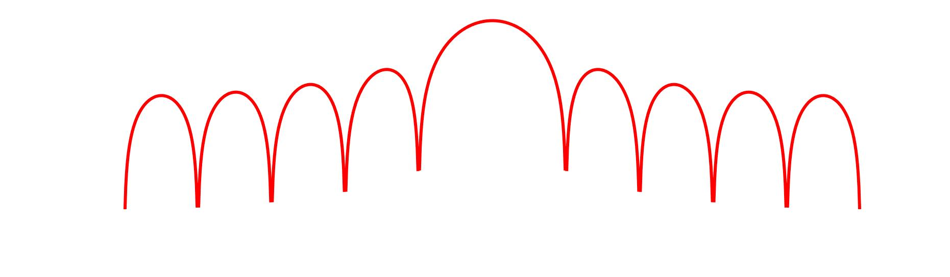



Single Carrier Modulation
Symbols modulated on a single carrier frequency
Low Spectral Efficiency: leakage
ISI: Inter-Symbol-Interference limits performance
$$f$$
$$−B$$
$$B$$

Slide 33
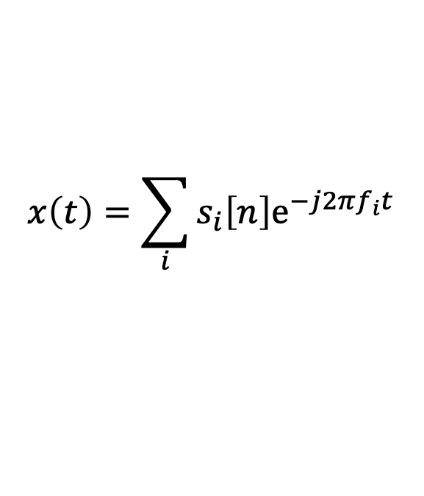
Multi-Carrier Modulation
Symbols modulated on multiple Sub-carrier frequencies
Divide spectrum into many narrow bands
$$x\left(t\right)=\sum_{i}{s_{i}\left[n\right]e^{−j2πf_{i}t} }$$
Transmit symbols on different carriers in narrow bands
Channel is Flat → No need to worry about ISI

Slide 34
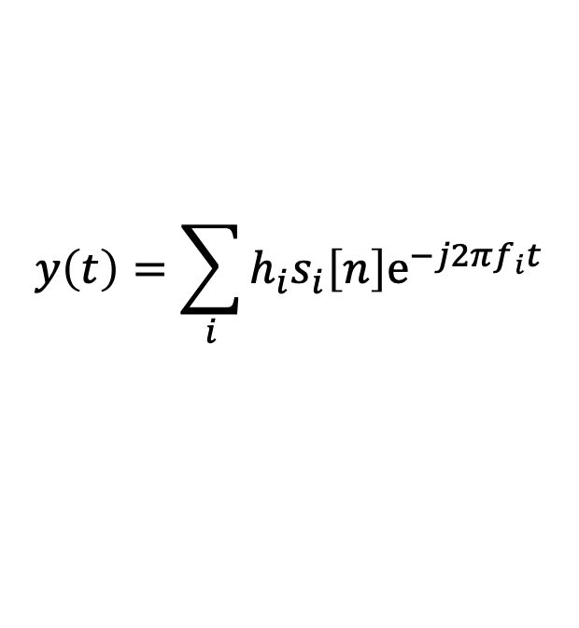
Multi-Carrier Modulation
Symbols modulated on multiple Sub-carrier frequencies
Divide spectrum into many narrow bands
$$x\left(t\right)=\sum_{i}{s_{i}\left[n\right]e^{−j2πf_{i}t} }$$
$$y\left(t\right)=\sum_{i}{h_{i}s_{i}\left[n\right]e^{−j2πf_{i}t} }$$
Transmit symbols on different carriers in narrow bands
Channel is Flat → No need to worry about ISI

Slide 35
Multi-Carrier Modulation
Symbols modulated on multiple Sub-carrier frequencies
Divide spectrum into many narrow bands
$$x\left(t\right)=\sum_{i}{s_{i}\left[n\right]e^{−j2πf_{i}t} }$$
$$y\left(t\right)=\sum_{i}{h_{i}s_{i}\left[n\right]e^{−j2πf_{i}t} }$$
Transmit symbols on different carriers in narrow bands
Channel is Flat → No need to worry about ISI
Not That Simple!

Slide 36

Multi-Carrier Modulation
Symbols modulated on multiple Sub-carrier frequencies
Guard Bands
Divide spectrum into many narrow bands
$$f$$
$$f$$
Significant Leakage between adjacent subcarriers
Need Guard Bands → Very inefficient!
Solution: Make the Sub-Carriers Orthogonal

Slide 37
Multi-Carrier Modulation
Symbols modulated on multiple Sub-carrier frequencies
Make the Sub-Carriers Orthogonal

Slide 38
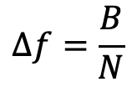
OFDM: Orthogonal Frequency Division Multiplexing
Subcarriers are orthogonal: At the sub-carrier frequency, the sampled value has zero leakage from other subcarriers.
Subcarrier separation can be very small, for N subcarriers and bandwidth B:
$$Δf=\frac{B}{N}$$

Slide 39
OFDM: Orthogonal Frequency Division Multiplexing
Subcarriers are orthogonal: At the sub-carrier frequency, the sampled value has zero leakage from other subcarriers.
Subcarrier separation can be very small, for N subcarriers and bandwidth B:
$$Δf=\frac{B}{N}$$
How to Achieve This?

Slide 40
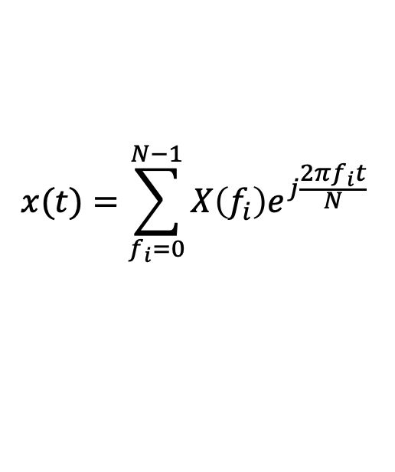
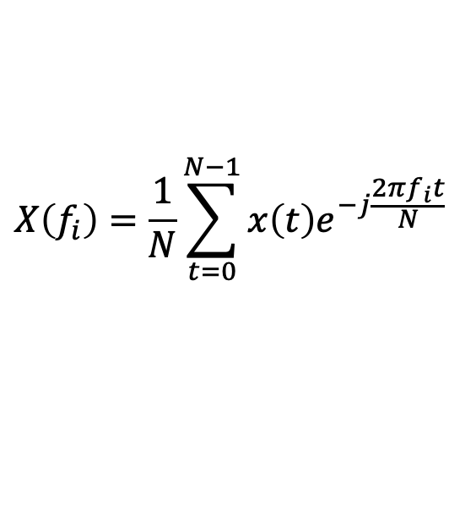
OFDM: Orthogonal Frequency Division Multiplexing
Use DFT: Discrete Fourier Transform
$$X\left(f_{i}\right)=\frac{1}{N}\sum_{t=0}^{N−1}{x\left(t\right)e^{−j\frac{2πf_{i}t}{N}} }$$
N-Point DFT:
$$x(t)=\sum_{f_{i}=0}^{N−1}{X\left(f_{i}\right)e^{j\frac{2πf_{i}t}{N}} }$$
N-Point IDFT:
Send symbols in Frequency Domain
$X\left(f_{i}\right)=s\left[n\right]→$ Compute and transmit $x\left(t\right)$ using IDFT

Slide 41
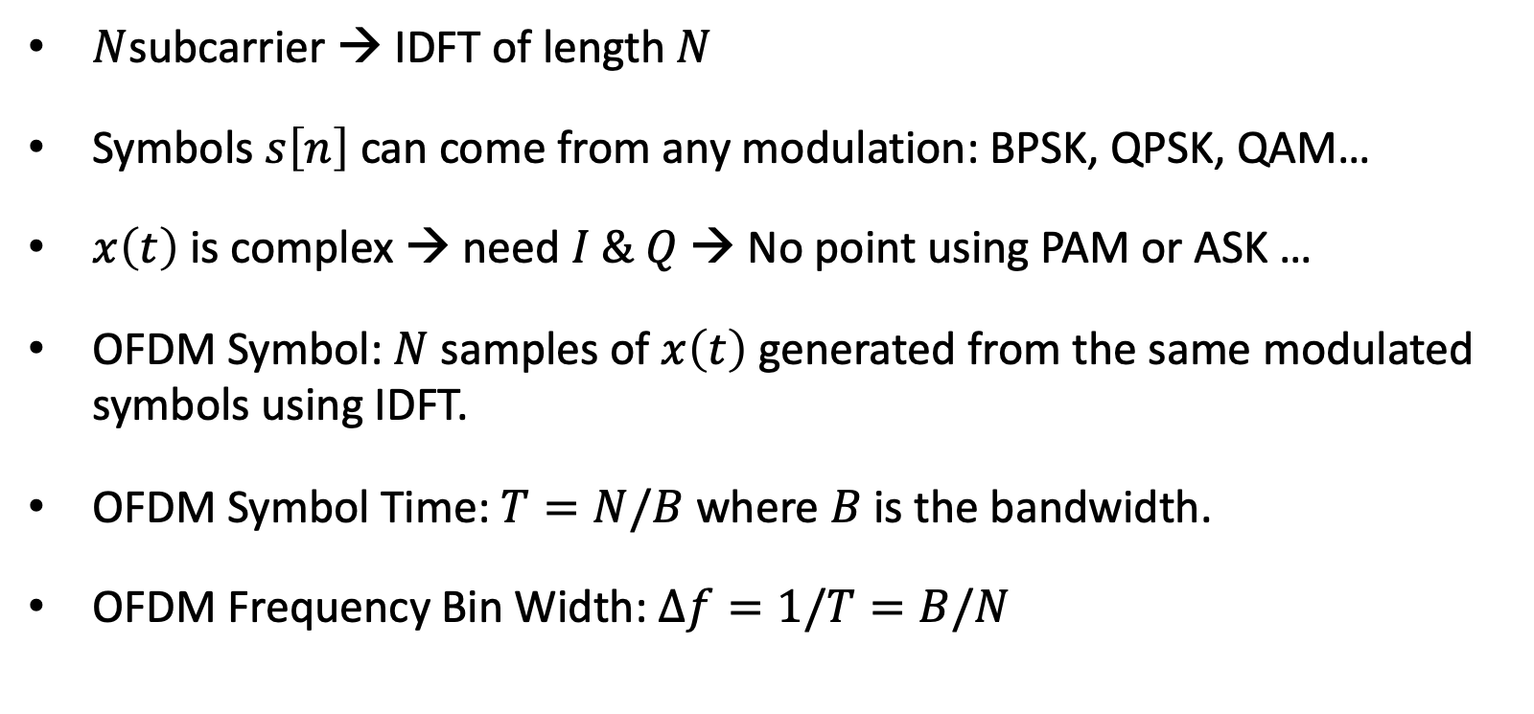
OFDM: Orthogonal Frequency Division Multiplexing
Send symbols in Frequency Domain
$X\left(f_{i}\right)=s\left[n\right]→$ Compute and transmit $x\left(t\right)$ using IDFT
$N$subcarrier → IDFT of length $N$
Symbols $s\left[n\right]$ can come from any modulation: BPSK, QPSK, QAM…
$x\left(t\right)$ is complex → need $I \& Q$ → No point using PAM or ASK …
OFDM Symbol: $N$ samples of $x\left(t\right)$ generated from the same modulated symbols using IDFT.
OFDM Symbol Time: $T=N/B$ where $B$ is the bandwidth.
OFDM Frequency Bin Width: $Δf=1/T=B/N$

Slide 42
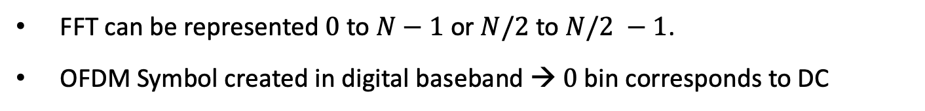



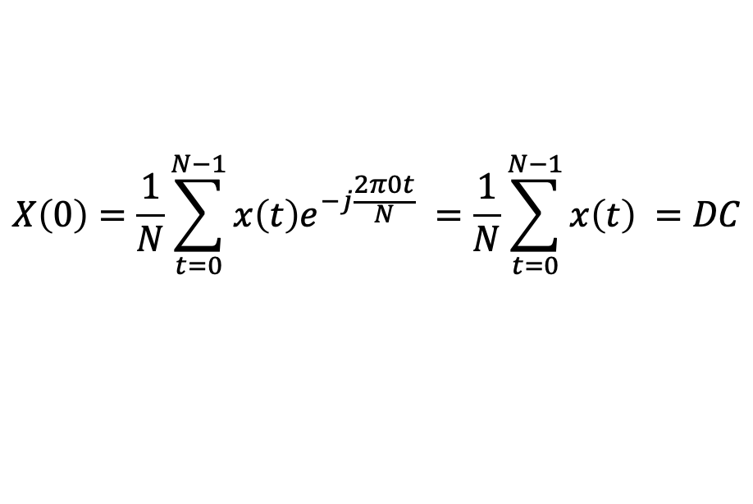
OFDM Symbol in Frequency Domain
$$−\frac{N}{2}$$
$$0$$
$$\frac{N}{2}−1$$
FFT can be represented $0$ to $N−1$ or $N/2$ to $N/2 −1$.
OFDM Symbol created in digital baseband → $0$ bin corresponds to DC
$$X\left(0\right)=\frac{1}{N}\sum_{t=0}^{N−1}{x\left(t\right)e^{−j\frac{2π0t}{N}} }=\frac{1}{N}\sum_{t=0}^{N−1}{x\left(t\right) }=DC$$

Slide 43
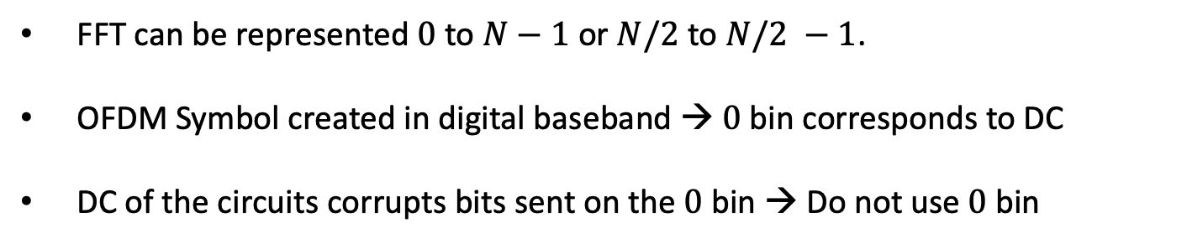
OFDM Symbol in Frequency Domain
$$−\frac{N}{2}$$
$$0$$
$$\frac{N}{2}−1$$
FFT can be represented $0$ to $N−1$ or $N/2$ to $N/2 −1$.
OFDM Symbol created in digital baseband → $0$ bin corresponds to DC
DC of the circuits corrupts bits sent on the $0$ bin → Do not use $0$ bin

Slide 44
OFDM Symbol in Frequency Domain
DC Bin
$$−\frac{N}{2}$$
$$0$$
$$\frac{N}{2}−1$$
FFT can be represented $0$ to $N−1$ or $N/2$ to $N/2 −1$.
OFDM Symbol created in digital baseband → $0$ bin corresponds to DC
DC of the circuits corrupts bits sent on the $0$ bin → Do not use $0$ bin

Slide 45
OFDM Symbol in Frequency Domain
DC Bin
$$−\frac{N}{2}$$
$$0$$
$$\frac{N}{2}−1$$
Subcarriers orthogonal to each other but not to near by channels.
Need Guard Bins at sides of the channel → Transmit nothing there

Slide 46
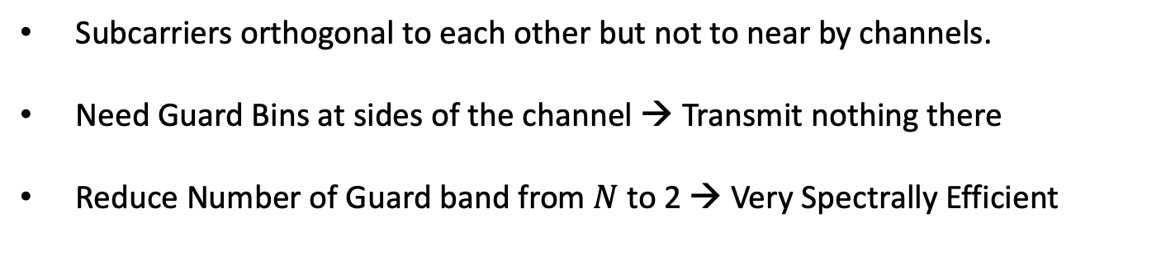
OFDM Symbol in Frequency Domain
Guard Bins
DC Bin
Guard Bins
$$−\frac{N}{2}$$
$$0$$
$$\frac{N}{2}−1$$
Subcarriers orthogonal to each other but not to near by channels.
Need Guard Bins at sides of the channel → Transmit nothing there
Reduce Number of Guard band from $N$ to 2 → Very Spectrally Efficient

Slide 47
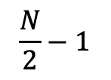
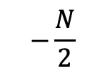

OFDM Symbol
Bits:
$$1 0 1 0 1 0 0 0 1 1 0 1 1 0 0$$
$$…,+1,−1,+1,−1,+1,−1,−1,−1,+1,+1,−1, +1,+1,−1,−1,…$$
Guard
Bins
DC
Guard
Bins
$$−\frac{N}{2}$$
$$0$$
$$\frac{N}{2}−1$$
IFFT
Symbol in Time

Slide 48










OFDM Symbol
$$⋯$$
Symbol in Time
Symbol in Time
Symbol in Time
Symbol in Time
$$⋯$$
FFT
FFT
FFT
FFT
$$…,+1,−1,+1,…$$
$$…,+1,+1,+1,…$$
$$…,−1,−1,+1,…$$
$$…,+1,−1,−1,…$$
$$…101…$$
$$…111…$$
$$…001…$$
$$…100…$$
Not That Simple

Slide 49

OFDM Symbol
$$⋯$$
S1
S2
S3
S4
$$⋯$$
FFT Window
FFT
$$…,+1,−1,+1,…$$
$$…101…$$

Slide 50

OFDM Symbol
$$⋯$$
S1
S2
S3
S4
$$⋯$$
FFT Window
FFT
FFT
$$…,+1,−1,+1,…$$
$$…,+1,+1,+1,…$$
$$…101…$$
$$…111…$$

Slide 51


OFDM Symbol
$$⋯$$
S1
S2
S3
S4
$$⋯$$
FFT Window
FFT
FFT
FFT
$$…,+1,−1,+1,…$$
$$…,+1,+1,+1,…$$
$$…,−1,−1,+1,…$$
$$…101…$$
$$…111…$$
$$…001…$$

Slide 52

OFDM Symbol
$$⋯$$
S1
S2
S3
S4
$$⋯$$
FFT Window
FFT
FFT
FFT
FFT
$$…,+1,−1,+1,…$$
$$…,+1,+1,+1,…$$
$$…,−1,−1,+1,…$$
$$…,+1,−1,−1,…$$
$$…101…$$
$$…111…$$
$$…001…$$
$$…100…$$
Assumes FFT window is perfectly aligned with symbol boundaries

Slide 53

OFDM Symbol
$$⋯$$
S1
S2
S3
S4
$$⋯$$
FFT Window
FFT
$$…,+0.5+1i,−0.7+0.3i, …$$
Cannot decode!
FFT window is misaligned with symbol
Subcarriers are no longer orthogonal.

Slide 54
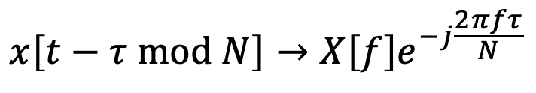

OFDM Cyclic Prefix
$$⋯$$
S1
S2
S3
S4
$$⋯$$
FFT Window
DFT (FFT) assumes time samples are periodic of period $N$
Circular Shift before taking FFT:
$$x[t]→X[f]$$
$$x\left[t−τ mod N\right]→X\left[f\right]e^{−j\frac{2πfτ}{N}}$$

Slide 55
OFDM Cyclic Prefix
S1
S1
S2
S2
S3
S3
FFT Window
DFT (FFT) assumes time samples are periodic of period $N$
Circular Shift before taking FFT:
$$x[t]→X[f]$$
$$x\left[t−τ mod N\right]→X\left[f\right]e^{−j\frac{2πfτ}{N}}$$

Slide 56
OFDM Cyclic Prefix
S1
S1
S2
S2
S3
S3
FFT Window
Even if FFT window is misaligned, CP ensures that all samples come from the same symbol → Orthogonality is preserved!
Cyclic Prefix can be created by:
  Take first few samples and append them to end of symbol.
  Take last few samples and prefix them to beginning of symbol.
Simple Phase Shift → Can be corrected by lumping with channel $H[f]$

Slide 57
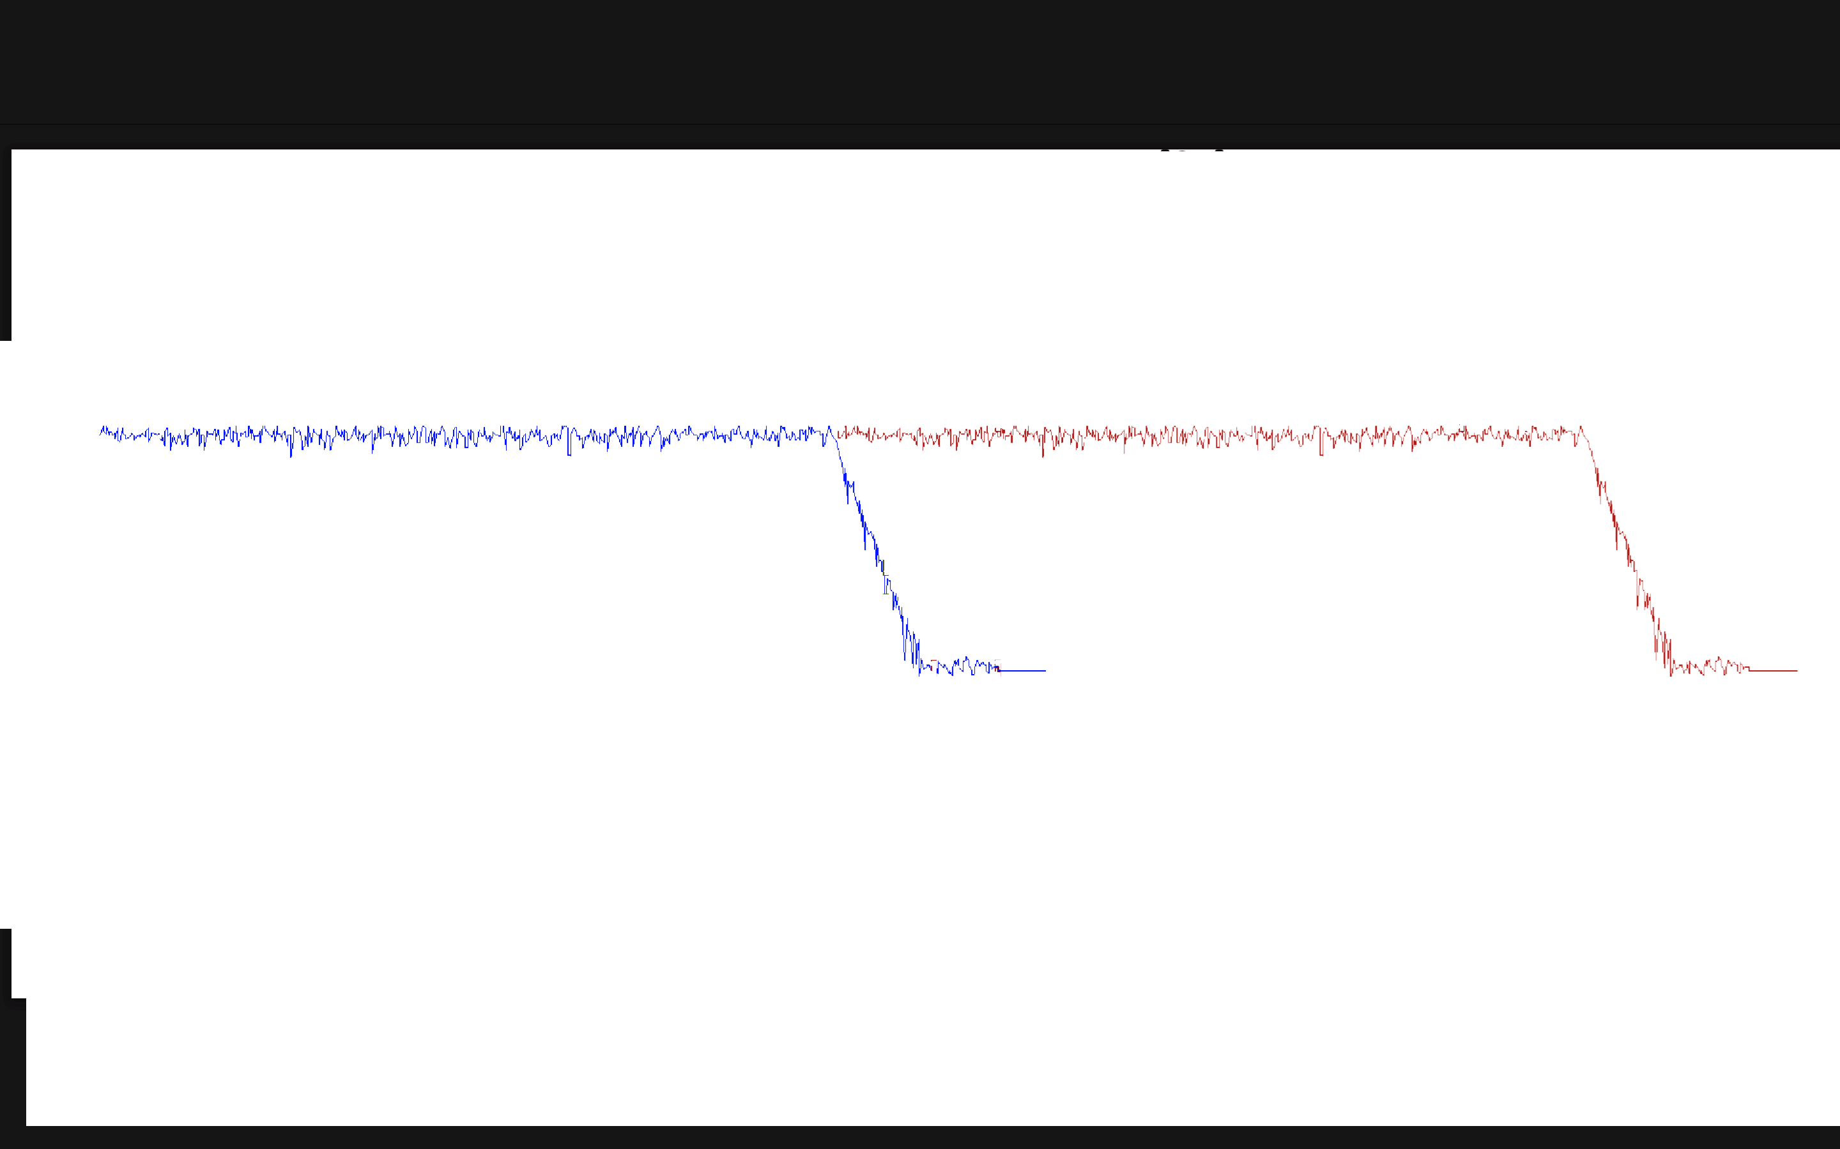
OFDM Cyclic Prefix
Cyclic Prefix:
Preserves orthogonality by allowing some misalignment in FFT Window
Deals with Inter-Symbol-Interference
S1
S1
S2
S2
S3
S3
FFT Window
ISI
ISI
ISI

Slide 58
OFDM Cyclic Prefix
Cyclic Prefix:
Preserves orthogonality by allowing some misalignment in FFT Window
Deals with Inter-Symbol-Interference
S1
S1
S2
S2
S3
S3
FFT Window
ISI
ISI
ISI
NO ISI in
FFT Window

Slide 59
OFDM Cyclic Prefix
Cyclic Prefix:
Preserves orthogonality by allowing some misalignment in FFT Window
Deals with Inter-Symbol-Interference
S1
S1
S2
S2
S3
S3
FFT Window
FFT Window
FFT Window
ISI
ISI
ISI
NO ISI in
FFT Window
NO ISI in
FFT Window
NO ISI in
FFT Window

Slide 60
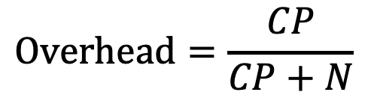
OFDM Cyclic Prefix
Cyclic Prefix:
Preserves orthogonality by allowing some misalignment in FFT Window
Deals with Inter-Symbol-Interference
Overhead: Send $CP + N$samples for every $N$ samples
$$Overhead=\frac{CP}{CP+N}$$
$$e.g. WiFi 802.11n:N=64, CP=16→Overhead=20\%$$
$$e.g. LTE:N=1024, CP=72→Overhead=6.5\%$$

Slide 61
OFDM Cyclic Prefix
S1
S1
S2
S2
S3
S3
FFT Window
Cyclic prefix is a not a bullet proof solution.
Can still end up misaligned!
Need a way to ensure we detect the beginning of the packet correctly.
If we do, CP will ensure that even if we are not accurate, we can still decode.

Slide 62
OFDM Transmitter
101101011
Data Bits
Modulation
IFFT
Add Cyclic Prefix
Transmit Signals
Repeat until all data bits are transmitted

Slide 63


OFDM Packet Detection
Detect Beginning of packet to make sure we are within the CP
Send Training Sequence: Preamble Symbols
Preamble Symbols: Known Symbol Repeated at the beginning of packet
Preamble
Preamble
$$⋯$$
Preamble
S1
CP1
S2
CP2
$$⋯$$
No need for CP with preamble symbols

Slide 64
OFDM Transmitter
101101011
Known Preamble Bits
BPSK
IFFT
Duplicate N times
Transmit
Preamble
101101011
Data Bits
Modulation
IFFT
Add Cyclic Prefix
Transmit Signals
Repeat until all data bits are transmitted

Slide 65
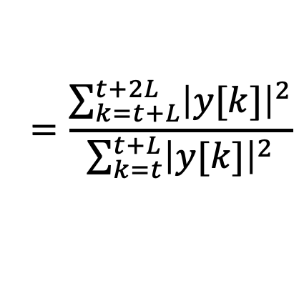

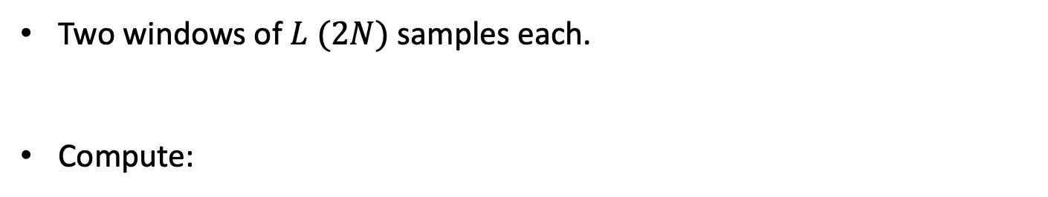




OFDM Packet Detection: Sliding Window
Preamble
Preamble
$$⋯$$
Preamble
S1
CP1
S2
CP2
$$⋯$$
A
B
$$\frac{P_{B}}{P_{A}}$$
$$1$$
Two windows of $L (2N)$ samples each.
Compute:
$$\frac{P_{B}}{P_{A}}$$
$$=\frac{\sum_{k=t+L}^{t+2L}{{\left|y[k]\right|}^{2}}}{\sum_{k=t}^{t+L}{{\left|y[k]\right|}^{2}}}$$

Slide 66
OFDM Packet Detection: Sliding Window
Preamble
Preamble
$$⋯$$
Preamble
S1
CP1
S2
CP2
$$⋯$$
A
B
$$\frac{P_{B}}{P_{A}}$$
$$1$$
Two windows of $L (2N)$ samples each.
Compute:
$$\frac{P_{B}}{P_{A}}$$
$$=\frac{\sum_{k=t+L}^{t+2L}{{\left|y[k]\right|}^{2}}}{\sum_{k=t}^{t+L}{{\left|y[k]\right|}^{2}}}$$

Slide 67
OFDM Packet Detection: Sliding Window
Preamble
Preamble
$$⋯$$
Preamble
S1
CP1
S2
CP2
$$⋯$$
A
B
$$\frac{P_{B}}{P_{A}}$$
$$1$$
Two windows of $L (2N)$ samples each.
Compute:
$$\frac{P_{B}}{P_{A}}$$
$$=\frac{\sum_{k=t+L}^{t+2L}{{\left|y[k]\right|}^{2}}}{\sum_{k=t}^{t+L}{{\left|y[k]\right|}^{2}}}$$

Slide 68
OFDM Packet Detection: Sliding Window
Preamble
Preamble
$$⋯$$
Preamble
S1
CP1
S2
CP2
$$⋯$$
A
B
$$\frac{P_{B}}{P_{A}}$$
$$1$$
Two windows of $L (2N)$ samples each.
Compute:
$$\frac{P_{B}}{P_{A}}$$
$$=\frac{\sum_{k=t+L}^{t+2L}{{\left|y[k]\right|}^{2}}}{\sum_{k=t}^{t+L}{{\left|y[k]\right|}^{2}}}$$

Slide 69
OFDM Packet Detection: Sliding Window
Preamble
Preamble
$$⋯$$
Preamble
S1
CP1
S2
CP2
$$⋯$$
A
B
$$\frac{P_{B}}{P_{A}}$$
$$1$$
Two windows of $L (2N)$ samples each.
Compute:
$$\frac{P_{B}}{P_{A}}$$
$$=\frac{\sum_{k=t+L}^{t+2L}{{\left|y[k]\right|}^{2}}}{\sum_{k=t}^{t+L}{{\left|y[k]\right|}^{2}}}$$

Slide 70
OFDM Packet Detection: Sliding Window
Preamble
Preamble
$$⋯$$
Preamble
S1
CP1
S2
CP2
$$⋯$$
A
B
$$\frac{P_{B}}{P_{A}}$$
$$1$$
Packet Start +L
Two windows of $L (2N)$ samples each.
Compute:
$$\frac{P_{B}}{P_{A}}$$
$$=\frac{\sum_{k=t+L}^{t+2L}{{\left|y[k]\right|}^{2}}}{\sum_{k=t}^{t+L}{{\left|y[k]\right|}^{2}}}$$

Slide 71






Carrier Frequency Offset
101101011
101101011
TX
RX
$$x\left(t\right)$$
$$x\left(t\right)×e^{−j2πf_{c}t}$$
$$h\left(t\right)∗ x\left(t\right)e^{−j2πf_{c}t}$$
$$h\left(t\right)∗ x\left(t\right)e^{−j2πf_{c}t}×e^{j2πf_{c}t}$$
$$h\left(t\right)∗ x\left(t\right)$$
$$y\left(t\right)=h\left(t\right)∗ x\left(t\right)+v\left(t\right)$$
Assumes TX & RX perfectly synched

Slide 72







Carrier Frequency Offset
101101011
101101011
TX
RX
$$x\left(t\right)$$
$$x\left(t\right)×e^{−j2πf_{c}t}$$
$$h\left(t\right)∗ x\left(t\right)e^{−j2πf_{c}t}$$
$$h\left(t\right)∗ x\left(t\right)e^{−j2πf_{c}t}×e^{j2πf_{c}^{′}t}$$
TX & RX are not synched
$h\left(t\right)∗ x\left(t\right)$ $e^{−j2π{Δf}_{c}t}$
CFO: ${Δf}_{c}=f_{c}−f_{c}^{′}$
$$y\left(t\right)=h\left(t\right)∗ x\left(t\right)e^{−j2π{Δf}_{c}t}+v\left(t\right)$$
Phase changes with time!

Slide 73











Carrier Frequency Offset
Consider BPSK Modulation.
$$0→−1$$
$$1→+1$$
$$Q$$
$$Q$$
$$−1$$
$$+1$$
$$I$$
$$−1$$
$$+1$$
$$I$$
$$x\left(t\right)$$
$$h x\left(t−τ\right)e^{−j2π{Δf}_{c}t}+v\left(t\right)$$

Slide 74
Carrier Frequency Offset
Consider BPSK Modulation.
$$0→−1$$
$$1→+1$$
$$Q$$
$$Q$$
$$−1$$
$$+1$$
$$I$$
$$−1$$
$$+1$$
$$I$$
$$x\left(t\right)$$
$$h x\left(t−τ\right)e^{−j2π{Δf}_{c}t}+v\left(t\right)$$
Impossible to Decode!

Slide 75


Carrier Frequency Offset
Consider 16 QAM Modulation
$$Q$$
$$I$$
Need to estimate and correct CFO to decode!

Slide 76
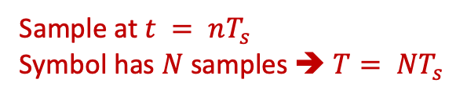




OFDM CFO Estimation & Correction
Preamble
Preamble
$$⋯$$
Preamble
S1
CP1
S2
CP2
$$⋯$$
Use Preamble to estimate CFO
$$y_{1}\left(t\right)=x\left(t\right)e^{−j2πΔf_{c}t}$$
Sample at $t = nT_{s}$
Symbol has $N$ samples ➔ $T= NT_{s}$
$$y_{2}\left(t\right)=x\left(t\right)e^{−j2πΔf_{c}\left(t+T\right)}$$

Slide 77
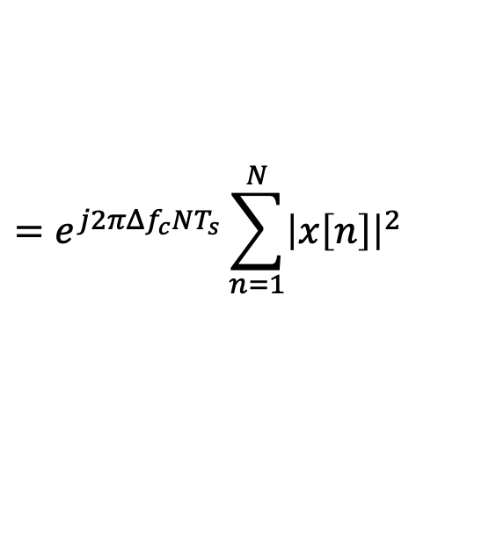
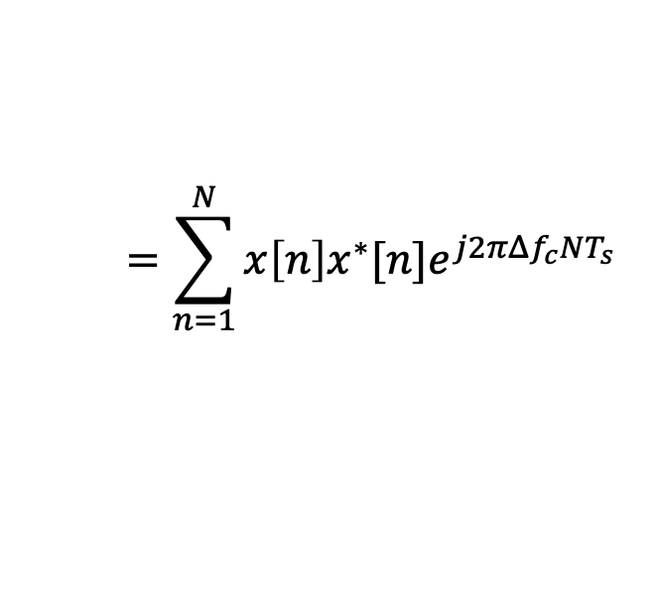
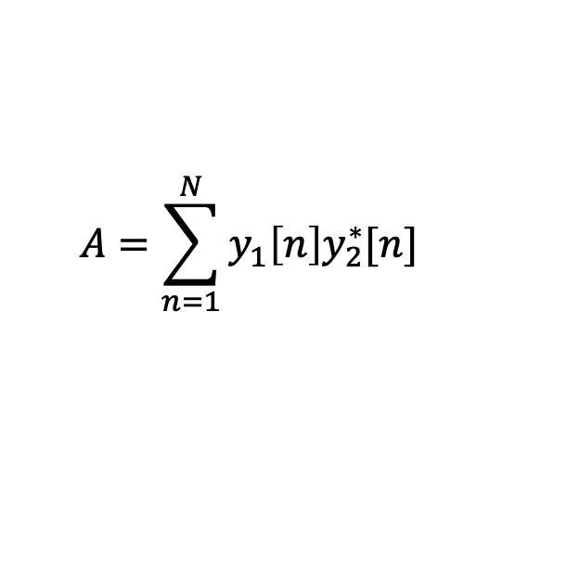


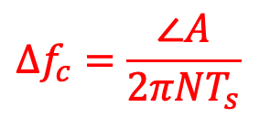
OFDM CFO Estimation & Correction
Preamble
Preamble
$$⋯$$
Preamble
S1
CP1
S2
CP2
$$⋯$$
Use Preamble to estimate CFO
Sample at $t = nT_{s}$
Symbol has $N$ samples ➔ $T= NT_{s}$
$$y_{1}[n]=x[n]e^{−j2πΔf_{c}nT_{s}}$$
$$y_{2}[n]=x[n]e^{−j2πΔf_{c}\left(nT_{s}+NT_{s}\right)}$$
$$A=\sum_{n=1}^{N}{y_{1}\left[n\right]y_{2}^{∗}[n]}$$
$$=\sum_{n=1}^{N}{x\left[n\right]x^{∗}[n]e^{j2πΔf_{c}NT_{s}}}$$
Compute:
$$=e^{j2πΔf_{c}NT_{s}}\sum_{n=1}^{N}{{\left|x\left[n\right]\right|}^{2}}$$
$$Δf_{c}=\frac{∠A}{2πNT_{s}}$$

Slide 78

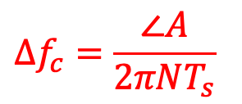
OFDM CFO Estimation & Correction
Preamble
Preamble
$$⋯$$
Preamble
S1
CP1
S2
CP2
$$⋯$$
Use Preamble to estimate CFO
$$y_{1}[n]=x[n]e^{−j2πΔf_{c}nT_{s}}$$
$$y_{2}[n]=x[n]e^{−j2πΔf_{c}\left(nT_{s}+NT_{s}\right)}$$
$$A=\sum_{n=1}^{N}{y_{1}\left[n\right]y_{2}^{∗}[n]}$$
$$Δf_{c}=\frac{∠A}{2πNT_{s}}$$
Compute:
Correct CFO:
$$y\left[n\right]×e^{j2πΔf_{c}nT_{s}}$$

Slide 79
OFDM Channel Estimation
Preamble
Preamble
$$⋯$$
Preamble
S1
CP1
S2
CP2
$$⋯$$
Use Preamble to estimate the channel
$$y\left(t\right)=h\left(t\right)∗x\left(t\right)↔Y\left(f\right)=H\left(f\right) X\left(f\right)$$
Send $X\left(f\right)$:
$$−1,+1,−1,−1,−1,+1,…$$
Receive:
$$−H(1),H(2),−H(3),−H(4),−H(5),H(6),…$$
$$\tilde{H}\left(f\right)=\frac{Y\left(f\right)}{X\left(f\right)}$$
Estimate:
$$\tilde{H}\left(f\right)=\frac{Y_{1}\left(f\right)+Y_{2}\left(f\right)}{2 X\left(f\right)}$$
Use two preambles to average noise:

Slide 80
OFDM Receiver
Received Signal
Packet Detection
CFO Estimation & Correction
Channel Estimation
Remove Cyclic Prefix
FFT
Channel Correction
Decoding
101101011
Data Bits
Repeat until all OFDM Symbols are decoded

Slide 81
Phase Tracking
So Far: Estimated and Corrected For Coarse Value of CFO
Residual CFO:
$$y\left(t\right)=h\left(t\right) x\left(t\right)e^{−j2π{Δf}_{c}t}+v\left(t\right)$$
$$Δf_{c}=df_{c}+δf_{c}$$
Coarse CFO
Residual CFO
We estimated and corrected for coarse CFO!
Even small residual can accumulate over time to create large phase: $e^{−j2π{δf}_{c}t}$
Need to track the phase

Slide 82
Phase Tracking
$$Q$$
$$Q$$
$$−1$$
$$+1$$
$$I$$
$$−1$$
$$+1$$
$$I$$
$$h x\left(t−τ\right)e^{−j2π{Δf}_{c}t}+v\left(t\right)$$
$$h x\left(t−τ\right)e^{−j2π{δf}_{c}t}+v\left(t\right)$$
Without Course CFO Correction
Without Residual CFO Correction

Slide 83
Phase Tracking
Residual CFO (Carrier Frequency Offset)
Residual SFO (Sampling Frequency Offset)

Slide 84
Phase Tracking
Residual CFO (Carrier Frequency Offset)
Residual SFO (Sampling Frequency Offset)
When we sample the signal there is a residual sampling offset: $nδT_{s}$
$$y[n]=x[n+nδT_{s}]e^{−j2πδf_{c}nT_{s}}$$
$$=\sum_{f=0}^{N−1}{X\left[f\right]e^{j\frac{2πf(n+nδT_{s})}{N}}}e^{−j2πδf_{c}nT_{s}}$$
$$Y\left[f\right]=X[f]e^{j\frac{2πfnδT_{s}}{N}−2πδf_{c}nT_{s}}$$

Slide 85
Phase Tracking
Residual CFO (Carrier Frequency Offset)
Residual SFO (Sampling Frequency Offset)
$$Y_{1}\left[f\right]=X_{1}[f]e^{j\frac{2πfnδT_{s}}{N}−2πδf_{c}nT_{s}}$$
$$Y_{2}\left[f\right]=X_{2}[f]e^{j\frac{2πf(n+N+CP)δT_{s}}{N}−2πδf_{c}\left(n+N+CP\right)T_{s}}$$
$$Δφ=2πf\frac{\left(N+CP\right)δT_{s}}{N}−2πδf_{c}(N+CP)T_{s}$$
Phase accumulation:

Slide 86
Phase Tracking
Residual CFO (Carrier Frequency Offset)
Residual SFO (Sampling Frequency Offset)
$$Δφ=2πf\frac{\left(N+CP\right)δT_{s}}{N}−2πδf_{c}(N+CP)T_{s}$$
Phase accumulation:
Slope: SFO
y-intercept: CFO
$$−N/2$$
Frequency Bins
$$N/2$$

Slide 87
OFDM Phase Tracking
$$Δφ=2πf\frac{\left(N+CP\right)δT_{s}}{N}−2πδf_{c}(N+CP)T_{s}$$
Phase accumulation:
Slope: SFO
y-intercept: CFO
$$−N/2$$
Frequency Bins
$$N/2$$
Sufficient to estimate slope & y-intercept to know the phase accumulated for all subcarriers.
Use only few subcarriers as pilots & send known bits in them.

Slide 88
OFDM Phase Tracking
Guard
Bins
Pilots
DC
Pilots
Guard
Bins
$$−\frac{N}{2}$$
$$0$$
$$\frac{N}{2}−1$$
$$Δφ$$
Use Linear Regression to estimate phase accumulated
$$−N/2$$
$$N/2$$

Slide 89
OFDM Phase Tracking
$$Δφ$$
Use Linear Regression to estimate phase accumulated
Slope: SFO
y-intercept: CFO
$$−N/2$$
$$N/2$$
$$Slope=2π\frac{\left(N+CP\right)δT_{s}}{N}$$
$$Y−intercept=−2πδf_{c}(N+CP)T_{s}$$
$$Δφ=2πf\frac{\left(N+CP\right)δT_{s}}{N}−2πδf_{c}(N+CP)T_{s}$$
$${\tilde{H}}_{new}\left(f\right)={\tilde{H}}_{old}\left(f\right)×e^{jΔφ}$$

Slide 90
Be Careful!
$$Δφ$$
Phase Wraps Around $2π$
$$−N/2$$
$$N/2$$

Slide 91
Be Careful!
$$Δφ$$
Phase Wraps Around $2π$
$$−N/2$$
$$N/2$$

Slide 92
Be Careful!
$$Δφ$$
Phase Wraps Around $2π$
Wrong Estimates
$$−N/2$$
$$N/2$$
Need to unwrap phase mod $2π$ first!
When estimating slope and y-intercept, equation assumes subcarriers index $f$ is between$–N/2$and $N/2−1$

Slide 93
Be Careful!
When estimating slope and y-intercept, equation assumes subcarriers index $f$ is between$–N/2$and $N/2−1$
Guard
Bins
Guard
Bins
Guard
Bins
Pilots
DC
Pilots
Guard
Bins
Pilots
DC
Pilots
$$0$$
$$−\frac{N}{2}$$
$$0$$
$$\frac{N}{2}−1$$

Slide 94
Be Careful!
When estimating slope and y-intercept, equation assumes subcarriers index $f$ is between$–N/2$and $N/2−1$
Guard
Bins
Guard
Bins
Guard
Bins
Pilots
DC
Pilots
Guard
Bins
Pilots
DC
Pilots
$$0$$
$$−\frac{N}{2}$$
$$0$$
$$\frac{N}{2}−1$$
$$0$$
$$N−1$$

Slide 95
Be Careful!
When estimating slope and y-intercept, equation assumes subcarriers index $f$ is between$–N/2$and $N/2−1$
Guard
Bins
Pilots
DC
Pilots
Guard
Bins
$$−\frac{N}{2}$$
$$0$$
$$\frac{N}{2}−1$$
DC
Pilots
Guard
Bins
Guard
Bins
Pilots
$$0$$
$$N−1$$

Slide 96
Be Careful!
When estimating slope and y-intercept, equation assumes subcarriers index $f$ is between$–N/2$and $N/2−1$
Guard
Bins
Pilots
DC
Pilots
Guard
Bins
$$−\frac{N}{2}$$
$$0$$
$$\frac{N}{2}−1$$
DC
Pilots
Guard
Bins
Guard
Bins
Pilots
$$0$$
$$N−1$$

Slide 97
OFDM Transmitter
101101011
Known Preamble Bits
BPSK
IFFT
Duplicate N times
Transmit
Preamble
Add Pilots
101101011
Data Bits
Modulation
IFFT
Add Cyclic Prefix
Transmit Signals
Repeat until all data bits are transmitted

Slide 98
OFDM: Putting it Together
At TX:
Create preamble symbol from training sequence (Uses BPSK)
Repeat preamble symbol:
4 times for packet detection
2 times for CFO estimation
2 times for channel estimation
Add CP for the last preamble
Create data symbol from:
  Data bits (Uses BPSK, QPSK, M-QAM)
  Pilot bits (Uses BPSK)
Add cyclic prefix to data symbols.

Slide 99
OFDM Receiver
Received Signal
Packet Detection
Shift by 0.25 CP to avoid ISI
CFO Estimation & Correction
Channel Estimation
Remove Cyclic Prefix
FFT
Phase Tracking
Update Channel
Channel Correction
101101011
Data Bits
Decoding
Repeat until all OFDM Symbols are decoded

Slide 100
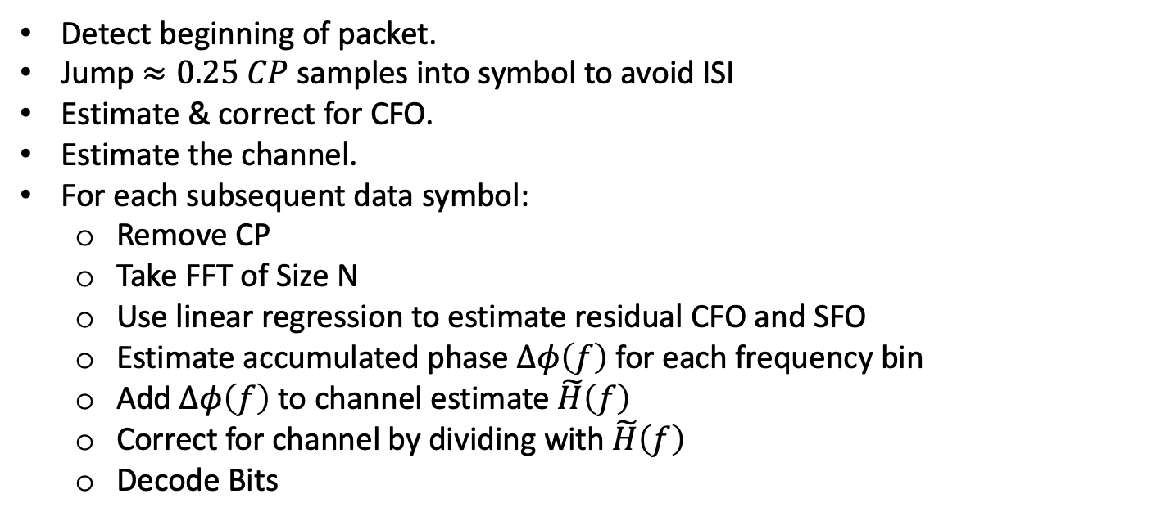
OFDM: Putting it Together
At RX:
Detect beginning of packet.
Jump $≈0.25 CP$ samples into symbol to avoid ISI
Estimate & correct for CFO.
Estimate the channel.
For each subsequent data symbol:
  Remove CP
  Take FFT of Size N
  Use linear regression to estimate residual CFO and SFO
  Estimate accumulated phase $Δφ\left(f\right)$for each frequency bin
  Add $Δφ\left(f\right)$to channel estimate $\tilde{H}\left(f\right)$
  Correct for channel by dividing with $\tilde{H}\left(f\right)$
  Decode Bits

