Slide 1
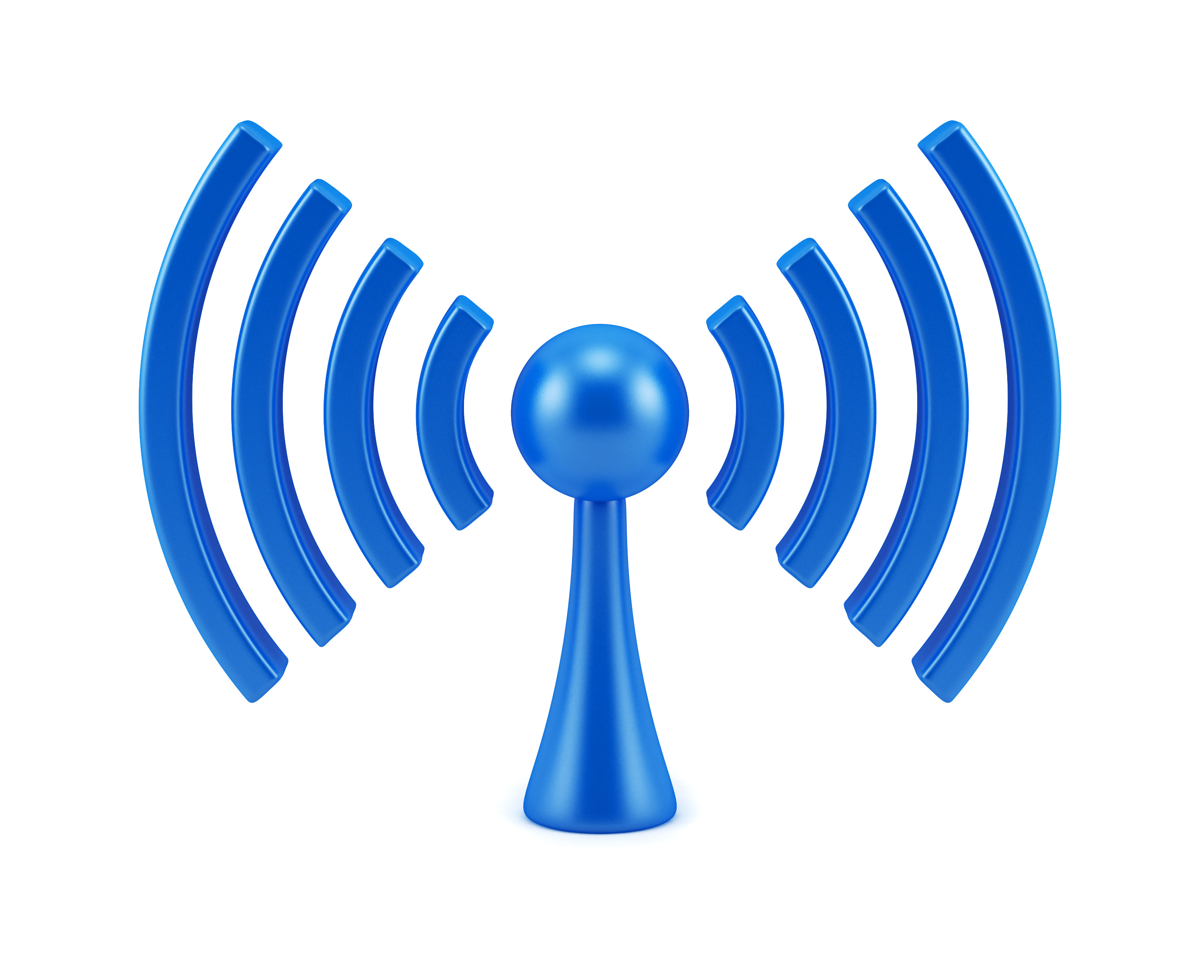


COM-405: Mobile Networks
Lecture 11.0: Wireless Security
Haitham Hassanieh
Slides courtesy of Jean-Pierre Hubaux (with gratitude to Ludovic Barman and Sylvain Chatel who produced some of the slides and Eduard Vlad who recently edited the slides)
Laboratory of SEnsing
& Networking Systems

Slide 2

This course contains material related to security and privacy, including the description of attacks. The purpose is to help you learn how to best protect networks. In no case should you feel entitled to perpetrate such attacks, neither against the EPFL network, nor anywhere else.

Slide 3
Outline
Brief Reminder of Security and crypto principles
Challenges in Wireless Networks Security
Cellular Network Security
WiFi 802.11 Network Security
Wireless Pairing & Bluetooth

Slide 4

Cryptography in Data Security & Privacy
Cryptography is used to enforce data security:
  Confidentiality
    Encryption
  Integrity & Non-repudiation
    Hash-and-sign
…at rest and in transit
🕵️‍♂️
🕵️‍♂️
👩‍💻
👩‍💻
👨‍💻

Slide 5









Cryptographic tools – Symmetric encryption
$sk$
$sk$
$m$
Enc
$Enc(m)$
Dec
$$m$$
sk = secret key (shared)
At Rest
In Transit
🕵️‍♂️
🕵️‍♂️
Enc
Dec
👩‍💻
Enc
Dec
👨‍💻
$sk$
$sk$
👩‍💻
$sk$
Still need to exchange $sk$ somehow

Slide 6









Cryptographic tools – Asymmetric encryption
KeyGen
$pk$
$sk$
$m$
Enc
$c$
Dec
$$m$$
🕵️‍♂️
At Rest
In Transit
Enc
Enc
Enc
Dec
🕵️‍♂️
👩‍💻
Enc
Dec
👨‍💻
👨‍💻
👨‍💻
👨‍💻
👩‍💻
$sk_{alice}$
$pk_{bob}$
🕵️‍♂️
$sk_{bob}$
$pk_{alice}$
KeyGen
KeyGen

Slide 7
Cryptography in Data Security & Privacy
Cryptography is used to enforce data security:
  Confidentiality
    Encryption
  Integrity & Non-repudiation
    Hash-and-sign
…at rest and in transit
Is it enough ?
🕵️‍♂️
🕵️‍♂️
👩‍💻
👩‍💻
👨‍💻

Slide 8
Wireless Network Security - Outline
Brief reminder of security and crypto principles
Challenges in Wireless Networks Security
Cellular Network Security
WiFi 802.11 Network Security
Wireless Pairing & Bluetooth

Slide 9
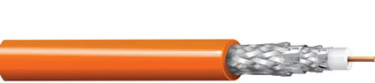
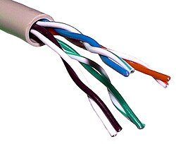

Wired and Wireless Topologies
1982: 10BASE5 Ethernet
👨‍💻
👨‍💻
Today: Wireless
👨‍💻
👨‍💻
👨‍💻
👨‍💻
👨‍💻
Shared bus for all (CSMA/CD)
Today: 10BASE-T... Ethernet
👨‍💻
👨‍💻
👨‍💻
👨‍💻
👨‍💻
Air Interface: Shared bus for all
👨‍💻
👨‍💻
👨‍💻
Partitioned collision domains, no broadcast
[1]: https://nassaunationalcable.com/cdn/shop/products/Belden9880_1024x1024@2x.png?v=1762488061

Slide 10
Why is security more of a concern in wireless?
No inherent physical protection
  Physical connections between devices are replaced by logical associations
  Sending and receiving messages do not need physical access to the network infrastructure (cables, hubs, routers, etc.)
Broadcast communications
  Wireless usually means radio, which has a broadcast nature
  Transmissions can be overheard by anyone in range
  Anyone can generate transmissions,
    Which will be received by other devices in range
    Which will interfere with other nearby transmissions and may prevent their correct reception (jamming)
Eavesdropping is easy
Injecting bogus messages into the network is easy
Replaying previously recorded messages is easy
Illegitimate access to the network and its services is easy
Denial of service is easily achieved by jamming

Slide 11
Security Requirements
Confidentiality
  Messages sent over wireless links must be encrypted
Authenticity
  Origin of messages received over wireless links must be verified
Replay detection
  Freshness of messages received over wireless links must be checked
Integrity
  Modifying messages on-the-fly (during radio transmission) is not so easy, but possible …
  Integrity of messages received over wireless links must be verified
Access control
  Access to the network services should be provided only to legitimate entities
  Access control should be permanent
    It is not enough to check the legitimacy of an entity only when it joins the network and its logical associations are established, because logical associations can be hijacked
Protection against jamming

Slide 12
Wireless Network Security - Outline
Brief reminder of security and crypto principles
Challenges in Wireless Networks Security
Cellular Network Security
WiFi 802.11 Network Security
Wireless Pairing & Bluetooth

Slide 13
Cellular Network Security
Standards that we will (briefly) explore :
GSM (2G), Global System for Mobile communications
  introduced in 1991, now deprecated but very useful to explain things
  It is called 2G, but is actually the first digital cellular system (1G designates the analog versions)
UMTS (3G), Universal Mobile Telecommunications Systems
  introduced in 2001
LTE (4G), Long Term Evolution
  introduced in 2009
5G
  Introduced in 2020
Objective: get a sense of the security measures used by these standards
It is not meant to be exhaustive

Slide 14
GSM Security
Main security requirement :
  Subscriber authentication (for the sake of billing)
    Challenge-response protocol
    Long-term secret key shared between the subscriber and the home network operator
    Supports roaming without revealing long-term key to the visited networks (privacy-friendly)
  Missing: Network authentication
Other security services provided by GSM :
  Confidentiality (communications + signaling)
    over the wireless channel
    wired network in clear-text
  Protection of the subscriber’s identity from eavesdroppers on the wireless channel
    Usage of short-term temporary identifiers

Slide 15
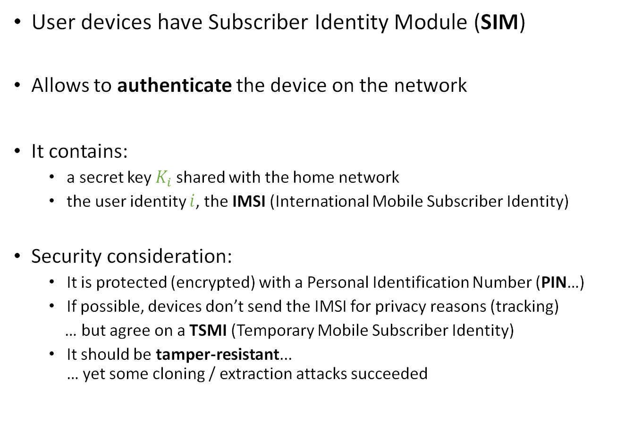
GSM Security – SIM
User devices have Subscriber Identity Module (SIM)
Allows to authenticate the device on the network
It contains:
  a secret key $K_{i}$ shared with the home network
  the user identity $i$, the IMSI (International Mobile Subscriber Identity)
Security consideration:
  It is protected (encrypted) with a Personal Identification Number (PIN…)
  If possible, devices don’t send the IMSI for privacy reasons (tracking)
  … but agree on a TSMI (Temporary Mobile Subscriber Identity)
  It should be tamper-resistant...
  … yet some cloning / extraction attacks succeeded
C.f.: https://www.etsi.org/deliver/etsi_ts/155200_155299/155205/18.00.00_60/ts_155205v180000p.pdf

Slide 16
GSM Security – Cryptography
Devices use three cryptographic algorithms: A3, A5 and A8
  A3 for authentication
  → Produces a 32 bits challenge
  A8 for key generation
    → Produces a 64 bits encryption key
  A5 for encryption
Left unspecified by the standard: operator may choose
Often: A5/A8 implemented together as a hash function
Pseudorandom functions
Stream cipher

Slide 17


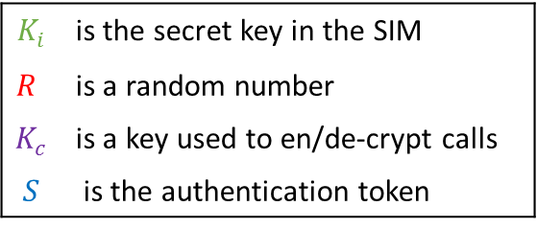
GSM Cryptography
User’s secret key
Random number
$$Ki$$
$$R$$
A8
A3
$K_{c}$ $S$ $R$
Triplet
Authentication (see next slide)
call data
A5
Encryption
$K_{i}$ | is the secret key in the SIM
$$R$$ | is a random number (RAND)
$K_{c}$ | is a key used to en/de-crypt calls
$$S$$ | is the authentication token
Encrypted call data

Slide 18
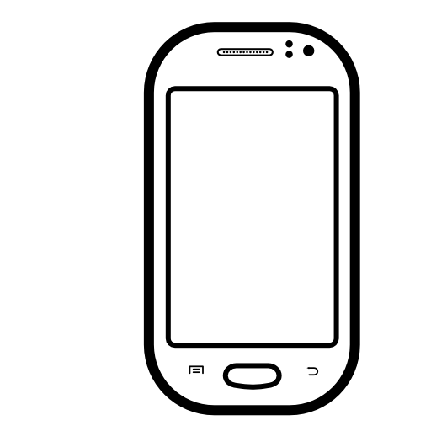

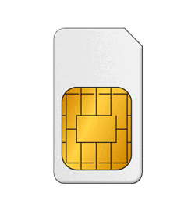







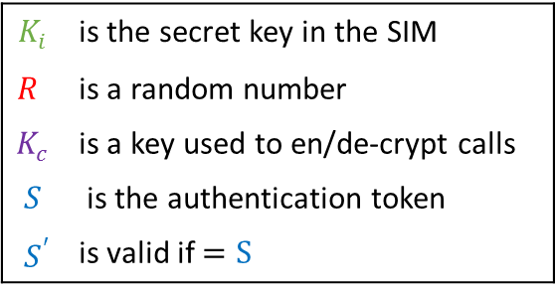






GSM Authentication
Mobile Station Visited network Home network
IMSI (or TMSI)
$$Ki$$
$R$
IMSI
A8 A3
$$(Kc, R, S)$$
$$Kc$$
$$S$$
$$R$$
Stores $K_{c}, S$
$$Ki$$
$$R$$
$K_{i}$ | is the secret key in the SIM
$$R$$ | is a random number
$K_{c}$ | is a key used to en/de-crypt calls
$$S$$ | is the authentication token
$${ S}^{′}$$ | is valid if $=S$
A8 A3
$$Kc$$
$$S’$$
$$S’$$
$S$=$S’$ ?

Slide 19
GSM Weaknesses – “By design”
Unilateral authentication:
  The network authentifies the user, but not the opposite
  A fake base station can pretend to be the legitimate network
  E.g it can collect identities (IMSI) to spy on users (movement profiles)
  E.g it can mount a MitM and decrypt the traffic
No Security within the wired network:
  Call data is decrypted at the visiting network
  No end-to-end confidentiality
  Signaling messages are not protected
3. A5 secret key can be extracted from recorded traffic
  Missing salt in encryption enables attackers to pre-compute Rainbow Tables [1]
  [1]: https://srlabs.de/blog/decrypting-gsm​

Slide 20
GSM Weaknesses – Attacks
Over-the-air cracking:
  Cryptographic weakness in the 1st generation of A3/A8
    (that allowed an adversary to decrypt calls)
  Extraction of IMSI (to spy on user) via packet injection
SIM Cloning:
  Allows to receive calls instead of someone
  … or make «free» calls
  Yet the network will probably detect / ban the two identical SIMs
  It is thus a rather short-lived attack

Slide 21
GSM Weaknesses (cont’d)
Security by obscurity for the crypto protocols
  Closed-source design
  Was reverse-engineered
  Finally made public (but when it was already implemented and widespread)
  A very bad decision for cryptographic protocols!
Note:
the Snowden-leaked documents show that the NSA is able to «process encrypted A5 [GSM] data» [1]
[1] Timberg, Craig; Soltani, Ashkan (13 December 2013). "By cracking cellphone code, NSA has ability to decode private conversations», Washington Post, Dec. 2013

Slide 22


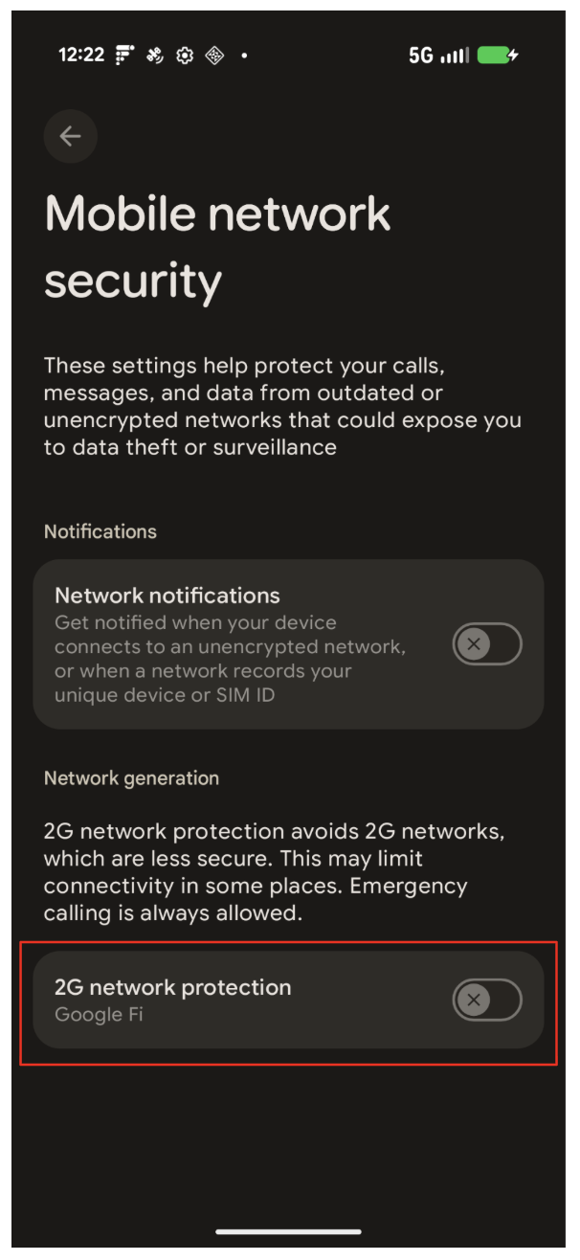
Attacks Today: IMSI Catching in 2G
TMSI?
Plain: TMSI
Authentic
Operator
Rogue base station
Attack due to missing mutual authentication:
Rogue base station overshadows the authentic operator’s signals
Collection of unique and permanent identifiers: TMSI, IMEI
➔ Enables tracking and collection of movement profiles
➔ Recommendation: Disable 2G (GSM) if possible [1]
[1]: https://source.android.com/docs/security/features/cellular-security/toggle-2g

Slide 23
UMTS Security improvements
Network to Device authentication:
  Protection against the false base station attack
Increased key length:
  allows for stronger encryption and integrity verification algorithms
Security mechanisms within and between networks
  Through authentication and encryption on the wire
Introduced authentication sequence number
  Protection against re-use of compromised authentication vector
Addition of a mandatory cipher mode, with stronger security, that allows the mobile to verify that encryption is enabled.

Slide 24
(Brief) UMTS (3G) security assessment
Some improvements with respect to GSM:
  It fixed the obvious flaws
  Cryptographic algorithms were publicly discussed
    Allows for review, ultimately brings stronger security
  Integrity of the signaling messages is protected
Quite conservative solution
Privacy/anonymity of the user not completely protected
  E.g. still no end-to-end encryption

Slide 25
Attacking 3G: Downgrade to 2G
3G Radio
2G: TMSI?
2G: Plain: TMSI
Authentic
Operator
Rogue base station
3G Radio Jamming
Mutual authentication of 3G prohibits IMSI catchers
However: Attacker can downgrade to 2G by jamming the 3G band
Reduce attack to the (concurrently running) 2G stack

Slide 26
LTE (4G) Security Improvements
LTE is more secure than its precedent standards
  Integrity protection mechanisms are required
  Unfortunately: many of the new security mechanisms are
    optional
    disabled by default
LTE is completely IP-based
  End of circuit-based communications
  Leverages on all the knowledge of IP networks …
  … but a flaw / 0-day exploit may now affect both networks (Internet and cellular) at the same time

Slide 27
LTE security principles [1]
Permanent security association with home network
  Permanent key stored both in devices and in the home network.
  It is used to securely derive ephemeral keys
New key hierarchy
  A new local master key enables cryptographic network separation
  This master key is less exposed (it remains in the core network)
Reciprocal authentication mechanisms
  The mobile phone can also verify the authenticity of the network
  Additional shared cryptographic material between the terminal and the network allows for the confidentiality and integrity-protection of the transmitted data
[1] Anastasios N. Bikos, Nicolas Sklavos, "LTE/SAE Security Issues on 4G Wireless Networks", IEEE Security & Privacy vol. 11, p. 55-62, 2013

Slide 28
LTE security principles (cont’d)
Trusted environment and secure execution in the devices
  Isolated, even from the OS
  Device authentication executed within the trusted environment
  Support for autonomous validation, in which the network is assured of the integrity of authenticated devices. (i.e. the computations were done in an uncompromised trusted environment)
DoS protection of the network
  Restriction in the number of connections
  Only validated network elements should be allowed in the core network
User privacy
  IMSI should be kept secret both inside the device (from the Apps) and over the air
  Confidentiality of signaling and user data must be retained
Authorization
  Authorization is required for the connection to core networks and for software integrity

Slide 29
LTE Security in Practice
LTE more secure than predecessor as a standard
but in practice:
  Implementation mistakes
  Configuration flaws
  Specification/protocol deficiencies
Researchers have found several flaws in currently deployed LTE networks that can result in:
  Privacy leaks
  Denial of service attacks

Slide 30
Practical attacks against Privacy and Availability in 4G/LTE [1]
Vulnerabilities in 4G specifications and networks
  User Equipment (UE) measurement reports
    Requests are not authenticated, reports are not encrypted
  Tracking area update (TAU) procedure
    Reject messages are not integrity protected
  Attach procedure
    Network capabilities are not protected against bidding down attacks
  Radio Capabilities can be tampered – Bidding Down attack
  User Plane Data is not integrity protected
Implementation flaws (all vendors)
  Radio Link Failure (RLF) reports
    Requests not authenticated, reports are not encrypted
[1] Shaik A, Borgaonkar R, Asokan N, Niemi V, Seifert JP, Practical attacks against privacy and availability in 4G/LTE mobile communication systems, NDSS, 2016. https://arxiv.org/pdf/1510.07563.pdf

Slide 31
Practical attacks against Privacy and Availability in 4G/LTE (cont’d)
Location leaks
  Track user locations and movements to much higher levels of granularity than was previously thought possible
  Social applications used for silent tracking
DoS attack enables downgrade attacks
  Deny access to LTE network to LTE-capable device
  Users limited to less secure 2G/3G networks
  Silent and persistent attack from the user’s point of view

Slide 32
LTEInspector: A Systematic Approach for Adversarial Testing of LTE [1]
Systematic framework for adversarially analyzing LTE specification to find security and privacy problems
  Abstract model based on LTE standards
  Relies on a symbolic model checker and a cryptographic protocol verifier
  Analyzes three critical procedures: attach, detach and paging
Findings
  Uncovered 10 new attacks
  Identified 9 prior attacks: IMSI-catching DoS, linkability, MitM in 3G and 2G.
[1] Hussain SR, Chowdhury O, Mehnaz S, Bertino E. LTEInspector: A Systematic Approach for Adversarial Testing of 4G LTE, NDSS, 2018

Slide 33
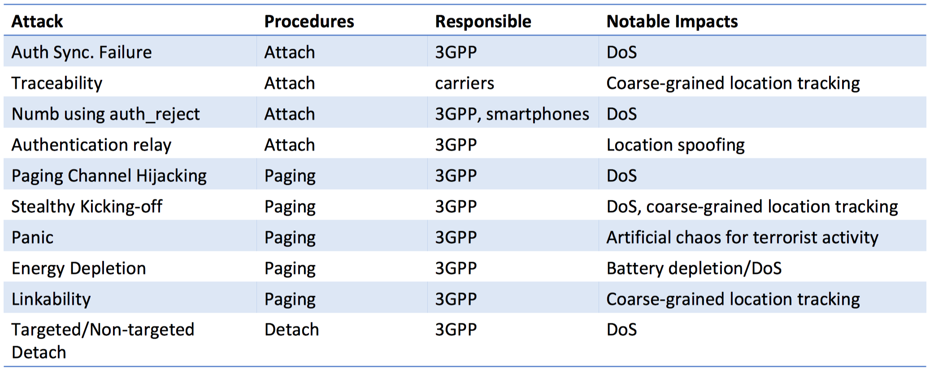
LTEInspector: New attacks Uncovered
3GPP is the main standardization body of cellular networks

Slide 34
LTEInspector: Panic Attack
Adversary can inject fake emergency paging messages to a large number of user equipments
“Panic situation”: Drops Authentication and Confidentiality requirements UEs
Unauthenticated ETWS Message
Security Mode Command (Plain)
[[ Plaintext Communication]]
Rogue base station
ETWS: Emergency and Tsunami Warning System

Slide 35
5G Security Features
Integrity Protection for User Plane Function (IP traffic)
Radio Capabilities are sent over a Secured Channel
  Prevents Bidding Down Attacks
Additional Authentication Primitives
  EAP = Extensible Authentication Protocol
  Enables interop with e.g. WiFi subscriber management
Introduce Subscriber Unique Concealed Identifier (SUCI) to cryptographically secure the IMSI (SUPI)
Decoupling the IMSI for paging procedures
  Instead of IMSI / SUPI a Globally Unique Temporary Identifier (GUTI) is used for paging
  Mitigation of tracking with ephemeral identifiers

Slide 36
Papers on Analysis of 5G Security and Privacy
Ijaz Ahmad et al. Overview of 5G Security Challenges and Solutions, IEEE Communications Standards Magazine, March 2018
R. P. Jover, V. Marojevic. Security and Protocol Exploit Analysis of the 5G Specifications, IEEE Access, Feb. 2019
D. Basin et al. A Formal Analysis of 5G Authentication. ACM CCS 2018

Slide 37
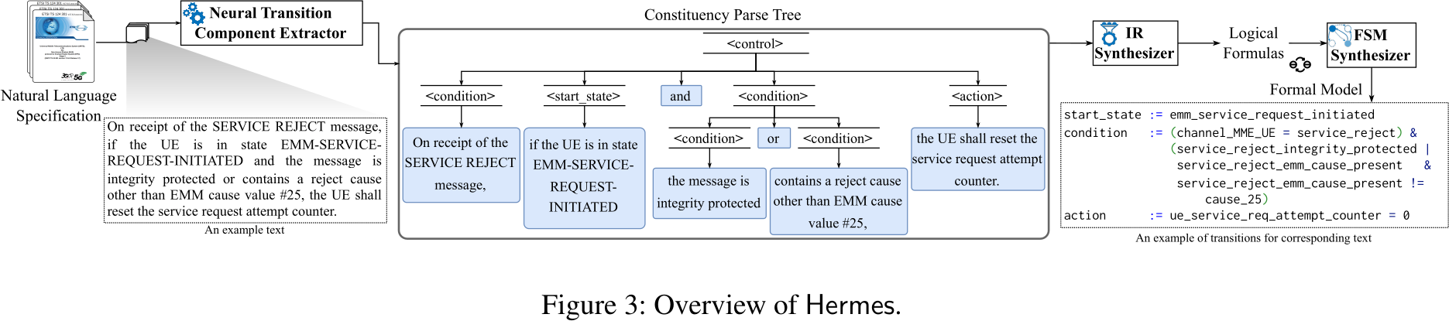
Protocol-Focused Analysis
Hermes (SEC'24) Synthesizing Formal Models via NLP
Approach:
  Synthesizing Protocol State machines with ML (consituency parsing, domain-specific language design)
  (a) model-checking on specification to verify security properties
  (b) check if COTS baseband respect the model
Evaluation:
  Perform MC on generated FSM to find deviations, that were not designed
  Analysis of LTE and 5G - NAS, RRC

Slide 38
Protocol-Focused Analysis
"Demystifying Privacy in 5G Stand Alone Networks" (MobiCOM'24)
Surveys and compares 5G NSA and SA security for real operator networks
Attack on privacy because of unauthenticated GUTI Reallocation
  Drop "GUTI Reallocation" message -> identity tracking via "permanent" GUTI
GUTI Reallocation
[New GUTI]
Authentic
Operator
MITM Attacker
(Old) GUTI

Slide 39
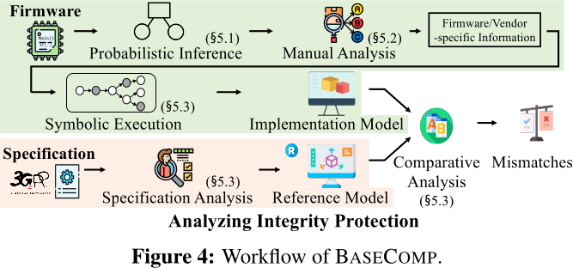
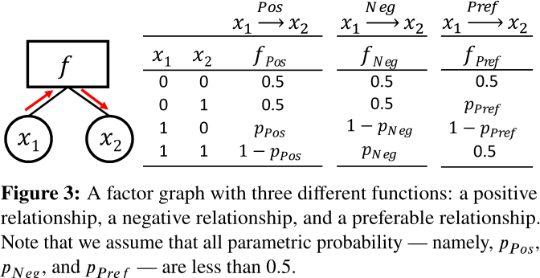
Implementation-Focused Analysis
"BaseComp" (SEC '23) Static Analysis between Specification ↔ Baseband
Approach: Analyze integrity protection function
  Compare the specification graph with the
  firmware's probabilistically identified graph
  Perform symbolic execution on the extracted
  function and compare to the specification
Evaluation:
  Finds logic bugs, since the behavior is analyzed
  Requires a reference model for integrity protection
  → built manually
  Manual analysis required (e.g. for symbolic execution)

Slide 40
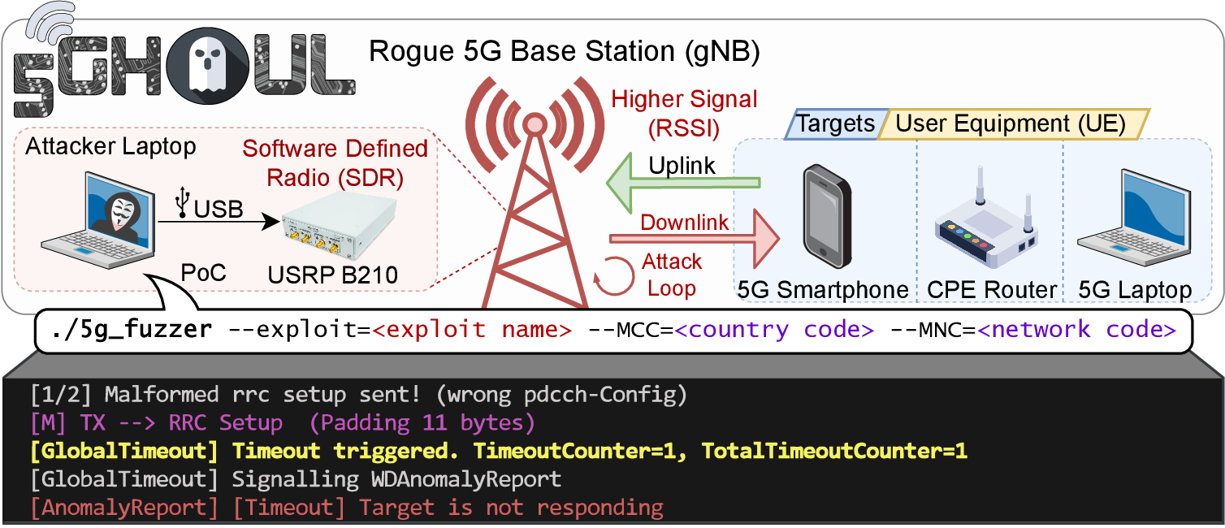
Hardware-In-The-Loop Testing
5Ghoul (2024)
Approach:
Hardcoding the protocol fields for the tested UE (extracted from specification)
Instrumenting open-source gNB to send messages from a protocol-based fuzzer to the target UE
UE reply is verified in the open-source gNB implementation
Evaluation:
Requires to have the gNB running during fuzzing, especially
verifying message flows
Manual (and error-prone) work to implement the protocol fields for fuzzing

Slide 41
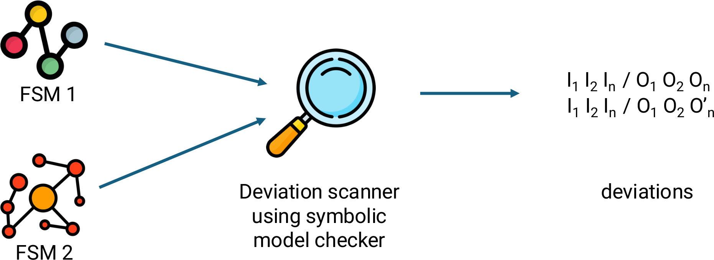
Hardware-In-The-Loop Testing
5GBaseChecker (SEC'24)
Approach:
Automata learning and differential testing: construct a state machine (FSM) for a vendor
FSMs should be used to compare between vendors, regardless of implementation
  Reason: black-box testing: no insight into the baseband given
  Advantage: Flexible use against different vendors without additional effort
Steps for Analysis:
Passive learning (from traces → bootstrap the FSM)
Model refinement (active learning to validate and extend)
Probe the state machines to find differences between the FSMs
(Manual step) Read in the specification to decide what the correct behavior is

Slide 42
Cellular Security Landscape
3G: Public Security Algorithms
Security improvements on radio link
Lacking security in core network
➔ Hardening the radio interface
5G: Hardening and Integration
Introduce SUCI for concealment
Introduce EAP for Auth
➔ Focus on Implementation Flaws
2G: First Digital Cellular System
Insufficient Security
Lacking mutual auth
“Easy” USIM cloning
➔ “Security by obscurity”
4G: IP-based communication
Lacking UPF authentication
ETWS security downgrade
➔ Unify network layer

Slide 43
Wireless Network Security - Outline
Brief reminder of security and crypto principles
Challenges in Wireless Networks Security
Cellular Network Security
WiFi 802.11 Network Security
Wireless Pairing & Bluetooth

Slide 44
IEEE 802.11 “WiFi” Security
WEP, Wired Equivalent Privacy
  introduced in 1997
  part of the original IEEE 802.11 standard
WPA, Wi-Fi Protected Access
  introduced in 2003
  part of the draft of IEEE 802.11i standard
WPA2
  introduced in 2004
  part of the final IEEE 802.11i standard
WPA3
  introduced in 2018
WPA4
  TBD
Note: IEEE 802.11i is the standard (part of IEEE 802.11) related to security

Slide 45
WEP
Stands for Wired Equivalent Privacy
Goals:
  make WiFi networks at least as secure as a wired LAN (that has no particular protection mechanisms)
  WEP was never intended to achieve strong security
Services:
  access control to the network
  message confidentiality
  message integrity

Slide 46
WEP (cont’d)
before association, the station needs to authenticate itself to the AP
authentication is based on a simple challenge-response protocol:
  STA → AP: authenticate request
  AP → STA: authenticate challenge (r) // r is 128 bits long
  STA → AP: authenticate response (e_{K}(r)) // signature of r
  AP → STA: authenticate success/failure
if authentication fails, no association is possible
once authenticated, the station can send an association request and join the network

Slide 47
WEP Weaknesses
WEP is insecure and should not be used.
authentication is one-way only
  AP is not authenticated to the device (c.f. 2G in cellular)
  device is at risk to associate to a rogue AP
the same shared secret key is used for authentication and encryption
  weaknesses in any of the two protocols can be used to break the key
no session key is established during authentication
  access control is not continuous
  once a device has authenticated and associated to the AP, an attacker can send messages using the MAC address of the station
  correctly encrypted messages cannot be produced by the attacker, but replay of messages is possible

Slide 48
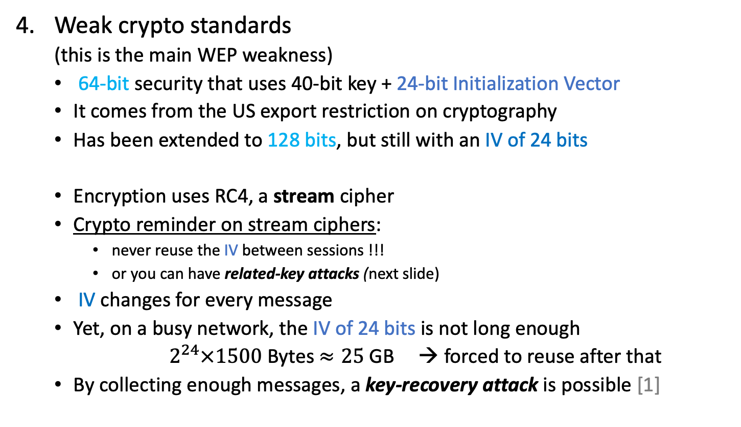
WEP Weaknesses (cont’d)
Weak crypto standards
  (this is the main WEP weakness)
  64-bit security that uses 40-bit key + 24-bit Initialization Vector
  It comes from the US export restriction on cryptography
  Has been extended to 128 bits, but still with an IV of 24 bits
  Encryption uses RC4, a stream cipher
  Crypto reminder on stream ciphers:
    never reuse the IV between sessions !!!
    or you can have related-key attacks (next slide)
  IV changes for every message
  Yet, on a busy network, the IV of 24 bits is not long enough
        $2^{24}×1500$ Bytes $≈25$ GB → forced to reuse after that
  By collecting enough messages, a key-recovery attack is possible [1]
[1] Fluhrer, S., Mantin, I., and A. Shamir, Weaknesses in the Key Scheduling of RC4

Slide 49
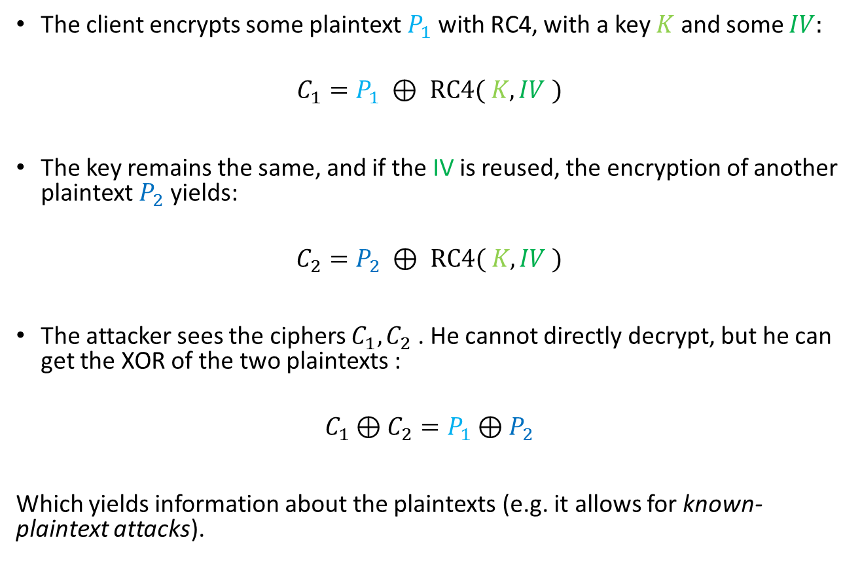
Related-Key attack - details
The client encrypts some plaintext $P_{1}$ with RC4, with a key $K$ and some $IV:$
$$C_{1}=P_{1} ⊕ RC4( K, IV )$$
The key remains the same, and if the IV is reused, the encryption of another plaintext $P_{2}$ yields:
$$C_{2}=P_{2} ⊕ RC4( K, IV )$$
The attacker sees the ciphers $C_{1}, C_{2}$ . He cannot directly decrypt, but he can get the XOR of the two plaintexts :
$$C_{1}⊕C_{2}=P_{1}⊕P_{2}$$
Which yields information about the plaintexts (e.g. it allows for known-plaintext attacks).
<- this is catastrophic

Slide 50
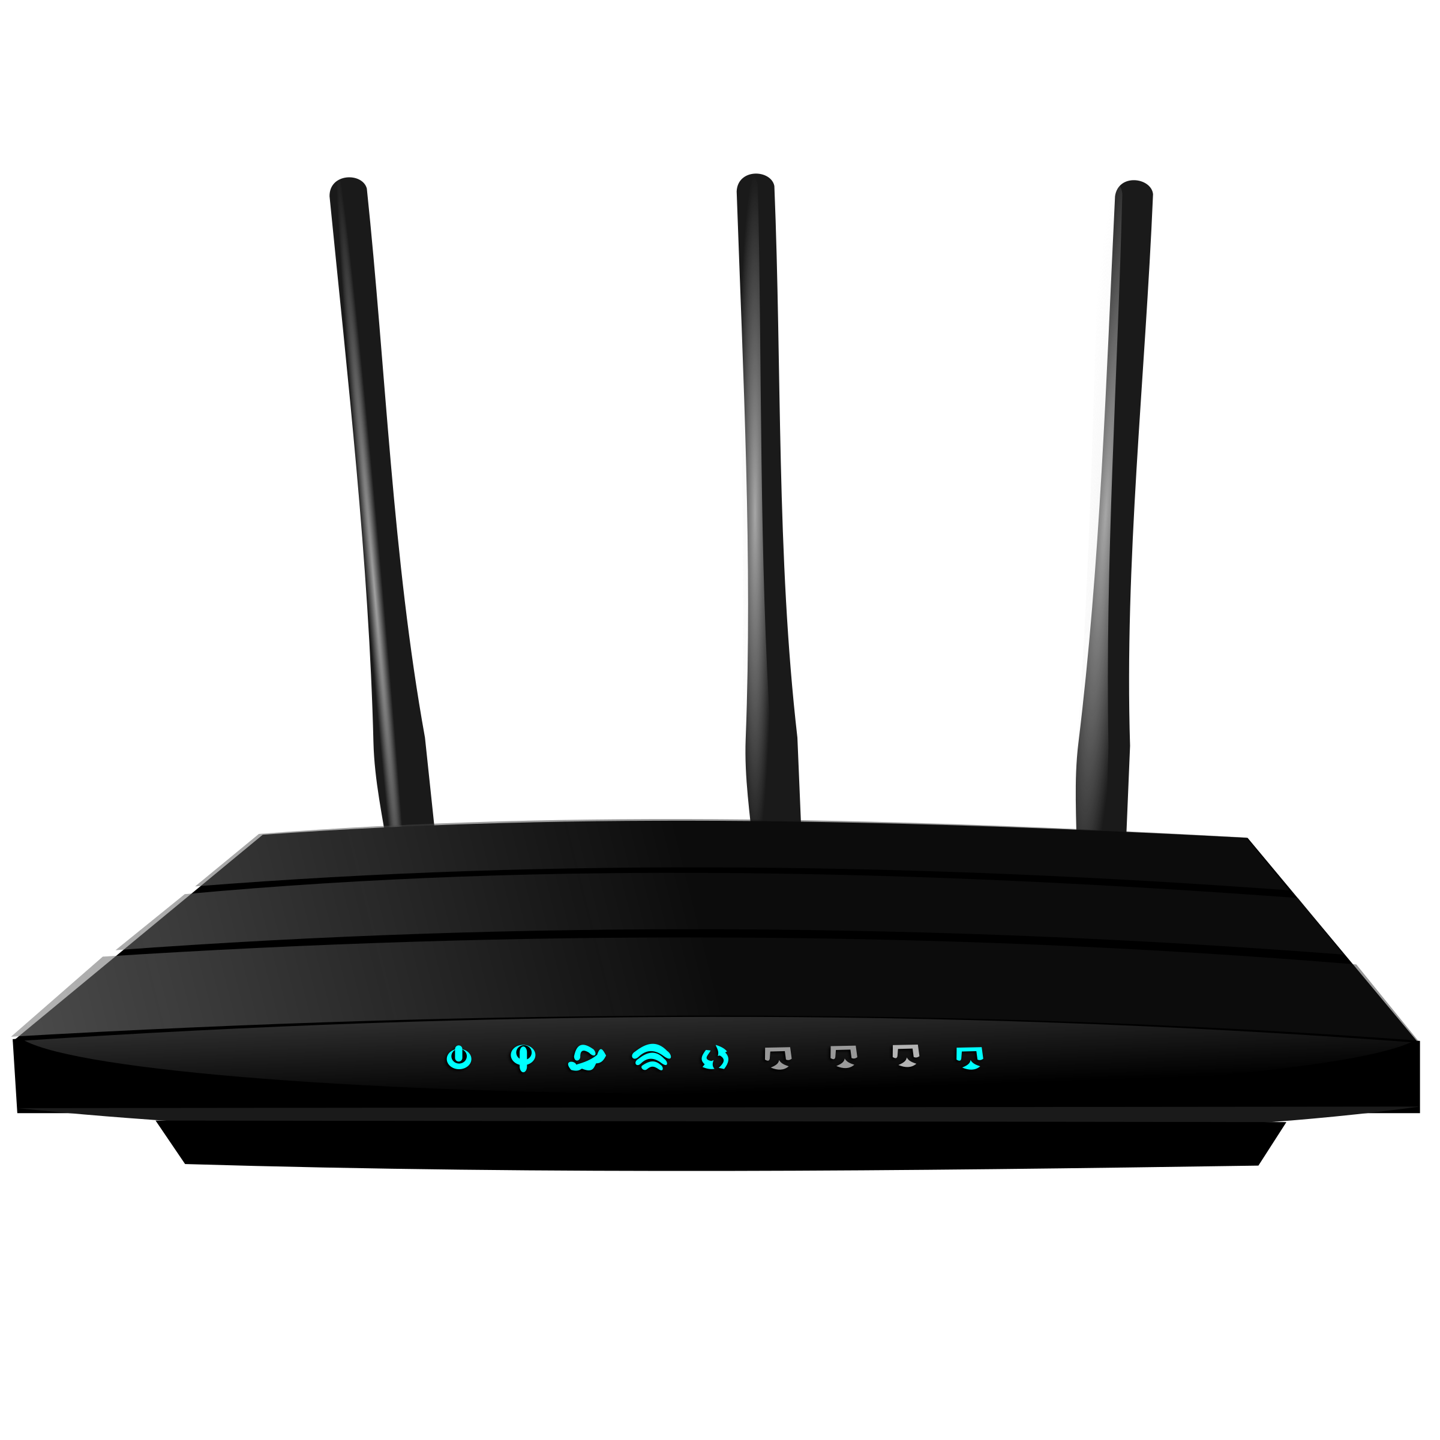
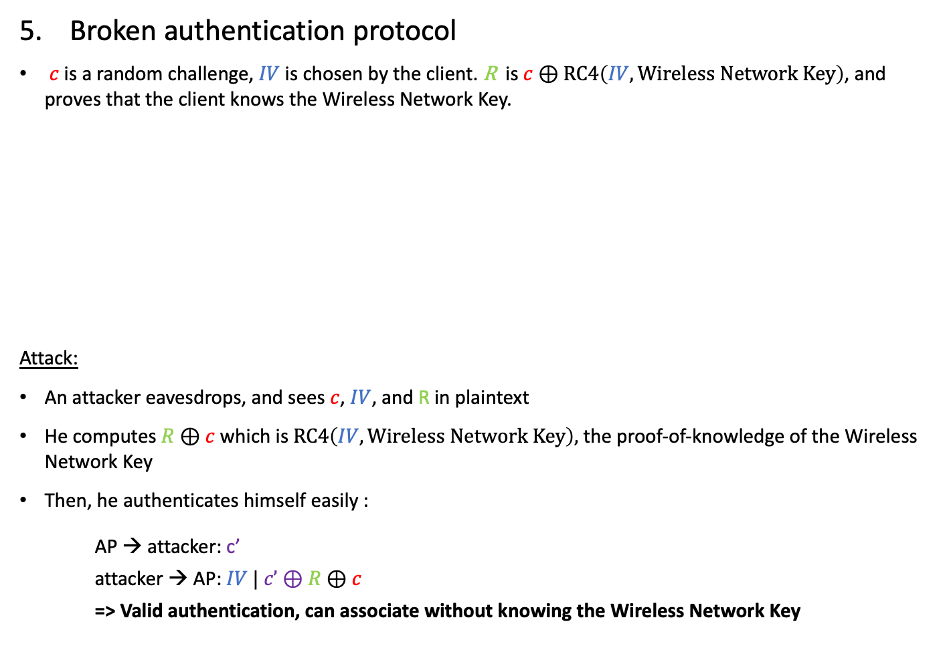


WEP Weaknesses (cont’d)
Broken authentication protocol
$c$ is a random challenge, $IV$ is chosen by the client. $\text{R}$ is $c⊕RC4\left(IV, Wireless Network Key\right)$, and proves that the client knows the Wireless Network Key.
Attack:
An attacker eavesdrops, and sees $c$, $IV$, and R in plaintext
He computes $R⊕c$ which is $RC4\left(IV, Wireless Network Key\right),$ the proof-of-knowledge of the Wireless Network Key
Then, he authenticates himself easily :
  AP → attacker: c’
  attacker → AP: $IV | c’⊕R⊕c$
  => Valid authentication, can associate without knowing the Wireless Network Key
$$c$$
$$IV | \text{R}$$

Slide 51
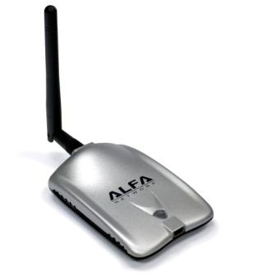
Cracking WEP
Linux + an external, monitoring-capable antenna
Most popular antenna for «playing around»:
ALFA AWUS036h
Five steps:
Put the interface in monitoring
Choose and eavesdrop on a WEP WiFi LAN for encrypted packets
… wait (for IV repetitions), or…
Spam the network with DEAUTH packets that forces devices to reconnect (this generates legitimate traffic on the network)
Let the automated tool recover the key
=> Takes less than a minute on a modern computer

Slide 52
WEP – Lesson learnt
Engineering security protocols is difficult:
One can combine otherwise strong building blocks in a wrong way and obtain an insecure system at the end
  Example:
    stream ciphers alone are OK
    challenge-response protocols for entity authentication are OK
    but they could be combined in an insecure way (Weakness n°5)
Don’t do it alone
  functional properties can be tested
  security is a non-functional property
  → extremely difficult to tell if a system is secure or not
Using an expert in the design phase pays out
→ Fixing the system after deployment will be much more expensive
Experts cannot guarantee that a system is 100% secure, but know the pitfalls
E.g., they know the details of crypto algorithms (e.g. RC4 weak keys)

Slide 53
IEEE 802.11 “WiFi” Security
WEP, Wired Equivalent Privacy
  introduced in 1997
  part of the original IEEE 802.11 standard
WPA, Wi-Fi Protected Access
  introduced in 2003
  part of the draft of IEEE 802.11i standard
WPA2
  introduced in 2004
  Is part of the final IEEE 802.11i standard
WPA3
  introduced in 2018
WPA4
  TBD
Note: IEEE 802.11i is the standard (part of IEEE 802.11) related to security

Slide 54
WPA/WPA2
Main novelties in WPA/WPA2 w.r.t to WEP:
  Encryption is replaced by either:
    TKIP: Now insecure + deprecated,
      → (Ugly) temporary solution replacing WEP while using the same hardware
    or AES: Strong
      But required changing all network cards…
      This is the standard now.
  Flexible authentication: EAP (Extensible Authentication Protocol)
    Multiple authentication mechanisms available
    Successful authentication results in a per-session shared session key
    Can interoperate with 5G for authentication
  Integrity protection is improved, notably by sequence counters and Message Authentication Codes
  Different functions (encryption, integrity) use different keys derived from the session key using a one-way function

Slide 55
WPA/WPA2 authentication model
Wireless router
device
services
authenticator
authentication
server
port
controls
Wireless LAN
the authenticator controls access to the services (controls the state of a port)
the authentication server authorizes access to the services
the device authenticates itself to the authentication server
if the authentication is successful, the authentication server instructs the authenticator to switch the port on
the authentication server informs the device that access is allowed, and sends a session key shared between the mobile device and the authentication server

Slide 56
WPA/WPA2 authentication
Three main supported modes :
PSK, Pre-Shared Key
  All users share a (usually human-readable) key
  Mostly deployed in homes, small companies
  The authentication server is very simple, and part of the wireless router
  Simple, but not flexible
Entreprise
  The authentication server is an external RADIUS server
  Every user/device has a different key
  Complex setup, flexible
WPS (Wi-Fi Protected Setup)
  This is a way to bootstrap/set up PSK, but with a very secure key
  Aims to prevent bruteforce attack on PSK with weak keys (e.g., «password123»)

Slide 57
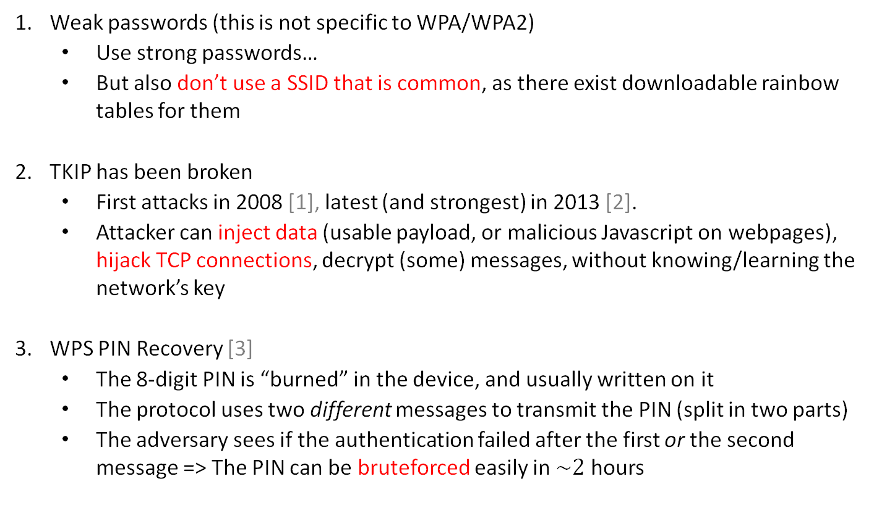
WPA/WPA2 weaknesses
Weak passwords (this is not specific to WPA/WPA2)
  Use strong passwords…
  But also don’t use a SSID that is common, as there exist downloadable rainbow tables for them
TKIP has been broken
  First attacks in 2008 [1], latest (and strongest) in 2013 [2].
  Attacker can inject data (usable payload, or malicious Javascript on webpages), hijack TCP connections, decrypt (some) messages, without knowing/learning the network’s key
WPS PIN Recovery [3]
  The 8-digit PIN is “burned” in the device, and usually written on it
  The protocol uses two different messages to transmit the PIN (split in two parts)
  The adversary sees if the authentication failed after the first or the second message => The PIN can be bruteforced easily in $\sim 2$ hours
[Pairwise Master Key with PBKDF2(passphrase || SSID)]
[1] http://dl.aircrack-ng.org/breakingwepandwpa.pdf
[2] https://lirias.kuleuven.be/bitstream/123456789/401042/1/wpatkip.pdf
[3] Stefan Viehböck, Brute Forcing Wi-Fi Protected Setup

Slide 58
WPA2 4-Way Handshake
Used to connect to any protected WiFi network
Two main purposes:
  Mutual authentication
  Negotiate fresh pairwise temporal key (PTK)
Appeared to be secure:
  No attacks in over a decade (apart from password guessing)
  Proven that negotiated key (PTK) is secret [1]
  Encryption protocol formally proven secure [2]
[1] C. He, M. Sundararajan, A. Datta, A. Derek, and J. Mitchell, A Modular Correctness Proof of IEEE 802.11i and TLS, CCS, 2005.
[2] J. Jonsson, On the security of CTR+ CBC-MAC, SAC, 2002.

Slide 59
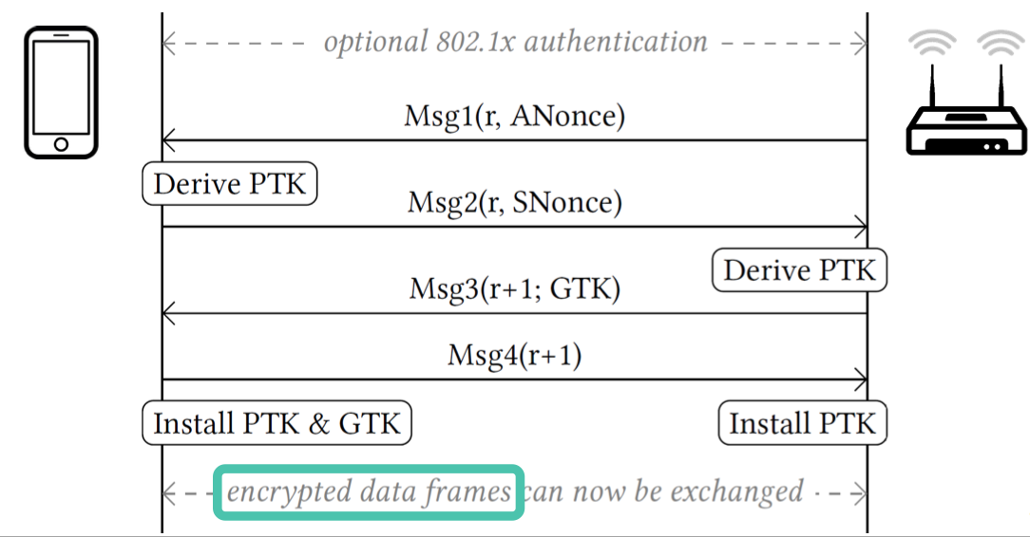
WPA2 4-Way Handshake (simplified)
PTK = Combine (shared secret, ANonce, SNonce)
GTK = Group Temporal Key (broadcast & multicast)

Slide 60
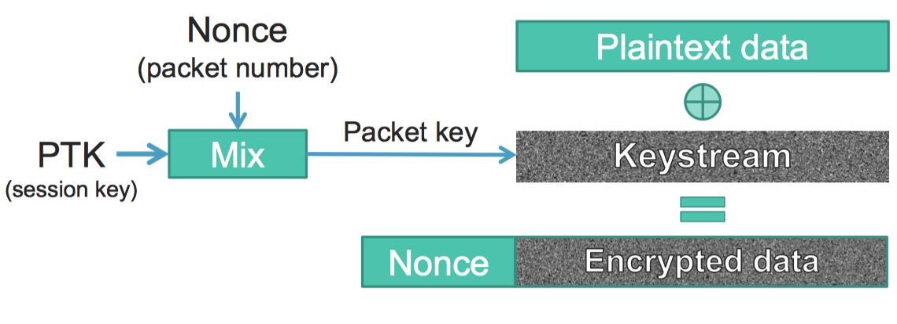
WPA2 Frame Encryption (simplified)
→Nonce reuse implies keystream reuse (in all WPA2 ciphers)
Reuse occurs after 2^48 packets (over 281 trillion packets)

Slide 61
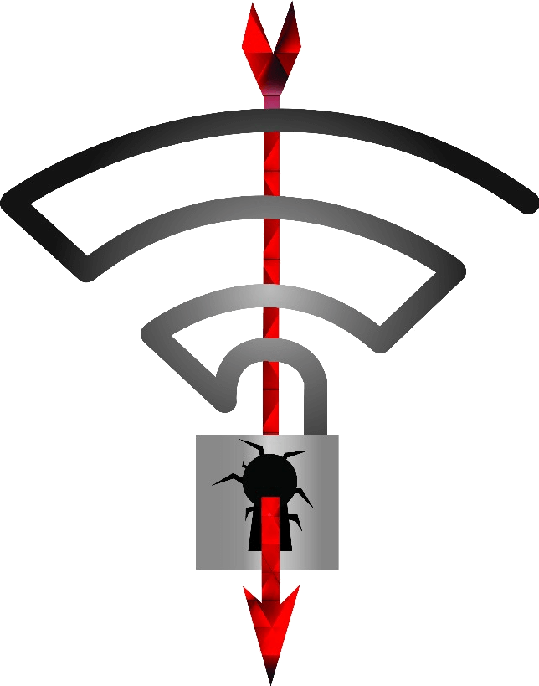
WPA2 Key Reinstallation Attacks [1]
Exploit of WPA2 4-way handshake
Weaknesses in the WiFi standard itself
  Any correct implementation of WPA2
  is likely affected
https://www.krackattacks.com/
[1] Vanhoef, M. and Piessens, F., Key reinstallation attacks: Forcing nonce reuse in WPA2, CCS, 2017

Slide 62
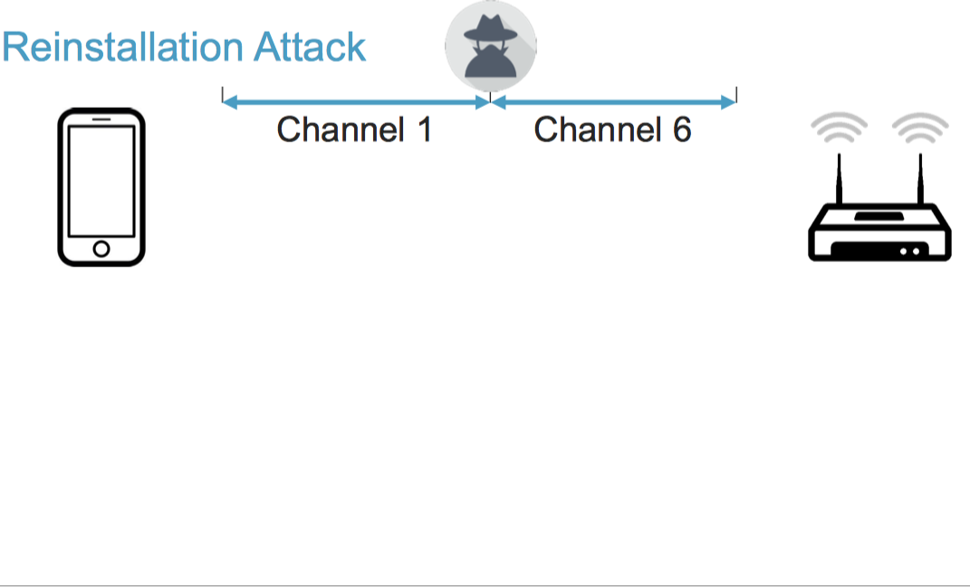
Key Reinstallation Attack (1)
MITM adversary
Adversary gains MITM position to manipulate messages exchanged
between client and AP
  E.g., clone access point on a different channel
  Delay or block messages
Adversary cannot decrypt messages, just manipulate messages

Slide 63
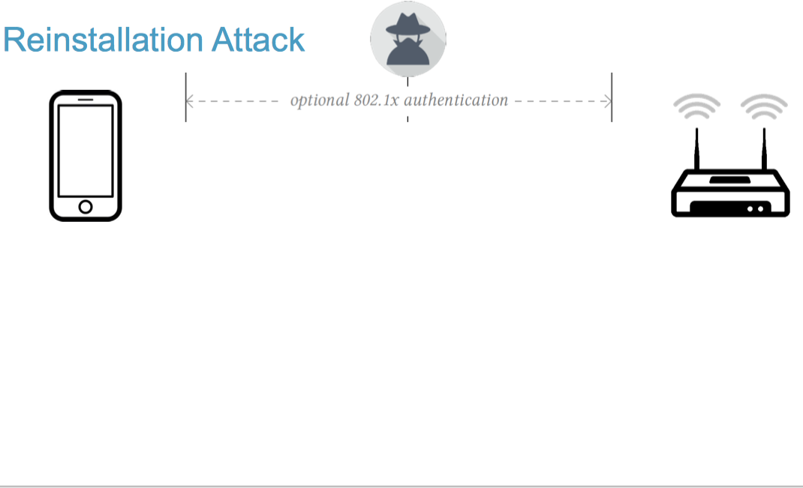
Key Reinstallation Attack (2)
If 802.1x authentication is used, adversary just forwards the messages

Slide 64
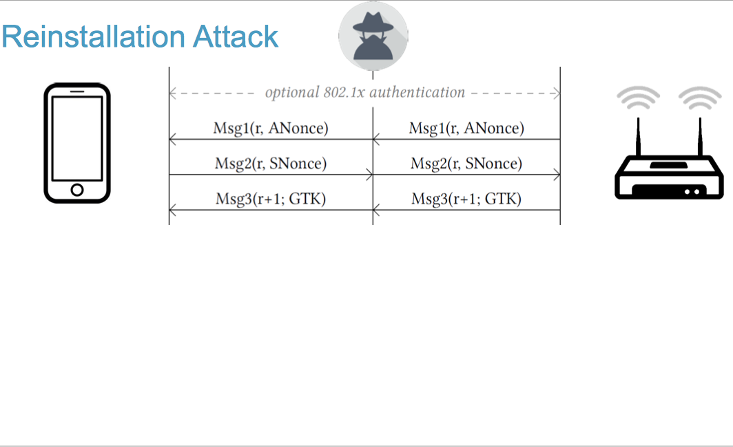
Key Reinstallation Attack (3)
Adversary forwards the first three messages of the exchange

Slide 65
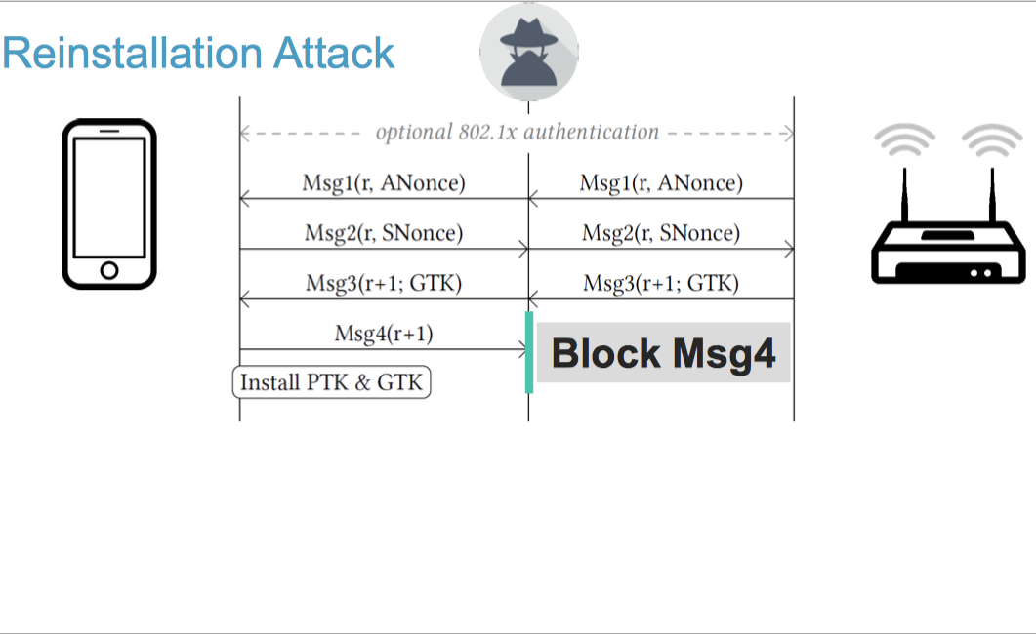
Key Reinstallation Attack (4)
Adversary blocks message 4 from the client
Client assumes that the handshake has completed and proceeds to install the key PTK; client is ready to encrypt data

Slide 66
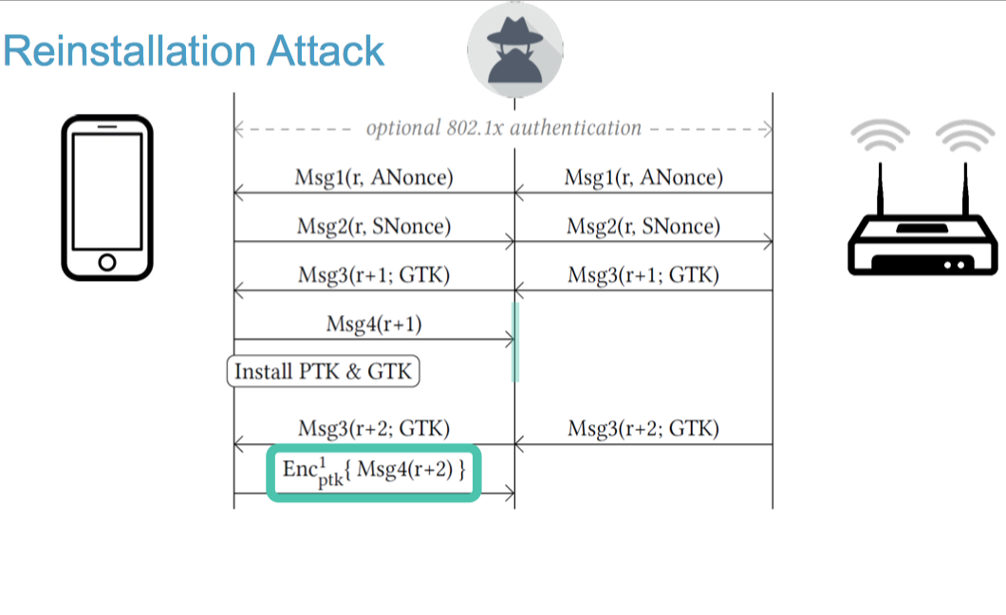
Key Reinstallation Attack (5)
Access point assumes that message 3 or client’s message 4 got dropped, proceeds to retransmit message 3
Client assumes previous message 4 got lost, proceeds to send a new message 4

Slide 67
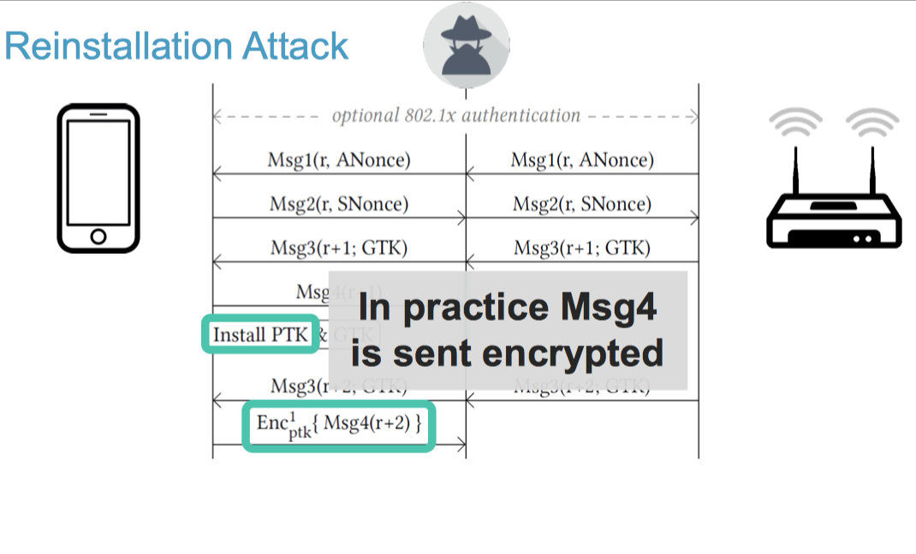
Key Reinstallation Attack (6)
Standards state that normally the new message 4 should not be encrypted with PTK, but in practice it is!

Slide 68
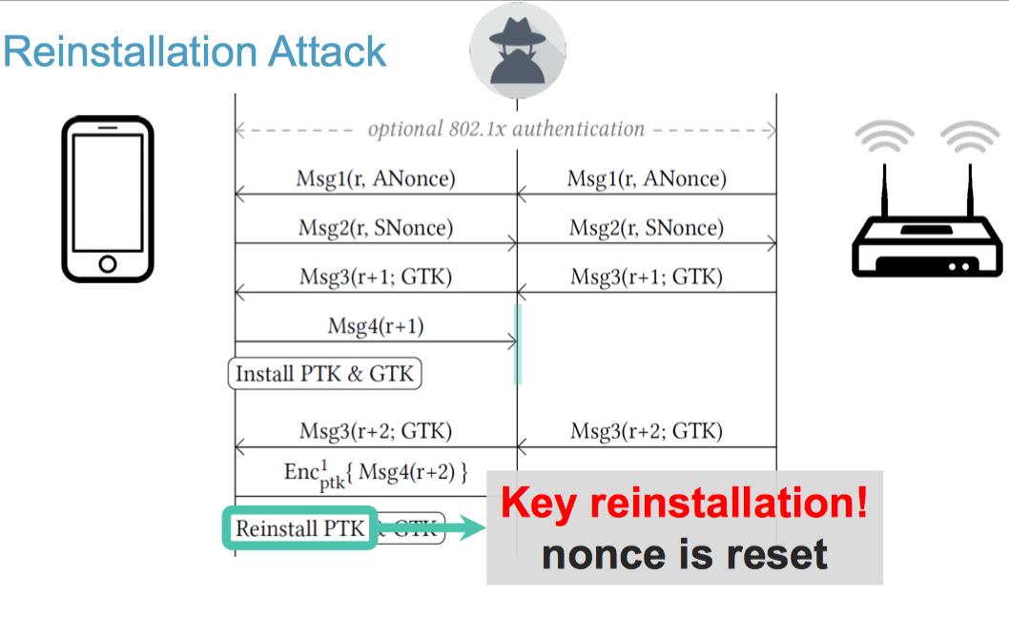
Key Reinstallation Attack (7)
The standards stipulates that Msg3 triggers key (re)installation
Same key PTK is reinstalled, nonce is reset to 0

Slide 69
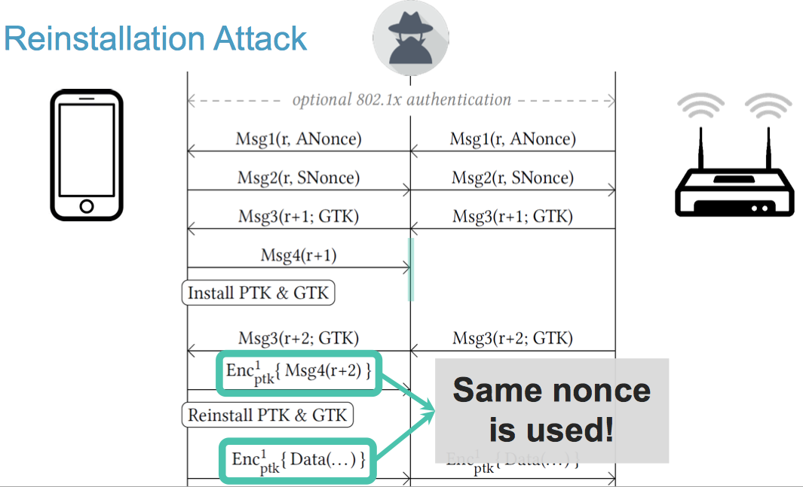
Key Reinstallation Attack (8)
New messages will be encrypted with the same nonce previously used

Slide 70
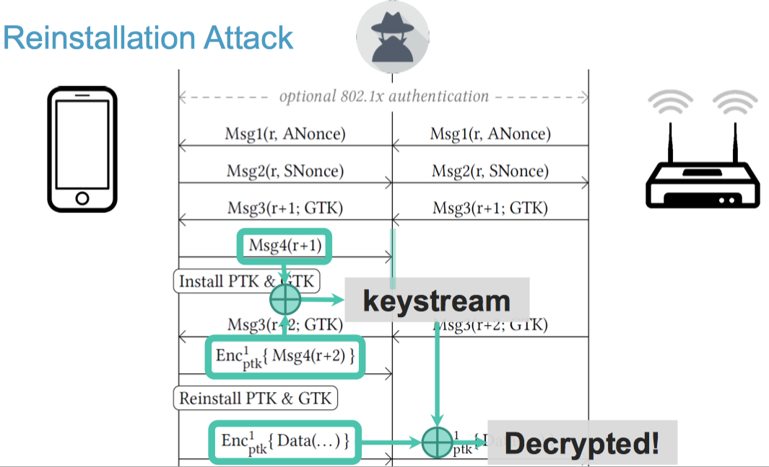
Key Reinstallation Attack (9)
Adversary can obtain--n bytes of the keystream (>80 bytes) and start decrypting messages

Slide 71
Key Reinstallation Attack: Impact
Nonce re-use = decrypt messages sent from client
Replay frames towards victim

Slide 72
Evolution of wireless security in WiFi
WEP: Flawed Algorithms / Flawed Protocol
  Stations can read each other's traffic (no PTK)
WPA: Flawed Algorithms / Flexible Protocol
  Introducing PTK but Algorithms still too weak
  Only GTK-encrypted messages are visible for all stations
WPA2: Secure Algorithms / Flexible Protocol / Impl. Flaws
  KRACK: Exploiting inconsistencies in specification and implementation.
WPA3: Forward Secrecy in case of leaked secrets
  Stronger Encryption, Rate Limiting
Parallel to Cellular security:
➔ Shifting from Protocol via Algorithms to Implementations

Slide 73
Wireless Network Security - Outline
Brief reminder of security and crypto principles
Challenges in Wireless Networks Security
Cellular Network Security
WiFi 802.11 Network Security
Wireless Pairing & Bluetooth

Slide 74
Device Pairing : Problem
In some settings, there is no central authority distributing the keys
  Wireless ad-hoc networks
  Bluetooth devices
  Internet of Things (in some cases)
Devices have to pair autonomously: set up keys for
  Encryption
  Message Authentication
Key establishment is easy over an authenticated channel
  Public-key cryptography (e.g. Diffie-Hellman)
  Symmetric key techniques (under special assumptions)
→ But it is rarely the case in practice

Slide 75

Device Pairing : Problem
Given a pair of wireless devices, how do they establish a secret key in the presence of an adversary either
  passive
  or active – MITM attack ? (MITM: « man-in-the-middle »)
We assume the devices have no preloaded keys / credentials as for WEP/WPA/WPA2-PSK
(e.g., two mobile phones, a phone and a printer, ...)
Here is my Public key
A
B
Thanks
M

Slide 76





Diffie-Hellman Protocol
The DH protocol enables secret key establishment in cleartext :
Based on the hardness of the Computational Diffie-Hellman problem:
Given a prime $p$, a generator $g$ of $Z_{p}^{∗}$ and elements $ga mod p$ and $gb mod p$, it is computationally difficult to find $gab mod p$.
Itself based on the hardness of the Discrete Logarithm problem :
Given $gxmod p$it is computationally difficuly to find $x$.
1. generate $a$
2. send $ga mod p$
3. compute
$$k = (gb mod p)a$$
$$ga mod p$$
1. generate $b$
2. send $gbmod p$
3. compute
$$k = (ga mod p)b$$
A
B
$$gb mod p$$

Slide 77




Diffie-Hellman Protocol (cont’d)
The DH protocol enables secret key establishment in cleartext :
DH fully resists passive attackers (eavesdropping only).
DH is not secure against active attackers (MITM attacks).
1. generate $a$
2. send $ga mod p$
3. compute
$$k = (gb mod p)a$$
$$ga mod p$$
1. generate $b$
2. send $gbmod p$
3. compute
$$k = (ga mod p)b$$
A
B
$$gb mod p$$
M

Slide 78


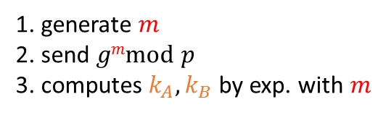




Diffie-Hellman Protocol (cont’d)
DH is not secure against active attackers (MITM attacks) :
Hence, messages need to be authenticated (which violates our requirement that devices have no preloaded keys )
Or, there need to exist a procedure to verify if the keys are identical
1. generate $a$
2. send $ga mod p$
3. compute
$$k_{A} = (gm mod p)a$$
A
B
1. generate $b$
2. send $gbmod p$
3. compute
$$k_{B} = (gm mod p)b$$
$$gm mod p$$
$$gm mod p$$
$$ga mod p$$
$$gb mod p$$
M
1. generate $m$
2. send $gmmod p$
3. computes $k_{A}, k_{B}$ by exp. with $m$

Slide 79
Device Pairing Examples
[1993] Maher: Short String Comparison
[2005] McCune et al: Seeing is Believing
[2005] Goodrich et al: Loud and Clear
[2006] Capkun, Cagalj, Hubaux: Integrity Regions

Slide 80







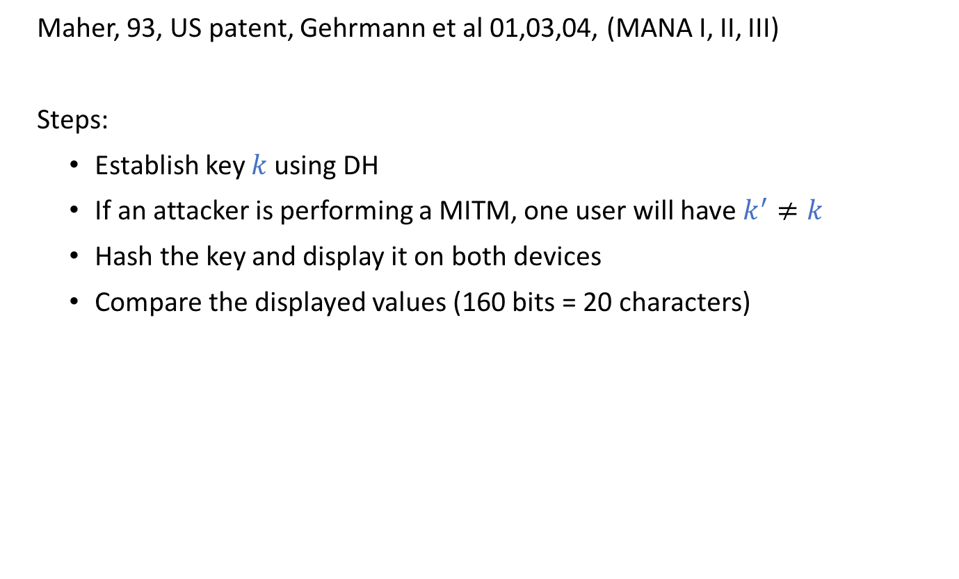

Device Pairing: Short String Comparison
Maher, 93, US patent, Gehrmann et al 01,03,04, (MANA I, II, III)
Steps:
Establish key $k$ using DH
If an attacker is performing a MITM, one user will have $k^{′}≠k$
Hash the key and display it on both devices
Compare the displayed values (160 bits = 20 characters)
A
Establish a shared $k$ with DH
B
$$s=text_display (SHA3\left(k\right))$$
$$s′=text_display (SHA3\left(k^{′}\right))$$
Visually compare $s$ and $s′$
$$s$$
$$s′$$
$$s=s^{′} k=k′$$
$$\overset{⇒}{\text{w}\text{ith} \text{high} \text{Prob}\text{.}}$$

Slide 81
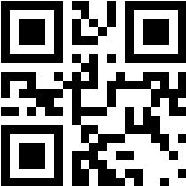

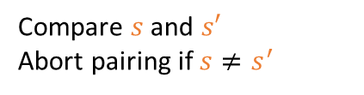




Device Pairing: Seeing is Believing
McCune et al. 05
Idea: Send the public witness of the key over an optical channel.
It uses the optical channel (in which it is impossible to perform a MitM attack steathily) to validate the key exchange
A
Establish a shared $k$ with DH
B
$$s=QR_ENCODE(SHA3\left(k\right))$$
$$s′=SHA3\left(k^{′}\right)$$
Optical channel
$$s=QR_DECODE(SHA3\left(k\right))$$
Compare $s$ and $s′$
Abort pairing if $s≠s^{′}$

Slide 82




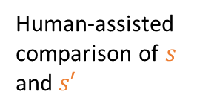
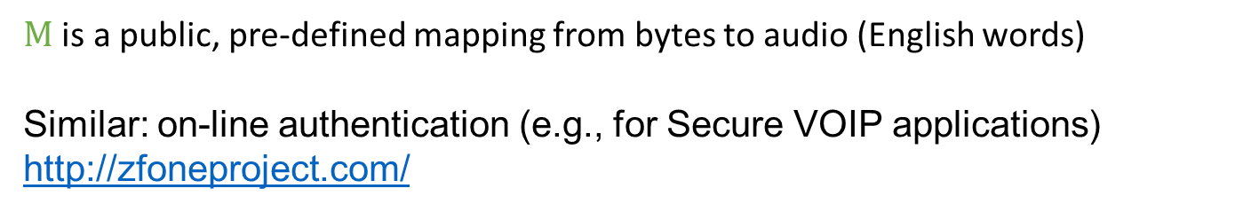

Device Pairing: Loud and Clear
Goodrich et al. 05
Idea : Human-assisted string comparison using voice communication
A
Establish a shared $k$ with DH
B
$$s=M(SHA3\left(k\right))$$
$$s′=M(SHA3\left(k^{′}\right))$$
Sends $s$over the cellular audio channel
Human-assisted comparison of $s$ and $s′$
$M$ is a public, pre-defined mapping from bytes to audio (English words)
Similar: on-line authentication (e.g., for Secure VOIP applications) http://zfoneproject.com/

Slide 83
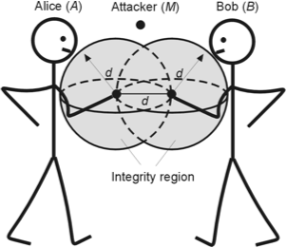
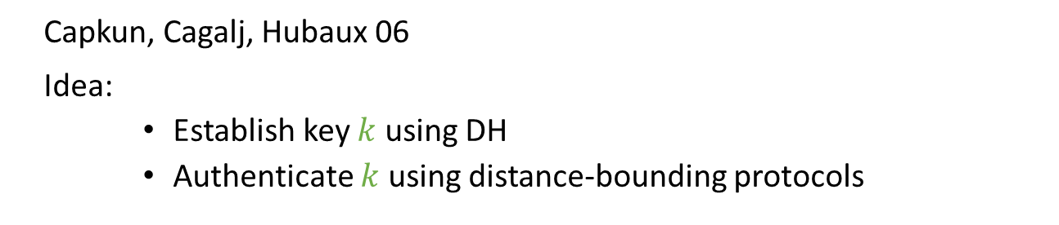
Device Pairing: Integrity Regions
Capkun, Cagalj, Hubaux 06
Idea:
  Establish key $k$ using DH
  Authenticate $k$ using distance-bounding protocols
Distance-bounding protocols are based on a proximity proof :
→ proves that devices are at most at distance X from each others
Assumption: “close-by devices are considered friendly”
These ideas were later used to launch a start-up company: https://www.3db-access.com

Slide 84
Device Pairing: Conclusion
Diffie-Hellman can be "protected" against MITM attacks
  MITM cannot be avoided, but can be detected
  … without previously established keys/certificates.
  … but assuming a side verification channel
Lots of approaches exploiting different side channels:
  physical contact
  string comparison (voice communication)
  image comparison (hash visualization)
  distance bounding (physical presence verification)

Slide 85
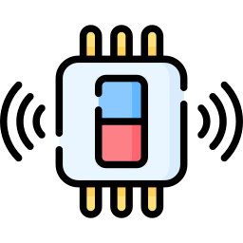




Case Study: Bluetooth LE
Pairing: establishing an encrypted connection
Bonding: Store information of pairing process to not repeat pairing on next connection

Slide 86
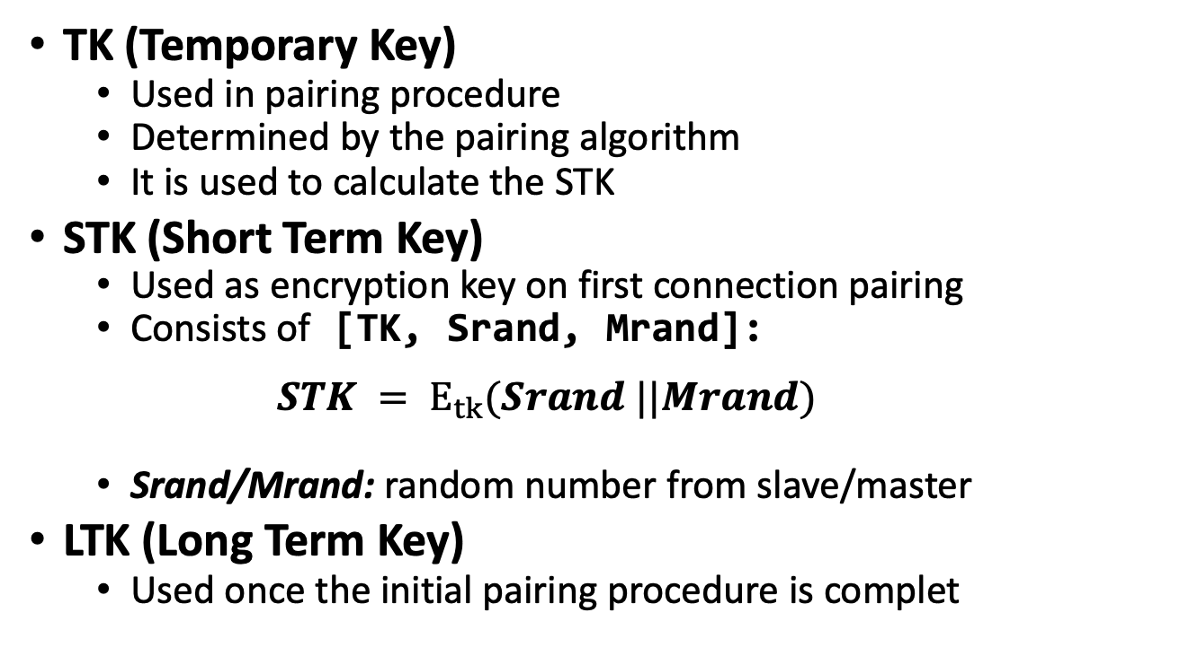
BLE Shared Keys
TK (Temporary Key)
  Used in pairing procedure
  Determined by the pairing algorithm
  It is used to calculate the STK
STK (Short Term Key)
  Used as encryption key on first connection pairing
  Consists of [TK, Srand, Mrand]:
  $STK = E_{tk}(Srand ||Mrand)$
  Srand/Mrand: random number from slave/master
LTK (Long Term Key)
  Used once the initial pairing procedure is complet

Slide 87
BLE Pairing Methods
Pairing Request
[[plain]] I/O capabilities, Auth. Requirements
[[Pairing Method]] Exchange TK
BLE 4.1
Just Works: Set TK to 0
  Can be brute-forced or sniffed
  Used for low-power no I/O devices
Out-of-Band: Use a different wireless technology
  E.g. NFC for proximity, mitigating a MITM attacker
Passkey Entry: 6 digit number exchanged by devices
  E.g. LCD shows 123456 and the other device’s keypad is used to confirm the numbers
  Can protect against passive eavesdropping
Numeric Comparison (4.2): Like JustWorks with extra verification
  Both devices independently generate 6-digit confirmation numbers
  User manually verifies the digits matching to assure no MITM attack

