Slide 1
Introduction to the fundamental concepts of signal processing

Slide 2
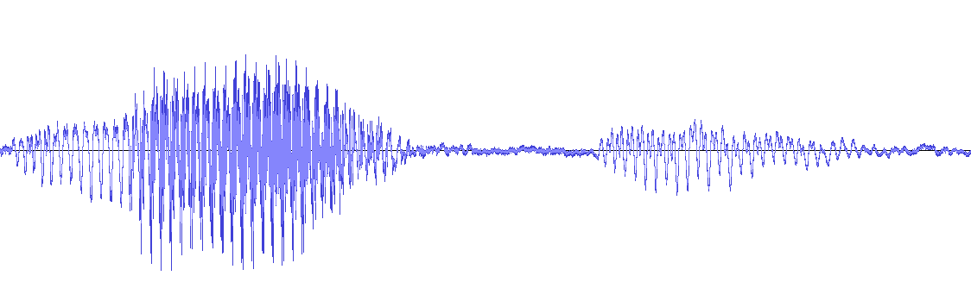
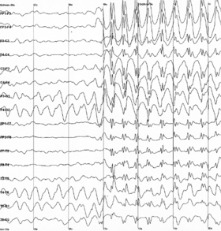
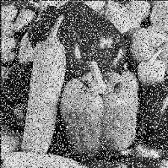
Why signal processing
Univariate speech signal
Bidimensional image
Multivariate EEG signal

Slide 3
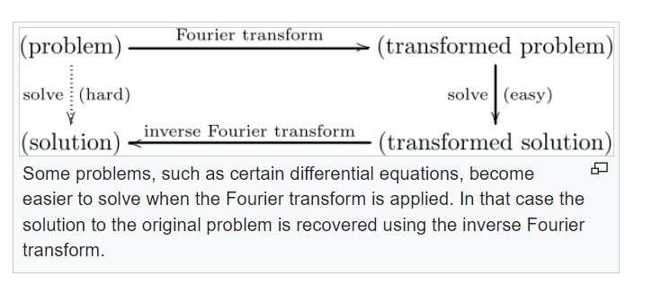
Why signal processing
*picture from wikipedia

Slide 4
I – Fourier Transform
A - Introduction

Slide 5
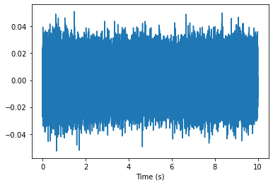
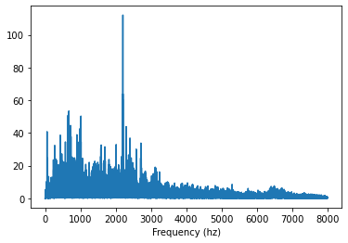
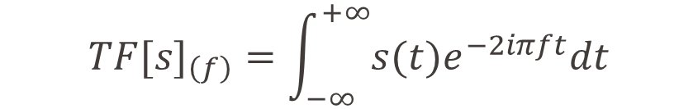
Fourier Transform
Considering a signal s:
$${TF[s]}_{\left(f\right)}=\int_{−∞}^{+∞}{s(t)e^{−2iπft}dt}$$
Input signal
Module of the fourier transform
TF

Slide 6
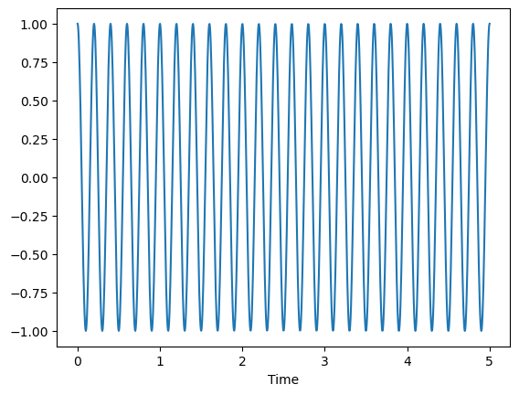
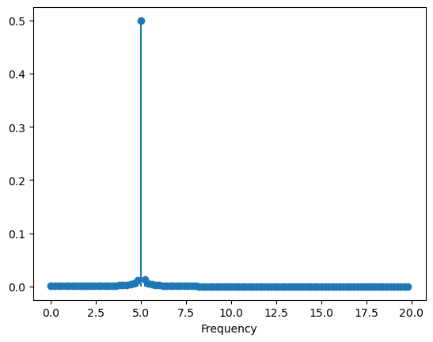
Fourier Transform
https://www.geogebra.org/m/t9uspumz#material/aenhzjpz
Time signal
FFT spectrum

Slide 7
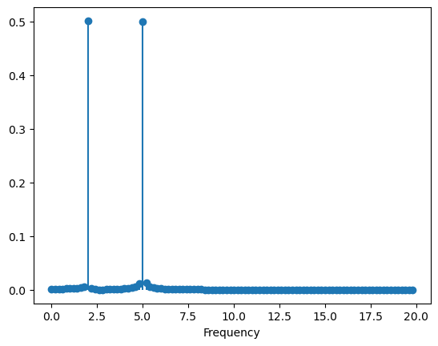
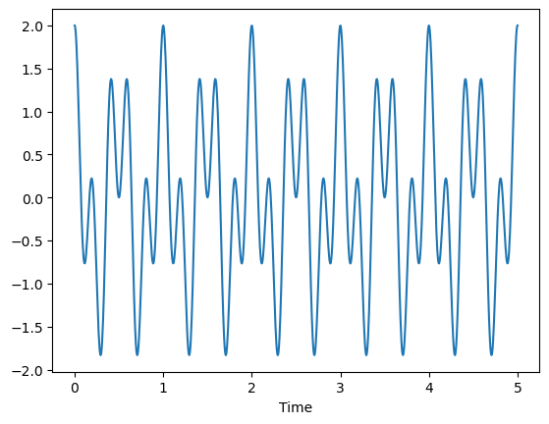
Fourier Transform
https://www.geogebra.org/m/t9uspumz#material/aenhzjpz
Time signal
FFT spectrum

Slide 8
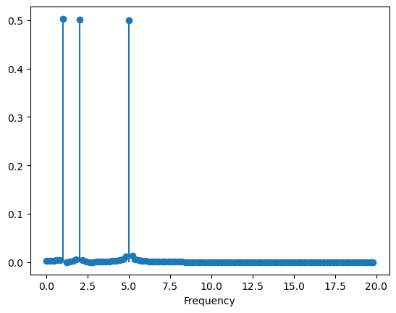
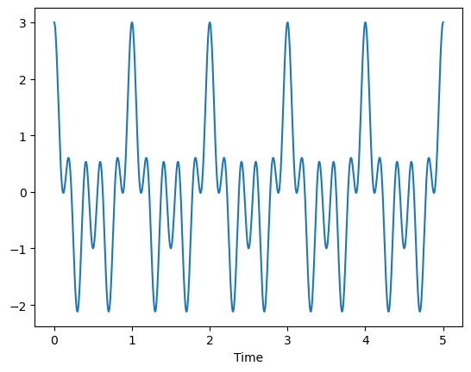
Fourier Transform
https://www.geogebra.org/m/t9uspumz#material/aenhzjpz
Time signal
FFT spectrum

Slide 9
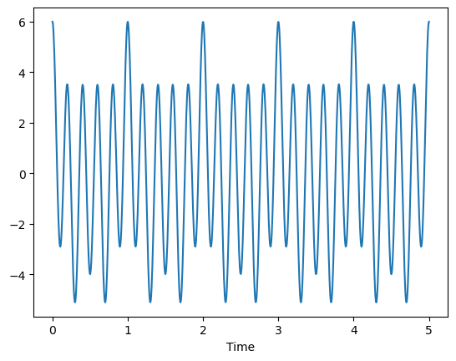
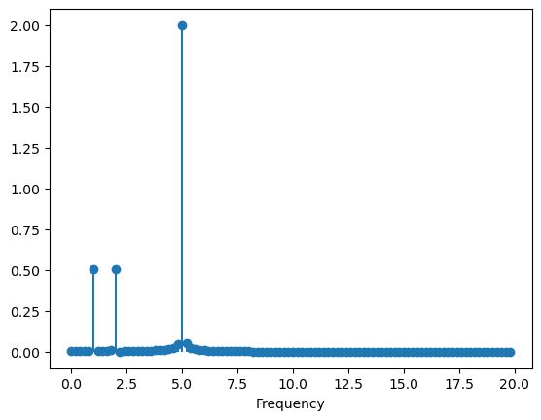
Fourier Transform
https://www.geogebra.org/m/t9uspumz#material/aenhzjpz
Time signal
FFT spectrum

Slide 10

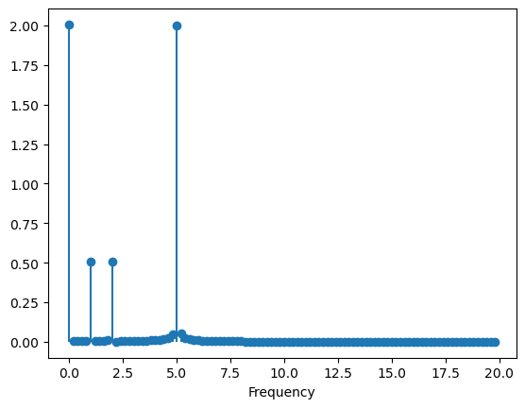
Fourier Transform
https://www.geogebra.org/m/t9uspumz#material/aenhzjpz
Time signal
FFT spectrum

Slide 11
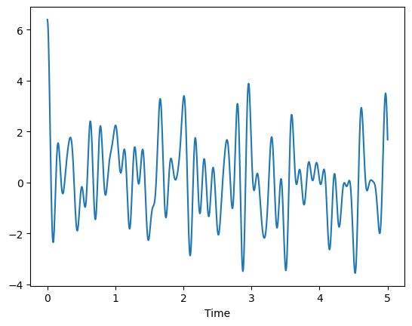
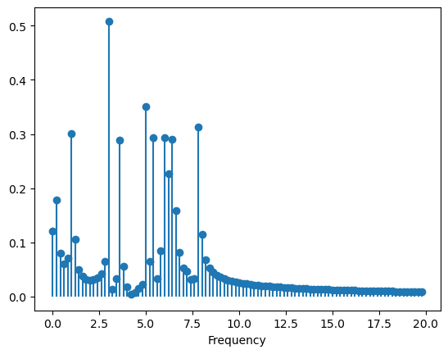
Fourier Transform
https://www.geogebra.org/m/t9uspumz#material/aenhzjpz
Time signal
FFT spectrum

Slide 12
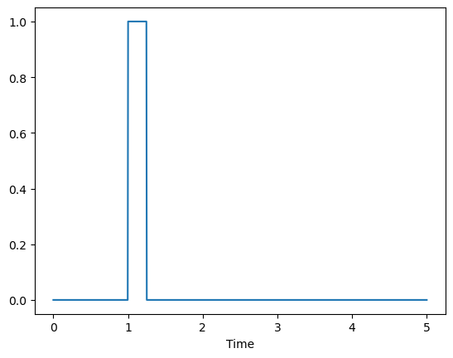
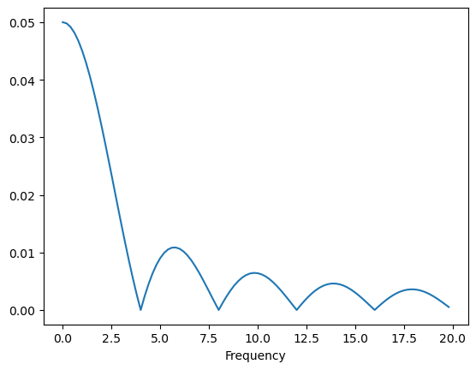
Periodicity in Fourier Transform
Time signal
FFT spectrum
If one is periodic, then the other is discrete
If one not periodic, the other is continuous
If one has finite support, the other has infinite support

Slide 13
I – Fourier Transform
B – Dirac function

Slide 14
Introduction to the Dirac distribution
$${TF[s]}_{\left(f\right)}=\int_{−∞}^{+∞}{s(t)e^{−2iπft}dt}$$
Exercise 1: Calculate the Fourier transform for the function s(t) = 1, considering both the specific case where f = 0 and cases where f ≠ 0.

Slide 15
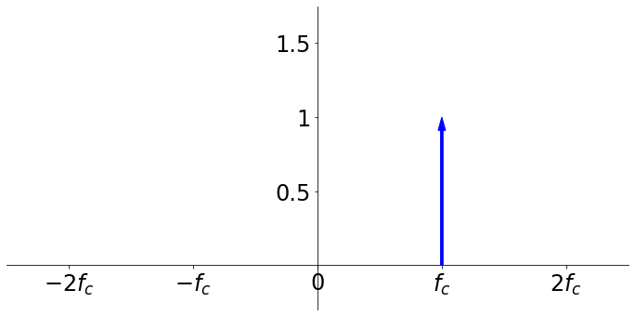
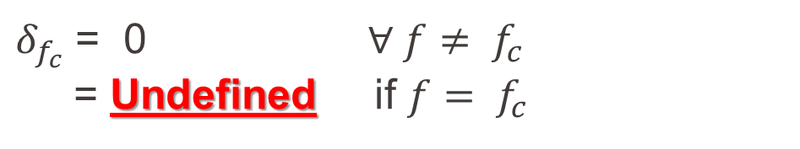
Why Dirac?
$δ_{f_{c}}$ = 0 $∀ f≠ f_{c}$
= Undefined if $f$ $= f_{c}$
Outcome of integrating a function with infinite energy yet finite power

Slide 16

The Dirac distribution
$δ_{f_{c}}$ = 0 $∀ f≠ f_{c}$
= Undefined if $f$ $= f_{c}$
Dirac is not a function but a mathematical object that has the following property:
$$\int_{−∞}^{+∞}{δ_{f_{c}}K\left(f\right)df=K(f_{c})}$$

Slide 17
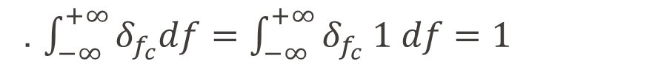
The Dirac distribution
$δ_{f_{c}}$ = 0 $∀ f≠ f_{c}$
= Undefined if $f$ $= f_{c}$
Note 1 : Integrate a dirac alone is equal to 1
. $\int_{−∞}^{+∞}{δ_{f_{c}}df=\int_{−∞}^{+∞}{δ_{f_{c}} 1 df=1}}$
Note 2 : Integrate can be «associated» to a real or complex number
. $\int_{−∞}^{+∞}{{(\frac{1}{2}δ}_{f_{c}})K\left(f\right)df=\frac{1}{2}\int_{−∞}^{+∞}{δ_{f_{c}}K\left(f\right)df=\frac{1}{2}K(f_{c})}}$

Slide 18
I – Fourier Transform
C – Amplitude, phase, frequency, spectrum

Slide 19
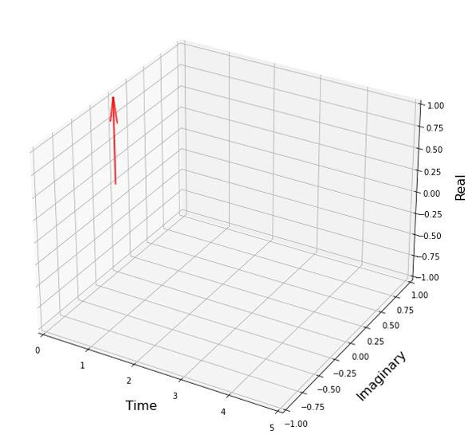


Concepts of amplitude, phase and frequency
- The complex exponential over time
(time)
$$e^{2iπf_{c}t}$$
TF
$$δ_{f_{c}}$$
(frequency)

Slide 20
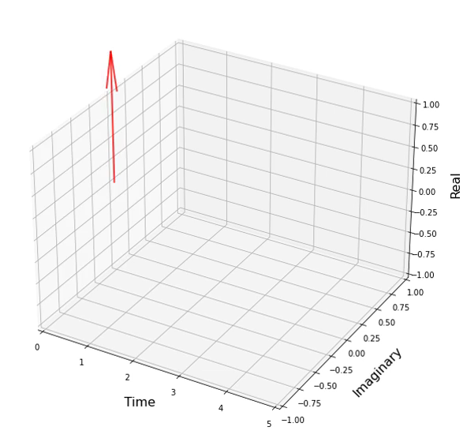
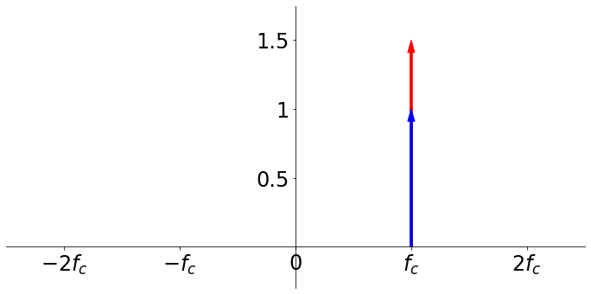


Concepts of amplitude, phase and frequency
- The amplitude: radius of the circle
(time)
$${1.5e}^{2iπf_{c}t}$$
TF
$${1.5δ}_{f_{c}}$$
(frequency)

Slide 21
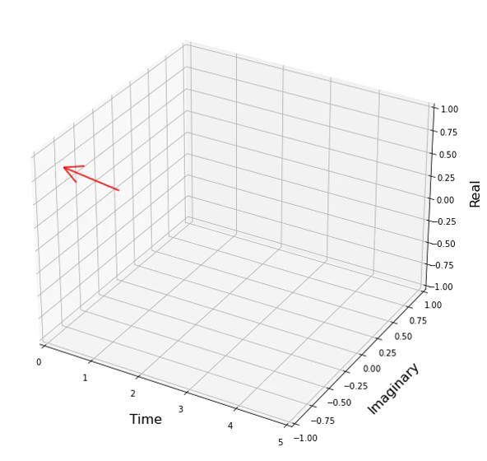
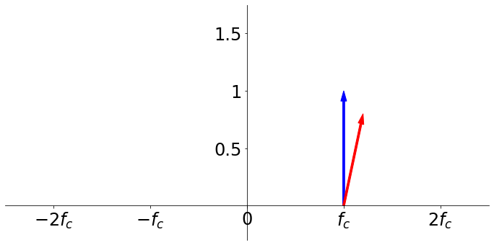


Concepts of amplitude, phase and frequency
- The phase: position at the origine or delay
(time)
$$e^{2iπ(f_{c}t−\frac{1}{8})}$$
TF
$$e^{−iπ/4}δ_{f_{c}}$$
(frequency)

Slide 22
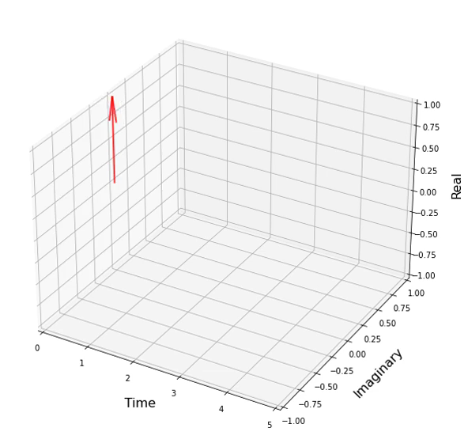
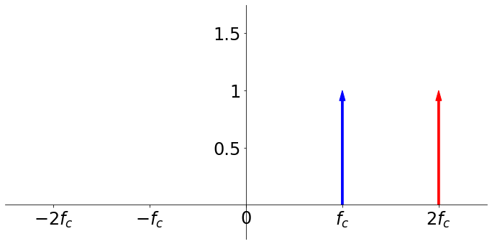


Concepts of amplitude, phase and frequency
- The frequency: it corresponds to the angular speed
(time)
$$e^{2iπ(2f_{c}t)}$$
TF
$$δ_{2f_{c}}$$
(frequency)

Slide 23
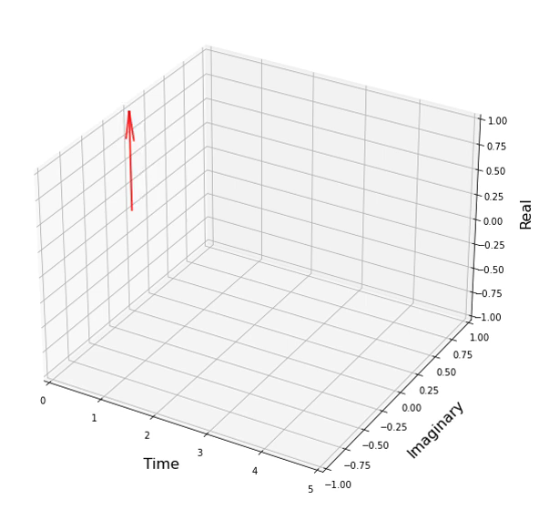
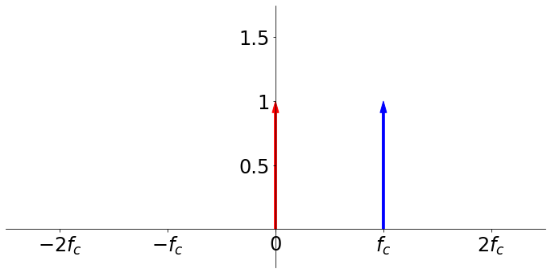


Concepts of amplitude, phase and frequency
- The frequency: it corresponds to the angular speed. Null speed:
(time)
$$e^{2iπ(0f_{c}t)}=1$$
TF
$$δ_{0}$$
(frequency)

Slide 24

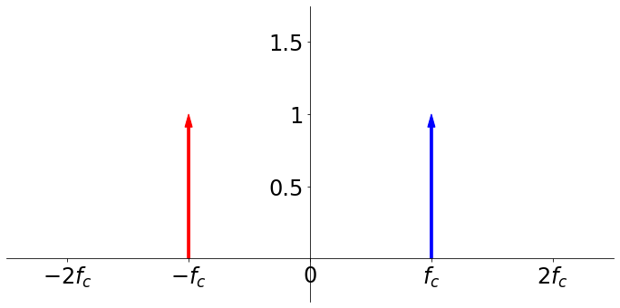


Concepts of amplitude, phase and frequency
- The negative frequency: rotation in the opposite direction
(time)
$$e^{−2iπf_{c}t}$$
TF
$$δ_{−f_{c}}$$
(frequency)

Slide 25
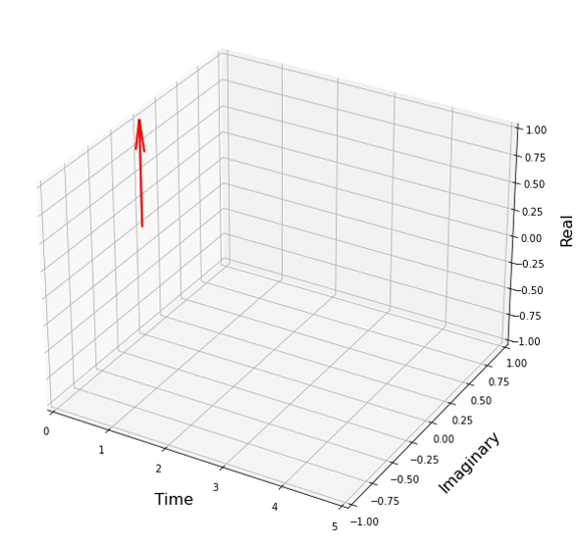
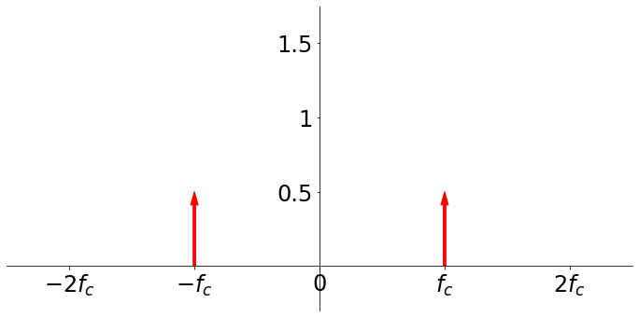

Understand the Fourier Transform of the cosinus
TF[cos($2πf_{c}t$)] =${ 1/2(δ}_{−f_{c}}+{ δ}_{f_{c}})$

Slide 26
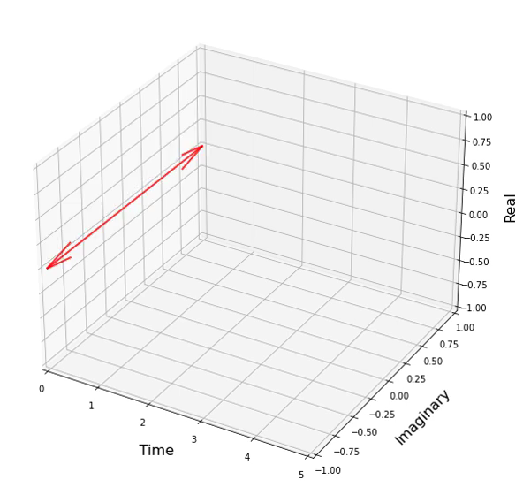
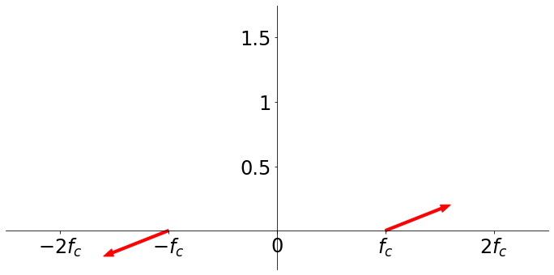

Understand the Fourier Transform of the sinus
TF[sin($2πf_{c}t$)] =${ −i/2(δ}_{−f_{c}}−{ δ}_{f_{c}})$

Slide 27
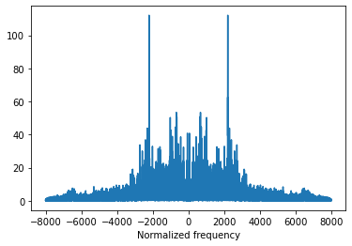
Additional comments
1. Be carefull: Fourier transform is different from a spectrum (modulus of the FT)
2. The spectrum of a real function is symmetric about 0
FT of the sinus function
Spectrum of the sinus function
(cosinus and sinus share same spectrum)

Slide 28
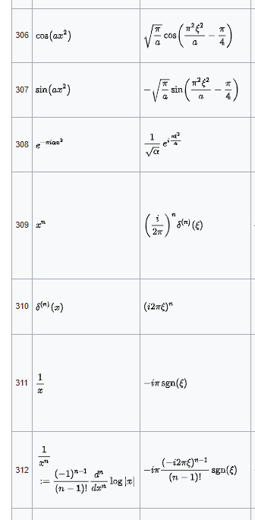
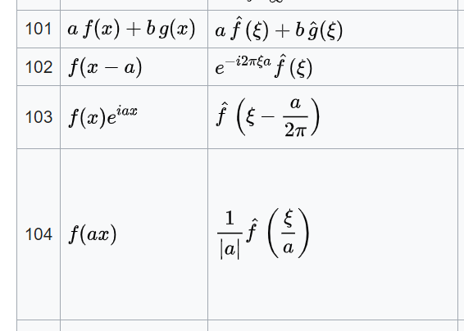
How to compute Fourier Transform
Most FT of basic function can be found (ex wikipedia):
Combined with FT properties

Slide 29
II – Discrete signal

Slide 30
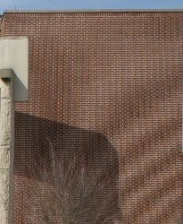
Moiré pattern
Why those patterns sometimes appear on images?

Slide 31
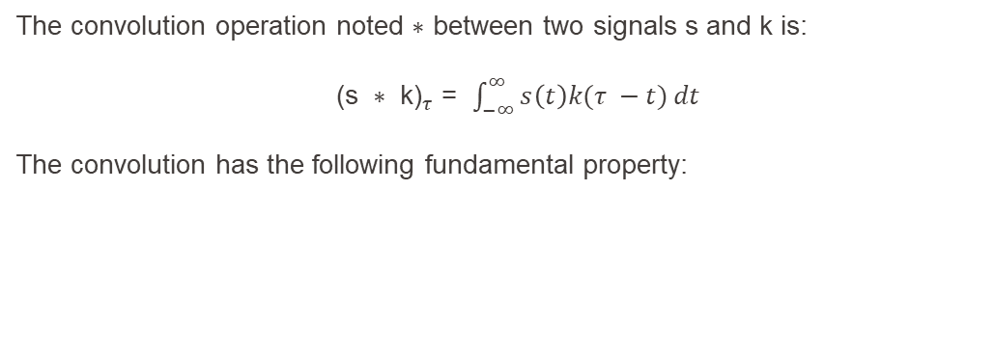
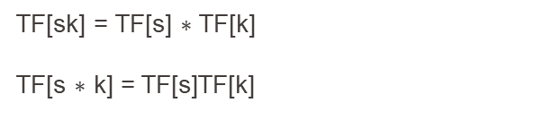
Convolution
The convolution operation noted $∗$ between two signals s and k is:
${ \text{(}\text{s} ∗ \text{k}\text{)}}_{τ}$ = $\int_{−∞}^{∞}{s\left(t\right)k(τ −t)}dt$
The convolution has the following fundamental property:
TF[sk] = TF[s] $∗$ TF[k]
TF[s $∗$ k] = TF[s]TF[k]

Slide 32
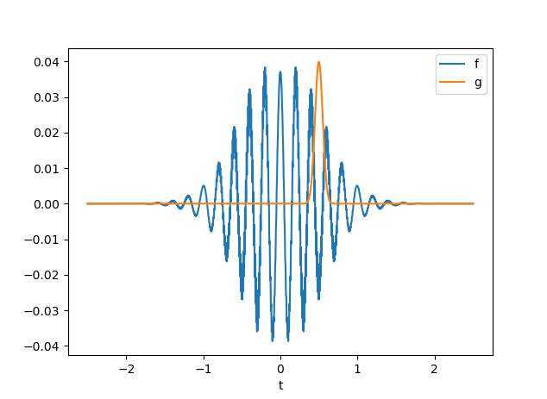

Example
${ \text{(}\text{s} ∗ \text{k}\text{)}}_{τ}$=$\int_{−∞}^{∞}{s\left(t\right)k(τ −t)}dt$

Slide 33
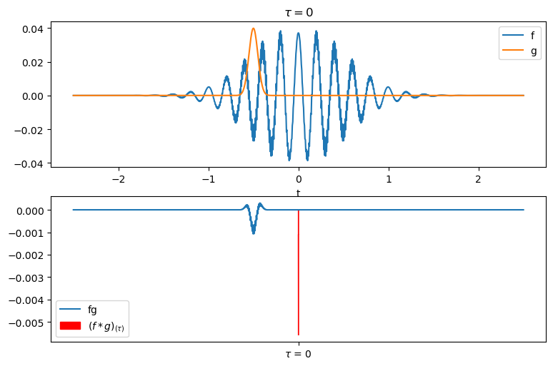

Example
${ \text{(}\text{s} ∗ \text{k}\text{)}}_{τ}$=$\int_{−∞}^{∞}{s\left(t\right)k(τ −t)}dt$

Slide 34
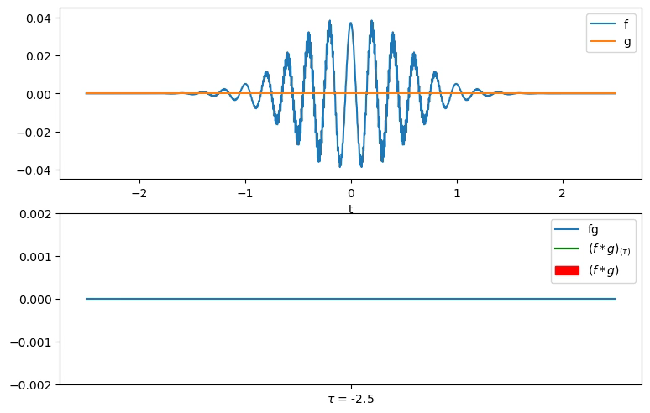

Slide 35
Convolution
The convolution operation noted $∗$ between two signals s and k is:
${ \text{(}\text{s} ∗ \text{k}\text{)}}_{τ}$ = $\int_{−∞}^{∞}{s\left(t\right)k(τ −t)}dt$
The convolution has the following fundamental property:
TF[sk] = TF[s] $∗$ TF[k]
TF[s $∗$ k] = TF[s]TF[k]
Exercice 2: Calculate the convolution between $\cos\left(2πFt\right)$and $δ_{T}=δ\left(t−T\right)$by two different ways

Slide 36
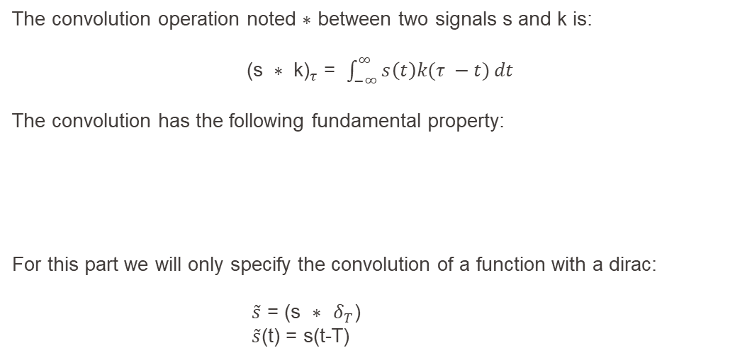
Convolution
The convolution operation noted $∗$ between two signals s and k is:
${ \text{(}\text{s} ∗ \text{k}\text{)}}_{τ}$ = $\int_{−∞}^{∞}{s\left(t\right)k(τ −t)}dt$
The convolution has the following fundamental property:
For this part we will only specify the convolution of a function with a dirac:
$\tilde{s}$ = (s $∗$ $δ_{T}$)
$\tilde{s}$(t) = s(t-T)
TF[sk] = TF[s] $∗$ TF[k]
TF[s $∗$ k] = TF[s]TF[k]

Slide 37
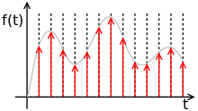
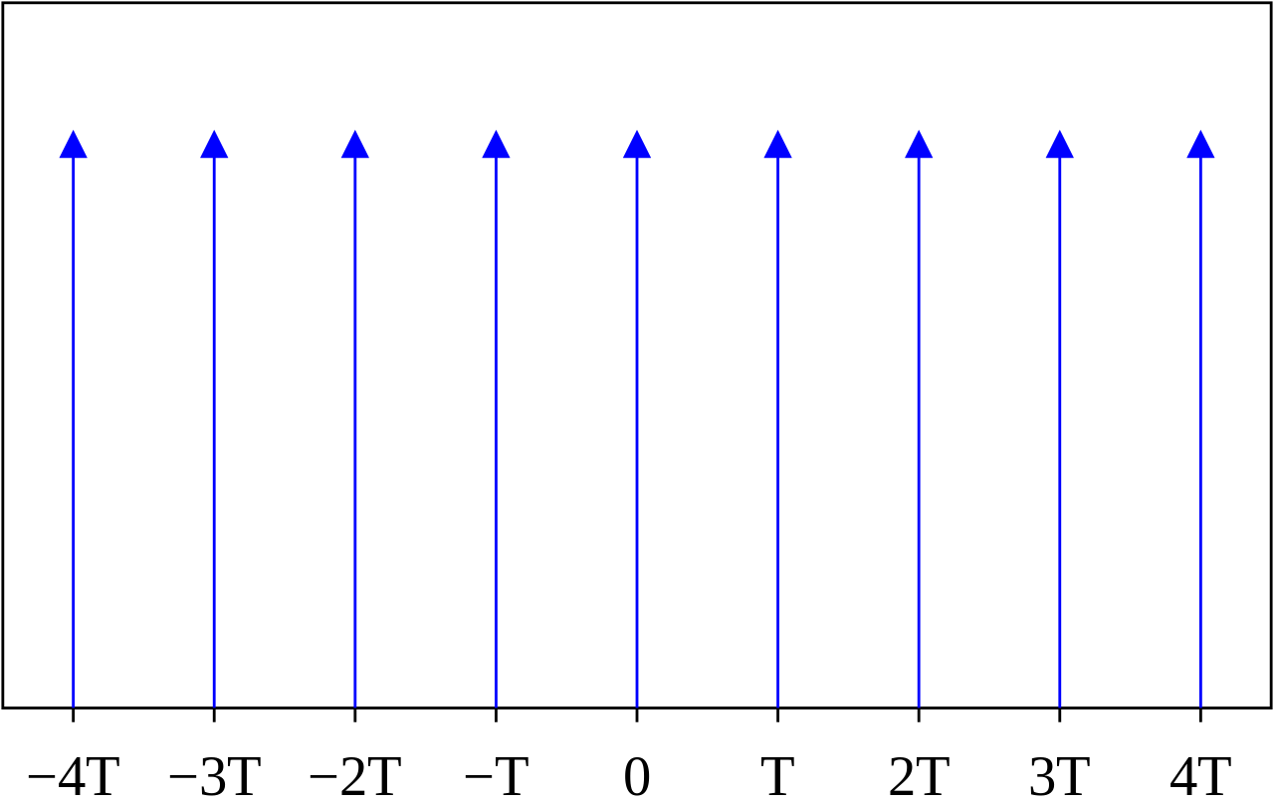
What is a discrete signal
Multiplication of a continuous signal with a Dirac comb

Slide 38



What is a discrete signal
s(t)
TF[s](f)
(spectrum)
TF
t
f
X (times)
$∗$ (convolution)
$$III(t)$$
$$TF\left[III\right]\left(f\right)$$
(spectrum)
TF
T
1/T
t

Slide 39
What is a discrete signal
TF[f](f)
(spectrum)
TF
f

Slide 40
What is a discrete signal
TF[f](f)
(spectrum)
TF
f
TF
…

Slide 41
What is a discrete signal
TF[f](f)
(spectrum)
TF
f
TF[f](f)
(spectrum)
TF
…
f

Slide 42
What is a discrete signal
TF[f](f)
(spectrum)
TF
f
TF

Slide 43
What is a discrete signal
TF[f](f)
(spectrum)
TF
f
TF[f](f)
(spectrum)
TF
f

Slide 44
What is a discrete signal
TF[f](f)
(spectrum)
TF
f
TF[f](f)
(spectrum)
TF
Aliasing
f

Slide 45
Moiré pattern
High frequencies became low frequencies artifacts due to subsampling

Slide 46

Shannon Nyquist theorem
If s(t) contains no frequency higher than $F_{max}$ Hz,
Then,
It is completely determined by giving its ordinates at a series of points spaced $\frac{1}{2F_{max}}$
(Or the sampling frequency should be higher than $2F_{max}$)

Slide 47
Discrete FFT representation
TF[f](f)
(spectrum)
f
1
0
-0,5
0,5
1/Ts =Fs
Max freq 0,5 Fs

Slide 48
Discrete FFT representation
Module of the fourier transform
TF[f](f)
(spectrum)
f
1
0
-0,5
0,5
times Fs
0
0,5

Slide 49
III – Filtering

Slide 50
Filtering: Low pass filter
Module of the fourier transform

Slide 51
Filtering: Low pass filter
Remove frequencies above f0
Module of the fourier transform

Slide 52
Filtering: High pass filter
Module of the fourier transform

Slide 53
Filtering: High pass filter
Remove frequencies below f0
Module of the fourier transform

Slide 54
Filtering: Band pass filter
Module of the fourier transform

Slide 55
Filtering: Band pass filter
Remove frequencies outside the support f1-f2
Module of the fourier transform

Slide 56
Filtering: Stop band filter (or cut band)
Module of the fourier transform

Slide 57
Filtering: Cut band filter
Remove frequencies inside the support f1-f2. Also called Notch filter if the support is tight
Module of the fourier transform

Slide 58
Decimation: Filtering + Subsampling
Before subsampling by a factor N, use a lowpass filter that remove frequencies above fs/(2*N) to avoid aliasing
Module of the fourier transform

Slide 59


Filtering via convolution

Slide 60

Filtering via convolution

Slide 61

Filtering via convolution

Slide 62

Filtering via convolution

Slide 63
Filtering via convolution
Low-pass filter

Slide 64

Filtering via convolution
High-pass filter

Slide 65
Filtering via convolution
Trade-of precision of the cutting frequency vs riples

Slide 66

Filtering via convolution
Trade-of precision of the cutting frequency vs riples

Slide 67

Filtering with numpy
Filter family:
Butter=Butterworth
Other family:
Chebyshev, elliptic, gaussian, bessel
Coefficients that characterise the filter
Create the filter:
Lowcut=High-pass cutoff frequency
Highcut=Low-pass cutoff frequency
Fs=sampling frequency
Order =related to the number of coefficients

Slide 68

Moiré pattern
Apply low pass before: decimation
High frequencies became low frequencies artifacts due to subsampling

