Slide 1
Scientific literature analysis in neuroscience
BIOENG-451
Accademic year: 2025-2026
Teacher: Prof. Gioele La Manno
TA: Alessandro Valente
Mock JC presentation
17.09.25

Slide 2
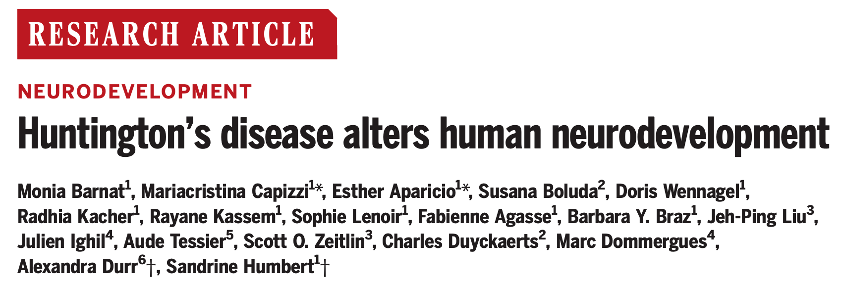

Slide 3
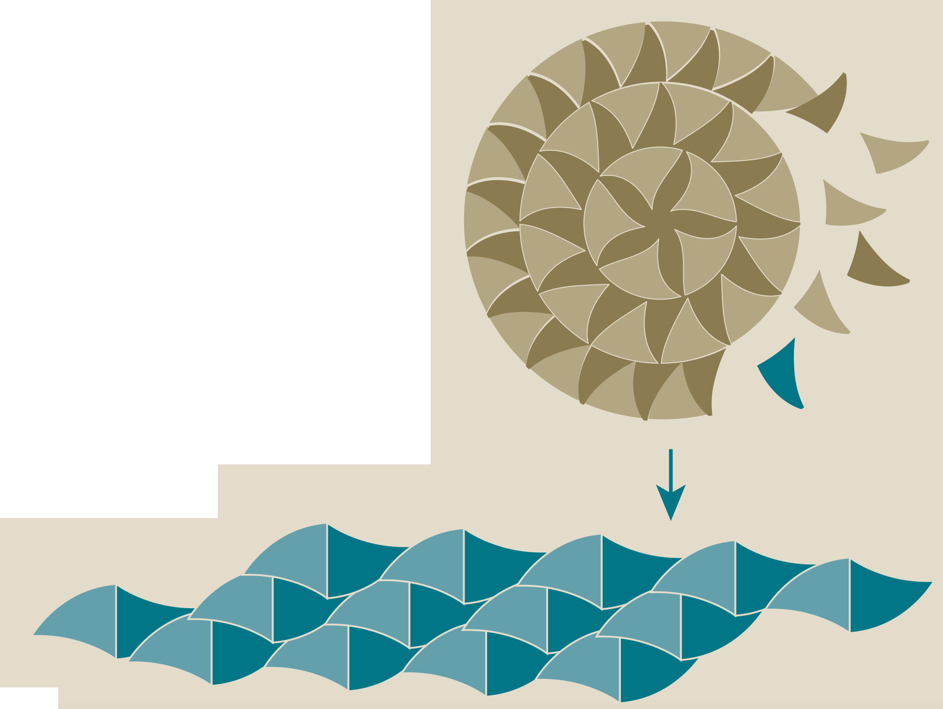
Huntington’s disease at a glance
Huntington disease is an autosomal dominant neurological disorder caused by mutation in the HTT gene
HTT encodes the protein huntingtin, which has several functions that are not completely understood
CAG repeat lengths of ≥40 units are disease-causing and highly penetrant
Glutamine (Q) repeats over this number forms fibrils that aggregates – proteinopathy
Gln repeats
Gln aggregates
From mouse studies we know that during brain development HTT is important for neural progenitor cell division and neuronal migration and maturation
How mutant HTT impairs human brain development?

Slide 4
How does mutated HTT affect the apical junctional complex in radial glia cells?

Slide 5
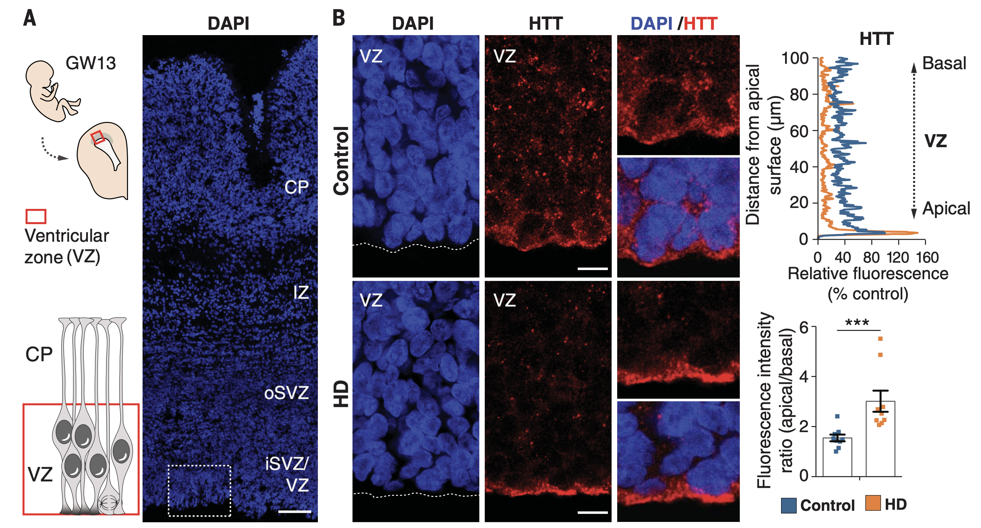
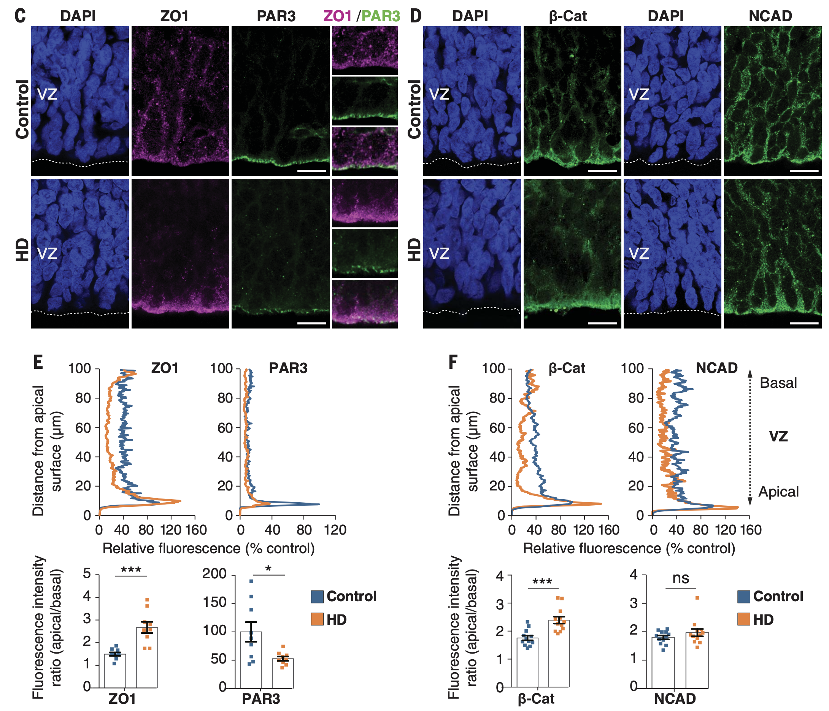
Figure 1
E
F
ZO1 and b-Catenin are more enriched in the apical side in mHTT
PAR3 is more enriched in the apical side in controls
NCAD is stable between different conditions
HTT and junctional complex proteins mis-localize in the VZ of human foetuses with HD-causing mutations

Slide 6
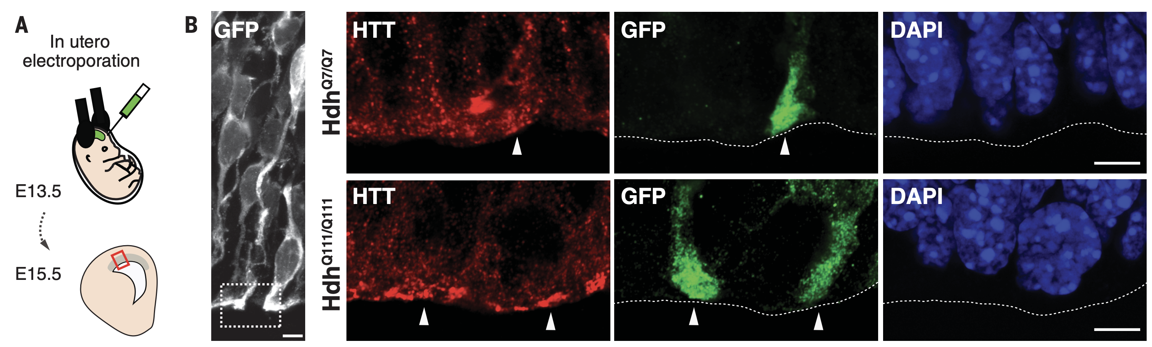
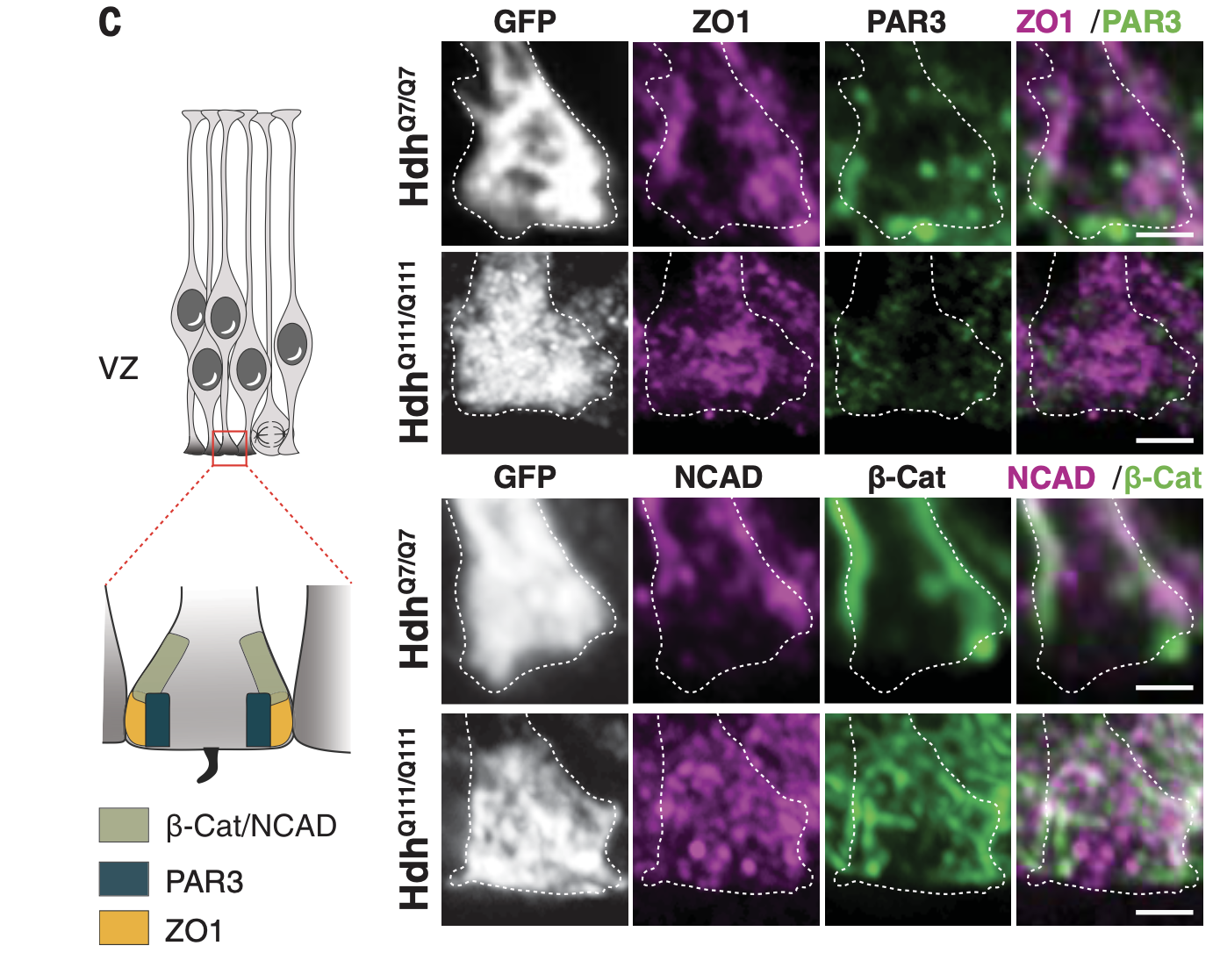
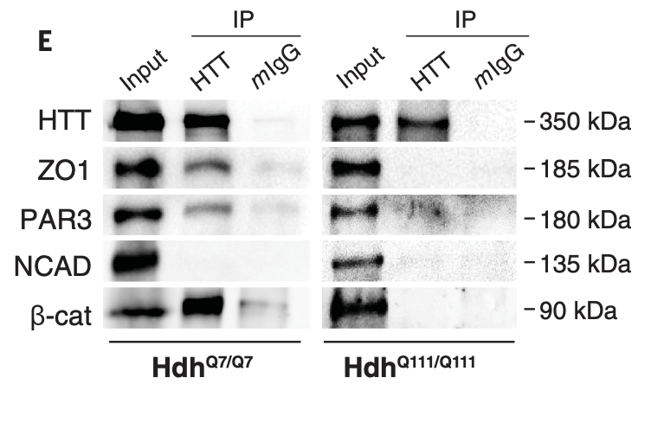
Junctional protein complexes are disrupted in the apical end-feet of HD mouse embryos
Figure 2
pCAG-GFP
Immunoprecipitation
HTT associates with ZO1, PAR3, and b-catenin.
These interactions were disrupted in HD
Junctional protein mislocalize at the apical end-feet of radial glia cells

Slide 7
How does mutated HTT affect the cell cycle and proliferation of radial glia cells ?

Slide 8
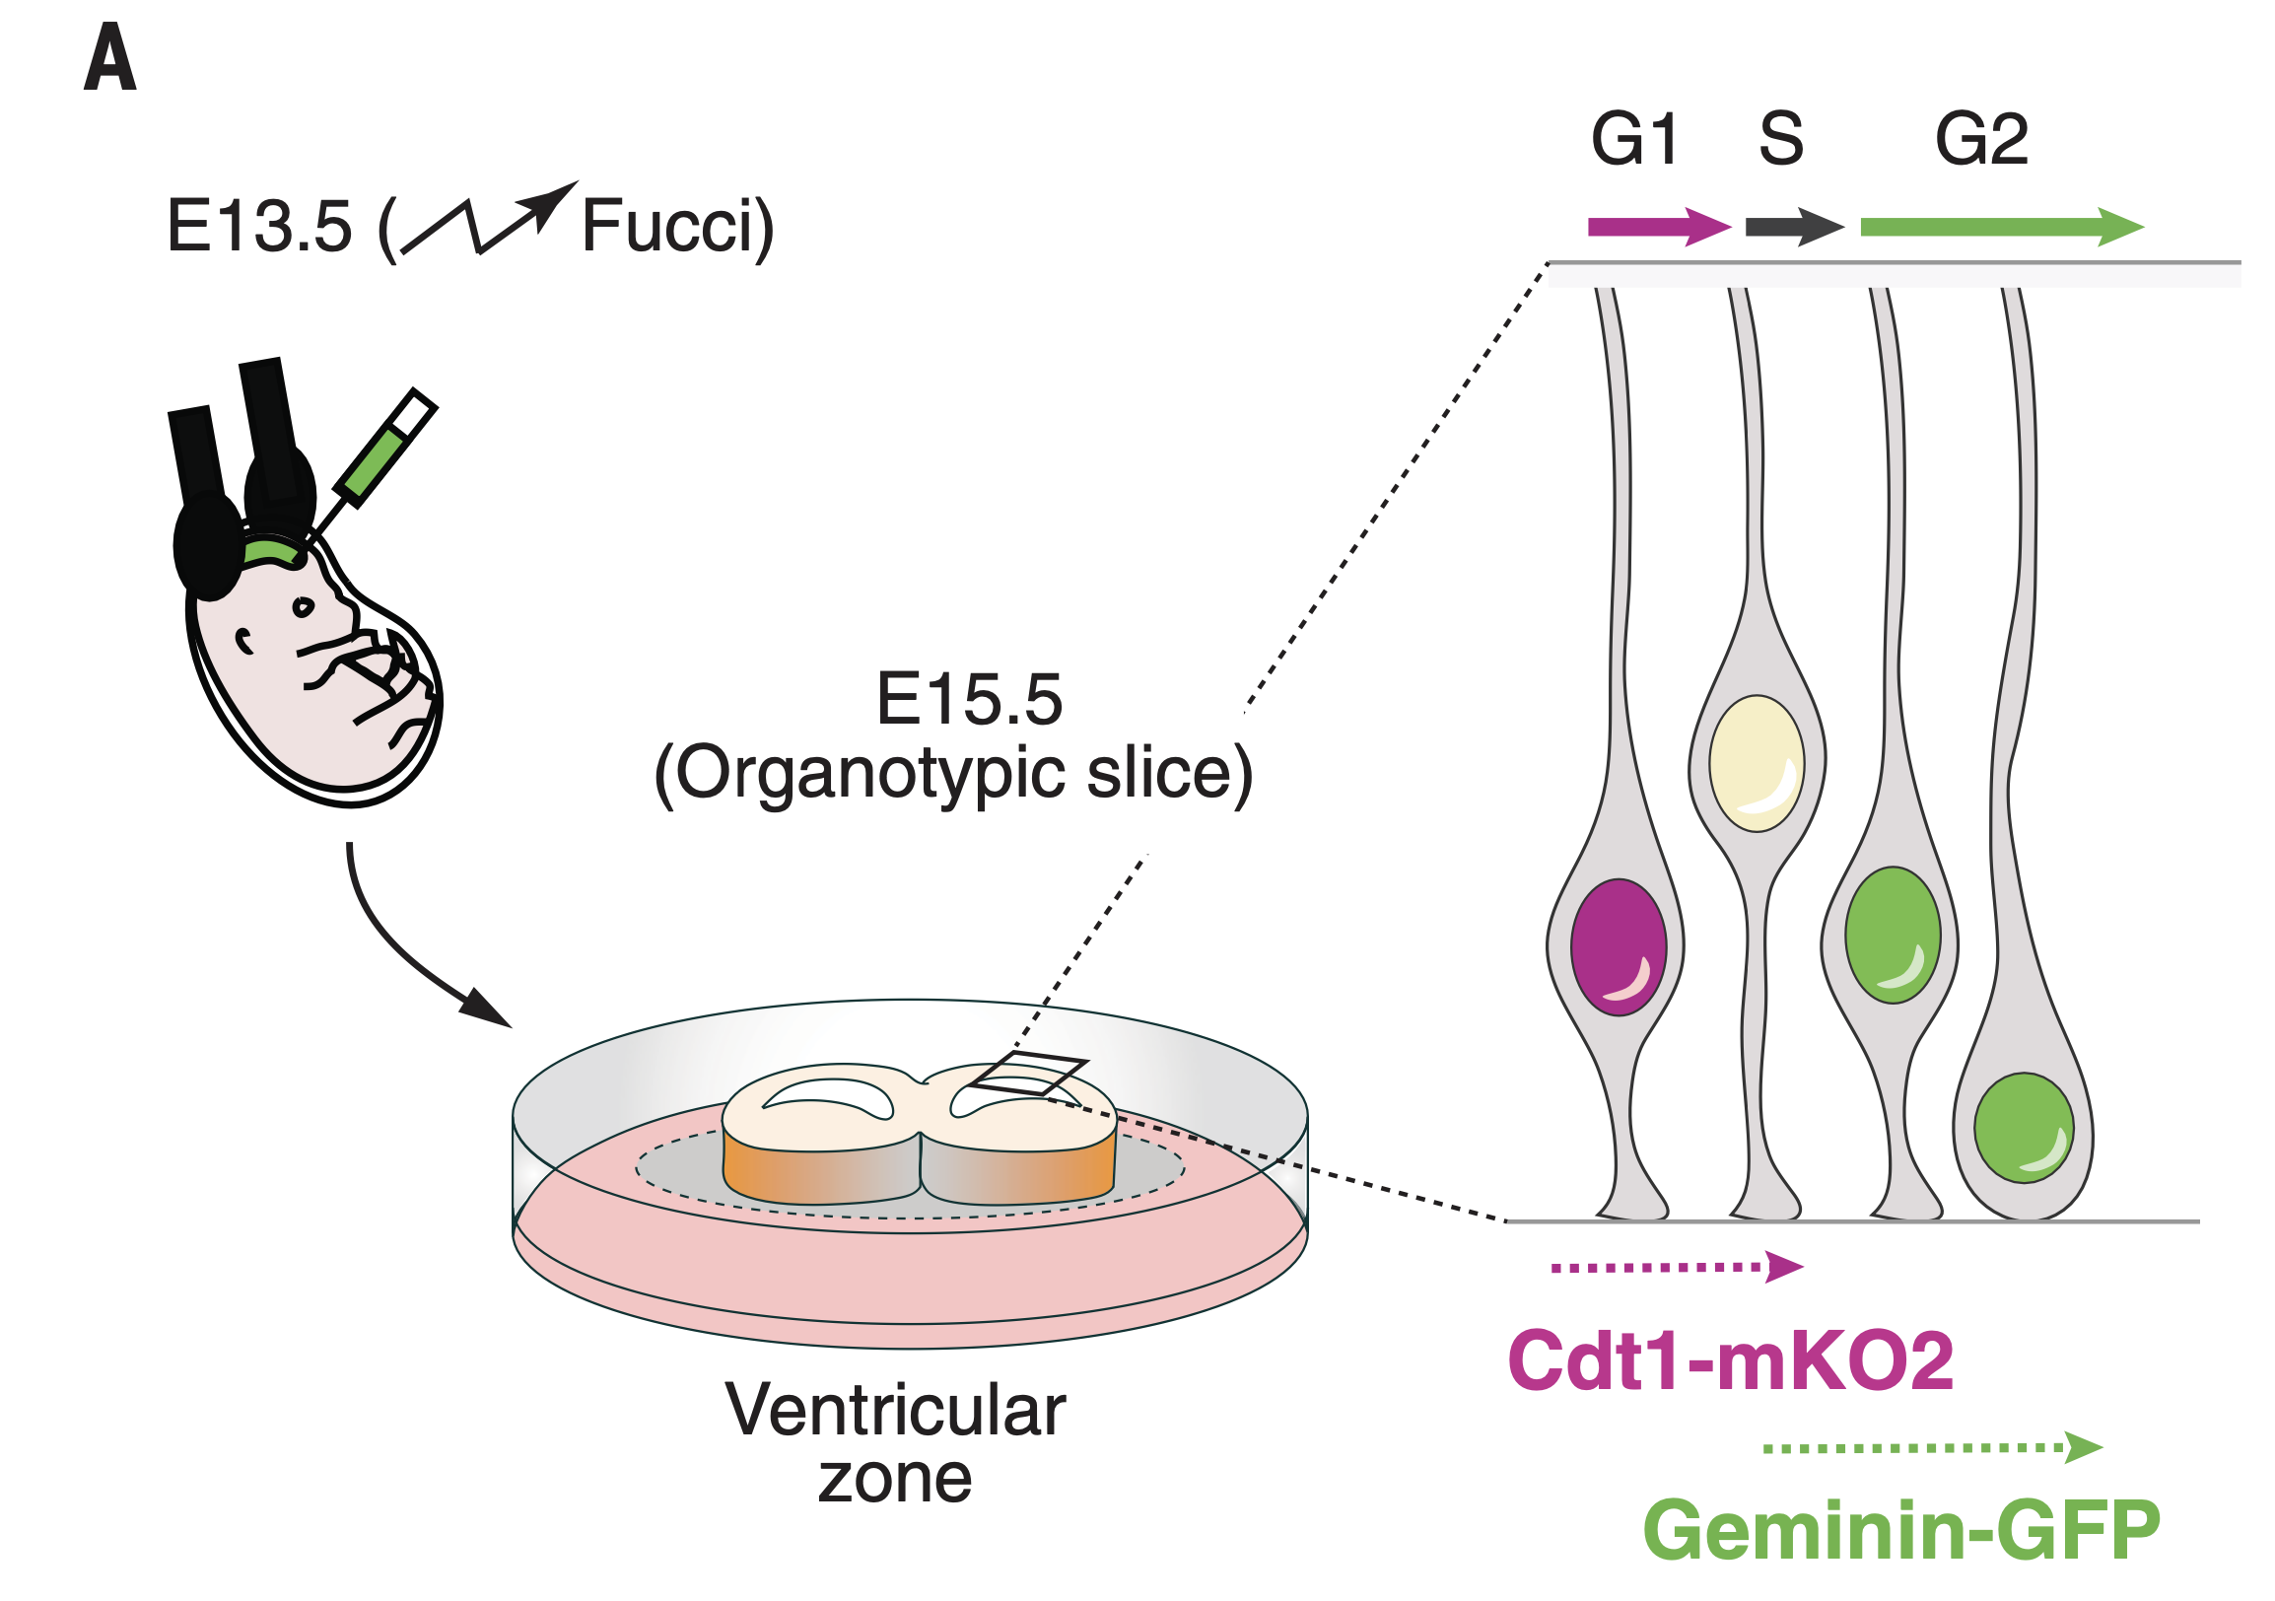
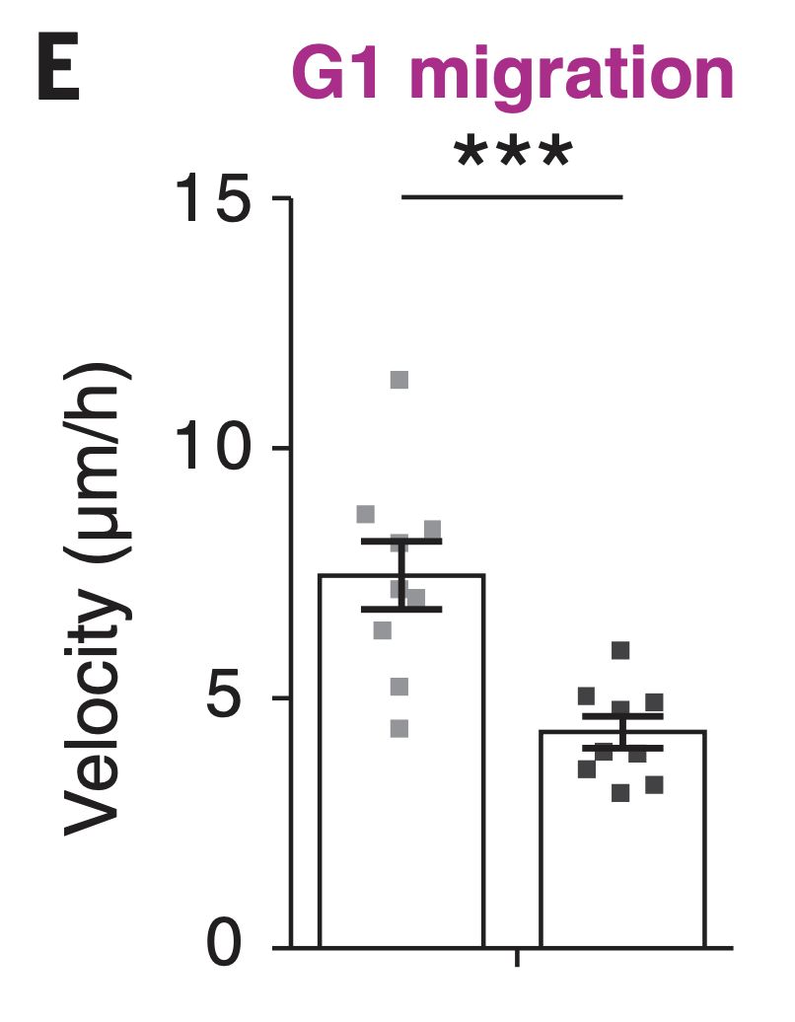
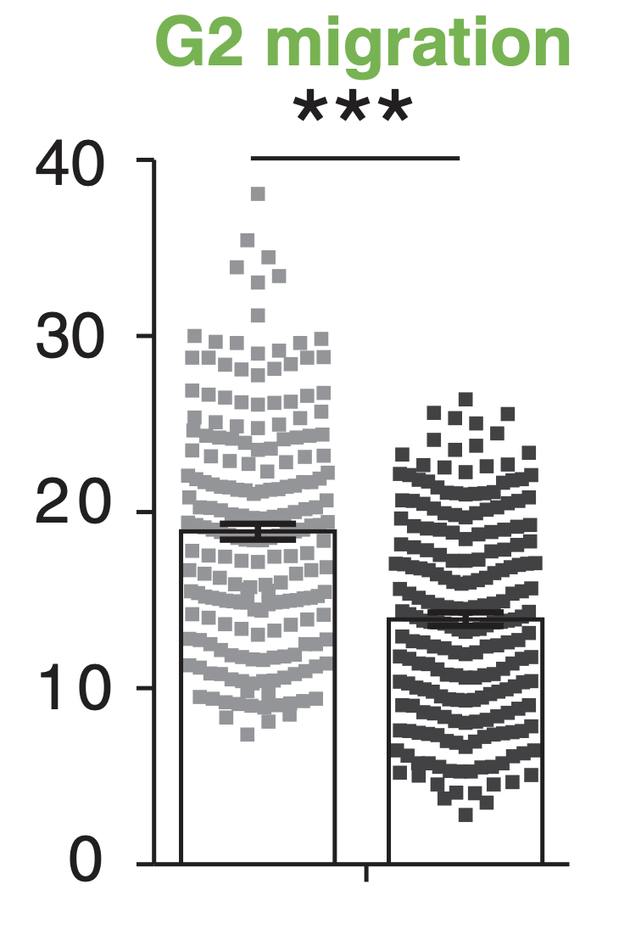
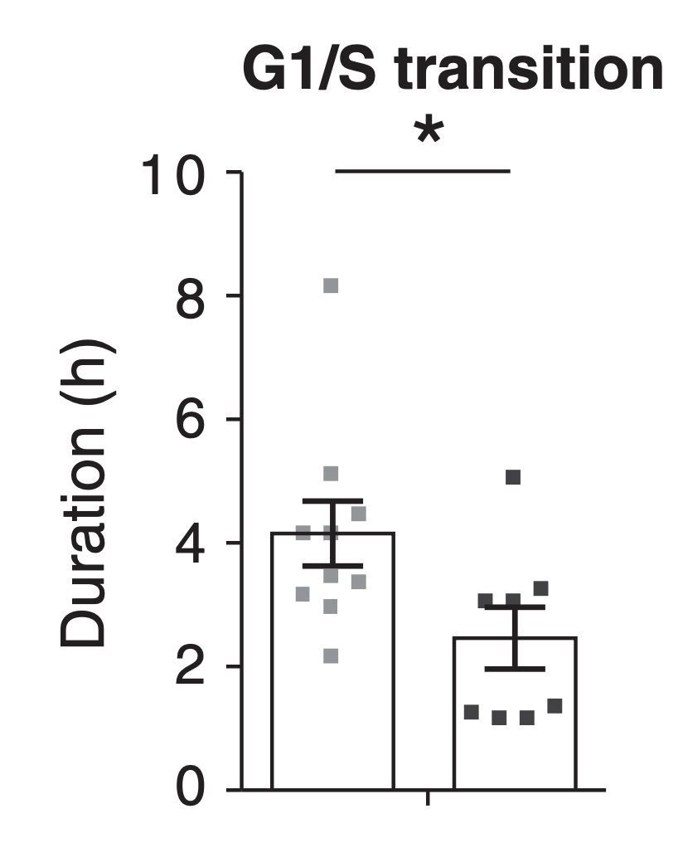
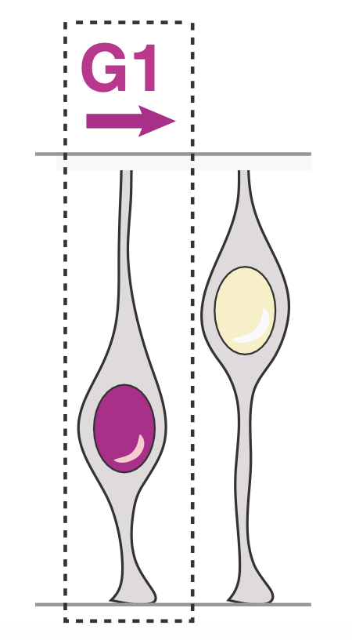
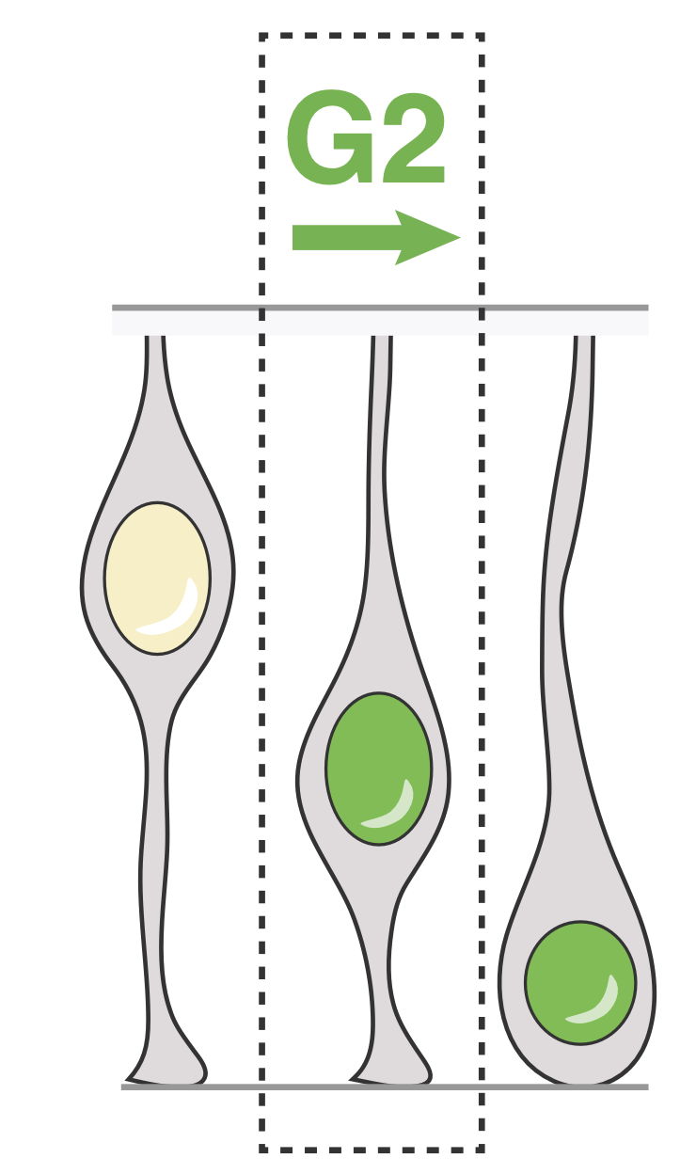
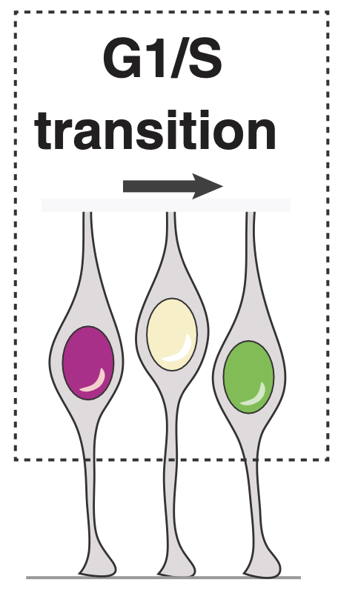
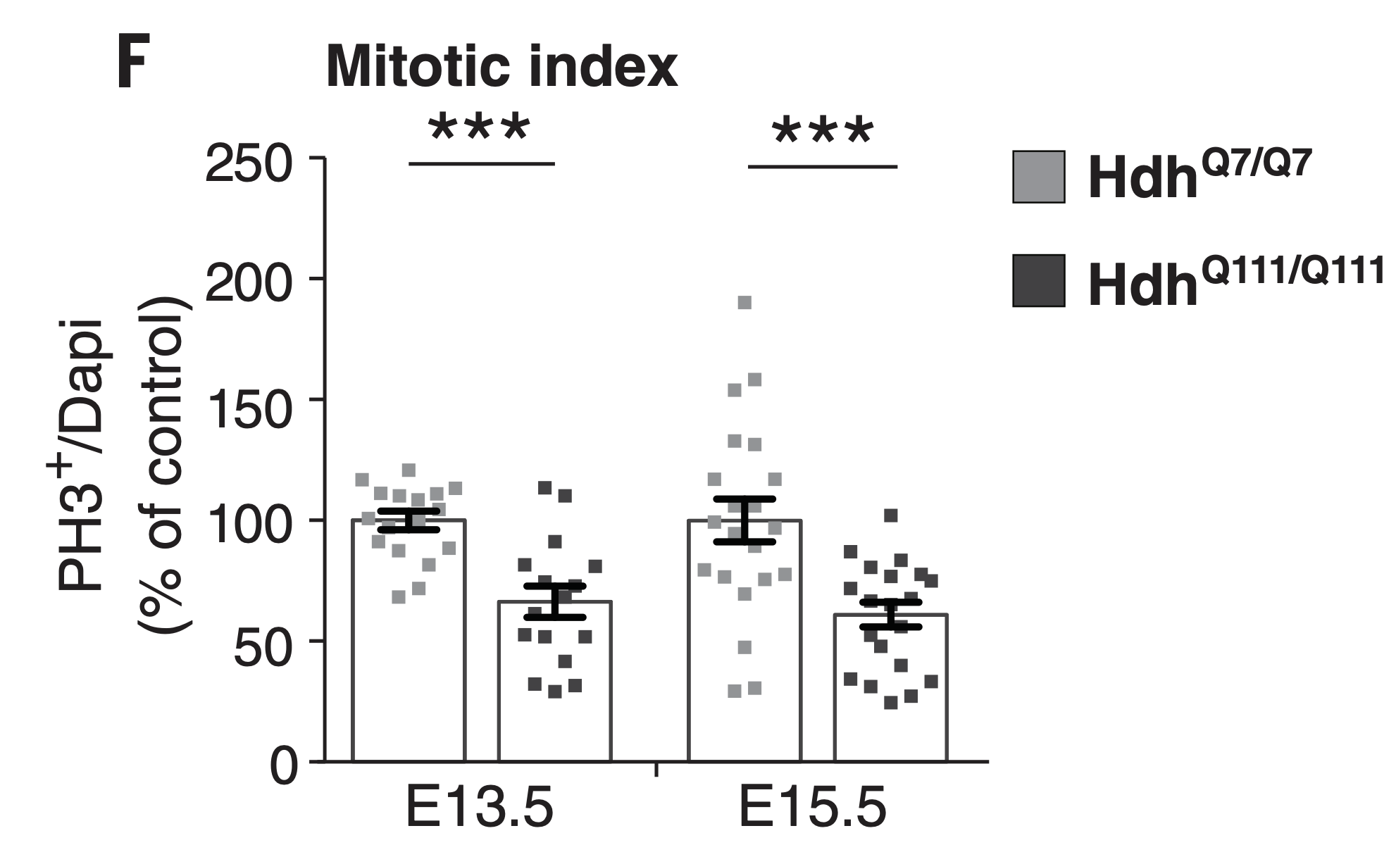
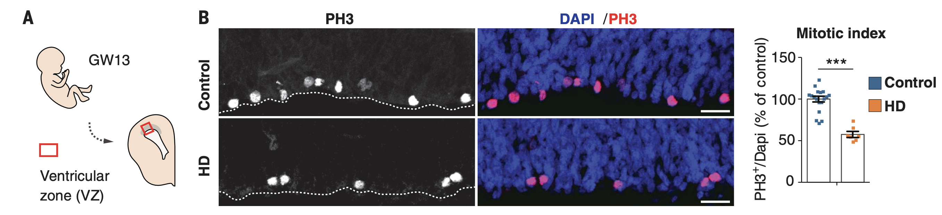
Interkinetic nuclear migration and mitosis of cortical apical progenitors are impaired in HD mouse embryos
Figure 3

Slide 9
Does mutated HTT affects primary cilia in radial glia cells and their early differentiation trajectory?

Slide 10
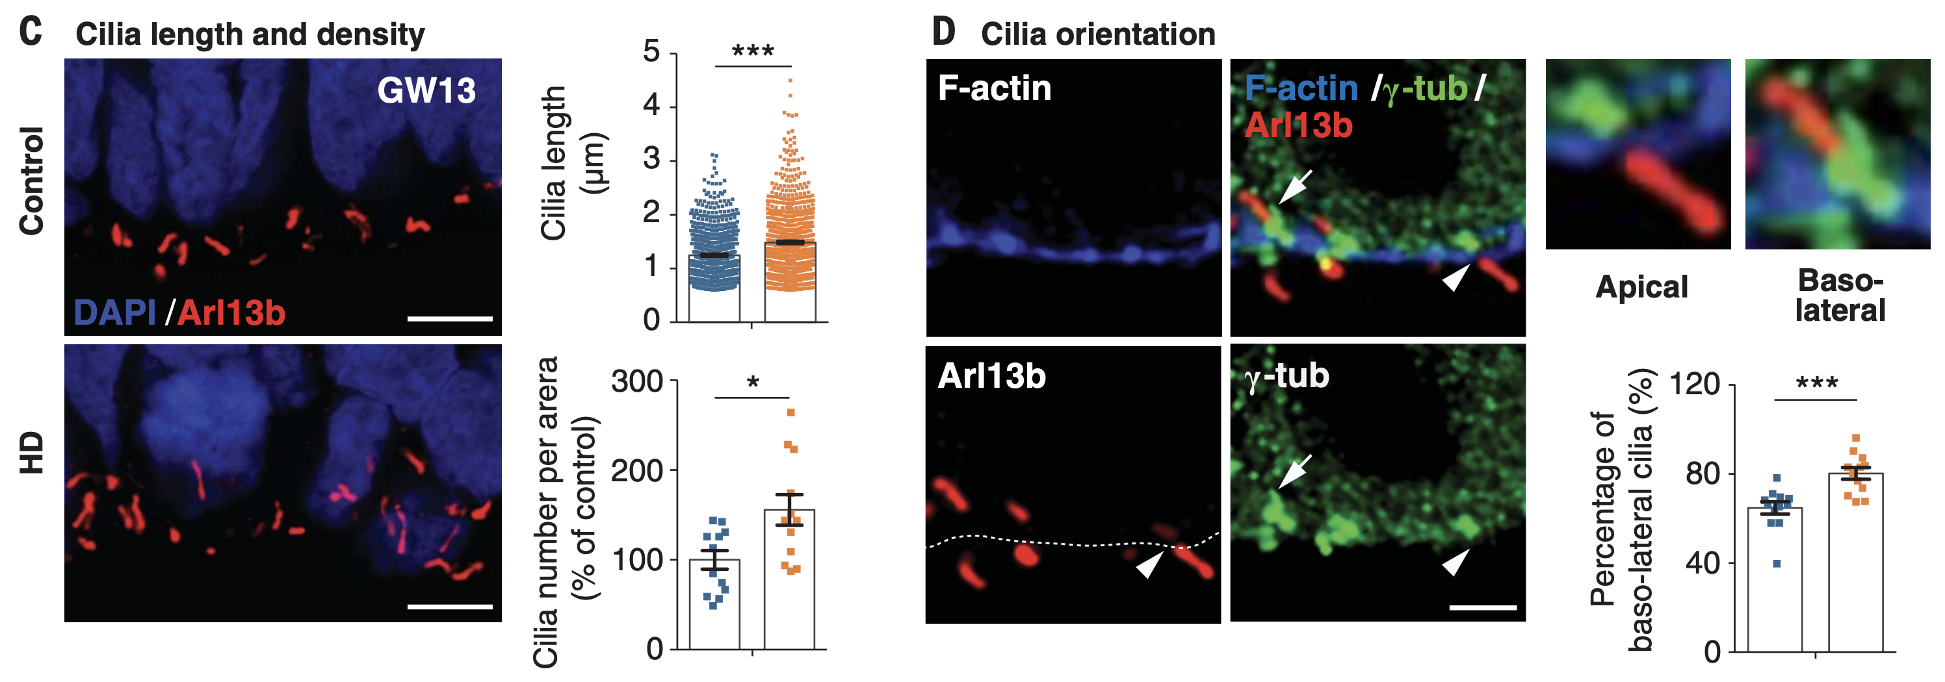
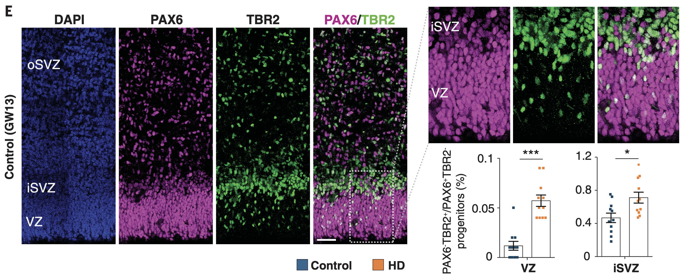
Mutant huntingtin shifts neurogenesis toward neuronal lineage
Figure 4
Cilia in the VZ of human and mouse mHTT show:
More and longer cilia
More baso-lateral than apical polarity
PAX6 - apical progenitors - VZ
TBR2 – basal progenitors – iSVZ
mHTTs in both mouse and human show higher TBR2 positive progenitors
mHTT show early differentiation and lower progenitor pool

Slide 11
Discussion
mHTT mislocalizes at junctional complexes and disrupts the polarity of human and mouse neuroepithelium.
mHTT cause the primary cilia of apical radial glia cells to be longer and more basolateral oriented.
mHTT interferes with the cell cycle of apical progenitors, leading to fewer and slower proliferating progenitors.
mHTT interferes with apical radial glia specification resulting in early neuronal differentiation.

