Slide 1

Scientific Literature Analysis In Neuroscience
Introduction to the Course
BIOENG-451
Academic year: 2025-2026
Teacher: Prof. Gioele La Manno
TA: Alessandro Valente

Slide 2
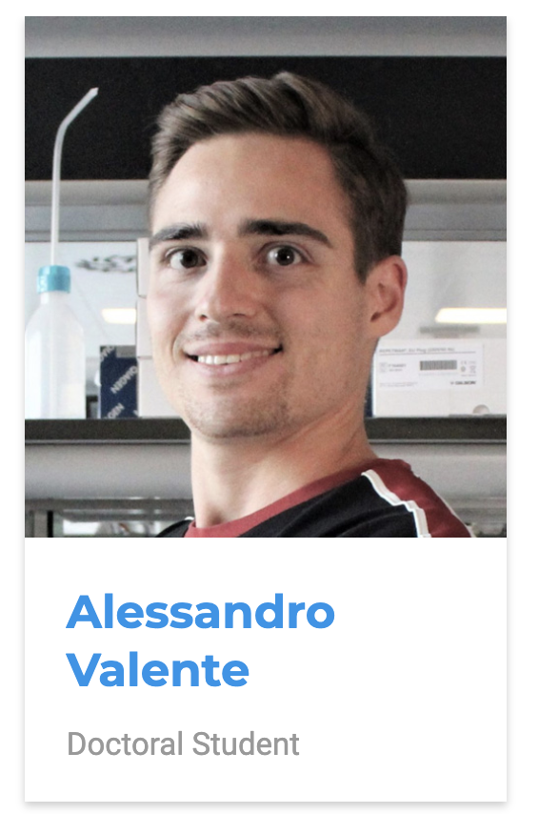
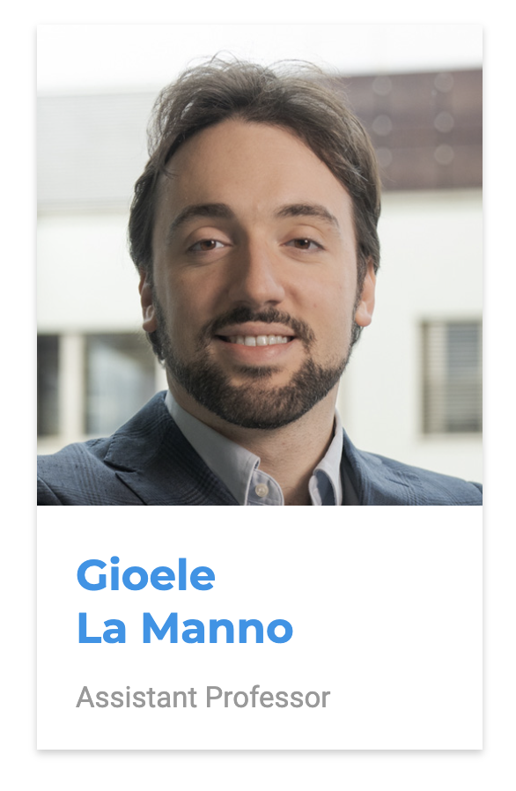

Contacts
MAIN CONTACT
alessandro.valente@epfl.ch
PROFESSOR CONTACT
gioele.lamanno@epfl.ch
MOODLE
https://moodle.epfl.ch/course/view.php?id=14338

Slide 3

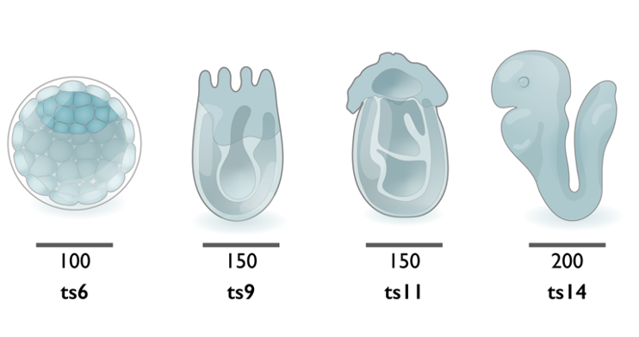
What is our goal?
Learn to…
analyze a scientific paper critically,
question if the data support the conclusions,
produce constructive referee reports in written or oral form.
The papers considered will give an overview of the field of
developmental neurobiology.

Slide 4
How we want to achieve it?
Atmosphere conductive to learning!
Caring about your own and your collogues
participation and learning.
Honesty and transparency.
Any problems or doubt better if communicated early.

Slide 5
You will be able to…
Synthesize a scientific paper’s narrative.
Analyse its results and methodological approach.
Evaluate solidity of a papers’ claims with respect to the supporting evidence.
Critique its contributions in the context of neurodevelopment literature.
Express this analysis in oral and written form.
Extract and elaborate information from a publication, to achieve an objective beyond the original scope of the work.

Slide 6

Course schedule
Week 1 - 10.09 - Intro to the course + [Lecture 1] Critical paper reading
Week 2 - 17.09 - Examples of JC + Peer Review + Coordination
Week 3 - 24.09 - [Lecture 2] Outline about brain development
Week 4 - 01.10 - [Lecture 3] About Part 1
Week 5 - 08.10 - Papers 1-2 about Patterning and Gene Regulation
Week 6 - 15.10 - Papers 3-4 about Patterning and Gene Regulation
Week 7 - 29.10 - [Lecture 4] About Part 2
Week 8 - 05.11 - Papers 5-6 about Cell type determination
Week 9 - 12.11 - Papers 7-8 about Cell type determination
Week 10 - 19.11 - [Lecture 5] About Part 3
Week 11 - 26.11 - Papers 9-10 of Late development and human models
Week 12 - 03.12 - Papers 11-12 of Late development and human models
Week 13 - 10.12 - Check on Miniproject prep
Week 14 - 17.12 - 3-slide Flash presentations on the peer review

