Slide 1
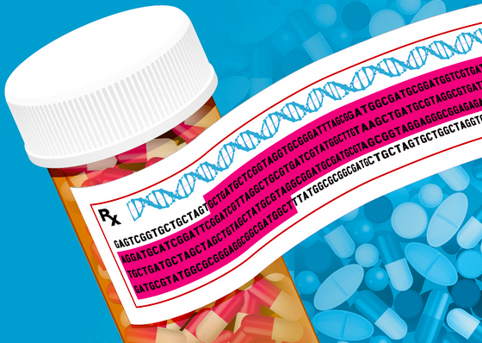
Pharmacogenetic Polymorphisms
From Genetic Variants to Precision Medicine
BIO698 – 13.11.25
Greta Bordin

Slide 2
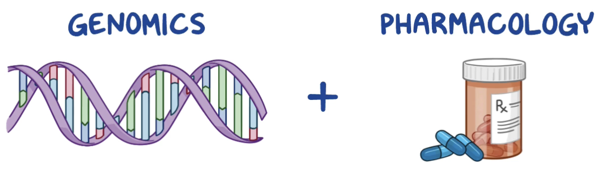
What is pharmacogenetics?
The study of how genetic differences affect drug response
Pharmacogenetics
analyzes variations within individual genes
Pharmacogenomics
considers broader interactions in the whole genome and variations in gene expression
Notes:
Monogenic

Slide 3



Mutations vs SNPs
Permanent changes to the DNA sequence
(substitutions, INDELs, duplications, frameshifts, CNVs)
Mutation
<1% population
Often pathogenic
Arise de novo
Single Nucleotide Polymorphism (SNP)
>1% population
Usually benign, or minor effect on phenotype
Inherited, stable in populations

Slide 4
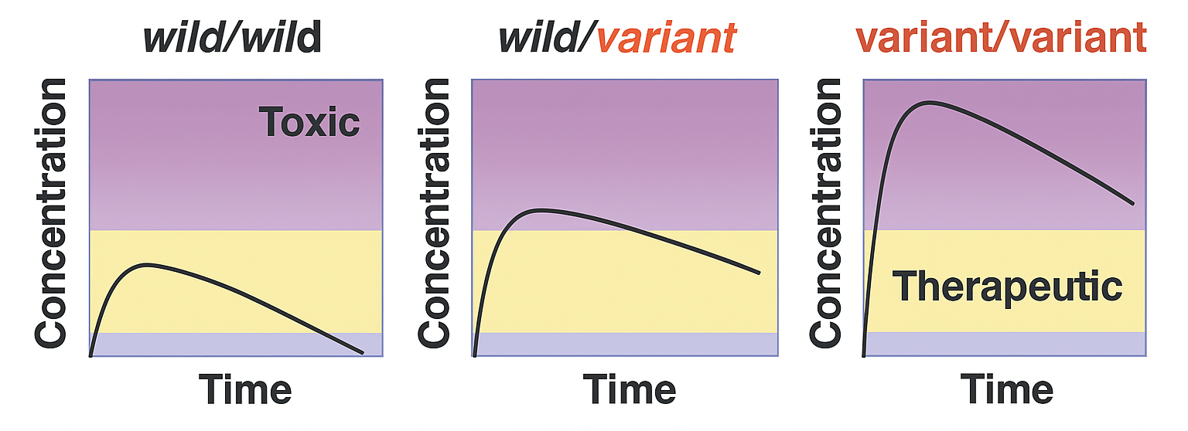
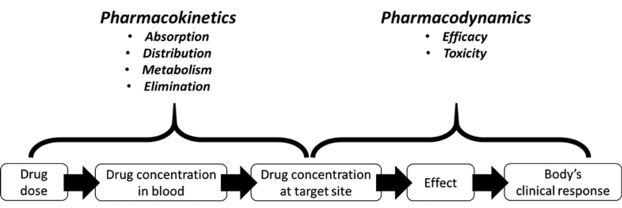
What could a single polymorphism possibly do?
Suppose the genetic variation occurs in a drug-metabolizing enzyme…
Altered PK/PD
Notes:
PK: what the body does to the drug
PD: what the drug does to the bnody

Slide 5
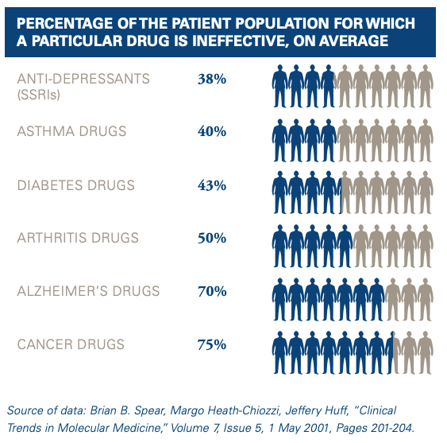
Flaws of the “one fits all” dosing approach
The same dose is administered to all patients → major drugs are ineffective (or harmful) for some

Slide 6
Adverse drug reactions (ADRs)
Definition (FDA):
“Any noxious, unintended and undesired effect of a drug, which occurs at doses used in humans for prophylaxis, diagnosis or therapy. This excludes therapeutic failures, intentional and accidental poisoning and drug abuse”
Dose-related reactions (Type A reactions) caused by an overdosing of the compound relative to individuals and resulting in either toxic effects or side effects.
Non-dose related or idiosynchratic reactions (Type B reactions)
4th-6th leading cause of death for hospitalized patients in the US
(>100,000 per year)
Micaglio, Emanuele et al. “Role of Pharmacogenetics in Adverse Drug Reactions: An Update towards Personalized Medicine.”
Frontiers in pharmacology (2021)

Slide 7
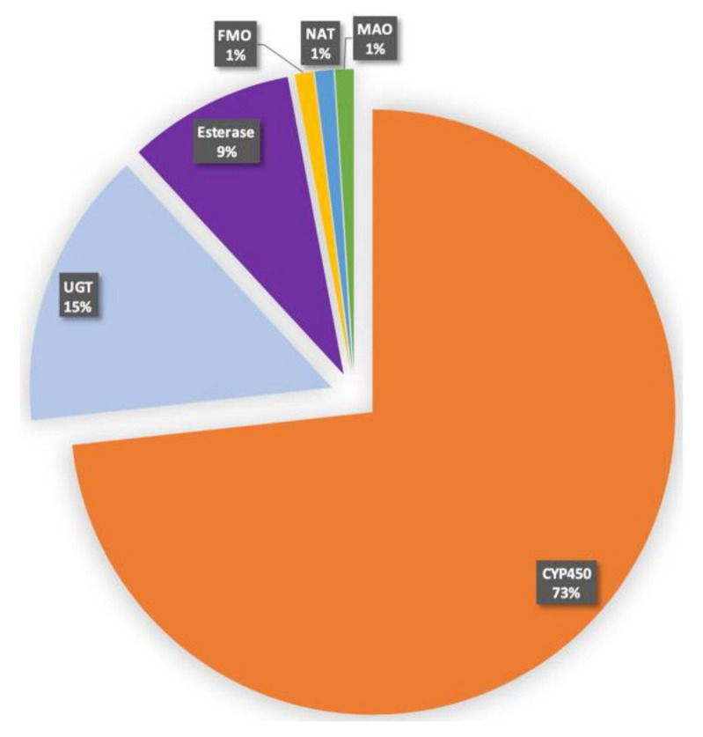
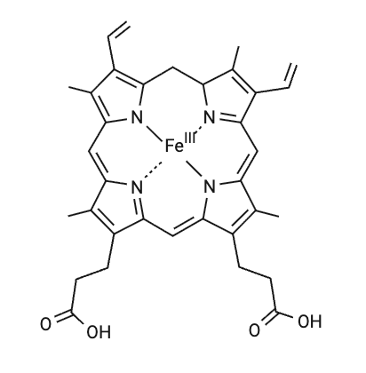
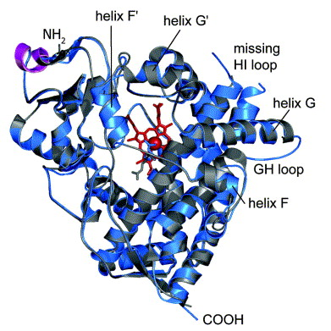
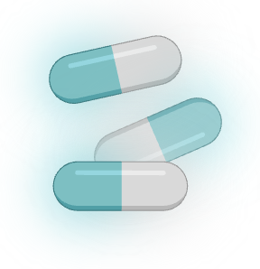
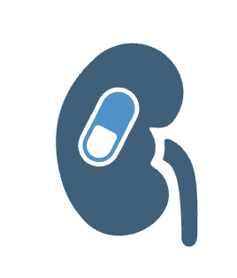

Cytochrome P450 and drug metabolism in humans
CYP
Active drug
Excretion
Prodrug
Active drug
Superfamily of hemoprotein isozymes (57)
Metabolize > 75% drugs
Zhao, Mingzhe et al. “Cytochrome P450 Enzymes and Drug Metabolism in Humans.”
International journal of molecular sciences (2021)
Brian Gilani; Manouchkathe Cassagnol, “Biochemistry, Cytochrome P450”, (2023)

Slide 8
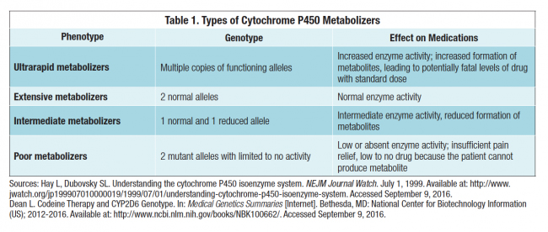


Types of metabolizers
Individuals are classified according to their ability to metabolize drugs based on their genetic makeup
Dose adjustment
Active drug
Prodrug

Slide 9
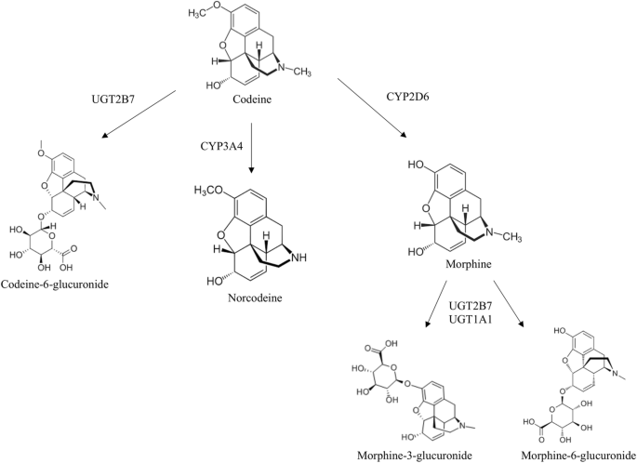
Codeine and CYP2D6
Notes:
https://www.youtube.com/watch?v=RXmrUhSSSlo

Slide 10
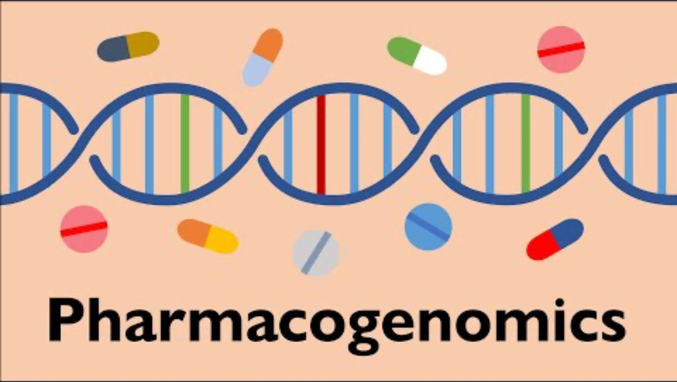
Codeine and CYP2D6
Notes:
https://www.youtube.com/watch?v=RXmrUhSSSlo

Slide 11
Pharmacogenetics of key CYP-mediated drugs
Drug | Mechanism / Indication | CYP Enzyme | Poor Metabolizer (PM) | Ultra-Rapid Metabolizer (UM) | Clinical Implication
Codeine | Opioid analgesic (pain relief) | CYP2D6 | ↓ Morphine → ↓ analgesia | ↑ Morphine → risk of toxicity | PMs may need alternative analgesic; UMs at risk of overdose
Tramadol | Opioid analgesic (moderate pain) | CYP2D6 | ↓ active metabolite → ↓ analgesia | ↑ active metabolite → ↑ risk of toxicity | Dose adjustment or alternative therapy recommended
Clopidogrel | Antiplatelet Prodrug (prevents clotting) | CYP2C19 | ↓ active metabolite → ↓ platelet inhibition | ↑ metabolite → ↑ bleeding risk | PMs may require alternative antiplatelet therapy
Warfarin | Anticoagulant Active drug (prevents thromboembolism) | CYP2C9 | ↓ clearance → ↑ bleeding risk | ↑ clearance → ↓ anticoagulation | Genotype-guided dosing recommended
Tamoxifen | Hormonal therapy for breast cancer | CYP2D6 | ↓ active metabolite (endoxifen) → ↓ efficacy | ↑ active metabolite → ↑ efficacy (possible toxicity) | PMs may need alternative therapy or dose adjustment
Notes:
antithrombotic drugs:
CYP2C9 and Warfarin Metabolism
Warfarin is a racemic mixture:
S-warfarin = more potent (3–5 times stronger than R-warfarin)
R-warfarin = less potent
CYP2C9 is the main enzyme that metabolizes S-warfarin in the liver.
Clinical Implications
Poor metabolizers of CYP2C9:
Warfarin stays in the body longer.
High risk of over-anticoagulation and bleeding.
Require lower starting doses.
Extensive metabolizers (normal):
Standard dosing works.
Ultrarapid metabolizers (rare for CYP2C9):
Metabolize warfarin faster → may need higher doses.

Slide 12
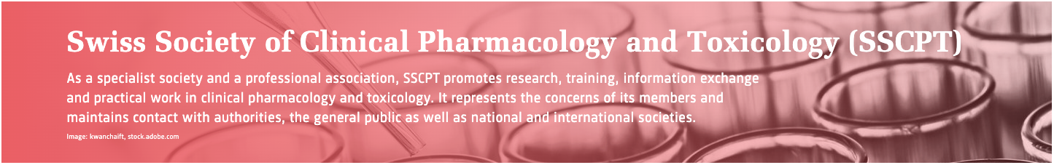
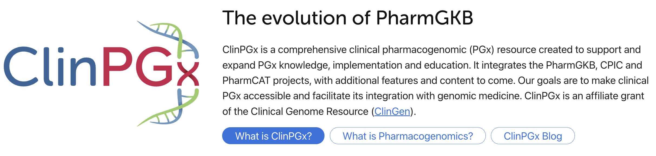
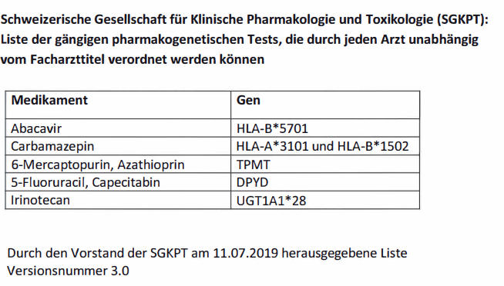
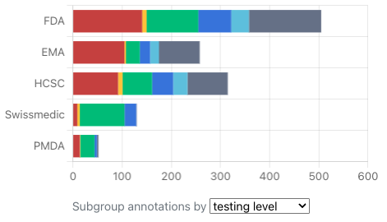
Pharmacogenetics testing in Switzerland
SSCPT list
Drugs requiring mandatory genetic testing
Permitted for prescription by any physician
Covered by basic health insurance
ClinPGx Drug Label Annotations
Annotates regulatory agency-approved drug labels containing PGx information
https://sscpt.ch/en
https://www.clinpgx.org/labelAnnotations
Notes:
The SSCPT has been assigned by Switzerland’s Federal Office of Public Health (FOPH) to elaborate and maintain a list of gene–drug pairs. sscpt.ch+2sscpt.ch+2
This list identifies specific pharmacogenetic tests (genetic analyses) that are eligible under certain conditions for prescription by any physician, and for reimbursement under the basic health insurance system.
The SSCPT list names specific drugs together with specific genetic markers (genes/alleles) for which testing is deemed to have actionable clinical relevance.
If a gene–drug pair is not on the list, then prescribing the test is more restricted: it usually must be requested by a physician with specialization in Clinical Pharmacology & Toxicology.
Abacavir – Antiretroviral drug used to treat HIV infection.
Carbamazepine – Antiepileptic / mood stabilizer used for epilepsy, trigeminal neuralgia, and bipolar disorder.
Azathioprine / 6‑Mercaptopurine – Immunosuppressants used for autoimmune diseases (like Crohn’s disease, ulcerative colitis) and preventing transplant rejection.
5‑Fluorouracil / Capecitabine – Chemotherapy drugs used mainly for colorectal, breast, and gastrointestinal cancers.
Irinotecan – Chemotherapy drug used primarily for colorectal cancer.
Swissmedic: These drug label annotations were created from a collaboration between PharmGKB (now ClinGPx) and Pharmaceutical Care Research Group in University of Basel in 2019 and the labels have not been subsequently reviewed or updated.

Slide 13
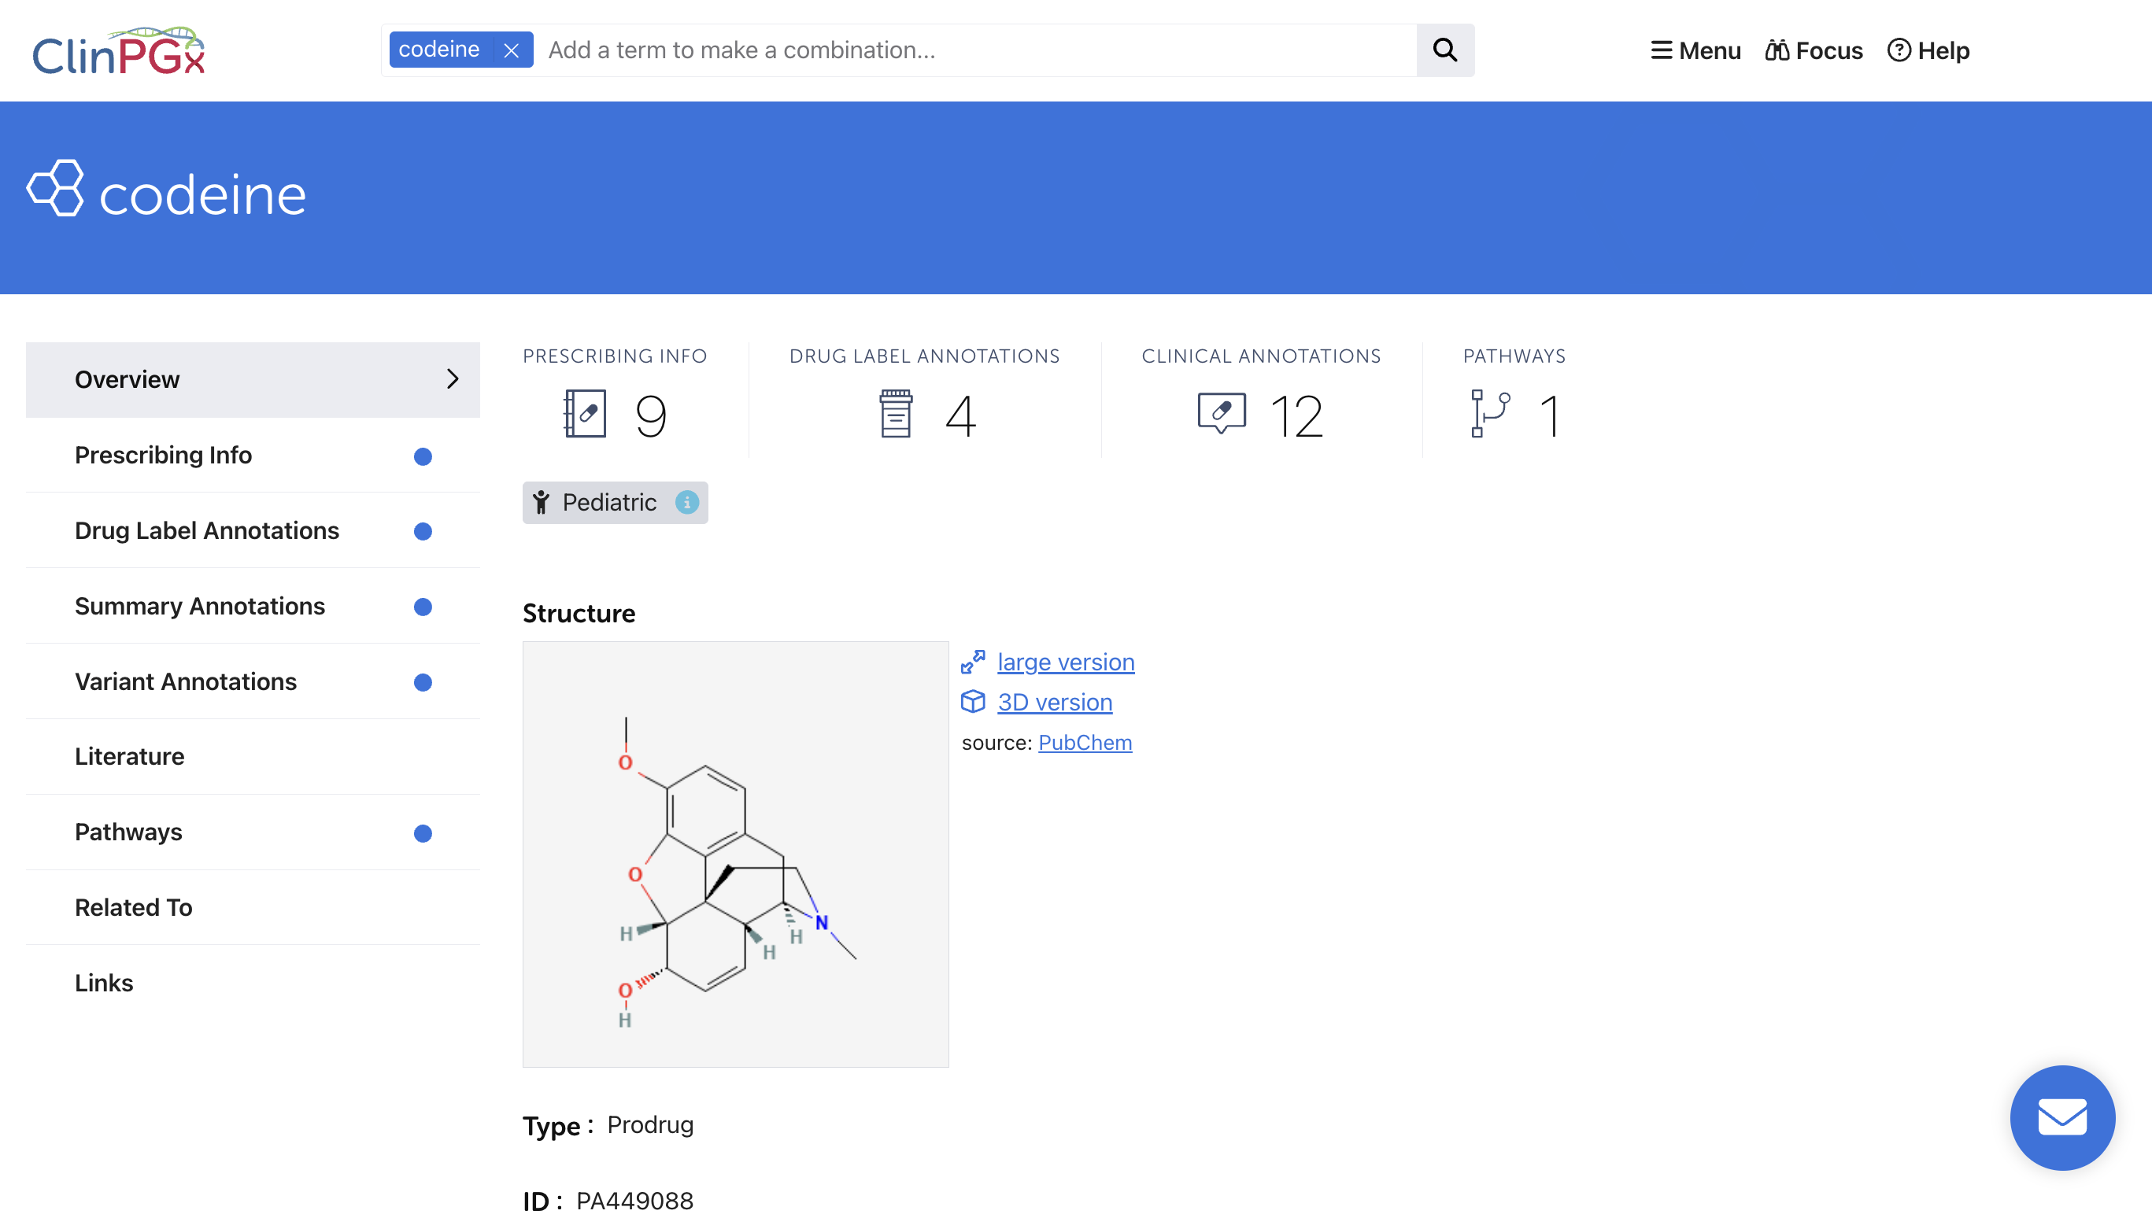
ClinPGx demo
ClinPGx.org

Slide 14
Thank you for your attention!

