Slide 1

HealthBridge: medical record summarizer
Clarity for Patients. Insights for Doctors
BIO698 Health Hackathon

Slide 2

The problem: communication gap in healthcare

Slide 3

Pain for doctors too

Slide 4
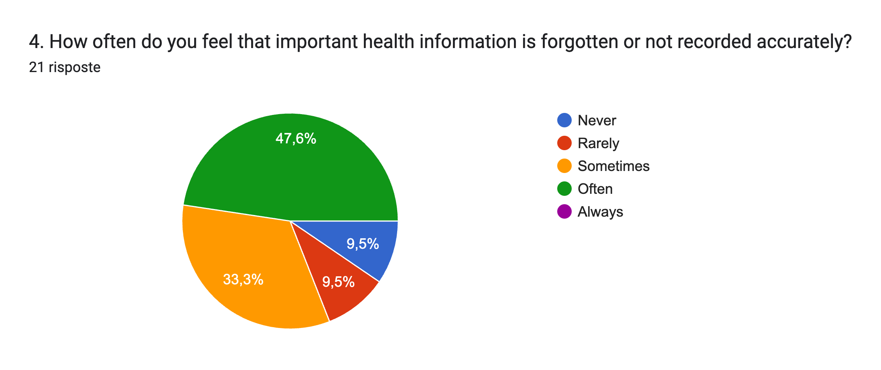
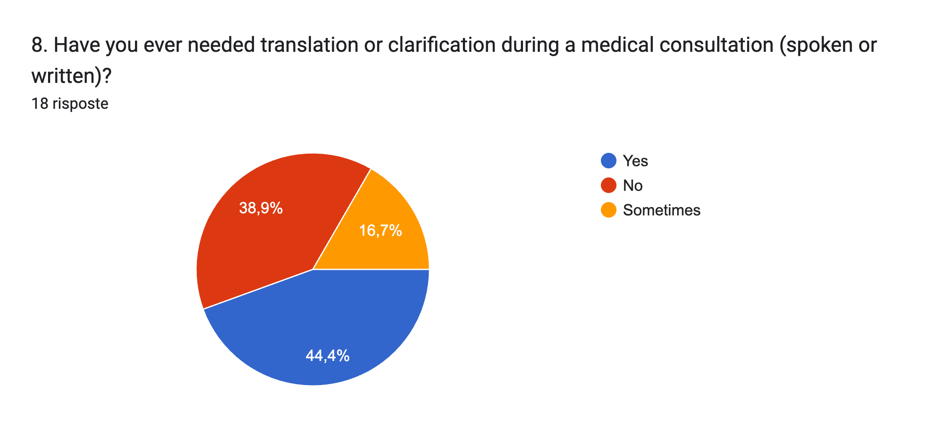
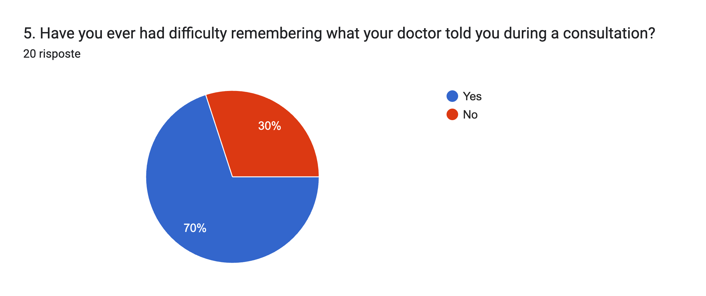
A real world issue

Slide 5






Our goal

Slide 6
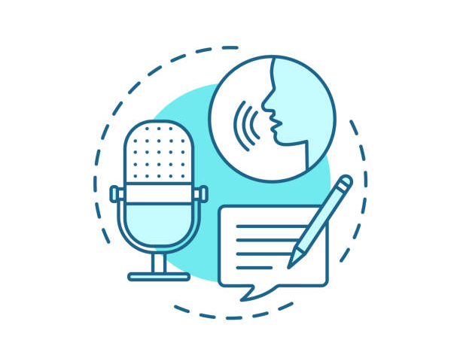



What's needed –Patient Feedback
Medication reminders (42.9%).
Automatic recording of doctor- patient conversations (71.4%).
Summaries of written doctor instructions (85.7%).
Symptom tracking (52.4%).
Notes:
Only trained on text
Augmented with specialised modules for the input-output:
X--> text, text -->X (audio – transcribed, translated, sent to model) (prompt --> image)
Docs input:
Medical Reports (Lab results, radiology reports, discharge notes)
Technical Medical Jargon (Complex terminology, specialist language)
Handwritten Prescriptions (Scans, photos, handwritten notes)
Patient input
Symptom Tracking
Pain levels, mood, fatigue, etc.
Medication Intake
Doses, adherence, timestamps
Lifestyle Variables
Sleep, steps, meals, stress levels
Simplified Translations
“What your doctor meant in plain language”
Easy Summaries of Reports
5–7 bullet points
Actionable Instructions
Medication reminders, follow-ups

Slide 7
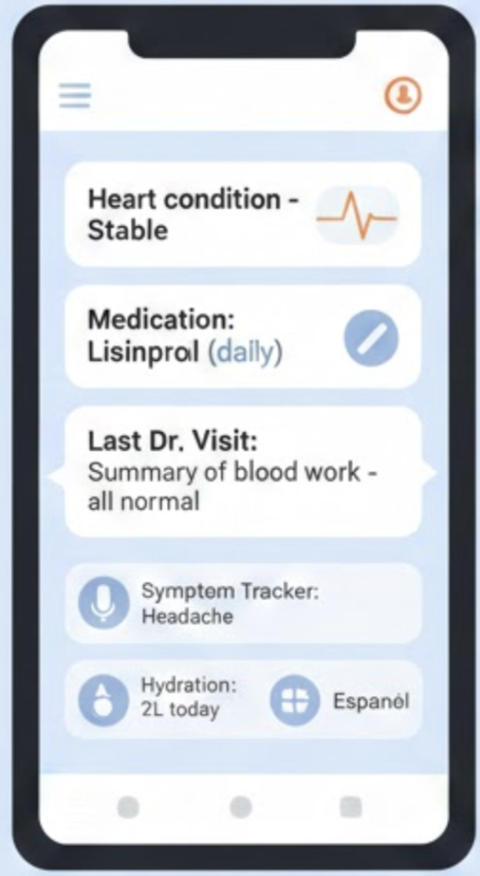
Patient side
Empowering Patients with Clarity
1. Conversation Tracking:
How it works: Generates an interpretable summary of a medical consultation
  Possibility of translating to another language
  Simplifies the medical jargon to everyday language
2. Extracts key insights from handwritten prescriptions and text-based medical reports
  Therapeutic instructions
3. My Health Snapshot ("How am I doing lately?")
  Symptom tracker
  Medication and measurement reminder
  App compiles patterns from symptoms, medication adherence (Especially relevant in chronic diseases)
Notes:
Features:
Written summaries of medical instructions
Automatic recording of doctor-patient conversairtons
Symptoms tracking
Medication reminders
Translation/simplification (medical to common) of medical
Easy sharing
Health snapshot

Slide 8
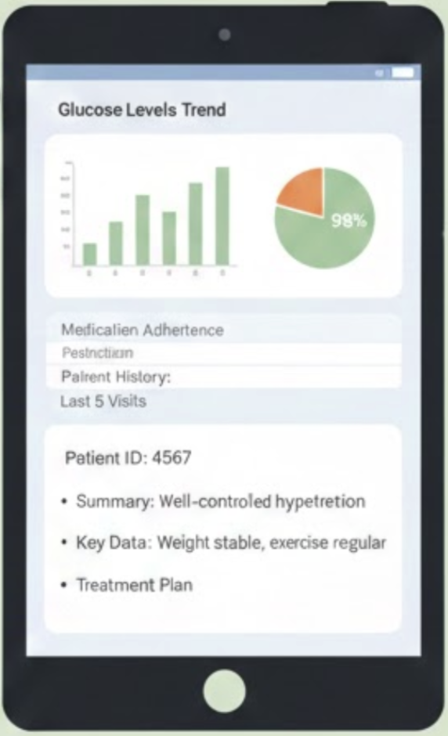
Doctor side
The Clinical Dashboard​
The Patient Snapshot:​
  What it is: Summary of the patient's status since the last visit
  Trends visualizations from longitudinal data provided by the patient (medication intake, symptoms, lifestyle)
  Detection and flagging of anomalies
  Example: "Patient adherent to MedicationX. Reports subsiding vertigo, but new onset of mild rash on arms."
Notes:
Organised reports from symptoms and medications to patient status
Plots: correlation between status and variables (medications, lifestyle)
snapshot

Slide 9

Our solution
Doctor's inputs
Patient's output
Medical reports
Technical jargon
Interpretable summaries of reports (translation)
Actionable instructions
Multimodal LLM
Medical reasoning engine
Patient's inputs
Doctor's outputs
Symptom tracking
Medication intake
Lifestyle variables
Structured patient's status report
Time-series trend analysis
Notes:
OCR (Optical Character Recognition) Modules:Extract text from printed documents, PDFs, scanned forms.
Handwriting Recognition (HTR) Modules:Read handwritten notes, prescriptions, notebook-style entries.
Speech-to-Text (ASR) Modules
Goal: Convert doctor–patient conversations into text.
Google vision
Only trained on text
Augmented with specialised modules for the input-output:
X--> text, text -->X (audio – transcribed, translated, sent to model) (prompt --> image)
Docs input:
Medical Reports (Lab results, radiology reports, discharge notes)
Technical Medical Jargon (Complex terminology, specialist language)
Handwritten Prescriptions (Scans, photos, handwritten notes)
Patient input
Symptom Tracking
Pain levels, mood, fatigue, etc.
Medication Intake
Doses, adherence, timestamps
Lifestyle Variables
Sleep, steps, meals, stress levels
Simplified Translations
“What your doctor meant in plain language”
Easy Summaries of Reports
5–7 bullet points
Actionable Instructions
Medication reminders, follow-ups

Slide 10
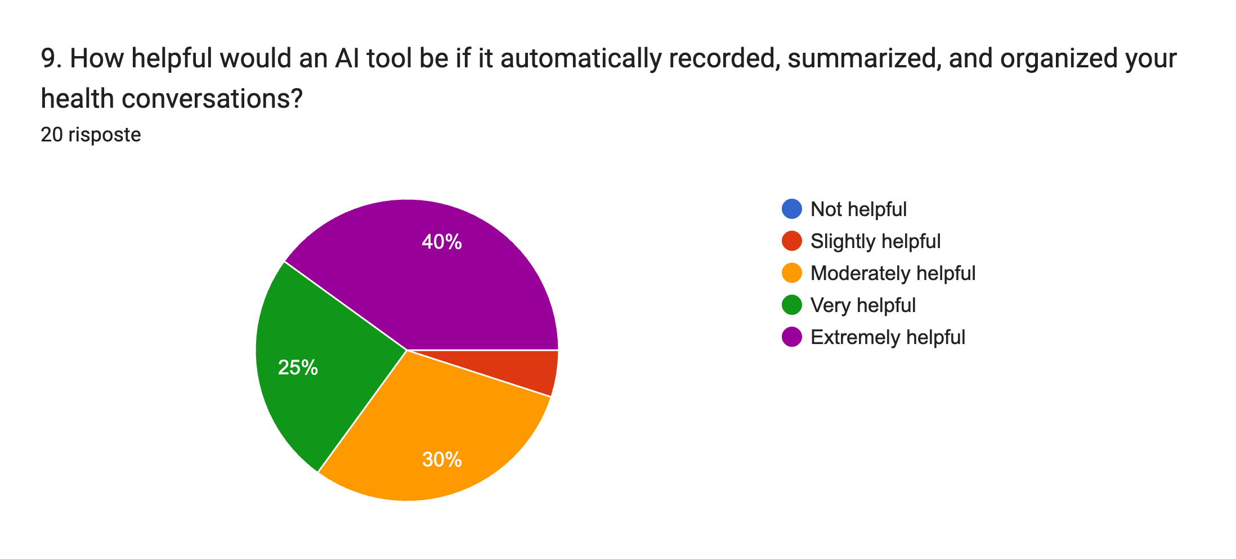
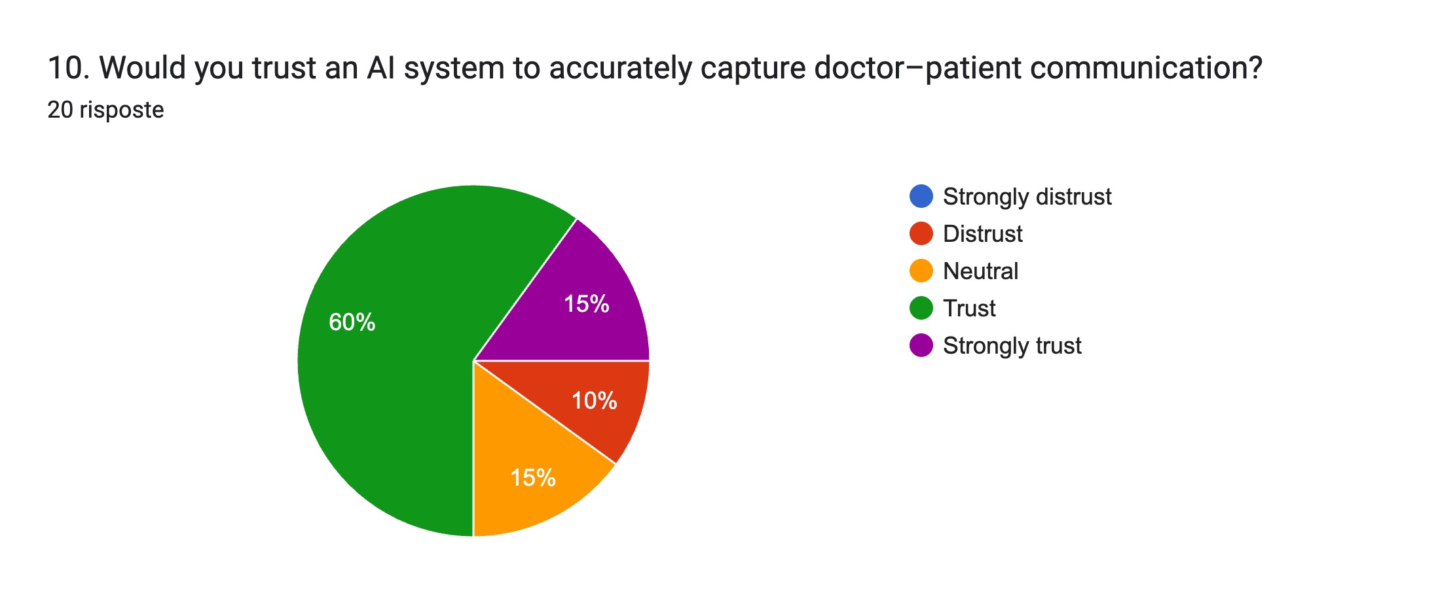
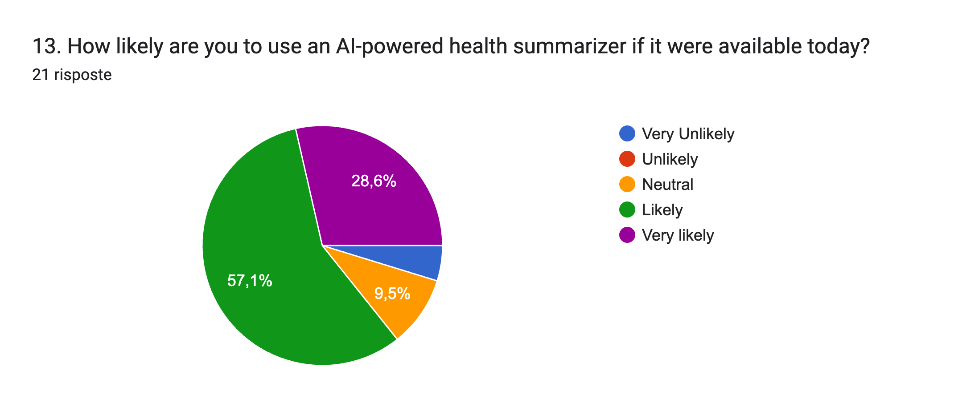
Market sentiment

Slide 11



Market size
CHF 1.1 Billion
The Entire Digital Health Market in Switzerland
The total projected revenue of the Swiss Digital Health & eHealth sector by 2028
TAM
CHF 50 Million / Year
The Software Market for Chronic Care Management
350CHF/Month per doctor * 12k doctors
Similar income from Insurance companies
SAM
CHF 1.5 Million / Year
Our Goal for 3% market share
SOM

Slide 12



Business model
Software as a service (SaaS)
Software/App
Patients
Health Insurances
Hospitals/Clinics

Slide 13
Business model
Software as a service (SaaS)
  1. For Patients (Free): All the features in the app are free to use.
  2. For Clinics (SaaS Subscription): Clinics pay a monthly per-seat fee.
      Value: Reduces documentation time by 2 hours/day.
      Value: Increases billing codes for Remote Patient Monitoring (RPM).
  3. Integration Fees: Custom API integration for large hospital EHR systems.

Slide 14
Roadmap
  2025Q4 – Q2 2026
  Q2 2026 - 2027
  2027-2029
  The MVP Launch
  Tech: Conversational
  tracker, Summary
  generator and My Health
  Snapshot
  Goal: Finalize Hackathon prototype and launch Alpha testing with 50 users.
Clinical Pilots & Compliance
  Milestone: GDPR Certification (Crucial for trust - data security).
  Action: Beta Pilot with 5 private clinics (focus on Chronic disease patients).
Reimbursement & Revenue
Allows clinics to bill insurance for using our tool, driving massive B2B adoption.
  Growth: Expansion into EU and other markets (utilizing our multilingual AI).

Slide 15
HealthBridge: medical record summarizer
Clarity for Patients. Insights for Doctors
Thanks for your attention!

Slide 16


Competition matrix
WebMD
https://www.webmd.com/
Generic/Static
Epic Mychart
https://www.mychart.org/
(Personalized/Static)
  Vs. WebMD: We offer personalized interpretation, not generic articles.
  Vs. Epic MyChart: We provide actionable summaries, not just a folder of static documents.
  Our Edge: True Bi-Directional AI. We don't just store data; we synthesize it into plots and narratives.
Notes:
"Current competitors like 'MyChart' are just file storage folders—they store data but don't explain it. WebMD is generic and scares patients. Our advantage is Interpretation. We don't just show the lab result; we explain what it means specifically for that patient, in their language."

