Slide 1
Tumour immunity

Slide 2
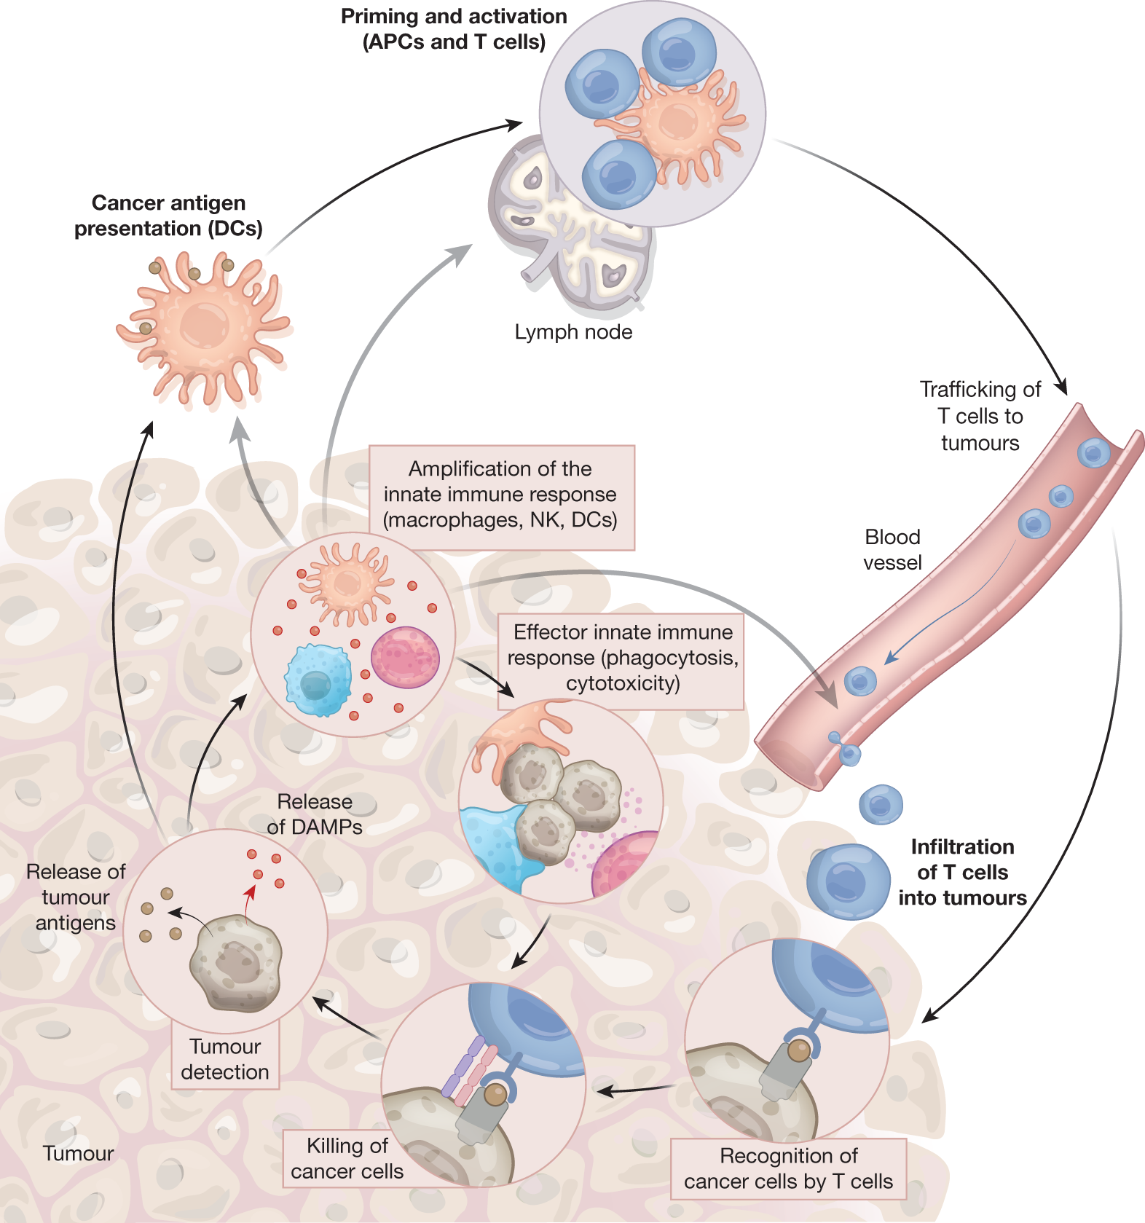
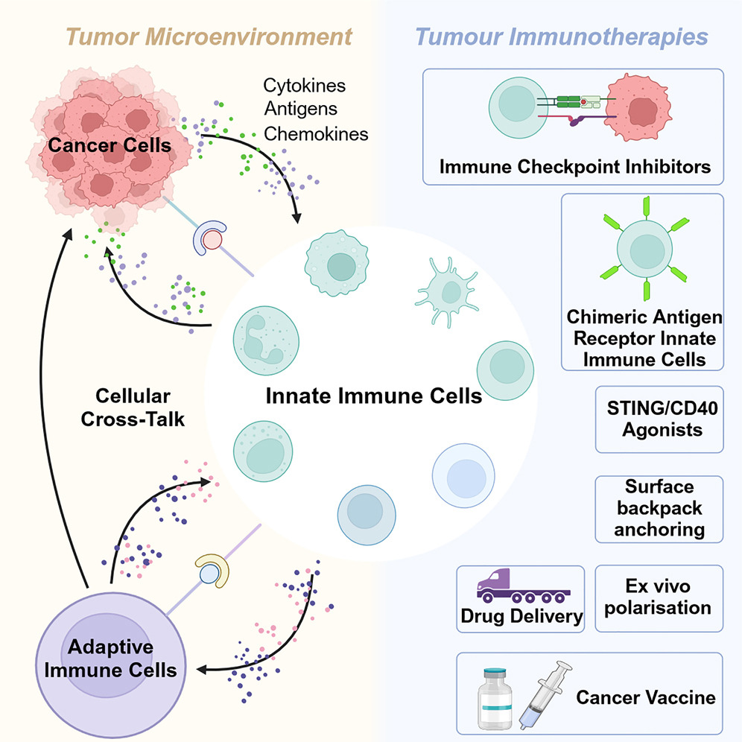
Immune activation during cancer
Demaria et al. (Nature, 2019)
How does a tumour activate innate immunity?
Notes:
The cancer–immunity cycle has conceptualized the mechanisms that drive the T-cell response against tumours⁴. Innate immunity is essential to the onset and maintenance of adaptive immunity and fully integrates the cancer–immunity cycle. Tumour detection induces activation of innate immune cells, which promotes effector functions and tumour cell destruction. Tumour destruction eventually generates more detection signals, propagating the response. In addition to their direct tumoricidal effect, tumour-activated innate immune cells participate in all steps of T-cell generation and activity against cancer cells, by participating in tumour-specific T-cell priming, expansion and infiltration at the tumour site. The cancer–innate immunity cycle is also regulated by inhibitory factors that limit innate immune cell functions, with direct consequences for their tumour-killing capacities and T-cell protective immunity. Steps of the cancer–immunity cycle that require innate immune cells are highlighed in bold.
https://www.nature.com/articles/s41586-019-1593-5

Slide 3
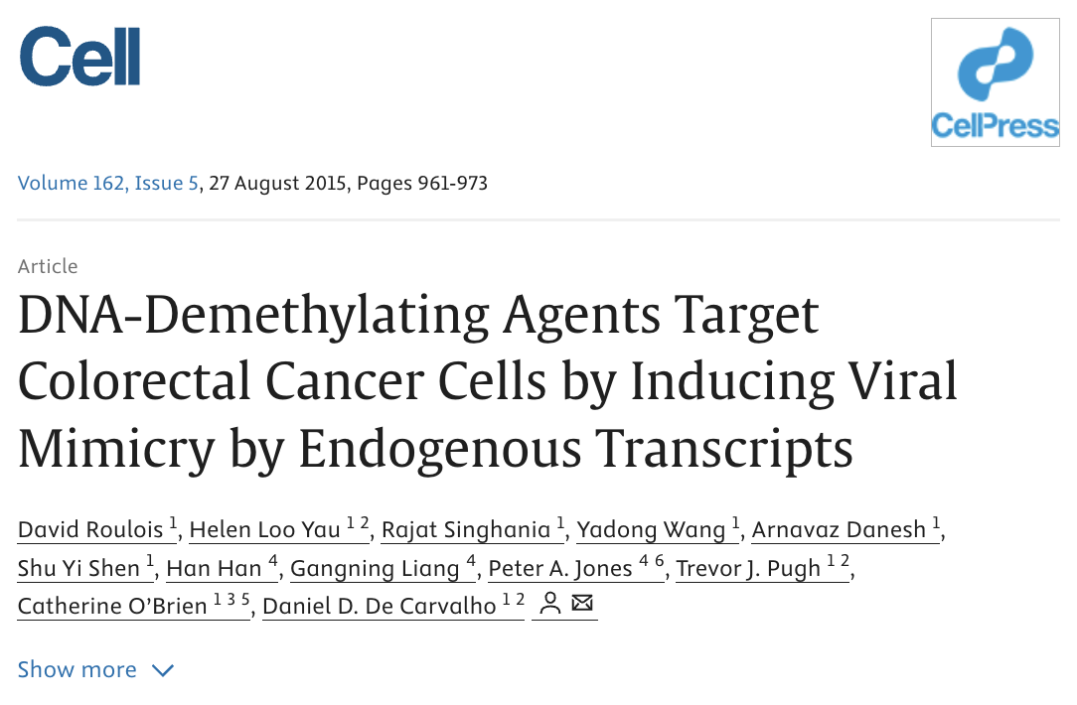
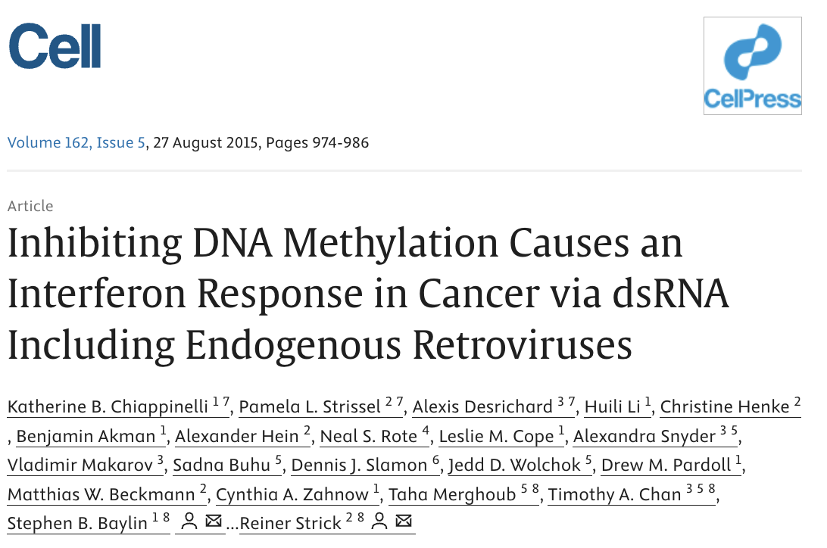
Immune activation during cancer:
A component of self-activation?

Slide 5
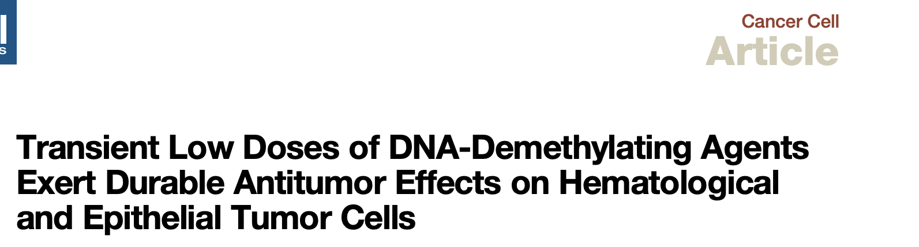
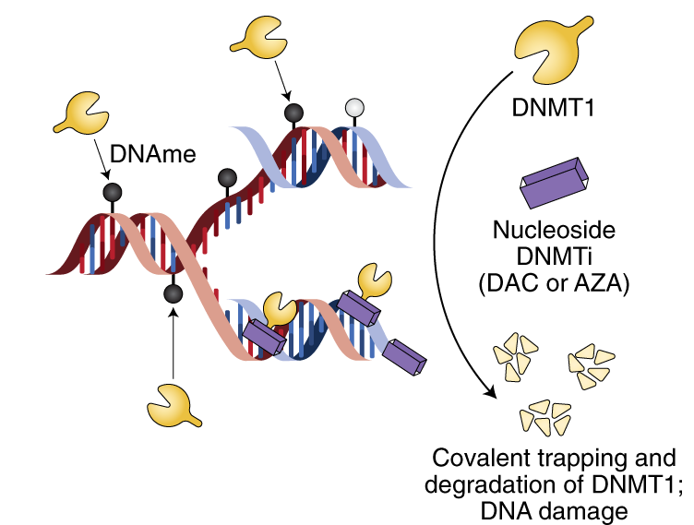
DNMTs maintain methylation on genomic DNA
DNMTs can be blocked by DNMTis: trap DNMTs and prevent them from maintaining methylation.
Observation: DNMTis seem to induce an immune response, and show benefits in cancer treatments.
What could be the link between DNA methylation and immune activation?
How would this protect cancer patients?
Mehdipour, Chen & De Carvalho (2021, Nat Cancer)
Tsai et al. (2012, Cancer Cell)
Notes:
https://www.nature.com/articles/s43018-021-00271-z

Slide 6
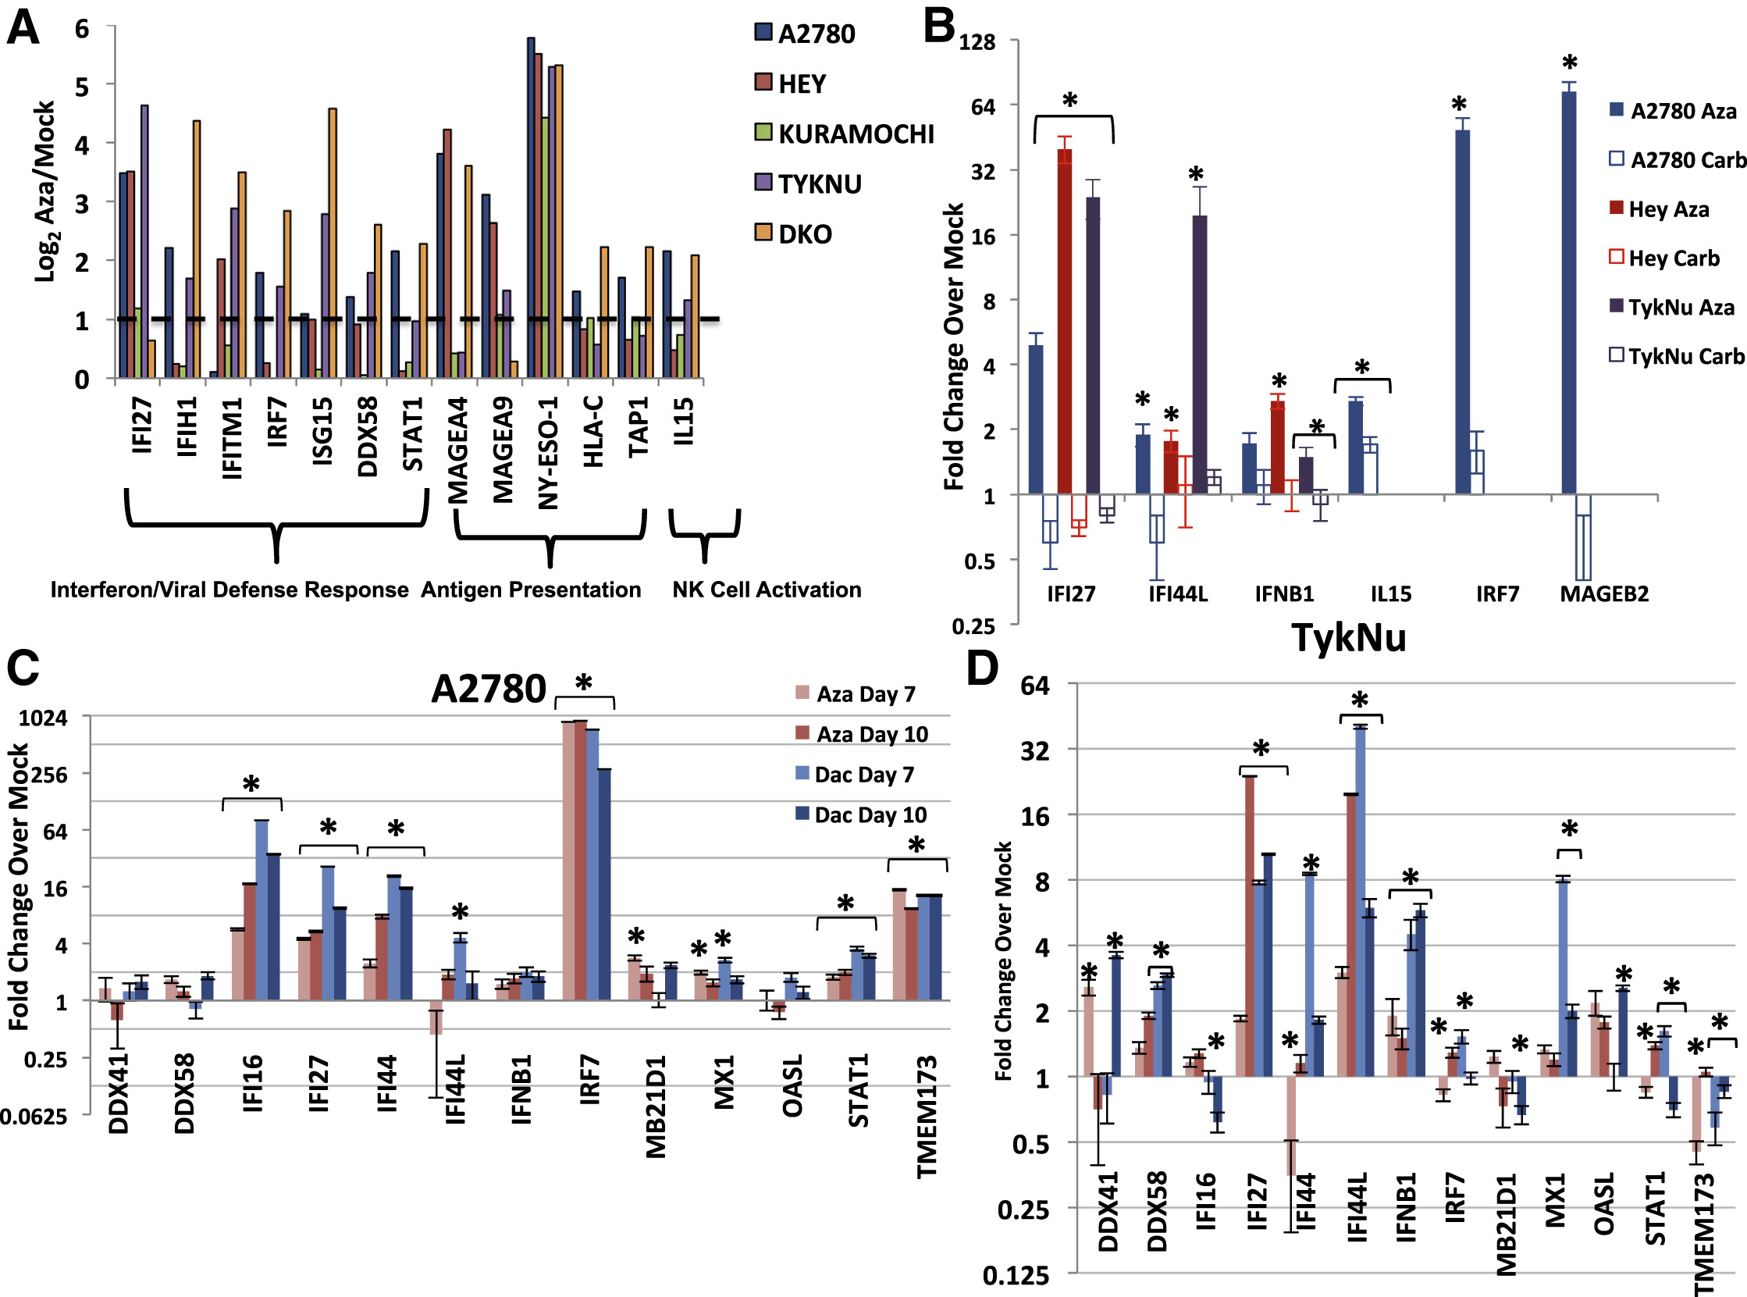
FIGURE 1

Slide 7
Observed induction of immune genes by AZA compound was highest in epithelial ovarian cancer (EOC) and non-small cell lung cancer (NSCLC)
Figure 1B.

Slide 8
Cell lines used
A2780, Hey, TykNu are human ovarian cancer cell lines
A2780: moderately chemosensitive cancer cell line, known to respond to DNMTis
Hey: more resistant ovarian cancer phenotype
TykNu: highly chemoresistant, ovarian clear-cell carcinoma cell line
Compounts used
Aza = 5-aza-2’-deoxycytidine – a type of DNMTi
Carb = Carboplatin – standard chemotherapy, which does not induce interferon
Mock is an untreated control condition
Notes:
Why multiple cell lines? To show whether the response is general or cell-line-specific. To demonstrate that DNMT inhibitor–induced interferon signaling occurs across diverse ovarian cancer subtypes: chemosensitive (A2780), chemoresistant serous (Hey), and a genetically distinct clear-cell carcinoma (TykNu). This strengthens the claim that the viral-mimicry effect is not lineage-restricted and could be relevant across human ovarian tumors.

Slide 9
Observed induction of immune genes by AZA compound was highest in epithelial ovarian cancer (EOC) and non-small cell lung cancer (NSCLC)
Figure 1B.
Cell lines used
A2780, Hey, TykNu are human ovarian cancer cell lines
A2780: moderately chemosensitive cancer cell line, known to respond to DNMTis
Hey: more resistant ovarian cancer phenotype
TykNu: highly chemoresistant, ovarian clear-cell carcinoma cell line
Compounts used
Aza is a type of DNMTi
Carb = Carboplatin – standard chemotherapy, which does not induce interferon
Mock is an untreated control condition
Which “data pairs” should you compare?
Explain the y-axis
Based on this data, what can we say about DNMTi treatment vs. regular chemotherapy?
Explain the x-axis
Notes:
IFI27 – interferon-stimulated gene (ISG), marker of Type I IFN response
IFI44L – ISG strongly induced downstream of IFN-α/β
IFNB1 – gene encoding interferon-β, the key antiviral cytokine of the “viral mimicry” model
IL15 – cytokine promoting NK and T-cell activation
IRF7 – interferon regulatory factor; master TF for Type I IFN amplification loop
MAGEB2 – cancer-testis antigen (normally silenced by DNA methylation, re-expressed when demethylated)
Why these specific genes?
Because they represent both the sensors (IFI27/IFI44L), the cytokine (IFNB1), the transcription factor (IRF7), and immune effector pathways that become activated during a “viral mimicry” interferon response.
How to read the axes…
Y-axis = fold change over mock. A value of 1 = no change compared to untreated cells, > 1 = induction of gene expression, <1 = repression.
For each gene, the filled bar = Aza treatment, open bar = Carboplatin treatment, and the three different cell lines are colour coded.

Slide 10
Observed induction of immune genes by AZA compound was highest in epithelial ovarian cancer (EOC) and non-small cell lung cancer (NSCLC)
Figure 1B.
Cell lines used
A2780, Hey, TykNu are human ovarian cancer cell lines
A2780: moderately chemosensitive cancer cell line, known to respond to DNMTis
Hey: more resistant ovarian cancer phenotype
TykNu: highly chemoresistant, ovarian clear-cell carcinoma cell line
Compounts used
Aza is a type of DNMTi
Carb = Carboplatin – standard chemotherapy, which does not induce interferon
Mock is an untreated control condition
DNMT inhibition uniquely activates an interferon response that regular chemotherapy does not.

Slide 11
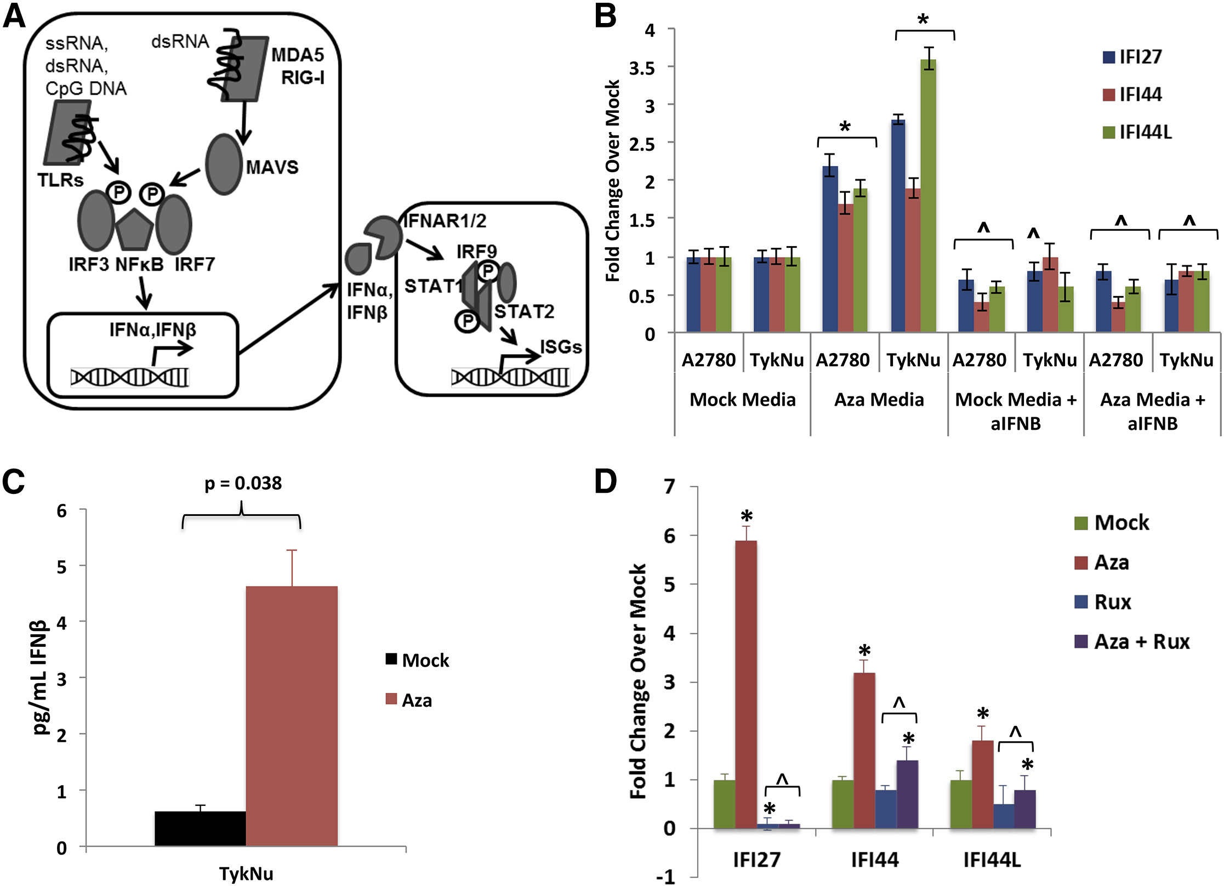
FIGURE 2

Slide 12
Figure 2C.
What does this data show?
What are they measuring exactly?
Why would this measured substrate matter in a cancer context?
(C) ELISA of IFNβ in media from TykNu cells at day 10 […]. y axis, pg/mL IFNβ.

Slide 13
Figure 2C.
→ Aza induces secretion of IFNβ protein
(C) ELISA of IFNβ in media from TykNu cells at day 10 […]. y axis, pg/mL IFNβ.

Slide 14
Figure 2B.
What is the consequence of this Aza-induced IFNβ secretion?
(B) Treatment of recipient A2780 or TykNu cells with media from cells treated with Mock or Aza, +/− addition of anti-IFNβ. y axis, qRT-PCR fold Aza/Mock of ISGs.

Slide 15
Figure 2B.
What is the consequence of this Aza-induced IFNβ secretion?
Look at ”mock media” vs “Aza media”: Does Aza-conditioned media contain something that induces ISGs?
Look at “Aza media” vs. ”Aza media + anti-IFNβ”: What is the contribution of IFNβ?
Look at “mock media” vs. “mock media + anti-IFNβ”: Is anti-IFNβ doing anything nonspecific?

Slide 16
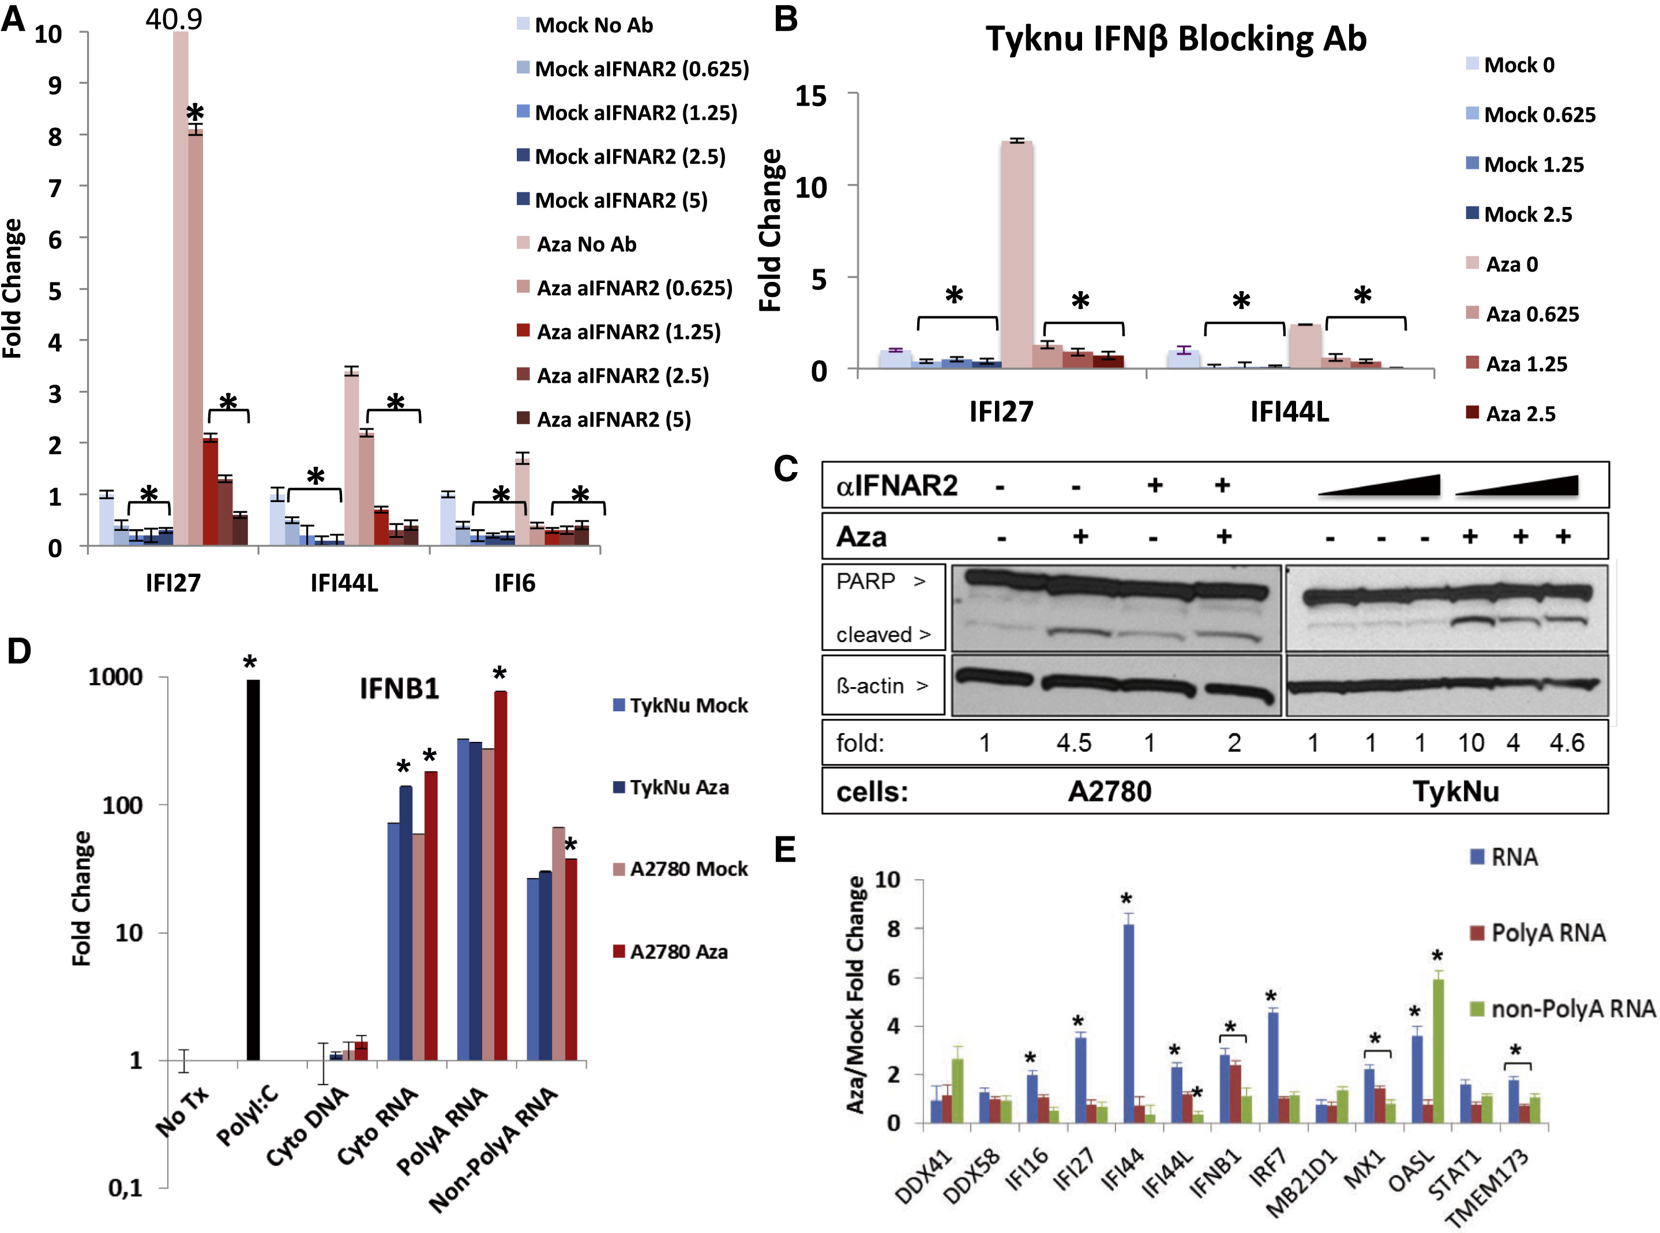
FIGURE 3

Slide 17
How does Aza trigger IFNβ production?
Schematic from Figure 2

Slide 18
How does Aza trigger IFNβ production?
Figure 3D
They purified different nucleic acid fractions from treated vs. untreated cells
Transfected those nucleic acids into a recipient cell line
Measured IFNB1 induction in the recipient cells
The fold change must be over untransfected cells, not Aza/Mock (as stated in the legend) …
(D) Indicated nucleic acids from the cytoplasm of A2780- or TykNu-treated cells with no drug (Mock) or 500 nM Aza (Aza) […] before transfection into recipient HT29 cells. y axis, fold change, Aza/Mock, for IFNβ1 transcript induced in HT29s
Notes:
1. No Tx = Control with no transfection.
2. Poly(I:C) = positive control for RNA-sensing pathway, confirm that the reporter cells can respond to dsRNA, to make sure that the transfections are working
3. Cytoplasmic DNA extracted from Aza-treated or mock-treated A2780/TykNu cells. To test whether Aza induces cytoplasmic DNA accumulation
(e.g., via DNA damage, cGAS pathway). DNA could theoretically activate cGAS → STING → IRF3. What it tells us: Cyto DNA from both mock and Aza shows almost no IFNB1 induction. So DNA is not the trigger
4. Total cytoplasmic RNA from mock or Aza donor cells. This RNA mixture contains mRNAs, noncoding RNAs, ERV transcripts, possible dsRNA hybrids… Does RNA from Aza-treated cells contain immunostimulatory material that induces IFNβ?

Slide 19
How does Aza trigger IFNβ production?
Figure 3D
What is the level of IFNB1 in untransfected (“Tx”) recipient cells?
What happens to IFNB1 when cells receive synthetic dsRNA (poly:IC)?
What happens to IFNB1 when cells receive cytoplasmic DNA from Aza-treated cells? And from mock-treated cells?
What happens to IFNB1 when cells receive cytosolic RNA from Aza-treated cells? And from mock-treated cells?
What is the difference between polyA RNA and non-polyA RNA?
Do you think this experiment answers the above question?
The fold change must be over untransfected cells, not Aza/Mock (as stated in the legend) …
(D) Indicated nucleic acids from the cytoplasm of A2780- or TykNu-treated cells with no drug (Mock) or 500 nM Aza (Aza) […] before transfection into recipient HT29 cells. y axis, fold change, Aza/Mock, for IFNβ1 transcript induced in HT29s
Notes:
1. No Tx = Control with no transfection.
2. Poly(I:C) = positive control for RNA-sensing pathway, confirm that the reporter cells can respond to dsRNA, to make sure that the transfections are working
3. Cytoplasmic DNA extracted from Aza-treated or mock-treated A2780/TykNu cells. To test whether Aza induces cytoplasmic DNA accumulation
(e.g., via DNA damage, cGAS pathway). DNA could theoretically activate cGAS → STING → IRF3. What it tells us: Cyto DNA from both mock and Aza shows almost no IFNB1 induction. So DNA is not the trigger
4. Total cytoplasmic RNA from mock or Aza donor cells. This RNA mixture contains mRNAs, noncoding RNAs, ERV transcripts, possible dsRNA hybrids… Does RNA from Aza-treated cells contain immunostimulatory material that induces IFNβ? Cyto RNA from both mock and Aza donors induces IFNB1.
But Aza-derived RNA induces more. Interpretation: RNA is sufficient to trigger IFNB1, and Aza increases immunogenic RNA species.
5. Polyadenylated RNA (mRNAs): ERV RNAs are often not polyadenylated or are poorly polyadenylated. … PolyA RNA = RNA molecules with a poly-adenylated tail (A-string) at the 3′ end. / Non-polyA RNA = all RNA molecules that lack a poly-A tail. PolyA RNA is mainly mature mRNA — the stuff cells want to express. Non-polyA RNA is everything else: noncoding RNAs, antisense, repeats, ERVs, and other ‘noisy’ transcripts.

Slide 20
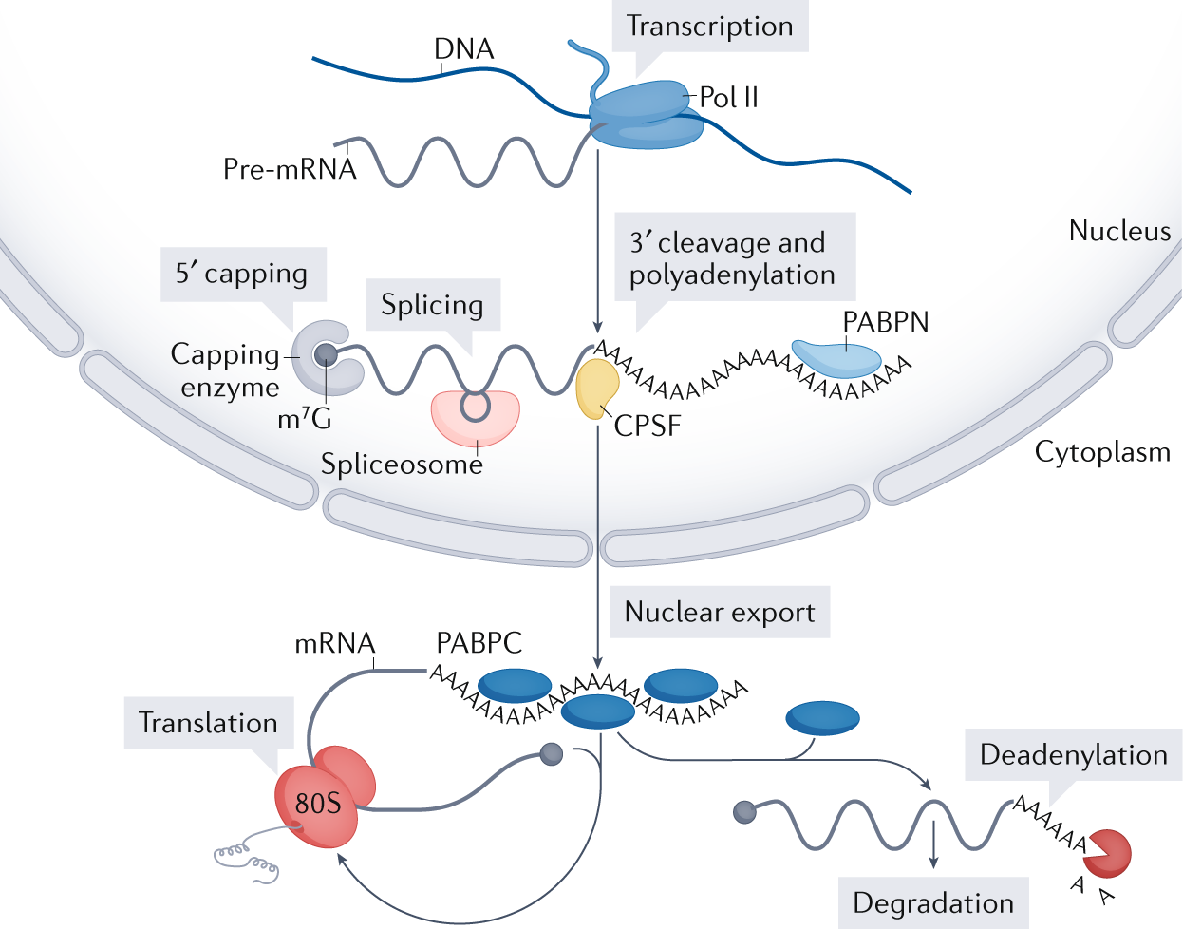
Passmore & Coller (2021, Nat Rev Mol Cell Biol)

Slide 21
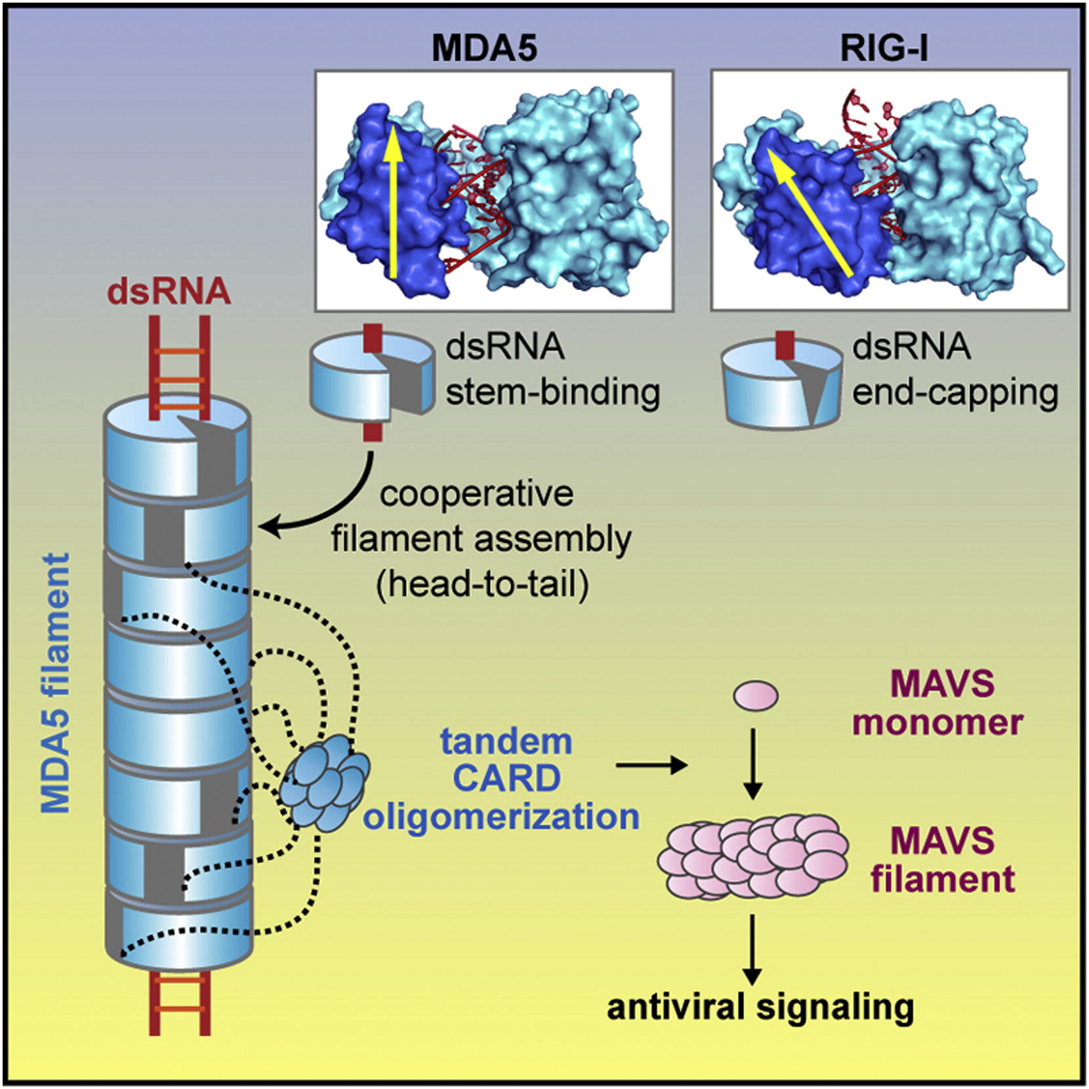
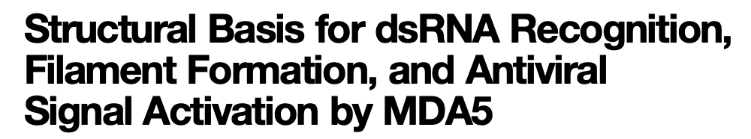
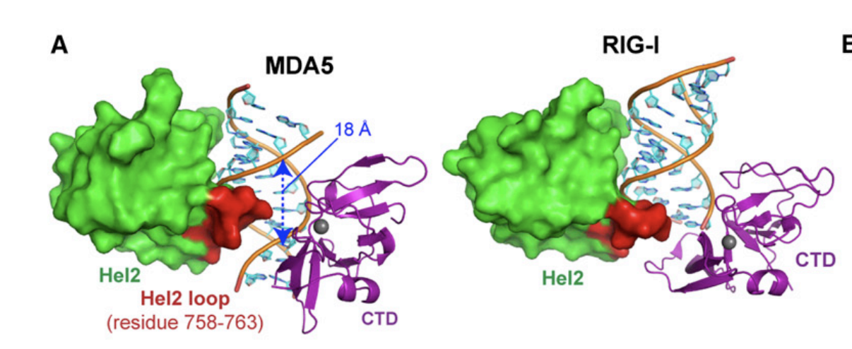
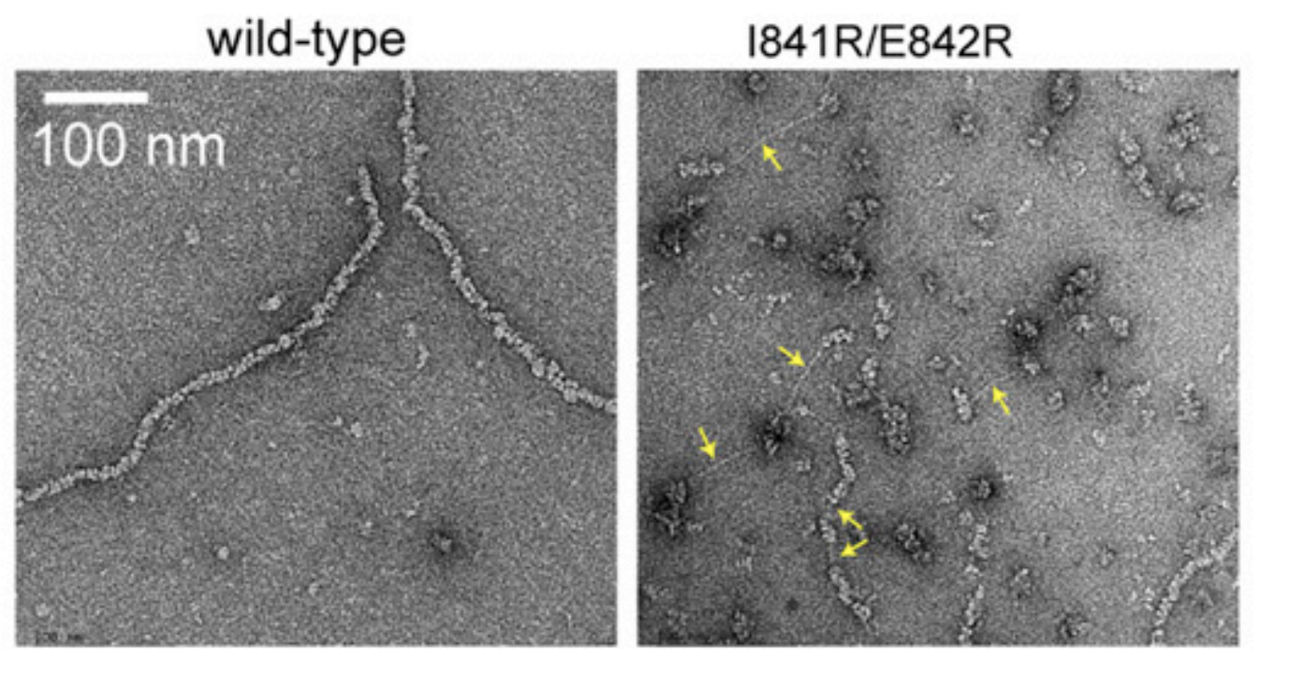
Wu et al. (2013, Cell)
Notes:
► MDA5 forms an open, C-shaped ring around the viral dsRNA stem ► The CTD of MDA5 has a different orientation and flexibility compared to RIG-I ► MDA5 forms filaments by stacking monomers head-to-tail with a 70° turn per monomer ► The 2CARD domain assembles into oligomers that activate interferon signaling via MAVS
https://www.cell.com/action/showPdf?pii=S0092-8674%2812%2901436-5
Fig 4: The Hel2 Loop Is Inserted into the Major Groove of dsRNA (A) Position of the Hel2 loop (red) relative to dsRNA in MDA5 (left) and RIG-I (right, 3TMI). The Hel2 loop of MDA5 is inserted into the major groove, which is accompanied by widening of the major groove from 12 A˚ to 18 A˚ , whereas the RIG-I loop is near the dsRNA end with little change in the width of the major groove. See also Figure S3B.
Fig 5: (I) Representative EM images of WT and I841R/E842R mutant MDA5DN (0.3 mM) bound to 1012 bp dsRNA (2.4 mg/ml). Long stretches of naked dsRNA exposed in the mutant complex are indicated by arrows. See also Figure S4.

Slide 22

Things I find strange about this experiment …
Figure 3D
HT29 are cGAS–STING deficient → they do not respond to DNA transfection.
Using HT29 – the results cannot reflect endogenous signaling in A2780/TykNu.
No DNA response in HT29 ≠ no DNA response in Aza-treated tumor cells.
Transfection is highly artificial → bypasses normal RNA localization/decay; even mock RNA becomes strongly immunogenic
The assay tests forced RNA delivery into a different cell line, not physiological dsRNA accumulation in Aza-treated cells.
Figure 3D cannot identify the endogenous trigger (RNA vs DNA) in the original system — it only shows RNA is sufficient in HT29, not that RNA is the true endogenous ligand.
Notes:
HT29 are cGAS-STING deficient, that is why they do not respond to DNA transfection at all
At the same time, what is the reason for introducing that specific cell line ? Results can not be linked to endogenous signaling in A2780/TykNu … Absence of DNA-induced IFNB1 in HT29 CANNOT be used to conclude absence of cGAS-STING signaling in the original Aza-treated cells?
Transfection is hyper-artificial, bypasses normal compartmentalization and decay etc. Just look at the response to dsRNA of the mock cells…
Related to prev, the experiment does not test physiological dsRNA accumulation, it tests what happens when purified RNA is forcibly introduced into an unrelated cell
Figure 3D simply can not say that the endogenous trigger in Aza-treated cells is RNA

Slide 23
How does Aza trigger IFNβ production?
Figure 3D
The only information I would take away from this data is that we can rule out cytoplasmic DNA as the immune substrate in this specific context.
So basically, if you purify RNA from Aza-treated cells and force it into the cytosol of a reporter cell, it induces IFNB1. DNA, here, does not.
Notes:
1. No Tx = Control with no transfection.
2. Poly(I:C) = positive control for RNA-sensing pathway, confirm that the reporter cells can respond to dsRNA, to make sure that the transfections are working
3. Cytoplasmic DNA extracted from Aza-treated or mock-treated A2780/TykNu cells. To test whether Aza induces cytoplasmic DNA accumulation
(e.g., via DNA damage, cGAS pathway). DNA could theoretically activate cGAS → STING → IRF3. What it tells us: Cyto DNA from both mock and Aza shows almost no IFNB1 induction. So DNA is not the trigger
4. Total cytoplasmic RNA from mock or Aza donor cells. This RNA mixture contains mRNAs, noncoding RNAs, ERV transcripts, possible dsRNA hybrids… Does RNA from Aza-treated cells contain immunostimulatory material that induces IFNβ? Cyto RNA from both mock and Aza donors induces IFNB1.
But Aza-derived RNA induces more. Interpretation: RNA is sufficient to trigger IFNB1, and Aza increases immunogenic RNA species.
5. Polyadenylated RNA (mRNAs): ERV RNAs are often not polyadenylated or are poorly polyadenylated. … PolyA RNA = RNA molecules with a poly-adenylated tail (A-string) at the 3′ end. / Non-polyA RNA = all RNA molecules that lack a poly-A tail. PolyA RNA is mainly mature mRNA — the stuff cells want to express. Non-polyA RNA is everything else: noncoding RNAs, antisense, repeats, ERVs, and other ‘noisy’ transcripts.

Slide 24
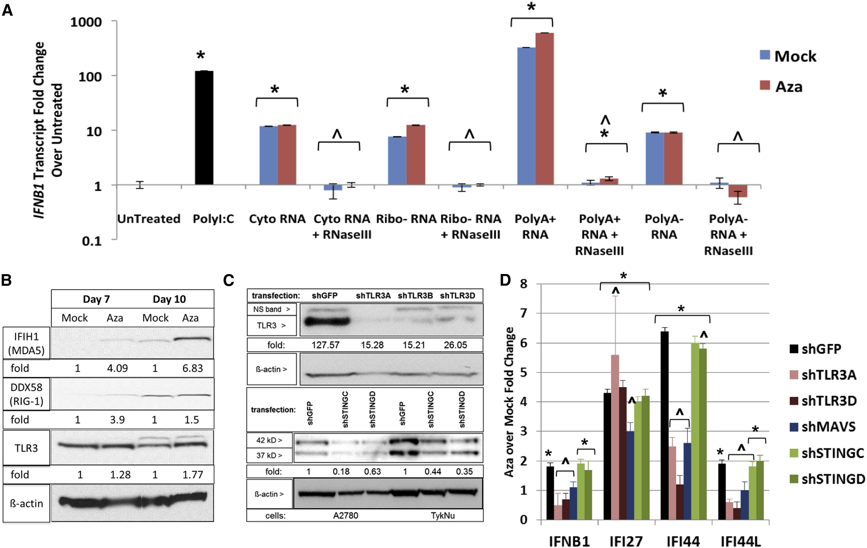
FIGURE 4

Slide 25
Figure 4D.
“sh” = short hairpin RNA, a method to target specific genes and downregulate their expression
Let’s go through the genes that they knock down – which ones do you recognize?
How does the knockdown of TLR3 affect IFNB1 transcription in Aza-treated cells?
How does the knockdown of STING affect IFNB1 transcription in Aza-treated cells?
What do you think of the behaviour of the other ISGs?
Their interpretation of the data: In A2780 cells, TLR3 and MAVS, but not STING, contribute to Aza-induced IFNB1/ISGs.
Notes:
Note that TLR3 knockdown reduces IFNB1 but not IFI27 … maybe TLR3 is not the sole upstream receptor. Cytosolic dsRNA sensing (MDA5/RIG-I → MAVS) maybe compensates for TLR3 loss ? The authors don’t discuss this nuance, but maybe it aligns with sensor redundancy in antiviral pathways….

Slide 26
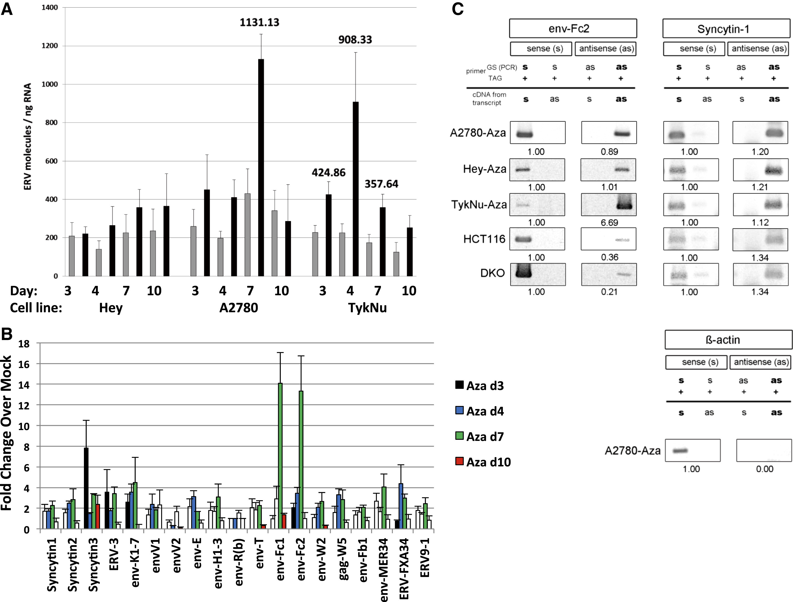
FIGURE 5

Slide 27
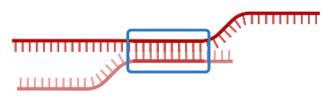
Q: What is the source of the dsRNA ?
Transposable elements
As their sequences are highly repetitive, it is easy for dsRNA byproducts to form

Slide 28
Figure 5A.
Figure 5C.
Why is there no antisense β-actin band?
Why does the presence of both sense & antisense ERV transcripts support the idea that Aza-treated cells produce dsRNA?
(A) Total number of molecules for all ERV genes (y axis = ERV molecules/ng RNA). Error bars, SEM for four independent experiments; numbers above bars, significant data for indicated days; gray, Mock; black, Aza.
Which control is arguably missing?
Notes:
They used a qPCR-based quantification of total ERV copy number using primers targeting a conserved region shared across many ERV families.
Results were then normalized to total input RNA (ng).
So “ERV molecules/ng RNA” = number of ERV amplicons detected per ng of total RNA extracted from the cells
Q: Why does the appearance of both sense and antisense ERV transcripts support the idea that Aza-treated cells produce dsRNA? → Because complementary RNAs from the same locus can anneal → dsRNA formation
Q: Why is there no antisense β-actin band? → β-actin is not bidirectionally transcribed, validating the assay

Slide 29
Figure 5A.
Figure 5C.
(A) Total number of molecules for all ERV genes (y axis = ERV molecules/ng RNA). Error bars, SEM for four independent experiments; numbers above bars, significant data for indicated days; gray, Mock; black, Aza.
Aza-treated cells express sense and antisense ERV transcripts
Bidirectional transcription → these RNAs can hybridize into dsRNA
Notes:
They used a qPCR-based quantification of total ERV copy number using primers targeting a conserved region shared across many ERV families.
Results were then normalized to total input RNA (ng).
So “ERV molecules/ng RNA” = number of ERV amplicons detected per ng of total RNA extracted from the cells
Figure 5C demonstrates that Aza-treated cells express both sense and antisense ERV transcripts, enabling dsRNA formation.
However, the figure does not include untreated controls, so we cannot determine from this panel alone whether antisense transcription is specifically induced by Aza or already present at baseline.
Other figures (ERV upregulation + demethylation) make induction plausible, but Figure 5C itself only shows the presence of bidirectional transcripts in Aza-treated cells.

Slide 30
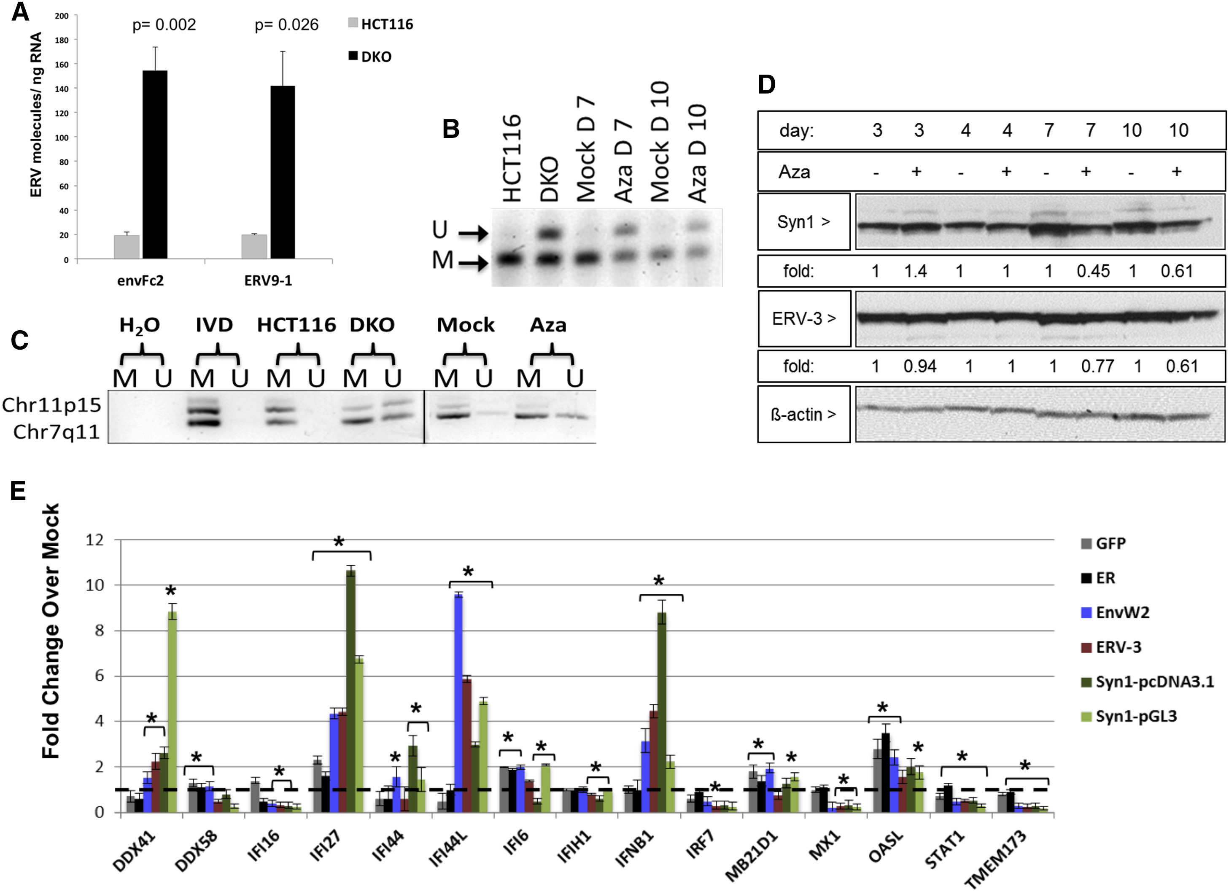
FIGURE 6

Slide 31
Figure 6E.
(E) Transfection of full-length env genes from EnvW2, ERV-3, or Syncytin-1 or EGFP and ER controls in TykNu cells. qRT-PCR was performed for ISGs 7 days after transfection.
They overexpressed different ERVs (Syncytin-1 / ERV-3 / EnvW2) and compared to a regular plasmid transfection (GFP) → ERV-specific ISG induction
ERV transcripts can trigger antiviral responses
Notes:
They used a qPCR-based quantification of total ERV copy number using primers targeting a conserved region shared across many ERV families.
Results were then normalized to total input RNA (ng).
So “ERV molecules/ng RNA” = number of ERV amplicons detected per ng of total RNA extracted from the cells

Slide 32
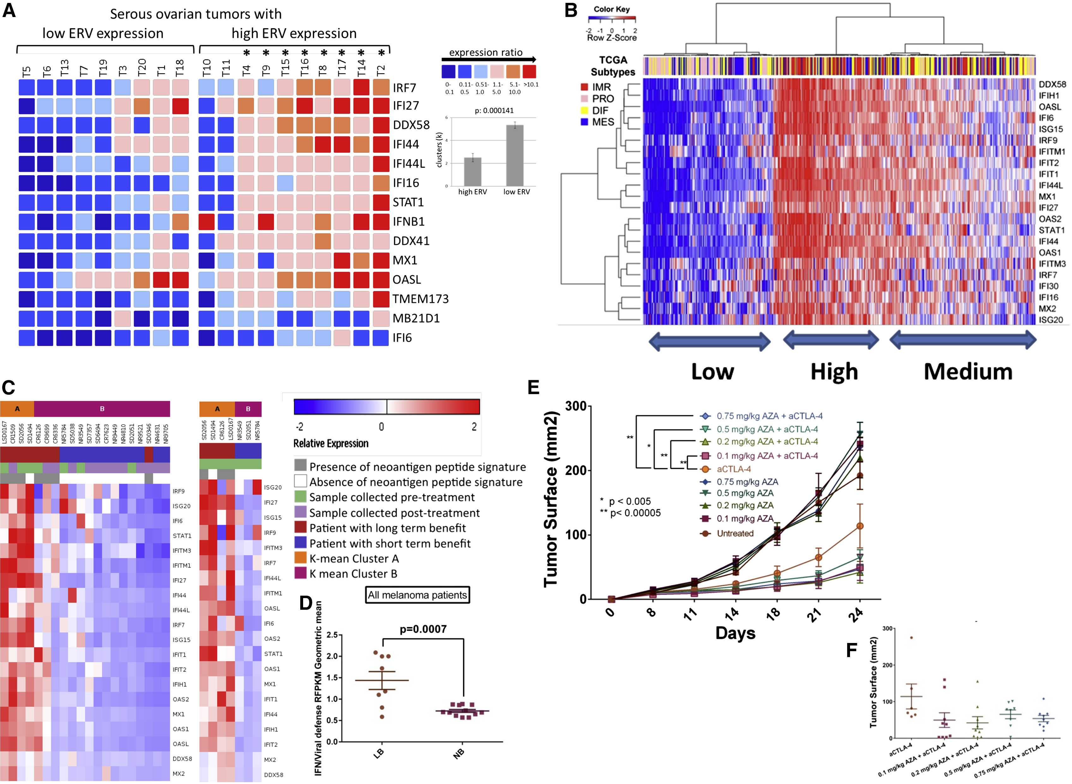
FIGURE 7

Slide 33
Figure 7E.
Tumour growth curves in mice (B16-F10 melanoma)
Four treatment types
- Untreated
- anti-CTLA-4
- Aza
- Aza + anti-CTLA-4 combo therapy
What is CTLA-4? Is it inflammatory or anti-inflammatory?
Notes:
CTLA-4 blockade: An immunotherapy (a checkpoint inhibitor) that enhances T-cell activation against tumors.
Recap of CTLA-4 biology…. CTLA-4 is on activated CD4 and CD8 T cells. Constitutively high on Treg cells. Competes with CD28 for binding CD80/CD86 (B7-1/B7-2) on antigen-presenting cells (APCs).
CTLA-4 has higher affinity → “steals” B7 ligands → raises the activation threshold for T cells.
Which treatment group shows the strongest tumor growth inhibition? → Aza + anti–CTLA-4.
Why might Aza pretreatment sensitize tumors to CTLA-4 blockade? → Aza → ERV activation → dsRNA → IFN → T-cell priming → improved immunotherapy. The idea of their interaction… DNMTi makes the tumor more visible and immunogenic; anti–CTLA-4 amplifies and unleashes the T-cell response against those newly visible antigens.
What additional experiment would you do to prove that ERV/dsRNA induction is necessary for this synergy? → Do the combination in MAVS KO tumors, use STING KO to test DNA-pathway contributions, use ERV knockdowns…
Aza alone at any dose does not produce strong tumor suppression — all Aza-only curves cluster around untreated from day ~11 onward.

Slide 36
Figure 7E.
Tumour growth curves in mice (B16-F10 melanoma)
Four treatment types
- Untreated
- anti-CTLA-4
- Aza
- Aza + anti-CTLA-4 combo therapy
What is CTLA-4? Is it inflammatory or anti-inflammatory?
What outcome would you expect when combining anti-CTLA-4 with Aza?
Which treatment is working best?
How well is Aza working by itself?
Does this seem like the ‘simplest’ solution to you to achieve this effect?
Notes:
CTLA-4 blockade: An immunotherapy (a checkpoint inhibitor) that enhances T-cell activation against tumors.
Recap of CTLA-4 biology…. CTLA-4 is on activated CD4 and CD8 T cells. Constitutively high on Treg cells. Competes with CD28 for binding CD80/CD86 (B7-1/B7-2) on antigen-presenting cells (APCs).
CTLA-4 has higher affinity → “steals” B7 ligands → raises the activation threshold for T cells.
Which treatment group shows the strongest tumor growth inhibition? → Aza + anti–CTLA-4.
Why might Aza pretreatment sensitize tumors to CTLA-4 blockade? → Aza → ERV activation → dsRNA → IFN → T-cell priming → improved immunotherapy. The idea of their interaction… DNMTi makes the tumor more visible and immunogenic; anti–CTLA-4 amplifies and unleashes the T-cell response against those newly visible antigens.
What additional experiment would you do to prove that ERV/dsRNA induction is necessary for this synergy? → Do the combination in MAVS KO tumors, use STING KO to test DNA-pathway contributions, use ERV knockdowns…
Aza alone at any dose does not produce strong tumor suppression — all Aza-only curves cluster around untreated from day ~11 onward.

Slide 37
In summary: DNMTi treatment (AZA) → endogenous retrovirus re-activation → cytosolic dsRNA sensing → type I interferon response → sensitization to immune checkpoint blockade
Notes:
DNMTi → ERV demethylation → dsRNA → IFN-I pathway → viral defense signature → CTLA-4 trial + B16 anti-CTLA-4 sensitization

Slide 38
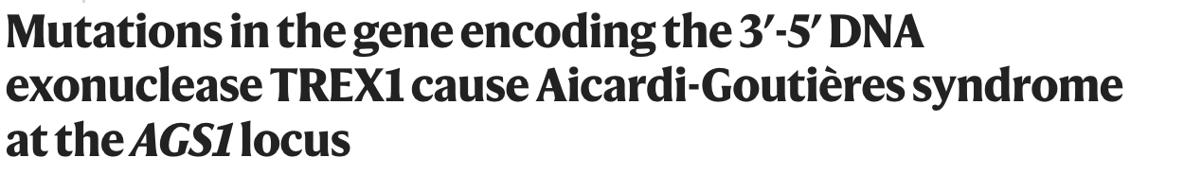
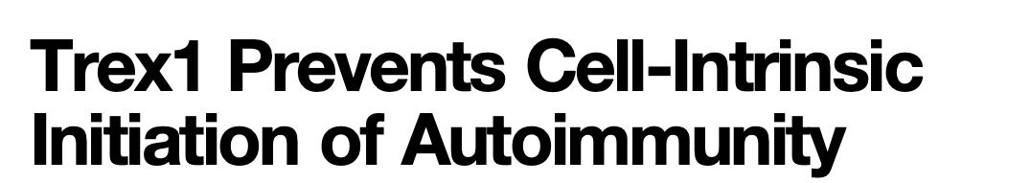
Call-back to our first exercise session
Crow et al. (2006, Nat Genetics)
Stetson, Ko, Heidmann & Medzhitov (2009, Cell)

Slide 39
Call-back to our first exercise session
Endogenous immunostimulatory nucleic acids in autoimmune disease
Notes:
Low concentrations of nucleic acids arising from the reverse transcription of endogenous retroelements are kept in check by AGS-related enzymes. We predict that the sensitivity of the sensors of DNA (left) must be above that threshold to prevent inappropriate activation of the DNA-sensing pathway and autoimmune disease. That level of detection would help DNA viruses to maintain their genome in the nucleus during latent infection. We predict that during latency, some DNA viruses would act to inhibit the DNA-sensing pathway and thereby raise the threshold needed to initiate an immune response. During AGS, the burden of nucleic acids from endogenous retroelements reaches a concentration now detectable by the sensors of DNA and initiates a chronic immune response that leads to autoimmune disease. The threshold of sensitivity for sensors of RNA (right) can be much lower because of a lack of endogenous RNA ligands. HSV, herpes simplex virus.

Slide 40
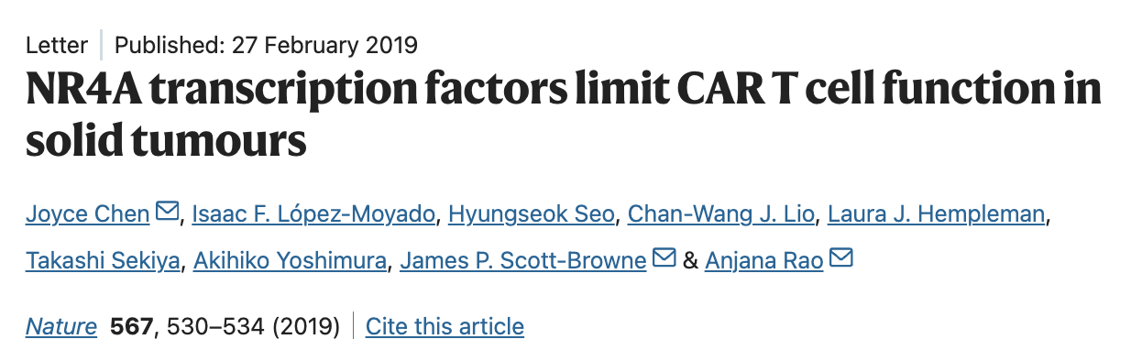

Slide 41
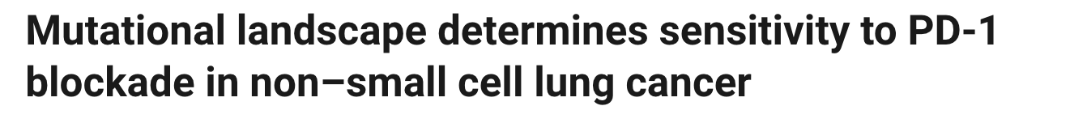
How does a patient’s genetic background influence treatment efficacy?
Rizvi et al. (2015, Science)

Slide 42
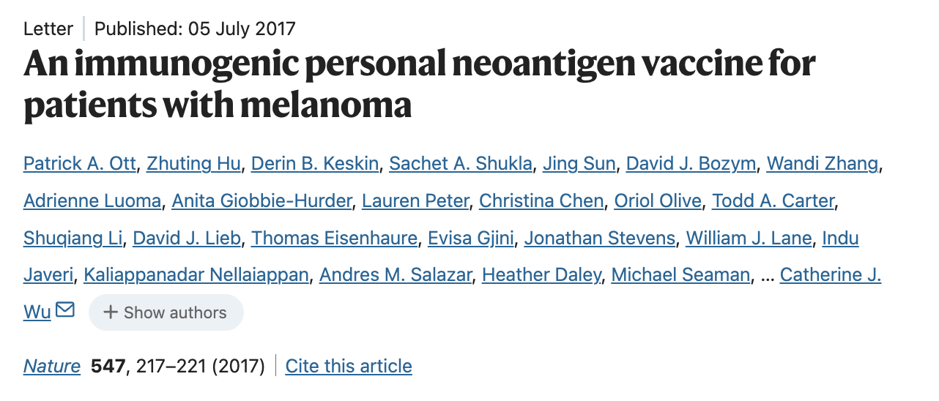
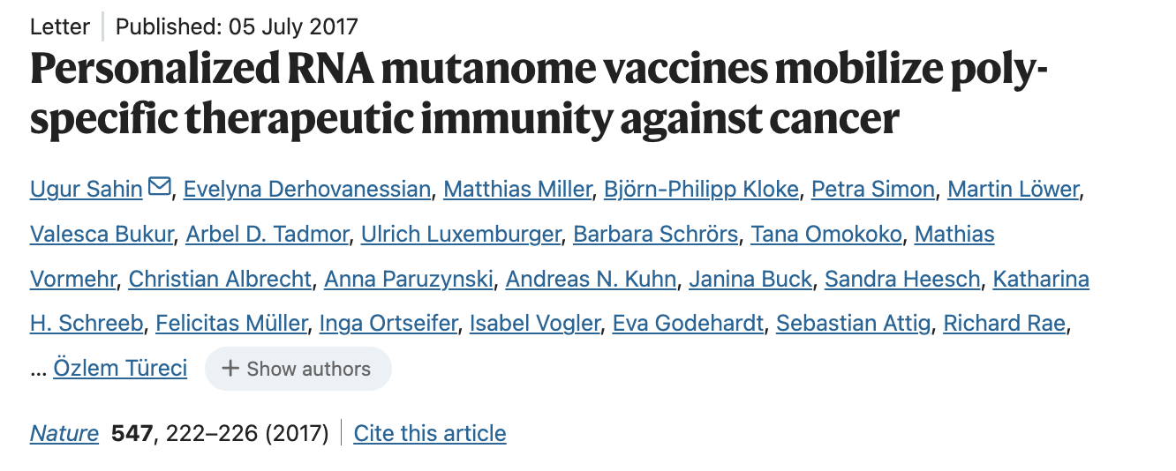
Rise of personalized cancer treatments ?

