Slide 2
Introduction
Transplantation of cells and organs offers huge potential for many diseases that currently lack efficient therapies
An inherent problem of transplanting allogeneic cells or tissues is their recognition by the immune system
Immunosuppression is common, but has substantial shortcomings, and is insufficient for long-term tolerance
The generation of “universal cells”, which are invisible to the recipient immune system, offers an alternative to overcome the immune destruction of transplants
What is an allogeneic transplant?
What is the usual approach to avoid this immune recognition?
Do you remember any of the mentioned immunosuppressants, and their associated side effects?
Can you think of any immune hurdles that a “universal donor cell” must overcome?
Notes:
Answer 1: a transplant betweeen genetically different individuals of the same species. Allograft = Tissue transferred between genetically different individuals of the same species (most common type of human transplant).
Answer 2: Immunosupression. Immunosuppression prevents acute rejection but causes infections, malignancies, nephrotoxicity, and does not induce true tolerance.
Answer 3: Calcineurin inhibitors (e.g., cyclosporine, tacrolimus) → Nephrotoxicity, hypertension, neurotoxicity, metabolic side effects. // Antimetabolites (e.g., azathioprine, mycophenolate mofetil): → Bone-marrow suppression, GI toxicity, infection risk. // Corticosteroids → Broad immunosuppression, metabolic syndrome, osteoporosis, increased infection risk. // mTOR inhibitors (e.g., sirolimus/rapamycin) → Delayed wound healing, dyslipidemia, cytopenias. // Depleting antibodies (e.g., ATG, alemtuzumab) → Profound lymphopenia, cytokine-release reactions, infection/malignancy risk. // Anti–IL-2R antibodies (e.g., basiliximab) → Fewer acute side effects; risk mainly tied to over-immunosuppression (infections).
Answer 4: CD8 T cells – they recognize foreign MHC class I and kill mismatched donor cells; NK cells – they kill cells that lack MHC class I, interpreting this as “abnormal” or “danger.; Anti-HLA antibodies – antibodies already present in many patients can bind donor MHC molecules and destroy the cells through complement.

Slide 3
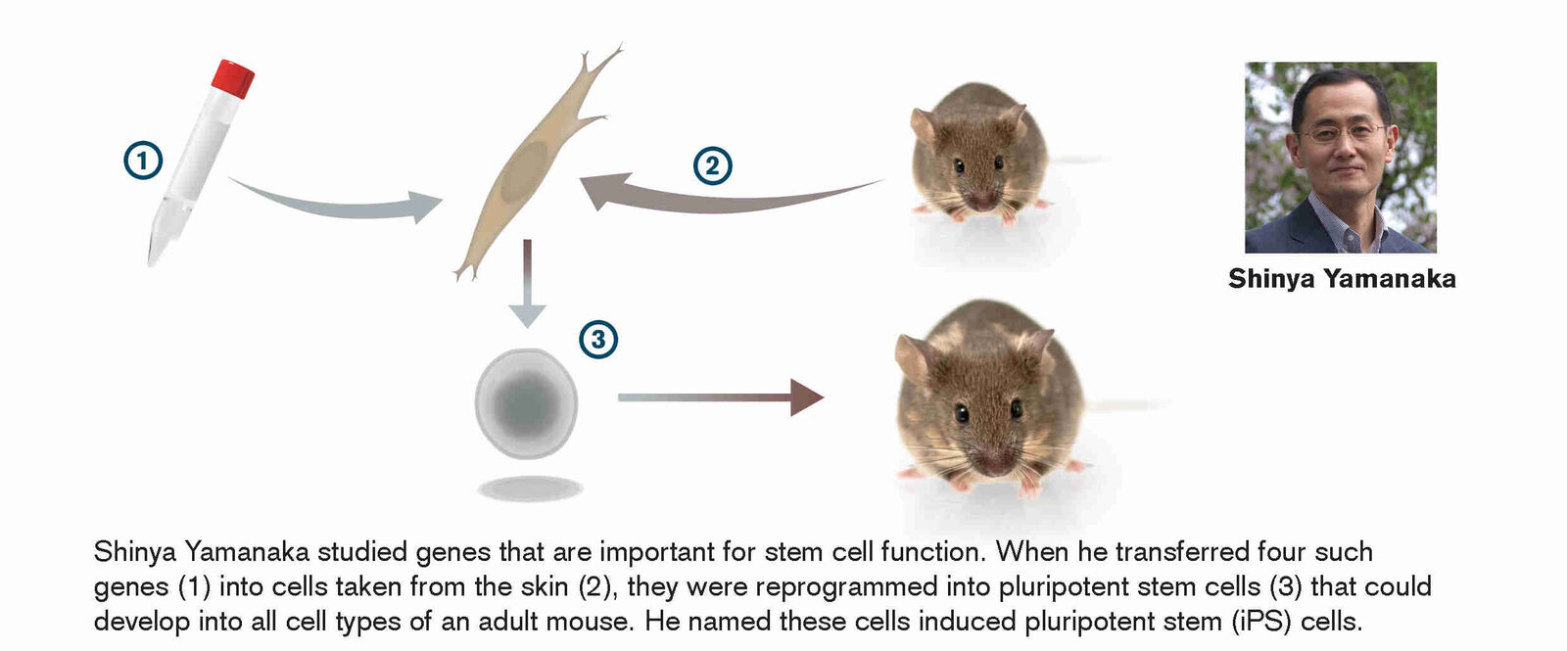
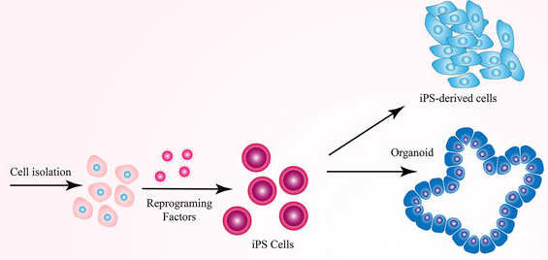

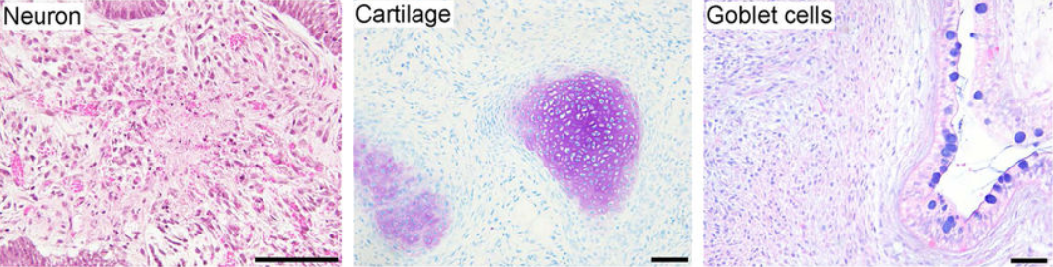
Pluripotent stem cells
2012 Nobel prize in Physiology or Medicine
Healthy donor
Notes:
Before we dive into the HLA-E paper, let’s remind ourselves why universal donor stem cells would actually matter clinically.
Pluripotent stem cells can differentiate into almost any cell type in the body, and many of these tissues are already being tested or envisioned as therapies

Slide 4
Notes:
Before we dive into the HLA-E paper, let’s remind ourselves why universal donor stem cells would actually matter clinically.
Pluripotent stem cells can differentiate into almost any cell type in the body, and many of these tissues are already being tested or envisioned as therapies
For example, on the left, we see retinal pigment cells for treating ocular diseases like macular degeneration; cardiac progenitors for repairing damaged myocardium after a heart attack; and insulin-producing beta cells that could one day replace insulin injections in diabetes.
On the right, we have vascular progenitors that might help with limb ischemia, organ failure, or diabetic microvascular complications. And at the bottom, blood and immune-cell products — platelets, red blood cells, and even CAR-T or CAR-NK cells — could be generated from universal PSCs for transfusion or cancer therapy.
So the big idea is this: across multiple organs and diseases, stem-cell–derived products could treat millions of patients — if we can overcome immune rejection. That’s exactly the challenge the HLA-E engineering paper tries to solve.

Slide 5
Why would PSCs be an allograft?
Why not just use patient-derived (autologous) PSCs?
Generating autologous PSCs takes months and is extremely costly
Hard to scale → each patient needs a custom manufacturing pipeline
PSCs would carry the patient’s genetic disease mutations
Not all patients can donate suitable starting cells
Therefore: universal donor PSCs would be far more practical

Slide 6
MHC molecules / HLA
Major mediator of immune rejection of transplants
HLA-I: expressed on the surface of all nucleated cells and present antigens to CD8 T cells
HLA-II: majorly expressed on antigen- presenting cells and engages CD4 T cells
Classical HLA-I (HLA-A, -B, -C): highly polymorphic
They can present diverse peptides to CD8 T cells, variation helps population survive pathogens
Non-classical HLA-I (HLA-E, -F, -G): limited polymorphism
Challenge #1: how to avoid this
Notes:
Before we look at the engineered HLA-E PSCs, let’s briefly remind ourselves what MHC molecules actually do in transplantation.
MHCs - or HLAs - are the main reason why allogeneic transplants get rejected. They’re extremely polymorphic, meaning every person has their own unique set. So when donor cells express a different HLA than the recipient, the recipient’s immune system sees those HLAs as foreign.
Class I molecules — HLA-A, -B, and -C — are on virtually all nucleated cells and present peptides to CD8 T cells. If the CD8 T cell recognizes this HLA as foreign, you get killing of the donor cell, as shown in the cartoon on the right.
Class II molecules are mostly on antigen-presenting cells and interact with CD4 T cells, but for most cell therapies, it’s mismatched class I that triggers the strongest and fastest rejection.
So the challenge for creating universal donor PSCs is: how do we prevent donor cells from being attacked by CD8 T cells due to mismatched HLA class I?
Why focus on HLA-I vs HLA-II?
For the purpose of generating universal donor stem cells, the biggest challenge we need to solve is class I HLA, not class II.
Why? Because class I is present on every single nucleated cell in the body, including pluripotent stem cells and all of their derivatives.
This means any PSC-derived tissue will automatically display HLA-A, -B, and -C to the recipient’s CD8 T cells — and mismatched class I triggers very rapid killing.
In contrast, class II is mainly expressed by professional antigen-presenting cells — dendritic cells, macrophages, B cells — and PSC-derived grafts don’t typically express class II unless they become inflamed.
So the most immediate barrier for universal donor PSCs is really CD8 T-cell recognition through HLA class I.

Slide 7
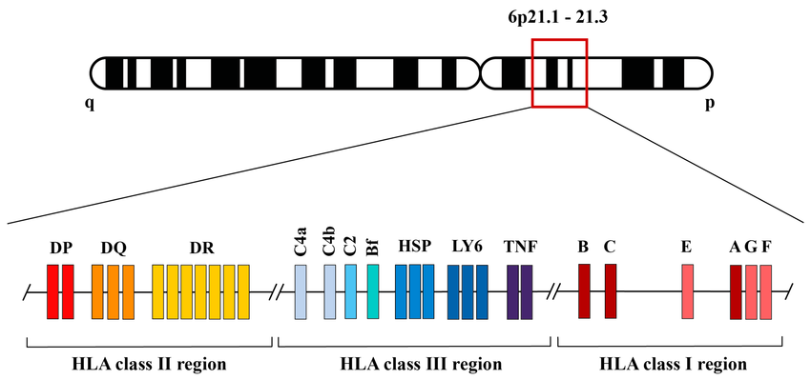

(Non)-classical HLA
*
*
*
Suarez-Trujillo et al. 2024 IJMS
Notes:
https://www.researchgate.net/publication/384599765_The_Immune_Modulation_HLA-G010101_Full_Allele_Is_Associated_with_Gastric_Adenocarcinoma_Development

Slide 8
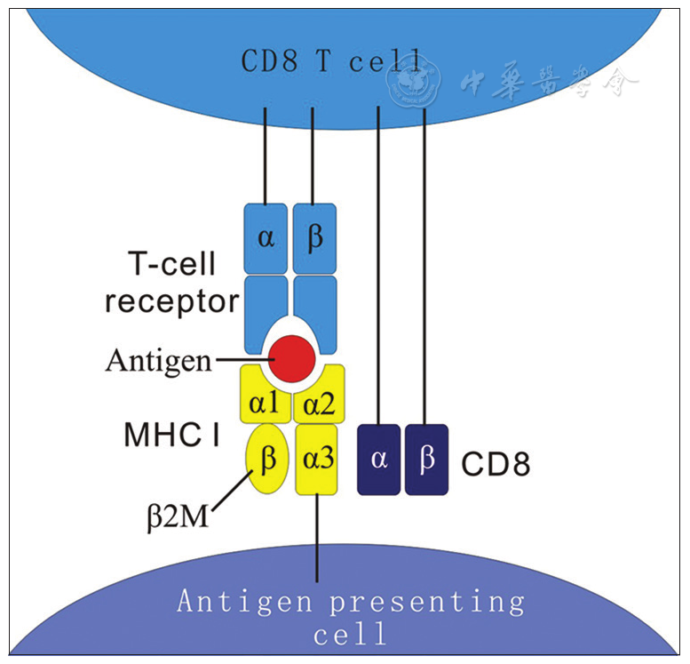
The MHC I complex is anchored via β2M
Li et al. 2016 MedNexus
Notes:
What happens in the regular scenario?
Polymorphic HLA class I (normal situation):
- All of our cells normally show classical HLA class I molecules — HLA-A, HLA-B, HLA-C.
- Because these molecules vary so much from person to person, they are the main reason the immune system recognizes donor cells as ‘foreign’
- They activate CD8 T cells, and they are also the targets of anti-HLA antibodies.

Slide 9
Can’t we just knock out β2M?
No HLA, no problem?
Notes:
Deleting all HLA class I by knocking out β2-macroglobulin
- One idea is to get rid of all classical HLA molecules by deleting β2-microglobulin — the piece needed for HLA class I to reach the cell surface.
- This prevents recognition by CD8 T cells, which is good.
- But the problem is: cells with no HLA look dangerous to natural killer cells.
- NK cells interpret the absence of HLA as a ‘missing-self’ signal and will kill these cells.
a | On interacting with a normal, autologous target cell, a natural killer (NK) cell might receive activating signals; however, because the target cell expresses the appropriate self-MHC class I alleles, the NK cell does not lyse the target cell. This is a consequence of inhibitory signals from the ligated MHC-binding receptor at the surface of the NK cell. b | If the target cell loses expression of MHC class I molecules, owing to viral infection or transformation, then the MHC-binding inhibitory receptor at the surface of the NK cell is not engaged. In this way, the NK cell does not receive inhibitory signals and therefore lyses the target cell. In this case, the target cell is perceived by the NK cell to be missing self. c | In the setting of an allogeneic transplant, host NK cells interact with donor target cells that express foreign MHC class I alleles. In most cases, the foreign, non-self-MHC class I molecules do not engage all of the inhibitory receptors at the surface of a host NK cell. This leads to lysis of the allogeneic cells by host NK cells. https://www.nature.com/articles/nri1603 Figure 1: NK-cell self-tolerance and the 'missing-self' hypothesis.

Slide 10
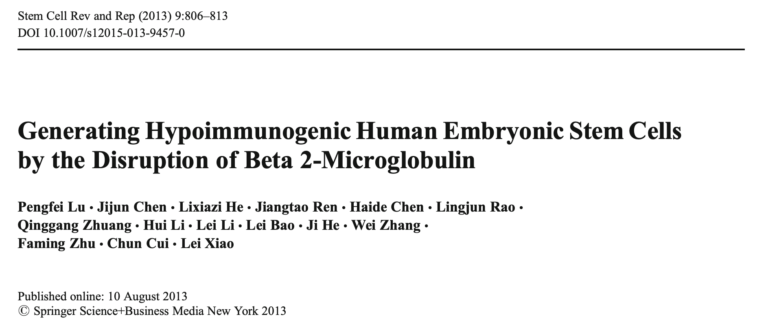
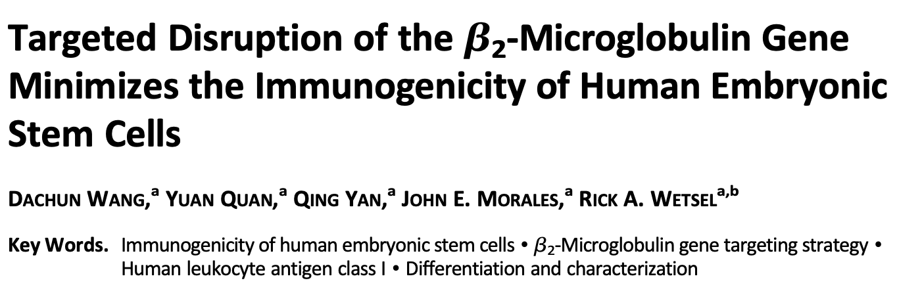
It’s been done, but what could the issue be?

Slide 11
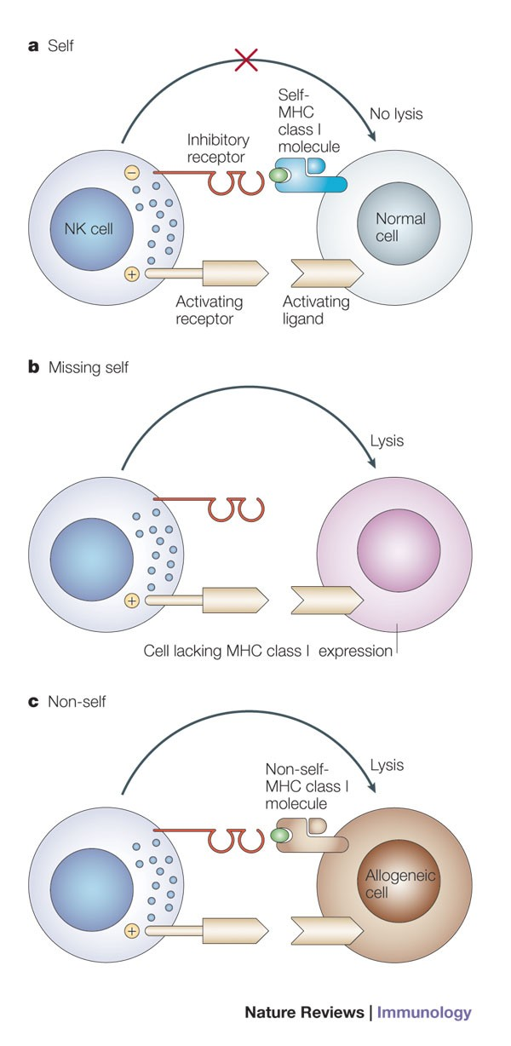
Can’t we just knock out β2M?
No HLA, no problem?
Kumar & McNerney, 2005 Nature Reviews Immunology
Notes:
Deleting all HLA class I by knocking out β2-macroglobulin
- One idea is to get rid of all classical HLA molecules by deleting β2-microglobulin — the piece needed for HLA class I to reach the cell surface.
- This prevents recognition by CD8 T cells, which is good.
- But the problem is: cells with no HLA look dangerous to natural killer cells.
- NK cells interpret the absence of HLA as a ‘missing-self’ signal and will kill these cells.
a | On interacting with a normal, autologous target cell, a natural killer (NK) cell might receive activating signals; however, because the target cell expresses the appropriate self-MHC class I alleles, the NK cell does not lyse the target cell. This is a consequence of inhibitory signals from the ligated MHC-binding receptor at the surface of the NK cell. b | If the target cell loses expression of MHC class I molecules, owing to viral infection or transformation, then the MHC-binding inhibitory receptor at the surface of the NK cell is not engaged. In this way, the NK cell does not receive inhibitory signals and therefore lyses the target cell. In this case, the target cell is perceived by the NK cell to be missing self. c | In the setting of an allogeneic transplant, host NK cells interact with donor target cells that express foreign MHC class I alleles. In most cases, the foreign, non-self-MHC class I molecules do not engage all of the inhibitory receptors at the surface of a host NK cell. This leads to lysis of the allogeneic cells by host NK cells. https://www.nature.com/articles/nri1603 Figure 1: NK-cell self-tolerance and the 'missing-self' hypothesis.

Slide 12
So, to recap: MHC-I interactions
With NK cells:
“Is MHC-I present?”
If no → “missing self” → NK-mediated killing
With CD8 T cells:
”Which peptide is present on MHC-I?”
Peptides are scanned by TCR – if foreign → CD8 T-cell mediated killing
Inhibitory receptor unbound

Slide 13
Adding a non-polymorphic HLA molecule
While different HLA-A complexes will bind different peptides across individuals, HLA-E complex will bind the same peptides in almost everyone
HLA-E looks identical across individuals AND presents identical peptides across individuals → CD8 T cells ignore it, NK inhibitory receptors recognize it
Notes:
Adding back a non-polymorphic HLA molecule (HLA-E, HLA-F, or HLA-G):
A smarter solution is to add back a single, non-polymorphic HLA molecule — for example HLA-E.
This molecule doesn’t activate CD8 T cells, but it sends an inhibitory signal to NK cells, telling them ‘don’t kill this cell.’
So this approach avoids both CD8 T-cell rejection and NK-cell killing.
So the key idea is: remove the polymorphic HLAs that trigger rejection, but add back a non-polymorphic HLA that keeps NK cells calm.

Slide 14
So, to recap: MHC-I interactions
With NK cells:
“Is MHC-I present?”
If no → “missing self” → NK-mediated killing
With CD8 T cells:
”Which peptide is present on MHC-I?”
Peptides are scanned by TCR – if foreign → CD8 T-cell mediated killing
AVOID THIS: DISPLAY MHC
AVOID THIS: Display non-canonical HLA
Inhibitory receptor unbound

Slide 15
The idea:
2. Re-introduce β2M fused to HLA-E
1. Knock out β2M
Engineered cells that express HLA-E as their only surface HLA class I molecule
Notes:
Adding back a non-polymorphic HLA molecule (HLA-E, HLA-F, or HLA-G):
A smarter solution is to add back a single, non-polymorphic HLA molecule — for example HLA-E.
This molecule doesn’t activate CD8 T cells, but it sends an inhibitory signal to NK cells, telling them ‘don’t kill this cell.’
So this approach avoids both CD8 T-cell rejection and NK-cell killing.
So the key idea is: remove the polymorphic HLAs that trigger rejection, but add back a non-polymorphic HLA that keeps NK cells calm.

Slide 16
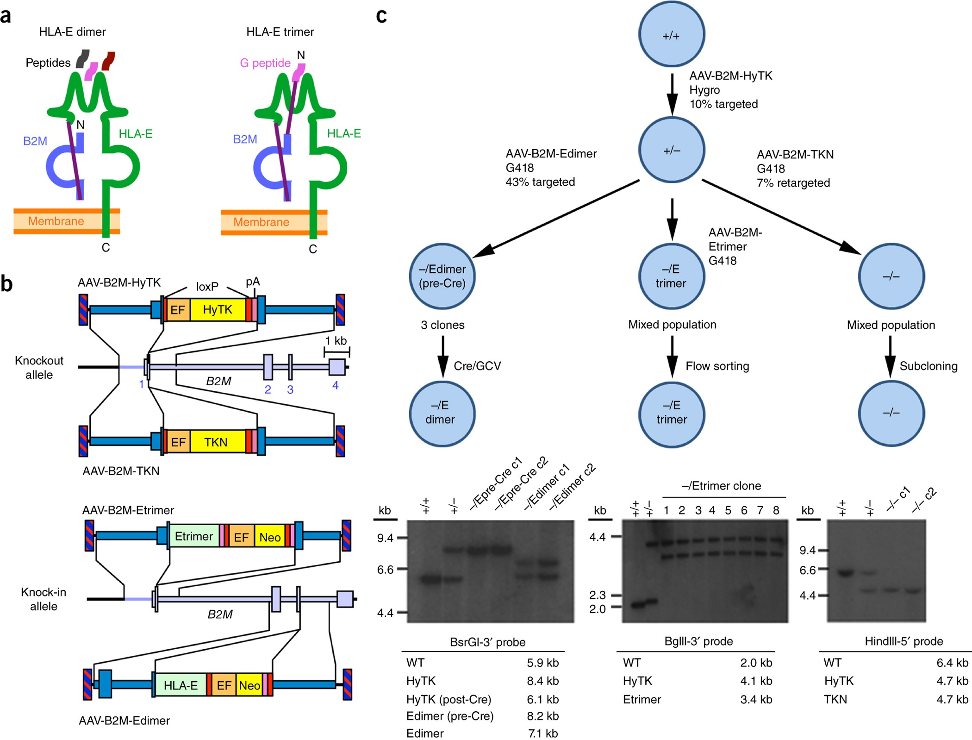
Cell engineering strategy
β2M – HLA-E fusion (“dimer”) that can bind available peptides
β2M – HLA-E – pre-bound peptide “trimer”
Adeno-associated viral vector (AAV) delivery strategy delivers single-stranded DNA with the indicated constructs
What could be the reason for this construct?
Is there a reason to insert the β2M – HLA-E fusion product at the original β2M genomic locus? Could they have just inserted it anywhere else in the genome?
Notes:
To engineer universal donor PSCs, the authors modify the B2M gene, which normally allows all classical MHC-I molecules to be displayed. They create three types of edited cells.
On the left is the HLA-E dimer construct. This is HLA-E linked to β2-microglobulin, just like a natural MHC-I molecule. It can load whatever peptides the cell provides, but because peptide loading may be inefficient, its surface expression can be low
In the middle is the HLA-E trimer. Here, the peptide is already attached to the molecule. Because the complex is pre-assembled, it folds well and reaches the cell surface much more efficiently. This usually gives stronger and more reliable HLA-E expression.
On the right is the complete B2M knockout. These cells cannot display any form of MHC-I at all. That makes them invisible to CD8 T cells — but extremely sensitive to NK-cell ‘missing-self’ killing. So this serves as a key control condition.
To generate each of these lines, the authors use adeno-associated virus to insert the constructs at the B2M locus, first targeting one allele and then modifying the second allele to produce either the dimer, the trimer, or the full knockout.

Slide 17
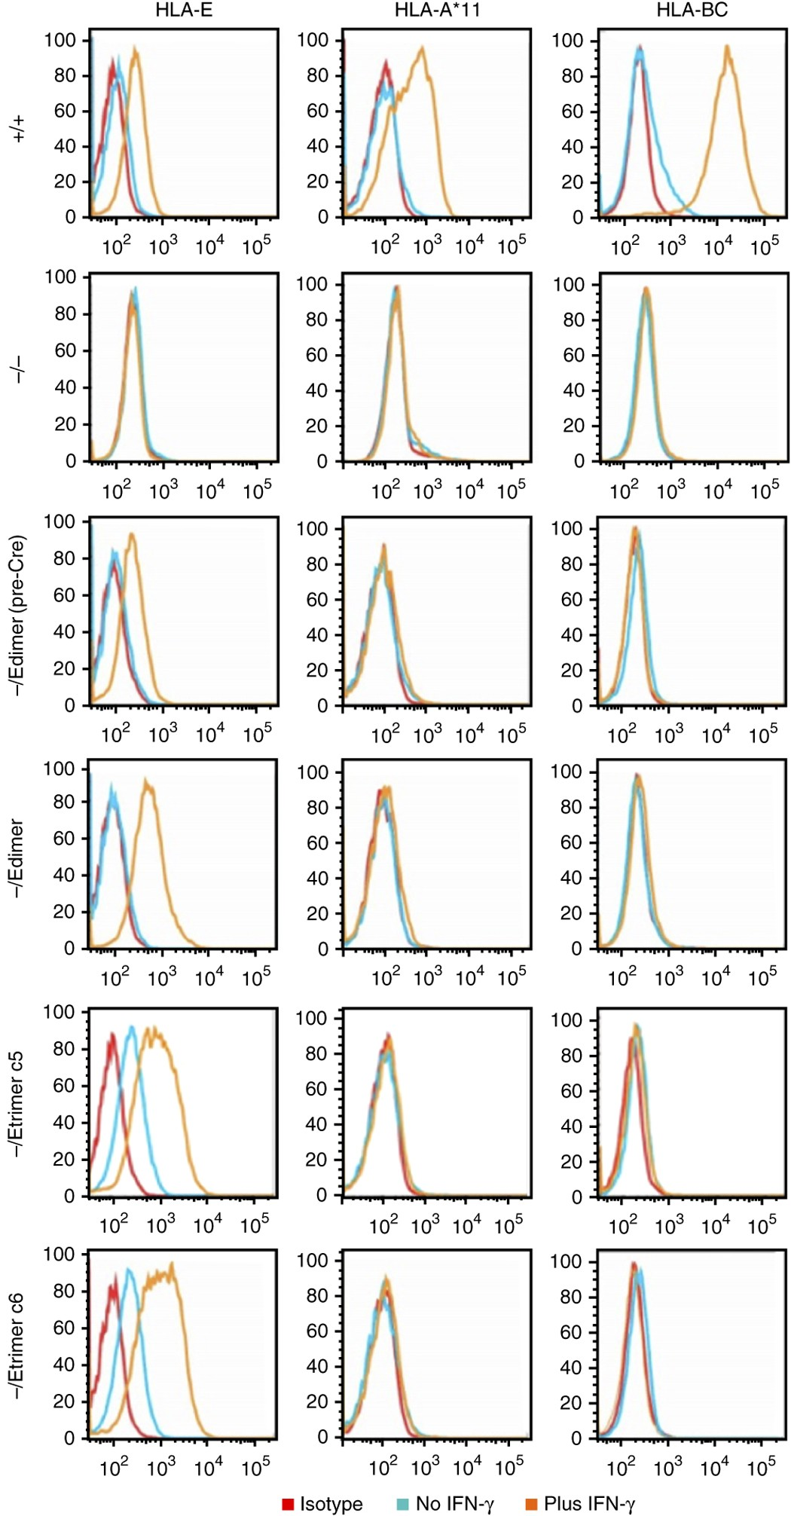
Figure 2: Inducible HLA-E expression without other class I molecules. Flow cytometry of HLA-E, HLA-A*11 (present in WT Elf-1 cells) and HLA-BC expression in the presence (orange) or absence (light blue) of IFNγ treatment. Isotype control tracings are shown in red. Single-cell suspensions of Elf-1 ESCs with each indicated B2M genotype were derived by trypsin digestion of IFN-γ-treated ESCs.
Let’s first look at the legend. Do you remember any link between IFN-y and HLA biology ?

Slide 18
From Lecture 2:
Notes:
IFN-γ strongly increases MHC-I expression by upregulating β2-microglobulin and antigen-processing machinery. This improves folding and surface expression of the HLA-E dimer!!

Slide 19
Antibody for HLA-E
Antibody for HLA-A
Antibody for HLA-B&C
Unedited cells
Full β2M knockout
β2M – HLA-E
β2M – HLA-E + peptide
Non-specific antibody control
Baseline MHC expression
Induced MHC expression
Notes:
Isotype is just the background antibody control; ‘No IFN-γ’ shows baseline MHC levels, and ‘+IFN-γ’ shows how the cells respond when we add a cytokine that increases MHC-I expression.
HLA-E
Specific antibody for HLA-E.
This is the column that matters most for us: it tells us how well the engineered E-dimer and E-trimer are expressed.
HLA-A*11
Recognizes one classical HLA-A allele that WT Elf-1 PSCs express.
Only the +/+ row should show a shift; all B2M-edited rows should sit on the isotype.
HLA-BC
Recognizes HLA-B and HLA-C.
Again, only +/+ should be positive; all B2M-edited lines negative.

Slide 20
Antibody for HLA-E
Antibody for HLA-A
Antibody for HLA-B&C
What kind of data is this? Do you know the method by which this was acquired?
What happens in unedited cells following IFN-y stimulation?
What happens in the β2M knockout cells?
What happens in the cells that have the β2M – HLA-E fusion construct? Which MHC components get expressed?
Compare expression of HLA-E *without IFN-y stimulation* in the version with vs. without peptide. What do you see?
Unedited cells
Full β2M knockout
β2M – HLA-E
β2M – HLA-E + peptide
Non-specific antibody control
Keep in mind: the goal is to make these cells maximally resistant to NK killing. Which genotype is best for this?
Baseline MHC expression
Induced MHC expression
Notes:
1. What kind of data is this? Do you know the method by which this was acquired?
These are flow cytometry histograms measuring surface expression of MHC class I molecules.
Cells were stained with fluorescent antibodies against HLA-E, HLA-A*11, or HLA-BC, plus an isotype control.
2. What happens in unedited cells following IFN-γ stimulation?
In unedited (wild-type) cells, all MHC-I signals shift strongly to the right after IFN-γ.
→ IFN-γ upregulates classical HLA-A/B/C and endogenous HLA-E, increasing their surface expression.
3. What happens in the β2M knockout cells?
β2M-/- cells show no detectable MHC-I expression at all — all histograms sit on the isotype control.
Even with IFN-γ, no HLA-A/B/C or HLA-E appears because β2M is essential for any MHC-I molecule to reach the surface.
4. What happens in the cells that have the β2M–HLA-E fusion construct? Which MHC components get expressed?
These engineered cells express HLA-E only, not HLA-A/B/C.
HLA-E surface expression is weak at baseline but increases clearly with IFN-γ.
Classical MHC-I remains absent because endogenous β2M is knocked out.
5. Compare expression of HLA-E without IFN-γ stimulation in the version with vs. without peptide. What do you see?
Without peptide (E-dimer): HLA-E expression is low at baseline.
With peptide (E-trimer): HLA-E expression is much higher and more stable even without IFN-γ.
Conclusion:
The pre-loaded peptide in the trimer construct greatly improves HLA-E folding and surface expression compared to the dimer.
6. Keep in mind: the goal is to make these cells maximally resistant to NK killing. Which genotype is best for this?
The β2M–HLA-E + peptide (E-trimer) genotype is best.
It provides strong, stable HLA-E surface expression even without IFN-γ, giving a reliable inhibitory signal to NK cells and preventing “missing-self”–mediated killing.
The E-dimer expresses too weakly, and the β2M knockout lacks MHC-I entirely, making it highly NK-sensitive.

Slide 21
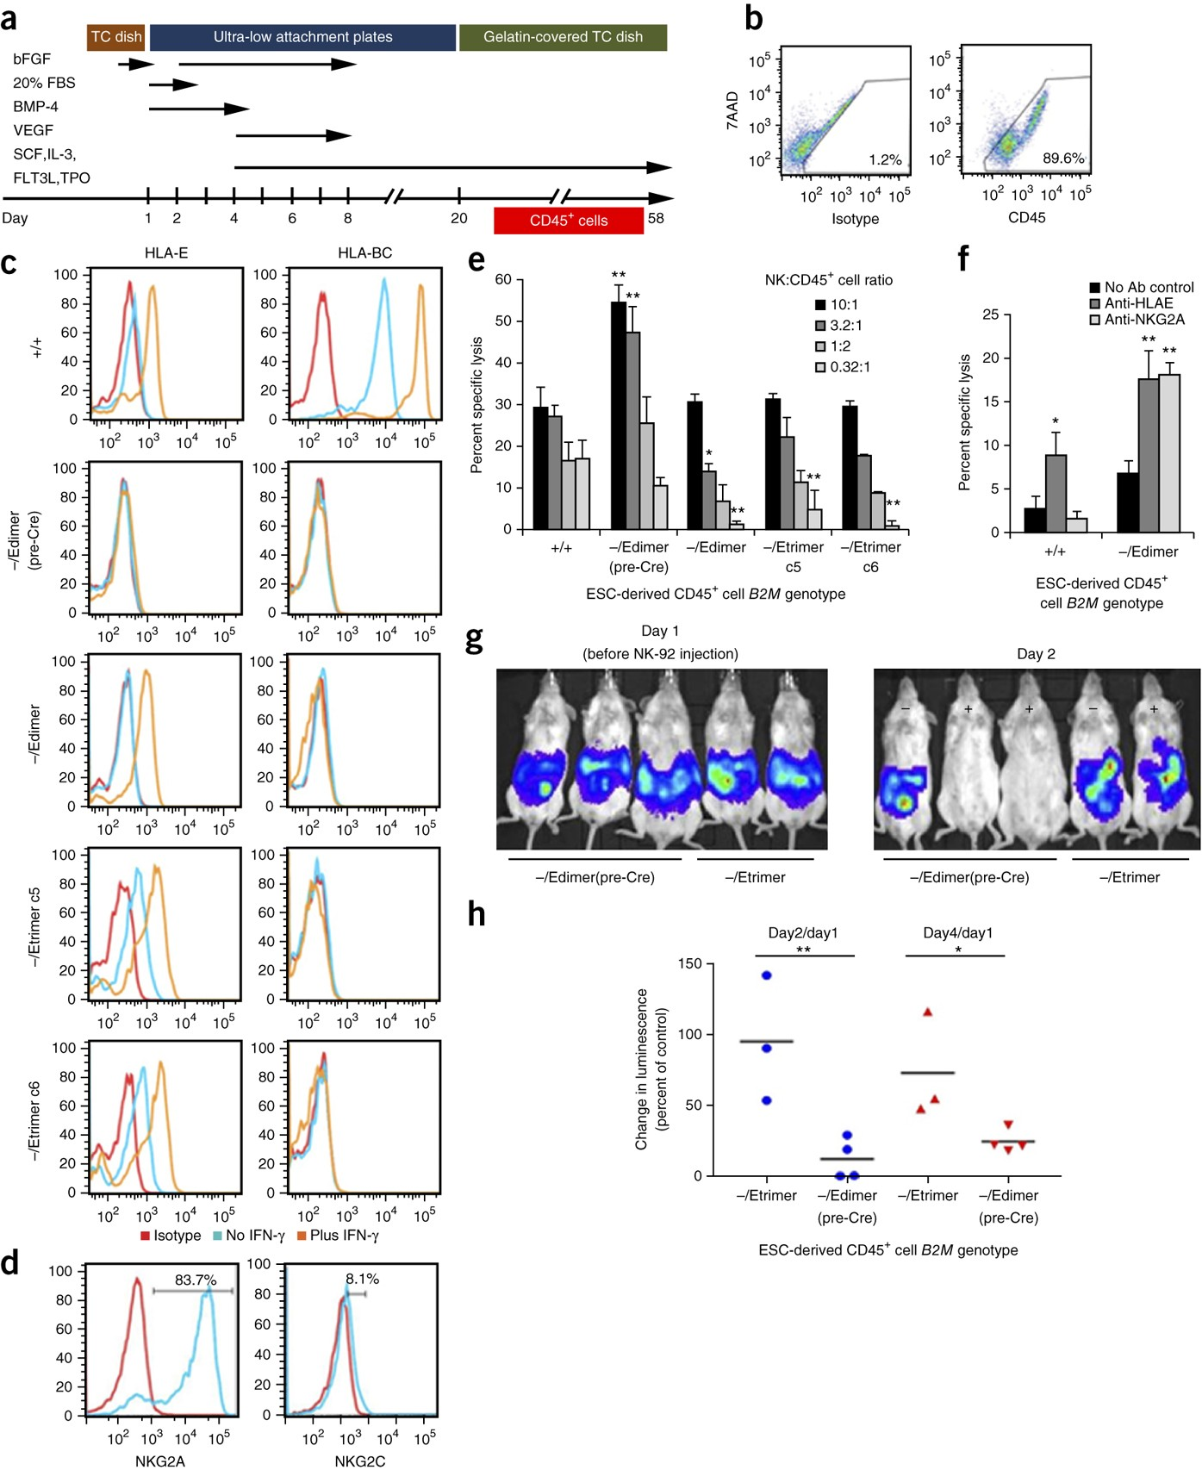
Does HLA-E protect cells from NK cell killing ?
Artificial co-culture assay to assess how efficiently the NK cells are killing
Let’s try to interpret the wild-type (+/+) data. What’s going on here?
Full β2M KO increases NK killing
WT: only killed ~ 30%, but they *would* then get killed by CD8 T cells, so clinically useless
What happens in the full β2M KO (-/Edimer pre-Cre)?
β2M – HLA-E brings that back in check
What does addition of HLA-E achieve?
Equivalent to β2M knockout
2 versions of the same thing
Notes:
NK:CD45 T cell ratios that are often used (serial dilution setup) → 10:1, 3.2:1, 1:2, 0.32:1. Correspond to high-pressure killing” → “moderate” → “balanced competition” → “low-effector environment.
The E-trimer brings NK killing of MHC-I–null cells back down to WT levels — giving NK protection without reintroducing polymorphic HLA-A/B/C, which is essential for creating an allogeneic universal donor cell.
What happens to NK-mediated killing when we block HLA-E or its inhibitory receptor NKG2A? What does that tell us? →

Slide 22
Does HLA-E protect cells from NK cell killing ?
Artificial co-culture assay to assess how efficiently the NK cells are killing
Full β2M KO increases NK killing
Ratio NK : derived cells here 1:1
WT: only killed ~ 30%, but they *would* then get killed by CD* T cells, so clinically useless
β2M – HLA-E brings that back in check
NKG2A is the inhibitory receptor on NK cells that recognizes HLA-E
→ Blocking HLA-E, OR the receptor on NK cells that can receive the inhibitory signal, makes the cell killing increase again
Equivalent to β2M knockout
2 versions of the same thing
Notes:
NK:CD45 T cell ratios that are often used (serial dilution setup) → 10:1, 3.2:1, 1:2, 0.32:1. Correspond to high-pressure killing” → “moderate” → “balanced competition” → “low-effector environment.
The E-trimer brings NK killing of MHC-I–null cells back down to WT levels — giving NK protection without reintroducing polymorphic HLA-A/B/C, which is essential for creating an allogeneic universal donor cell.
What happens to NK-mediated killing when we block HLA-E or its inhibitory receptor NKG2A? What does that tell us? →

Slide 23
Injected cells express luminescence, their survival can be measured by glowing
Mouse without NK cells
These mice are NSG mice:
T cell deficient
B cell deficient
NK cell deficient
Lack complement activity
Lack multiple innate immune components
That’s why they introduce NK cells via injection
HLA-E trimer–engineered cells survive NK attack
What happens to the mice that receive NK cells, and have a full β2M KO (-/Edimer pre-Cre)?
What happens to the mice that receive NK cells, and express the β2M - HLA-E fusion?
Notes:
Here the authors test whether the engineered cells survive NK attack in vivo.
They use immunodeficient NSG mice, which have no endogenous NK cells, so they can add human NK-92 cells in a controlled way.”
“When they inject the β2M-knockout cells — the ones with no MHC-I at all — the graft signal disappears almost immediately. These cells are perfect ‘missing-self’ targets, so NK-92 cells wipe them out.”
“In contrast, the cells expressing the HLA-E trimer survive very well. The strong, stable HLA-E signal is enough to inhibit NK cells in vivo, so these engineered grafts remain intact over time.”
“This in vivo experiment makes the difference much clearer than in vitro:
without HLA-E, the graft is eliminated;
with high-level HLA-E, the graft persists.”

Slide 24
So now, what about the CD8+ T cells?

Slide 25
Remember this plot?
Artificial co-culture assay to assess how efficiently the NK cells are killing
Full β2M KO increases NK killing
WT: only killed ~ 30%, but they *would* then get killed by CD8 T cells, so clinically useless
β2M – HLA-E brings that back in check
Equivalent to β2M knockout
2 versions of the same thing

Slide 26
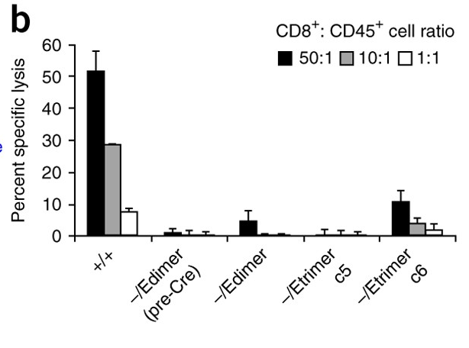
So now, what about the CD8+ T cells?
See here: the wild-type cells get obliterated by allogeneic CD8⁺ T cells, while the cells lacking β2M or expressing only the β2M–HLA-E constructs escape death completely
How do you synthesize this CD8+ data with the NK data? What is the general conclusion that can be made about these β2M – HLA E engineered cells?
Remember, this is basically a β2M knockout
Notes:
Q: How do you synthesize this CD8⁺ data with the NK data? What general conclusion can we make about these β2M–HLA-E engineered cells?
A: Deleting β2M removes classical HLA-I, so CD8⁺ T cells can no longer kill these cells. But this creates missing-self and makes them vulnerable to NK killing — unless we add back HLA-E. The β2M–HLA-E engineered cells therefore escape both CD8⁺ T-cell attack and NK-cell attack.
In other words, they meet two major requirements for universal donor cells. β2M knockout protects from CD8⁺ T cells; HLA-E protects from NK cells. Together, the engineered cells evade both arms of cytotoxic immunity.

Slide 27
The β2M – HLA-E engineered cells escape both CD8⁺ T-cell attack and NK-cell attack
A step towards universal donor cells

Slide 28
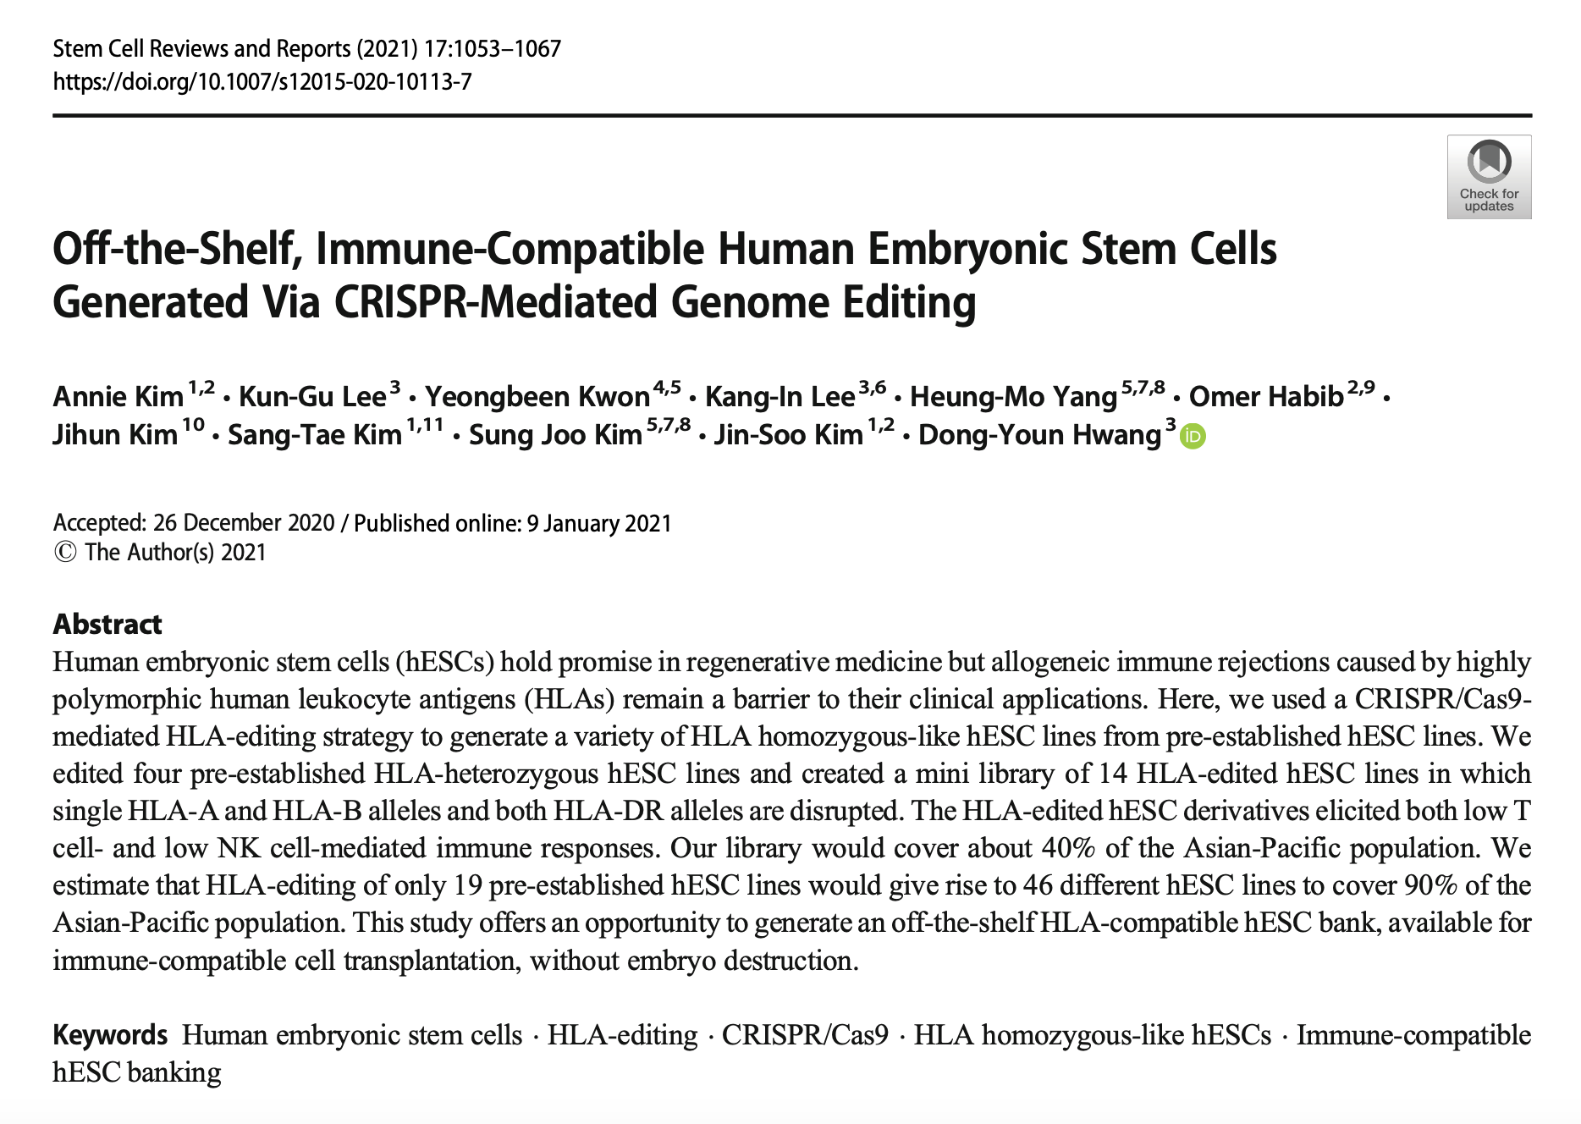
Alternative approaches…

Slide 29
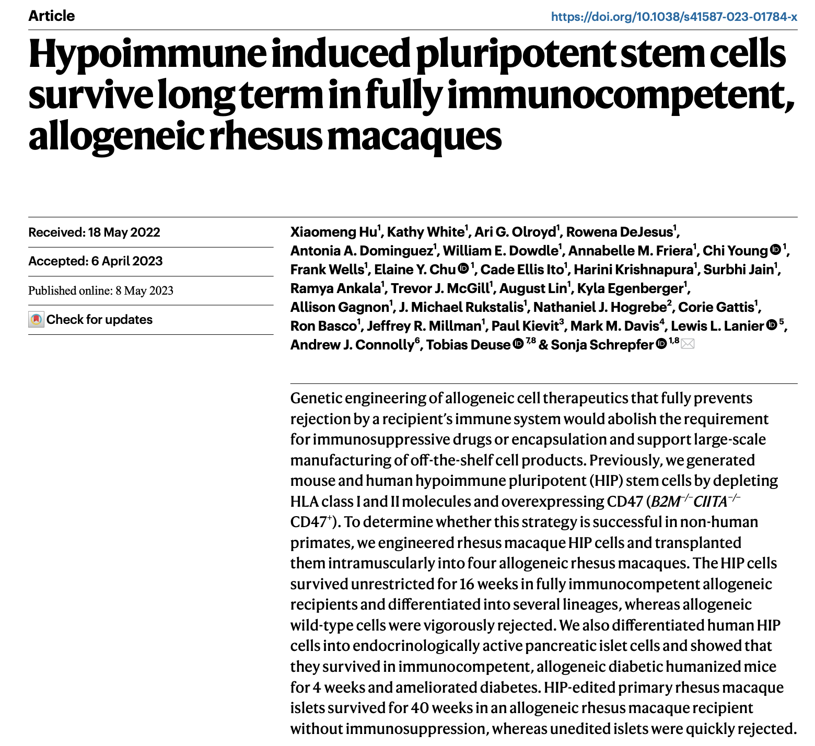
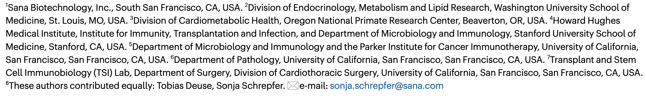
Work in progress…

