Slide 1
Understanding statistics & experimental design

Slide 2
Content
Basic Probability Theory
Signal Detection Theory (SDT)
SDT and Statistics I and II
Statistics in a nutshell
Multiple Testing
ANOVA
Experimental Design & Statistics
Correlations & PCA
Meta-Statistics: Basics
Meta-Statistics: Too good to be true
Meta-Statistics: How big a problem is publication bias?
Meta-Statistics: What do we do now?
Notes:
Not for book ppt

Slide 3
Effect sizes, power, and violations of hypothesis testing
Greg Francis

Slide 4
Experiments
We run experiments to test specific hypotheses about population parameters
  H₀: μ₁=μ₂
  H₀: μ=3
We gather data from samples to try to infer something about the populations
The fundamental question in hypothesis testing is whether the sample effect is big enough to not be attributed to chance from random sampling
  We want to quantify “big enough”

Slide 5
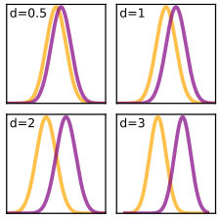
Standardized effect size
Differences across groups are often quantified in terms of so called “effect size”
This usually refers to the magnitude of an effect, scaled to the variability in the population. There are several ways to define it, depending on the details of the experiment.
Ideally, an effect size is a population parameter rather than a statistic.
There are two basic types: “difference magnitude” and
“variance explained”
Assumes equal population variance!

Slide 6
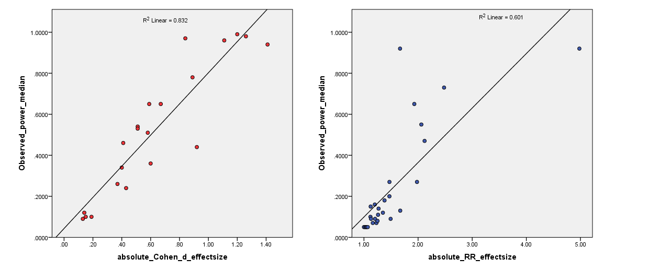
Standardized effect size
Differences across groups are often quantified in terms of so called “effect size”
This usually refers to the magnitude of an effect, scaled to the variability in the population. There are several ways to define it, depending on the details of the experiment.
Ideally, an effect size is a population parameter rather than a statistic.
There are two basic types: “difference magnitude” and “variance explained”

Slide 7
Estimating (differences)
The terminology is messy
Population value: Cohen’s d
Estimate using pooled s: Cohen’s d (over-estimates δ for small samples)
Correction for small samples: Hedge’s g
When sample 1 is a “control”: Glass’ Δ
Hedge’s g
Cohen’s d
Glass’ Δ
Cohen’s d

Slide 8
Computing (Hedge’s g)
Straightforward if you have the sample sizes, means, and standard deviations
Can also be derived from reported t or F values (F=t²)
Beware of formulas published on-line. They often assume n₁=n₂
Hedge’s g
Cohen’s d
J

Slide 9
Computing (Hedge’s g)
The variance of g is pretty easy to calculate
Cohen’s d
Hedge’s g

Slide 10
Computing (Hedge’s g)
A first approximation to a 95% confidence interval is to suppose g is normally distributed
A precise 95% confidence interval for g is rather tricky because g is actually distributed as a “non-central t distribution”
Computing the confidence interval requires rather complicated details
A good approach is to use the MBESS library in R
=(0.220, 1.18)
Using Cohen’s d (could also use g)
Using t-value
> library(MBESS)
> ci.smd(smd=0.7094638, n.1=36, n.2=36)
$Lower.Conf.Limit.smd
[1] 0.2304514
$smd
[1] 0.7094638
$Upper.Conf.Limit.smd
[1] 1.183711
> library(MBESS)
> ci.smd(ncp=3.01, n.1=36, n.2=36)
$Lower.Conf.Limit.smd
[1] 0.2304514
$smd
[1] 0.7094638
$Upper.Conf.Limit.smd
[1] 1.183711

Slide 11
Why bother?
Do not get too caught up in standardized effect sizes. Often the best measure to report is the effect in meaningful units
    Meters
    Test scores
    Candelas/meter²
1) Meta-analysis allows for pooling of standardized effect sizes to improve the estimated size of an effect
  This can happen even for different measures of an effect (if standardization is appropriate, which depends on theory)
2) Experimental power (probability of rejecting the null when there is an effect) is largely determined by the magnitude of the standardized effect size
  Helps you design better experiments that are more likely to work or to meaningfully fail

Slide 12
Meta-analysis
Suppose you have 5 experiments that investigate the same topic (e.g., handling money reduces distress over social exclusion)
n₁ | n₂ | t | g | v_{g}
36 | 36 | 3.01 | 0.702 | 0.058
36 | 36 | 2.08 | 0.485 | 0.056
36 | 36 | 2.54 | 0.592 | 0.057
46 | 46 | 3.08 | 0.637 | 0.045
46 | 46 | 3.49 | 0.722 | 0.046

Slide 13
Meta-analysis
Weight each effect size by its inverse variance
  Similar to weighting by sample size
n₁ | n₂ | t | g | v_{g} | w | wg
36 | 36 | 3.01 | 0.702 | 0.058 | 17.3 | 12.15
36 | 36 | 2.08 | 0.485 | 0.056 | 17.9 | 8.66
36 | 36 | 2.54 | 0.592 | 0.057 | 17.6 | 10.43
46 | 46 | 3.08 | 0.637 | 0.045 | 22.2 | 14.17
46 | 46 | 3.49 | 0.722 | 0.046 | 21.9 | 15.83
=0.632

Slide 14
Meta-analysis
Things can get complicated quite quickly
If you have some between-subject designs and some within-subject designs, you need to be sure you use equivalent effect size measures
  For the within-subject effect size, compensate for the correlation that is used to produce the t value
  This gives a d that is “equivalent” to a between-subject’s design
Similar issues for ANCOVA
Cohen’s d
Hedge’s g

Slide 15
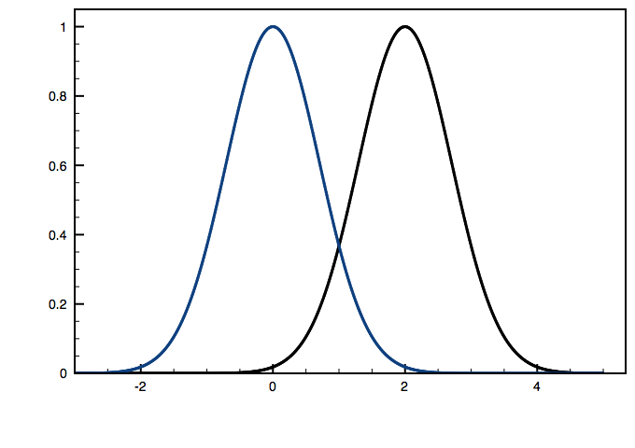
Power
If the alternative hypothesis is true, power is the probability you will reject H₀
The calculation of power requires knowledge of
  Sample size(s)
  Standardized effect size (or equivalent information)
I use the pwr library in R
> pwr.t2n.test(n1=35, n2=35, d=0.5)
t test power calculation
n1 = 35
n2 = 35
d = 0.5
sig.level = 0.05
power = 0.5406879
alternative = two.sided

Slide 16
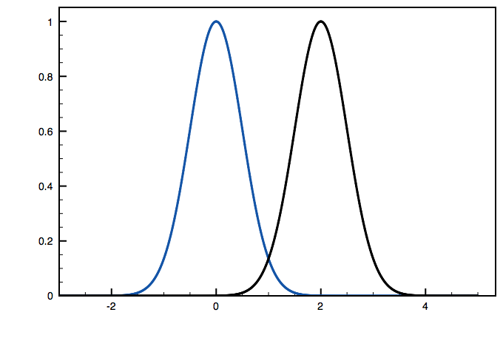
Power and sample size
The standard deviation of the sampling distribution is inversely related to the (square root of the) sample size
Power increases with larger sample sizes
> pwr.t2n.test(n1=100, n2=100, d=0.5)
t test power calculation
n1 = 100
n2 = 100
d = 0.5
sig.level = 0.05
power = 0.9404272
alternative = two.sided

Slide 17
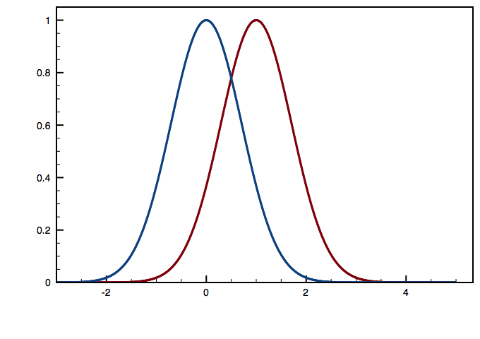
Effect size and power
Experiments with smaller effect sizes have smaller power
> pwr.t2n.test(n1=35, n2=35, d=0.5)
t test power calculation
n1 = 35
n2 = 35
d = 0.5
sig.level = 0.05
power = 0.5406879
alternative = two.sided
> pwr.t2n.test(n1=35, n2=35, d=0.2)
t test power calculation
n1 = 35
n2 = 35
d = 0.2
sig.level = 0.05
power = 0.1308497
alternative = two.sided

Slide 18
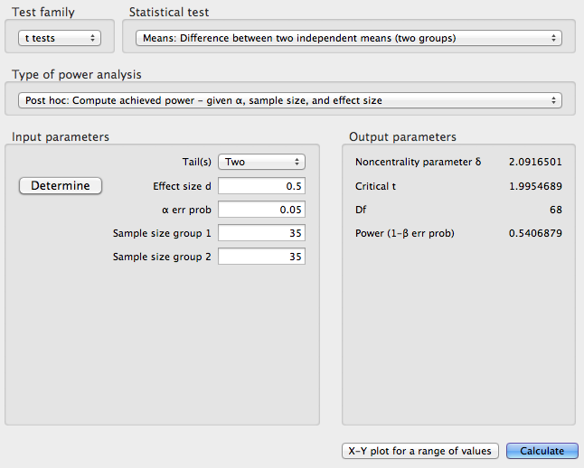
Computing power
Many people like the graphical interface provided by a program called G*Power
It works for lots of different tests
I find G*Power to be rather confusing for some tests (computing the effect size can be complicated)

Slide 19
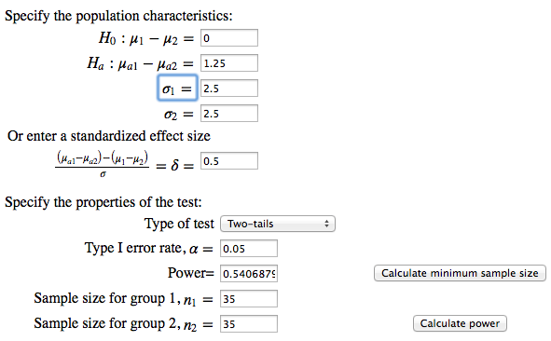
Computing power
I like the on-line calculators at
https://yipstats.com/OnlineStatistics/chapters/calculators/calculators.shtml
They require “typical” information
  Means
  Standard deviations
  Correlations

Slide 20
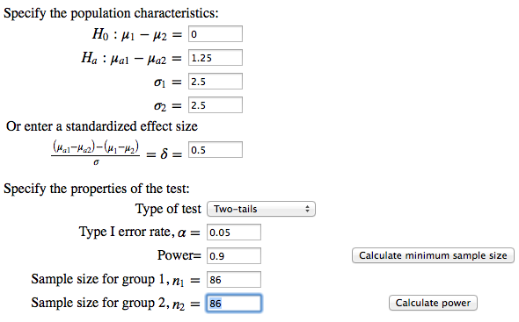
Computing sample size
Both G*Power and IntroStats Online can compute a smallest sample size that provides a requested power

Slide 21
How to use power?
A lot of current advice is to run experiments with high power
What is missing is how to actually do this
To estimate power, you need to know the standardized effect size
  But if you knew the standardized effect size, you probably would not be running the experiment
Best bets:
  Previous literature
  Theoretical predictions
  Meaningful implications
Good attitude: if you cannot predict power, then do not be surprised if your experiment does not produce a significant outcome

Slide 22
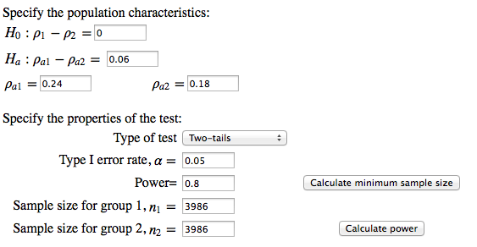
Example 1
Height is correlated with economic success (income, wealth). Taller people are more successful.
Across multiple studies, it seems that the correlation is stronger for men than for women
  Men: r₁=0.24
  Women: r₂=0.18
How big samples do you need to detect this difference in correlation with 80% power?
Notes:
Jeanette: How much should I cut the picture? Is it Okay if I cut the

Slide 23
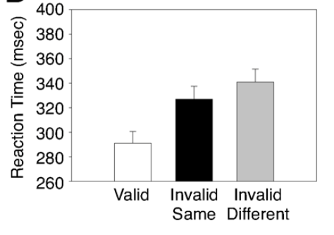
Example 2
Observers are much faster at detecting a target if it appears at the same location as a cue
Also a difference for target on same object as the cue

Slide 24
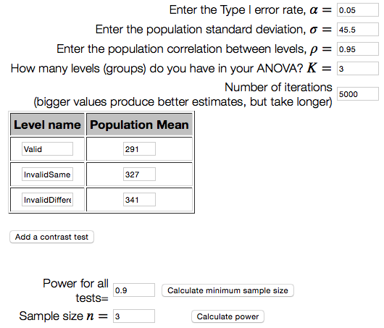
Example 2
Suppose you want to replicate the experiment
To do the power analysis, for the main effect of the ANOVA you extract means, standard deviation, correlation

Slide 25
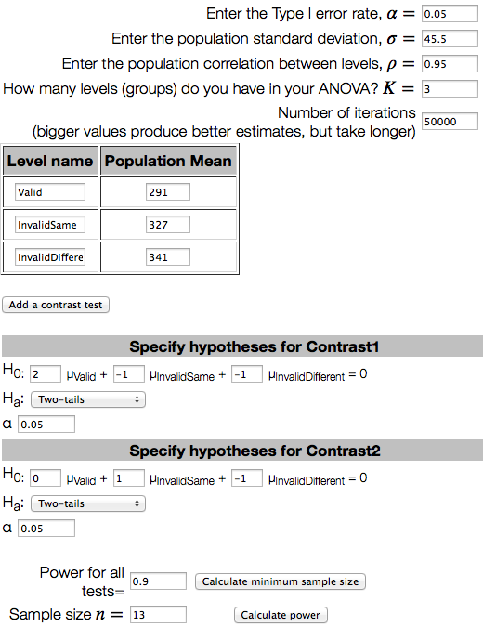
Example 2
Importantly, though, the main effect of the ANOVA is not the only result of the analysis
The main effect is supplemented by contrast t tests to compare valid vs. invalid (both same and different) and InvalidSame vs. InvalidDifferent
Including these tests makes a big difference

Slide 26
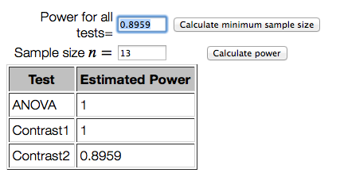
Example 2
Power of a set of tests is often determined by the weakest test

Slide 27
Generalize power
In many cases we want to reject the null, so power is the probability of a successful outcome
But for some experiments, “success” involves more than one outcome
Suppose you either prime people to think about “Whites” or “Blacks” or “No prime”
  Then have them identify a noisy object related to crime or not (within-subjects)
  Eberhardt et al. (2004)

Slide 28
Generalize power
Theory: Black and White primes tune detection of crime-relevant objects, in opposite directions. Seven outcomes are important for this theory
1) A significant difference between black and white primes for crime-relevant objects
2) a significant difference between the Black and no-prime conditions for crime-relevant objects
3) a significant difference between the White and no-prime conditions for the crime-relevant objects
4) a non-significant difference between the Black and no-prime conditions for crime-irrelevant objects
5) a non-significant difference between the White and no-prime conditions for crime-irrelevant objects
6) a significant difference between crime-related
and crime-irrelevant objects for Black priming
7) a significant difference between crime-related
and crime-irrelevant objects for White priming
Note, there is no “effect size” for this pattern of results

Slide 29
Generalize power
Suppose you wanted to repeat this experiment. What sample size should you use to give you an 90% chance of success?
Run simulated experiments. Estimate population values from the previous experiment.

Slide 30
Generalize power
To get a sense of the probability of these outcomes all working, consider the probability of success for the sample sizes used in the original study
n_{White}=13, n_{None}=12, n_{Black}=14
We draw samples from a normal distribution having the mean and standard deviation indicated
  Samples for within-subject scores are correlated as indicated
Run each hypothesis test and observe whether or not we reject the null
Repeat this 10,000 times to estimate success probabilities

Slide 31
Generalize power
1) A significant difference between black and white primes for crime-relevant objects (0.995)
2) a significant difference between the Black and no-prime conditions for crime-relevant objects (0.682)
3) a significant difference between the White and no-prime conditions for the crime-relevant objects (0.518)
4) a non-significant difference between the Black and no-prime conditions for crime-irrelevant objects (0.942)
5) a non-significant difference between the White and no-prime conditions for crime-irrelevant objects (0.932)
6) a significant difference between crime-related
and crime-irrelevant objects for Black priming (0.788)
7) a significant difference between crime-related
and crime-irrelevant objects for White priming (0.581)
The probability of a single sample satisfying all of
these outcomes is (0.158)
  We need a much larger sample

Slide 32
Generalize power
I tried various values for n_{White}= n_{None}= n_{Black}
There seems to be no sample size to make
these tests uniformly “successful” with a high
probability
n_{White}= n_{None}= n_{Black} | Probability all tests work
15 | .239
20 | .431
30 | 0.668
40 | 0.748
50 | 0.743
60 | 0.728
70 | 0.700
80 | 0.664
90 | 0.639
100 | 0.621

Slide 33
Generalize power
For experimental design you want to consider all of the comparisons that matter for your theory
The more constraints you impose on your dataset, the lower the probability any dataset will satisfy those constraints
Simple theories are easier to test than complex theories
In a complementary way, setting a criterion of p<.05 is only for a particular test
If you have multiple tests in a complex design, the probability of at least one test producing a Type I error is larger than .05

Slide 34
Assumptions
Common hypothesis tests
  t-tests, ANOVA
Make assumptions about the population distributions
  Normal distribution
  Equal variances
Make assumptions about sampling
  Fixed sample size
What happens when these assumptions are violated?
  Not much in some situations
  Very bad things in some situations
We mostly focus on control of the Type I error rate

Slide 35
Normal distributions
Simulated experiments for two-sample t tests with true null hypothesis
  https://yipstats.com/OnlineStatistics/index.shtml
  Log in with: ID=USEDF16-0, Password=epflstats
  Then navigate to https://yipstats.com/OnlineStatistics/chapters/chapter12/homogeneity_variance_sim.shtml
  What if population distributions are not normal?
  Slight decrease in Type I error
What if one population is normal and the other is not?
  Some increase in Type I error, especially if the non-normal population has a larger sample size
  Tends to disappear as sample sizes get larger
As long as population distributions are approximately normal, then a t-test does a pretty good job controlling Type I error

Slide 36
Unequal variances
What if population distributions have different variances?
  Some increase in Type I error
  Tends to disappear as sample sizes get larger
What if variances are unequal and sample sizes are unequal?
  Big decrease in Type I error, if big n is with big standard deviation
  Big increase in Type I error, if big n is with small standard deviation
Normality has little to do with these issues
There is a simple modification of the t-test (Welch’s test) that controls for these problems

Slide 37
Sampling
In general, larger samples are better for statistics
More accurate measures of means, standard deviations, correlations
More likely to reject the null if there is a true effect
But the p value in hypothesis testing is based on the sampling distribution, which is typically defined for a fixed sample size
If the sample size is not fixed, then the p value is not what it appears
This has a number of effects

Slide 38
Adding subjects
Suppose you run a two-sample t-test with n₁=n₂=10 subjects
  You get p>.05, but you want p<.05
Many researchers add 5 new subjects to each group and repeat the test
But you now have had two chances to reject the null. Even if the null is really true, the Type I error rate is now about 0.08
Do this a second time and the Type I error rate is 0.10
Do this a third time and the Type I error rate is 0.12
Keep going up to a maximum sample size of n₁=n₂=50, and the Type I error rate is 0.17
There is no need to add 5 subjects at a time. What if you just added 1 subject at a time to each group?
  Type I error rate is 0.21
Sampling to a foregone conclusion!

Slide 39
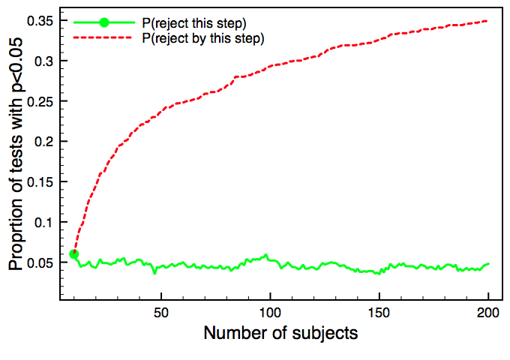
Impact on Type I error
With each additional sample you add noise to the statistics
Some samples that were previously just above 0.05 now dip below 0.05 (you reject the null hypothesis and stop the experiment)
P(reject this step)
P(reject by this step)

Slide 40
Optional stopping
The real problem is not with adding subjects, but with stopping when you like the outcome (e.g., p<.05)
  If you observe p=0.03 and add more subjects, you might get p>.05
This means that the interpretation of your p value depends on what you would do if you observed p<.05 or p>.05
If you would have added subjects when getting p>.05, then even if you actually get p<.05 you have an experimental method with an inflated Type I error rate
If you do not know what you would have done, then you do not know the Type I error rate of your hypothesis test
  In fact, a given test does not have a Type I error rate, the error rate applies to the procedure not to a specific test

Slide 41
Data peeking
Subjects are scarce, so researchers sometimes “peek” at the data to see if the experiment is working
If the knowledge from such a peek changes their sample, then there is loss of Type I error control
Consider the following experiment plan
  Data is gathered from n₁=n₂=10 subjects. A p value is computed
    If p<0.2, additional data is gathered to produce n₁=n₂=50, and the results are reported
    If p>0.2, the experiment is aborted and not reported
  Among the reported experiments, the Type I error rate is 13%
The effect is bigger when the peek occurs at what is closer to the final value
  Data is gathered from n₁=n₂=10 subjects. A p value is computed
    If p<0.2, additional data is gathered to produce n₁=n₂=20, and the results are reported
    If p>0.2, the experiment is aborted and not reported
  Among the reported experiments, the Type I error rate is 20%

Slide 42
Conclusions
Effect sizes
  Meta-analysis
  Power
Power
  Hard to apply
  Needs to consider the full definition of experimental success
Violations of hypothesis testing
  Minor effects for non-normal distributions
  Fixable effects for unequal variances
  Inflation of Type I error for non-fixed samples

Slide 43
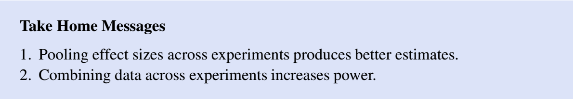
Take home messages

Slide 44
END Class 9

