Slide 1
Understanding statistics & experimental design

Slide 2
Content
Basic Probability Theory
Signal Detection Theory (SDT)
SDT and Statistics I and II
Statistics in a nutshell
Multiple Testing
ANOVA
Experimental Design & Statistics
Correlations & PCA
Meta-Statistics: Basics
Meta-Statistics: Too good to be true
Meta-Statistics: How big a problem is publication bias?
Meta-Statistics: What do we do now?
Notes:
Not for book ppt

Slide 3
What do we do now?
Greg Francis – lecture IV

Slide 4
Reproducibility
Open Science Collaboration (2015) “Estimating the reproducibility of psychological science”. Science.
Conducted replications of 100 studies from three top psychology journals published in 2008
  Psychological Science
  Journal of Personality and Social Psychology
  Journal of Experimental Psychology: Learning, Memory, and Cognition
Only 36% of replications produced statistically significant effects
 | Replications P<.05 in original direction | Percent
Overall | 35/97 | 36
JPSP, social | 7/31 | 23
JEP:LMC, cognitive | 13/27 | 48
PSCI, social | 7/24 | 29
PSCI, cognitive | 8/15 | 53

Slide 5
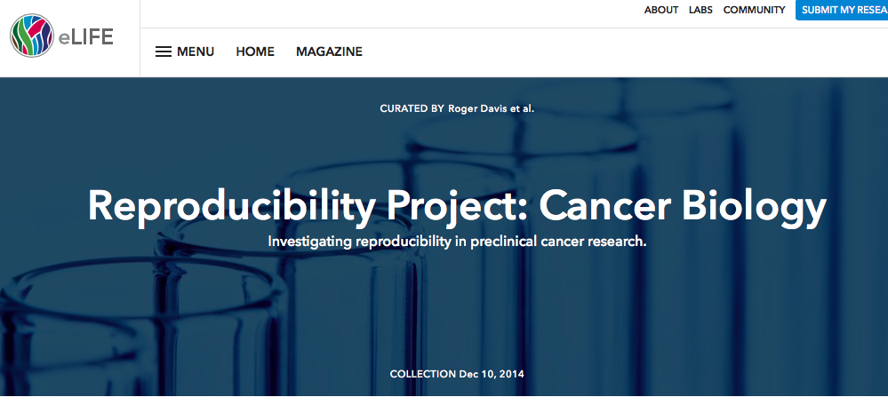
Reproducibility
Reproducibility Project: Cancer Biology
Motived by the report from Amgen that 47 of 53 landmark cancer papers did not replicate
Conducting independent replications of 50 cancer studies published in Nature, Science, Cell and other high-impact journals
  Summer 2018: reduced to 18 studies
As of December 2018:
  4 studies reproduced important parts of the original papers
  3 studies produced mixed results
  2 studies produced negative results
  2 studies could not be interpreted

Slide 6
Reproducibility
I find the these reproducibility projects rather strange
  They are purely empirical investigations of replication
  The findings are devoid of any theoretical context (for the field in general and for the original studies)
Still, the low replication rates are disturbing
There are now calls for new ways of doing science
  Do not trust a single study
  Trust only replicable findings
  Pre-register experiment / analysis designs
  Run high powered studies
  Lower the p-value criterion for significance
  Alternative statistics
I don’t think any of these ideas are sufficient, we need to explore fundamental issues

Slide 7
1) Can we trust a single study?
If it is a well done study, I do not see why not.
  p=0.01 means the same thing whether the data are from a single study or from a pooling of multiple studies
  I do not deny value in replication studies, but it is too much to claim that we cannot trust a study by itself
The value of replication is to test experimental methods
  Generalization (across samples, equipment, experimenters)
Such replication tests are very difficult because the comparison of methods requires multiple well done studies with convincing results
  Science is difficult

Slide 8
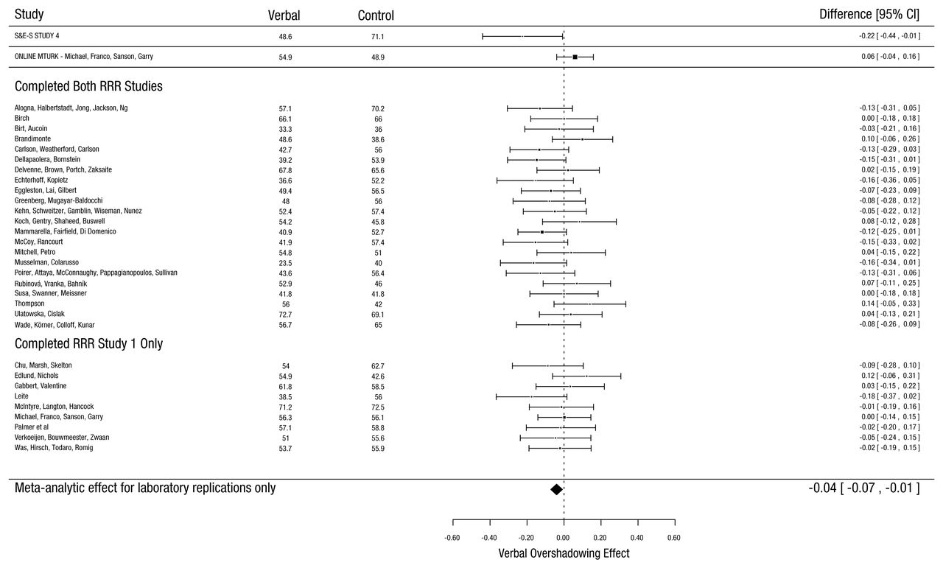
2) Should we only trust replicated findings?
We already saw that too much success (replication) can indicate that the reported findings are biased and should not be trusted
Moreover, the studies that fail to replicate (e.g., produce non-significant outcomes) still contain some information

Slide 9
2) Should we publish regardless of significance?
Non-significant experiments contain information about effects
Publishing both significant and non-significant effects would allow readers to see all the data and draw proper conclusions about effects
But, readers may not know how to interpret an individual study
  Can there be a “conclusions” section to an article when it only adds data to a pool?
  Have to use meta-analysis (how to decide which findings to include?)
When do you stop running experiments?
  If the meta-analysis gives p=0.08, do you add more experiments until p<0.05?
  That’s just optional stopping at the experiment level
If you publish all findings for later analysis, why bother with the hypothesis test at all?
When would you do the hypothesis test?

Slide 10
3) Does pre-registration help?
One suggestion is that experiments should be “pre-registered”
A description of the experiment and its analysis is posted in some public place before gathering data
  Limits publication bias
  Specifies sample size – no optional stopping
  Specifies experimental measures – cannot “fish” for significant effects
  Specifies planned analyses / hypotheses – cannot try various tests to get significance
In as much as it forces researchers to think carefully about their experiment designs, pre-registration is a good idea
Exploratory work is still fine, one just has to be clear about what it is

Slide 11
3) Does pre-registration help?
Still, pre-registration strikes me as unnecessary or silly
Extreme case 1 (Unnecessary)
  Suppose I have a theory that makes a clear prediction (e.g., Cohen’s d=0.5)
  I design the experiment to have power of 0.99 (n₁=308, n₂=308)
  If the experiment produces a significant result, I can take that as some support for the theory
  If the experiment fails to produce a significant result, I can take that as evidence against the theory
  But, if I can justify the experiment design with the properties of the theory, then all I have to do to convince others that I had a good experiment is to explain the theory
      pre-registration does not improve the experimental design or change the conclusions

Slide 12
3) Does pre-registration help?
Still, pre-registration strikes me as unnecessary or silly
Extreme case 2 (Silly)
  Suppose I have no theory that predicts an effect size, but I have a “feeling” that there may be a difference in two conditions for some measure
  I guess that I need n₁=30 and n₂=30, and I pre-register this design (along with other aspects of the experiment)
  If the experiment produces a significant result, I cannot take that as support for a theory (because there is no theory). The best we can conclude is that my “feeling” may have been right. But that’s not a scientific conclusion (no one else can have my “feeling”)
  If the experiment fails to produce a significant result, I cannot take that as evidence against the “feeling”. I never had a proper justification to believe the experiment would work.
  Pre-registration cannot improve an experiment with unknown design quality

Slide 13
4) Why don’t we run high powered studies?
Suppose you run a 2x2 between subjects design
You analyze your data to look for main effects and an interaction
  If there really is no difference in the populations, you have a Type I error rate of 14% for at least one of the tests being significant
Suppose you just “follow the data” and conclude the presence/absence of an effect as indicated by statistical significance
  What are the odds that a replication produces the same pattern of results?
Consider it with a simulation, where you randomly generate 4 population means drawn from a normal distribution with a standard deviation SD_{p}
  Then take data samples from normal distributions having those population means
  Run an ANOVA and draw your conclusions (based on p<.05 for main effects and the interaction)
  Take another sample (of the same size) from the populations and run another ANOVA. See if you get the same conclusions

Slide 14
4) Why don’t we run high powered studies?
The replication rate is often low because some of your conclusions are based on findings that are close to the criterion for statistical significance
Increasing the sample size does not solve this problem, it just shifts it to a different
set of conclusions
In practice, the problem would be even worse
  A significant interaction would motivate
  a look for significant contrasts
  HARKing

Slide 15
4) Why don’t we run high powered studies?
Consider a study by Gliga et al. (2015, Current Biology) on autism and visual search
  concluded that measurements on a visual search task among infants could predict emerging autism symptoms that appeared months later
  82 high-risk for autism infants
  27 low-risk control infants

Slide 16
4) Why don’t we run high powered studies?
Theoretical conclusions were based on significant and non-significant correlations between measurements

Slide 17
4) Why don’t we run high powered studies?
Comparison | r | p | Probability of success
9-month VS and 15-month VS | 0.24 | 0.02 | 0.676
9-month VS and 9-month AOSI | 0.08 | 0.44* | 0.877
9-month VS and 15-month AOSI | 0.22 | 0.03 | 0.602
9-month VS and 2-year ADOS | 0.24 | 0.02 | 0.679
15-month VS and 15-month AOSI | NA | >0.05* | 0.950
15-month VS and 2-year ADOS | NA | >0.05* | 0.949
2-year VS and 2-year ADOS | NA | >0.05* | 0.949
9-month AOSI and 15-month AOSI | 0.34 | 0.0007 | 0.940
9-month AOSI and 2-year ADOS | 0.31 | 0.002 | 0.888
15-month AOSI and 2-year ADOS | 0.50 | <0.0001 | ≈1.00
High-risk infants only
9-month VS and 15-month AOSI | 0.223 | 0.049 | 0.454
9-month VS and 2-year ADOS | 0.27 | 0.02 | 0.524
Partial correlations
9-month VS and 15-month AOSI; factoring out 9-month AOSI | 0.182 | 0.046 | 0.546
9-month VS and 2-year ADOS; factoring out 9-month AOSI and 15-month AOSI | 0.13 | 0.13* | 0.655
All tests |  |  | 0.052

Slide 18
4) Why don’t we run high powered studies?
We do not run high powered studies because we do not want them
As scientists we want to squeeze the maximum information out of our data set
That means we will continually break down strong (high powered) effects into more specific effects that (necessarily) have lower power
Given how we develop our theoretical claims, our experimental findings should have low power
If we want our findings to be reliable, we need a different way of developing theoretical claims

Slide 19
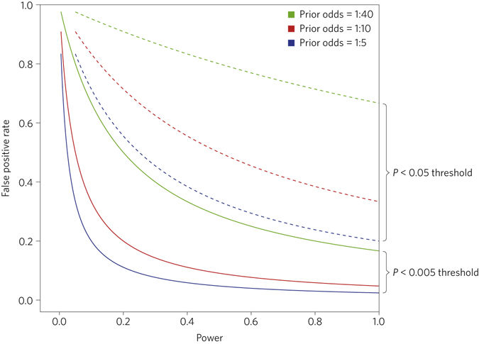
5) smaller p-value?
Benjamin et al. (2017). Redefine statistical significance. Nature Human Behaviour.
Propose using p<.005 rather than p<.05
More stringent, fewer false positives
  Depends on the prior probability of effects
  being real
Of course p<.005 and p<.05 are both arbitrary
Being more stringent means you reduce
power for a given effect size and sample size
  One does not generally promote replication
  by making success harder to achieve

Slide 20
6) Will alternative statistics help?
Many people argue that the currently dominant approach for statistical analysis is fundamentally flawed
  p-values, t-values
And that other statistics would be better
  Standardized effect size (Cohen’s d, Hedge’s g)
  Confidence interval for d or g
  JZS Bayes Factor
  Akaiki Information Criterion (AIC)
  Bayesian Information Criterion (BIC)

Slide 21
6) Will alternative statistics help?
In fact, for a 2-sample t-test with known sample sizes n₁ and n₂, all of these statistics (and a few others) are mathematically equivalent to each other
Each statistic tells you exactly the same information about the data set
  Signal-to-noise ratio
  Given one statistic, you can compute all the others
  http://www2.psych.purdue.edu/~gfrancis/EquivalentStatistics/
The statistics vary only in how you interpret that information
You should use the statistic that is appropriate for the inferential interpretation you want to make

Slide 22
6) Will alternative statistics help?
No method of statistical inference is appropriate for every situation
Common statistics are equivalent with regard to the information in the data set
But they can sometimes reach very different conclusions
  n₁=n₂=250, d=0.183
  CI₉₅ = (0.007, 0.359)
  p=0.04
  ΔBIC= - 2.03 (evidence for null)
  ΔAICc = 2.16 (full model better predicts future data than the null model)
  JZS Bayes Factor = 0.755 (weak evidence that slightly favors the null model)

Slide 23
Prisoner’s Dilemma
If you behave well (e.g., report null results, do not practice optional stopping), then you produce fewer “amazing” results than someone who behaves badly.
  Your advisor might be disappointed in your output and will not help you (so much) in your career
It can take a lot of time to convince established scientists that they are doing some things improperly
It is certainly true that statistics is not the only important characteristic of science
I wish I had good advice for how to deal with these issue
I think some threat of being “caught” is necessary in order to balance the field

Slide 24
Fundamentals
Statistical significance is not the long-term goal of science
Often want to put ourselves in a situation where statistics hardly matter at all (look at physics)
  Then replication helps identify methodological (rather than statistical) issues
DARPA once put out a call for methods to identify “robust effects” in the social sciences
  Wisdom of the crowds
  Replication
  Researcher reputation
  Pattern of citations
How do we know something is “robust”?

Slide 25
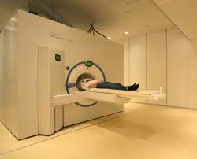



Not Just Replication
Consider superconductivity
Discovered in 1911, plays an important role in fMRI
How do we know superconductivity works the same in Lausanne and West Lafayette, Indiana?
  Mountains?
  Lake versus river?
  Brick buildings?
  French versus English?
  7T versus 3T?
It’s not just that superconductivity worked before!
  Every new environment is different

Slide 26
Mechanisms
There is a theory about superconductivity that describes mechanisms that produce it
  Meissner effect (1930s)
  Cooper pairs in quantum mechanisms (1950s)
This theory predicts when superconductivity works and when it does not
  That’s how engineering works
It’s not perfect
  High-temperature superconductivity remains unexplained
  That’s where science is being done
We know/believe fMRI will work in both Lausanne and West Lafayette because we understand the mechanisms that determine when superconductivity will happen

Slide 27
Getting To Mechanisms
If we want to have successful/robust science, our long term goal is identification of mechanisms
We might not get there in our lifetime
  Exploratory work
  Confirmatory work
  Proposing theories
  Testing theories
We are not going to have replicable/reproducible science until we can specify and justify mechanisms
  It might not look the same as in physics

Slide 28
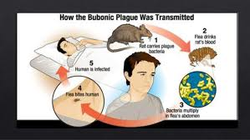
Plague
Paul-Louis Simond (1898) discovered that the plague was transmitted by fleas on rats
Once a mechanism is identified, it suggests what to do
To reduce occurrence of the plague, reduce the number of rats and contact with rats
  Kill rats
  Keep dogs and cats
  Seal food containers
  Set rat traps
  Avoid rats
  Don’t bother with quarantining the family of an infected person
Not precise predictions about the magnitude of the benefit (but they should all work to some extent)

Slide 29
Mechanisms In Life Sciences
Psychology faces challenges because there are very few proposed mechanisms
  Even when something seems to be a strong effect, we cannot judge when it will apply and when it will not
Neuroscience and medicine have some hope because scientists naturally seek out mechanisms based on biology
  But there are other problems with sample sizes and costs of investigations
Keep in mind that the long-term goal is to identify mechanisms, and plan studies and analyses accordingly

Slide 30
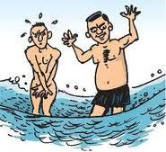
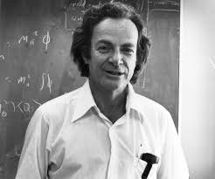
Conclusions
There are methods that identify improper or invalid scientific analyses
“Only when the tide goes out do you discover who has been swimming naked.” Warren Buffet
Science requires a level of care that goes well beyond most professions
Nobel prize winning physicist Richard Feynman described it this way:
  “The first principle is that you must not fool yourself--and you are the easiest person to fool.”
Be careful. Be honest.

Slide 31
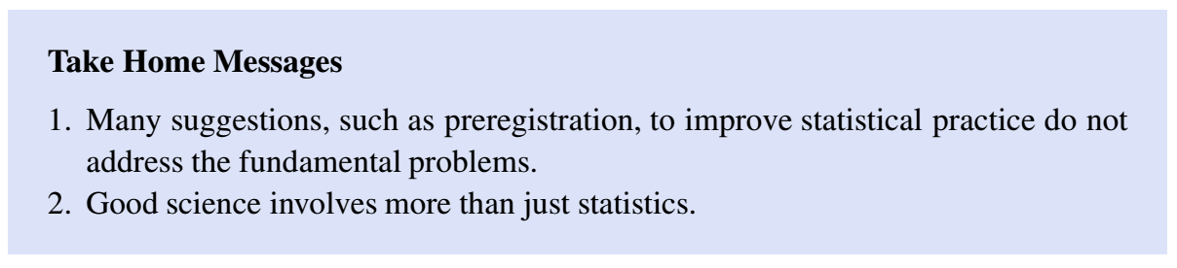
Take home messages

Slide 32
END Class 12

