Slide 1
Q1
How many conditions do you have?

Slide 2
Q2
How many conditions do you have?

Slide 3

Q3
How different are the Z scores?

Slide 4


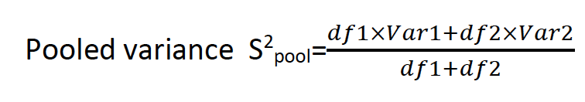
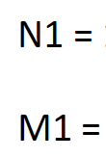
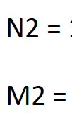
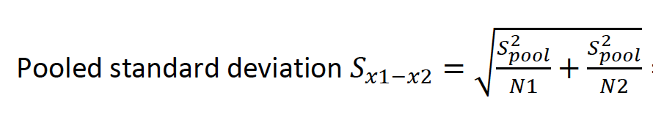



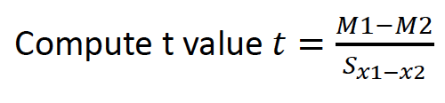
Q4
Step 1: State the hypothesis and select an alpha level.
Step 2: identify the critical region.
Step 3: compute the test statistic.
df2=
Is H0 rejected?
Is there a significant difference between two diets?

